Slide 1
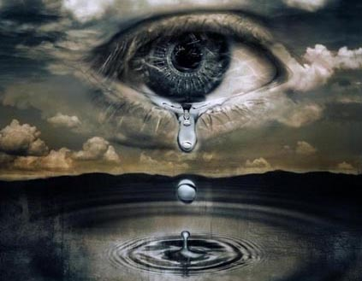
“Wherefore let them that suffer according to the will of God commit the keeping of their souls to him in well doing, as unto a faithful Creator.” (1 Peter 4:19)

Slide 2
Reasons why God’s children suffer
1. Sometimes God’s people suffer because of Satan's attack -
Jesus said to Peter "And the Lord said, Simon, Simon, behold, Satan hath desired to have you, that he may sift you as wheat."
Paul said - "...once and again, Satan hindered us."
The word of God call's Satan our "Enemy"
That is why we must "Put on the whole armor of God..."

Slide 4
“…taking the shield of faith, wherewith ye shall be able to quench all the fiery darts of the wicked.”

Slide 5
2. Sometimes God’s people suffer because other people are against God - "If the world hate you, ye know that it hated me before it hated you.“
3. Sometimes God’s people suffer simply because we live in a fallen and sinful world thus we suffer the consequences of the fall – Genesis 3
God does not always rescue his people from such troubles, although sometimes he does - "The rain falls on the just and unjust alike...Man is born to trouble..."
Such suffering and trouble are opportunities for us as Christians to trust God and draw closer to him - (Psalms)

Slide 6
Suffering will make you "bitter or better/ weaker or stronger"

Slide 7
4. Sometimes God’s people suffer because of their own sinful behavior and foolish decisions - "We reap what we sow”
We Don’t Follow God’s Instructions (Numbers 20:1-29)
We Make Bad Decisions (Genesis 16:1-6)
We Don’t Judge Ourselves (I Corinthians 11:31)
We Refuse Correction (Hebrews 12:5-11)
Our Past Sins Come Back to Haunt us (Proverbs 28:13)
We Are Hearers of the Word But Not Doers (James 1:22-25)

Slide 8
We Don’t Resist the Devil (James 4:7)
We Are Easily Enticed and Commit Sin (Proverbs 1:19-33)
We Lack Discipline and Self Control (II Peter 1:5-10)
We Put Our Trust in the Arm of the Flesh (Zechariah 4:6)
We Didn’t Obey the Voice of the Holy Spirit (Hebrews 3:7-19)
We Are Under a Generational Curse (Deuteronomy 5:6-9)

Slide 9
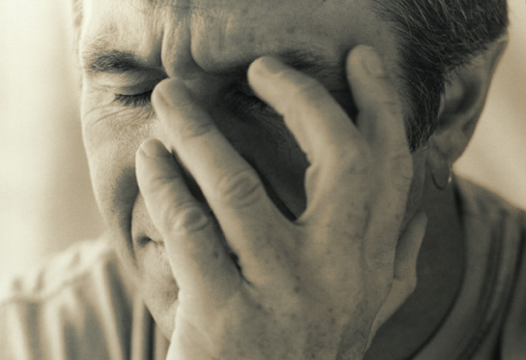
“As many as I love, I rebuke and chasten: be zealous therefore, and repent.” Rev. 3:19

Slide 10
5. Sometimes God allows his people to suffer because He is working in our lives – Romans 8:28
God teaches us valuable lessons through suffering that in no other way could be learned - (2 Corinthians 12:7-10)
> Infirmities- sickness
> Reproaches - insult, injury, bodily harm
> Necessities - unavoidable trials
> Persecutions - opposition and rejection (friends, family, world)
> Distress - calamity, anguish

Slide 11
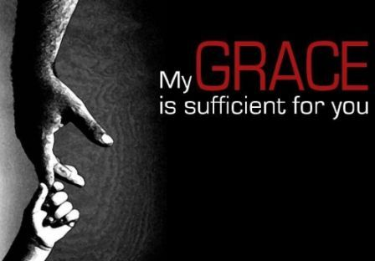
“Therefore I take pleasure in infirmities, in reproaches, in necessities, in persecutions, in distresses for Christ's sake: for when I am weak, then am I strong.”

Slide 12
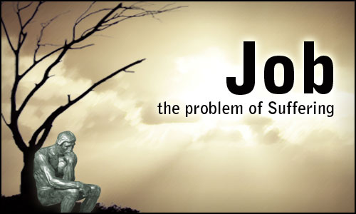
The unbelievable sufferings of Job were by the will of God, for his ultimate good and for God's glory.

Slide 13
"What? shall we receive good at the hand of God, and shall we not receive evil (bad)? In all this Job sinned not, nor charged God foolishly."

Slide 14
“In all this…”
What does all this include?

Slide 15
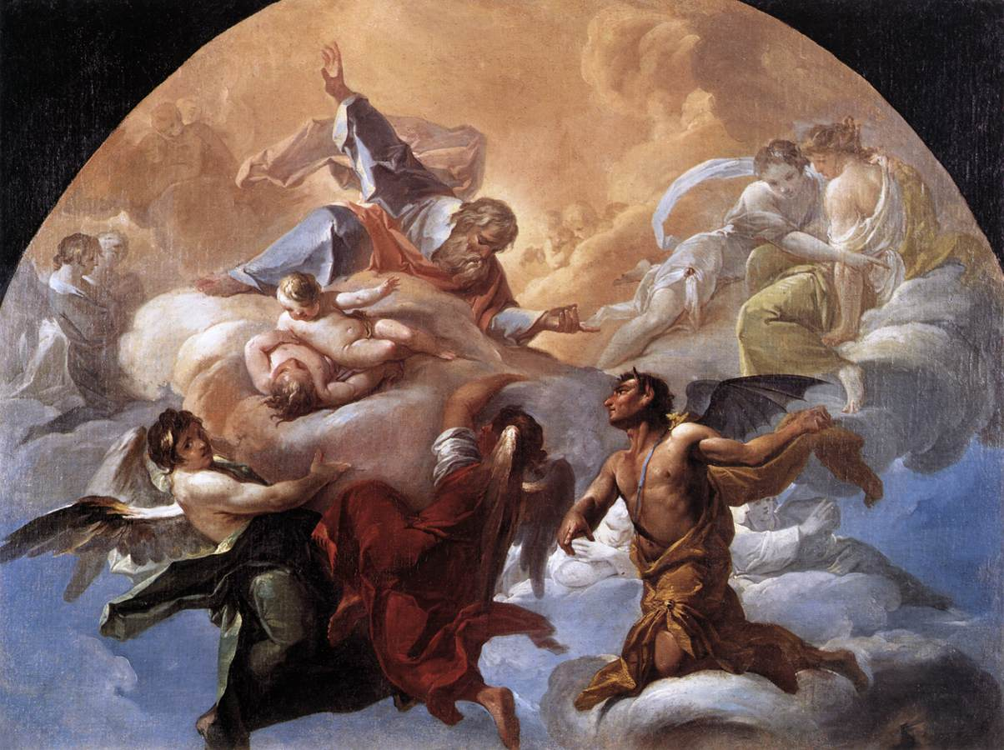
Satan attacked Job in seven areas of life (Job 1-2)

Slide 16
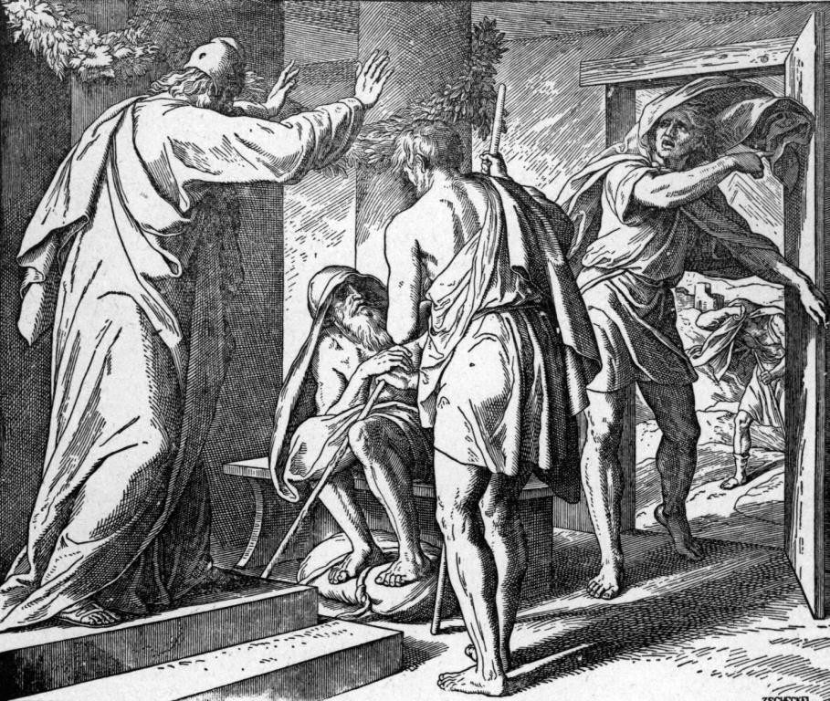
Attacked his job (Ox, servants) Job 1:14, 17

Slide 17
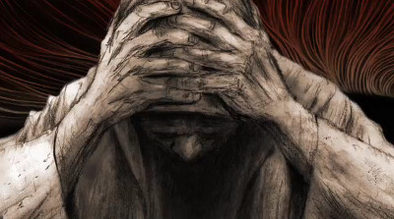
Attacked his wealth (sheep) Job 1:16

Slide 18
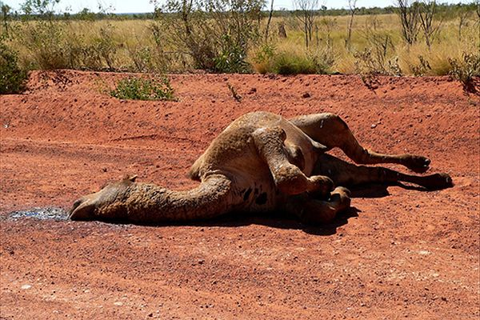
Attacked his transportation (camels) Job 1:3

Slide 19
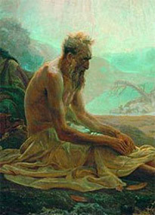
Attacked his family Job 1:18-19

Slide 20
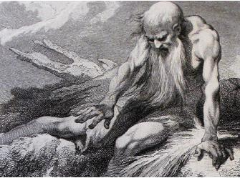
Attacked his health Job 2:7

Slide 21
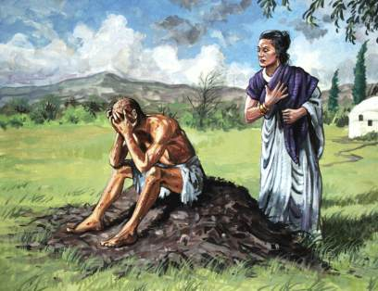
Attacked his marriage Job 2:8-9

Slide 22
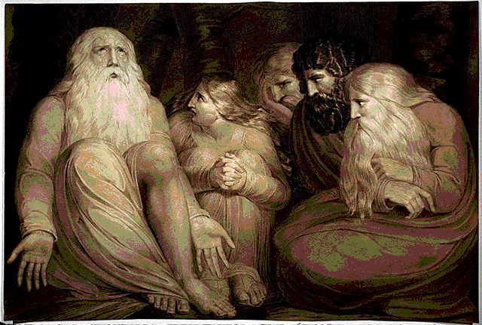
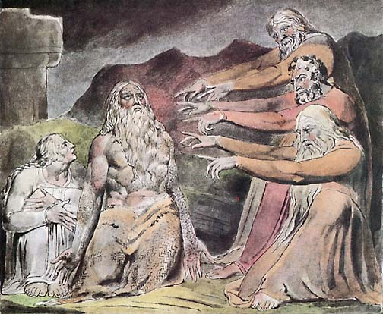
Attacked his friendships Job 5:11

Slide 23
“But he knoweth the way that I take: when he hath tried me, I shall come forth as gold.” Job 23:10

Slide 24
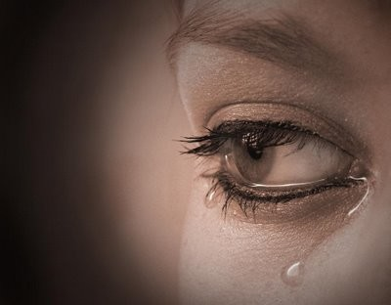
Suffering is a vital and important part of God's plan (will) for His people.
“Wherefore let them that suffer according to the will of God commit the keeping of their souls to him in well doing, as unto a faithful Creator.” (1 Peter 4:19)

Slide 25
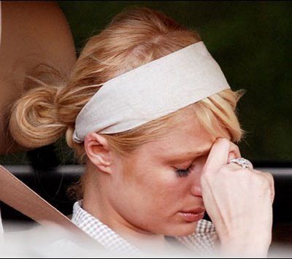
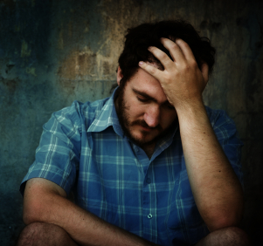
Twenty reasons God allows suffering to come into our lives

Slide 26
1) Suffering is God’s way of getting our attention - Psalms 25:1-2; Matthew 11:28
Note: Suffering is sometimes used as discipline for God's people, and as such comes from God's love, and causes us to grow in Christ: Heb 12:5-11
2) Suffering is God’s call for self-examination - Proverbs 28:13; I Corinthians 11:28-32
Note: Fellowship with God is restored, when we confess and repent of sin: 1 John 1:7-9; Prov. 28:13
Note: Suffering is used by God to teach us the importance of obedience: Heb 5:8; Phil 2:8

Slide 27
3) Suffering is God’s way of freeing us from a carnal view of life by causing us to refocus on things that are really important (right priorities in life) - Philippians 3:7-8; Colossians 3:2
Note: Reevaluating our priorities is a huge benefit of suffering: Exodus 20:9; Psalms 127:2; Haggai 1:3-8
4) Suffering is God’s way of revealing our faults - I Peter 2:18-20 "suffering for our faults"
5) Suffering is God’s way of increasing our patience - James 1:2-4
6) Suffering is God’s way of giving us new insights from Scripture - Romans 5:3-4

Slide 28
7) Suffering is God’s way of conquering our pride - Proverbs 16:18; 29:23; Luke 14:11
Note: Humility is needed in each of our lives. The Pride of life runs deeply in all of us: "...be clothed with humility: for God resisteth the proud, and giveth grace to the humble...But he giveth more grace. Wherefore he saith, God resisteth the proud, but giveth grace unto the humble."
8) Suffering is God’s method of purifying our faith - James 1:2-3; I Peter 1:6-7
9) Suffering is our motivation to cry out to God - Psalms 3:4; 9:12; 34:17; 56:9-10; 66:18

Slide 29
10) Suffering is God’s way of increasing our hatred for evil - Galatians 6:7-8; Hebrews 11:25
11) Suffering is God’s way of motivating us to pray - I Timothy 2:1-2
12) Suffering is God’s way of sifting our friendships - Proverbs 17:17
13) Suffering is God’s call to identify with Christ - Philippians 3:10
14) Suffering is our preparation for comforting others - II Corinthians 1:3-5; 4:8-10, 12, 16

Slide 30
15) Suffering is evidence that we are engaged in spiritual warfare - Ephesians 6:10-18
16) Suffering is a reminder of our weakness and his strength - II Corinthians 12:7-10
17) Suffering helps us grow in faith -1 Peter 1:6-8
18) Suffering provides opportunities to witness for Christ - 1 Pet 2:12, Phil 1:12-18
19) Suffering is God’s means of testing the genuineness of our salvation - Matthew 7:24-27
20) Suffering is our opportunity to glorify God - I Peter 2:12-25

Slide 31
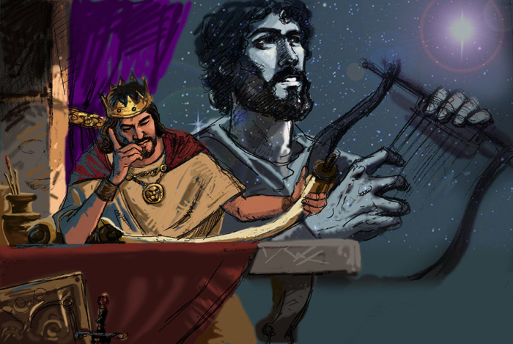
The Psalmist said "It is good for me that I have been afflicted; that I might learn thy statutes.” Psalm 119:71

Slide 32
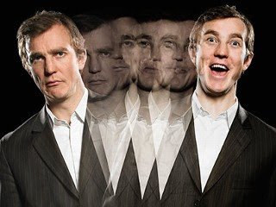
Developing a Biblical view of suffering will change your perspective on life.

Slide 33
Seven things you need to do when suffering comes into your life
First, check your self to see if you are being disciplined - "judge ourselves, that we be not judged".
Second, realize that you are not out of the will of God because you are experiencing suffering - 1 Peter 4:19
Third, seek God - Ask Him to reveal his plan and purpose in the suffering your are experiencing - 1 John 5:14

Slide 34
4. Forth, in everything give thanks: for this is the will of God in Christ Jesus concerning you - 1 Thess. 5:18
5. Fifth, remember that God, who has called you to suffer for a while, (according to His will) will in due course of time, make you perfect (mature), established, strengthened, and settled - 1 Pet 5:6-11
6. Sixth, focus on the truth that there will be no suffering for God's people in eternity - I Peter 4:12-19

Slide 35
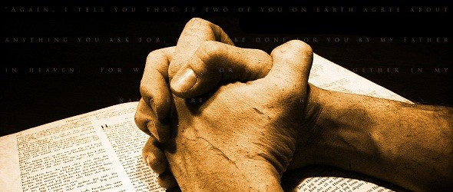
7. Seventh, continue doing good by committing your soul (Mind, Will, Emotion) to the keeping of God because He is a faithful creator – 1 Cor. 10:13 "There hath no temptation taken you but such as is common to man: but God is faithful, who will not suffer you to be tempted above that ye are able; but will with the temptation also make a way to escape, that ye may be able to bear it."

Slide 36
“Wherefore let them that suffer according to the will of God commit the keeping of their souls to him in well doing, as unto a faithful Creator.” (1 Peter 4:19)

