Slide 1
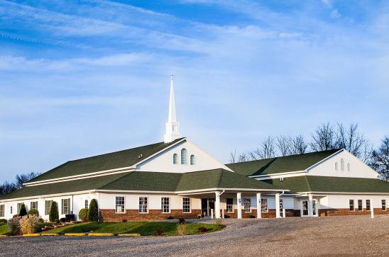
The Doctrine of the Church (Part 7)
The Officers of the Church
(Part 2)

Slide 3
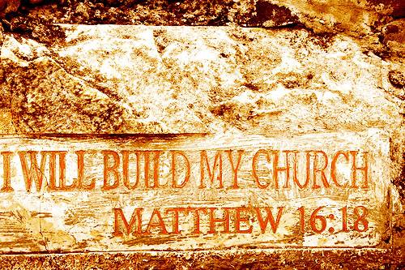

Slide 4
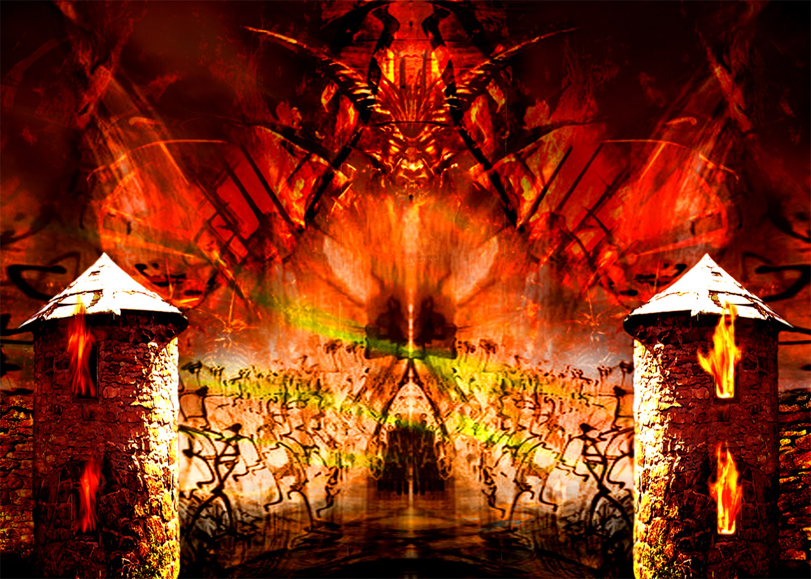
“…and the gates of hell shall not prevail against it.”

Slide 5
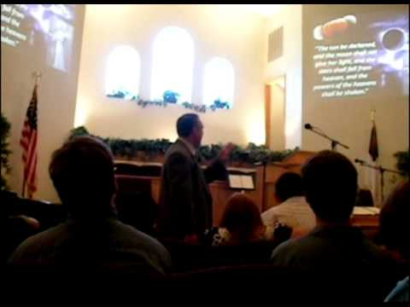
The Meaning of the Word "Church."
Thus, the literal meaning is - a call out assembly.
A called out Assembly of Baptized Believers gathered together for – Acts2:42; Phil. 3:3

Slide 6
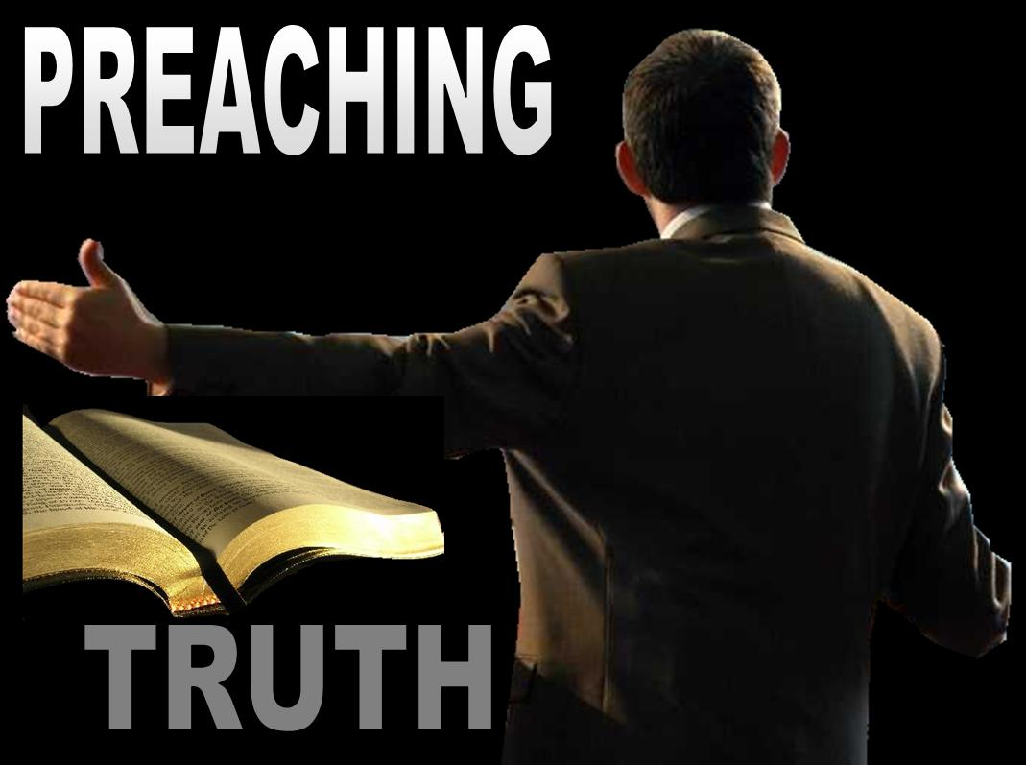
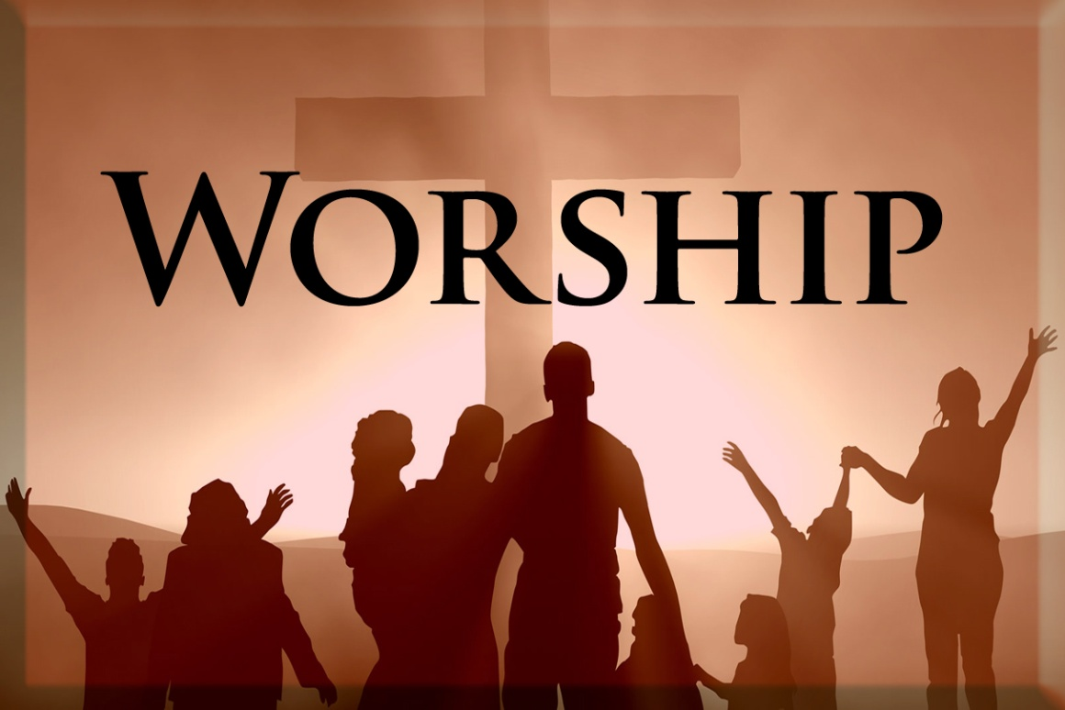

Slide 7
The Origin of the Church “When and where did the church actually begin?”

Slide 8
Several different views

Slide 9
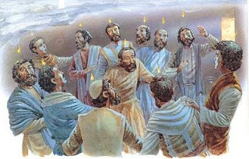
The Church begin on the Day of Pentecost

Slide 10
The Nature of the Church
“The characteristics or inherent features of the Church”

Slide 11
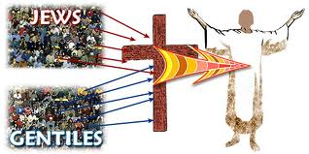
The Church is not Israel
(I Corinthians 10:32) “Give none offence, neither to the Jews (Israel), nor to the Gentiles, nor to the church of God.”
Covenant theologians teach that the church has become God’s elect people, as Israel once was.

Slide 12
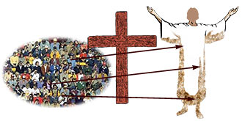
The Church is the Body of Christ
I Cor. 12:27 “Now ye are the body of Christ, and members in particular.
Eph. 4:12 “For the perfecting of the saints, for the work of the ministry, for the edifying of the body of Christ.”

Slide 13
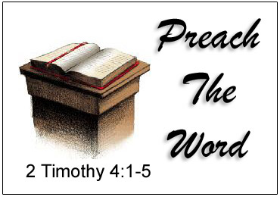
Christ is the head of the Church
Eph. 5:23 “For the husband is the head of the wife, even as Christ is the head of the church: and he is the saviour of the body.”

Slide 14
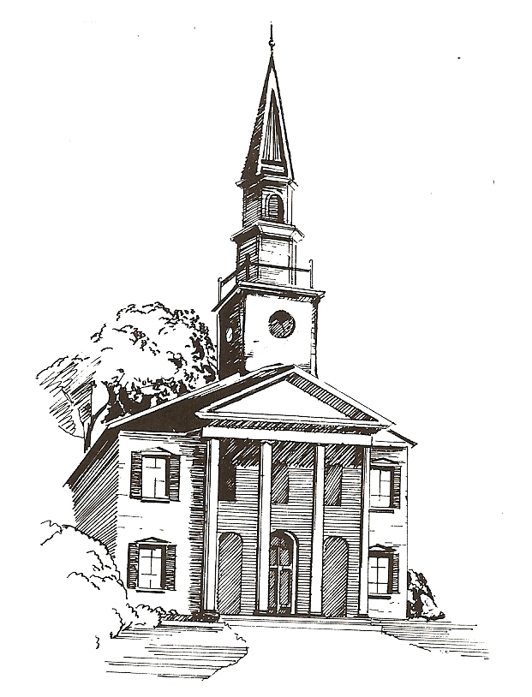
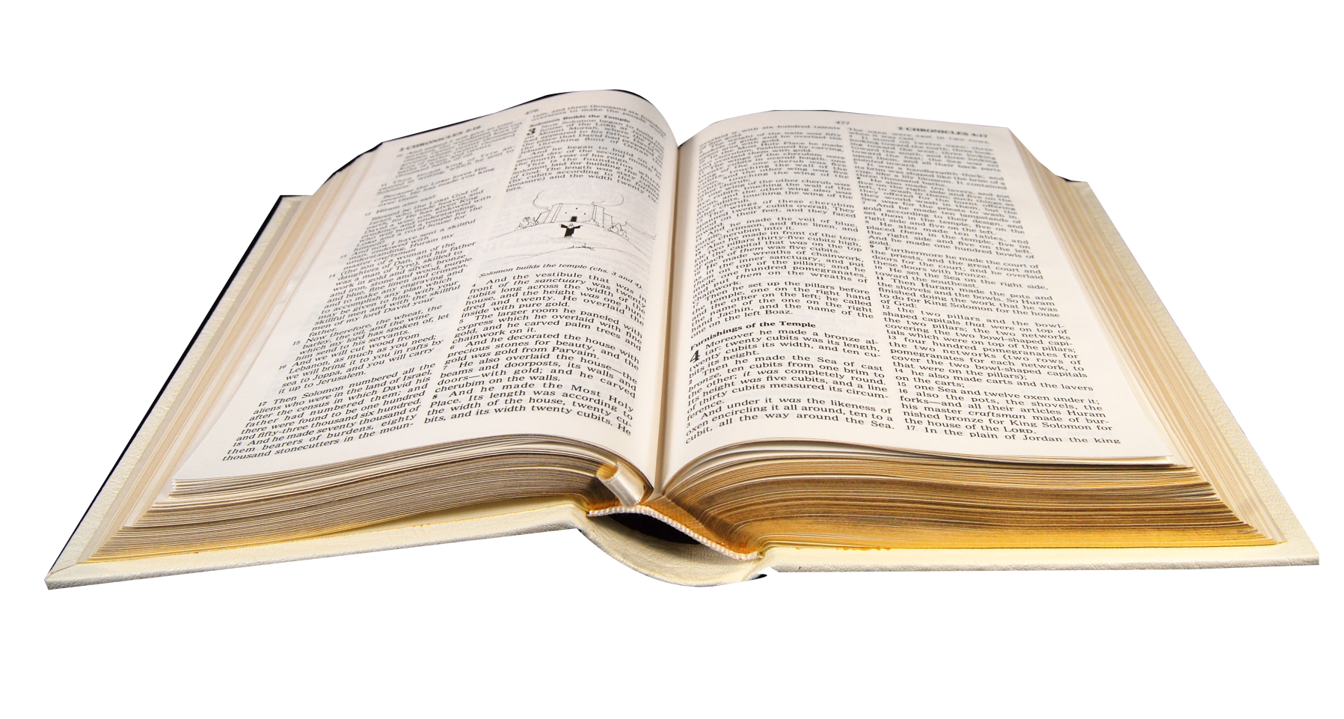
The Word of God is to be the Churches only rule of faith and practice!

Slide 15
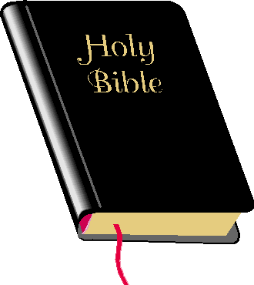
The Church is the Pillar and Ground of the Truth
I Tim. 3:15 “But if I tarry long, that thou mayest know how thou oughtest to behave thyself in the house of God, which is the church of the living God, the pillar and ground of the truth.”
Pillar = base; post; support
Ground = support; basis

Slide 16
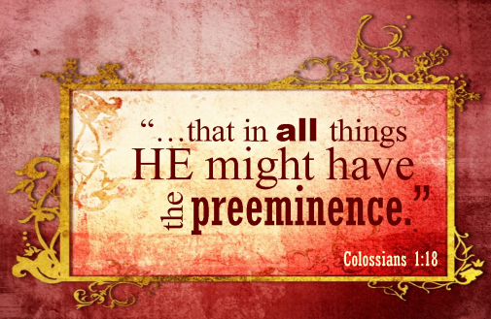
Jesus Christ alone is to have the Preeminence in His Church

Slide 18
“Thou art worthy, O Lord, to receive glory and honour and power: for thou hast created all things, and for thy pleasure they are and were created.” (Rev. 4:11)

Slide 19
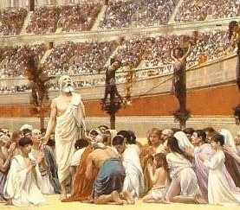
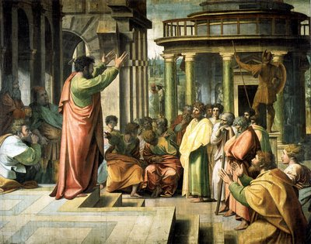
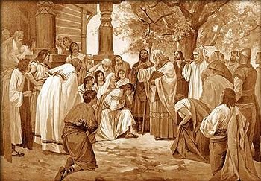
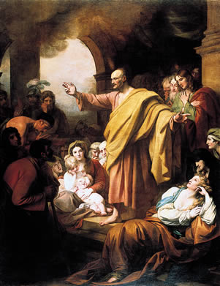
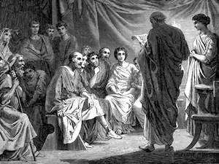
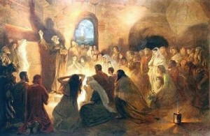
The History, Growth, and Character of the Various New Testament Churches.

Slide 20
The Early Christians were:

Slide 21
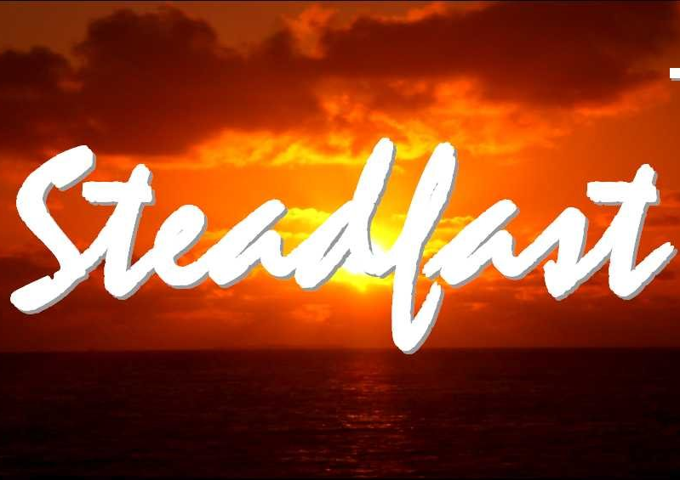

Slide 22
The Six Symbols of the Church

Slide 23
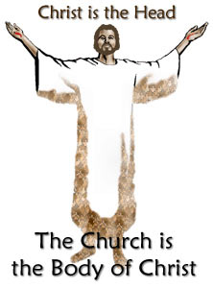
1. The Head of the Body

Slide 24
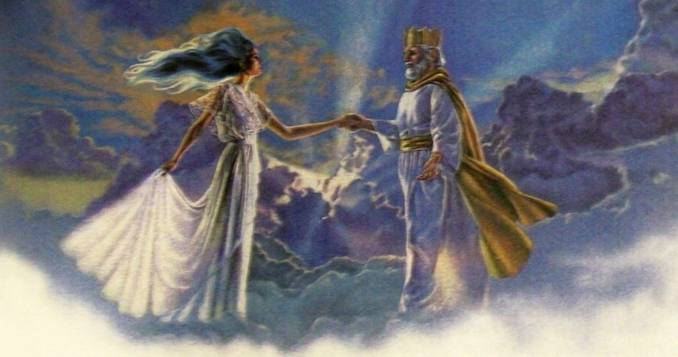
2. The Bridegroom and the Bride

Slide 25
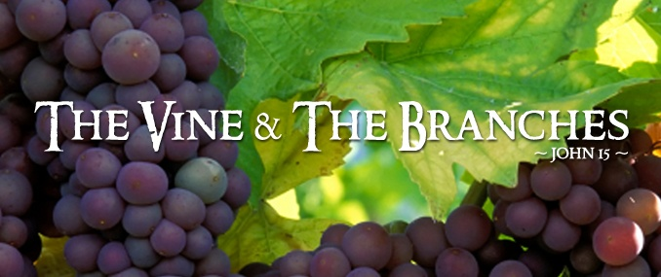
3. The Vine and the Branches

Slide 26
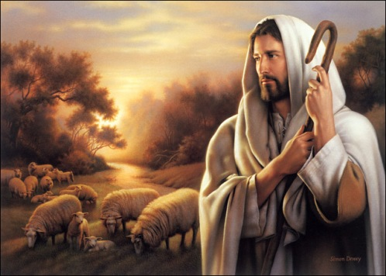
4. The Shepherd and the Sheep

Slide 27
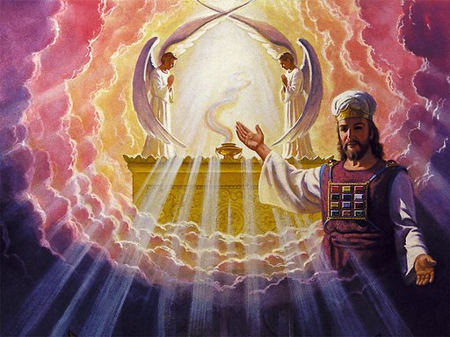
5. The High Priest and a Kingdom of Priests

Slide 28
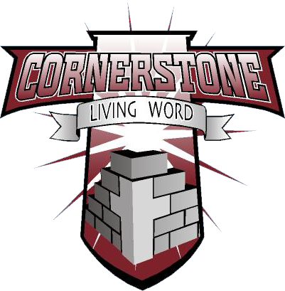
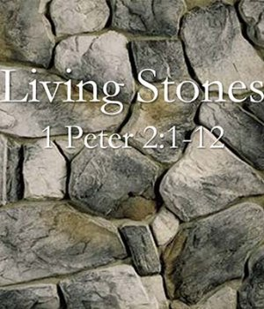
6. The Cornerstone and the Living Stones

Slide 29
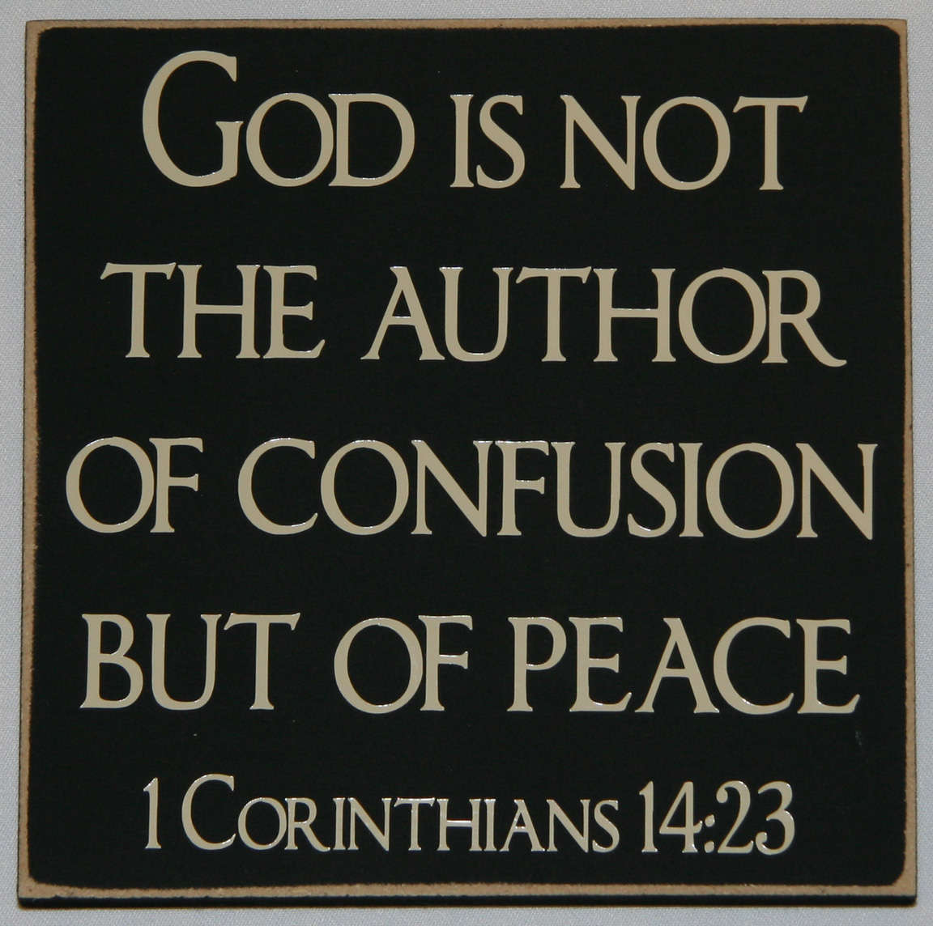
The Organization of the Church

Slide 31
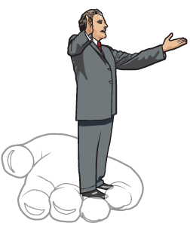
The New Testament Church had Officers
(Philippians 1:1) “Paul and Timotheus, the servants of Jesus Christ, to all the saints in Christ Jesus which are at Philippi, with the bishops and deacons.”

Slide 32
The Role of the Pastor

Slide 33
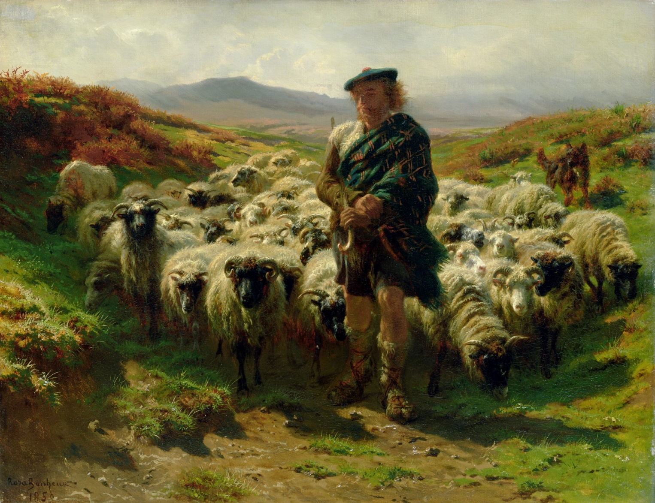
The pastor is your Shepherd – Eph. 4:12; Jeremiah 3:15; Acts 20:28-31; I Pet. 5:1-4 The pastor is The pastor is your Shepherd – Eph. 4:12; Jeremiah 3:15; Acts 20:28-31; I Pet. 5:1-4 your Shepherd – Eph. 4:12; Jeremiah 3:15; Acts 20:28-31; I Pet. 5:1-4
The Pastor as a Shepherd
(Eph. 4:12; Jeremiah 3:15;
Acts 20:28-31; I Pet. 5:1-4)

Slide 34
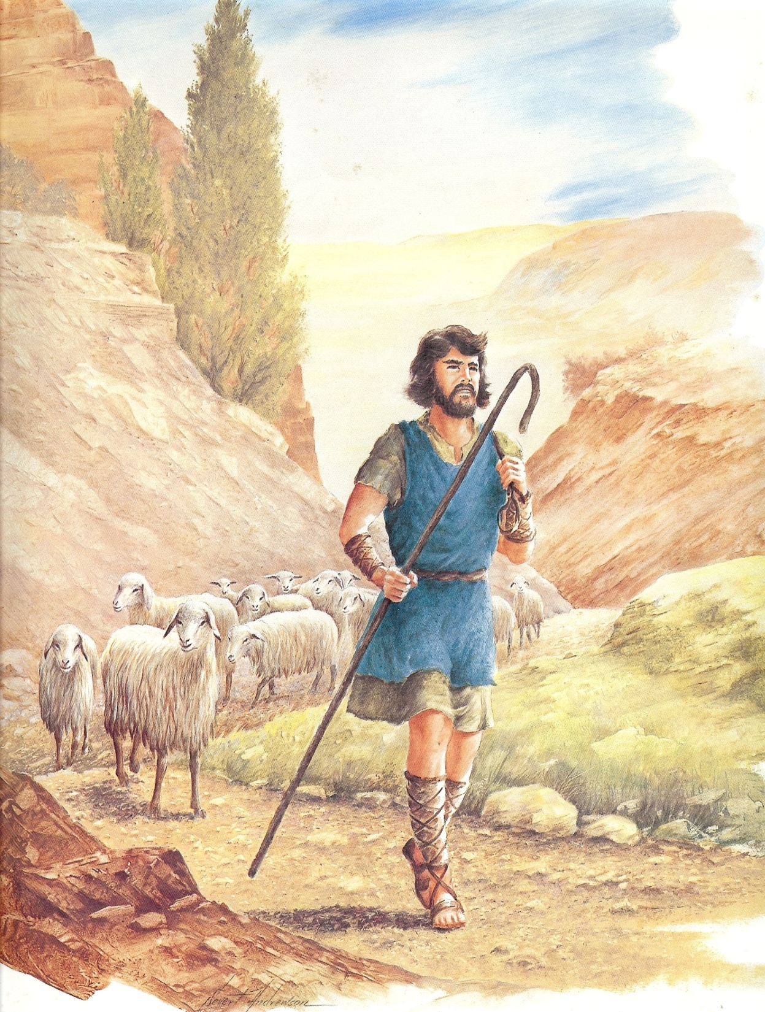
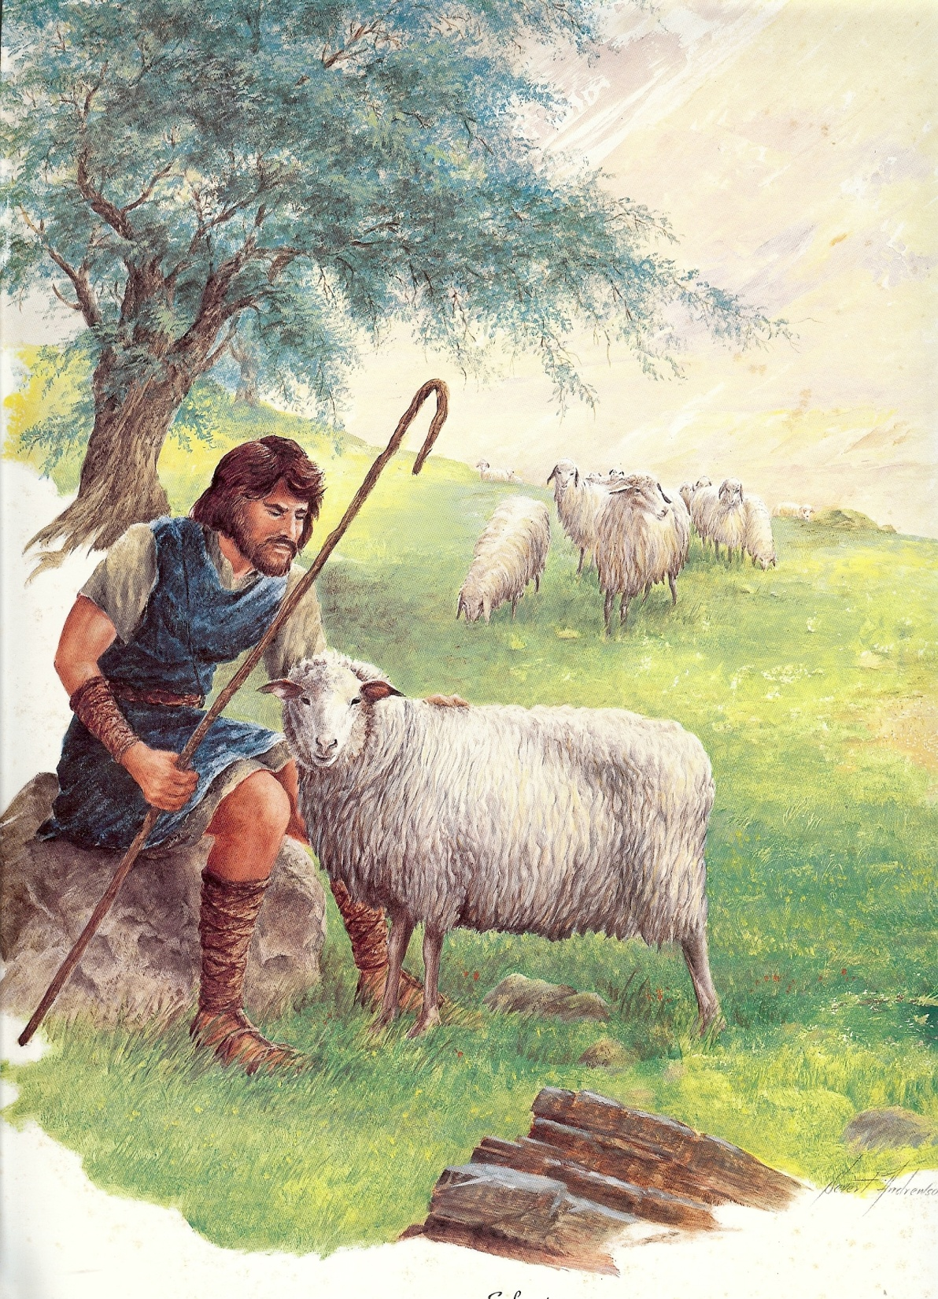
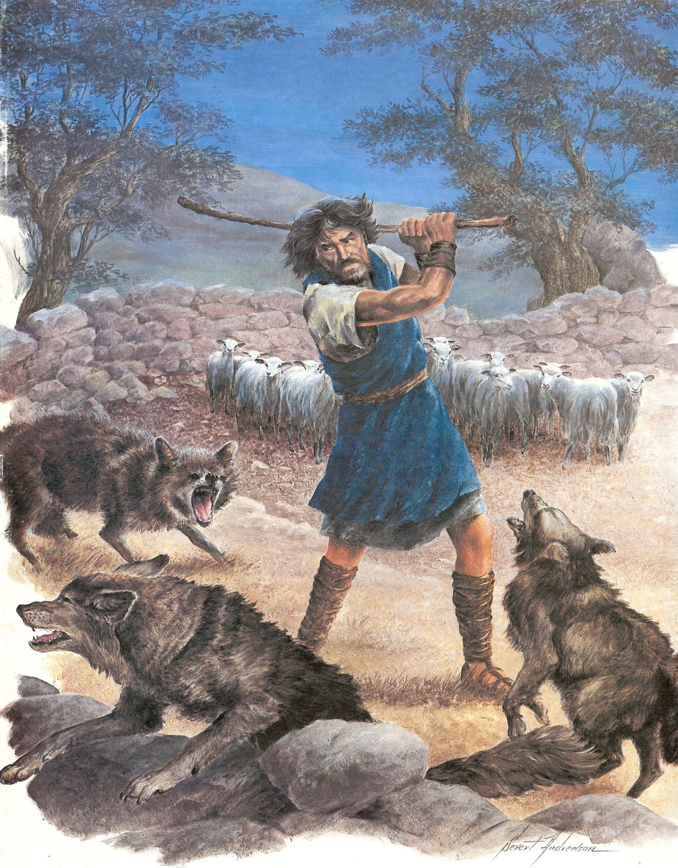

Slide 35
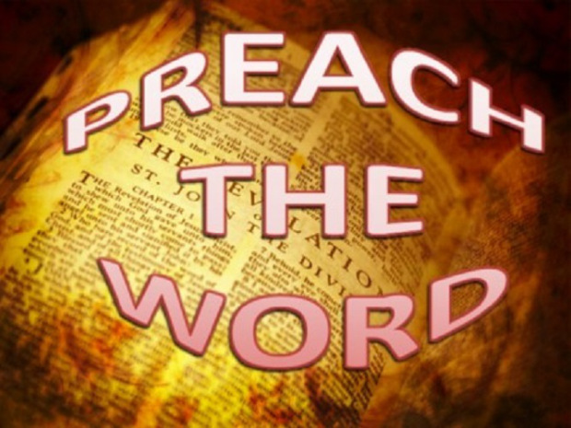
The Pastor as a Preacher (Heb. 13:20-21)

Slide 36
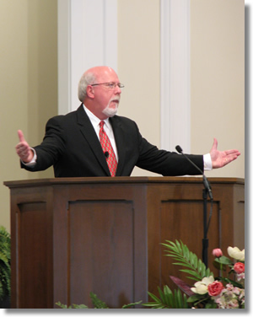
Speaking Ministry of the Pastor

Slide 37
[ 1 ] Admonish (niytgetei) - I Thessalonians 5:12
[ 2 ] EDIFY (oikodomeo) - I Corinthians 14:3
[ 3 ] EXHORT (paraklaleo) - I Corinthians 14:3
[ 4 ] Comfort (paraklesis) - I Corinthians 14:3
[ 5 ] preach (kataggello) - Colossians 1:28
[ 6 ] warning (nou) - Colossians 1:28
[ 7 ] teaching (didasko) - Colossians 1:28
[ 8 ] reprove (elegcho) - II Timothy 4:2
[ 9 ] Rebuke (epitimao) - II Timothy 4:2
[10] charge (paraggello) - I Timothy 1:3

Slide 38
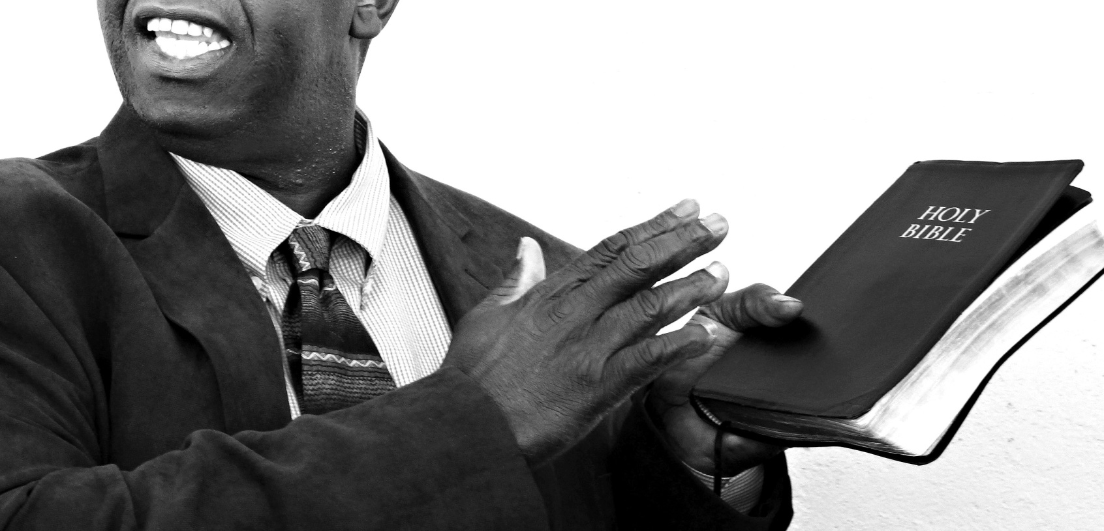
[11] counsel (Hebrew - tachbuloth) - Proverbs 11:14
[12] doctrine (didaskalia) - Titus 1:9
[13] correction (epanorihasis) - II Timothy 3:16
[14] instruction (paideia) - II Timothy 3:16

Slide 39
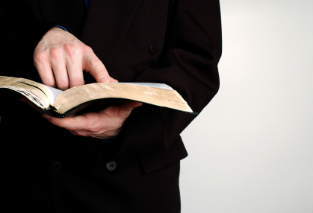
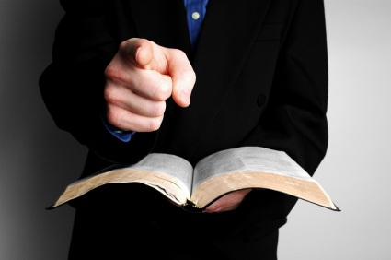
The Pastor as a Teacher (Eph. 4:11-12)

Slide 40
The Pastor as an Elder (I Tim. 5:17, Titus 1:5)

Slide 41
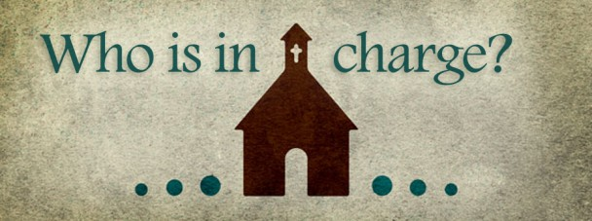
The Pastor as a Bishop (Phil. 1:1)
“Obey them that have the rule over you, and submit yourselves: for they watch for your souls, as they that must give account, that they may do it with joy, and not with grief: for that is unprofitable for you.” Heb. 13:17

Slide 43
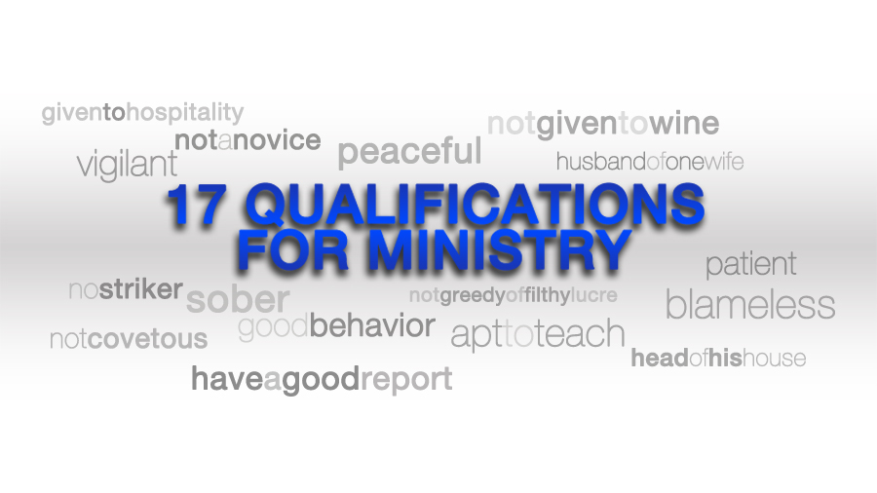

Slide 44
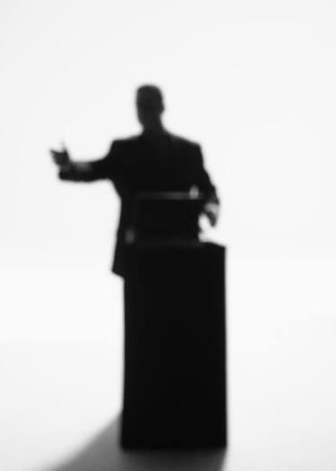
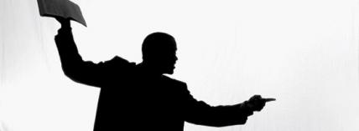
Qualifications of a Pastor (I Tim. 3:1-7)
He must be a male
Blameless = without reproach; unrebukeable
Husband of one wife = not divorced and remarried
Vigilant = watchful; alert (spiritual danger and temptations)
Sober = sound-minded
Good Behavior = orderly
Given to Hospitality = friendly

Slide 45
Able to Teach = capable teacher
Not given to wine = not beside wine
Not a Striker = not violent
Not Greedily of Money = not temporal valued
Patient = enduring
Not a Brawler = not a fighter
Not Covetous = does not covet worldly pleasures, possessions, power or recognition
Not self-willed = not stubborn; not arrogant
Not Easily Angered = not quick tempered; not hotheaded
Lover of Good Men = godly friendships

Slide 46
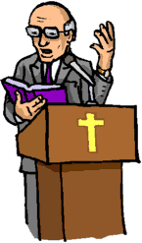
Just = honest; upright; fair
Holy = morally pure
Rule his own house = manages his household well
Children must be in Subjection = yielded to the father's leadership
Not a Novice = spiritually mature
Not Lifted up with Pride = humble
Good Report
Without Reproach

Slide 47
The Office of a Deacon

Slide 48
The Ministry of Deacons (Acts 6:1-7)
“And in those days, when the number of the disciples was multiplied, there arose a murmuring of the Grecians against the Hebrews, because their widows were neglected in the daily ministration. Then the twelve called the multitude of the disciples unto them, and said, It is not reason that we should leave the word of God, and serve tables. Wherefore, brethren, look ye out among you seven men of honest report, full of the Holy Ghost and wisdom, whom we may appoint over this business.

Slide 49
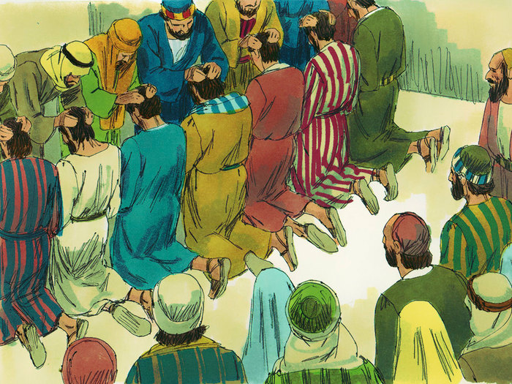
But we will give ourselves continually to prayer, and to the ministry of the word. And the saying pleased the whole multitude…Whom they set before the apostles: and when they had prayed, they laid their hands on them. And the word of God increased; and the number of the disciples multiplied in Jerusalem greatly; and a great company of the priests were obedient to the faith.”

Slide 50
The meaning of the word diakonos = servant (Vine's - one who renders free service)
Pastors are to be paid by the Church if possible - I Corinthians 9:9-14; I Timothy 5:17-18.
Deacons however are unpaid willing servants, serving only for eternal reward – I Timothy 3:13 “For they that have used the office of a deacon well purchase to themselves a good degree, and great boldness in the faith which is in Christ Jesus.”

Slide 51
Deacons are to have four main character qualities
1. Honest men
2. Spirit filled men (humble)
3. Wise men
4. Serving men - The word diakonos (deacon) is only found three times in scripture. The words diakonia (serve) and diakoneo (servant) appear 103 times and always refer to the physical service.

Slide 52
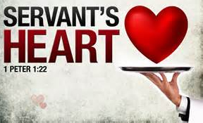

Slide 53
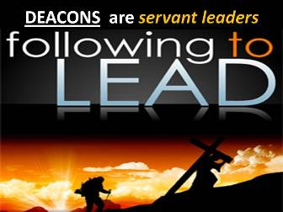

Slide 55
Qualifications of a Deacon (I Timothy 3:8-13; Acts 6:1-6)
Grave = respect; dignified
Not Doubled-tongued = truthful
Not Given to Much Wine = not addicted
Not Greedy of Filthy Lucre = not temporal valued
Blameless = without reproach
Servants Spirit - Acts 6:2-3
Grave = respected; dignified
Not Slanderous = "not an accuser"; false witness; malicious gossip - James 3:2-12

Slide 56
Sober = sound-minded; spiritually alert
Husband of one wife = "one woman man. . . "; (not divorced and remarried)
Control of His Family = ". . . ruling [his] children and [his] own houses well." (children under subjection)
Firm in Biblical Convictions - "Holding the mystery of the faith. . . "
Full of the Holy Spirit = spirit-filled
Wisdom = ability to see life from God's perspective (men strong in the Word - I John 2:13-14)

Slide 57
Qualifications of a Deacons Wife (I Timothy 3:11)
Even so must their wives be…
Grave - respected; dignified
Not slanderers - gossip
Sober - sound-minded; spiritually alert
Faithful in all things - dependable; servant to her husband, children, and church

