Slide 1
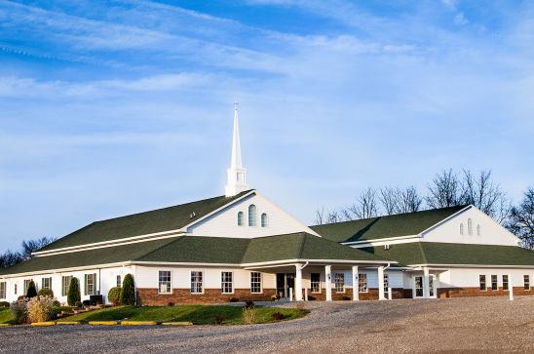
The Doctrine of the Church (Part 5 continued / application)
The History, Growth, and Character of the Various New Testament Churches

Slide 3
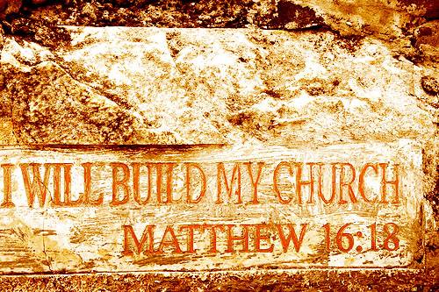

Slide 4
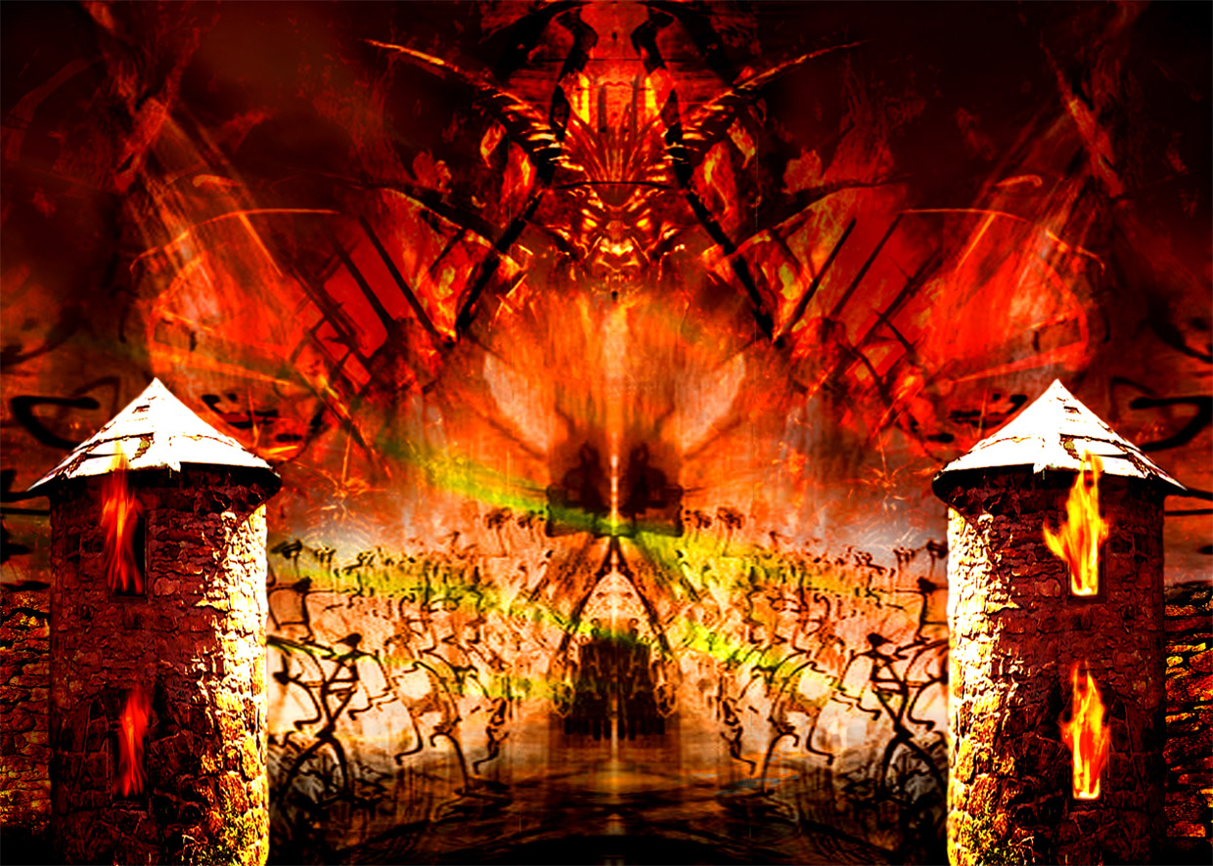
“…and the gates of hell shall not prevail against it.”

Slide 5
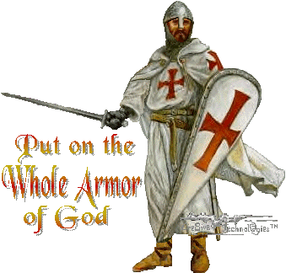

Slide 6
“Except the LORD build the house, they labor in vain that build it.” (Psalm 127:1)

Slide 7
“And are built upon the foundation of the apostles and prophets, Jesus Christ himself being the chief corner stone.” (Eph 2:20)

Slide 8
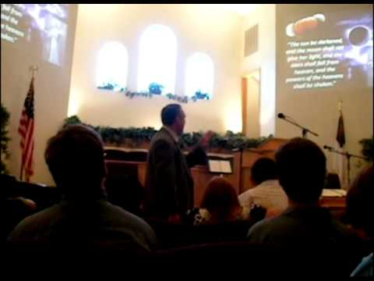
The Meaning of the Word "Church."
Thus, the literal meaning is - a call out assembly.
A called out Assembly of Baptized Believers gathered together for – Acts2:42; Phil. 3:3
1. Doctrine
2. Fellowship
3. Breaking of Bread
4. Prayers
5. Worship

Slide 9
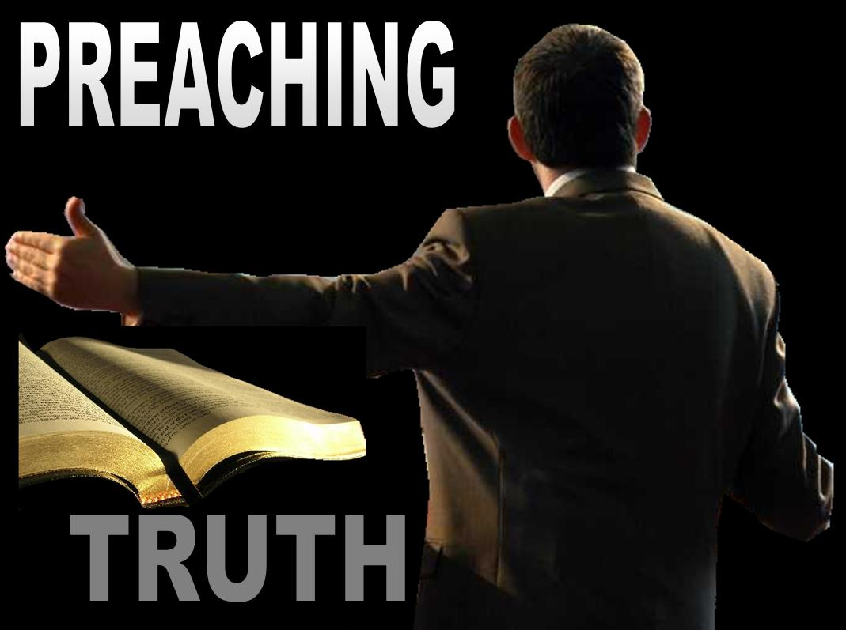
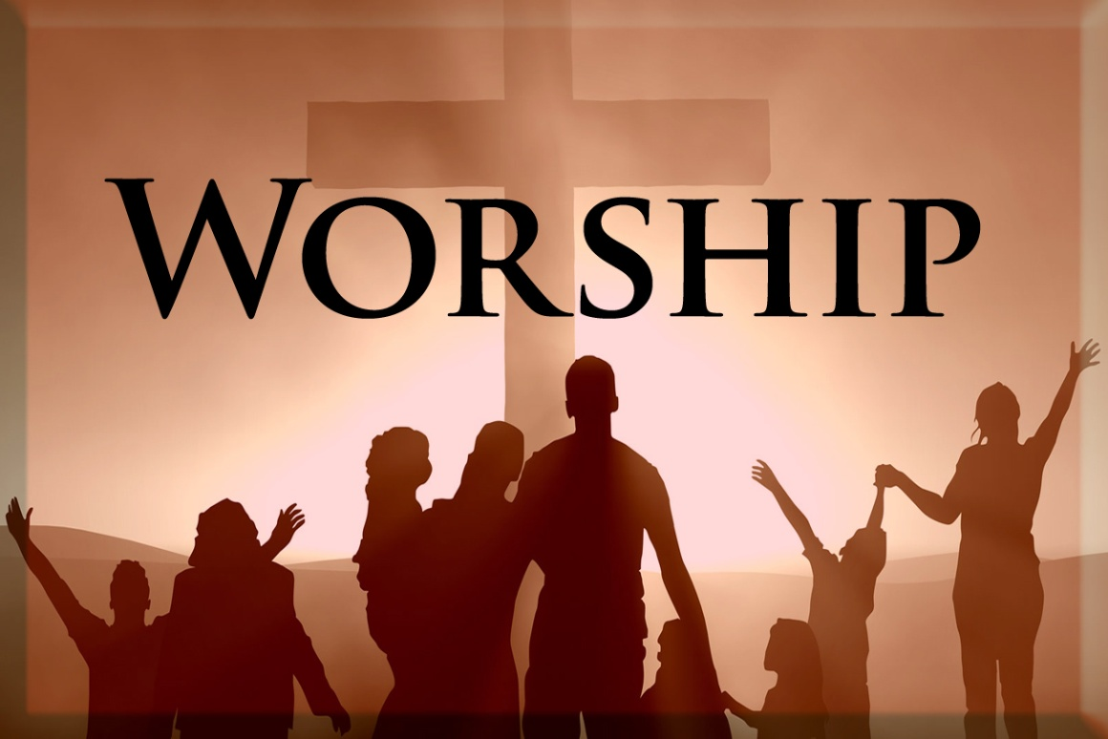

Slide 10
The Origin of the Church “When and where did the church actually begin?”

Slide 11
Several different views

Slide 12
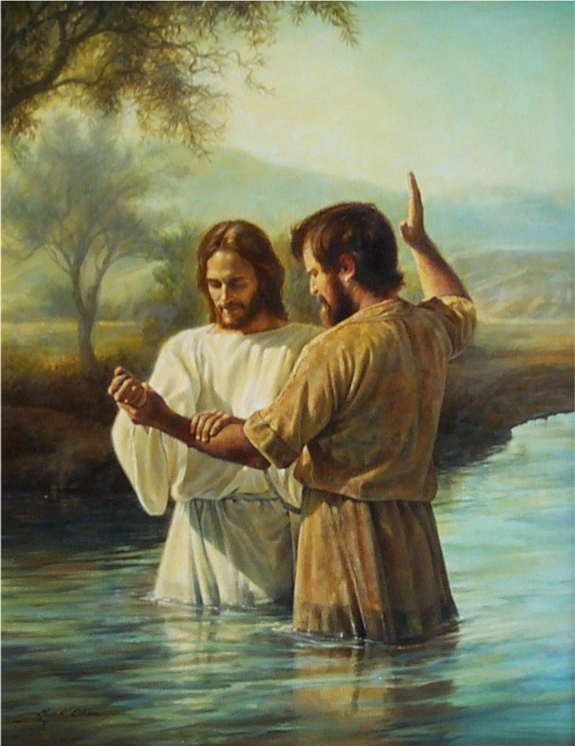
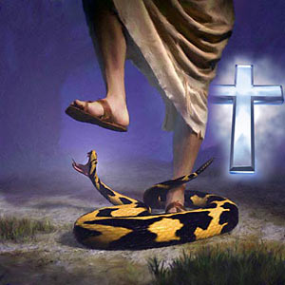
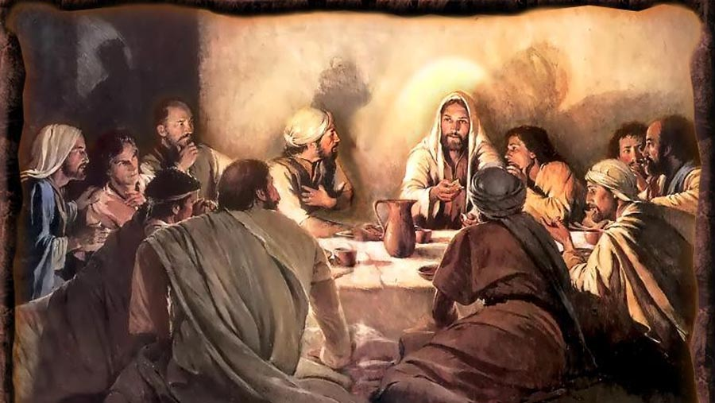
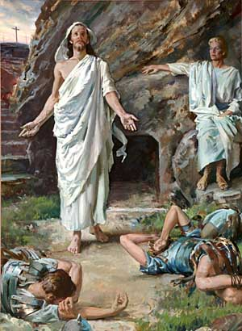
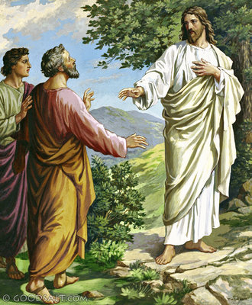
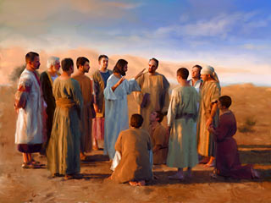
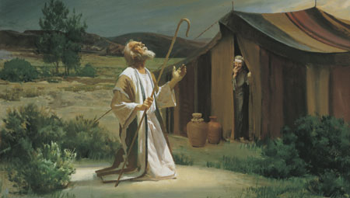

Slide 13
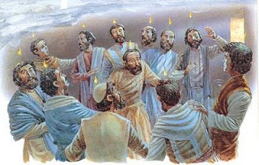
The Church begin on the Day of Pentecost

Slide 14
The Nature of the Church
“The characteristics or inherent features of the Church”

Slide 15
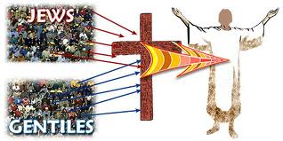
The Church is not Israel
(I Corinthians 10:32) “Give none offence, neither to the Jews (Israel), nor to the Gentiles, nor to the church of God.”
Covenant theologians teach that the church has become God’s elect people, as Israel once was.

Slide 16
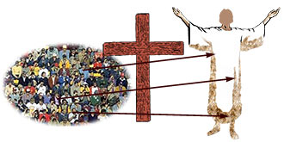
The Church is the Body of Christ
I Cor. 12:27 “Now ye are the body of Christ, and members in particular.
Eph. 4:12 “For the perfecting of the saints, for the work of the ministry, for the edifying of the body of Christ.”

Slide 17
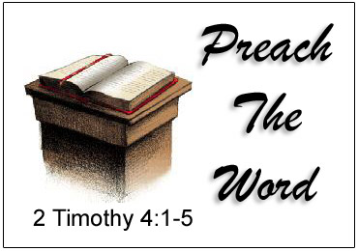
Christ is the head of the Church
Eph. 5:23 “For the husband is the head of the wife, even as Christ is the head of the church: and he is the saviour of the body.”

Slide 18
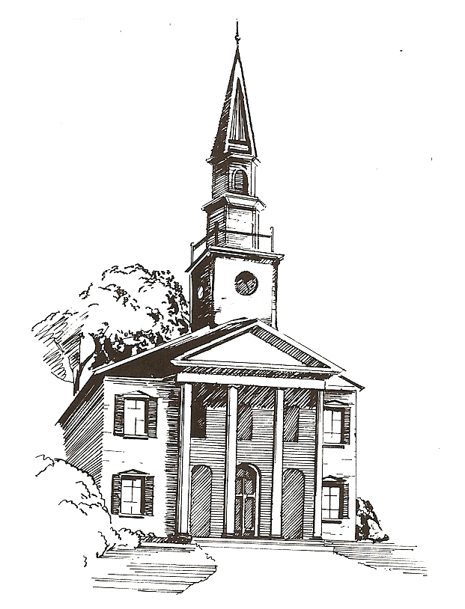
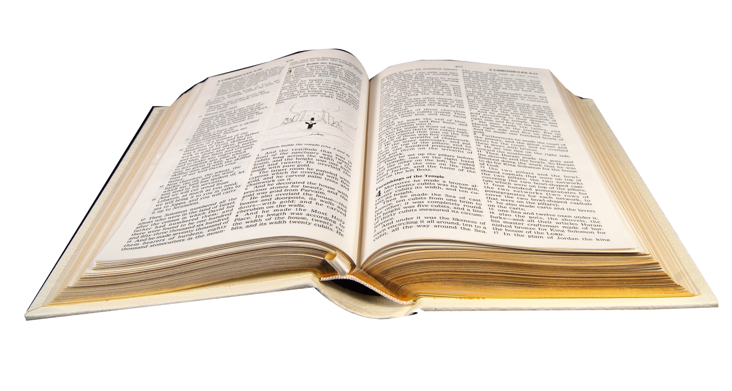
The Word of God is to be the Churches only rule of faith and practice!

Slide 19
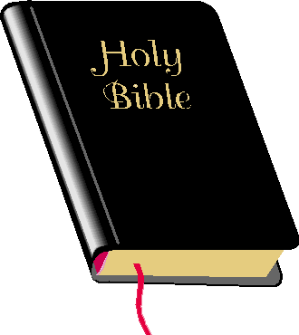
The Church is the Pillar and Ground of the Truth
I Tim. 3:15 “But if I tarry long, that thou mayest know how thou oughtest to behave thyself in the house of God, which is the church of the living God, the pillar and ground of the truth.”
Pillar = base; post; support
Ground = support; basis

Slide 20
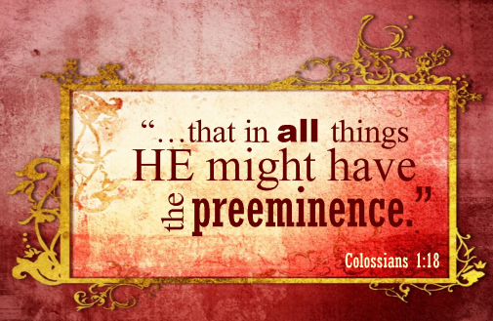
Jesus Christ alone is to have the Preeminence in His Church

Slide 22
The Main Purpose for the Church

Slide 23
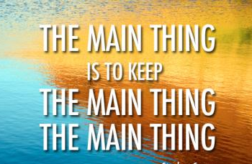

Slide 24
“Thou art worthy, O Lord, to receive glory and honour and power: for thou hast created all things, and for thy pleasure they are and were created.” (Rev. 4:11)

Slide 25
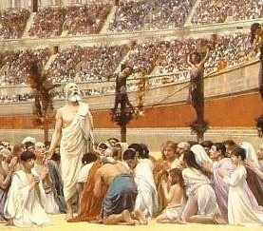
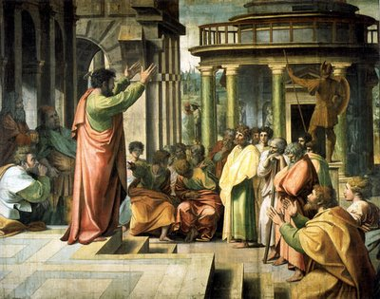
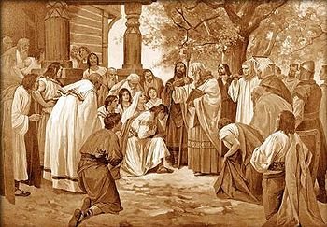
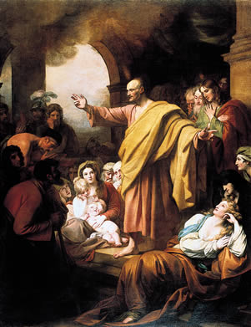
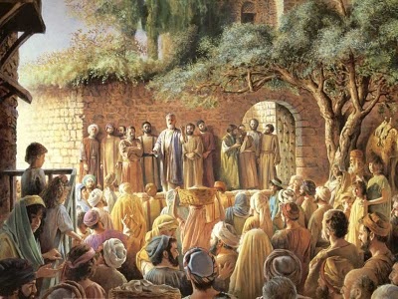
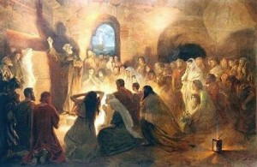
The History, Growth, and Character of the Various New Testament Churches.

Slide 28
Finally, brethren, whatsoever things are true, whatsoever things are honest, whatsoever things are just, whatsoever things are pure, whatsoever things are lovely, whatsoever things are of good report; if there be any virtue, and if there be any praise, think on these things.

Slide 29
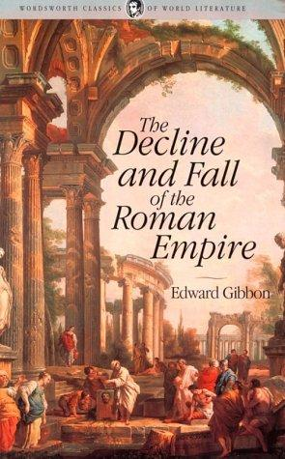

Slide 30
The classic history of ancient Rome is given by Gibbon in Decline and Fall of the Roman Empire, written in the eighteenth century by a scholar who was distinctly antagonistic to Christianity. But even Gibbon named four distinct reasons why Christianity grew so rapidly in the ancient world:

Slide 31
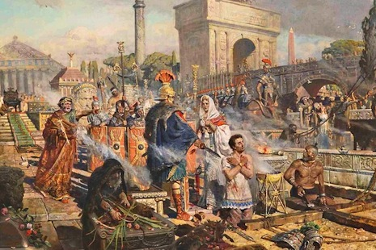
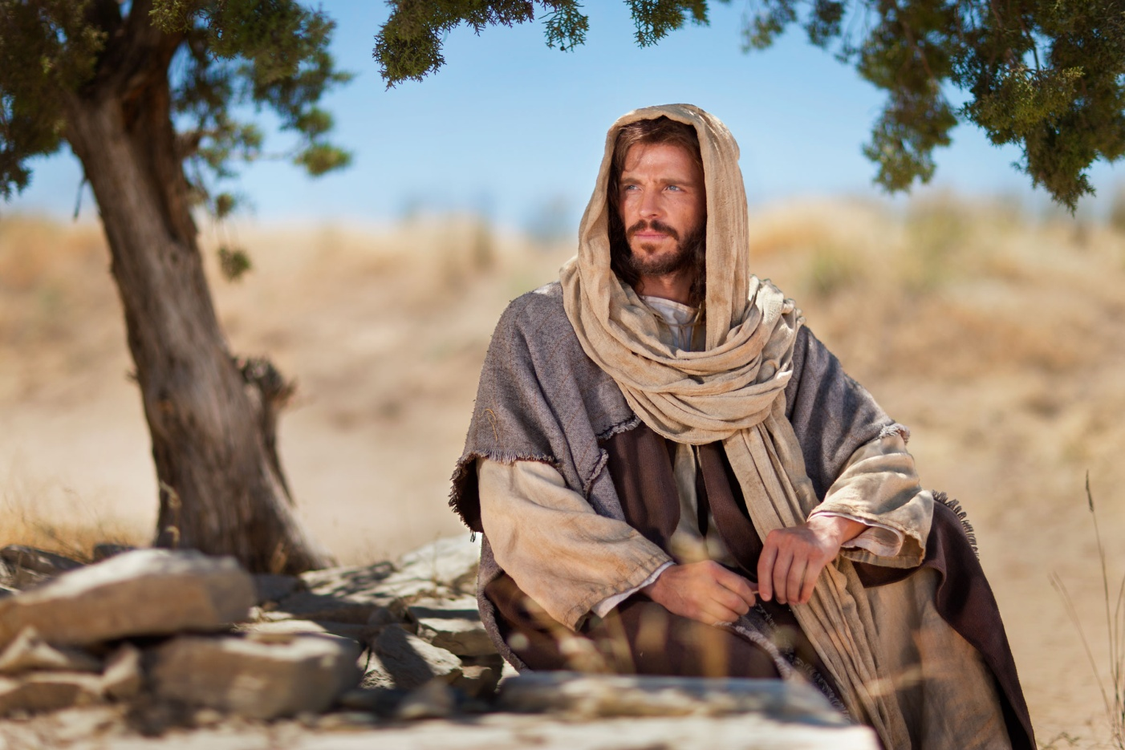
1. The inflexible zeal and enthusiasm of the Christians.
They took the teachings of Jesus at their face value. They refused to compromise with any pagan religion or secular code. ‘They were absolutely happy and always getting into trouble.’

Slide 32
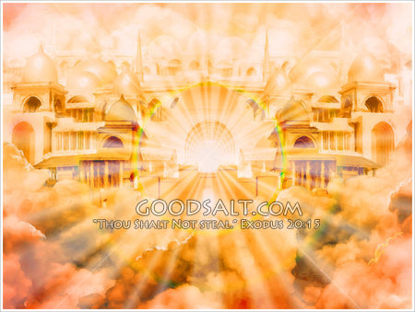
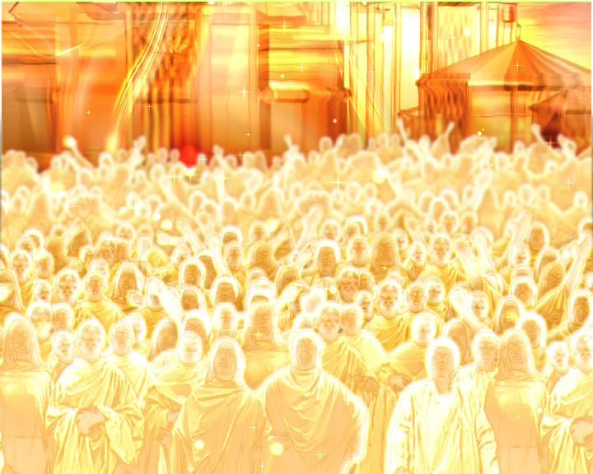
2. The Christian doctrine of the future life.
Even among the most brilliant of the Greek and Roman writers, ignorance, hesitancy, and professed insincerity about immorality are found. The Christian gospel gave people hope of eternal life with God.

Slide 33
3. The miraculous power ascribed to the early Church.
‘With great power gave the apostles witness’. Marvelous miracles were wrought by the disciples to demonstrate the truth of their assertion. Some of these are recorded in the New Testament, but there were many more.
(Mark 16:17-20) “And these signs shall follow them that believe; In my name shall they cast out devils; they shall speak with new tongues; They shall take up serpents; and if they drink any deadly thing, it shall not hurt them; they shall lay hands on the sick, and they shall recover. So then after the Lord had spoken unto them, he was received up into heaven, and sat on the right hand of God. And they went forth, and preached every where, the Lord working with them, and confirming the word with signs following. Amen.”

Slide 34
4. The pure, austere morals of the Christians.
They would not compromise with pagan immoralities. They abandoned their sins when they became Christians, lived exemplary lives and exhibited a standard of virtue unknown to the ancient world.

Slide 35
The virtuous way of life was beyond the understanding of men. They had been used to ‘mystery’ religions imported from the Orient, and were dependent upon secret rites for their appeal. But the ancient Christians exhibited what the apostle calls, ‘the mystery of Godliness.’ The first Christian aim in those days was to be Christ-like in life.

Slide 36
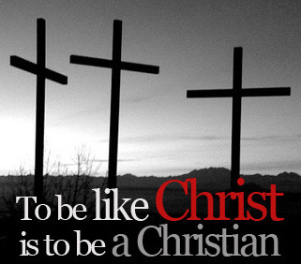
“And when he had found him, he brought him unto Antioch. And it came to pass, that a whole year they assembled themselves with the church, and taught much people. And the disciples were called Christians first in Antioch.” (Acts 11:26)

Slide 37
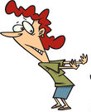
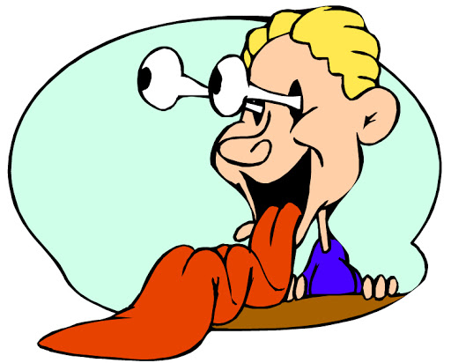
Today there is a vast difference in the spiritual character of the various members of the average local church.

Slide 38
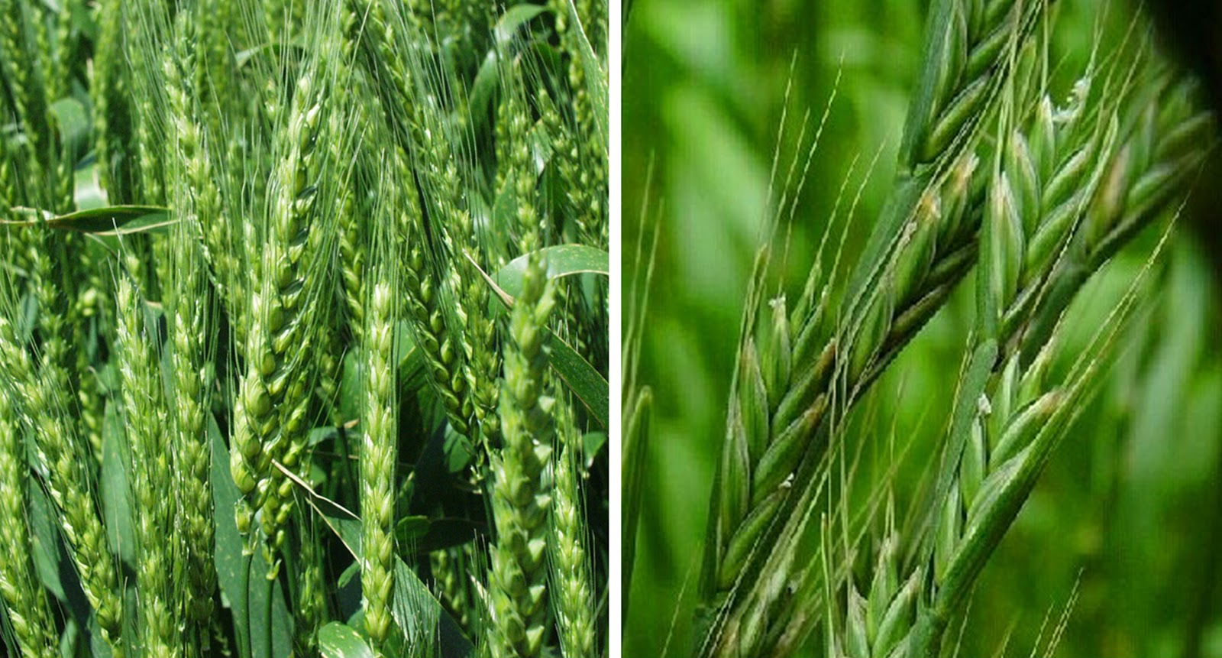
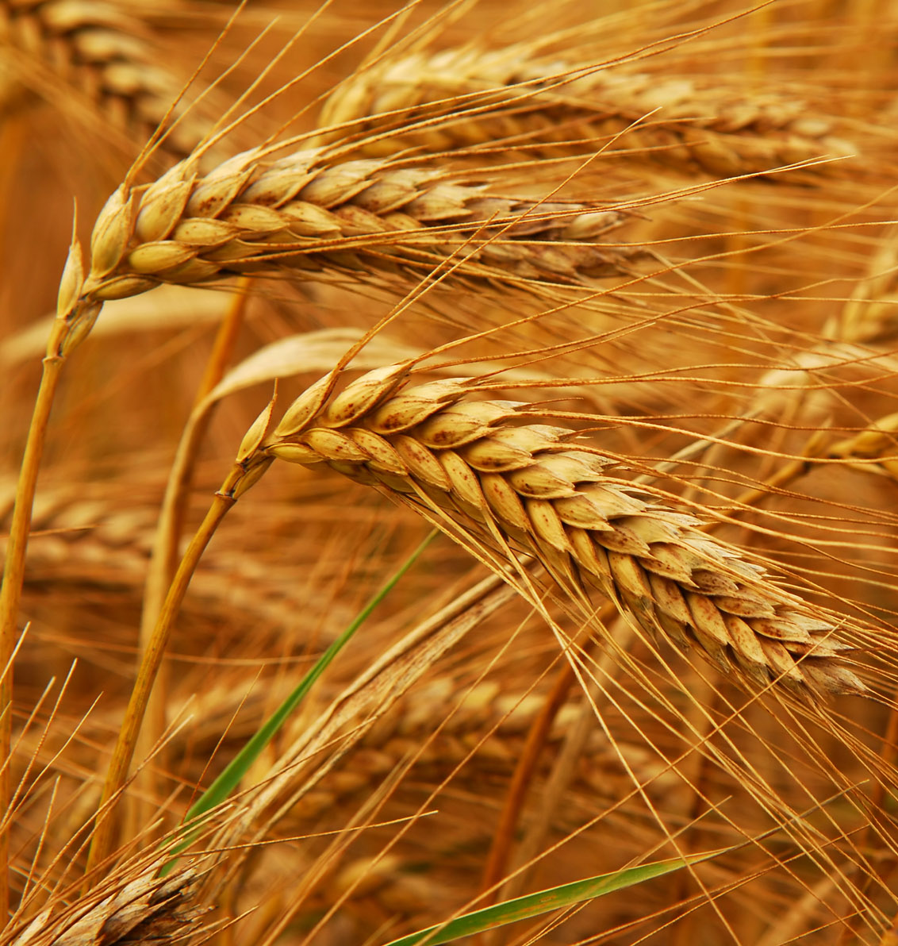
In every local assembly there may be ‘tares’ and ‘wheat’ growing together, that is, both saved and unsaved members. (Matthew 13:25)

Slide 39
The apostolic Church was perhaps the nearest to God’s desire for His Church.

Slide 40
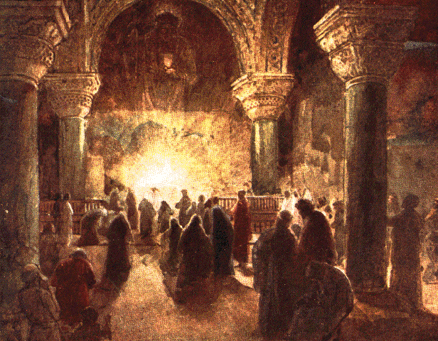
The early Christians were:

Slide 41
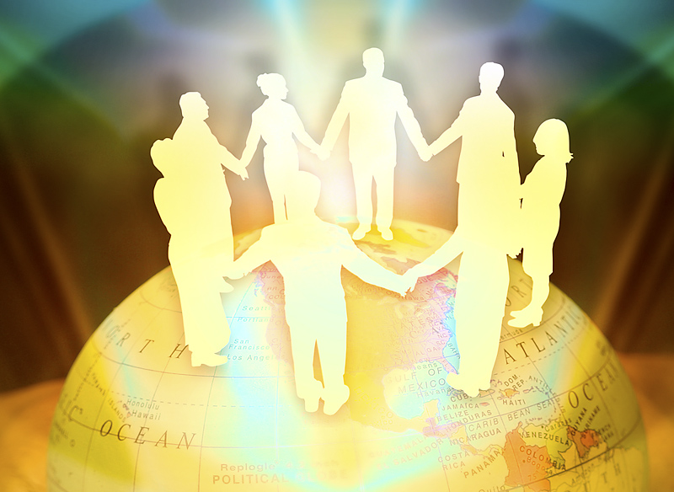
1. United (Acts 2:44; 4:32; Eph. 4:1-7)

Slide 42
(Acts 2:44-46 )
“And all that believed were together, and had all things common; And sold their possessions and goods, and parted them to all men, as every man had need. And they, continuing daily with one accord in the temple, and breaking bread from house to house, did eat their meat with gladness and singleness of heart, Praising God, and having favour with all the people. And the Lord added to the church daily such as should be saved.”

Slide 43
(Acts 4:32-33) “And the multitude of them that believed were of one heart and of one soul: neither said any of them that ought of the things which he possessed was his own; but they had all things common. And with great power gave the apostles witness of the resurrection of the Lord Jesus.”

Slide 44
(Ephesians 4:1-7)
“I therefore, the prisoner of the Lord, beseech you that ye walk worthy of the vocation wherewith ye are called, With all lowliness and meekness, with longsuffering, forbearing one another in love; Endeavouring to keep the unity of the Spirit in the bond of peace. There is one body, and one Spirit, even as ye are called in one hope of your calling; One Lord, one faith, one baptism, One God and Father of all, who is above all, and through all, and in you all. But unto every one of us is given grace according to the measure of the gift of Christ”

Slide 45
(Proverbs 6:16-18)
“These six things doth the LORD hate: yea, seven are an abomination unto him: A proud look, a lying tongue, and hands that shed innocent blood, An heart that deviseth wicked imaginations, feet that be swift in running to mischief, A false witness that speaketh lies, and he that soweth discord among brethren.”

Slide 46
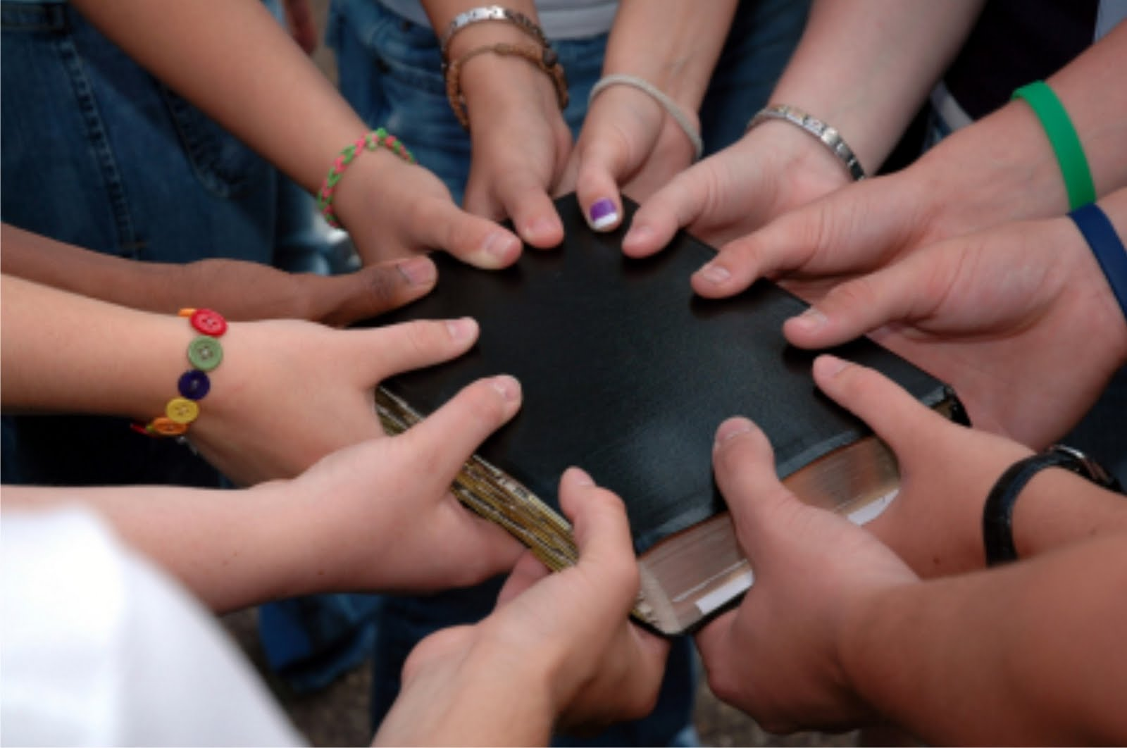
(Psalm 133:1) “Behold, how good and how pleasant it is for brethren to dwell together in unity!”

Slide 47
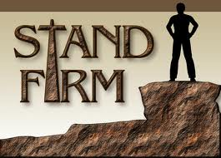
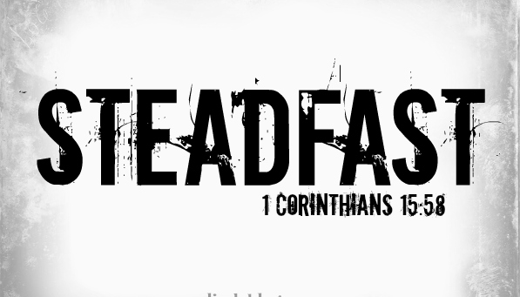
2. Steadfast

Slide 48
(Acts 2:41-42) “Then they that gladly received his word were baptized: and the same day there were added unto them about three thousand souls. And they continued stedfastly in…”

Slide 49
Steadfast in doctrine.
No turning aside from facts to fables, no heaping up teachers with itching ears, no wavering like the waves of the sea, tossing about from doubt in despair! They were steadfast in their belief in God’s Word – I Thess. 2:13
Steadfast in fellowship.
If the members had stopped to criticize, no doubt they would have found faults in each other and their church, but they remained steadfast in fellowship. They were quick to see their own failures, but slow to criticize others’ faults – Phil. 2:1

Slide 50
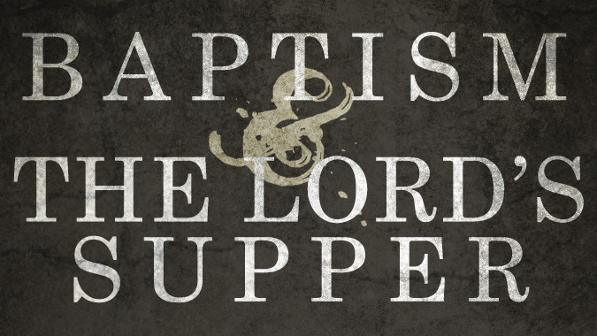
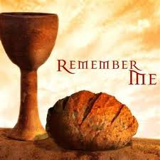
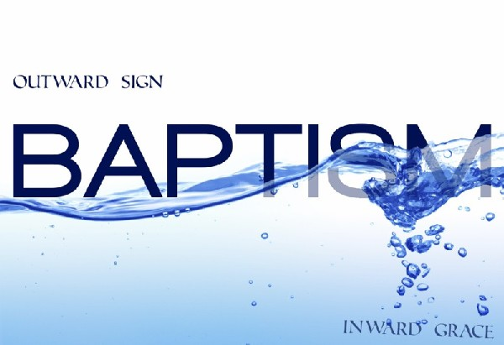
Steadfast in observing the ordinances.
Christ was the substance of sermons and the center of worship – Col. 1:18
The institution of the Lord’s Supper and of Baptism represented the work of grace in the hearts of the early believers - Rom. 6:3-4; 1 Cor. 11:23-26

Slide 51
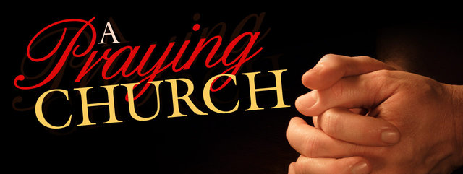
Steadfast in prayer.
They prayed ‘in one accord’ and received such a wonderful answer that they continued steadfast in prayer.
The true Church is composed of praying Christians - Acts 1:3-4, 12-14

Slide 52
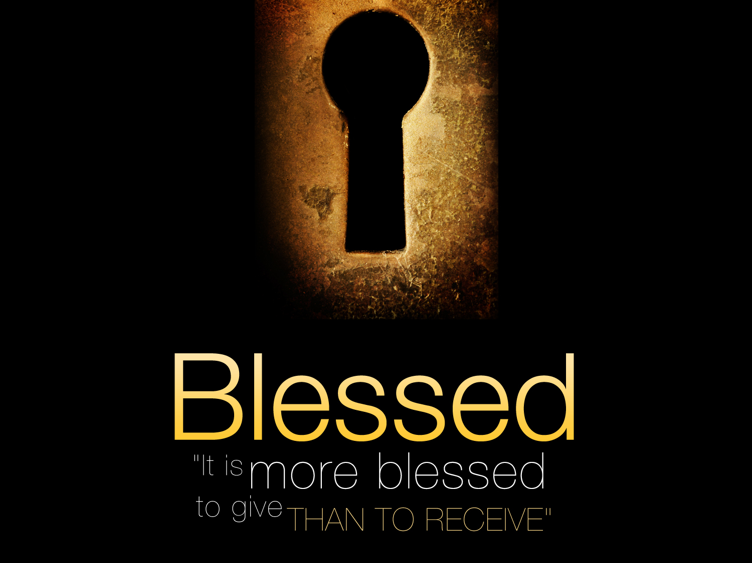
3. Sacrificial in Giving (Acts 2:45; 4:34-35; Eph. 4:28-32)

Slide 53
(Acts 2:45) “And sold their possessions and goods, and parted them to all men, as every man had need.”
(Acts 4:34-35) “Neither was there any among them that lacked: for as many as were possessors of lands or houses sold them, and brought the prices of the things that were sold, And laid them down at the apostles' feet: and distribution was made unto every man according as he had need.”
(Ephesians 4:28) “Let him that stole steal no more: but rather let him labour, working with his hands the thing which is good, that he may have to give to him that needeth.”

Slide 54
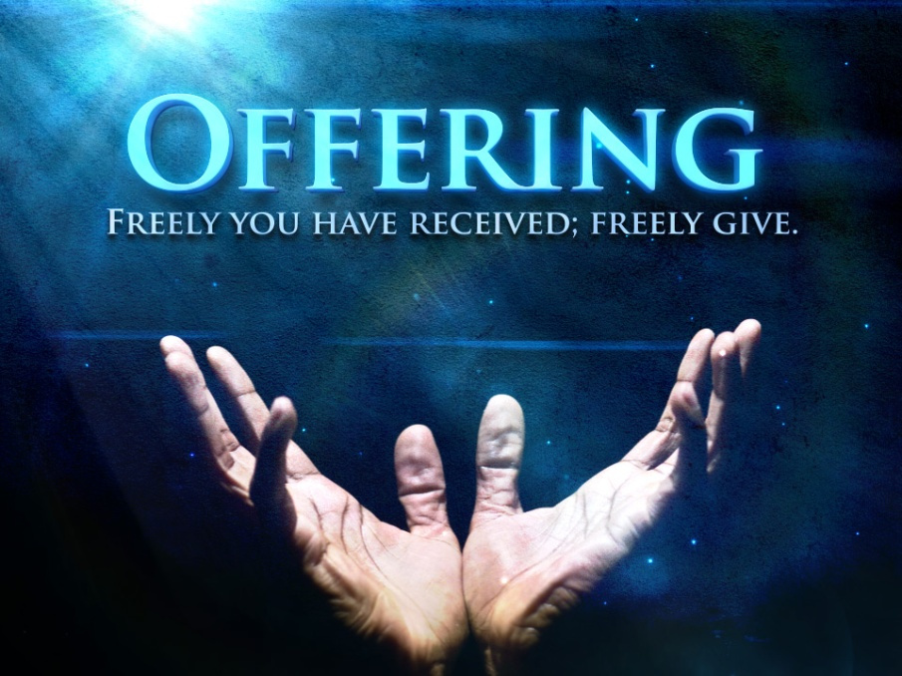

Slide 55
They ‘sold their possessions and goods, and parted them to all men, as every man had need.’
The members gave spontaneously.
Their love for each other was so great that they sold out their businesses and disposed of their lands, laying the money at the disciples’ feet.

Slide 56
Their charity was a wonderful testimony of the love of Christ.
Those who looked on the sacrificial giving of the early church commented - ‘See how they love one another.’

Slide 58
4. Joyful (Acts 2:46-47; Eph. 5:18-21)

Slide 59
They continued daily with one accord in the temple with gladness and singleness of heart.
It was this singleness of heart that made them happy.

Slide 60
They were not divided between Christ and the world, but being wholly the Lord’s, they rejoiced in the Lord.

Slide 61
Their communion with Christ was not clouded with the things of this world.
They rejoiced in God because they were so glad to be saved filling them with great joy.

Slide 62
Don’t ever get over being saved

Slide 63
5. Favor with men
(Acts 2:47)
“Praising God, and having favour with all the people. And the Lord added to the church daily such as should be saved.”

Slide 64
(Acts 5:13-14)
“And of the rest durst no man join himself to them: but the people magnified them. And believers were the more added to the Lord, multitudes both of men and women.”

Slide 65
It is a most remarkable thing that in spite of opposition and persecution from the people and the rulers, the early Church was exceedingly popular.
Far more than the average church today. The sincerity and joy of these first Christians could not fail to impress the people of the world who were looking for purpose, life and happiness.

Slide 66
Looking for Happiness in all the Wrong Places
“I have seen all the works that are done under the sun…I looked on all the works that my hands had wrought, and on the labour that I had laboured to do: and, behold, all was vanity and vexation of spirit, and there was no profit under the sun.”

Slide 67
Lost men believed in the reality of what they saw, and when they realized that the members of the church were united, steadfast, charitable, joyful, and downright earnest in their faith, they were greatly moved and converted to Christ.
Acts 2:47 “Praising God, and having favour with all the people. And the Lord added to the church daily such as should be saved.”
Acts 5:14 “And believers were the more added to the Lord, multitudes both of men and women.”

Slide 68
6. Successful (Acts 2:41, 47; 5:14; 6:7; 13:44; 16:5; 18:8)

Slide 69
Never was a church so richly blessed with the power of God. The church grew by leaps and bounds. For the first two centuries the Church ran along the ground like wild-fire in so much that the whole world was ‘turned upside down.’

