Slide 1
The inherent characteristics, quality's
and features of God

Slide 2
An attribute of God is whatever God has revealed as being true of Himself.
Some theologians prefer the word "perfection" to that of attributes –
I John 1:5 “This then is the message which we have heard of him, and declare unto you, that God is light, and in him is no darkness at all.”
Psalms 5:4 “For thou art not a God that hath pleasure in wickedness: neither shall evil dwell with thee.”

Slide 3
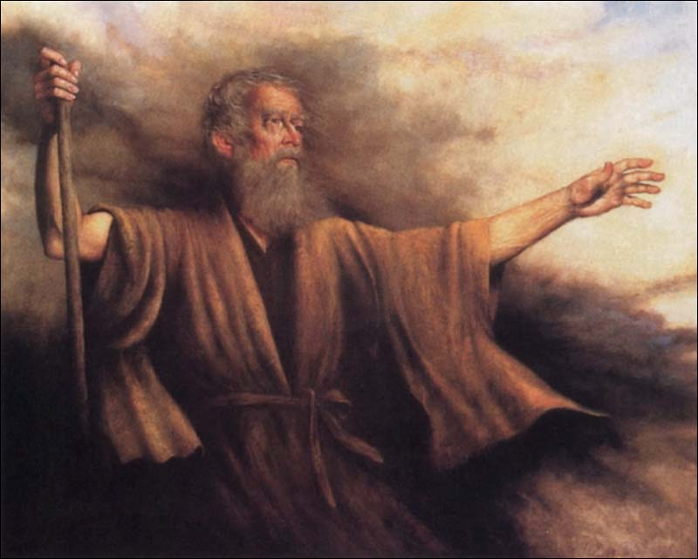
“I will publish the name of the LORD: ascribe ye greatness unto our God. He is the Rock, his work is perfect: for all his ways are judgment: a God of truth and without iniquity, just and right is he.” Deuteronomy 32:3-4

Slide 4
Psalm 18:30 “As for God, his way is perfect: the word of the LORD is tried: he is a buckler to all those that trust in him.”
Psalm 50:2 “The perfection of beauty, God hath shined.”
Psalm 19:7 “The law of the LORD is perfect, converting the soul: the testimony of the LORD is sure, making wise the simple.”
Deut. 32:4 “His work is perfect.”
II Sam. 22:31 “As for God, his way is perfect.”
Job 36:4 “For truly my words shall not be false: He that is perfect in knowledge is with thee.”

Slide 5
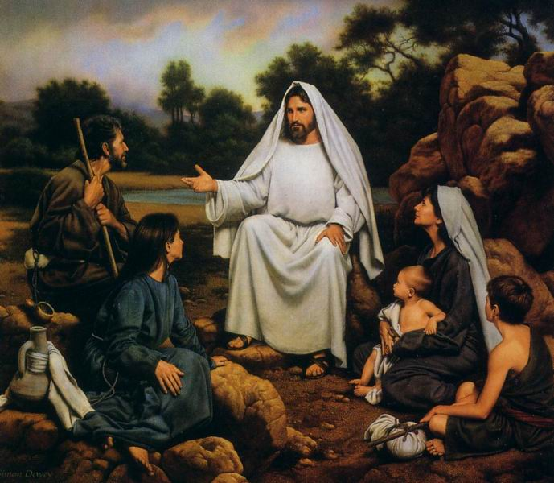
“Be ye therefore perfect, even as your Father which is in heaven is perfect.” Matthew 5:48

Slide 6
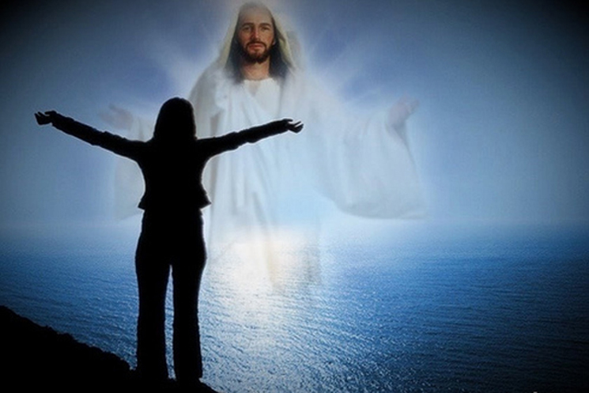
“Till we all come in the unity of the faith, and of the knowledge of the Son of God, unto a perfect man, unto the measure of the stature of the fulness of Christ.” Eph. 4:13

Slide 7
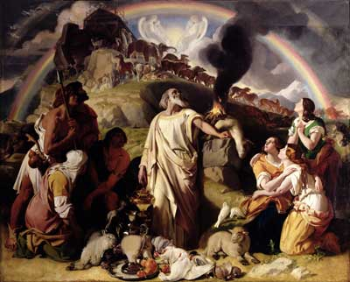
“These are the generations of Noah: Noah was a just man and perfect in his generations, and Noah walked with God.” Gen. 6:9

Slide 8
“And when Abram was ninety years old and nine, the LORD appeared to Abram, and said unto him, I am the Almighty God; walk before me, and be thou perfect.” Gen. 17:1

Slide 9
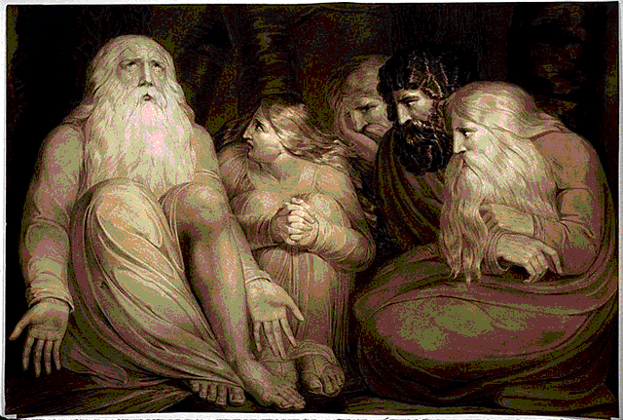
“There was a man in the land of Uz, whose name was Job; and that man was perfect and upright, and one that feared God, and eschewed evil.” Job 1:1

Slide 10
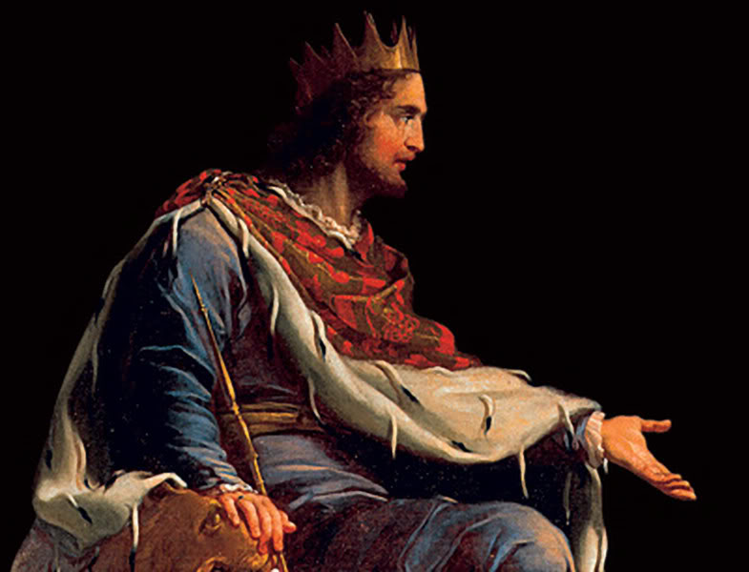
“And said, Remember now, O LORD, I beseech thee, how I have walked before thee in truth and with a perfect heart, and have done that which is good in thy sight. And Hezekiah wept sore.” Isa. 38:3

Slide 11
“Now the God of peace, that brought again from the dead our Lord Jesus, that great shepherd of the sheep, through the blood of the everlasting covenant, Make you perfect in every good work to do his will, working in you that which is wellpleasing in his sight, through Jesus Christ; to whom be glory for ever and ever. Amen.” Hebrews 13:20-21

Slide 12
II Sam. 22:33 “God is my strength and power: and he maketh my way perfect.”
Heb 6:1 “Therefore leaving the principles of the doctrine of Christ, let us go on unto perfection.”
I Kings 8:61 “Let your heart therefore be perfect with the LORD our God, to walk in his statutes, and to keep his commandments, as at this day.”
I Chron. 28:9 “Serve him with a perfect heart and with a willing mind: for the LORD searcheth all hearts, and understandeth all the imaginations of the thoughts: if thou seek him, he will be found of thee; but if thou forsake him, he will cast thee off for ever.”

Slide 13
“And He (Christ) gave gifts unto men…for the perfecting of the saints, for the work of the ministry, for the edifying of the body of Christ.” (Ephesians 4:8-13)
II Chron. 19:9 “And he charged them, saying, Thus shall ye do in the fear of the LORD, (serve Him) faithfully, and with a perfect heart.”

Slide 14
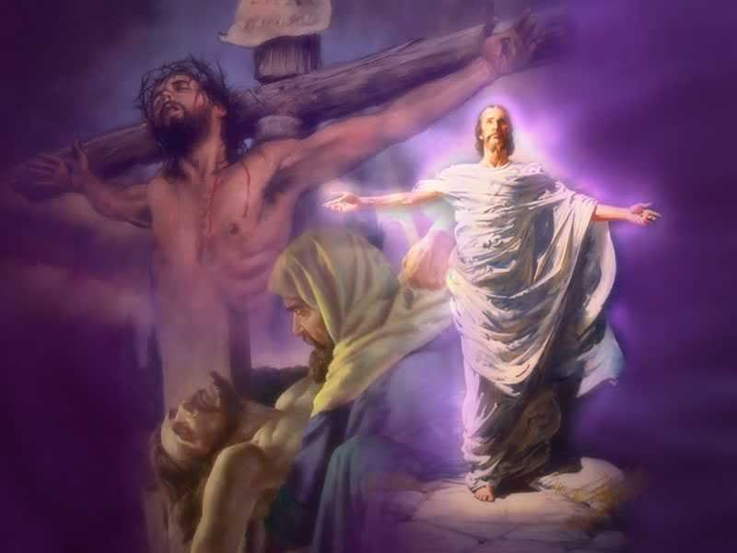
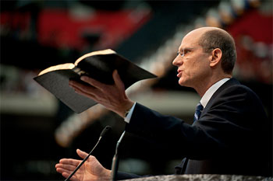
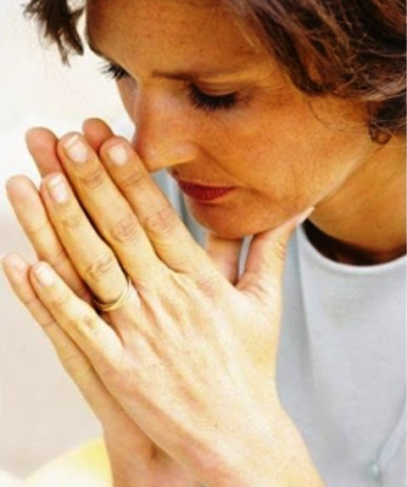
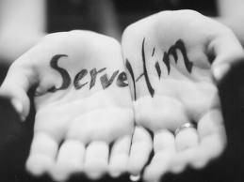
Glory of God
“The perfecting
of the saints…”

Slide 15
“That I may know him, and the power of his resurrection, and the fellowship of his sufferings, being made conformable unto his death; If by any means I might attain unto the resurrection of the dead. Not as though I had already attained, either were already perfect: but I follow after, if that I may apprehend that for which also I am apprehended of Christ Jesus. Brethren, I count not myself to have apprehended: but this one thing I do, forgetting those things which are behind, and reaching forth unto those things which are before.” (Philippians 3:10-13)

Slide 16
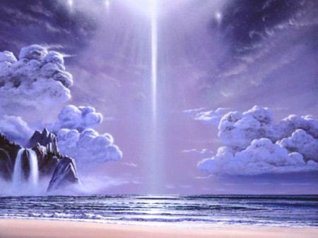
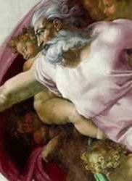
21 Attributes / Perfections of God

Slide 17
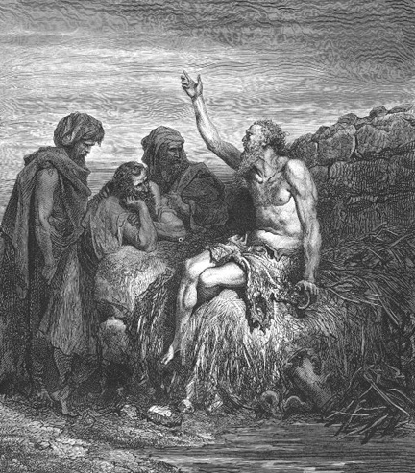
God is incomprehensible
"Canst thou by searching find out God? canst thou find out the Almighty unto perfection? It is as high as heaven; what canst thou do? deeper than hell; what canst thou know? The measure thereof is longer than the earth, and broader than the sea.“ Job 11:7-9

Slide 18
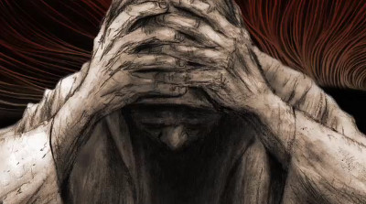
"I would seek unto God, and unto God would I commit my cause: Which doeth great things and unsearchable; marvellous
things without number.”
Job 5:7-9

Slide 19
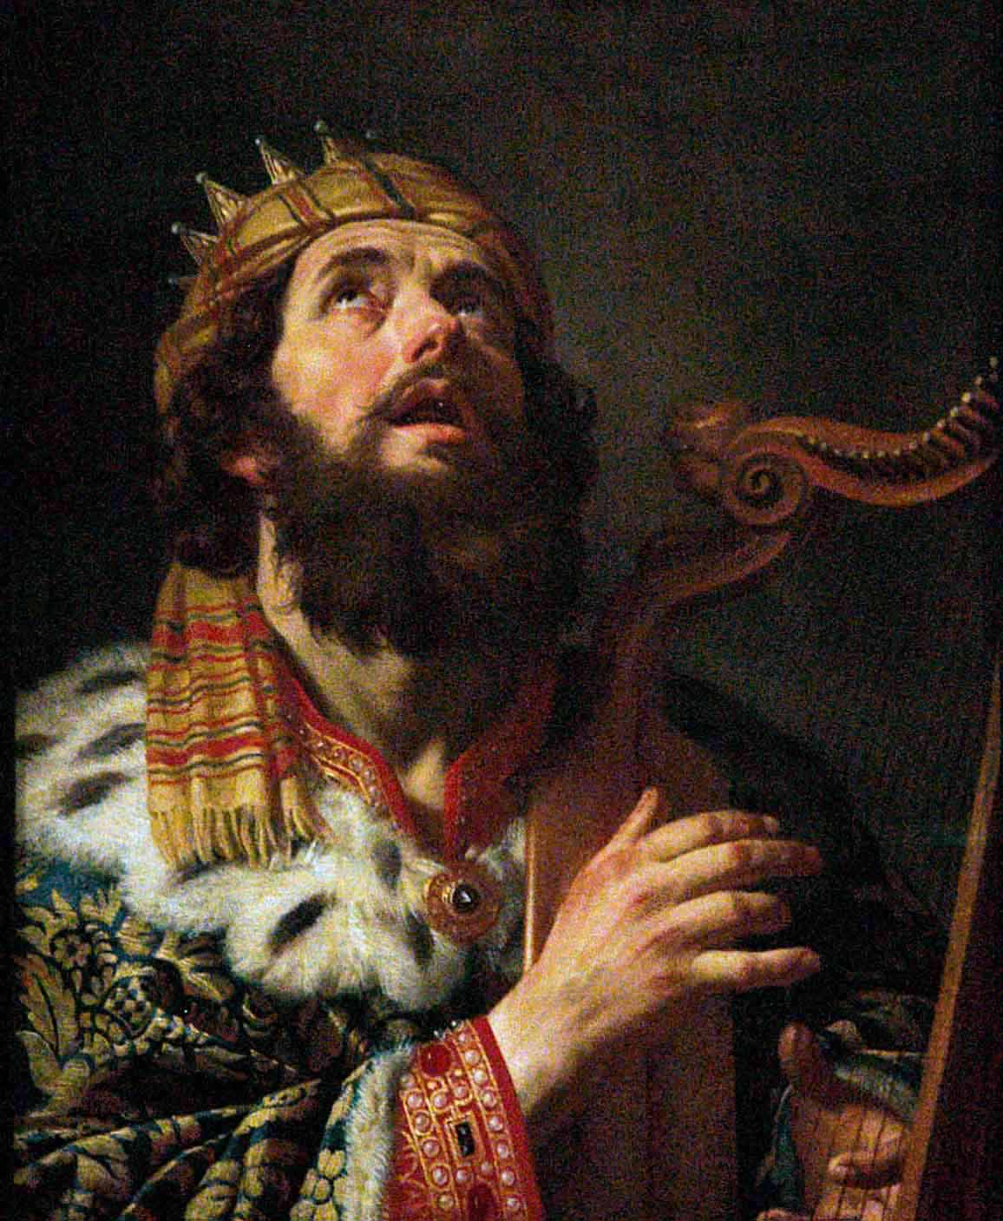
"Great is the LORD, and greatly to be praised; and his greatness is unsearchable." Psalm 145:3

Slide 20
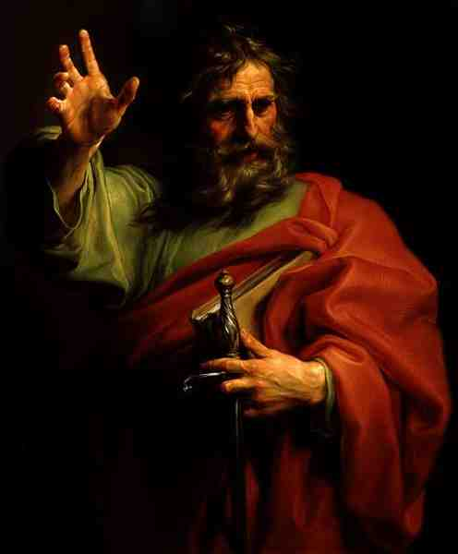
"O the depth of the riches both of the wisdom and knowledge of God! how unsearchable are his judgments, and his ways past finding out!” Romans 11:33

Slide 21
“The secret things belong unto the LORD our God: but those things which are revealed belong unto us.” Deut. 29:29

Slide 22
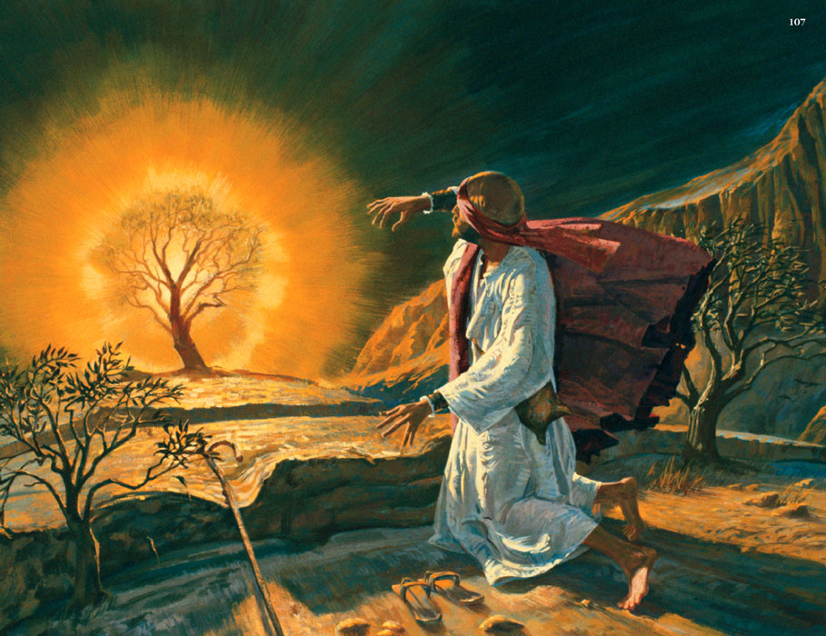
God is self-existent
"And Moses said unto God, Behold, when I come unto the children of Israel, and shall say unto them, The God of your fathers hath sent me, What is his name? What shall I say unto them? And God said unto Moses, I AM THAT I AM: and he said, Thus shalt thou say unto the children of Israel, I AM hath sent me unto you.”
Exodus 3:13-14

Slide 23
“God exists because He exists.”
God is not dependent upon anything or anyone –
His existence (Psalm 90:2)
His thoughts (Romans 11:33, 34)
His will (Romans 9:19; Eph. 1:5)
His power (Psalm 115:3)
His counsel (Psalm 33:10, 11)
Jesus said - John 8:24 “I said therefore unto you, that ye shall die in your sins: for if ye believe not that I am he, ye shall die in your sins.”

Slide 24
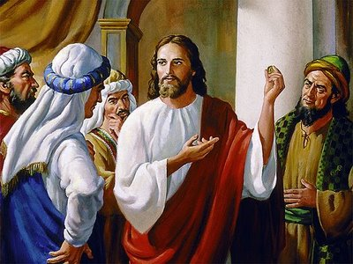
"Your father Abraham rejoiced to see my day: and he saw it, and was glad. Then said the Jews unto him, Thou art not yet fifty years old, and hast thou seen Abraham?" It should be observed that he did not say, "before Abraham was, I was," but "before Abraham was, I am".
John 8:56-58

Slide 25
God is self-sufficient
Psalm 50:10-12 "For every beast of the forest is mine, and the cattle upon a thousand hills. I know all the fowls of the mountains: and the wild beasts of the field are mine. If I were hungry, I would not tell thee: for the world is mine, and the fullness thereof.”
John 5:26 “For the Father hath life in himself.”
Acts 17:25 “Neither is worshipped with men's hands, as though he needed any thing, seeing he giveth to all life, and breath, and all things.”

Slide 26
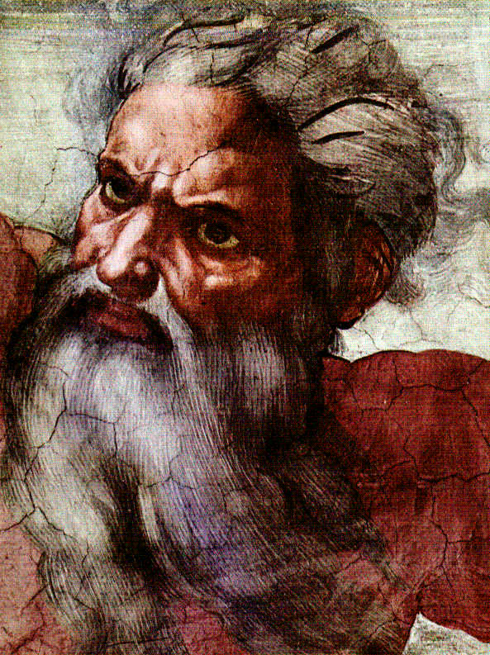
This attribute is closely connected to the attribute of self-existence, but carries it a step further. This means God has never had in eternity past, nor can ever have in the ages to come, a single need for which his own divine nature has not already provided.

Slide 27
God is eternal
Deuteronomy 33:27 "The eternal God is thy refuge, and underneath are the everlasting arms: and he shall thrust out the enemy from before thee.”
Psalm 102:11-12 "My days are like a shadow that declineth; and I am withered like grass. But thou, O Lord, shalt endure for ever; and thy remembrance unto all generations.”
Psalm 90:2 “Before the mountains were brought forth, or ever thou hadst formed the earth and the world, even from everlasting to everlasting, thou art God.”

Slide 28
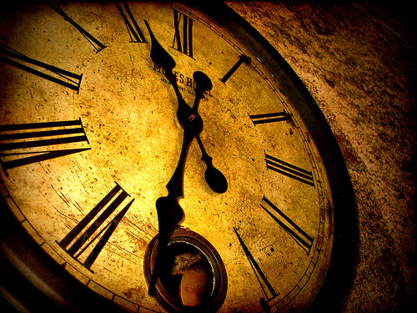
“Redeeming the time, because the days are evil.” Eph. 5:16

Slide 29
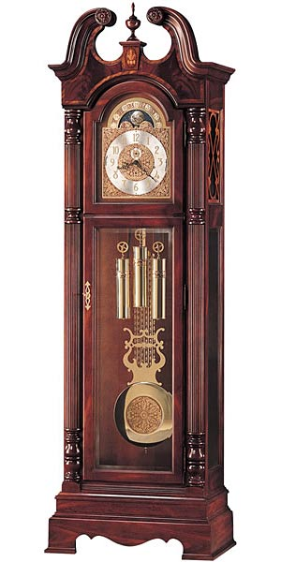
“What time is it?”
“There’s just not enough time in a day!”
“How am I ever going to get all this done on time?”
“Your time is up.”
Man is bound by time, hampered by time, frustrated with time. If things don't happen according to our timing, we become upset.
God is above all this!

Slide 30
When we speak of God being eternal, we mean that He has no beginning or end. God has always existed. He is above all temporal limits of time. He possesses all His existence in one indivisible present. He sees the past and future as clearly as the present. He is neither conditioned nor
confined by time.

Slide 31
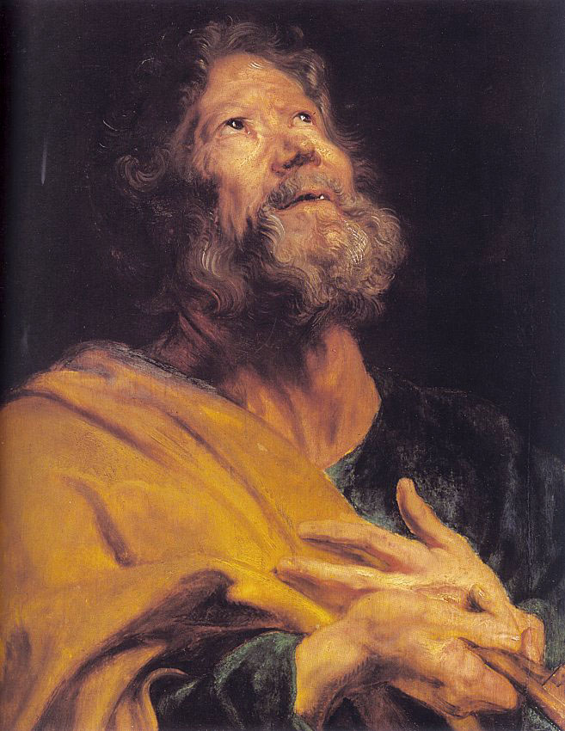
“But, beloved, be not ignorant of this one thing, that one day is with the Lord as a thousand years, and a thousand years as one day.” II Peter 3:8

Slide 32
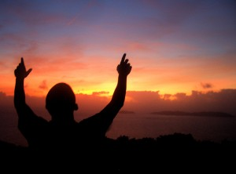
“For thus saith the high and lofty One that inhabiteth eternity, whose name is Holy; I dwell in the high and holy place, with him also that is of a contrite and humble spirit, to revive the spirit of the humble, and to revive the heart of the contrite ones.” Isa. 57:15

Slide 33
“For the life was manifested, and we have seen it, and bear witness, and shew unto you that eternal life, which was with the Father, and was manifested unto us.”
I John 1:2

Slide 34
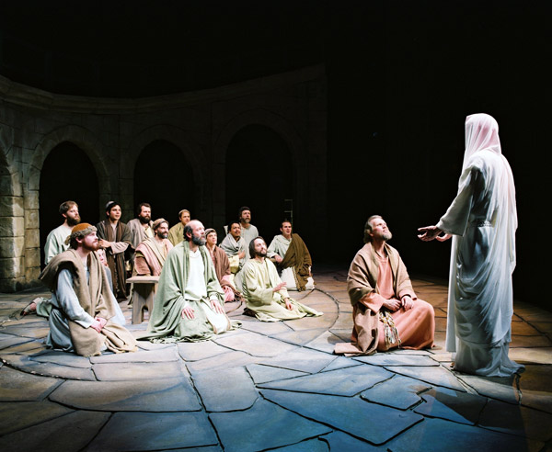

Slide 35
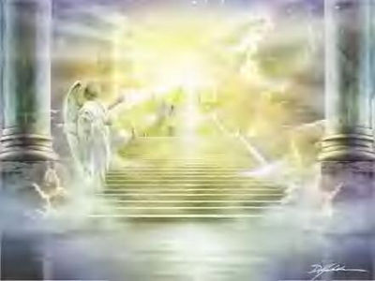
God is infinite

Slide 36
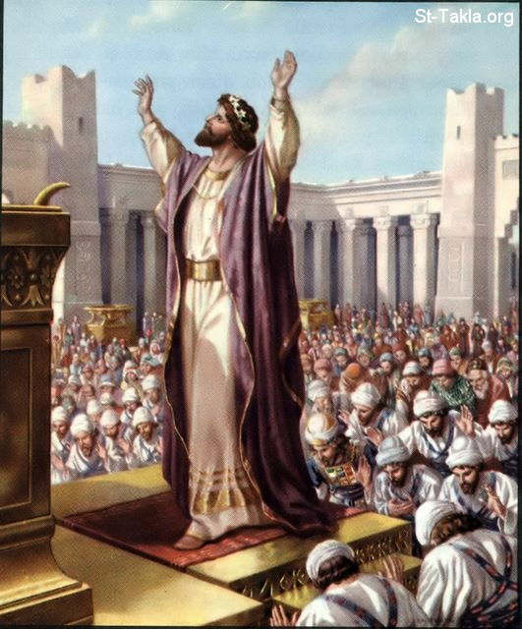
Unlimited and Unmeasurable

Slide 37
"And Solomon stood before the altar of the Lord in the presence of all the congregation of Israel, and spread forth his hands toward heaven: And he said, Lord God of Israel, there is no God like thee, in heaven above, or on earth beneath, who keepest covenant and mercy with thy servants that walk before thee with all their heart. Behold, the heaven and heaven of heavens cannot contain thee; how much less this house that I have builded?”
I Kings 8:22, 23, 27

Slide 38
He is infinitely “perfect” – Job 11:7-9; Jer. 31:37
He is infinite in His "purity, holiness, and justice” – Job 4:17-18; Isa. 6:2-3
He is infinite in “goodness and mercy” – Psalm 16:2; 100:5; 108:4
His "greatness" it is "unsearchable” - Psalm 145:3
The height, depth, length and breadth of the love of God, infinitely immeasurable - Eph. 3:18

Slide 39
His "understanding" is infinite - Psalm 147:5
There is "no searching of his understanding" there is no end of it - Isa. 40:28
He is a God of all “knowledge and wisdom”
His infinite wisdom and knowledge are beyond man’s ability to comprehend - Rom. 11:33
The power of God is infinite – Heb. 1:3
With Him nothing is impossible – Luke 1:37

Slide 40
His power has never been exerted to the uttermost – Matt. 22:29
He that has made the worlds, could have made millions.
Nothing but infinite power could ever have made everything out of nothing - Heb. 11:1-3
There is no end of His power – “eternal power”- Rom. 1:20

Slide 41
God is incomprehensible
God is self-existence
God is self-sufficient
God is eternal
God is infinite

