Slide 1
The inherent characteristics, quality's
and features of God
(Part 12)

Slide 2
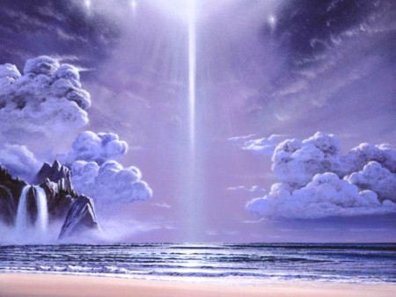
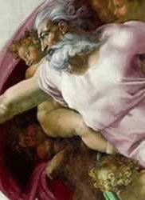
21 Attributes / Perfections of God

Slide 3
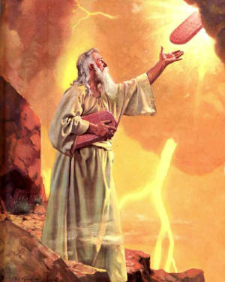
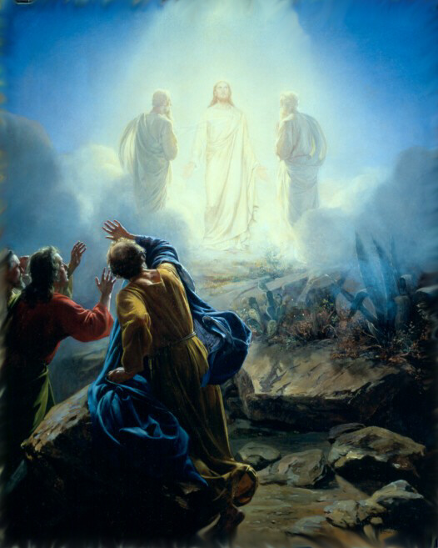
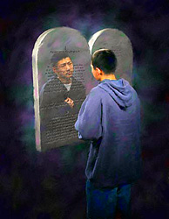
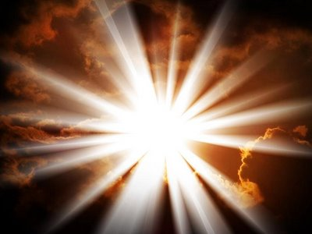
“But we all, with open face beholding as in a glass the glory of the Lord, are changed into the same image from glory to glory, even as by the Spirit of the Lord.” II Cor. 3:18

Slide 4
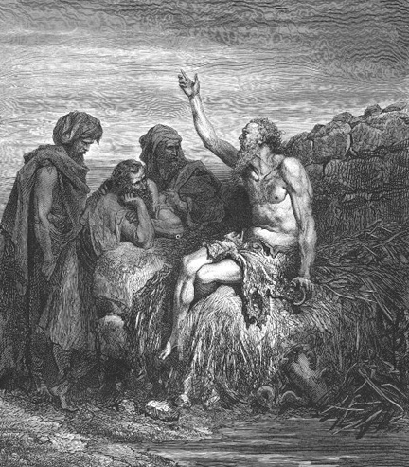
God is incomprehensible
“Canst thou by searching find out God? canst thou find out the Almighty unto perfection? It is as high as heaven; what canst thou do? deeper than hell; what canst thou know? The measure thereof is longer than the earth, and broader than the sea.” Job 11:7-9

Slide 5
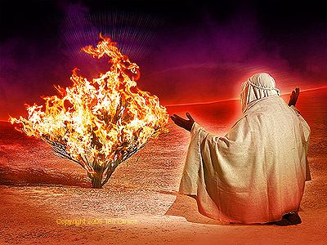
God is self-existent
"And Moses said unto God, Behold, when I come unto the children of Israel, and shall say unto them, The God of your fathers hath sent me, What is his name? What shall I say unto them? And God said unto Moses, I AM THAT I AM: and he said, Thus shalt thou say unto the children of Israel, I AM hath sent me unto you.”
Exodus 3:13-14

Slide 6
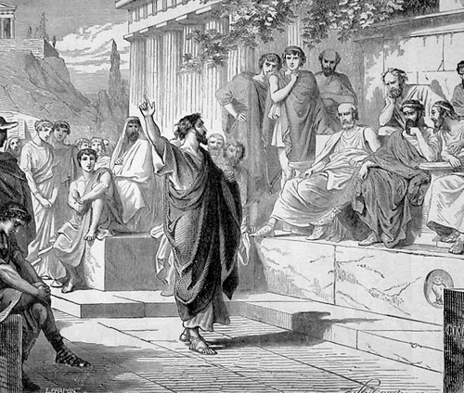
God is self-sufficient
“Neither is worshipped with men's hands, as though he needed any thing, seeing he giveth to all life, and breath, and all things.” Acts 17:25

Slide 7
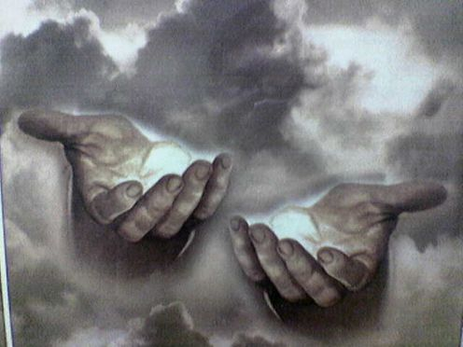
God is eternal
"The eternal God is thy refuge, and underneath are the everlasting arms: and he shall thrust out the enemy from before thee.” Deuteronomy 33:27

Slide 8
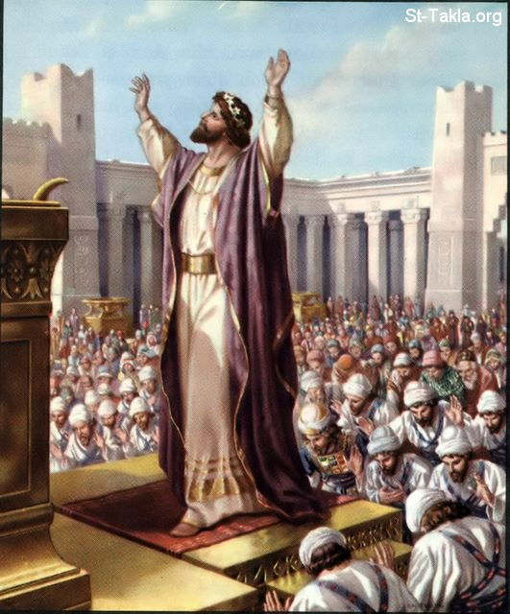
God is infinite
"And Solomon stood before the altar of the Lord in the presence of all the congregation of Israel, and spread forth his hands toward heaven: And he said…Behold, the heaven and heaven of heavens cannot contain thee; how much less this house that I have builded?”
I Kings 8:22, 23, 27

Slide 9
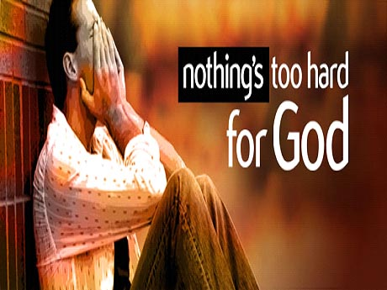
God is omnipotent
"Is any thing too hard for the Lord?” (Genesis 18:14)

Slide 10
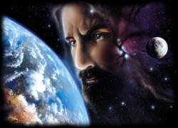
God is omnipresent
"Whither shall I go from thy spirit? or whither shall I flee from thy presence? If I ascend up into heaven, thou art there: if I make my bed in hell, behold, thou art there. If I take the wings of the morning, and dwell in the uttermost parts of the sea; even there shall thy hand lead me, and thy right hand shall hold me.”
Psalm 139:7-11

Slide 11
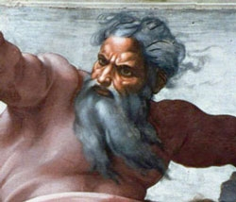
God is omniscient
"Great is our Lord, and of great power: his understanding is infinite.“ Psalm 147:5

Slide 12
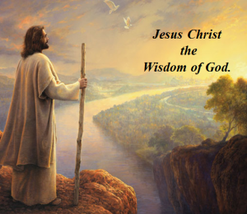
God is all wise
"To the only wise God our Saviour, be glory and majesty, dominion and power, both now and ever. Amen.” Jude 1:25

Slide 13
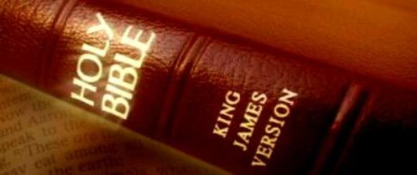
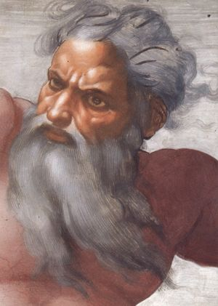
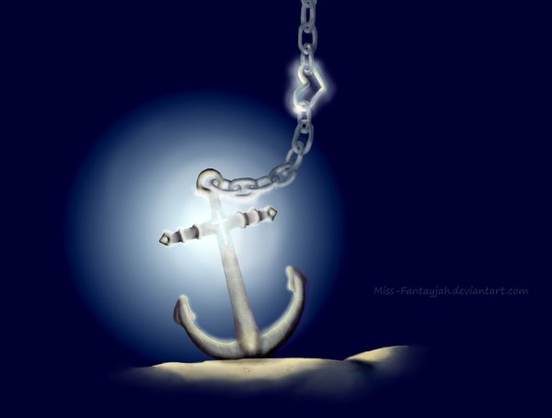
God is immutable “For I am the Lord, I change not.” Malachi 3:6
Hebrews 6:17-18

Slide 14
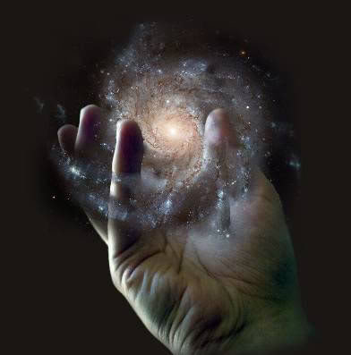
God is sovereign
"Remember the former things of old: for I am God, and there is none else; I am God, and there is none like me, declaring the end from the beginning, and from ancient times the things that are not yet done, saying, My counsel shall stand, and I will do all my pleasure: yes, I have spoken it, I will also bring it to pass; I have purposed it, I will also do it.” Isaiah 46:9-11

Slide 15
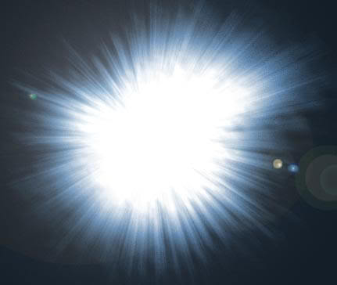
God is light
"This then is the message which we have heard of him, and declare unto you, that God is light, and in him is no darkness at all…But if we walk in the light, as he is in the light, we have fellowship one with another, and the blood of Jesus Christ his Son cleanseth us from all sin.” I John 1:5,7

Slide 16
God is inscrutable
INCOMPREHENSIBLE
beyond our understanding
MAN CANNOT PLUMB THE DEPTS OR LIMITS OF GOD
“For my thoughts are not your thoughts, neither are your ways my ways, saith the LORD. For as the heavens are higher than the earth, so are my ways higher than your ways, and my thoughts than your thoughts.”
Isa. 55:8-9

Slide 17
God is faithful

Slide 18
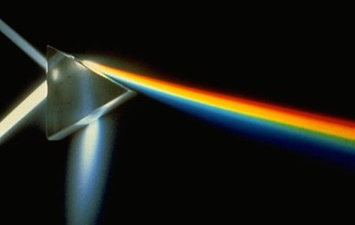
God is holy
God
wise, immutable, sovereign, inscrutable, light, faithful, incomprehensible, self-existence, self-sufficient, eternal, infinite, omnipotent, omnipresent, omniscient, righteousness, just, true, good, merciful, gracious, love
Holiness

Slide 19
God is just and righteous
“There is no God else beside me; a just God and a Saviour; there is none beside me.”
Isa. 45:21
“For the righteous God trieth the hearts and reins.”
Psalm 7:9

Slide 20
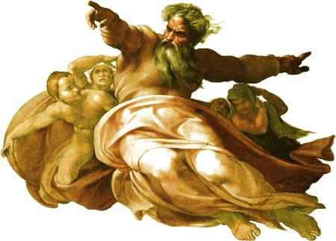
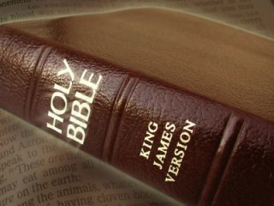
God is true
"And this is life eternal, that they might know thee the only true God, and Jesus Christ, whom thou hast sent.”
John 17:3
“Sanctify them through thy truth: thy word is truth.” John 17:17

Slide 21
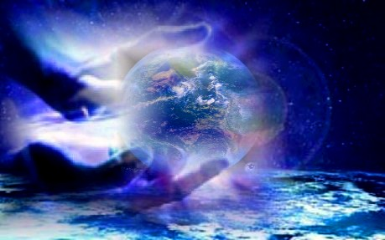
God is good
“Oh that men would praise the Lord for his goodness, and for his wonderful works to the children of men!” Psalm 107:8

Slide 22
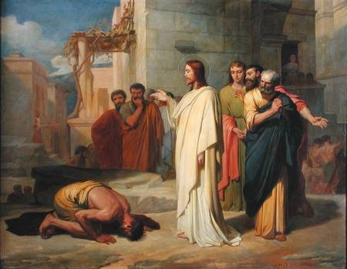
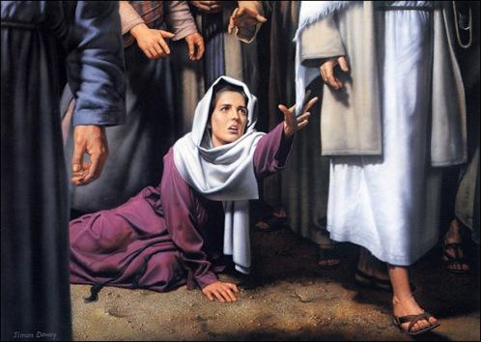
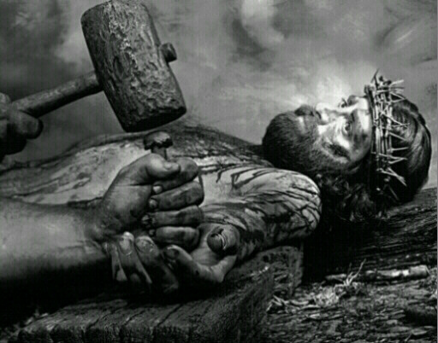
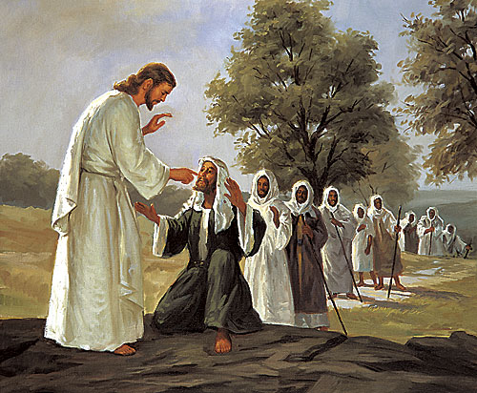
God is merciful
Psalm 136
“His mercy endureth forever…”

Slide 23
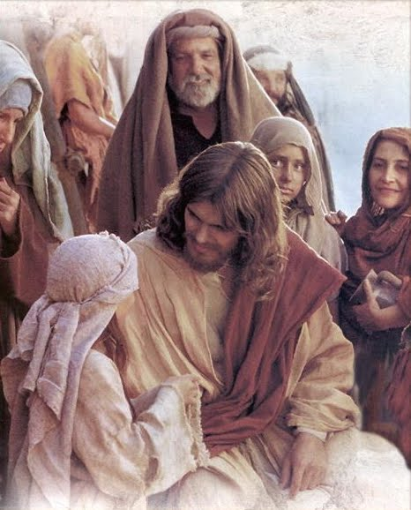
God is gracious
"Gracious is the Lord, and righteous; yea, our God is merciful.”
Psalm 116:5
“He hath made his wonderful works to be remembered: the Lord is gracious and full of compassion.” Psalm 111:4
“But the God of all grace, who hath called us unto his eternal glory by Christ Jesus, after that ye have suffered a while, make you perfect, stablish, strengthen, settle you.”
1 Peter 5:10
“If so be ye have tasted that the Lord is gracious.”
1 Peter 2:3

Slide 24
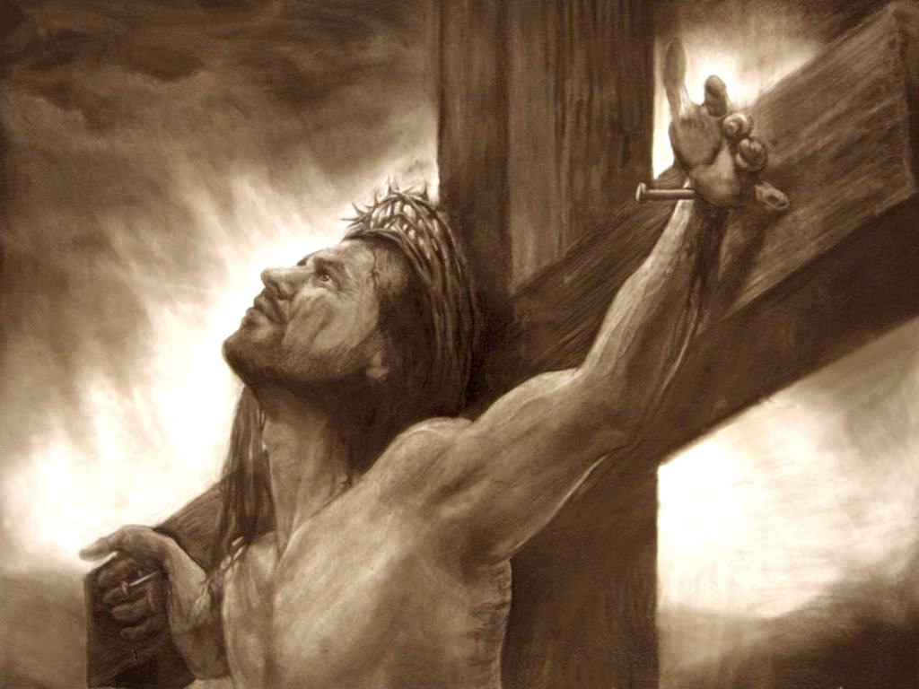
“For the grace of God that bringeth salvation hath appeared to
all men.”
Titus 2:11

Slide 25
God is love
I John 4:8,16 “He that loveth not knoweth not God; for God is love…And we have known and believed the love that God hath to us. God is love.”

Slide 26
Two definitions of love can be offered:
Love is unselfish concern about another’s welfare -
John 15:13 “Greater love hath no man than this, that a man lay down his life for his friends.”
Rom. 13:10 “Love worketh no ill to his neighbour: therefore love is the fulfilling of the law.”

Slide 28
2. Love is that act of one person seeking the highest good for another person -
I John 4:9-10 “In this was manifested the love of God toward us, because that God sent his only begotten Son into the world, that we might live through him. Herein is love, not that we loved God, but that he loved us, and sent his Son to be the propitiation for our sins.”

Slide 29
Wilmington's Guide to the Bible - This is the most universally known and universally misunderstood attribute of all. Millions have simply equated love with God, thus weakening or totally denying his other perfections. A man and woman may have an affair hidden from their spouses and justify their adulterous relationship by their great "love" for each other. But God’s love cannot be separated or isolated from his holiness and hatred for sin.

Slide 30
God
wise, immutable, sovereign, inscrutable, light, faithful, incomprehensible, self-existence, self-sufficient, eternal, infinite, omnipotent, omnipresent, omniscient, righteousness, just, true, good, merciful, gracious, love
Holiness

Slide 31
Having said all this, however, it must be admitted that of all his attributes, God’s love is probably more quickly seized upon by seeking sinners than any other perfection. The smallest child can sing with great understanding: "Jesus loves me, this I know, for the Bible tells me so.”

Slide 32
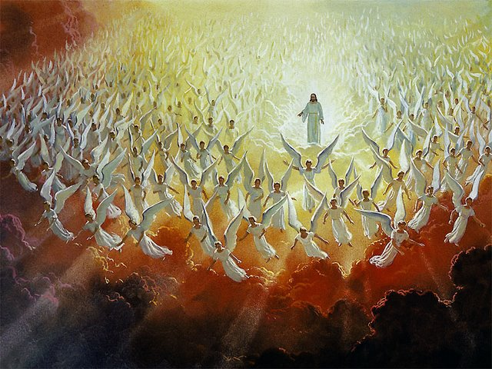
Of all the twenty-one attributes presented during this study, the final three (mercy, grace, love) will probably be the most difficult to explain to those who have never experienced them.
Angels can not understand the mercy, grace and love of God extended to man -

Slide 33
“Of which salvation the prophets have enquired and searched diligently, who prophesied of the grace that should come unto you: Searching what, or what manner of time the Spirit of Christ which was in them did signify, when it testified beforehand the sufferings of Christ, and the glory that should follow. Unto whom it was revealed, that not unto themselves, but unto us they did minister the things, which are now reported unto you by them that have preached the gospel unto you with the Holy Ghost sent down from heaven; which things the angels desire to look into.”
I Peter 1:10-12

Slide 34
Trying to explain the mercy, grace and love of God

Slide 35
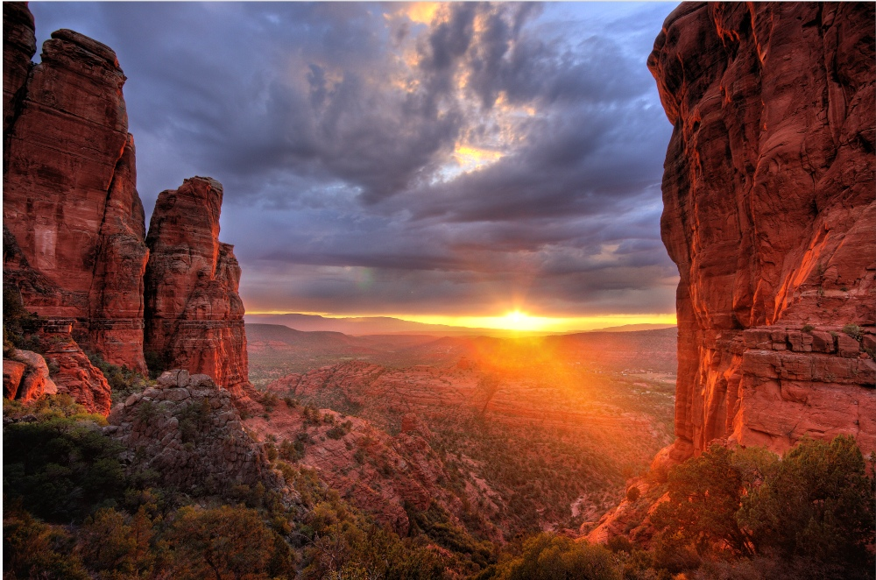
It would be like attempting to explain the breathtaking majesty of the Grand Canyon during a magnificent sunset to a friend who had been born blind.

Slide 36
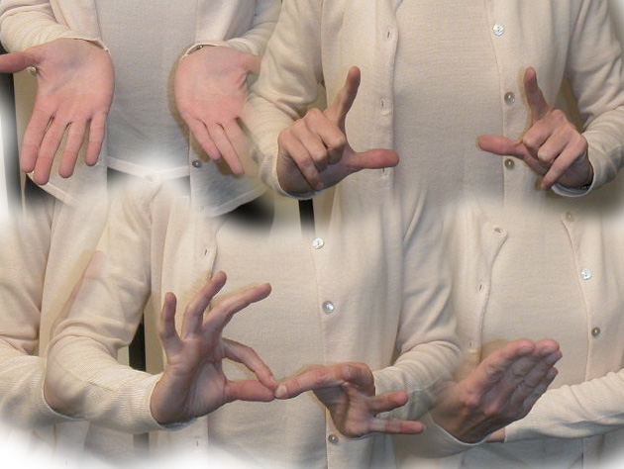
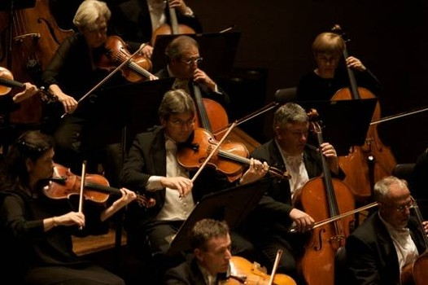
It would be like attempting to explain the glorious sound coming from a symphony orchestra to a friend who had been born deaf.

Slide 37
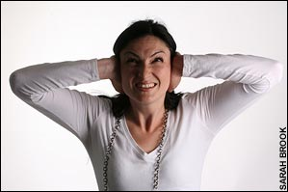
“Son of man, thou dwellest in the midst of a rebellious house, which have eyes to see, and see not; they have ears to hear, and hear not.”
Ezek. 12:2

Slide 38
Even those who have experience the mercy, grace and love of God can not fully comprehend it.
“That Christ may dwell in your hearts by faith; that ye, being rooted and grounded in love, May be able to comprehend with all saints what is the breadth, and length, and depth, and height; And to know the love of Christ, which passeth knowledge, that ye might be filled with all the fulness of God.” Ephesians 3:17-19

Slide 39
The importance of trying to understand the love of God
Paul’s prayer – “For this cause I bow my knees unto the Father of our Lord Jesus Christ, Of whom the whole family in heaven and earth is named.” Eph. 3:14
Paul’s request – That his readers might be able to comprehend and understand the enormous love that Christ has for them - (Eph. 3:18)

Slide 40
Paul’s desire – That they might be filled with all the fullness of God.
“…the fullness of God.”
The life
The character
The virtues
That the “…the fullness of God himself” might be fully developed in their lives.
“Image of Christ” – Rom. 8:29; I Cor. 15:49; II Cor. 3:18; Col. 3:10

Slide 41
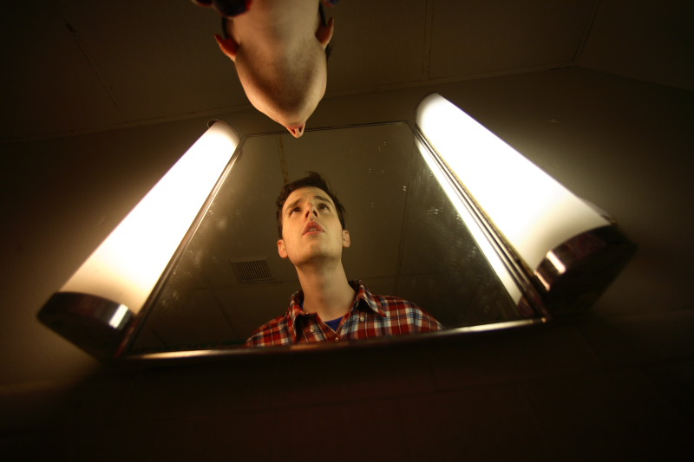
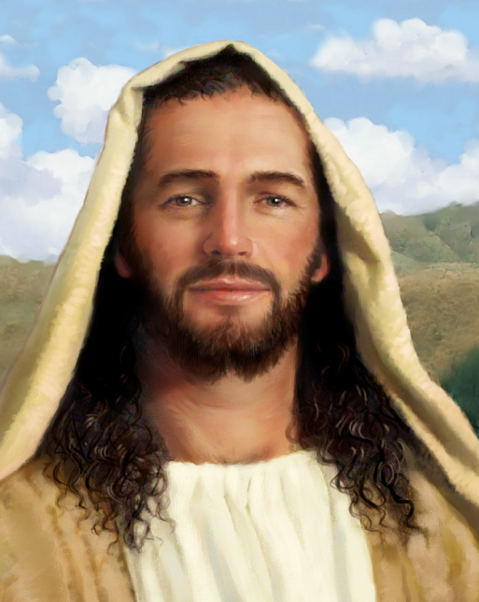

Slide 42
God’s Love Is Self-Giving
“For God so loved the world, that he gave his only begotten Son…” John 3:16

Slide 43
God’s Love Is Sacrificial
“But God commendeth his love toward us, in that, while we were yet sinners, Christ died for us.” Romans 5:8

Slide 44
God’s Love Is Unconditional
“And you, that were sometime alienated and enemies in your mind by wicked works, yet now hath he reconciled In the body of his flesh through death, to present you holy and unblameable
and unreproveable in his sight.”
Colossians 1:21-22

Slide 45
God’s Love Is Eternal
“The LORD hath appeared of old unto
me, saying, Yea, I have loved thee
with an everlasting love: therefore with lovingkindness have I drawn thee.”
Jeremiah 31:3

Slide 46
God’s Love Is Holy
“And ye have forgotten the exhortation which speaketh unto you as unto children, My son, despise not thou the chastening of the Lord, nor faint when thou art rebuked of him: For whom the Lord loveth he chasteneth, and scourgeth every son whom he receiveth…Now no chastening for the present seemeth to be joyous, but grievous: nevertheless afterward it yieldeth the peaceable fruit of righteousness unto them which are exercised thereby.” (Heb. 10)

Slide 47
God’s Love Is Comforting
“There is no fear in love; but perfect love casteth out fear: because fear hath torment. He that feareth is not made perfect in love.” I John 4:18

Slide 48
God’s Love is Life-Changing
“There is no fear in love; but perfect love casteth out fear: because fear hath torment. He that feareth is not made perfect in love. We love him, because he first loved us.” I John 4:18-19

Slide 49
Who does God Love?

Slide 50
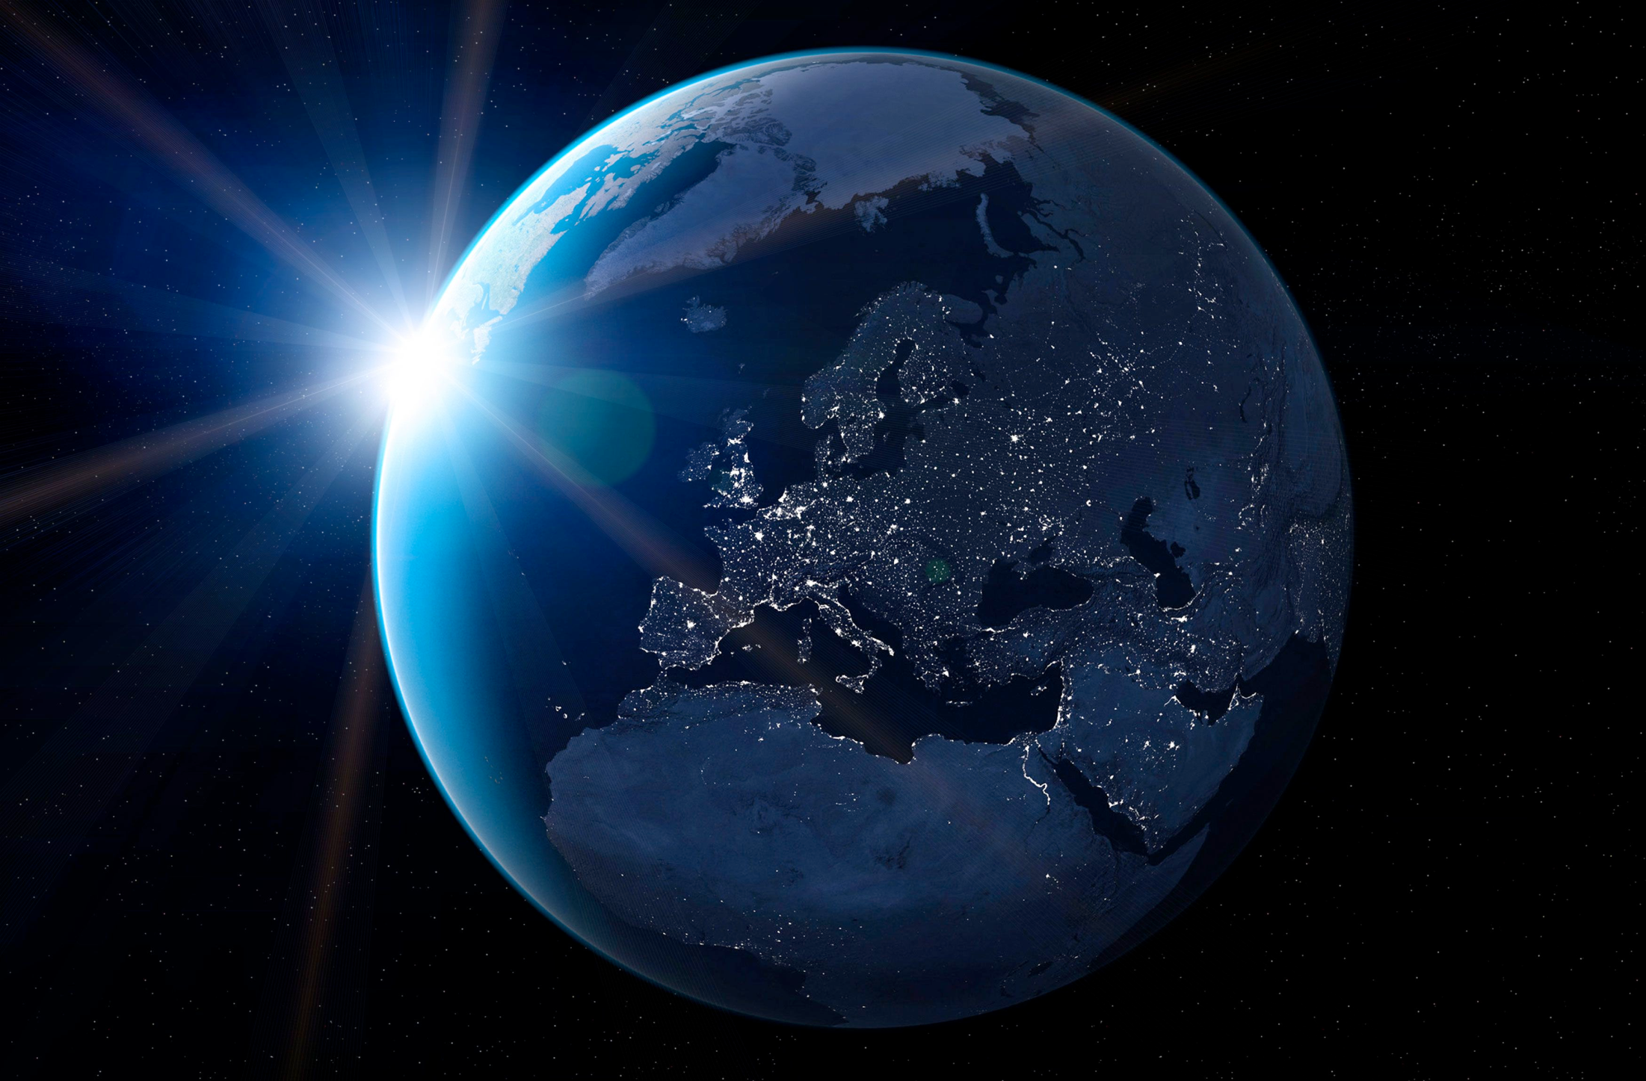
God loves the world
John 3:16 "For God so loved the world, that he gave his only begotten Son, that whosoever believeth in him should not perish, but have everlasting life."
I Timothy 2:3, 4 "For this is good and acceptable in the sight of God our Saviour; who will have all men to be saved, and to come unto the knowledge of the truth."
II Peter 3:9 "The Lord is not slack concerning his promise, as some men count slackness; but is longsuffering to usward, not willing that any should perish, but that all should come to repentance."

Slide 51
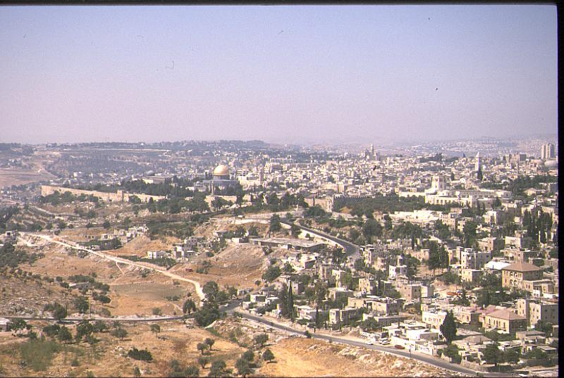
God loves Israel
Deuteronomy 7:7-8 "The Lord did not set his love upon you, nor choose you, because ye were more in number than any people; for ye were the fewest of all people. But because the Lord loved you, and because he would keep the oath which he had sworn unto your fathers, hath the Lord brought you out with a mighty hand, and redeemed you out of the house of bondmen, from the hand of Pharaoh king of Egypt."

Slide 52
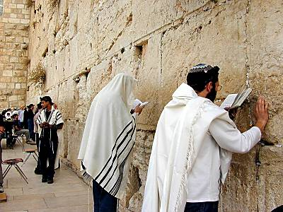
Isaiah 49:15 "Can a woman forget her sucking child, that she should not have compassion on the son of her womb? yea, they may forget, yet will I not forget thee."
Jeremiah 31:3 "The Lord hath appeared of old unto me, saying, Yea, I have loved thee with an everlasting love: therefore with lovingkindness have I drawn thee."
Malachi 1:2 "I have loved you, saith the Lord. Yet ye say, Wherein hast thou loved us? Was not Esau Jacob’s brother? saith the Lord: yet I loved Jacob."

Slide 53
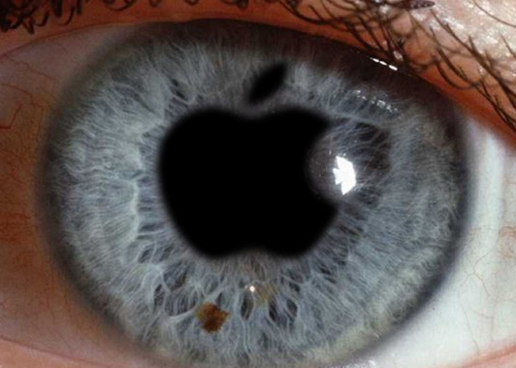
“He found him in a desert land, and in the waste howling wilderness; he led him about, he instructed him, he kept him as the apple of his eye.”
Deut. 32:10

Slide 54
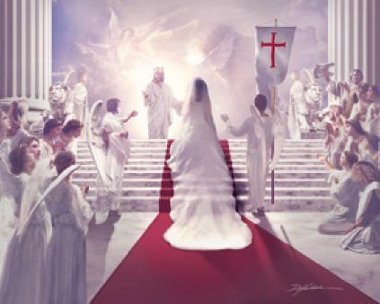
God loves the church
Ephesians 5:25-32 "Husbands, love your wives, even as Christ also loved the church, and gave himself for it; that he might sanctify and cleanse it with the washing of water by the word, that he might present it to himself a glorious church, not having spot, or wrinkle, or any such thing; but that it should be holy and without blemish. So ought men to love their wives as their own bodies. He that loveth his wife loveth himself. For no man ever yet hated his own flesh; but nourisheth and cherisheth it, even as the Lord the church; for we are members of his body, of his flesh, and of his bones. For this cause shall a man leave his father and mother, and shall be joined unto his wife, and they two shall be one flesh. This is a great mystery: but I speak concerning Christ and the church."

Slide 55
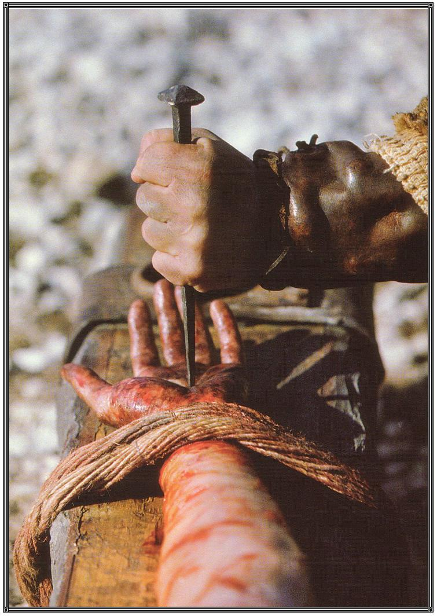
God loves the sinner
Romans 5:6-8 “For when we were yet without strength, in due time Christ died for the ungodly. For scarcely for a righteous man will one die: yet peradventure for a good man some would even dare to die. But God commendeth his love toward us, in that, while we were yet sinners, Christ died for us.”

Slide 56
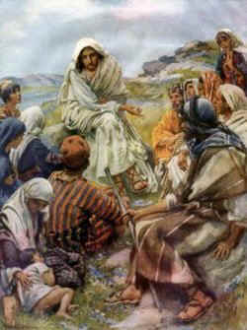
God loves the spiritual (obedient) Christian
Jesus - “He that hath my commandments, and keepeth them, he it is that loveth me: and he that loveth me shall be loved of my Father, and I will love him, and will manifest myself to him…If a man love me, he will keep my words: and my Father will love him, and we will come unto him, and make our abode with him.” (John 14)

Slide 57
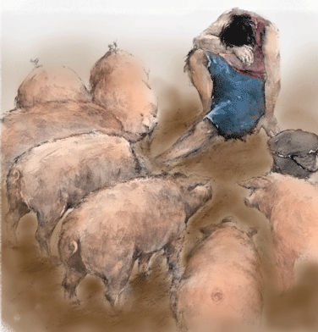
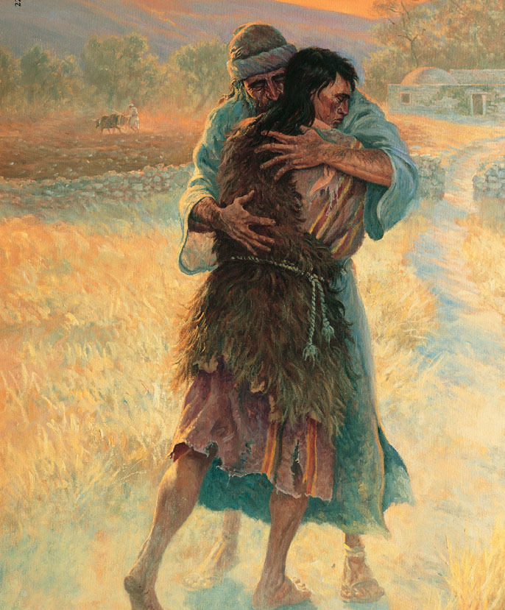
God loves the carnal (disobedient) Christian
Prodigal son – Luke 15

Slide 58
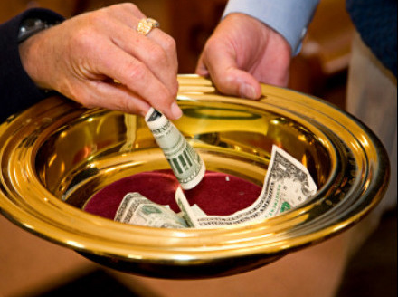
God loves the cheerful giver
II Corinthians 9:7 "Every man according as he purposeth in his heart, so let him give; not grudgingly, or of necessity: for God loveth a cheerful giver."

Slide 59
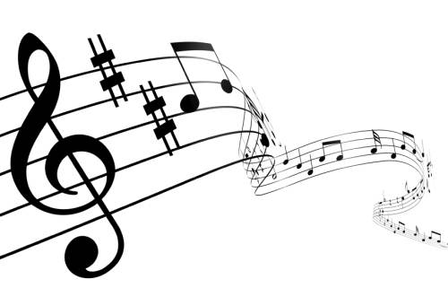
The Love of God
The love of God is greater far Than tongue or pen can ever tell; It goes beyond the highest star, And reaches to the lowest hell; The guilty pair, bowed down with care, God gave His Son to win; His erring child He reconciled, And pardoned from his sin.

Slide 60
When years of time shall pass away, And earthly thrones and kingdoms fall, When men, who here refuse to pray, On rocks and hills and mountains call, God’s love so sure, shall still endure, All measureless and strong; Redeeming grace to Adam’s race— The saints’ and angels’ song.

Slide 61
Could we with ink the ocean fill, And were the skies of parchment made, Were every stalk on earth a quill, And every man a scribe by trade, To write the love of God above, Would drain the ocean dry. Nor could the scroll contain the whole, Though stretched from sky to sky.

Slide 62
Refrain
O love of God, how rich and pure! How measureless and strong! It shall forevermore endure The saints’ and angels’ song.

