Slide 1
The inherent characteristics, quality's
and features of God
(Part 3)

Slide 2
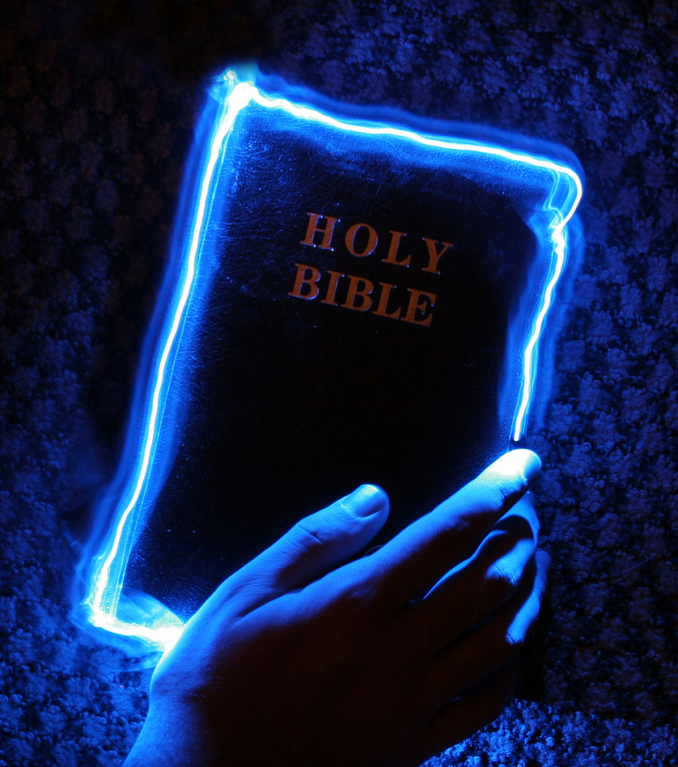
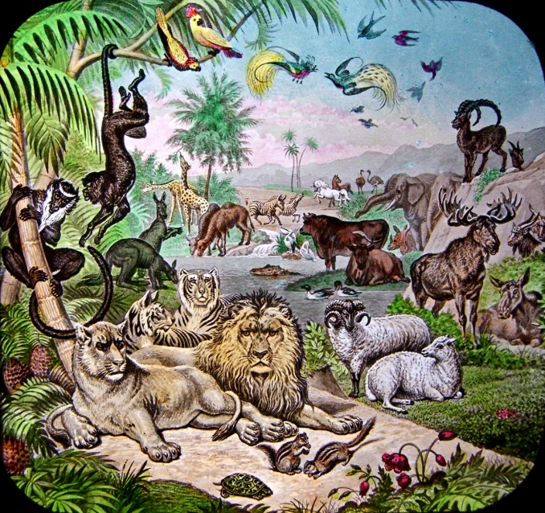
An attribute of God is whatever God has revealed as being true of Himself.

Slide 3
“For the invisible things of him from the creation of the world are clearly seen, being understood by the things that are made, even his eternal power and Godhead; so that they are without excuse.”
Romans 1:20

Slide 4
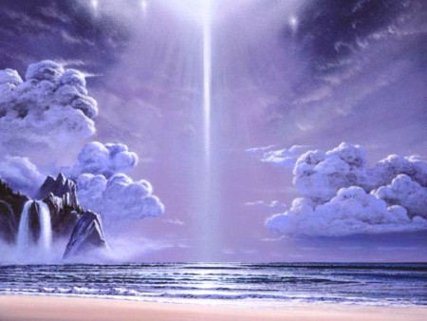
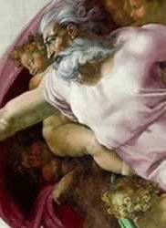
21 Attributes / Perfections of God

Slide 5
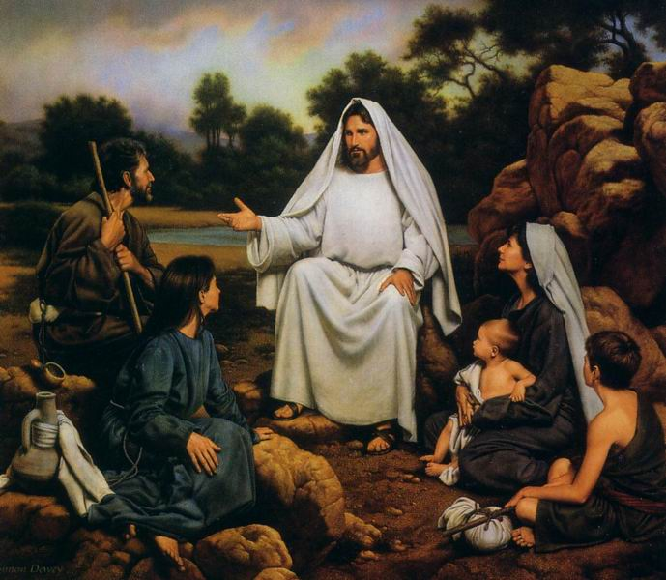
“Be ye therefore perfect, even as your Father which is in heaven is perfect.” Matthew 5:48

Slide 6
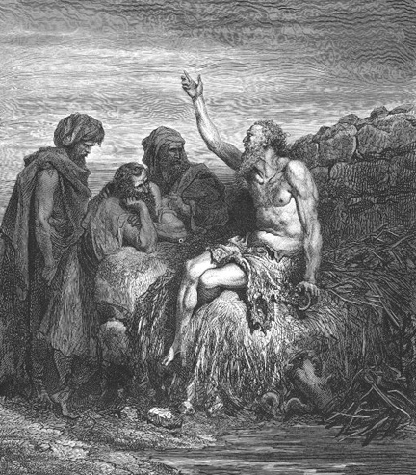
God is incomprehensible
“Canst thou by searching find out God? canst thou find out the Almighty unto perfection? It is as high as heaven; what canst thou do? deeper than hell; what canst thou know? The measure thereof is longer than the earth, and broader than the sea.” Job 11:7-9

Slide 7
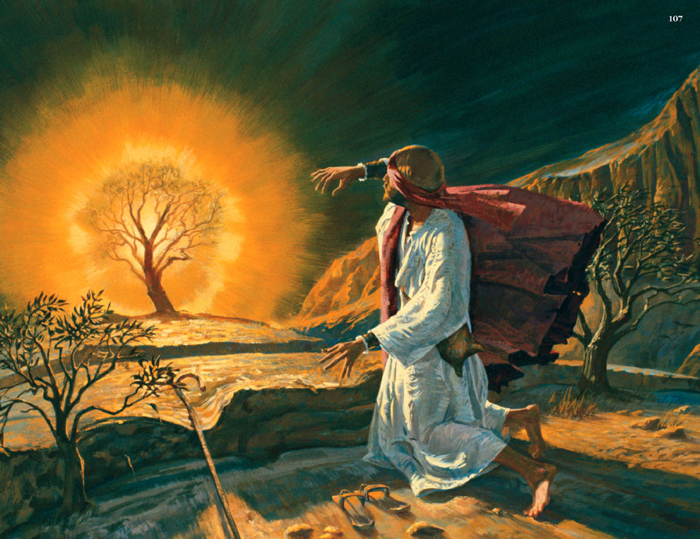
God is self-existent
"And Moses said unto God, Behold, when I come unto the children of Israel, and shall say unto them, The God of your fathers hath sent me, What is his name? What shall I say unto them? And God said unto Moses, I AM THAT I AM: and he said, Thus shalt thou say unto the children of Israel, I AM hath sent me unto you.”
Exodus 3:13-14

Slide 8
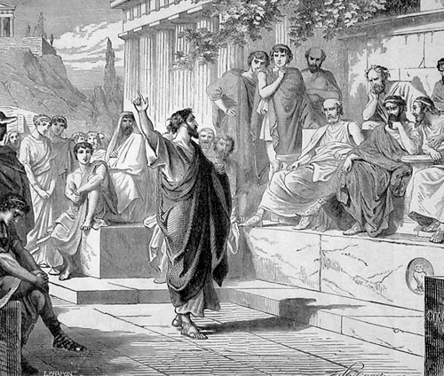
God is self-sufficient
“Neither is worshipped with men's hands, as though he needed any thing, seeing he giveth to all life, and breath, and all things.” Acts 17:25

Slide 9
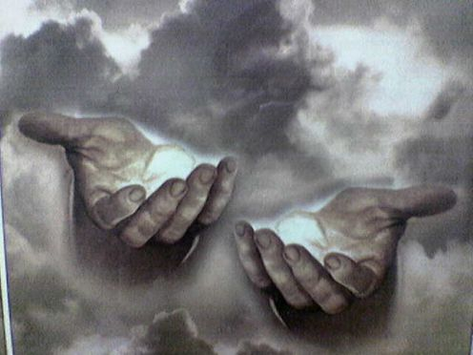
God is eternal
"The eternal God is thy refuge, and underneath are the everlasting arms: and he shall thrust out the enemy from before thee.” Deuteronomy 33:27

Slide 10
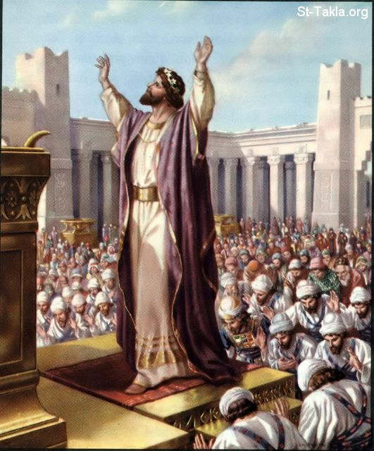
God is infinite
"And Solomon stood before the altar of the Lord in the presence of all the congregation of Israel, and spread forth his hands toward heaven: And he said…Behold, the heaven and heaven of heavens cannot contain thee; how much less this house that I have builded?”
I Kings 8:22, 23, 27

Slide 11
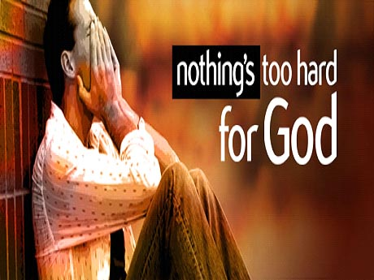
God is omnipotent
"Is any thing too hard for the Lord?” (Genesis 18:14)

Slide 12
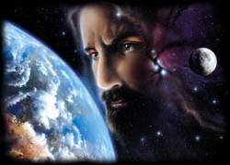
God is omnipresent
"Whither shall I go from thy spirit? or whither shall I flee from thy presence? If I ascend up into heaven, thou art there: if I make my bed in hell, behold, thou art there. If I take the wings of the morning, and dwell in the uttermost parts of the sea; even there shall thy hand lead me, and thy right hand shall hold me.”
Psalm 139:7-11

Slide 13
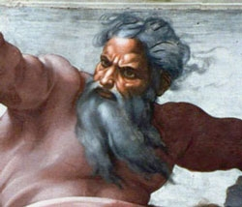
God is omniscient
"Great is our Lord, and of great power: his understanding is infinite.“ Psalm 147:5

Slide 14
God is incomprehensible
God is self-existence
God is self-sufficient
God is eternal
God is infinite
God is omnipotent
God is omnipresent
God is omniscient

Slide 15
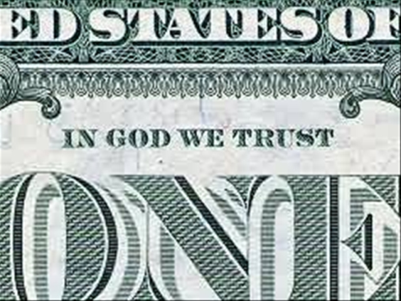
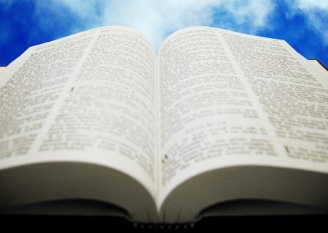
God is all wise
God’s wisdom is grounded
upon His omniscience
(Knowledge of all things)
Wisdom
Omniscience / Knowledge

Slide 16
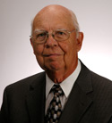
Robert Lightner writes:
"Though very closely related, knowledge and wisdom are not the same. Nor do they always accompany each other. No doubt we have all known those who had acquired a great deal of facts but who lacked the ability to use them wisely. Both knowledge and wisdom are imperfect in man but perfect and perfectly related to each other in God. Only He knows how to use His infinite knowledge to the best possible end. Through His wisdom God applies His knowledge to the fulfillment of His own purposes in ways which will bring the most glory to Him." (The God of the Bible, p. 99)

Slide 17
The following passages which declare the wisdom of God
Psalm 136:5 "To him that by wisdom made the heavens: for his mercy endureth for ever."
Proverbs 3:19 "The Lord by wisdom hath founded the earth; by understanding hath he established the heavens."
I Corinthians 2:7 "But we speak the wisdom of God in a mystery, even the hidden wisdom, which God ordained before the world unto our glory."

Slide 18
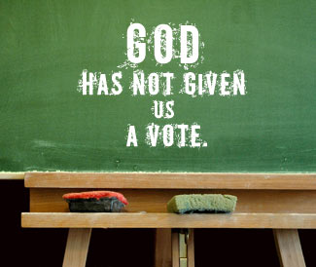
I Timothy 1:17 "Now unto the King eternal, immortal, invisible, the only wise God, be honour and glory for ever and ever. Amen."
Jude 1:25 "To the only wise God our Saviour, be glory and majesty, dominion and power, both now and ever. Amen."

Slide 19
God is immutable
The perfection of God by which He is devoid of all change in…
Essence
Nature
Attributes
Will
Promises
No change is possible in God, because all change must be to better or worse, and God is absolute perfection. No cause for change in God could possibility exists for He is a perfect God!

Slide 20
Psalm 102:27 “But thou art the same, and thy years shall have no end.”
James 1:17 “Every good gift and every perfect gift is from above, and cometh down from the Father of lights, with whom is no variableness, neither shadow of turning.”
Malachi 3:6 “For I am the Lord, I change not; therefore ye sons of Jacob are not consumed.”
Hebrews 6:17-18 “Wherein God, willing more abundantly to shew unto the heirs of promise the immutability of his counsel, confirmed it by an oath: That by two immutable things, in which it was impossible for God to lie, we might have a strong consolation, who have fled for refuge to lay hold upon the hope set before us.”

Slide 21
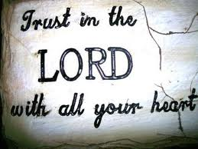
Hebrews 1:10-12 "And, Thou, Lord, in the beginning hast laid the foundation of the earth; and the heavens are the works of thine hands: They shall perish; but thou remainest; and they all shall wax old as doth a garment; and as a vesture shalt thou fold them up, and they shall be changed: but thou art the same, and thy years shall not fail."
Hebrews 13:8 "Jesus Christ the same yesterday, and to day, and for ever."

Slide 22
Application

Slide 23
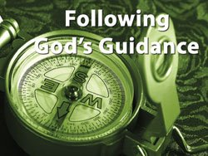
When things are going bad I won't blame God, asking why He has changed and doesn't seem to be living up to His promises. Since He doesn't change, I will look at my life and see where I have deviated from the path He wants me to follow. I will change my direction toward the right way and follow Him.

Slide 24
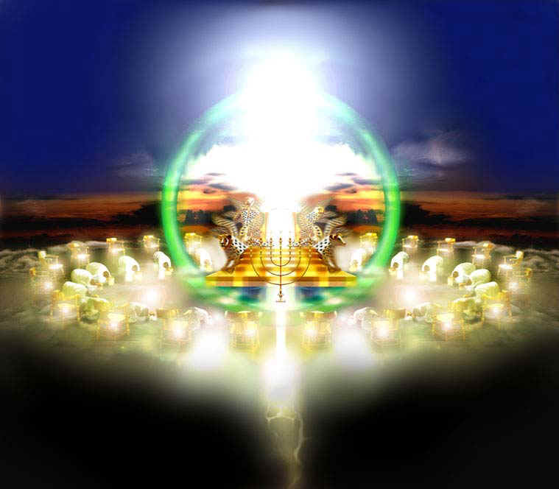
God is sovereign
If you were to look up the word “sovereign” in the dictionary, you would find words and phrases like “superior,” “greatest,” “supreme in power and authority,” “ruler,” and “independent of all others”
God’s sovereignty simply means - “God is in control.”

Slide 25
God is above all things and before all things. He is the alpha and the omega, the beginning and the end. He is immortal, and He is present everywhere (Revelation 21:6).
God created all things and holds all things together, both in heaven and on earth, both visible and invisible (Colossians 1:16).
God knows all things past, present, and future. There is no limit to His knowledge (Isaiah 40:28).
God knows everything completely before it even happens (Romans 11:33).

Slide 26
God can do all things and accomplish all things (Matthew 17:20).
Nothing is too difficult for Him (Luke 1:37).
He orchestrates and determines everything that is going to happen in your life, in America, and throughout the world (Isaiah 40:15).
Whatever He wants to do in the universe, He does, for nothing is impossible with Him (Jeremiah 32:17).

Slide 27
God is in control of all things and rules over all things. He has power and authority over nature, earthly kings, history, angels, and demons. Even Satan himself has to ask God’s permission before he can act (Psalm 103:19).
That’s what being sovereign means. It means being the ultimate source of all power, authority, and everything that exists.
Only God can make those claims; therefore, it’s God’s sovereignty that makes Him superior to all other gods and makes Him, and Him alone, worthy of worship.

Slide 28
Psalm 135:6 "Whatsoever the Lord pleased, that did he in heaven, and in earth, in the seas, and all deep places."
Isaiah 46:9-11 "Remember the former things of old: for I am God, and there is none else; I am God, and there is none like me, declaring the end from the beginning, and from ancient times the things that are not yet done, saying, My counsel shall stand, and I will do all my pleasure: yes, I have spoken it, I will also bring it to pass; I have purposed it, I will also do it."

Slide 29
Romans 8:28 promises that – “All things work together for good to them that love God, to them who are the called according to his purpose…”
That’s an amazing promise not only because it demonstrates that an all-powerful God cares about you, but because it cannot be fulfilled unless the one who gives it is all-knowing, all-wise, all-powerful, and all-loving.
The promise itself is a testimony to God’s sovereignty.

Slide 30
Think about the implications of that promise
Because God is sovereign and He loves you, nothing will ever come into your life that He does not either decree or allow. Consequently, no matter what you face in life, you can take comfort in the fact that God is sovereign.

Slide 31
Two problems that usually surface during any discussion of the sovereignty of God
If God is sovereign, how do we explain the presence of sin and evil?
If God is sovereign, how do we reconcile the responsibility and freedom of man to make choices (free will)?

Slide 32
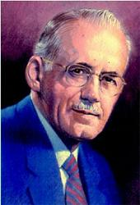
The only positive statement in our present ignorance is that the sovereign God has indeed allowed for (but not arranged for) sin to enter this universe, that through
it all He might receive the most glory (Rev. 4:11) and that the elect might receive the most good (Rom. 8:28).

Slide 33
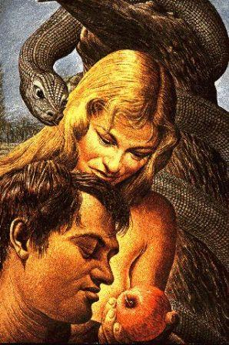
God’s sovereignty decreed that man should be free to exercise moral choice, and man from the beginning has fulfilled that decree by making his choice between good and evil.
The eternal decree of a sovereign God decided not which choice the man should make but that he should be free to make it.

Slide 34
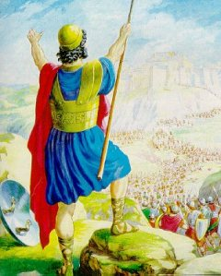
“And if it seem evil unto you to serve the LORD, choose you this day whom ye will serve; whether the gods which your fathers served that were on the other side of the flood, or the gods of the Amorites, in whose land ye dwell: but as for me and my house, we will serve the LORD.” Josh. 24:15

Slide 35
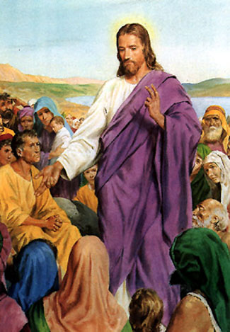
“Jesus saith unto them, Did ye never read in the scriptures, The stone which the builders rejected, the same is become the head of the corner: this is the Lord's doing, and it is marvellous in our eyes?” Matt. 21:42

Slide 36
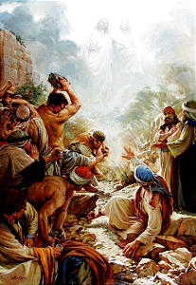
“Ye stiffnecked and uncircumcised in heart and ears, ye do always resist the Holy Ghost: as your fathers did, so do ye.” Acts 7:51

Slide 37
“But as many as received him, to them gave he power to become the sons of God, even to them that believe on his name.” John 1:12

Slide 38
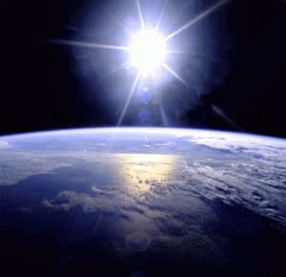
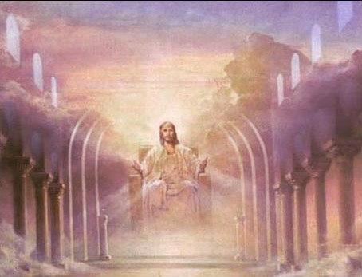
God is incomprehensible
God is self-existence
God is self-sufficient
God is eternal
God is infinite
God is omnipotent
God is omnipresent
God is omniscient
God is all wise
God is immutable
God is sovereign

