Slide 1
The inherent characteristics, quality's
and features of God
(Part 9)

Slide 2
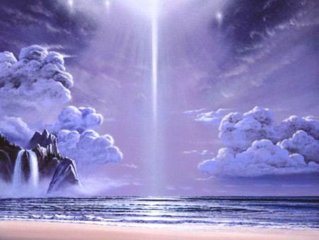
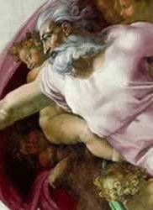
21 Attributes / Perfections of God

Slide 3
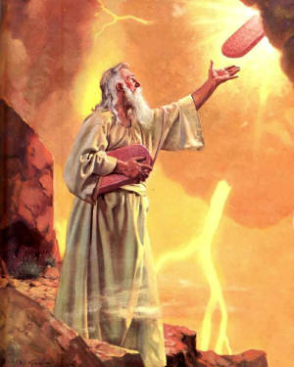
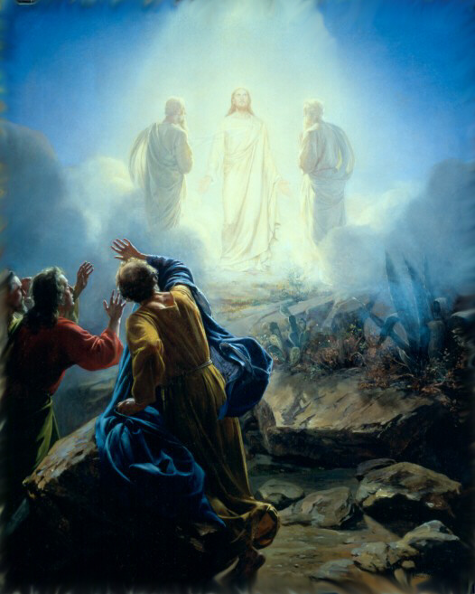
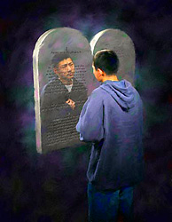
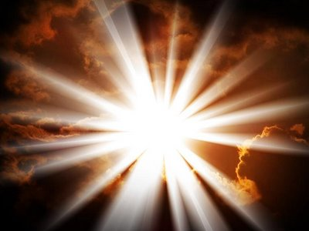
“But we all, with open face beholding as in a glass the glory of the Lord, are changed into the same image from glory to glory, even as by the Spirit of the Lord.” II Cor. 3:18

Slide 4
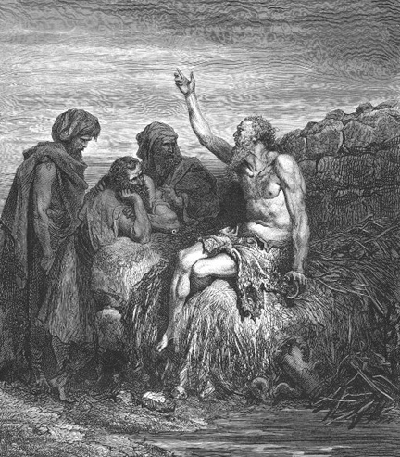
God is incomprehensible
“Canst thou by searching find out God? canst thou find out the Almighty unto perfection? It is as high as heaven; what canst thou do? deeper than hell; what canst thou know? The measure thereof is longer than the earth, and broader than the sea.” Job 11:7-9

Slide 5
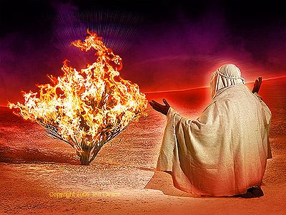
God is self-existent
"And Moses said unto God, Behold, when I come unto the children of Israel, and shall say unto them, The God of your fathers hath sent me, What is his name? What shall I say unto them? And God said unto Moses, I AM THAT I AM: and he said, Thus shalt thou say unto the children of Israel, I AM hath sent me unto you.”
Exodus 3:13-14

Slide 6
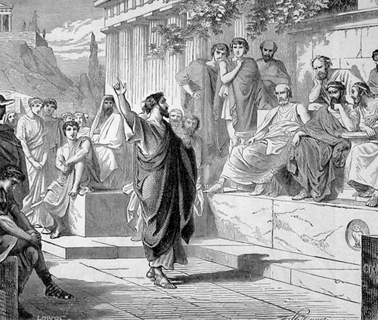
God is self-sufficient
“Neither is worshipped with men's hands, as though he needed any thing, seeing he giveth to all life, and breath, and all things.” Acts 17:25

Slide 7
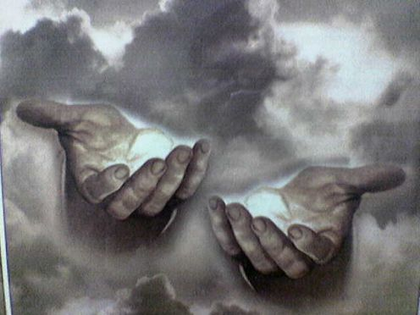
God is eternal
"The eternal God is thy refuge, and underneath are the everlasting arms: and he shall thrust out the enemy from before thee.” Deuteronomy 33:27

Slide 8
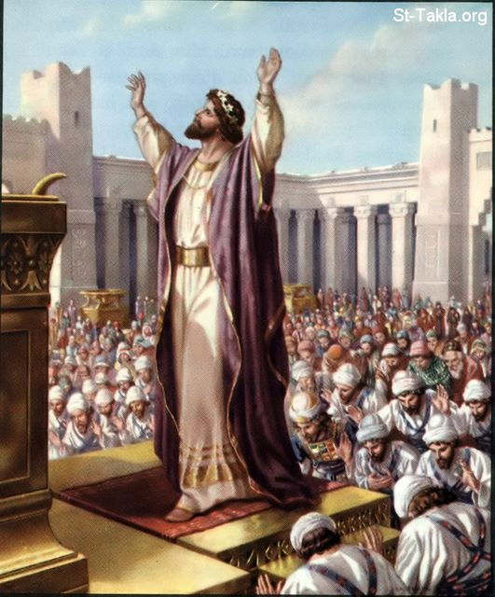
God is infinite
"And Solomon stood before the altar of the Lord in the presence of all the congregation of Israel, and spread forth his hands toward heaven: And he said…Behold, the heaven and heaven of heavens cannot contain thee; how much less this house that I have builded?”
I Kings 8:22, 23, 27

Slide 9
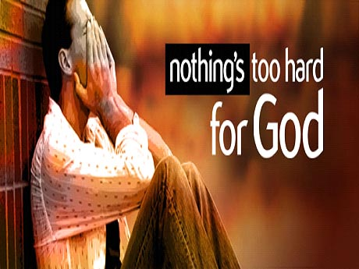
God is omnipotent
"Is any thing too hard for the Lord?” (Genesis 18:14)

Slide 10
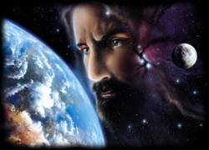
God is omnipresent
"Whither shall I go from thy spirit? or whither shall I flee from thy presence? If I ascend up into heaven, thou art there: if I make my bed in hell, behold, thou art there. If I take the wings of the morning, and dwell in the uttermost parts of the sea; even there shall thy hand lead me, and thy right hand shall hold me.”
Psalm 139:7-11

Slide 11
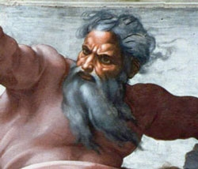
God is omniscient
"Great is our Lord, and of great power: his understanding is infinite.“ Psalm 147:5

Slide 12
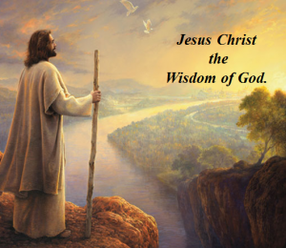
God is all wise
"To the only wise God our Saviour, be glory and majesty, dominion and power, both now and ever. Amen.” Jude 1:25

Slide 13
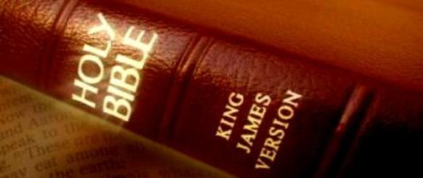
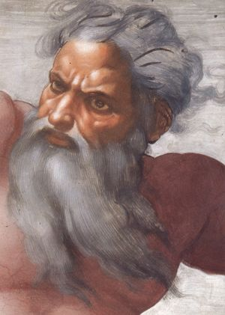
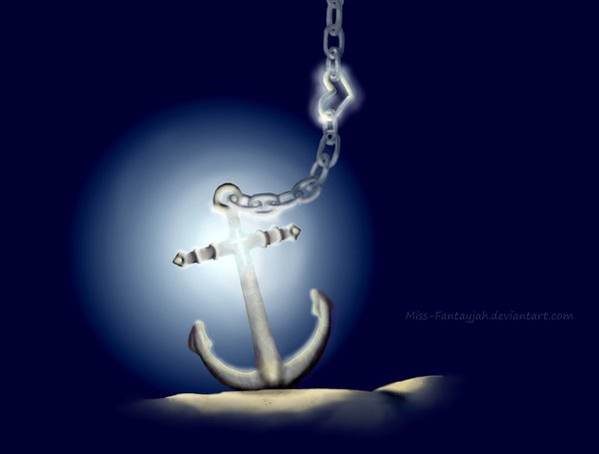
God is immutable “For I am the Lord, I change not.” Malachi 3:6
Hebrews 6:17-18

Slide 14
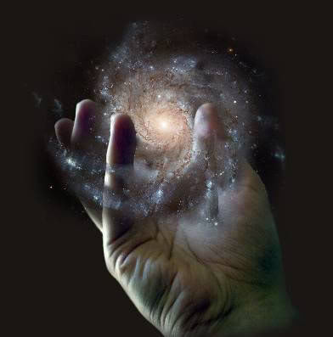
God is sovereign
"Remember the former things of old: for I am God, and there is none else; I am God, and there is none like me, declaring the end from the beginning, and from ancient times the things that are not yet done, saying, My counsel shall stand, and I will do all my pleasure: yes, I have spoken it, I will also bring it to pass; I have purposed it, I will also do it.” Isaiah 46:9-11

Slide 15
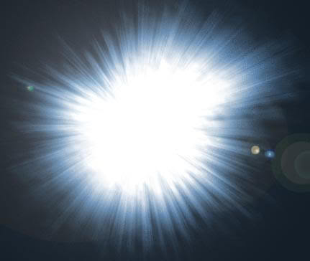
God is light
"This then is the message which we have heard of him, and declare unto you, that God is light, and in him is no darkness at all…But if we walk in the light, as he is in the light, we have fellowship one with another, and the blood of Jesus Christ his Son cleanseth us from all sin.” I John 1:5,7

Slide 16
God is inscrutable
“For my thoughts are not your thoughts, neither are your ways my ways, saith the LORD. For as the heavens are higher than the earth, so are my ways higher than your ways, and my thoughts than your thoughts.”
Isa. 55:8-9

Slide 17
God is faithful

Slide 18
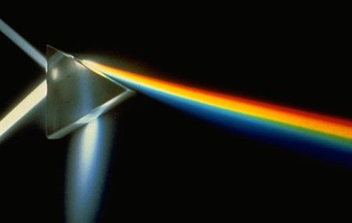
God is holy
God
wise, immutable, sovereign, inscrutable, light, faithful, incomprehensible, self-existence, self-sufficient, eternal, infinite, omnipotent, omnipresent, omniscient, righteousness, just, true, good, merciful, gracious, love
Holiness

Slide 19
God is just and righteous
“There is no God else beside me; a just God and a Saviour; there is none beside me.”
Isa. 45:21
“For the righteous God trieth the hearts and reins.”
Psalm 7:9

Slide 20
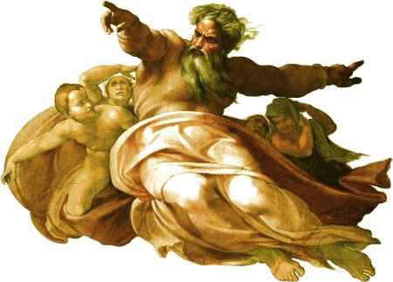
God is true
"And this is life eternal, that they might know thee the only true God, and Jesus Christ, whom thou hast sent.”
John 17:3

Slide 21
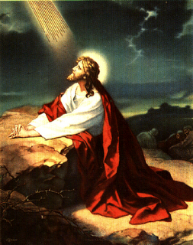
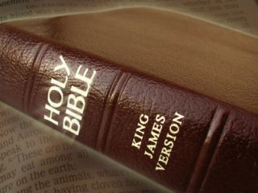
“Sanctify them through thy truth: thy word is truth.” John 17:17
“Thy word is true from the beginning.” Psalm 119:160

Slide 22
God is incomprehensible
God is self-existence
God is self-sufficient
God is eternal
God is infinite
God is omnipotent
God is omnipresent
God is omniscient
God is all wise
God is immutable
God is sovereign
God is light
God is inscrutable
God is faithful
God is holy
God is just and righteous
God is true

Slide 23
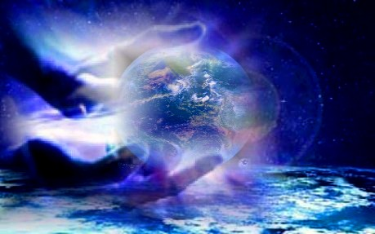
God is good
“Oh that men would praise the Lord
for his goodness, and for his wonderful
works to the children of men!”
Psalm 107:8

Slide 24
"The goodness of God is that which disposes Him to be kind, benevolent, and full of good will toward men. He is tenderhearted and of quick sympathy, and His unfailing attitude toward all moral beings is open, frank, and friendly. By His nature He is inclined to bestow blessedness and He takes holy pleasure in the happiness
of His people."
(The Knowledge of the Holy, p. 88)

Slide 25
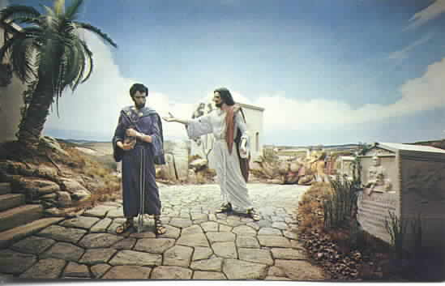
“And Jesus said unto him, Why callest thou me good? There is none good but one, that is, God.” Mark 10:18

Slide 26
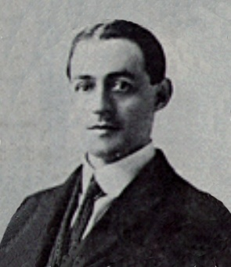
A.W. Pink
The original Saxon meaning of our English word "God" is "The Good." God is not only the Greatest of all beings, but the Best. All the goodness there is in any creature has been imparted from the Creator, but God’s goodness is the essence of His eternal nature.

Slide 27
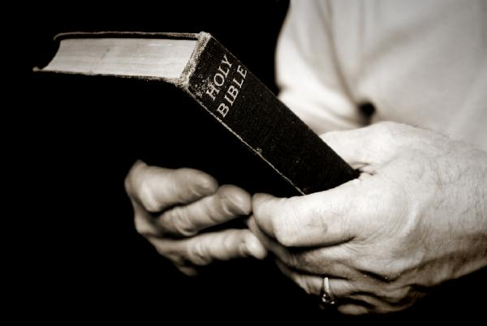
The Importance of the Goodness of God
The goodness of God is not only an attribute of God but a foundational truth every Christian should embrace – Rom. 8:28
Consider some of the reasons God’s goodness is important to us.

Slide 28
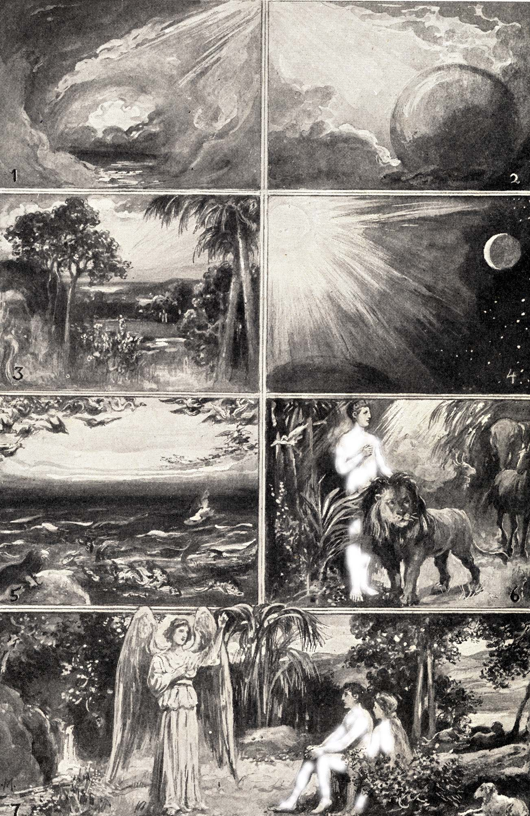
1. The “goodness” of God is prominent in the opening chapters of the Bible.
Repeatedly, God pronounced everything which He created “good” (see Genesis 1:4, 10, 18; I Timothy 4:4).
In chapter 2, God saw that it was “not good” for Adam to be alone, and so He created a wife for him (2:18-25).

Slide 29
In the garden of Eden, where God had placed Adam and Eve, there was “the tree of the knowledge of good and evil.”
From the fruit of this one tree, the man and woman were forbidden to eat.
The issues of “good” and “evil” are prominent at the very beginning of the Bible.

Slide 30
2. The goodness of God appears to be the sum total of all of God’s attributes.
The goodness of God may thus be viewed as one facet of His glorious nature and character.
The goodness of God must also be viewed as the overall summation of His nature and character.
Then Moses said, “I pray Thee, show me Thy glory!” And God said, “I Myself will make all My goodness pass before you, and will proclaim the name of the LORD before you.” (Exodus 33:19; 34:5-7).

Slide 31
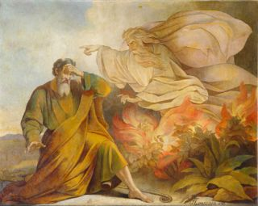
“Show me thy glory...And He said, I will make all my goodness pass before thee…”

Slide 32
The clearest expression of the goodness of God appeared when He sent forth His Son “…made of a woman, made under the law, to redeem them that were under the law, that we might received the adoption of sons." Gal. 4:4-5

Slide 33
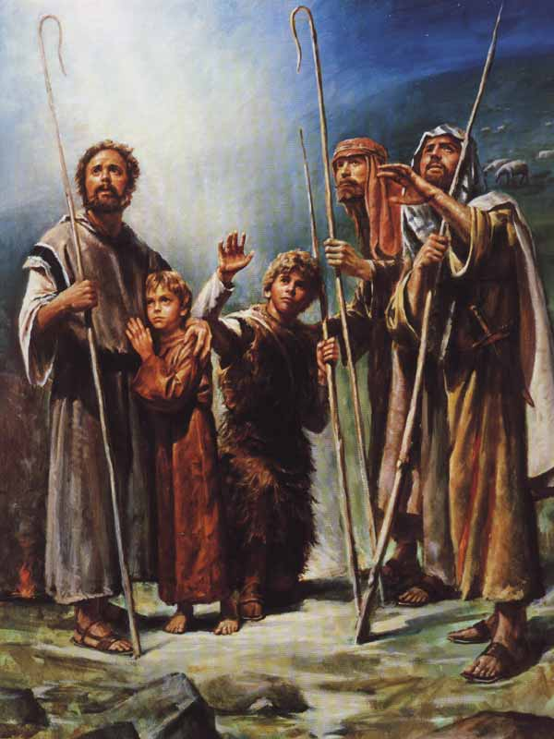
“And suddenly there was with the angel a multitude of the heavenly host praising God, and saying, Glory to God in the highest, and on earth peace, good will toward men.” Luke 2:13-15

Slide 34
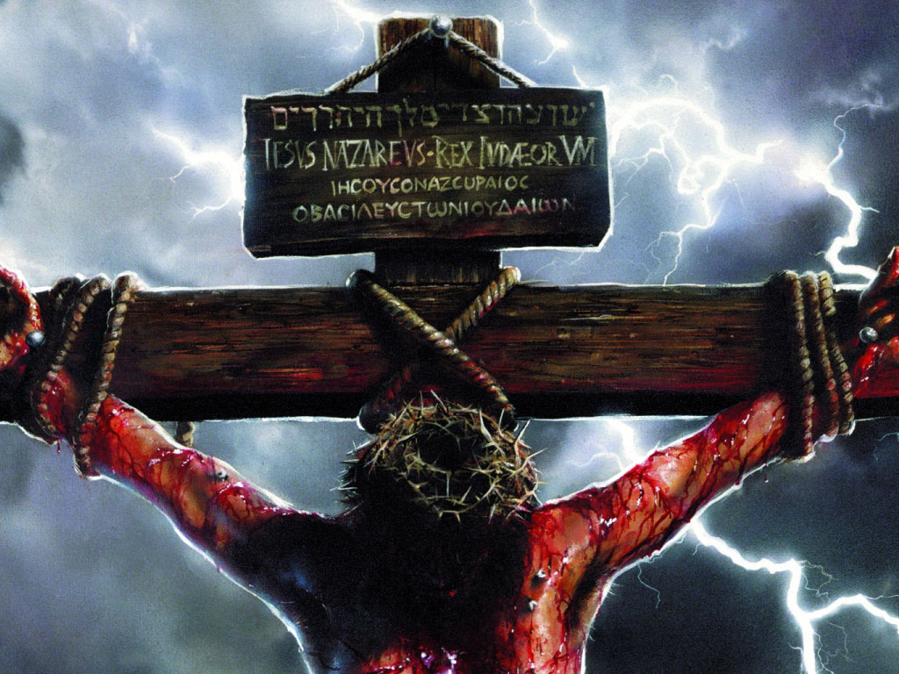
The Gospel
“The grace (Greek - benevolence of goodness) of God
that bringeth salvation hath
appeared to all men"
(Titus 2:11)

Slide 35
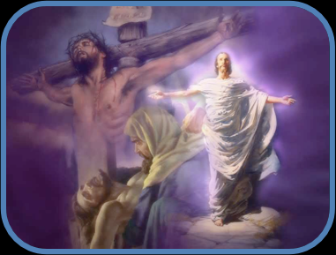
The goodness of God is evident in the gospel of Jesus Christ. The gospel is the “good news” (Isaiah 40:9; 41:27; 52:7; 61:6; Luke 1:19; 2:10; Acts 8:12; 13:32; Hebrews 4:2, 6),

Slide 36
3. We cannot separate what is good from God.
You cannot have goodness without God, just as you cannot have God without goodness.
God alone is good – “None good by God…”
Psalms 16:2 “I said to the LORD, Thou art my Lord; I have no good besides Thee.”
II Thess. 1:11 “Wherefore also we pray always for you, that our God would count you worthy of this calling, and fulfill all the good pleasure of his goodness, and the work of faith with power.”

Slide 37
No man is good: (Romans 3:9-18)
“The fool hath said in his heart, There is no God. They are corrupt, they have done abominable works, there is none that doeth good.” (Psalms 14:1; 53:1)
God is the source of everything that is good:
“Every good gift and every perfect gift is from above, and cometh down from the Father of lights, with whom is no variableness, neither shadow of turning.” (James 1:17)

Slide 38
God does not withhold anything that is truly good from His children.
“For the LORD God is a sun and shield; The LORD will give grace and glory; No good thing will He withhold from them who walk uprightly.” (Psalm 84:11)
“And we know that all things work together for good to them that love God, to them who are the called according to his purpose.” (Rom. 8:28)

Slide 39
We simply cannot separate “good” from “God.”
Society, and especially our educational system, should take note -
You cannot teach values, you cannot teach morality, without teaching about God – “Good and upright is the Lord. Therefore He instructs sinners in the way.” (Psalm 25:8)
“Be ye holy,” God said, “for I am holy” (see I Peter 1:16; Leviticus 11:44)

Slide 40
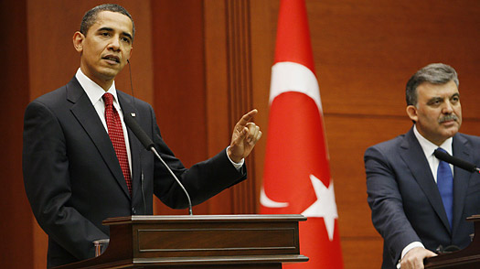
“We have a very large Christian population but we do not consider ourselves a Christian nation or a Jewish nation or a Muslim nation. We consider ourselves a nation of citizens who are bound by ideals and a set of values."
Press conference in Turkey

Slide 41
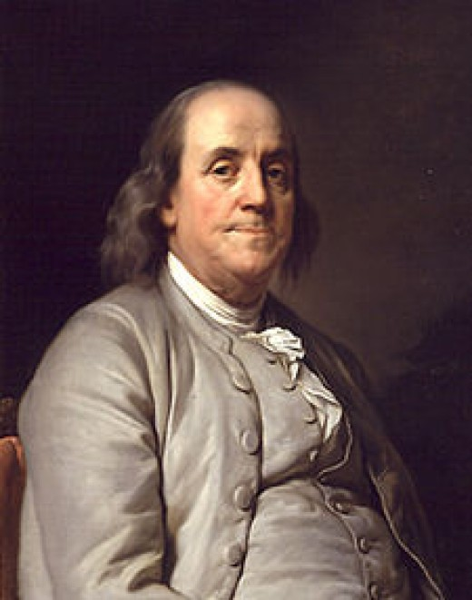
The "Fundamental Points" of all sound religion to be taught in the schools are the beliefs that our Founders referred to as the “Religion of America”.
The 5 points of fundamental religious belief expressed by
Ben Franklin are...

Slide 42
1. There exists a Creator who made all thing, and mankind should recognize and worship Him.
2. The Creator has revealed a moral code of behavior for happy living which distinguishes right from wrong.
3. The Creator holds mankind responsible for the way they treat each other.
4. All mankind live beyond this life.
5. In the next life mankind are judged for their conduct in this one.

Slide 43
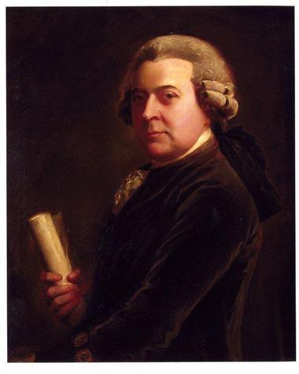
John Adams a signer of the Declaration of Independence, the Bill of Right and our second President "We have no government armed with power capable of contending with human passions unbridled by morality and religion . . . Our Constitution was made only for a moral and religious people. It is wholly inadequate to the government of any other."

Slide 44
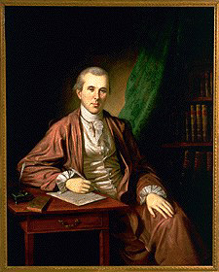
Benjamin Rush, Signer of the Declaration of Independence “The only foundation for a useful education in a republic is to be aid in religion. Without this there can be no virtue, and without virtue there can be no liberty, and liberty is the object and life of all republican governments. Without religion, I believe that learning does real mischief to the morals and principles of mankind.”

Slide 45
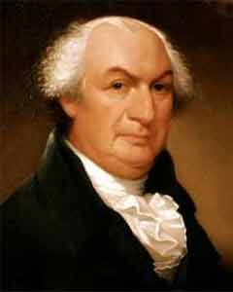
Gouverneur Morris, Signer of the Constitution “For avoiding the extremes of tyranny or anarchy . . . the only ground of hope must be on the morals of the people. I believe that religion is the only solid base of morals and that morals are the only possible support of free governments. Therefore education should teach the precepts of religion and the duties of man towards God.”

Slide 46
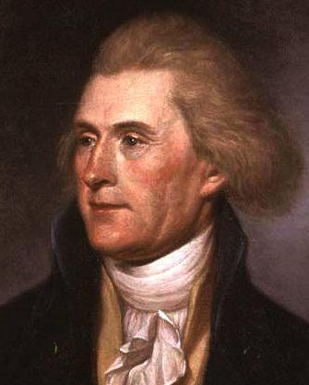
Thomas Jefferson, while President of the United States, became the first president of the Washington D. C. public school board, which used the Bible and Watt's Hymnal as reading texts in the classroom. Notice why Jefferson felt the Bible to be essential in any successful plan of education: “I have always said, always will say, that the studious perusal of the sacred volume will make us better citizens.”

Slide 47
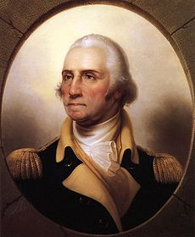
George Washington, General of the Revolutionary Army, president of the Constitutional Convention, First President of the United States of America, Father of our nation "Religion and morality are the essential pillars of civil society."

Slide 48
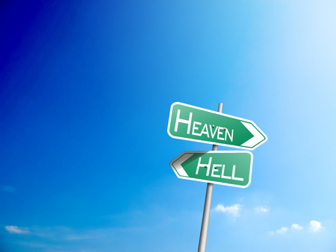
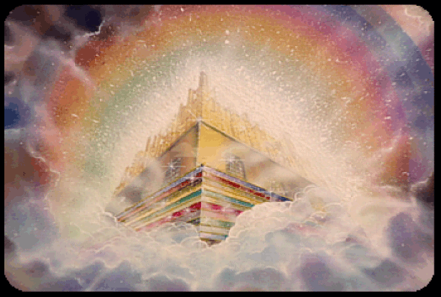
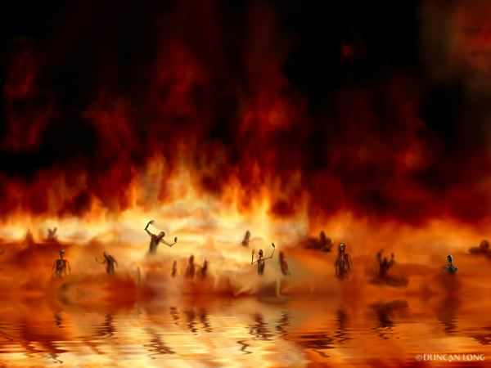
4. Man’s eternal destiny is determined by his decision as to how one can truly be good in God’s sight (See John 5:28-29; Romans 3:1-26; Titus 3:3-7).

Slide 49
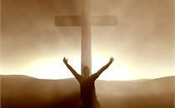
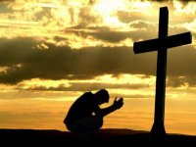
Rom. 3:22 “Even the righteousness of God which is by faith of Jesus Christ unto all and upon all them that believe.”
Rom. 10:3 “For they being ignorant of God's righteousness, and going about to establish their own righteousness, have not submitted themselves unto the righteousness of God.”

Slide 50
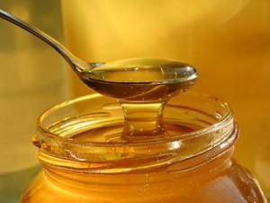
5. Apart from the divine revelation of the Scriptures, we cannot recognize true goodness, for it cannot be understood apart from knowing God and seeing life from His perspective.
Psalm 34:8 “O taste and see that the LORD is good: blessed is the man that trusteth in him.”
Psalm 119:103 “How sweet are thy words unto my taste! yea, sweeter than honey to my mouth!”

Slide 51
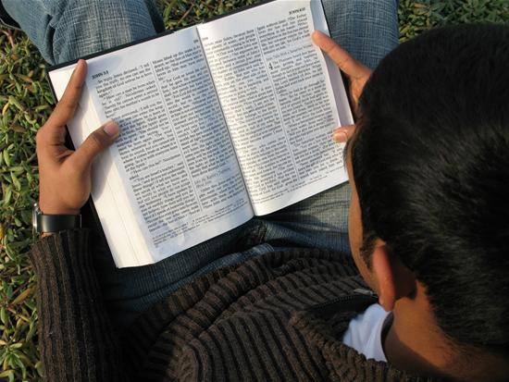
“Thy words were found, and I did eat them; and thy word was unto me the joy and rejoicing of mine heart: for I am called by thy name, O LORD God of hosts.” Jer. 15:16

Slide 52
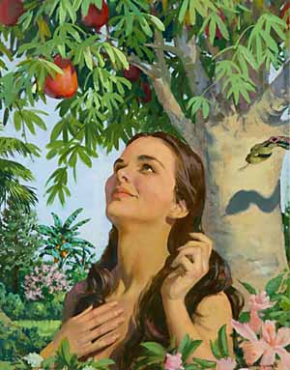
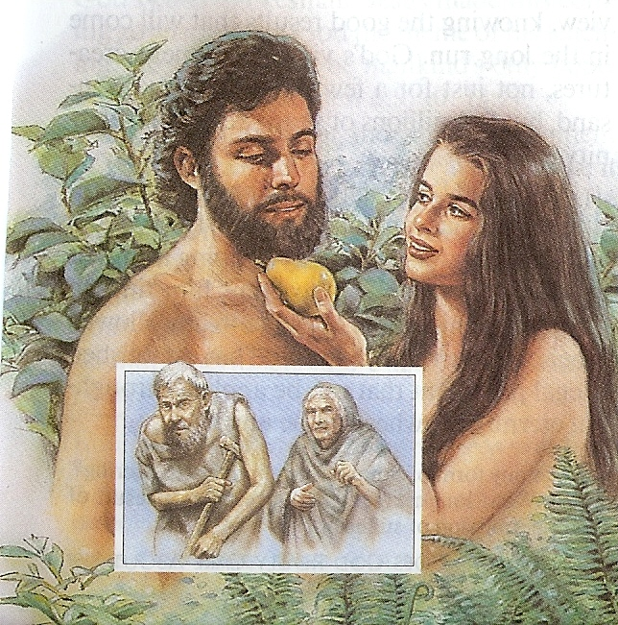
6. The goodness of God is a foundational truth that shapes our perspective toward God and His dealings with us in this life –
“The Lord is good to all and his mercies are over all his works.” Psalm 145:9
The fall of man occurred because Satan was able to create a doubt about the “goodness of God.” (see Gen. 3:1-5)

Slide 53
If God is good, and everything He created is good why will he not allow you to eat of the this tree.
Satan’s seemingly innocent question was intended to undermine Eve’s confidence in the goodness of God.
By the time Satan has finished, Eve had come to view God as the One who is less than good, and the forbidden fruit as that which was good.

Slide 54
7. The goodness of God must never be called into question, because there is suffering and sorrow in the world.
God is incomprehensible - (Job 11:7-9)
God is inscrutable – (Isaiah 55:8-9)
Psalm 52:1 “The goodness of God endureth continually.”
Psalm 73:1 “Truly God is good…”

Slide 55
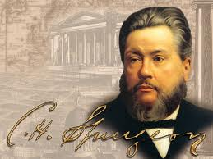
When others behave badly to us, it should only stir us up the more heartily to give thanks unto the Lord, because He is good; and when we ourselves are conscious that we are far from being good, we should only the more reverently bless Him that He is good. We must never tolerate for an instant unbelief as to the goodness of the Lord; whatever else may be questioned, this is absolutely certain, that Jehovah is good; His dispensations may vary, but His nature is always the same.

Slide 56
“In every thing give thanks: for this is the will of God in Christ Jesus concerning you.” I Thess. 5:18
Faith

Slide 57
8. Those who teach that God wants only to bless us with healing and prosperity in this life are false teachers.
“Before I was afflicted I went astray, But now I keep Thy word…I know, O LORD, that Thy judgments are righteous, And that in faithfulness Thou hast afflicted me.” Psalms 119:67, 75
“That I may know Him, and the power of His resurrection and the fellowship of His sufferings, being conformed to His death.” Philippians 3:10

Slide 58
“And lest I should be exalted above measure through the abundance of the revelations, there was given to me a thorn in the flesh, the messenger of Satan to buffet me, lest I should be exalted above measure. For this thing I besought the Lord thrice, that it might depart from me. And he said unto me, My grace is sufficient for thee: for my strength is made perfect in weakness. Most gladly therefore will I rather glory in my infirmities, that the power of Christ may rest upon me. Therefore I take pleasure in infirmities, in reproaches, in necessities (bare essentials), in persecutions, in distresses for Christ's sake: for when I am weak, then am I strong.” II Corinthians 12:7-10

Slide 59
"The Lord is good, a stronghold in the day of trouble, and He knoweth them that trust in Him" Nahum 1:7

Slide 60
"O that men would praise the Lord for His goodness, and for His wonderful works to the children of men." Psalm 107:8

Slide 61
Asaph, a Levite who was the chief of the musicians under King David (1 Chronicles 16:4-7,37) (Composed Psalm 73)
Asaph’s Psalm expresses his struggle in understanding and embracing the goodness of God –
Verse 1 “The Lord is Good…”
Verse 28 “But it is good for me to drew near to God: I will trust in the Lord God…”

Slide 62
“How God anointed Jesus of Nazareth with the Holy Ghost and with power: who went about doing good.” Acts 10:38
“Ye call me Master and Lord: and ye say well; for so I am. If I then, your Lord and Master, have washed your feet; ye also ought to wash one another's feet. For I have given you an example, that ye should do as I have done to you.”
John 13:13-15

Slide 63
“Let your light so shine before men, that they may see your good works, and glorify your Father which is
in heaven.”
Matt. 5:16

Slide 64
“Despisest thou the riches of his goodness and forbearance and longsuffering; not knowing that the goodness of God leadeth thee to repentance?”
Rom. 2:4

