Slide 1
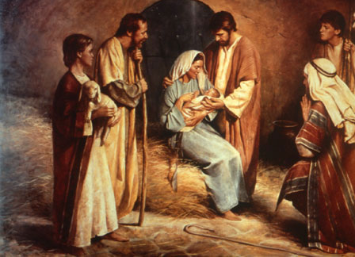
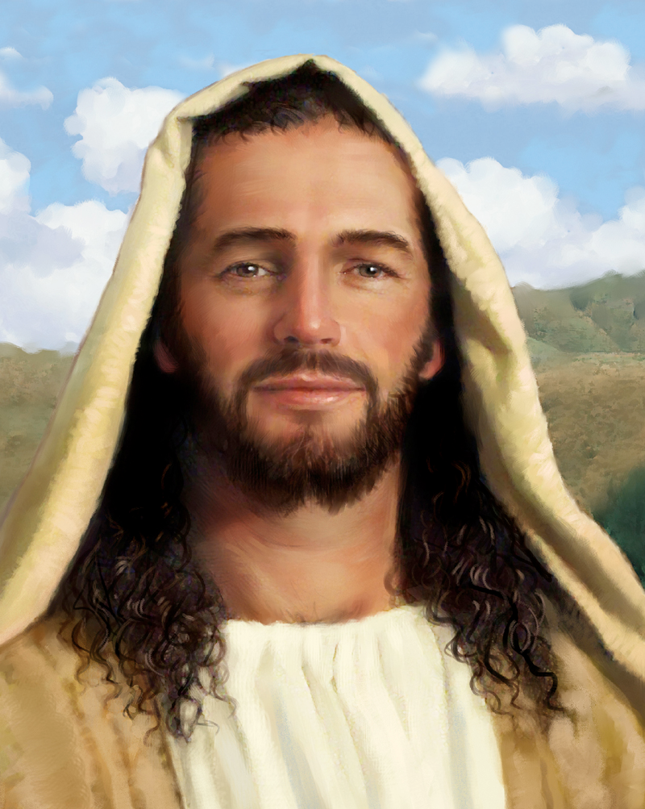
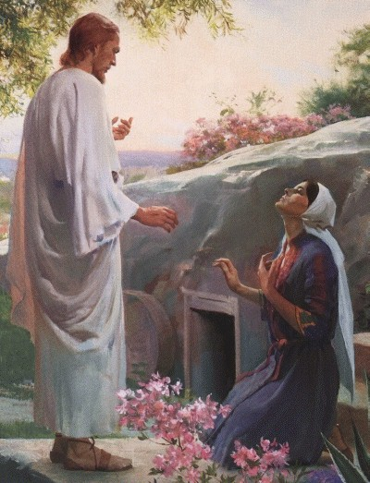
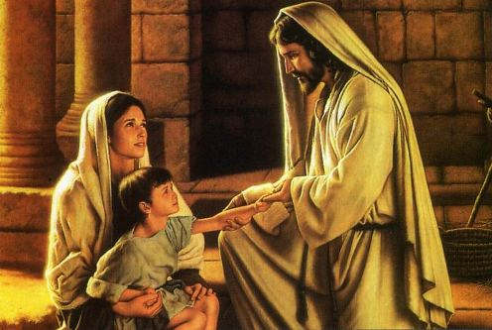
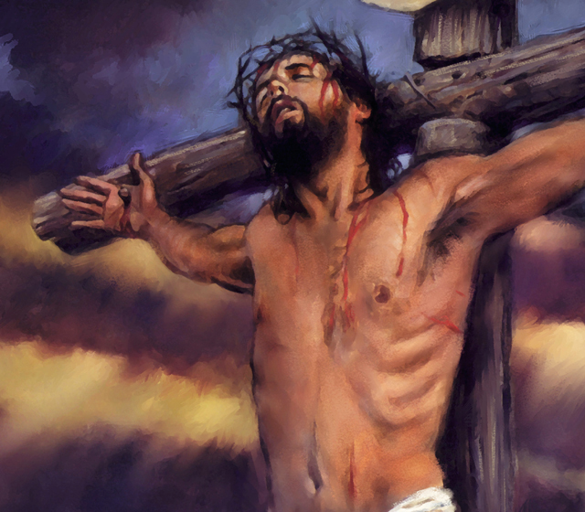
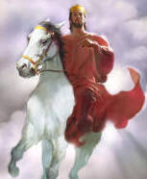
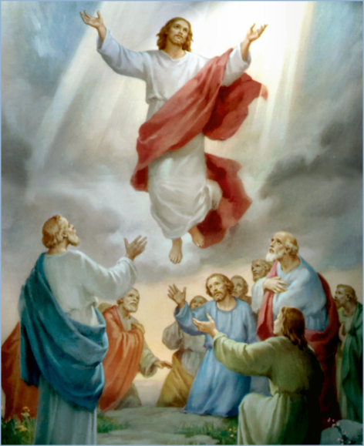
The Doctrine of Jesus Christ (Part 23)
The results of the resurrection

Slide 2
Review

Slide 4
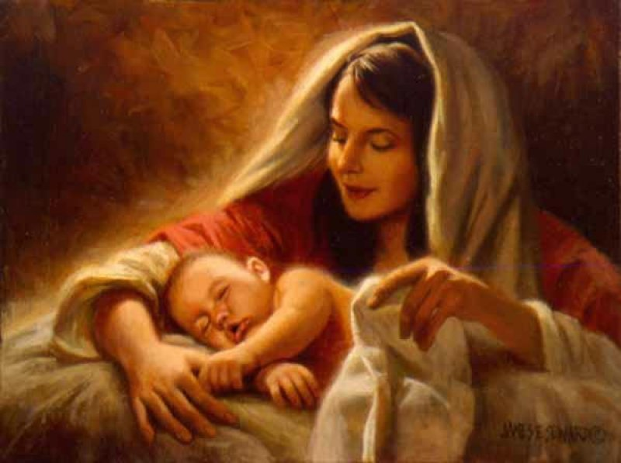
The Virgin Birth
“Behold, a virgin shall be with child, and shall bring forth a son, and they shall call his name Emmanuel, which being interpreted is, God with us.”
Matt. 1:23

Slide 6
Names and Titles of Jesus Christ

Slide 7
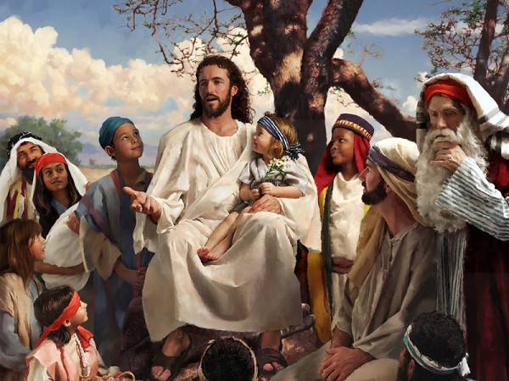
The Humanity of Jesus Christ

Slide 8
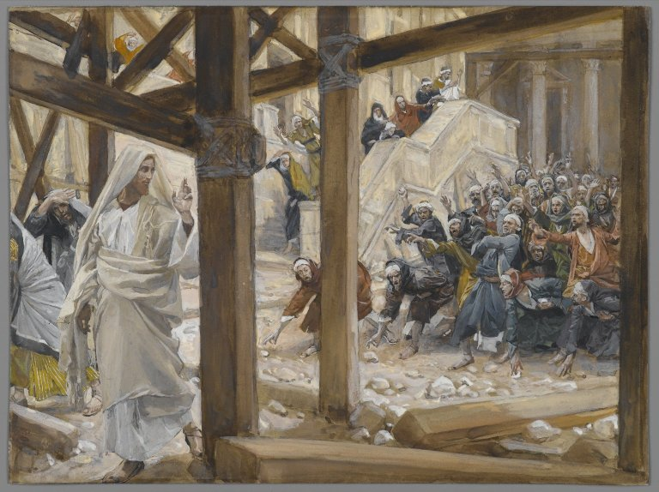
The Deity of Jesus Christ
(John 10:30-33)

Slide 9
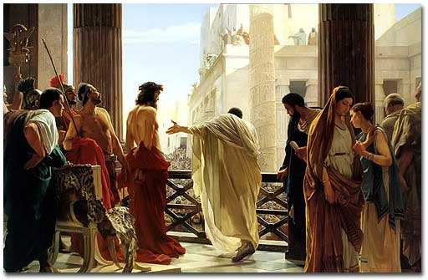
The Impeccability of Jesus Christ (John 18:38)

Slide 10
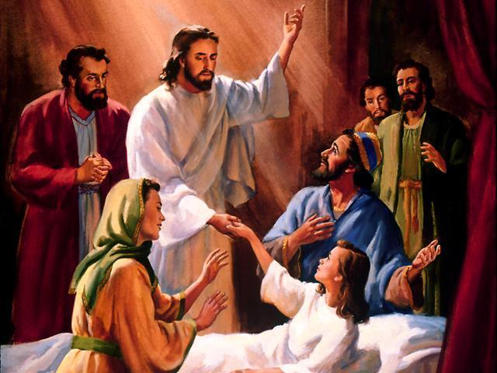
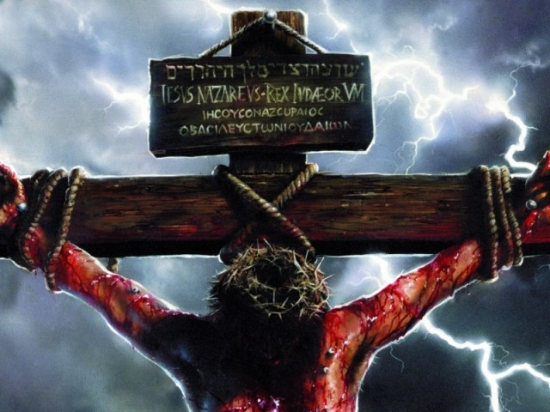
“For even the Son of man came not to be ministered unto, but to minister, and to give his life a ransom for many.” Mark 10:45
The Earthly Ministry of Jesus Christ

Slide 11
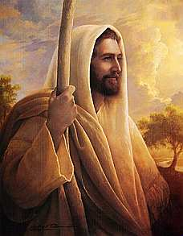
The Character of Jesus Christ
What kind of man was our Lord?
What were some of his characteristics?
zeal; compassion; meekness and gentleness; boldness and courage; love

Slide 12
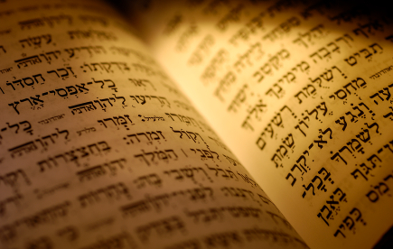
In the Old Testament three great offices were created by God to meet the spiritual and material needs of his chosen people.

Slide 13
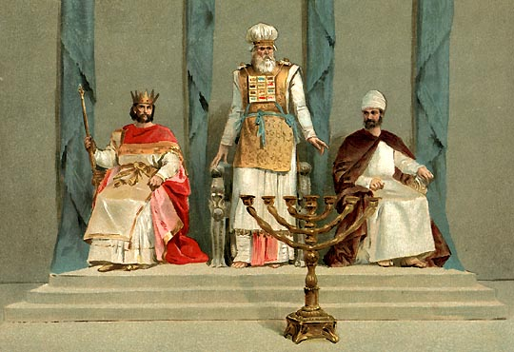
Jesus holds all three offices

Slide 14
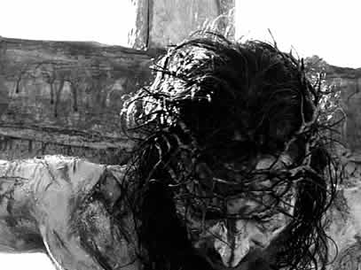
The Death of Jesus Christ

Slide 15
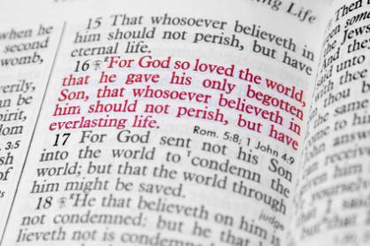

Slide 16
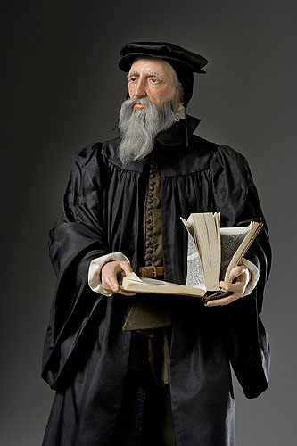
“Exposing the false Doctrine of Calvinism”
“I marvel that ye are so soon removed from him that called you into the grace of Christ unto another gospel …but there be some that trouble you, and would pervert the gospel of Christ. But though we, or an angel from heaven, preach any other gospel unto you than that which we have preached unto you, let him be accursed.” (Gal. 1:6-8)

Slide 17
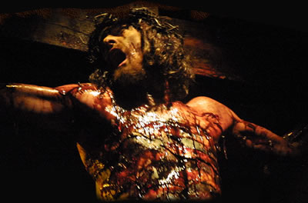
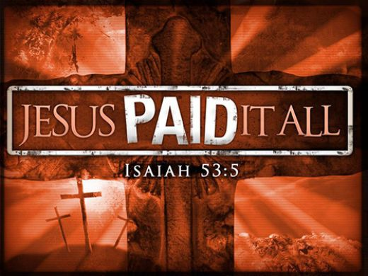
The Vicarious Atonement
“For he hath made him to be sin for us, who knew no sin; that we might be made the righteousness of God in him.” II Cor. 5:21
“Who his own self bare our sins in his own body on the tree.”
I Peter 2:24

Slide 18
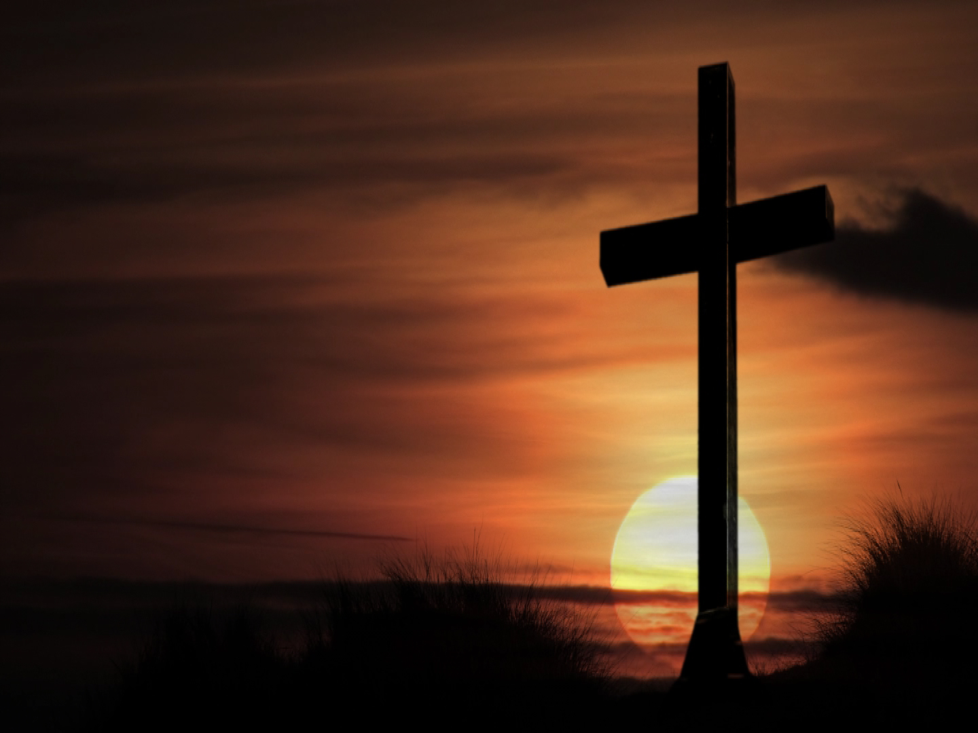
The results of the vicarious atonement
Redemption
Reconciliation
Justification
Sanctification
Glorification
Regeneration
Remission
Imputation
Propitiation
Forgiveness
Adoption
Ransom
Pardon
Eternal Salvation

Slide 19
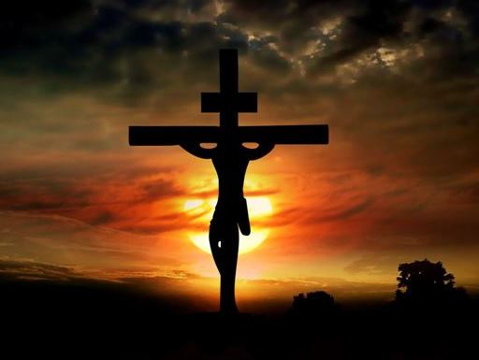
The seven last statements of Christ

Slide 20
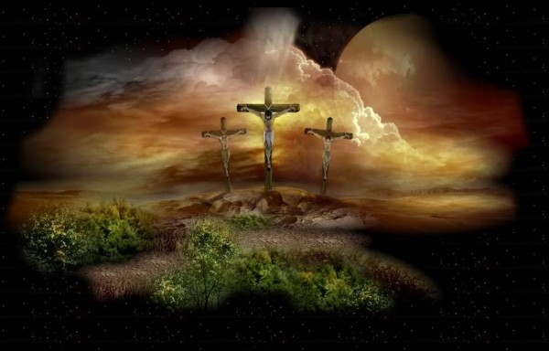
“Father, forgive them; for they know not what they do.”
“Today shalt thou be with me in paradise.”
“Woman, behold thy son! Then saith he to the disciple, Behold thy mother!”
“My God, my God, why hast thou forsaken me?”
“I thirst.”
“It is finished.”
“Father, into thy hands I commend my spirit.”

Slide 21
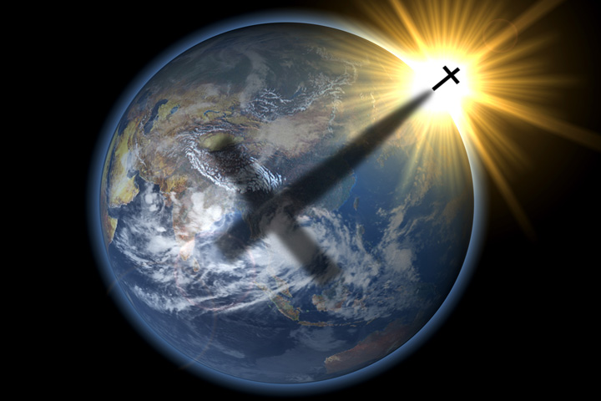
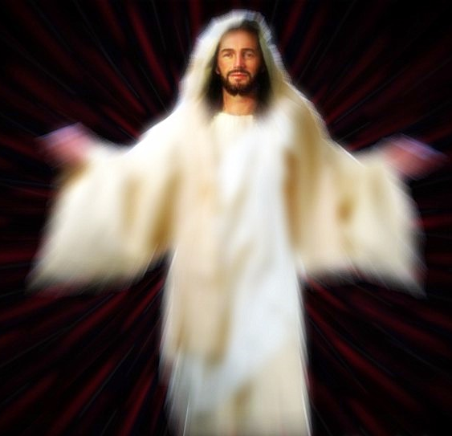
Christ descent into the heart of the earth

Slide 22
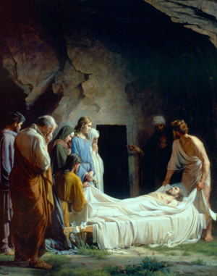
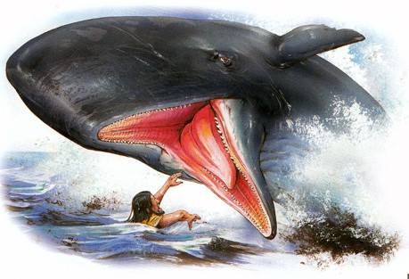
"For as Jonas was three days and three nights in the whale’s belly; so shall the Son of man be three days and three nights in the
heart of the earth."
Matt. 12:40

Slide 23
“For Christ also hath once suffered for sins, the just for the unjust, that he might bring us to God, being put to death in the flesh, but quickened by the Spirit: By which also he went and preached unto the spirits in prison; Which sometime were disobedient, when once the longsuffering of God waited in the days of Noah, while the ark was a preparing, wherein few, that is, eight souls were saved by water.” (I Peter 3:18-20)

Slide 24
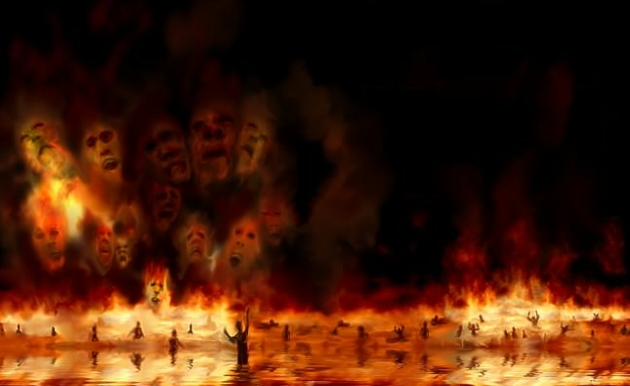
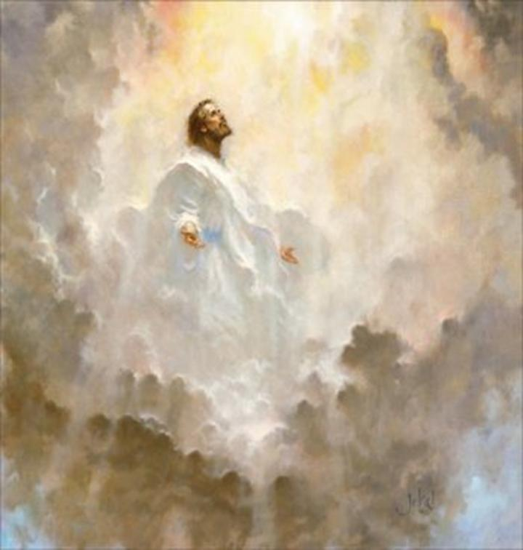
Torments
Paradise (Abraham's bosom)

Slide 25
“Wherefore he saith, When he ascended up on high, he led captivity captive, and gave gifts unto men. Now that he ascended, what is it but that he also descended first into the lower parts of the earth? He that descended is the same also that ascended up far above all heavens, that he might fill all things.” (Ephesians 4:8-9)

Slide 26
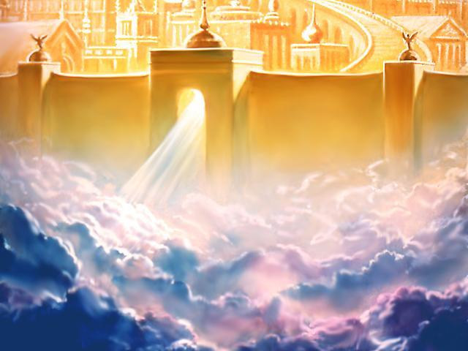
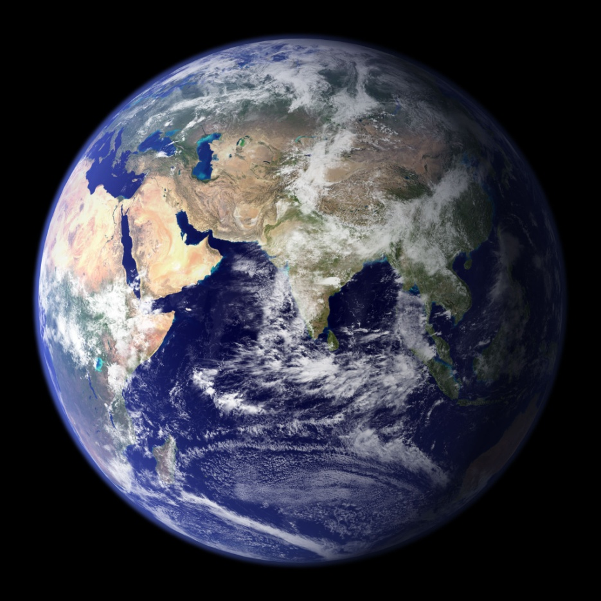
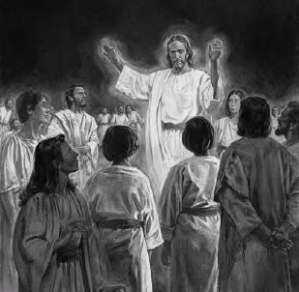

Slide 27
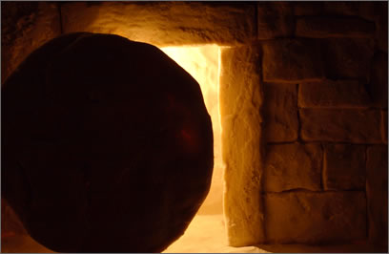
The Resurrection of Jesus Christ

Slide 28
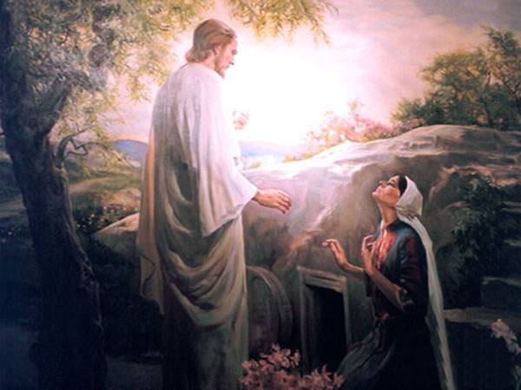
The Most Important Bible Doctrine (I Corinthians 15)

Slide 29
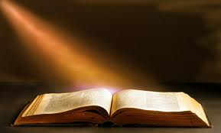
“And if Christ be not raised, your faith is vain; ye are yet in your sins. Then they also which are fallen asleep in Christ are perished.” I Cor. 15:17-18

Slide 30
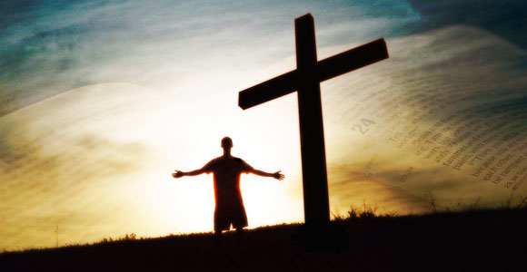
Romans 10:9
“That if thou shalt confess with thy mouth the Lord Jesus, and shalt believe in thine heart that God hath raised him from the dead, thou shalt be saved.”

Slide 31
The Infallible Proofs of the Resurrection
“The former treatise have I made, O Theophilus, of all that Jesus began both to do and teach, Until the day in which he was taken up, after that he through the Holy Ghost had given commandments unto the apostles whom he had chosen: To whom also he shewed himself alive after his passion by many infallible proofs, being seen of them forty days, and speaking of the things pertaining to the kingdom of God.” (Acts 1:1-3)

Slide 32
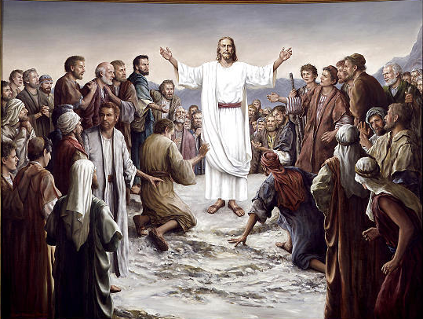
Seventeen appearances of Jesus after the resurrection

Slide 33
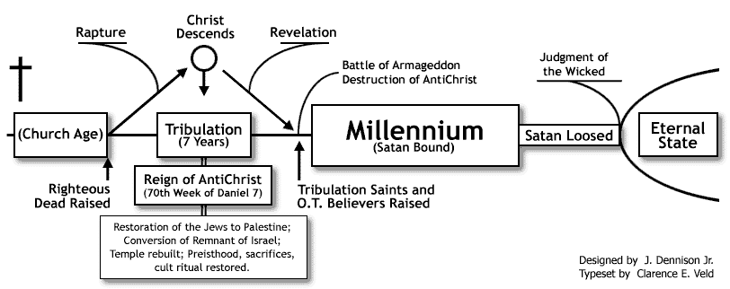
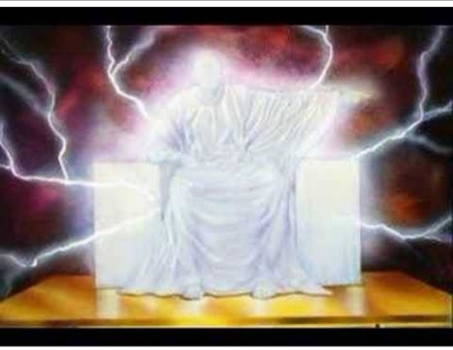
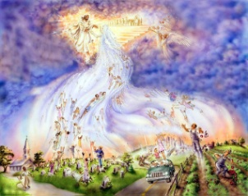
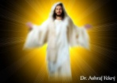
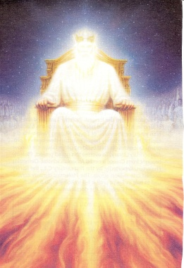
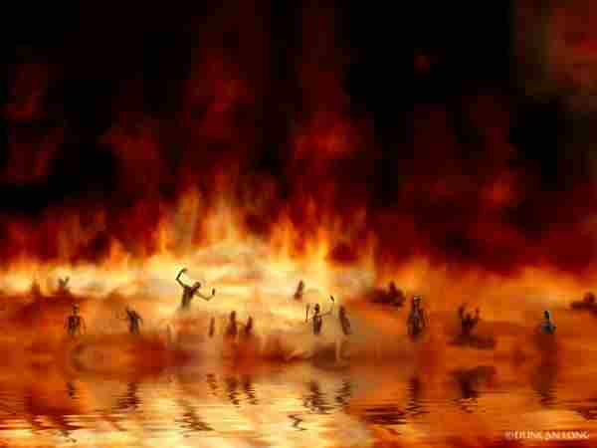
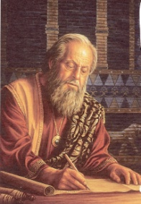
The order of the resurrection (I Cor. 15:20-25)
First Resurrection
Second Resurrection

Slide 34
Our Resurrection Bodies
“Who shall change our vile body, that it may be fashioned like unto his glorious body, according to the working whereby he is able even to subdue all things unto himself.”
(Phil. 3:21)

Slide 35
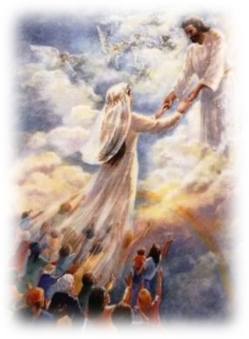
“For this we say unto you by the word of the Lord, that we which are alive and remain unto the coming of the Lord shall not prevent them which are asleep. For the Lord himself shall descend from heaven with a shout, with the voice of the archangel, and with the trump of God: and the dead in Christ shall rise first: Then we which are alive and remain shall be caught up together with them in the clouds, to meet the Lord in the air: and so shall we ever be with the Lord.”
(I Thessalonians 4:15-17)

Slide 36
GLORIFICATION: THE FINAL DIVINE ACT OF REDEMPTION
“Even we ourselves groan within ourselves, waiting for the adoption, to wit, the redemption of our body.”
(Rom. 8:23)

Slide 37
Tonight’s Message

Slide 38
The results of the resurrection (I Cor. 15:42-58)
42 So also is the resurrection of the dead. It is sown in corruption; it is raised in incorruption:
43 It is sown in dishonour; it is raised in glory: it is sown in weakness; it is raised in power:
44 It is sown a natural body; it is raised a spiritual body. There is a natural body, and there is a spiritual body.
45 And so it is written, The first man Adam was made a living soul; the last Adam was made a quickening spirit.

Slide 39
46 Howbeit that was not first which is spiritual, but that which is natural; and afterward that which is spiritual.
47 The first man is of the earth, earthy: the second man is the Lord from heaven.
48 As is the earthy, such are they also that are earthy: and as is the heavenly, such are they also that are heavenly.
49 And as we have borne the image of the earthy, we shall also bear the image of the heavenly.
50 Now this I say, brethren, that flesh and blood cannot inherit the kingdom of God; neither doth corruption inherit incorruption.

Slide 40
51 Behold, I shew you a mystery; We shall not all sleep, but we shall all be changed,
52 In a moment, in the twinkling of an eye, at the last trump: for the trumpet shall sound, and the dead shall be raised incorruptible, and we shall be changed.
53 For this corruptible must put on incorruption, and this mortal must put on immortality.
54 So when this corruptible shall have put on incorruption, and this mortal shall have put on immortality, then shall be brought to pass the saying that is written, Death is swallowed up in victory.
55 O death, where is thy sting? O grave, where is thy victory?

Slide 41
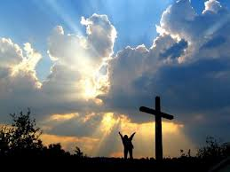
56 The sting of death is sin; and the strength of sin is the law.
57 But thanks be to God, which giveth us the victory through our Lord Jesus Christ.
58 Therefore, my beloved brethren, be ye stedfast, unmoveable, always abounding in the work of the Lord, forasmuch as ye know that your labour is not in vain in the Lord.

Slide 42
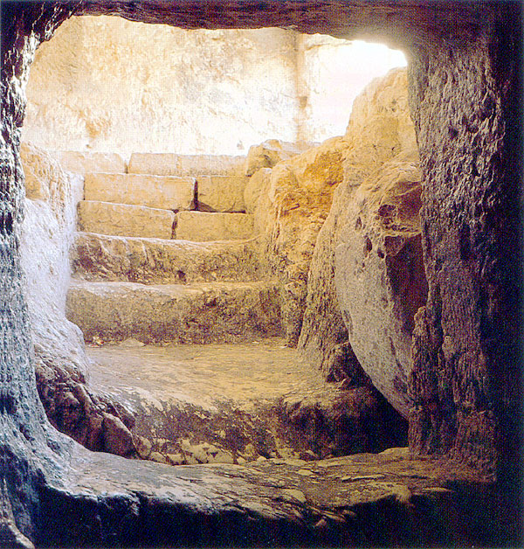
In relation to the believer

Slide 43
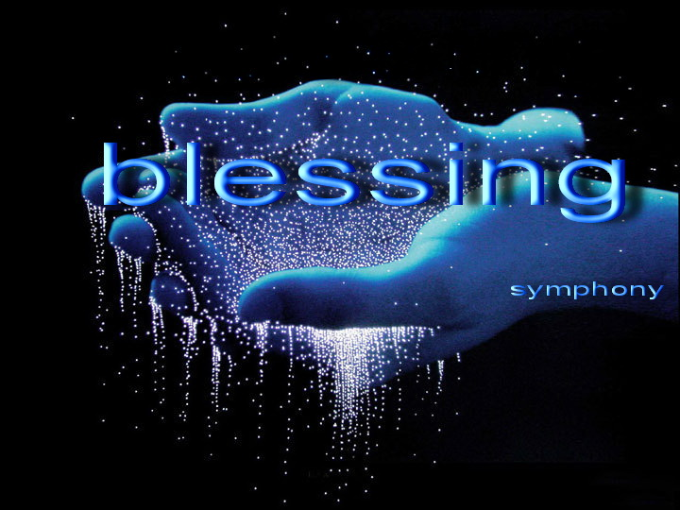
Immediate blessings
Eph 1:3 “Blessed be the God and Father of our Lord Jesus Christ, who hath blessed us with all spiritual blessings in heavenly places in Christ.”
Matt. 5:3-9 – Be-attitudes “blessed are…”

Slide 44
A guarantee of our justification
"Who was delivered for our offenses, and was raised again for our justification" (Romans 4:25)
Justification can be defined as that act of God whereby He declares absolutely righteous any and all who by faith take shelter in the blood of Christ as their only hope for salvation – (Romans 5:9)
Justification is a legal term which changes the believing sinner’s standing before God, declaring him acquitted and accepted by God, with the guilt and penalty of his sins put away forever – (Romans 6:23)

Slide 45
Rom. 5:9 “Much more then, being now justified by his blood, we shall be saved from wrath through him.”
Gal. 2:16 “Knowing that a man is not justified by the works of the law, but by the faith of Jesus Christ, even we have believed in Jesus Christ, that we might be justified by the faith of Christ, and not by the works of the law: for by the works of the law shall no flesh be justified.”

Slide 46
Being set free from the penility of my sin
Being set free from the penility of my sin
“That being justified by his grace, we should be made heirs according to the hope of eternal life.” Titus 3:7
Being set freeform the penalty of my sin

Slide 47
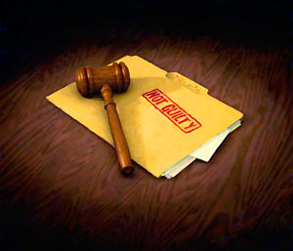
“There is therefore now no condemnation to them which are in Christ Jesus…” Rom. 8:1

Slide 48
A guarantee of present-day power and strength to live the Christian life (Eph. 1:18-2:10)
18 The eyes of your understanding being enlightened; that ye may know what is the hope of his calling, and what the riches of the glory of his inheritance in the saints,
19 And what is the exceeding greatness of his power to us-ward who believe, according to the working of his mighty power,
20 Which he wrought in Christ, when he raised him from the dead, and set him at his own right hand in the heavenly places,

Slide 49
21 Far above all principality, and power, and might, and dominion, and every name that is named, not only in this world, but also in that which is to come:
22 And hath put all things under his feet, and gave him to be the head over all things to the church,
23 Which is his body, the fullness of him that filleth all in all.
2:1 And you hath he quickened, who were dead in trespasses and sins;
2 Wherein in time past ye walked according to the course of this world, according to the prince of the power of the air, the spirit that now worketh in the children of disobedience:

Slide 50
3 Among whom also we all had our conversation in times past in the lusts of our flesh, fulfilling the desires of the flesh and of the mind; and were by nature the children of wrath, even as others.
4 But God, who is rich in mercy, for his great love wherewith he loved us,
5 Even when we were dead in sins, hath quickened us together with Christ,
6 And hath raised us up together, and made us sit together in heavenly places in Christ Jesus:
7 That in the ages to come he might shew the exceeding riches of his grace in his kindness toward us through Christ Jesus

Slide 51
8 For by grace are ye saved through faith; and that not of yourselves: it is the gift of God:
9 Not of works, lest any man should boast.
10 For we are his workmanship, created in Christ Jesus unto good works, which God hath before ordained that we should walk in them.

Slide 52
19 And what is the exceeding greatness of his power to us-ward who believe, according to the working of his mighty power, 20 Which he wrought in Christ, when he raised him from the dead, and set him at his own right hand in the heavenly places,

Slide 53
How to plug into the Resurrection Power of Christ?

Slide 54
Romans 6:1-11
1 What shall we say then? Shall we continue in sin, that grace may abound?
2 God forbid. How shall we, that are dead to sin, live any longer therein?
3 Know ye not, that so many of us as were baptized into Jesus Christ were baptized into his death?
4 Therefore we are buried with him by baptism into death: that like as Christ was raised up from the dead by the glory of the Father, even so we also should walk in newness of life.

Slide 55
5 For if we have been planted together in the likeness of his death, we shall be also in the likeness of his resurrection:
6 Knowing this, that our old man is crucified with him, that the body of sin might be destroyed, that henceforth we should not serve sin.
7 For he that is dead is freed from sin (justified).
8 Now if we be dead with Christ, we believe that we shall also live with him:
9 Knowing that Christ being raised from the dead dieth no more; death hath no more dominion over him.
10 For in that he died, he died unto sin once: but in that he liveth, he liveth unto God.

Slide 56
11 Likewise reckon ye also yourselves to be dead indeed unto sin, but alive unto God through Jesus Christ our Lord.

Slide 57
“As ye have therefore received Christ Jesus the Lord, so walk ye in him.” Col. 2:6

Slide 59
“But thanks be to God, which giveth us the victory through our Lord Jesus Christ.” I Cor. 15:57

Slide 60
Purpose to live a holy life – I Thess. 4:1-8
Yield yourself to the Lord – Rom. 6, 12:1-2
Renew your mind daily – Eph. 4:23-24
Make no provision for the flesh – Rom. 13:14
Flee temptation – II Tim. 2:22
Resist Satan by continual submission to God – James 4:6-10

Slide 61
Do not give place to the devil – Eph. 4:27–31 (bitterness, immorality, covetousness)
Keep your thoughts centered on things pure and lovely – Phil. 4:6-8
Set your affections on things above – Col. 3:1-4
Keep sin confessed – Prov. 28:13-14
Keep your conscience clear – Acts 24:16
Obey the promptings of the Holy Spirit – Rom. 8:14

Slide 62
Avoid quenching and grieving the Holy Spirit – I Thess. 5:19, Eph. 4:25-31
Ask God to fill you with the Holy Spirit – Luke 11:15

Slide 63
The Holy Spirit is called the “Spirit of Grace” (Heb. 10:29) “God gives grace to the humble…”

Slide 64
Sustaining grace – God giving strength to endure hardship
“For this thing I besought the Lord thrice, that it might depart from me. And he said unto me, My grace is sufficient for thee: for my strength is made perfect in weakness. Most gladly therefore will I rather glory in my infirmities, that the power of Christ may rest upon me. Therefore I take pleasure in infirmities, in reproaches, in necessities, in persecutions, in distresses for Christ's sake: for when I am weak, then am I strong.” II Cor. 12:8-10

Slide 65
Strengthening grace – God giving the ability to accomplish his will
“But by the grace of God I am what I am: and his grace which was bestowed upon me was not in vain; but I laboured more abundantly than they all: yet not I, but the grace of God which was with me.” I Cor. 15:10
“Be strong in the grace that is in Christ Jesus…”
“For our rejoicing is this, the testimony of our conscience, that in simplicity and godly sincerity, not with fleshly wisdom, but by the grace of God, we have had our conversation in the world, and more abundantly to you-ward.” II Cor. 1:12

Slide 66
A guarantee of fruitful labor
"Therefore, my beloved brethren, be ye steadfast, unmovable, always abounding in the work of the Lord, forasmuch as ye know that your labour is not in vain in the Lord.” I Cor. 15:58
“Ye have not chosen me, but I have chosen you, and ordained you, that ye should go and bring forth fruit, and that your fruit should remain: that whatsoever ye shall ask of the Father in my name, he may give it you.” John 15:16

Slide 67
Matthew 7:16-20
16 Ye shall know them by their fruits. Do men gather grapes of thorns, or figs of thistles?
17 Even so every good tree bringeth forth good fruit; but a corrupt tree bringeth forth evil fruit.
18 A good tree cannot bring forth evil fruit, neither can a corrupt tree bring forth good fruit.
19 Every tree that bringeth not forth good fruit is hewn down, and cast into the fire.
20 Wherefore by their fruits ye shall know them.

Slide 69
A guarantee of our resurrection
"Knowing that he which raised up the Lord Jesus shall raise up us also by Jesus, and shall present us with you"
II Cor. 4:14

Slide 70
“For the Lord himself shall descend from heaven with a shout, with the voice of the archangel, and with the trump of God: and the dead in Christ shall rise first:
Then we which are alive and remain shall be caught up together with them in the clouds, to meet the Lord in the air: and so shall we ever be with the Lord.”
I Thess. 4:16-17

Slide 71
Future blessings
Exchanging corruption for incorruption
“So also is the resurrection of the dead. It is sown in corruption; it is raised inincorruption.” I Cor. 15:42

Slide 72
Exchanging dishonor for glory
“It is sown in dishonour; it is raised in glory…” I Cor. 15:43

Slide 73
Exchanging weakness for power
“…it is sown in weakness; it is raised in power.” I Cor. 15:43

Slide 74
Exchanging a material body for a spiritual body
“It is sown a natural body; it is raised a spiritual body. There is a natural body, and there is a spiritual body.” I Cor. 15:44

Slide 75
I Cor. 15:40 “There are also celestial (heavenly) bodies, and bodies terrestrial: but the glory of the celestial (earthly) is one, and the glory of the terrestrial is another.”
Rom. 8:18-19 “For I reckon that the sufferings of this present time are not worthy to be compared with the glory which shall be revealed in us. For the earnest expectation of the creature waiteth for the manifestation of the sons of God.”

Slide 76
In relation to the Savior

Slide 77
It is the mark of his deity
"And declared to be the Son of God with power, according to the spirit of holiness, by the resurrection from the dead." Rom. 1:4

Slide 78
“Jesus answered and said unto them, Destroy this temple, and in three days I will raise it up. Then said the Jews, Forty and six years was this temple in building, and wilt thou rear it up in three days? But he spake of the temple of his body. When therefore he was risen from the dead, his disciples remembered that he had said this unto them; and they believed the scripture, and the word which Jesus had said.” John 2:19-22

Slide 79
"Him God raised up the third day" Acts 10:40

Slide 80
It resulted in his exaltation

Slide 81
"Wherefore God also hath highly exalted him, and given him a name which is above every name: that at the name of Jesus every knee should bow, of things in heaven, and things in earth, and things under the earth; and that every tongue should confess that Jesus Christ is Lord, to the glory of God the Father“
Phil. 2:9-11

Slide 82
"The God of our fathers raised up Jesus, whom ye slew and hanged on a tree. Him hath God exalted with his right hand to be a Prince and a Saviour, for to give repentance to Israel, and forgiveness of sins" Acts 5:30-31

Slide 83
It marks the beginning of his headship over the church.
"And what is the exceeding greatness of his power to us-ward who believe, according to the working of his mighty power, which he wrought in Christ, when he raised him from the dead, and set him at his own right hand in the heavenly places, far above all principality, and power, and might, and dominion, and every name that is named, not only in this world, but also in that which is to come: And hath put all things under his feet, and gave him to be the head over all things to the church, which is his body, the fullness of him that filleth all in all" Eph. 1:19-23

Slide 86
In relation to the sinner: It warns him of a coming judgment day
"Because he hath appointed a day, in the which he will judge the world in righteousness by that man whom he hath ordained; whereof he hath given assurance unto all men in that he hath raised him from the dead"
Acts 17:31

Slide 89
In relation to the devil: It seals his doom forever
Heb. 2:14 “Forasmuch then as the children are partakers of flesh and blood, he also himself likewise took part of the same; that through death he might destroy him that had the power of death, that is, the devil.”
Rev. 20:10 “And the devil that deceived them was cast into the lake of fire and brimstone, where the beast and the false prophet are, and shall be tormented day and night for ever and ever.”

Slide 91
In relationship to the Sabbath: It transfers the worship day from Saturday to Sunday
Acts 20:7 “And upon the first day of the week, when the disciples came together to break bread, Paul preached unto them, ready to depart on the morrow; and continued his speech until midnight.”
I Cor. 16:2 “Upon the first day of the week let every one of you lay by him in store, as God hath prospered him, that there be no gatherings when I come.”

Slide 92
Heb. 7:12 “For the priesthood being changed, there is made of necessity a change also of the law.”

Slide 93
“By a new and living way, which he (Jesus) hath consecrated for us, through the veil, that is to say, his flesh.” Heb 10:20

Slide 98
The symbol of the resurrection: Baptism (Rom. 6:3-11; Col. 2:11-13)

