Slide 1
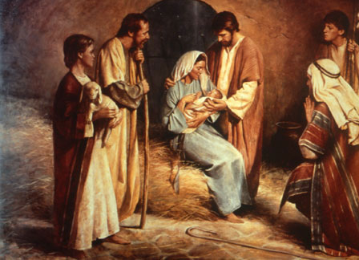
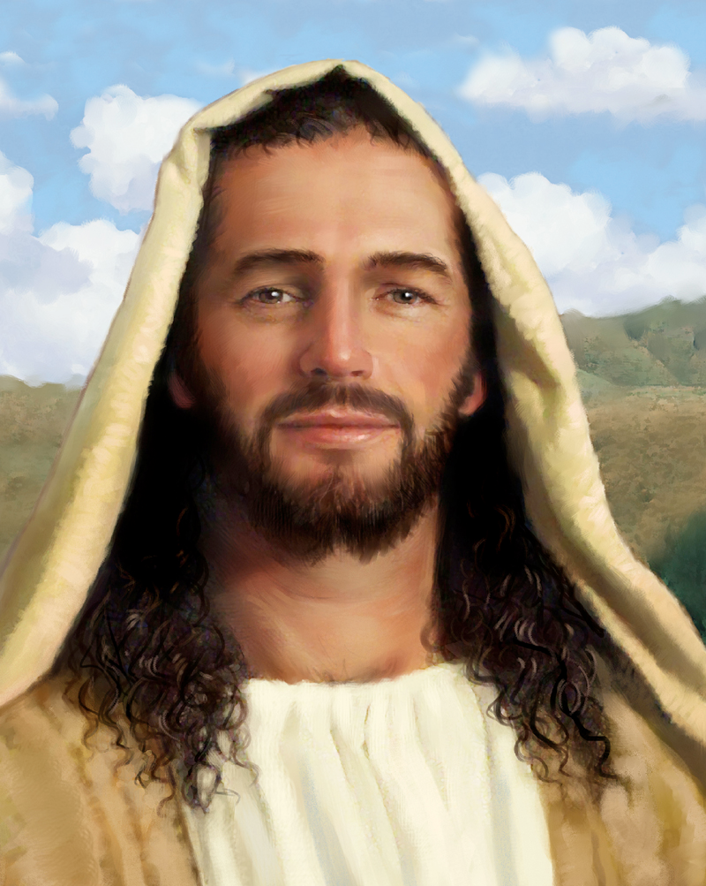
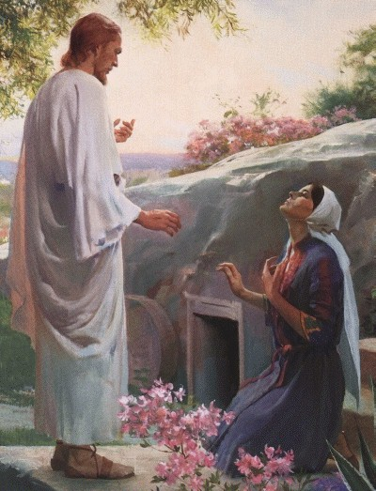
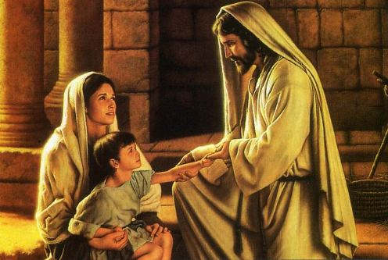
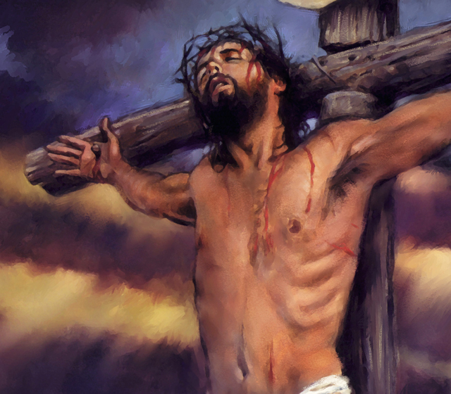
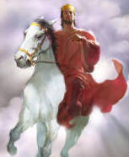
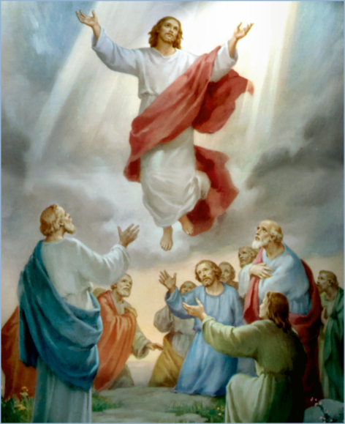
The Doctrine of Jesus Christ (Part 25)
The Present Day Ministry of Jesus Christ

Slide 2
Review

Slide 4
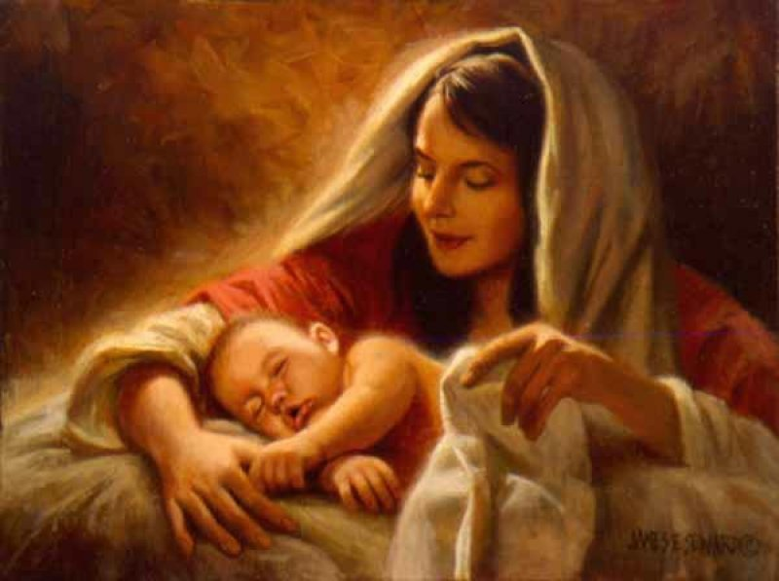
The Virgin Birth
“Behold, a virgin shall be with child, and shall bring forth a son, and they shall call his name Emmanuel, which being interpreted is, God with us.”
Matt. 1:23

Slide 6
Names and Titles of Jesus Christ

Slide 7
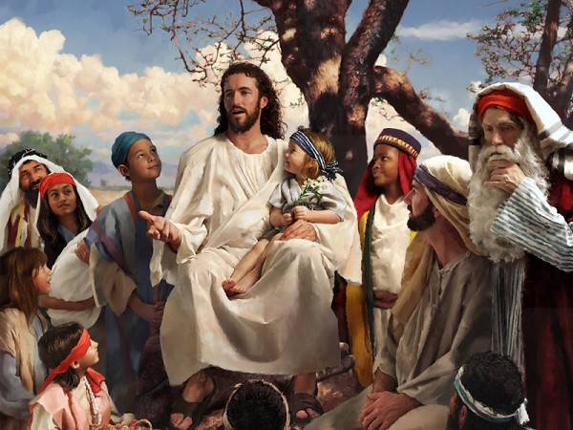
The Humanity of Jesus Christ

Slide 8
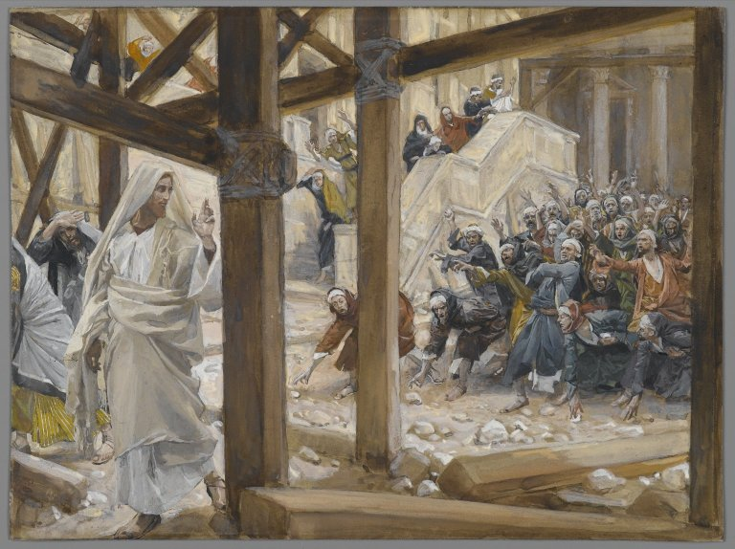
The Deity of Jesus Christ
(John 10:30-33)

Slide 9
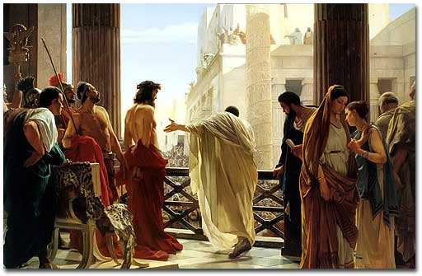
The Impeccability of Jesus Christ (John 18:38)

Slide 10
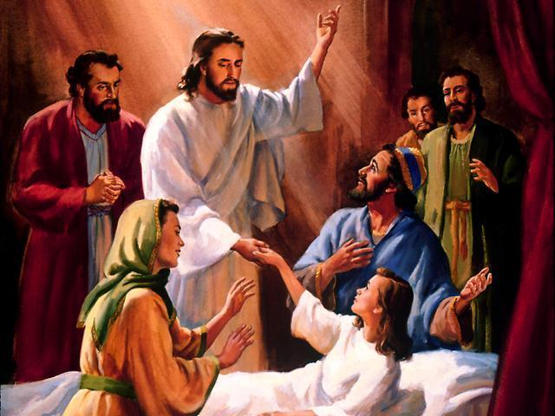
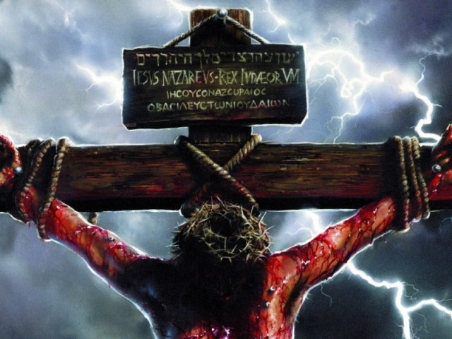
“For even the Son of man came not to be ministered unto, but to minister, and to give his life a ransom for many.” Mark 10:45
The Earthly Ministry of Jesus Christ

Slide 11
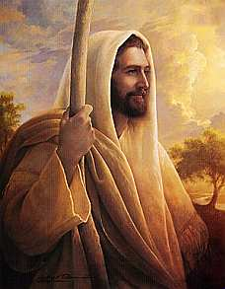
The Character of Jesus Christ
What kind of man was our Lord?
What were some of his characteristics?
zeal; compassion; meekness and gentleness; boldness and courage; love

Slide 12
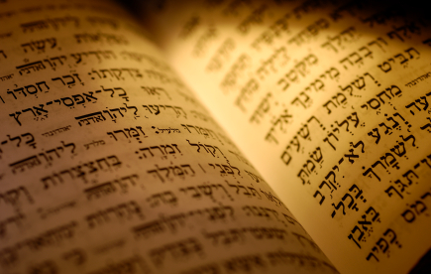
In the Old Testament three great offices were created by God to meet the spiritual and material needs of his chosen people.

Slide 13
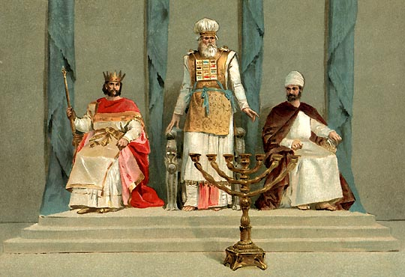
Jesus holds all three offices

Slide 14
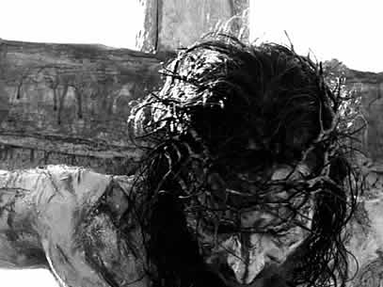
The Death of Jesus Christ

Slide 15
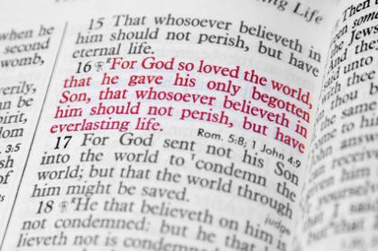

Slide 16
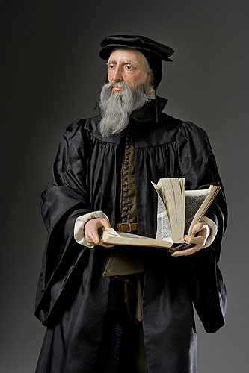
“Exposing the false Doctrine of Calvinism”
“I marvel that ye are so soon removed from him that called you into the grace of Christ unto another gospel …but there be some that trouble you, and would pervert the gospel of Christ. But though we, or an angel from heaven, preach any other gospel unto you than that which we have preached unto you, let him be accursed.” (Gal. 1:6-8)

Slide 17
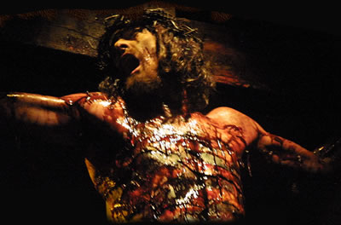
The Vicarious Atonement
“For he hath made him to be sin for us, who knew no sin; that we might be made the righteousness of God in him.” II Cor. 5:21
“Who his own self bare our sins in his own body on the tree.”
I Peter 2:24

Slide 18
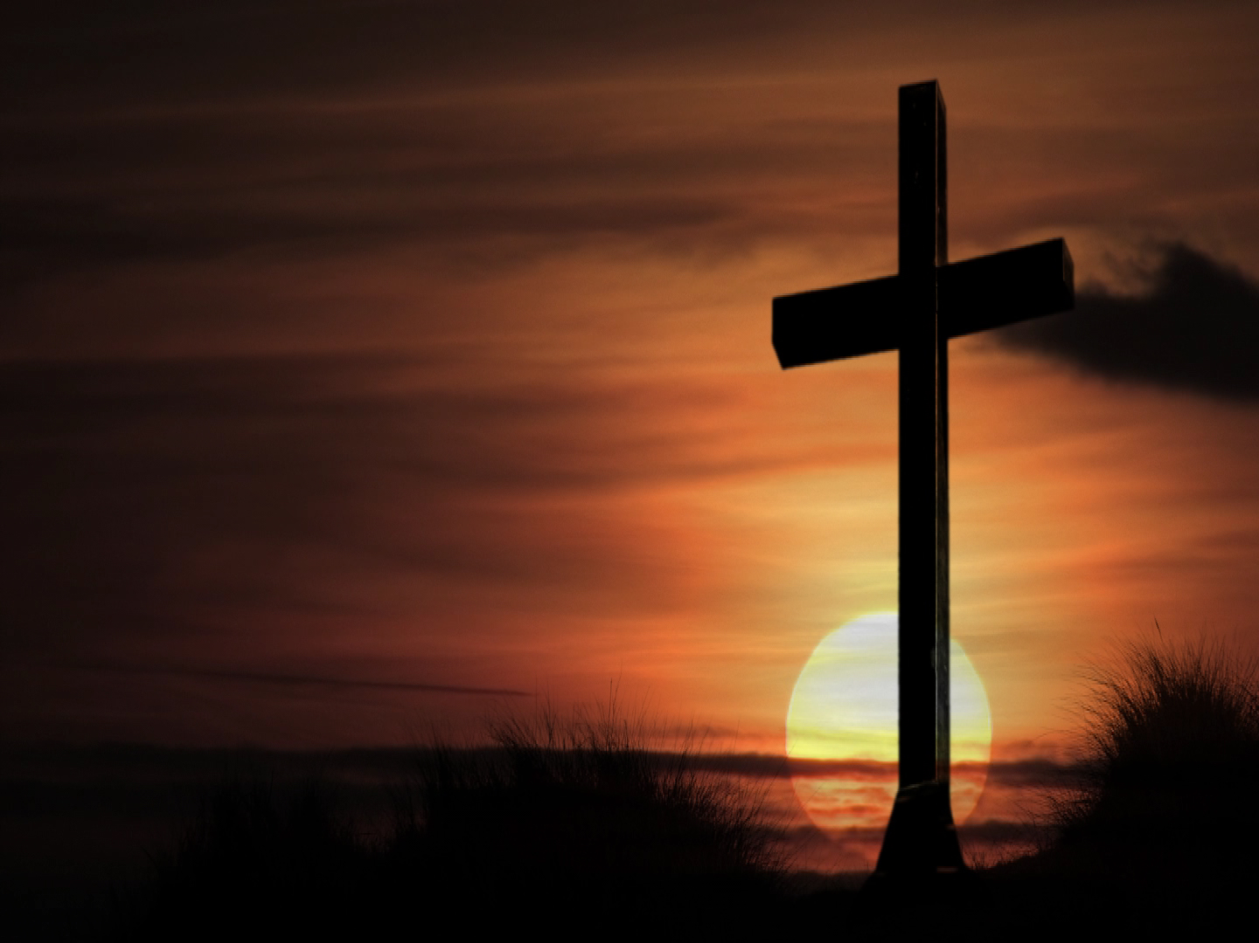
The results of the vicarious atonement
Redemption
Reconciliation
Justification
Sanctification
Glorification
Regeneration
Remission
Imputation
Propitiation
Forgiveness
Adoption
Ransom
Pardon
Eternal Salvation

Slide 19
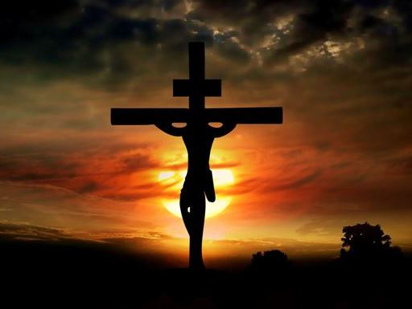
The seven last statements of Christ

Slide 20
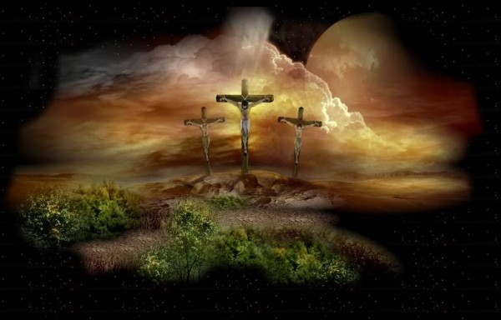
“Father, forgive them; for they know not what they do.”
“Today shalt thou be with me in paradise.”
“Woman, behold thy son! Then saith he to the disciple, Behold thy mother!”
“My God, my God, why hast thou forsaken me?”
“I thirst.”
“It is finished.”
“Father, into thy hands I commend my spirit.”

Slide 21
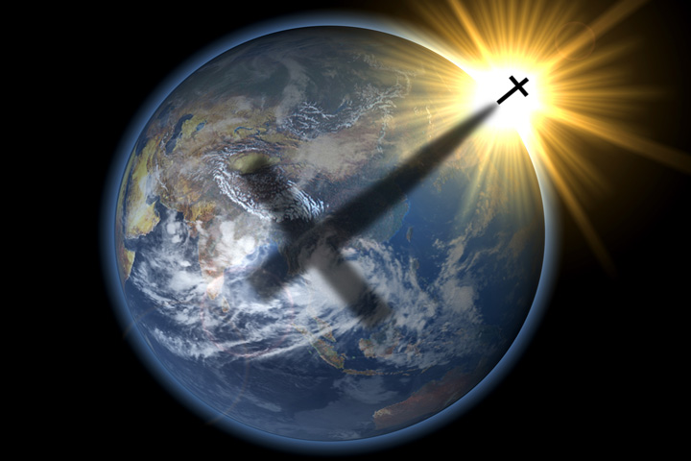
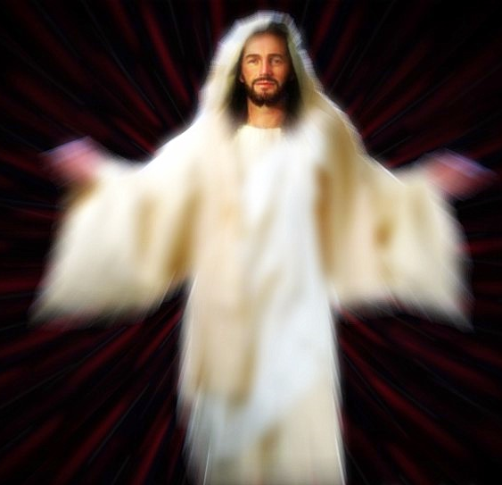
Christ descent into the heart of the earth

Slide 22
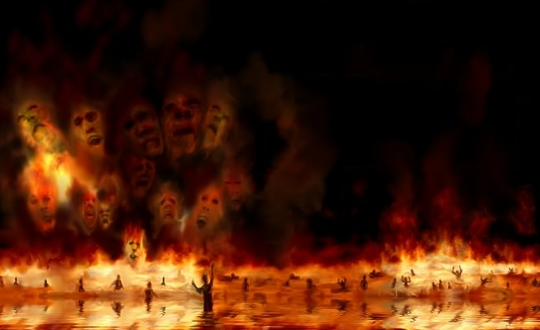
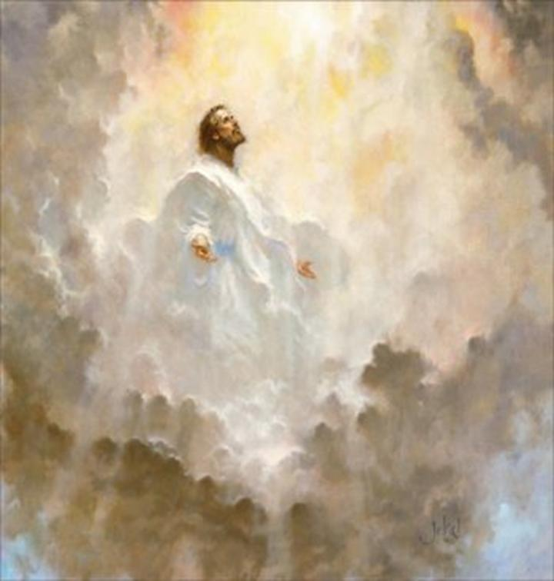
Torments
“…preached unto the
spirits in prison…”
“…led captivity captive…”
Paradise (Abraham's bosom)

Slide 23
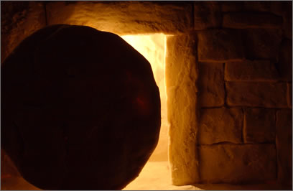
The Resurrection of Jesus Christ

Slide 24
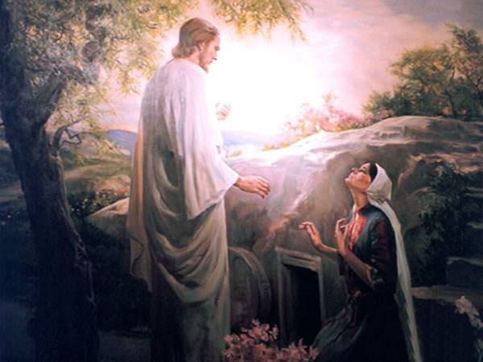
The Most Important Bible Doctrine (I Corinthians 15)

Slide 25
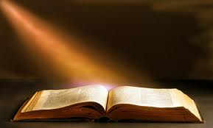
“And if Christ be not raised, your faith is vain; ye are yet in your sins. Then they also which are fallen asleep in Christ are perished.” I Cor. 15:17-18

Slide 26
The Ascension of Jesus Christ

Slide 27
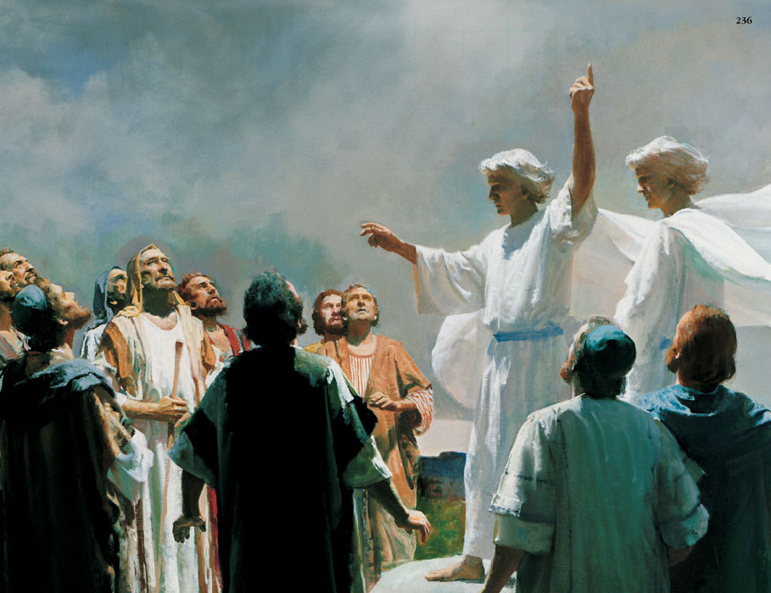
“And while they looked stedfastly toward heaven as he went up, behold, two men stood by them in white apparel; Which also said, Ye men of Galilee, why stand ye gazing up into heaven? this same Jesus, which is taken up from you into heaven, shall so come in like manner as ye have seen him go into heaven.” (Acts 1:10-11)

Slide 28
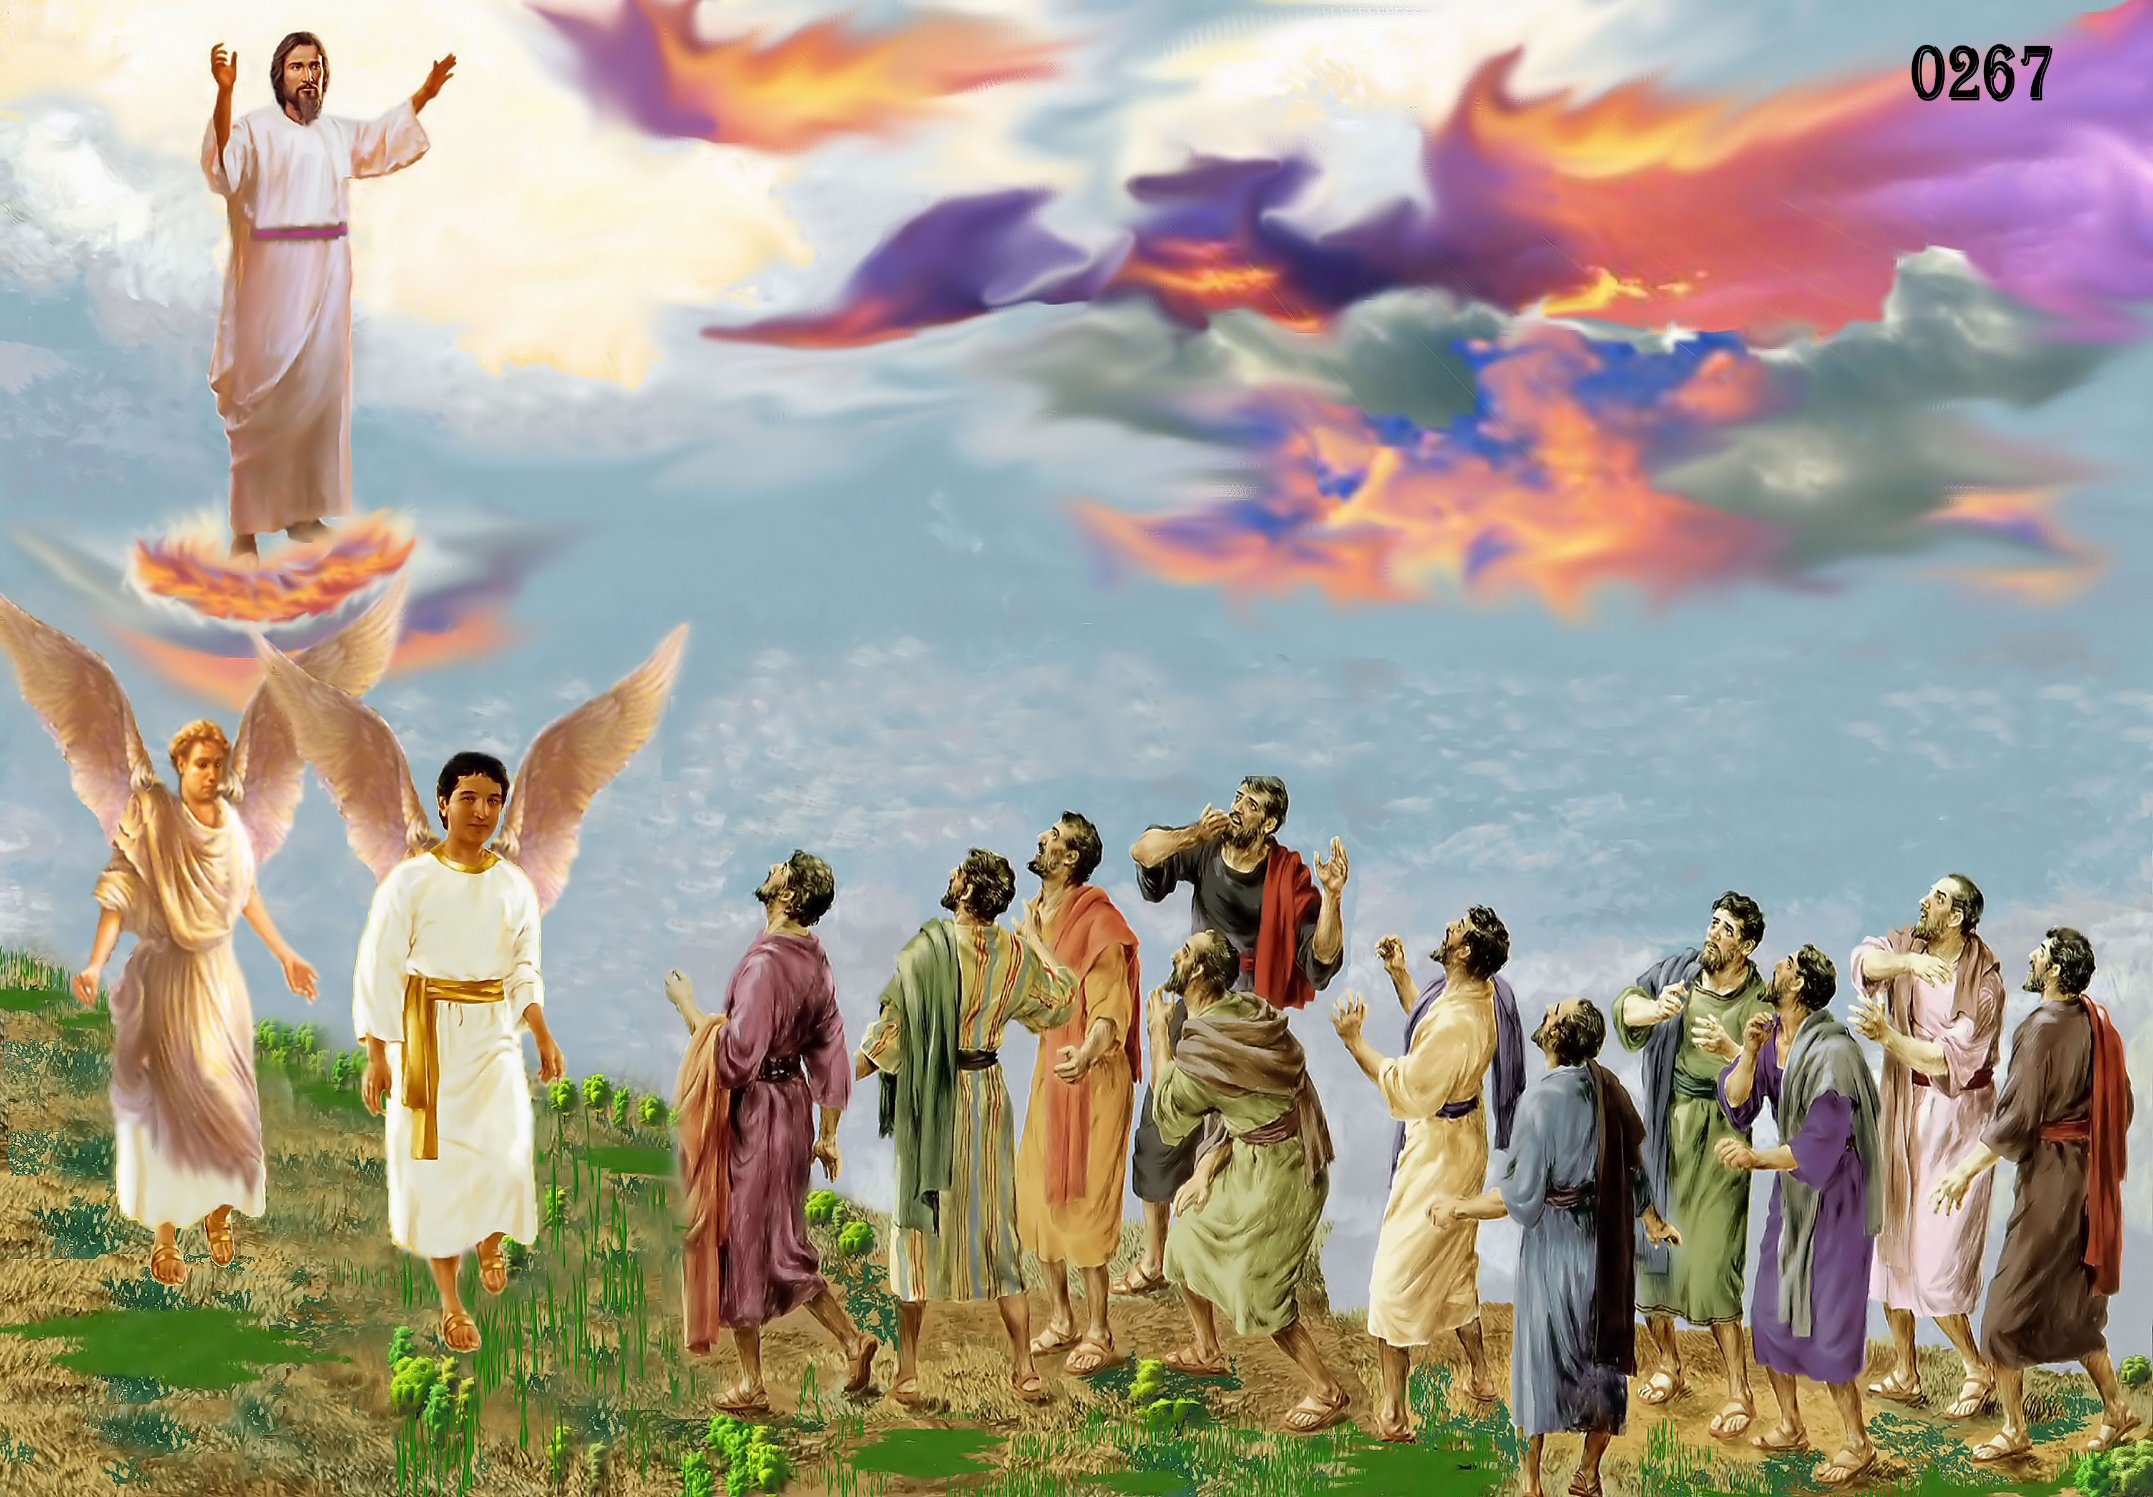
“I will come again…”

Slide 29
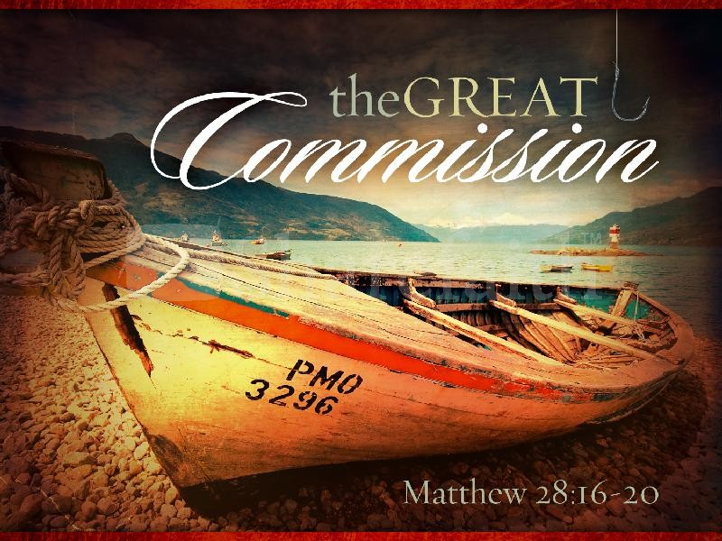

Slide 30
Tonight’s Message

Slide 31
The Present Day Ministry of Jesus Christ
"Who being the brightness of his glory, and the express image of his person, and upholding all things by the word of his power, when he had by himself purged our sins, sat down on the right hand of the Majesty on high" (Heb. 1:3).
"But this man, after he had offered one sacrifice for sins for ever, sat down on the right hand of God; from henceforth expecting till his enemies be made his footstool" (Heb. 10:12, 13).

Slide 32
"Looking unto Jesus the author and finisher of our faith; who for the joy that was set before him endured the cross, despising the shame, and is set down at the right hand of the throne of God" (Heb. 12:2).
"Who is gone into heaven, and is on the right hand of God; angels and authorities and powers being made subject unto him" (I Pet. 3:22).
"If ye then be risen with Christ, seek those things which are above, where Christ sitteth on the right hand of God" (Col. 3:1).

Slide 33
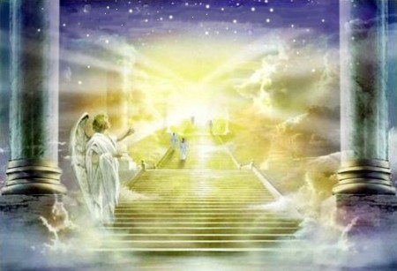

Slide 34
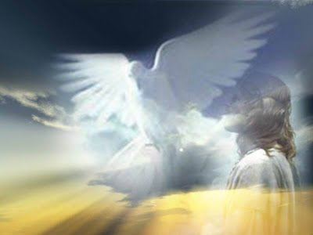
Sending the promise of the Father (Holy Spirit) to those who believe
“Nevertheless I tell you the truth; It is expedient for you that I go away: for if I go not away, the Comforter will not come unto you; but if I depart, I will send him unto you. And when he is come, he will reprove the world of sin, and of righteousness, and of judgment.” (John 16:7-8)

Slide 35
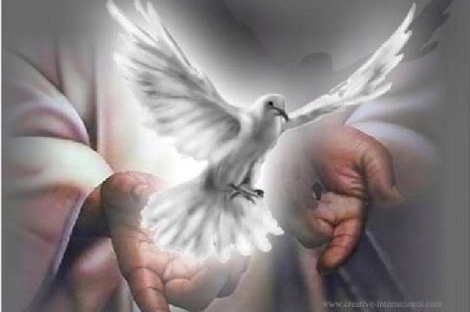
“I will send him unto you”

Slide 36
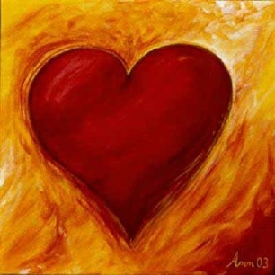
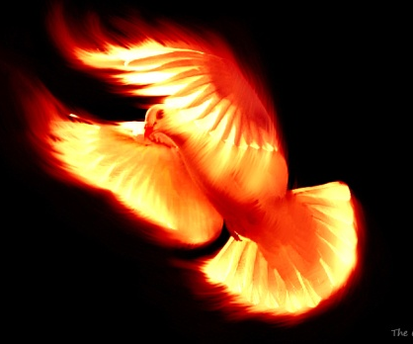
Working in the life of the believer through the indwelling presents of the Holy Spirit
“But ye are not in the flesh, but in the Spirit, if so be that the Spirit of God dwell in you. Now if any man have not the Spirit of Christ, he is none of his.” (Romans 8:9)

Slide 37
"Verily, verily, I say unto you, He that believeth on me, the works that I do shall he do also; and greater works than these shall he do; because I go unto my Father" (John 14:12)

Slide 38
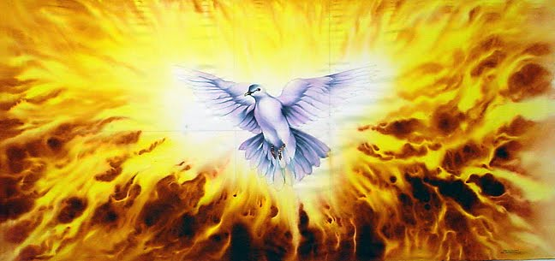

Slide 39
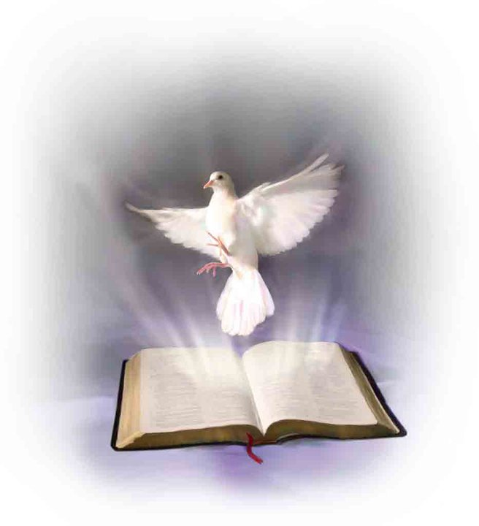
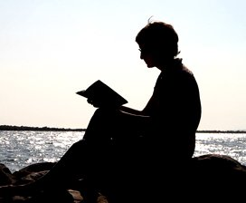
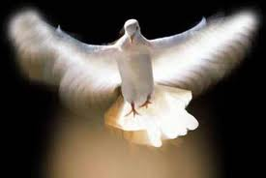
“Howbeit when he, the Spirit of truth, is come, he will guide you into all truth: for he shall not speak of himself; but whatsoever he shall hear, that shall he speak: and he will shew you things to come. He shall glorify me: for he shall receive of mine, and shall shew it unto you. All things that the Father hath are mine: therefore said I, that he shall take of mine, and shall shew it unto you.” (John 16:13-15)

Slide 40
“These things have I written unto you concerning them that seduce you. But the anointing which ye have received of him abideth in you, and ye need not that any man teach you: but as the same anointing teacheth you of all things, and is truth, and is no lie, and even as it hath taught you, ye shall abide in him.” (I John 2:26-27)

Slide 41
“But God hath revealed them unto us by his Spirit: for the Spirit searcheth all things, yea, the deep things of God. For what man knoweth the things of a man, save the spirit of man which is in him? even so the things of God knoweth no man, but the Spirit of God. Now we have received, not the spirit of the world, but the spirit which is of God; that we might know the things that are freely given to us of God. Which things also we speak, not in the words which man's wisdom teacheth,

Slide 42
but which the Holy Ghost teacheth; comparing spiritual things with spiritual. But the natural man receiveth not the things of the Spirit of God: for they are foolishness unto him: neither can he know them, because they are spiritually discerned. But he that is spiritual judgeth all things, yet he himself is judged of no man. For who hath known the mind of the Lord, that he may instruct him? But we have the mind of Christ.” (I Corinthians 2:10-16)

Slide 43
“For they that are after the flesh do mind the things of the flesh; but they that are after the Spirit the things of the Spirit. For to be carnally minded is death; but to be spiritually minded is life and peace.” (Romans 8:5-6)

Slide 44
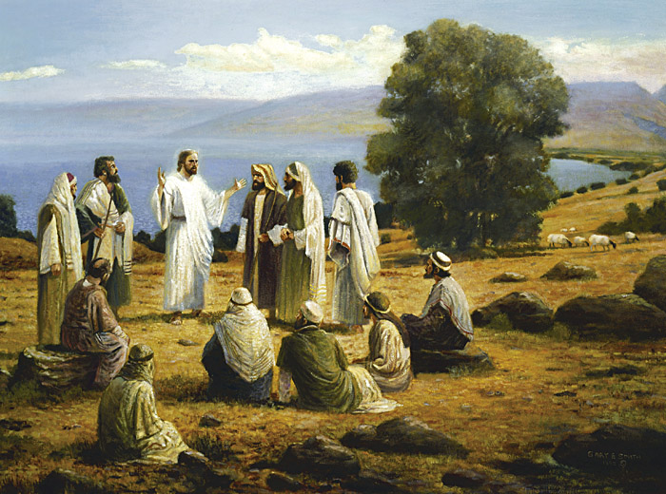
“And, being assembled together with them, commanded them that they should not depart from Jerusalem, but wait for the promise of the Father, which, saith he, ye have heard of me. For John truly baptized with water; but ye shall be baptized with the Holy Ghost not many days hence.” (Acts 1:4-5)

Slide 45
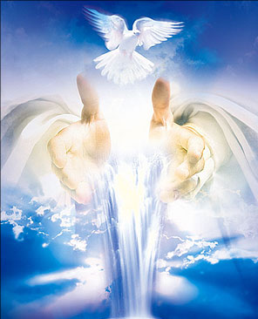
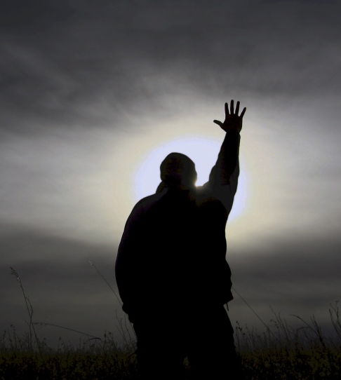
“Therefore being by the right hand of God exalted, and having received of the Father the promise of the Holy Ghost, he hath shed forth this, which ye now see and hear.”
(Acts 2:33)

Slide 46
“But ye shall receive power, after that the Holy Ghost is come upon you: and ye shall be witnesses unto me both in Jerusalem, and in all Judaea, and in Samaria, and unto the uttermost part of the earth.” (Acts 1:8)

Slide 48
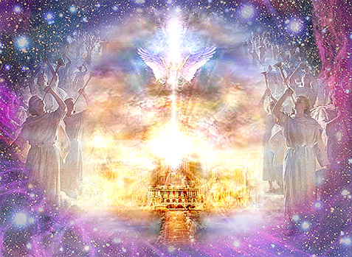
Preparing a place for us
"In my Father’s house are many mansions: if it were not so, I would have told you. I go to prepare a place for you."
(John 14:2)

Slide 49
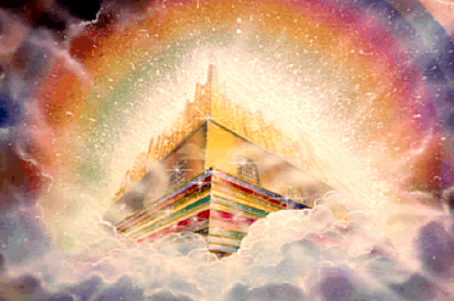
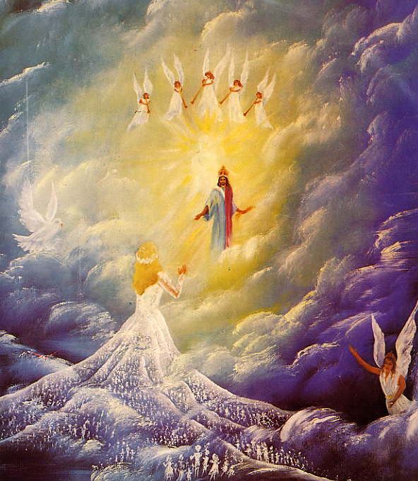
“And if I go and prepare a place for you, I will come again, and receive you unto myself; that where I am, there ye may be also.” (John 14:3)

Slide 50
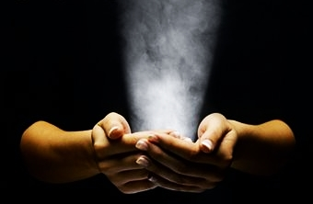
Giving spiritual gifts to his followers

Slide 51
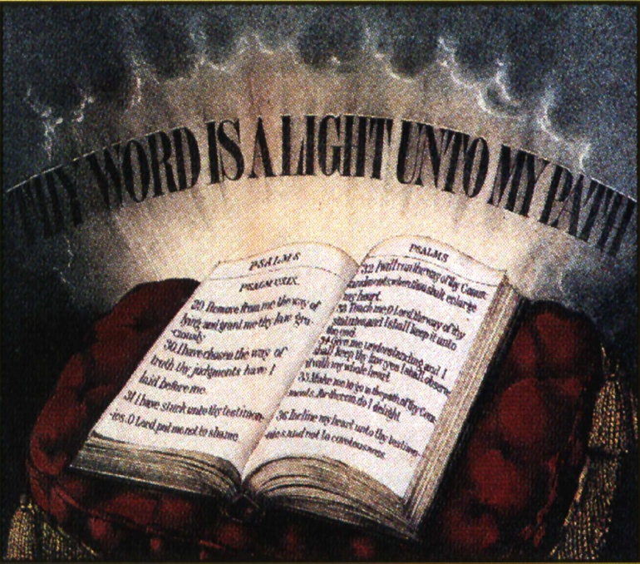
“Now concerning spiritual gifts, brethren, I would not have you ignorant.” (I Corinthians 12:1)

Slide 52
“As every man hath received the gift, even so minister the same one to another, as good stewards of the manifold grace of God.”

Slide 53
“When he ascended up on high…He (Christ) gave gifts unto men…for the perfecting of the saints, for the work of the ministry, for the edifying of the body of Christ.” (Ephesians 4:8-13)

Slide 54
Seven Motivational Gifts (Romans 12:3-8)
Prophet
Server
Teacher
Exhorter
Giver
Organizer
Mercy

Slide 55
To become our great high priest
"Which hope we have as an anchor of the soul, both sure and steadfast, and which entereth into that within the veil; whither the forerunner is for us entered, even Jesus, made a high priest for ever after the order of Melchizedek”
(Heb. 6:19-20)

Slide 56
Making high priestly prayers for us (Rom. 8:34; Heb. 4:14-16; 7:25-27; 8:1; 9:24).

Slide 57
Acting as our Intercessor
"Who is he that condemneth? It is Christ, that died, yea rather, that is risen again, who is even at the right hand of God who also maketh intercession for us" (Rom. 8:34)
"Wherefore he is able to save them to the uttermost that come unto God by him, seeing he ever liveth to make intercession for them” (Heb. 7:25)

Slide 58
Acting as our Mediator
“For there is one God, and one mediator between God and men, the man Christ Jesus.” (I Tim. 2:5)

Slide 59
Acting as our Advocate
"If we confess our sins, he is faithful and just to forgive us our sins, and to cleanse us from all unrighteousness…My little children, these things write I unto you, that ye sin not. And if any man sin, we have an advocate with the Father, Jesus Christ the righteous" (I John 1:9; 2:1).
*One that pleads the cause of another before a tribunal or judicial court
*One that defends or maintains another's cause.
*One that supports or promotes the interests of another.

Slide 60
"For Christ is not entered into the holy places made with hands, which are the figures of the true; but into heaven itself, now to appear in the presence of God for us" (Heb. 9:24)

Slide 62
"And I heard a loud voice saying in heaven, Now is come salvation, and strength, and the kingdom of our God, and the power of his Christ: for the accuser of our brethren is cast down, which accused them before our God day and night" (Rev. 12:10)

Slide 63
Holding all things together
“Who being the brightness of his glory, and the express image of his person, and upholding all things by the word of his power, when he had by himself purged our sins, sat down on the right hand of the Majesty on high.” (Heb. 1:3)

Slide 64
Creating all things
“For by him were all things created, that are in heaven, and that are in earth, visible and invisible, whether they be thrones, or dominions, or principalities, or powers: all things were created by him, and for him.”
(Col 1:16)

Slide 65
“All things were made by him; and without him was not any thing made that was made.”
(John 1:3)

Slide 66
“For in him we live, and move, and have our being…Forasmuch then as we are the offspring of God.” (Acts 17:28-29)
“For thou hast possessed my reins: thou hast covered me in my mother's womb. I will praise thee; for I am fearfully and wonderfully made: marvellous are thy works; and that my soul knoweth right well. My substance was not hid from thee, when I was made in secret.” (Psalms 139:13-15)

Slide 67
Caring, protecting and ministering to His church
“For where two or three are gathered together in my name, there am I in the midst of them.”
(Matt. 18:20)

Slide 68
“I John, who also am your brother, and companion in tribulation, and in the kingdom and patience of Jesus Christ, was in the isle that is called Patmos, for the word of God, and for the testimony of Jesus Christ.
(Revelation 1:9-20)

Slide 69
I was in the Spirit on the Lord's day, and heard behind me a great voice, as of a trumpet, Saying, I am Alpha and Omega, the first and the last: and, What thou seest, write in a book, and send it unto the seven churches which are in Asia; unto Ephesus, and unto Smyrna, and unto Pergamos, and unto Thyatira, and unto Sardis, and unto Philadelphia, and unto Laodicea.

Slide 70
And I turned to see the voice that spake with me. And being turned, I saw seven golden candlesticks; And in the midst of the seven candlesticks one like unto the Son of man, clothed with a garment down to the foot, and girt about the paps with a golden girdle.

Slide 71
His head and his hairs were white like wool, as white as snow; and his eyes were as a flame of fire; And his feet like unto fine brass, as if they burned in a furnace; and his voice as the sound of many waters. And he had in his right hand seven stars: and out of his mouth went a sharp twoedged sword: and his countenance was as the sun shineth in his strength

Slide 72
And when I saw him, I fell at his feet as dead. And he laid his right hand upon me, saying unto me, Fear not; I am the first and the last: I am he that liveth, and was dead; and, behold, I am alive for evermore, Amen; and have the keys of hell and of death.

Slide 73
Write the things which thou hast seen, and the things which are, and the things which shall be hereafter; The mystery of the seven stars which thou sawest in my right hand, and the seven golden candlesticks. The seven stars are the angels of the seven churches: and the seven candlesticks which thou sawest are the seven churches.”

Slide 74
“And he is the head of the body, the church: who is the beginning, the firstborn from the dead; that in all things he might have the preeminence.” (Col. 1:18)

Slide 75
Jesus has been highly exalted by the Father himself
"Behold, my servant shall deal prudently, he shall be exalted and extolled, and be very high" (Isa. 52:13)
"These words spake Jesus, and lifted up his eyes to heaven, and said, Father, the hour is come; glorify thy Son, that thy Son also may glorify thee" (John 17:1)
"But we see Jesus, who was made a little lower than the angels for the suffering of death, crowned with glory and honor; that he by the grace of God should taste death for every man" (Heb. 2:9)

Slide 76
“crowned with glory and honor”

Slide 77
Jesus has been given a name (position and place of authority) above all other names
“Which he wrought in Christ, when he raised him from the dead, and set him at his own right hand in the heavenly places, Far above all principality, and power, and might, and dominion, and every name that is named, not only in this world, but also in that which is to come.” (Ephesians 1:20-21)
“Being made so much better than the angels, as he hath by inheritance obtained a more excellent name than they.” (Hebrews 1:4)

Slide 78
“Far above all principality, and power, and might, and dominion, and every name that is named”

Slide 79
Jesus will be universally acknowledged as Lord of all
“Wherefore God also hath highly exalted him, and given him a name which is above every name: That at the name of Jesus every knee should bow, of things in heaven, and things in earth, and things under the earth; And that every tongue should confess that Jesus Christ is Lord, to the glory of God the Father.” (Philippians 2:9-11)

Slide 80
“…every knee should bow.”

Slide 81
“And that every tongue should confess that Jesus Christ is Lord, to the glory of God the Father.”

Slide 82
“These shall make war with the Lamb, and the Lamb shall overcome them: for he is Lord of lords, and King of kings: and they that are with him are called, and chosen, and faithful.”
(Revelation 17:14)

Slide 83
To confess Jesus in this life as Lord means salvation, but to wait until the next life will result in damnation. Thus, the supreme question is not when will you do this, but rather where.

