Slide 1
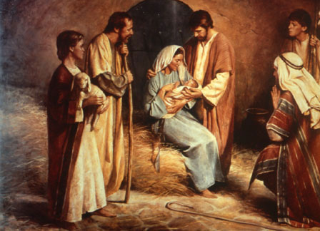
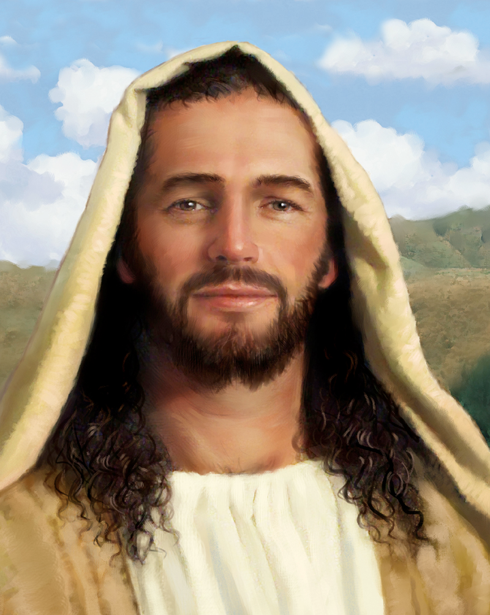
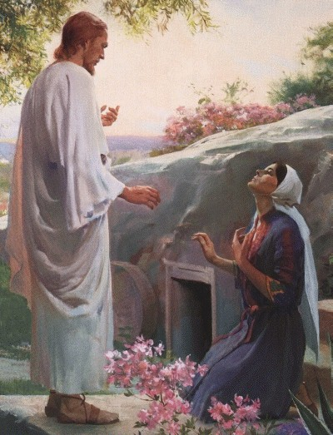
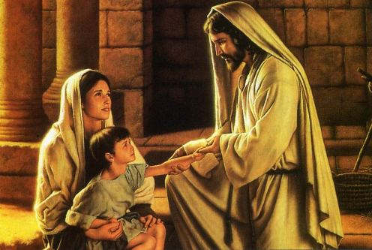
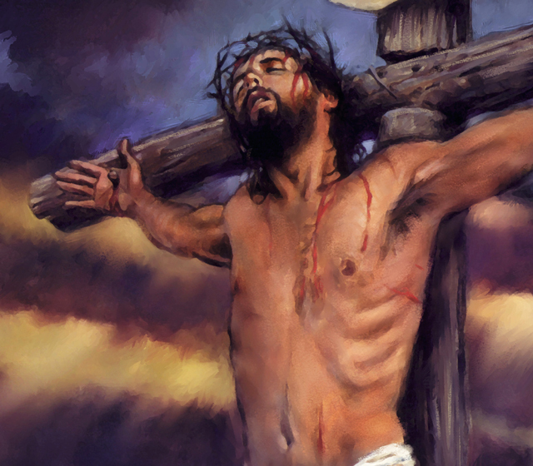
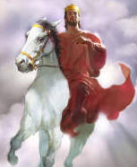
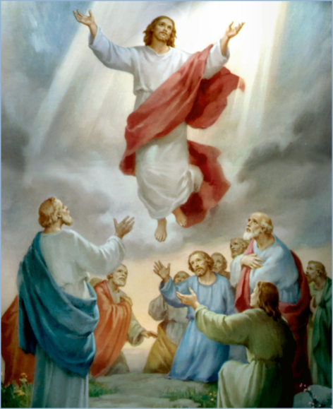
The Doctrine of Jesus Christ (Part 4)
The Biblical Names and
Titles of Jesus Christ
(Part 1)

Slide 2
Review

Slide 3
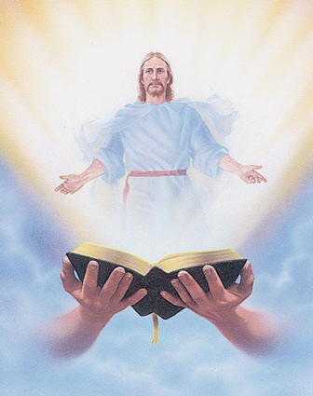
The fact of his divine preexistence
“Search the scriptures; for in them ye think ye have eternal life: and they are they which testify of me.”

Slide 4
The Old Testament records a number of theophanies. A theophany is a pre-Bethlehem appearance of Christ.

Slide 6
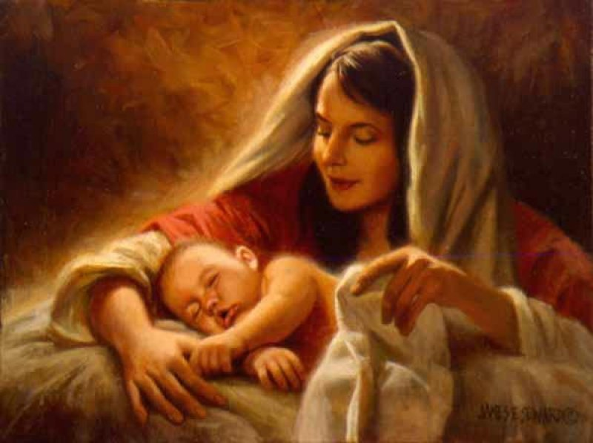
The Virgin Birth
“Behold, a virgin shall be with child, and shall bring forth a son, and they shall call his name Emmanuel, which being interpreted is, God with us.”
Matt. 1:23

Slide 7
The Incarnation of Christ
(John 1:1-14)
God the Son took upon himself the full nature of man and yet retain the full nature of God.

Slide 8
The “Kenosis” of Christ (Phil. 2:1-8)
The Greek word “kenosis” is translated in the KJV – “made himself of no reputation…”
Kenosis = Emptying – Christ who was “equal with God” / “I and my father are one…” Empted himself = Jesus limited Himself and yet never ceased to be God.

Slide 9
Made himself of no reputation –
Took upon him the form of a servant – “I came not to be ministered unto but to minister and to give my life…”
Made in the likeness of man – “Incarnation”
Found in fashion (appearance) as a man – “He shall grow up before him as a root out of dry ground, he hath no form nor comeliness, and when we shall see him there is no beauty that we should desire him…”
Became obedient unto death, even the death of the cross -

Slide 10
Names and Titles of Jesus Christ

Slide 11
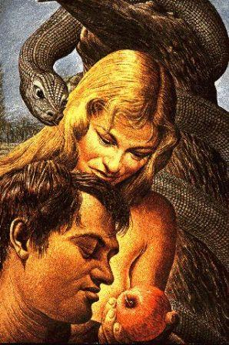
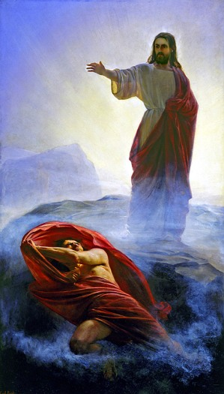
Adam (second or last) - (I Cor. 15:45)

Slide 12
Adam being the first man was created perfect and was born into a perfect world – Gen. 1-3
Adam was put to the test and failed, thus in Adam all died – II Cor. 15:22
Adam sinned therefore death came into play – Rom. 6:23 “For the wages of sin is death; but the gift of God is eternal life through Jesus Christ our Lord.”

Slide 13
Jesus was also born perfect, but he was born into a sinful world – John 1:29
Jesus was also put to the test and succeeded, He then died and rose again to redeem us from our fallen sinful condition - I Cor. 15:45
He won what Adam lost, everlasting life – I Cor. 15:22 “For as in Adam all die, even so in Christ shall all be made alive.”

Slide 14
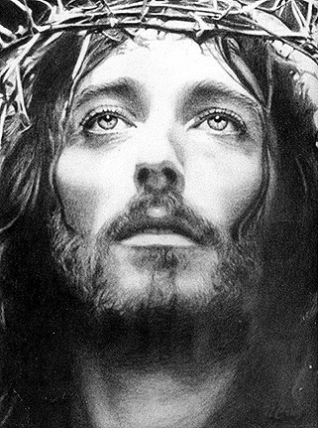
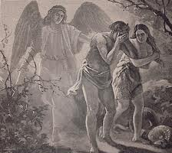
“For as in Adam all die, even so in Christ shall all be made alive.” I Cor. 15:22 (Romans 5-8; I Cor. 15)
First Adam
Death
Separation
Curse
Second Adam
Life
Reconciliation
Blessing

Slide 15
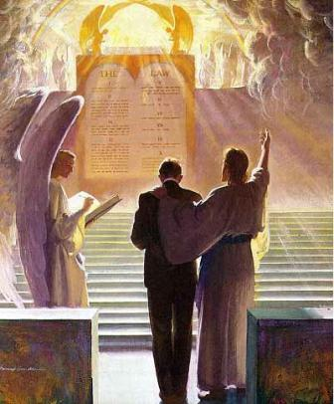
Advocate - (I John 2:1)
One that pleads the cause of another before a judge or judicial court.
One that defends the cause or promotes the interests of another in a court of law.
Defense attorney

Slide 16
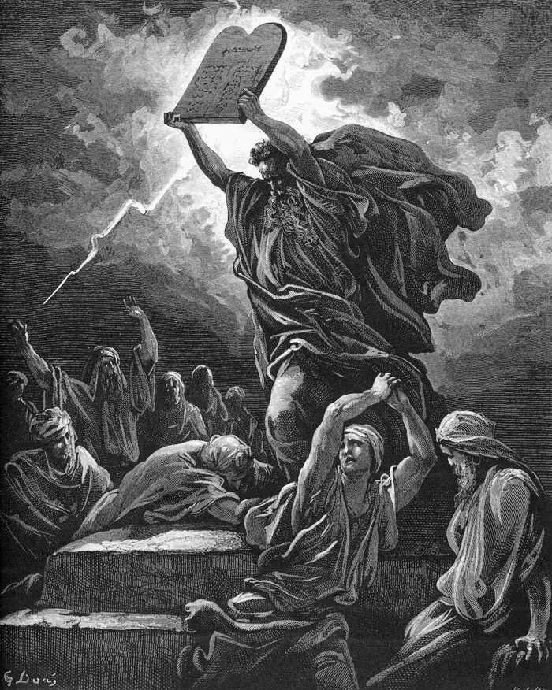
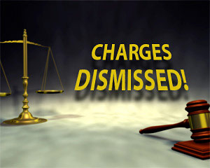
Condemned by the Law (Romans 3-5)
Justified
by Christ
(Romans 5-8)

Slide 17
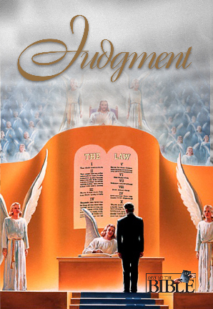
Jesus can be your Advocate (attorney) or He will be your Judge

Slide 18
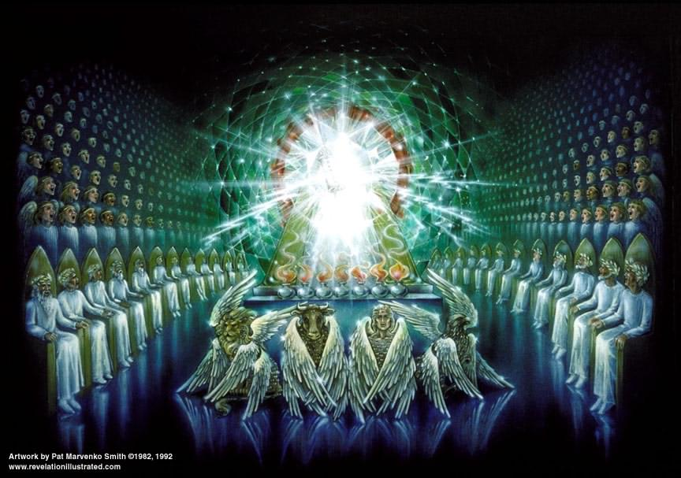
Almighty God - (Rev. 1:8)
Rev.4:8 “And the four beasts (Cherubim's) had each of them six wings about him; and they were full of eyes within: and they rest not day and night, saying, Holy, holy, holy, Lord God Almighty, which was, and is, and is to come.”

Slide 19
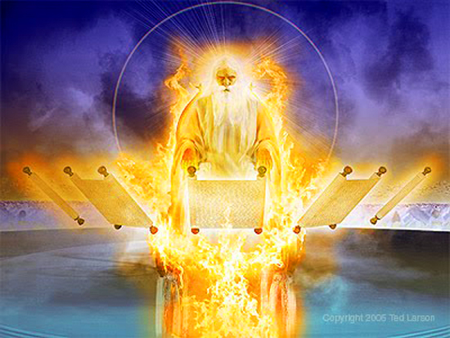
Ancient of Days - (Dan. 7:22)
Palm 90:2 “Before the mountains were brought forth, or ever thou hadst formed the earth and the world, even from everlasting to everlasting, thou art God.”

Slide 20
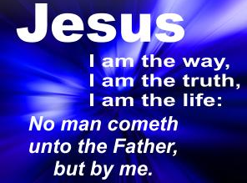
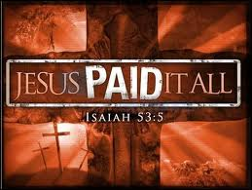
Author of Eternal Salvation - (Heb. 5:9)
“Neither is there salvation in any other: for there is none other name under heaven given among men, whereby we must be saved.” Acts 4:12

Slide 21
Amen - (Rev. 3:14)
The word rendered “amen” is a transliteration of a Hebrew word that means “so be it,” or “surely.”
“These things saith the Amen, the faithful and true witness…”

Slide 22
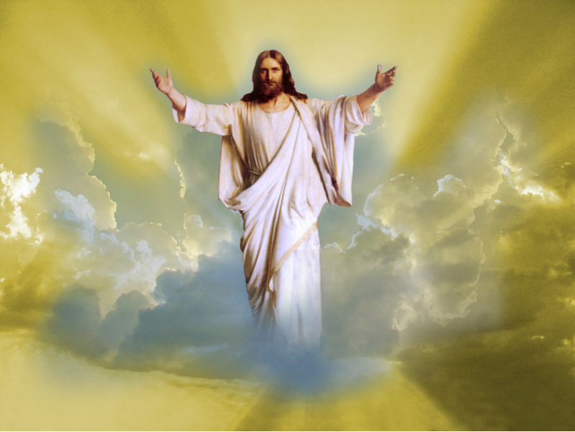
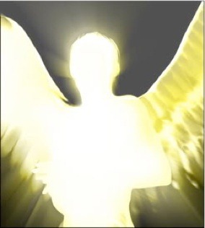
Angel of the Lord - (Gen. 16:9-14)
The most frequent appearance of Christ in the Old Testament

Slide 23
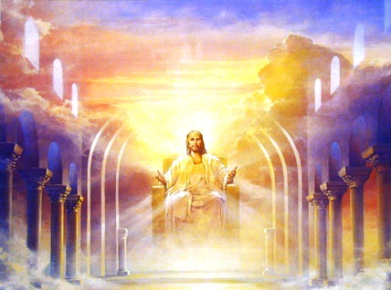
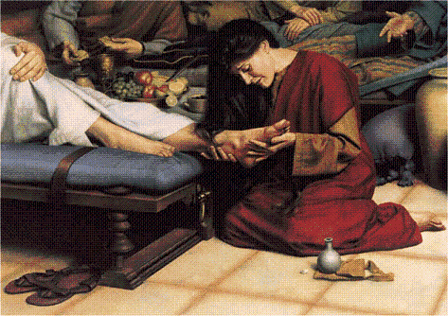
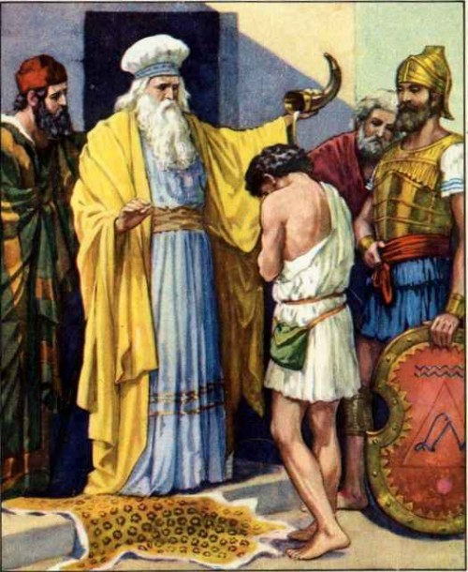
Anointed King - (Psalm 2:2)
Anointing of oil during a religious ceremony was a sign of sanctification or consecration

Slide 24
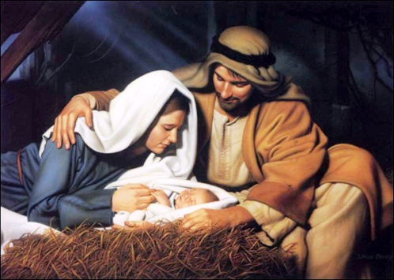
Babe - (Luke 2:16)
Incarnation
Kenosis

Slide 25
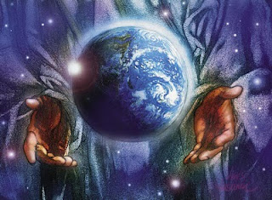
Beginning of creation - (Rev. 3:14)
“All things were made by him; and without him was not any thing made that was made.” John 1:3

Slide 26
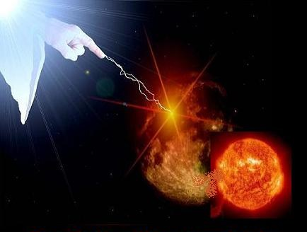
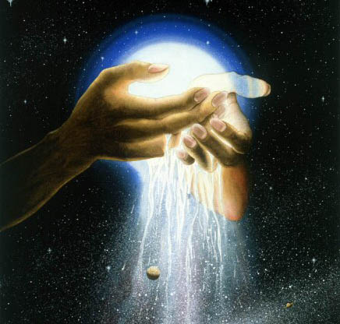
Beginning and the end - (Rev. 22:13)

Slide 27
Begotten of Father - (John 1:14)
"For God so loved the world, that He gave His only begotten Son, that whosoever believeth in Him should not perish, but have
everlasting life.” (John 3:16)
The most important question that anyone has to answer is, “Who is Jesus Christ?”
Or, as Jesus put it himself, “Who do you say the Son of Man is?”
How you answer that question determines your faith, and your fate.

Slide 28
Jesus is the only begotten Son of God –
Begotten / English = (of offspring) generated by procreation.
Begotten / Bible reference to Christ = comes from the Greek word MONOGENES which means unique or "one and only" Son. The only one of its kind.
Acts 4:12 “Neither is there salvation in any other: for there is none other name under heaven given among men, whereby we must be saved.”

Slide 29
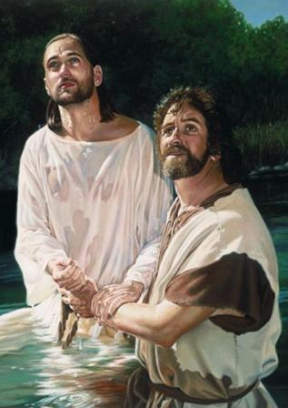
Beloved - (Matt. 3:17)
Beloved = The highest affection and regard.
Eph. 1:6 “To the praise of the glory of his grace, wherein he hath made us accepted in the beloved.”

Slide 30
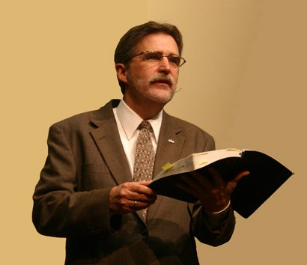
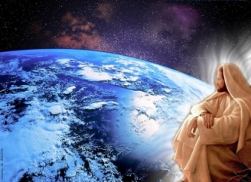
Bishop of our souls - (I Pet. 2:25)
Bishop = (English derivation of the New Testament Greek επίσκοπος /episcopos "overseer, guardian”

Slide 31
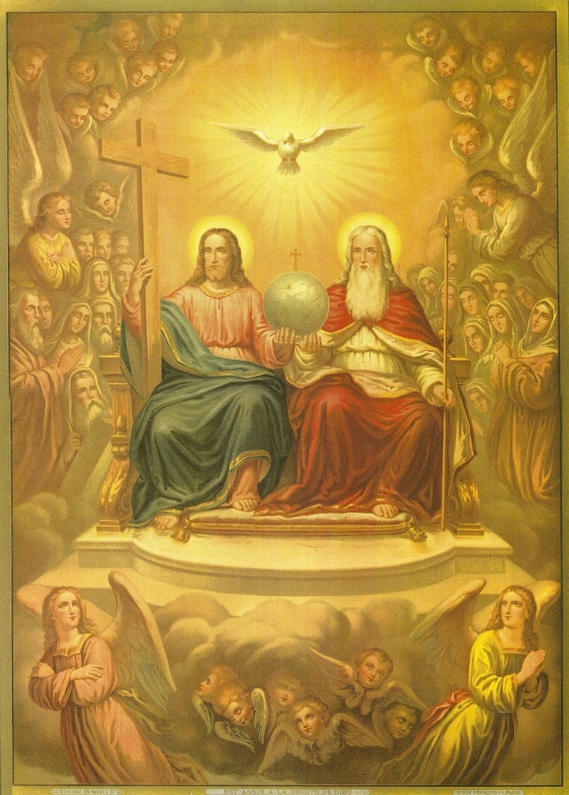
Blessed Son of God - (I Tim. 6:15)
Blessed = To confer a benefit on…fortunate, well off, happy.
Heb 12:2 “Looking unto Jesus the author and finisher of our faith; who for the joy that was set before him endured the cross, despising the shame, and is set down at the right hand of the throne of God.”

Slide 32
How to receive the blessing of God
Matt 5:3 Blessed are the poor in spirit: for theirs is the kingdom of heaven.
Matt 5:4 Blessed are they that mourn: for they shall be comforted.
Matt 5:5 Blessed are the meek: for they shall inherit the earth.
Matt 5:6 Blessed are they which do hunger and thirst after righteousness: for they shall be filled.

Slide 33
Matt 5:7 Blessed are the merciful: for they shall obtain mercy.
Matt 5:8 Blessed are the pure in heart: for they shall see God.
Matt 5:9 Blessed are the peacemakers: for they shall be called the children of God.
Matt 5:10 Blessed are they which are persecuted for righteousness' sake: for theirs is the kingdom of heaven.
Matt 5:11 Blessed are ye, when men shall revile you, and persecute you, and shall say all manner of evil against you falsely, for my sake

Slide 34
Luke 11:28 But he said, blessed are they that hear the word of God, and keep it.
Luke 12:37 Blessed are those servants, whom the lord when he cometh shall find watching.
John 20:29 Blessed are they that have not seen, and yet have believed.
Acts 20:35 Remember the words of the Lord Jesus, how he said, It is more blessed to give than to receive.
Rom. 4:7 Saying, Blessed are they whose iniquities are forgiven, and whose sins are covered.

Slide 35
Rev. 1:3 Blessed is he that readeth, and they that hear the words of this prophecy, and keep those things which are written therein: for the time is at hand.
Rev. 14:13 And I heard a voice from heaven saying unto me, Write, Blessed are the dead which die in the Lord.
Rev. 19:9 And he saith unto me, Write, Blessed are they which are called unto the marriage supper of the Lamb.
Rev. 22:14 Blessed are they that do his commandments, that they may have right to the tree of life, and may enter in through the gates into the city.

Slide 36
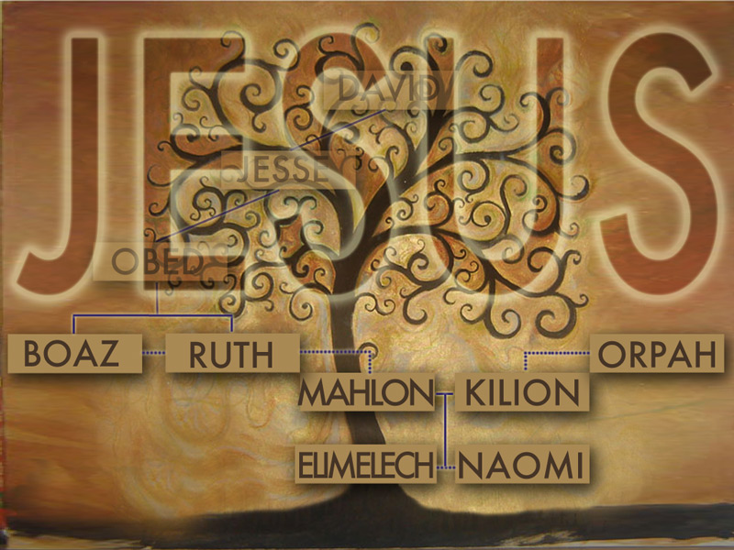
Branch - (Zech. 3:8)

Slide 37
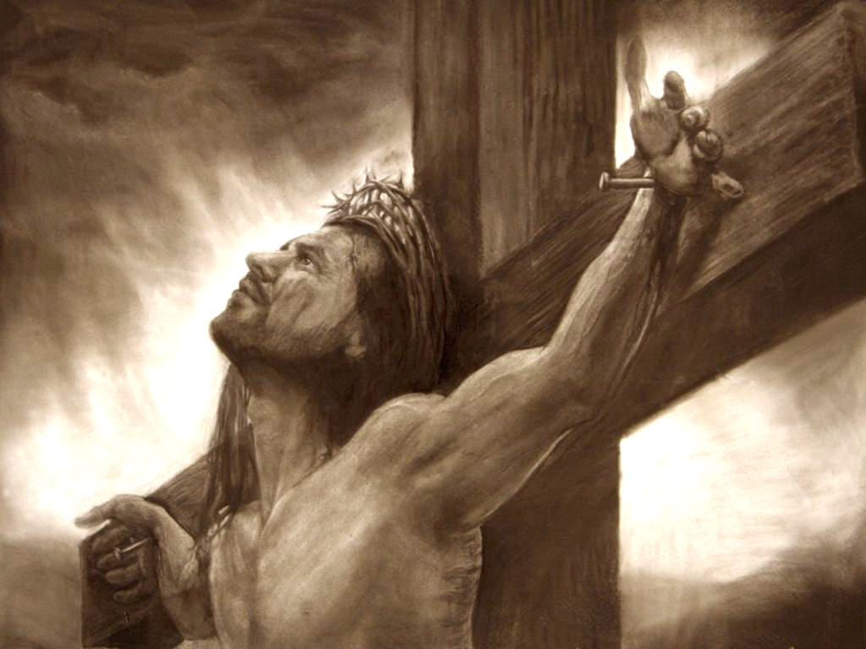
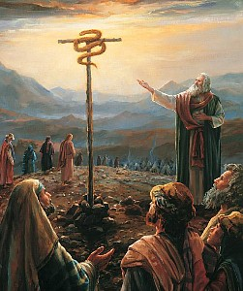
Brazen Serpent - (John 3:14)

Slide 38
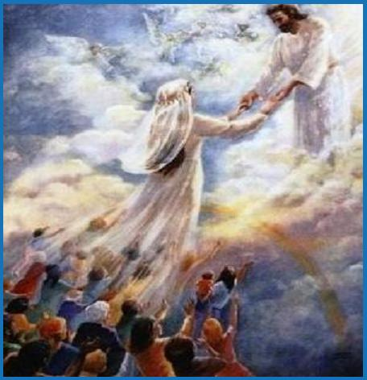
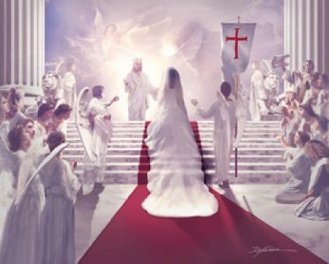
Bridegroom - (Matt. 9:15)

Slide 39
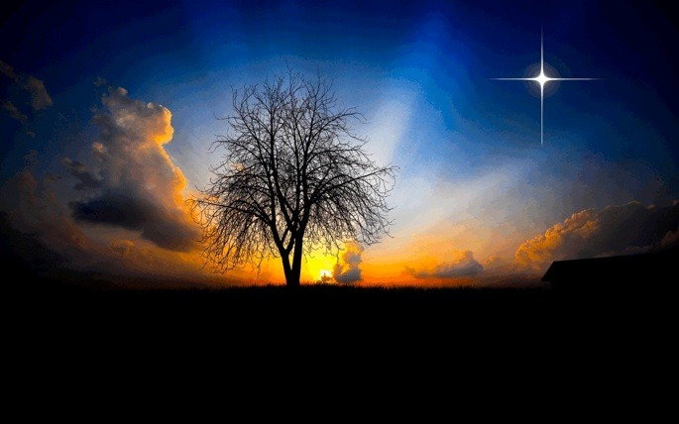
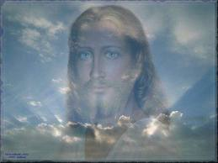
Bright Morning Star/ Day Star - (Rev. 22:16)
“For we have not followed cunningly devised fables, when we made known unto you the power and coming of our Lord Jesus Christ, but were eyewitnesses of his majesty. For he received from God the Father honour and glory, when there came such a voice to him from the excellent glory, This is my beloved Son, in whom I am well pleased. And this voice which came from heaven we heard, when we were with him in the holy mount. We have also a more sure word of prophecy; whereunto ye do well that ye take heed, as unto a light that shineth in a dark place, until the day dawn, and the day star arise in your hearts.” II Peter 1:16-19

Slide 40
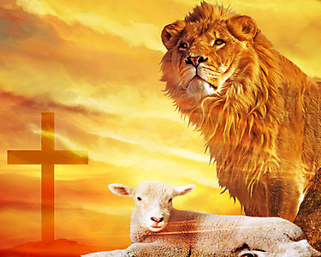

Slide 41
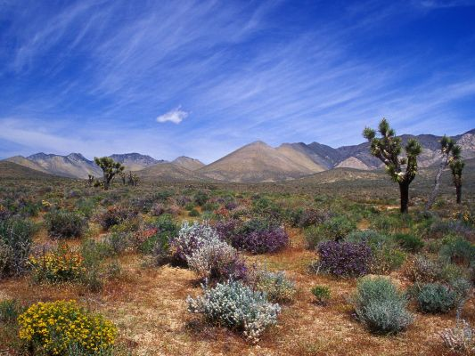

Slide 42
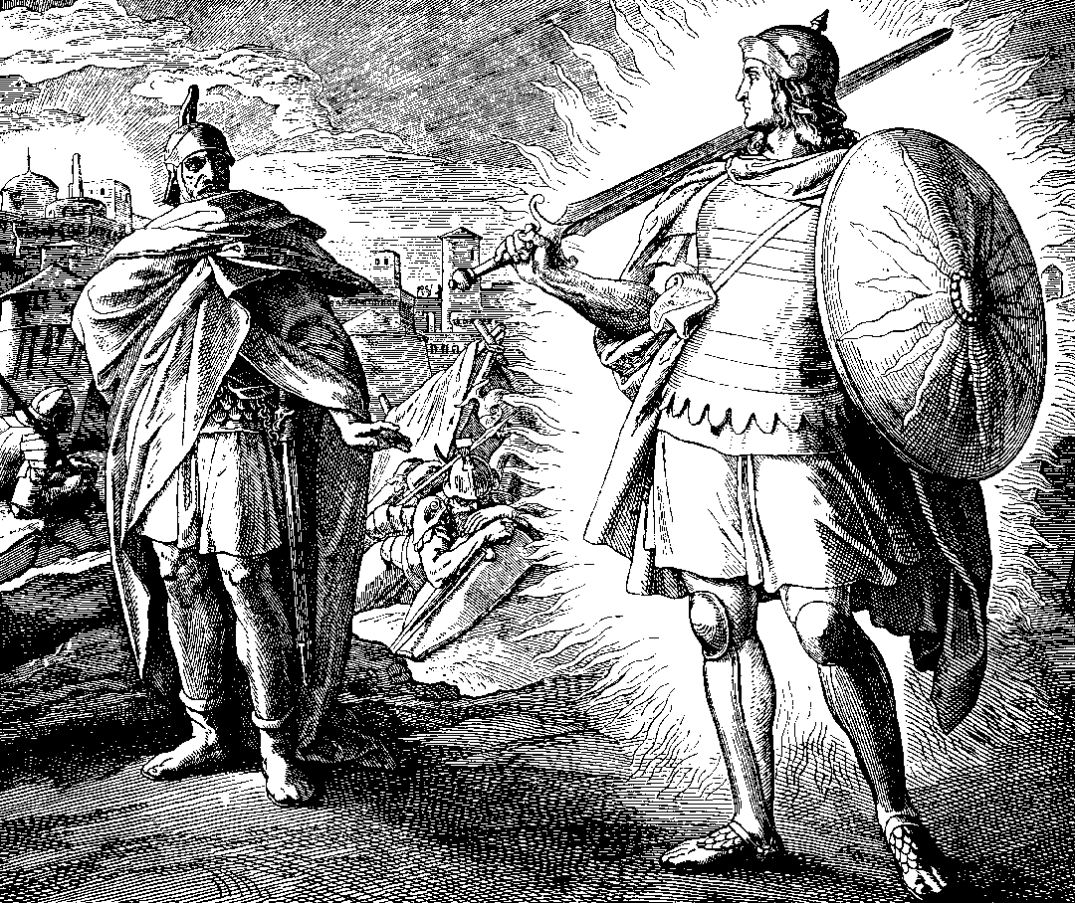
Captain of the host (army) of the Lord - (Josh. 5:13-15)

Slide 43
“And the armies which were in heaven followed him upon white horses, clothed in fine linen, white and clean.” Rev. 19:14

Slide 44
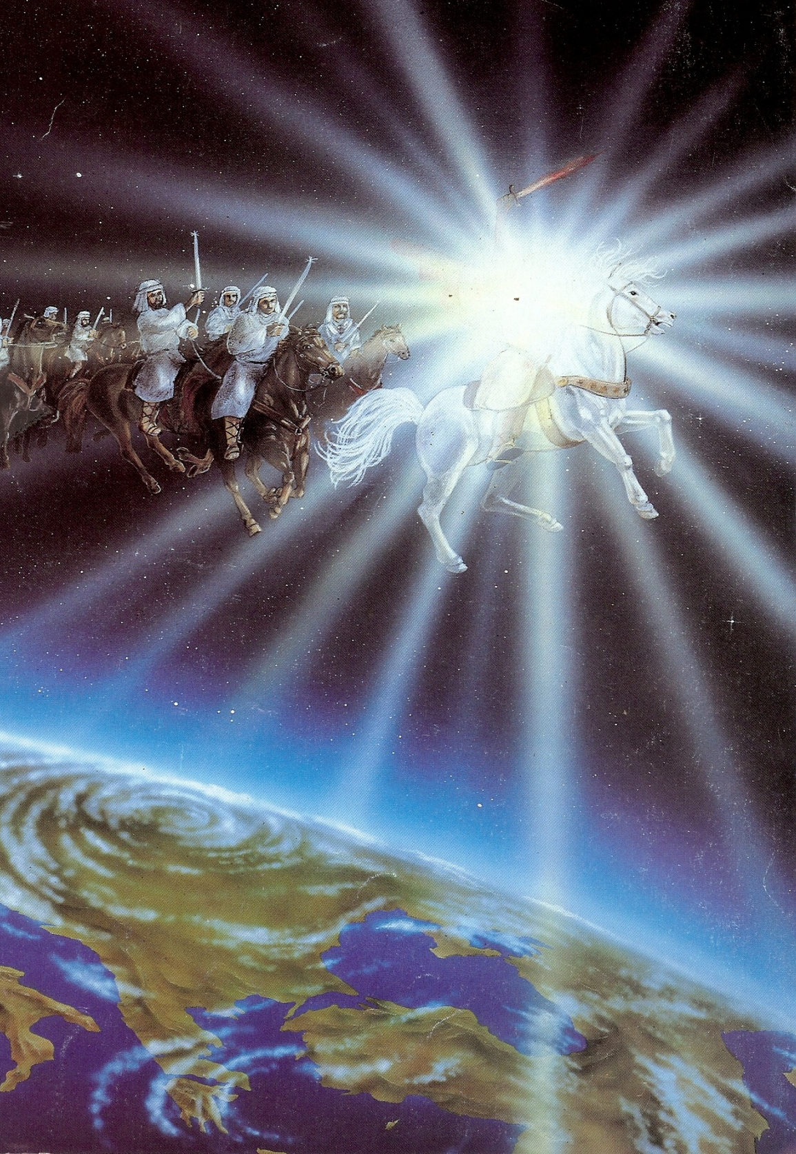
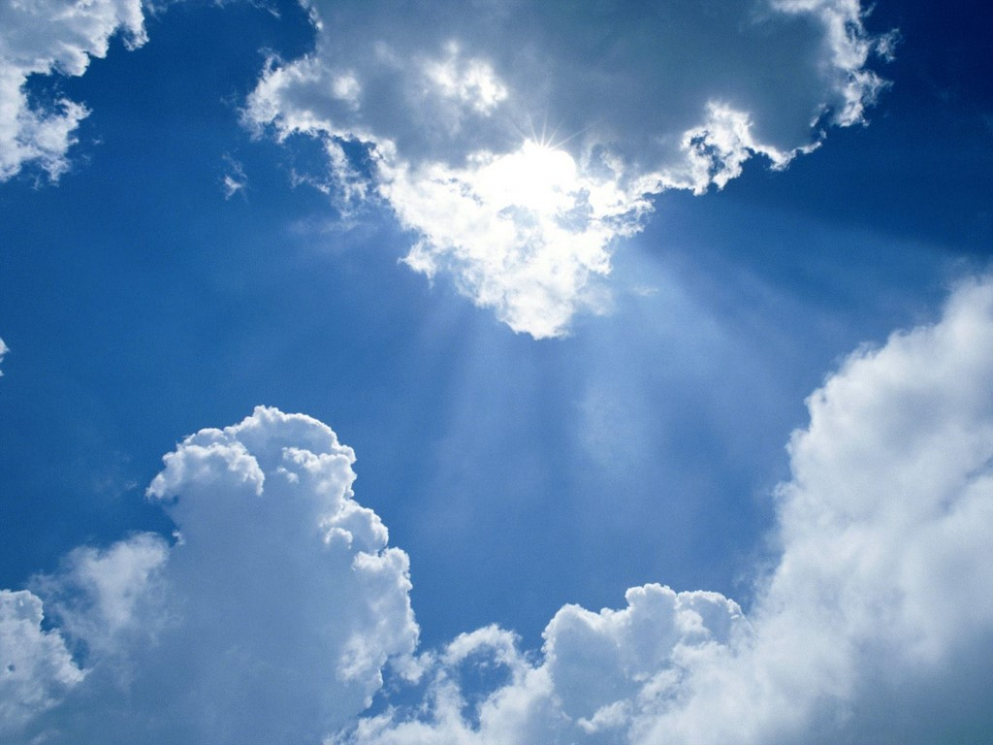

Slide 45
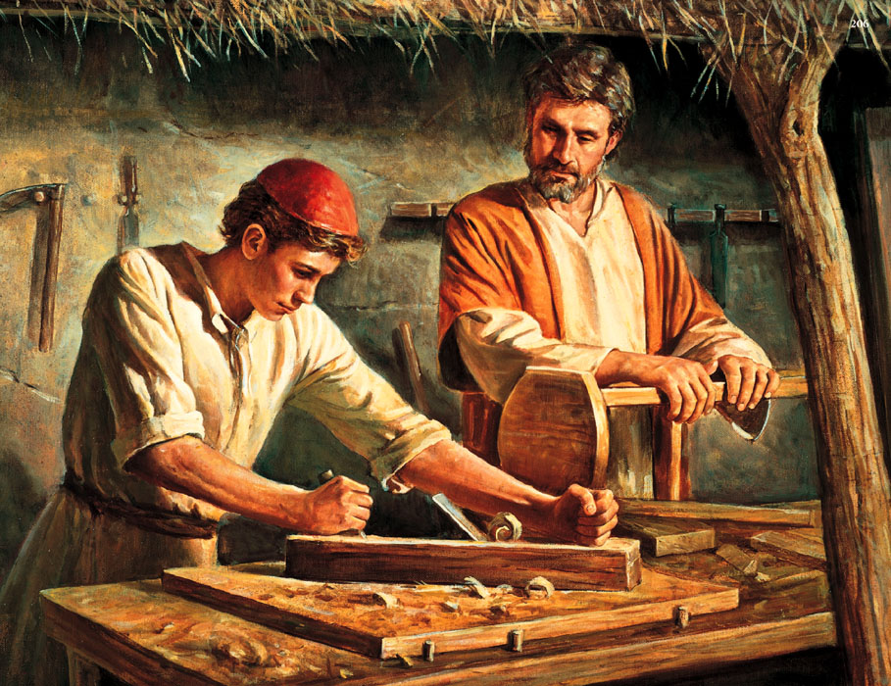
Carpenter and the Carpenter's son - (Mark 6:3; Matt. 13:55)

Slide 46
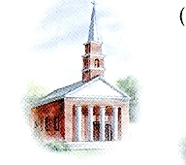
Matt.16:18 “Upon this rock I will build my church; and the gates of hell shall not prevail against it.”

Slide 47
“And he gave some, apostles; and some, prophets; and some, evangelists; and some, pastors and teachers; For the perfecting of the saints, for the work of the ministry, for the edifying of the body of Christ.” Ephesians 4:11-12

Slide 48
Creator of all things - (Col. 1:16)

Slide 49
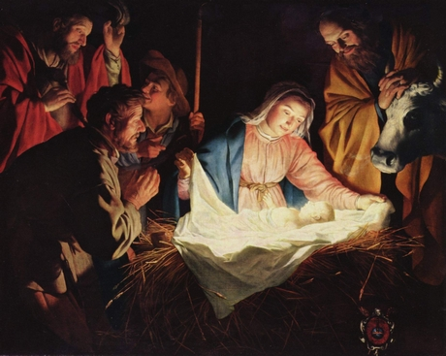
Child - (Isa. 9:6)

Slide 50
Christ - (Matt. 1:16)

Slide 51
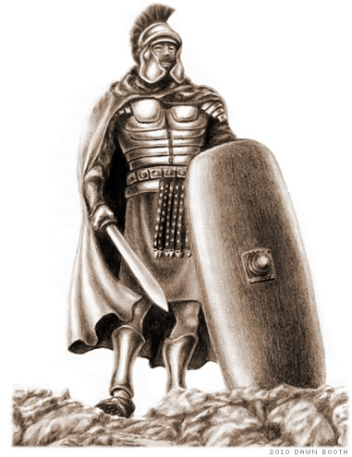
Commander (Chief / Leader) - (Isa. 55:4)

Slide 52
Consolation (hope) of Israel - (Luke 2:25)

Slide 53
Cornerstone - (Eph. 2:20)

Slide 55
Dayspring from on high - (Luke 1:78)
Dayspring = A light rising out of the darkness of the night. A dawning light.
Isa. 9:2 “The people that walked in darkness have seen a great light: they that dwell in the land of the shadow of death, upon them hath the light shined.”
John 8:12 “Then spake Jesus again unto them, saying, I am the light of the world: he that followeth me shall not walk in darkness, but shall have the light of life.”

Slide 56
Desire of nations - (Hag. 2:7)
Psalm 72:11 “Yea, all kings shall fall down before him: all nations shall serve him.”
Rev. 15:4 “Who shall not fear thee, O Lord, and glorify thy name? for thou only art holy: for all nations shall come and worship before thee; for thy judgments are made manifest.”

Slide 57
“And they sung a new song, saying, Thou art worthy to take the book, and to open the seals thereof: for thou wast slain, and hast redeemed us to God by thy blood out of every kindred, and tongue, and people, and nation” Revelation 5:9

Slide 58
Deliverer - (Rom. 11:26)

Slide 60
Door of the sheepfold - (John 10:7)

Slide 61
End of the Law of Righteousness - (Rom. 10:4)
“There is therefore now no condemnation to them which are in Christ Jesus…For what the law could not do, in that it was weak through the flesh, God sending his own Son in the likeness of sinful flesh, and for sin, condemned sin in the flesh.”
“Being justified freely by his grace through the redemption that is in Christ Jesus.”

Slide 62
Eternal God - (I Tim. 1:17)
“He that believeth on the Son hath everlasting life: and he that believeth not the Son shall not see life; but the wrath of God abideth on him.” John 3:36

Slide 63
Everlasting Father - (Isa. 9:6)

Slide 64
Express image of God - (Heb. 1:3)
“I and my Father are one. Then the Jews took up stones again to stone him. Jesus answered them, Many good works have I shewed you from my Father; for which of those works do ye stone me? The Jews answered him, saying, For a good work we stone thee not; but for blasphemy; and because that thou, being a man, makest thyself God.” John 10:30-33

Slide 65
Emmanuel - (Matt. 1:23)

Slide 66
Example - (I Pet. 2:21)
WWJD

Slide 67
Eternal - (I Tim. 1:17)
“While we look not at the things which are seen, but at the things which are not seen: for the things which are seen are temporal; but the things which are not seen are eternal.”
II Cor. 4:18

Slide 68
Faithful witness - (Rev. 1:5)
“After this, Jesus knowing that all things were now accomplished, that the scripture might be fulfilled, saith, I thirst.” John 19:28

Slide 69
“Be thou faithful unto death, and I will give thee a crown of life.” Rev. 2:10
crown of life

Slide 70
Finisher of our faith - (Heb. 12:12)

Slide 71
First Fruits - (I Cor. 15:23)
“Yet a little while, and the world seeth me no more; but ye see me: because I live, ye shall live also.” John 14:19

Slide 73
Foundation - (I Cor. 3:10-11)

Slide 74
Fountain for cleansing - (Zech. 13:1)
“The blood of Jesus Christ his Son cleanseth us from all sin.” I John 1:7

Slide 75
Forerunner - (Heb. 6:20)
“Wherein God, willing more abundantly to shew unto the heirs of promise the immutability of his counsel, confirmed it by an oath: That by two immutable things, in which it was impossible for God to lie, we might have a strong consolation, who have fled for refuge to lay hold upon the hope set before us: Which hope we have as an anchor of the soul, both sure and stedfast, and which entereth into that within the veil; Whither (in what place) the forerunner is for us entered, even Jesus.” Hebrews 6:17-20

Slide 78
Friend of sinners - (Matt. 11:19)

Slide 79
Great I AM - (John 8:24)

Slide 80
I AM: Jesus calls himself this name seven times in John’s Gospel:

Slide 81
1# I am the Bread of Life - (6:35)

Slide 82
2# I am the Light of the World - (9:5)

Slide 83
3# I am the Good Shepherd - (10:11)

Slide 84
4# I am the Resurrection and the Life - (11:25)

Slide 85
5# I am the Door - (10:9)

Slide 86
6# I am the true Vine - (15:1)

Slide 88
The secret of the vine (John 15)
The secret of fruit bearing is abiding
The secret of abiding is obeying
The secret of obeying is loving
The secret of loving is knowing

Slide 89
7# I am the Way, the Truth and the Life - (14:6)

Slide 90
Adam (second or last) - (I Cor. 15:45)
Almighty God - (Rev. 1:8)
Ancient of Days - (Dan. 7:22)
Author of Eternal Salvation - (Heb. 5:9)
Amen - (Rev. 3:14)
Angel of the Lord - (Gen. 16:9-14)
Anointed King - (Psalm 2:2)
Babe - (Luke 2:16)
Beginning of creation - (Rev. 3:14)
Beginning and the end - (Rev. 22:13)

Slide 91
Begotten of Father - (John 1:14)
Beloved - (Matt. 3:17)
Bishop of our souls - (I Pet. 2:25)
Blessed Son of God - (I Tim. 6:15)
Branch - (Zech. 3:8)
Brazen Serpent - (John 3:14)
Bridegroom - (Matt. 9:15)
Bright Morning Star/ Day Star - (Rev. 22:16)
Captain of the host (army) of the Lord - (Josh. 5:4)

Slide 92
Carpenter and the Carpenter's son - (Mark 6:3; Matt. 13:55)
Creator of all things - (Col. 1:16)
Child - (Isa. 9:6)
Christ - (Matt. 1:16)
Commander (leader) - (Isa. 55:4)
Consolation (hope) of Israel - (Luke 2:25)
Cornerstone - (Eph. 2:20)
Dayspring from on high - (Luke 1:78)
Desire of nations - (Hag. 2:7)

Slide 93
Deliverer - (Rom. 11:26)
Door of the sheepfold - (John 10:7)
End of the Law of Righteousness - (Rom. 10:4)
Eternal God - (I Tim. 1:17)
Everlasting Father - (Isa. 9:6)
Express image of God - (Heb. 1:3)
Emmanuel - (Matt. 1:23)
Example - (I Pet. 2:21)
Eternal - (I Tim. 1:17)
Faithful witness - (Rev. 1:5)

Slide 94
Finisher of our faith - (Heb. 12:12)
First Fruits - (I Cor. 15:23)
Foundation - (I Cor. 3:10-11)
Fountain for cleansing - (Zech. 13:1)
Forerunner - (Heb. 6:20)
Friend of sinners - (Matt. 11:19)
Great I AM - (John 8:24)

