Slide 1
The Doctrine of Man (Part 3)
His Original Duties
and Responsibilities

Slide 4
Job 7:17 “What is man, that thou shouldest magnify him? and that thou shouldest set thine heart upon him?”
Job 15:14 “What is man, that he should be clean? and he which is born of a woman, that he should be righteous?”
Ps. 8:4 “What is man, that thou art mindful of him? and the son of man, that thou visitest him?”
Ps. 144:3 “LORD, what is man, that thou takest knowledge of him! or the son of man, that thou makest account of him!”
Heb. 2:6 “But one in a certain place testified, saying, What is man, that thou art mindful of him? or the son of man, that thou visitest him?”

Slide 6
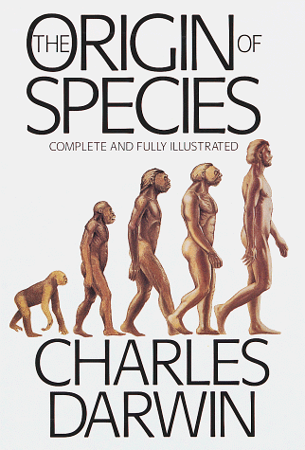
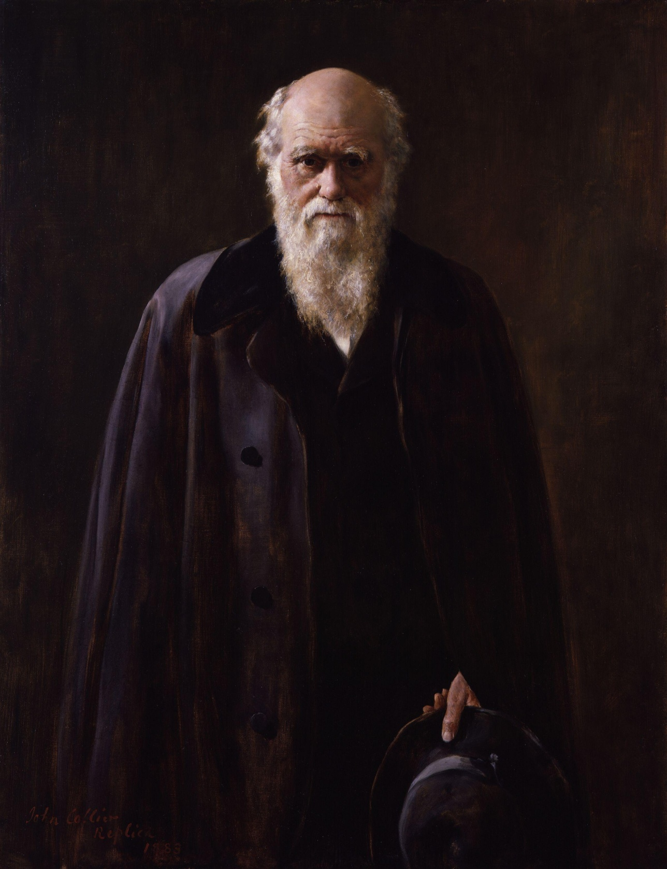

Slide 7
Rom. 1:21-24 “Because that, when they knew God, they glorified him not as God, neither were thankful; but became vain in their imaginations, and their foolish heart was darkened. Professing themselves to be wise, they became fools, And changed the glory of the uncorruptible God into an image made like to corruptible man, and to birds, and fourfooted beasts, and creeping things. Wherefore God also gave them up to uncleanness through the lusts of their own hearts, to dishonour their own bodies between themselves.”

Slide 9
John 1:1-4
“In the beginning was the Word, and the Word was with God, and the Word was God. The same was in the beginning with God. All things were made by him; and without him was not any thing made that was made. In him was life; and the life was the light of men.”

Slide 10
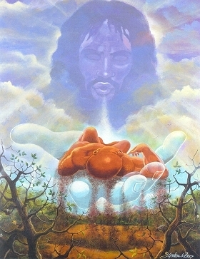
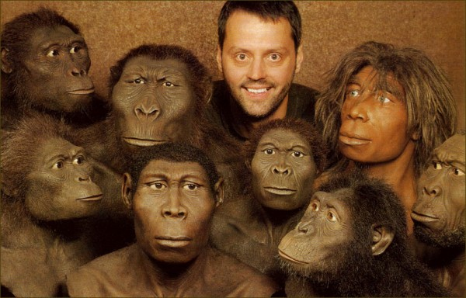

Slide 11
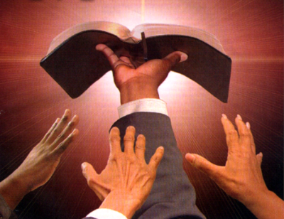
“Thy Word is Truth…”

Slide 12
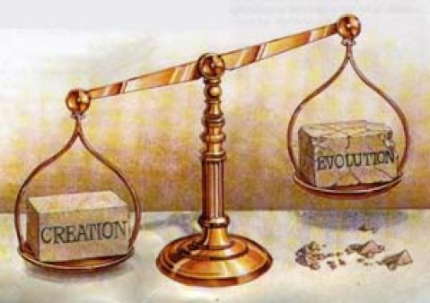

Slide 14
"And God said, Let us make man in our image, after our likeness; and let them have dominion over the fish of the sea, and the fowl of the air, and over the cattle, and over all the earth, and over every creeping thing that creepeth upon the earth. So God created man in his own image, in the image of God created he him; male and female created he them" (Gen. 1:26, 27)

Slide 15
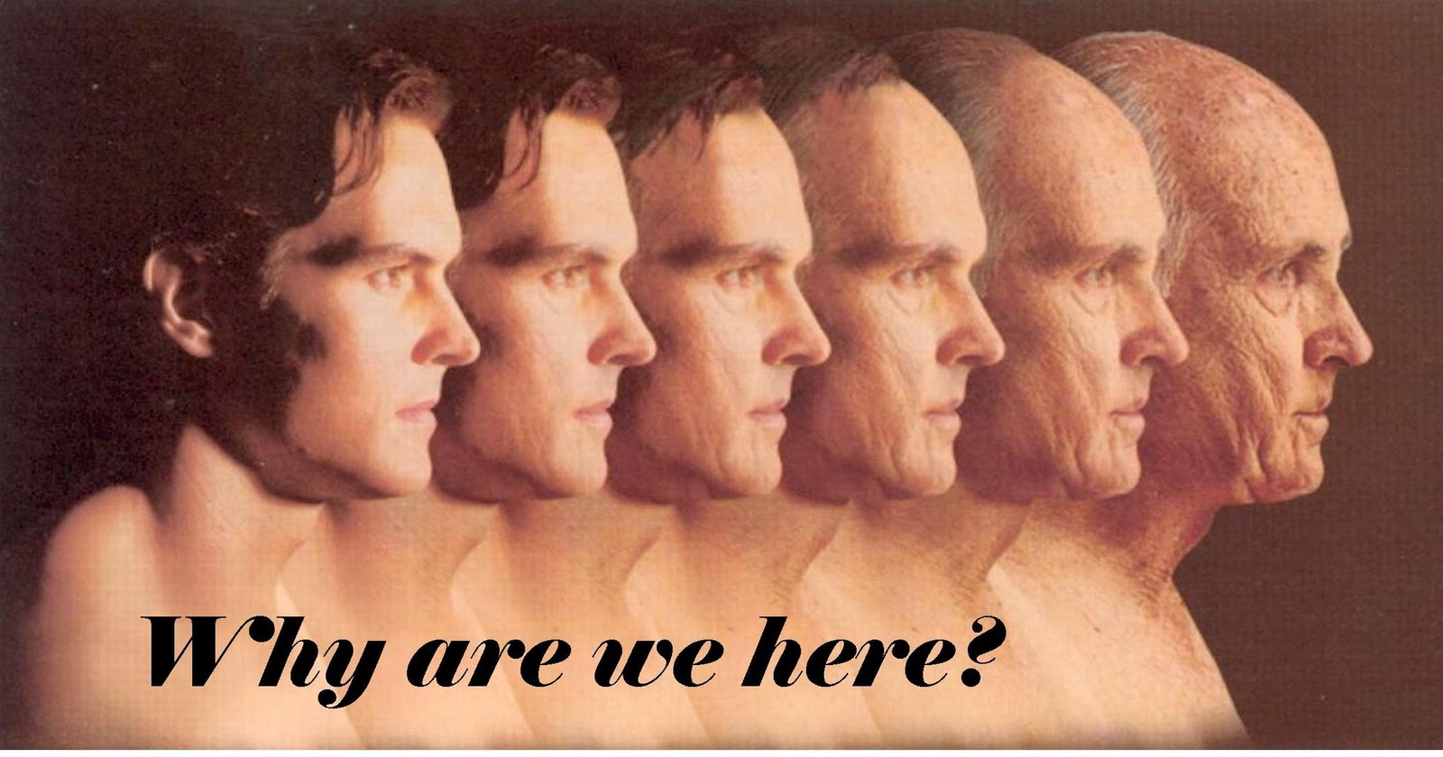

Slide 16
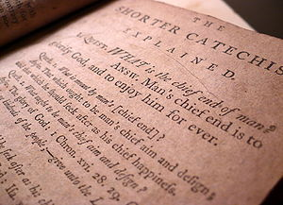

Slide 18
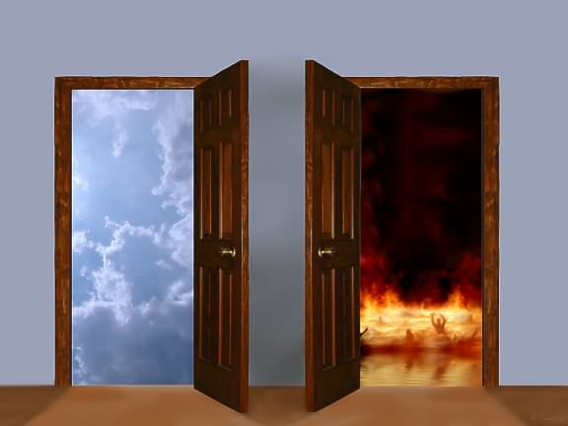

Slide 19
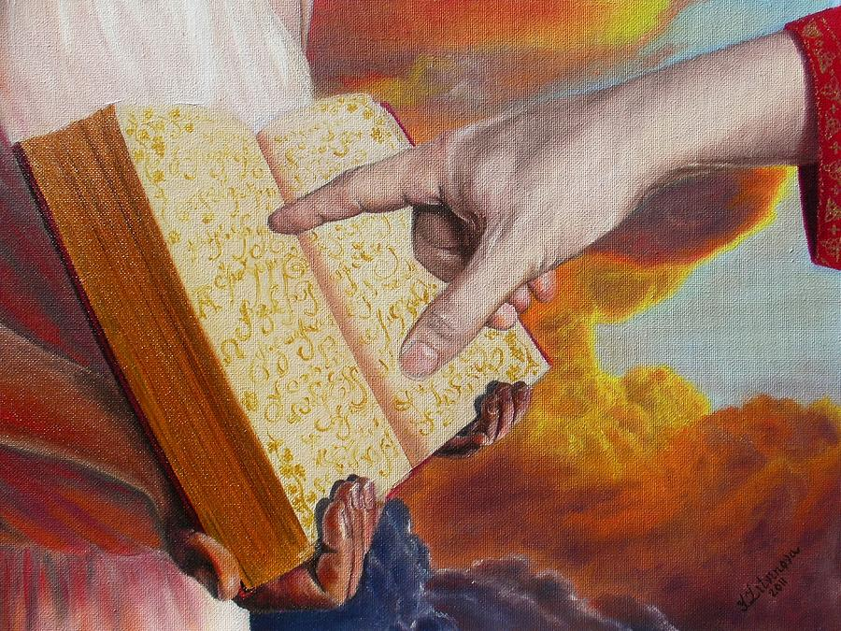
Rev. 20:15
“And whosoever was not found written in the book of life was cast into the lake of fire.”

Slide 20
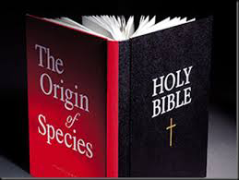

Slide 23
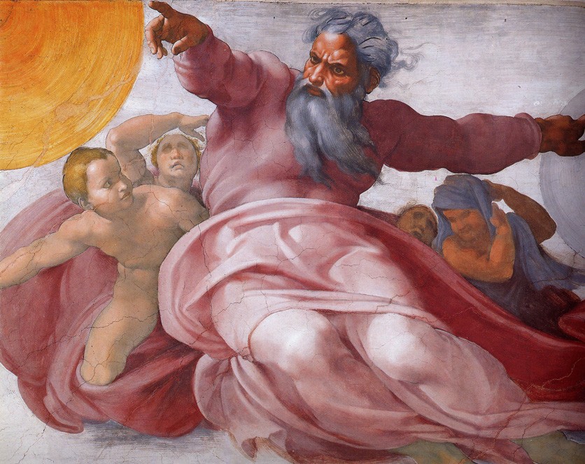
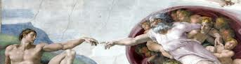
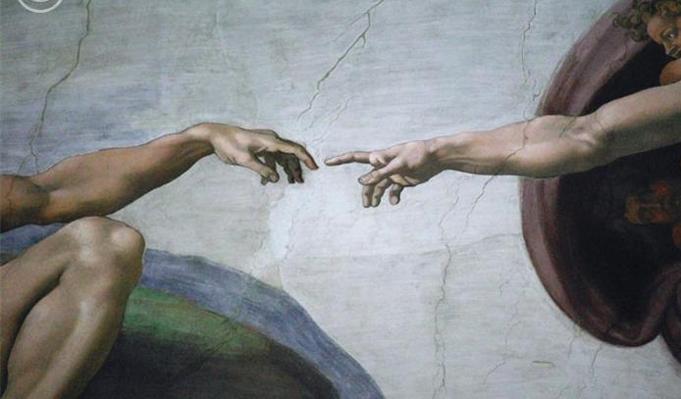
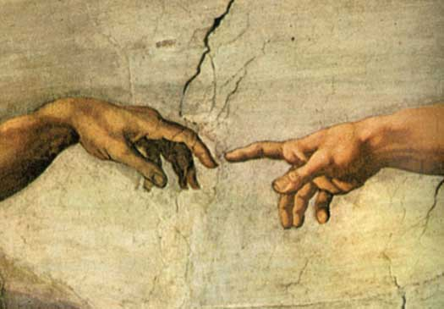
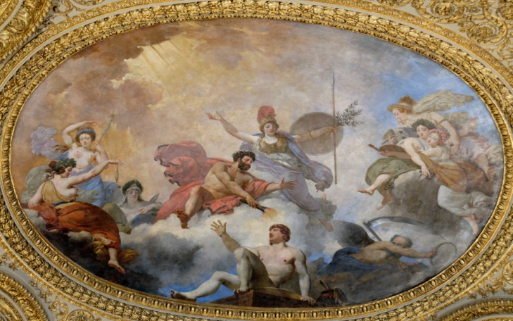
"And God said, Let us make man in our image, after our likeness; and let them have dominion over the fish of the sea, and the fowl of the air, and over the cattle, and over all the earth, and over every creeping thing that creepeth upon the earth. So God created man in his own image, in the image of God created he him; male and female created he them.” Gen. 1:26-27

Slide 24
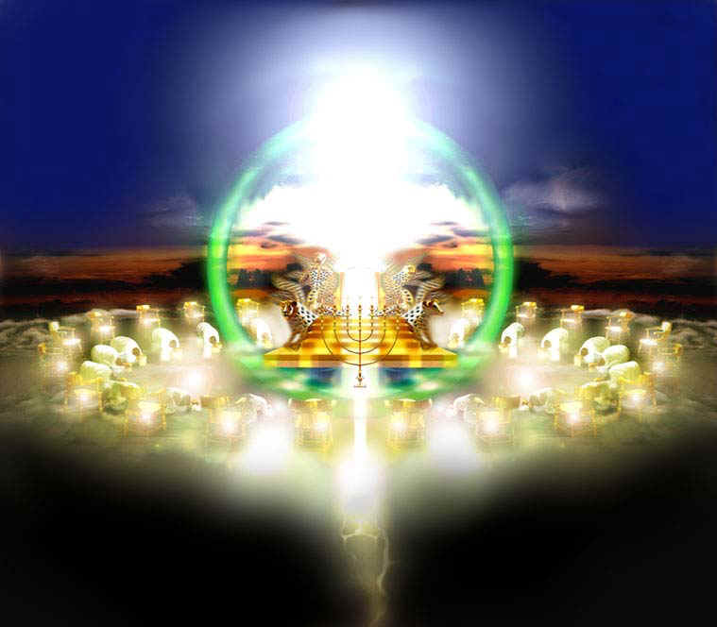
The expression "image of God" does not refer to physical likeness because "God is a spirit" (John 4:24) and He is “invisible” - (Col.1:15; I Tim.1:17).
“God is light and in Him is no darkness at all…” I John 1:5

Slide 25
If man does not bear the physical likeness and image of God, what likeness and image does he bear?

Slide 26
First, the truth about you is that you are creative because God is creative: "In the beginning God created the heavens and the earth" (Genesis 1:1).
The second truth about you is that you are spiritual because God is Spirit: "The Spirit of God was hovering over the waters" (Genesis 1:2).
A third truth about you is that you communicate because God communicates: "God said…” (Genesis 1:3).

Slide 27
A fourth truth about you is that you are intelligent because God is intelligent – Jude 1:25
A fifth truth about you is that you are relational because God is relational: “Let us make man in our image, in our likeness...It is not good for man to be alone…And they heard the voice of the LORD God walking in the garden in the cool of the day: and Adam and his wife hid themselves from the presence of the LORD God amongst the trees of the garden.”

Slide 28
A sixth truth about you is that you are morally responsible because God is a moral being (He is a Holy God) – Isa. 5:16 “But the LORD of hosts shall be exalted in judgment, and God that is holy shall be sanctified in righteousness.”
“Be ye holy for I am holy…” Because God is a moral being, we are to reflect his holy nature in our lives.

Slide 30
Use your creativity for the Glory of God – “Do all to the glory of God.”
Use your spiritual nature to seek the Lord – “If from thence thou shalt seek the LORD thy God, thou shalt find him, if thou seek him with all thy heart and with all thy soul.”
Use your communicative abilities to witness for the Lord – “Ye shall be witnesses of me…”
Use intelligence to serve the Lord – “So then with the mind I myself serve the law of God.”
Use your relationships to exalt the Lord – “Let us exalt his name together…”

Slide 31
6. Use your moral nature to seek after holiness - II Cor. 7:1 “Having therefore these promises, dearly beloved, let us cleanse ourselves from all filthiness of the flesh and spirit, perfecting holiness in the fear of God.

Slide 33
Is man a trichotomous (three-part) being? That is, does he consist of body, soul and spirit?

Slide 34
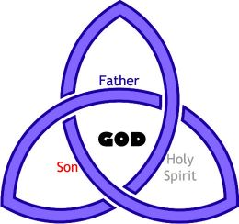
Three persons of the Godhead

Slide 35
Will
(Luke 22:42)
Intellect
(I Cor. 2:16)
God
Emotion
(Psalm 7:11)

Slide 36
The three elements of personality are
Intellect
Emotion
Will

Slide 37
Will
(Hebrews 10:26)
Intellect
(Romans 8:7)
Man/Soul
(Hebrews 4:12)
Emotion
(II Corinthians 6:11-13)

Slide 38
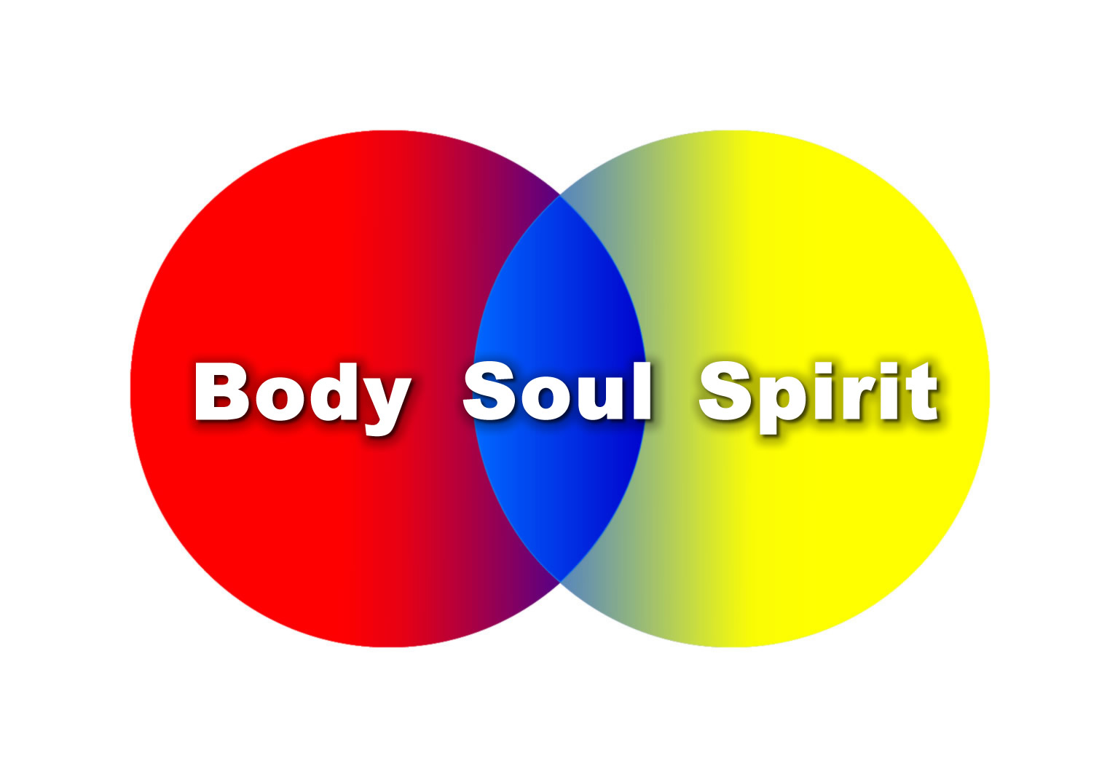

Slide 39
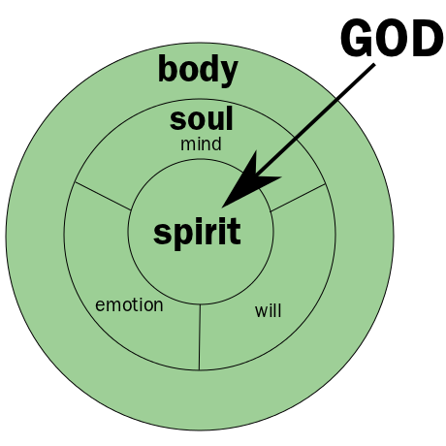

Slide 41
Man’s Original Duties and Responsibilities

Slide 42
Why did God create man?

Slide 43
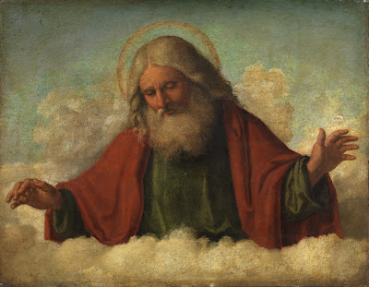
Before giving the various reasons, it should be stated that God did not make man because he was lonely!

Slide 44
Long before He created angels or man, the Father was having blessed fellowship with his beloved Son.

Slide 45
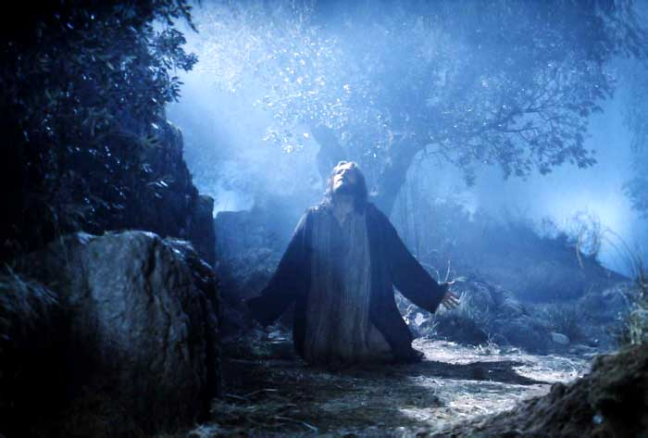
"And now, O Father, glorify thou me with thine own self with the glory which I had with thee before the world was. Father, I will that they also, whom thou hast given me, be with me where I am; that they may behold my glory, which thou hast given me: for thou lovedst me before the foundation of the world" (John 17:5, 24).

Slide 46
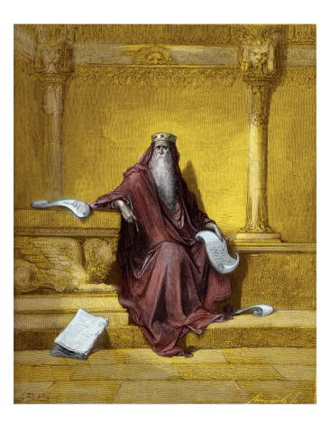
(Proverbs 8:22-30)

Slide 47
"The Lord possessed me in the beginning of his way, before his works of old. I was set up from everlasting, from the beginning, or ever the earth was. When there were no depths, I was brought forth; when there were no fountains abounding with water. Before the mountains were settled, before the hills was I brought forth: while as yet he had not made the earth, nor the fields, nor the highest part of the dust of the world. When he prepared the heavens,

Slide 48
I was there: when he set a compass upon the face of the depth: when he established the clouds above: when he strengthened the fountains of the deep: when he gave to the sea his decree, that the waters should not pass his commandment: when he appointed the foundations of the earth: Then I was by him, as one brought up with him: and I was daily his delight, rejoicing always before him"

Slide 49
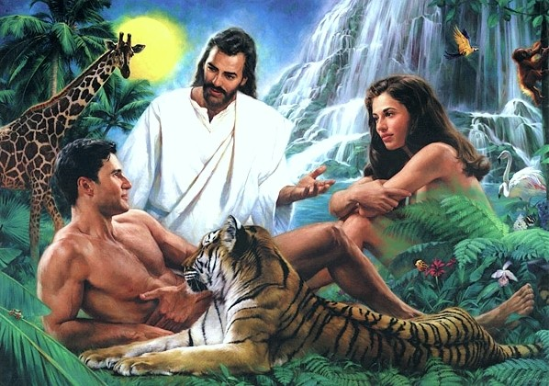
But why, then,
did God create man?

Slide 50
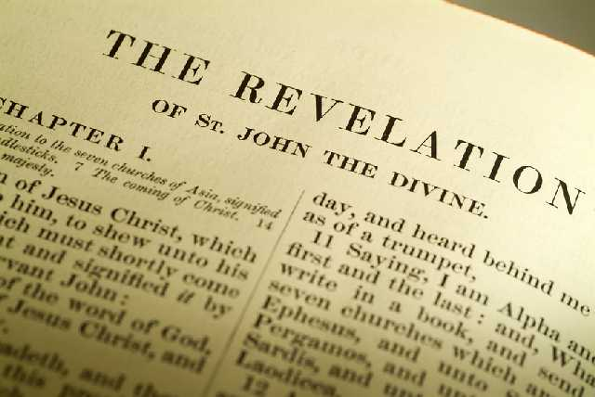
“Thou art worthy, O Lord, to receive glory and honour and power: for thou hast created all things, and for thy pleasure they are and were created.” (Rev. 4:11)

Slide 51
Man was created to bring God Pleasure
Psalm 5:4 “For thou art not a God that hath pleasure in wickedness: neither shall evil dwell with thee.”
Psalm 103:21 “Bless ye the LORD, all ye his hosts; ye ministers of his, that do his pleasure.”
Psalm 147:11 “The LORD taketh pleasure in them that fear him, in those that hope in his mercy.”
Psalm 149:4 “For the LORD taketh pleasure in his people: he will beautify the meek with salvation.”

Slide 52
“Furthermore then we beseech you, brethren, and exhort you by the Lord Jesus, that as ye have received of us how ye ought to walk and to please God, so ye would abound more and more.” (I Thess. 4:1)

Slide 53
“So then they that are in the flesh cannot please God.” (Romans 8:8)

Slide 54
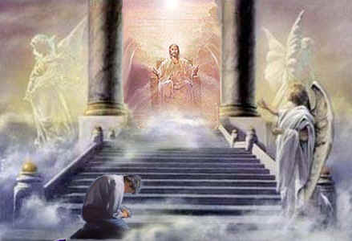

Slide 55
(II Corinthians 5:7-10)
“For we walk by faith, not by sight: We are confident, I say, and willing rather to be absent from the body, and to be present with the Lord. Wherefore we labour, that, whether present or absent, we may be accepted of him. For we must all appear before the judgment seat of Christ; that every one may receive the things done in his body, according to that he hath done, whether it be good or bad.”

Slide 56
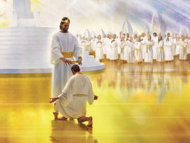

Slide 57
How do we bring pleasure to God?

Slide 58
I Cor. 7:32 “But I would have you without carefulness. He that is unmarried careth for the things that belong to the Lord, how he may please the Lord.”
II Tim. 2:4 “No man that warreth entangleth himself with the affairs of this life; that he may please him who hath chosen him to be a soldier.”
Heb 11:6 “But without faith it is impossible to please him.”
Gal. 1:10 “For do I now persuade men, or God? or do I seek to please men? for if I yet pleased men, I should not be the servant of Christ.”

Slide 60
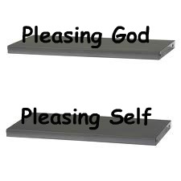
Who are you seeking to please?
Rom. 15:1 “We then that are strong ought to bear the infirmities of the weak, and not to please ourselves.”

Slide 61
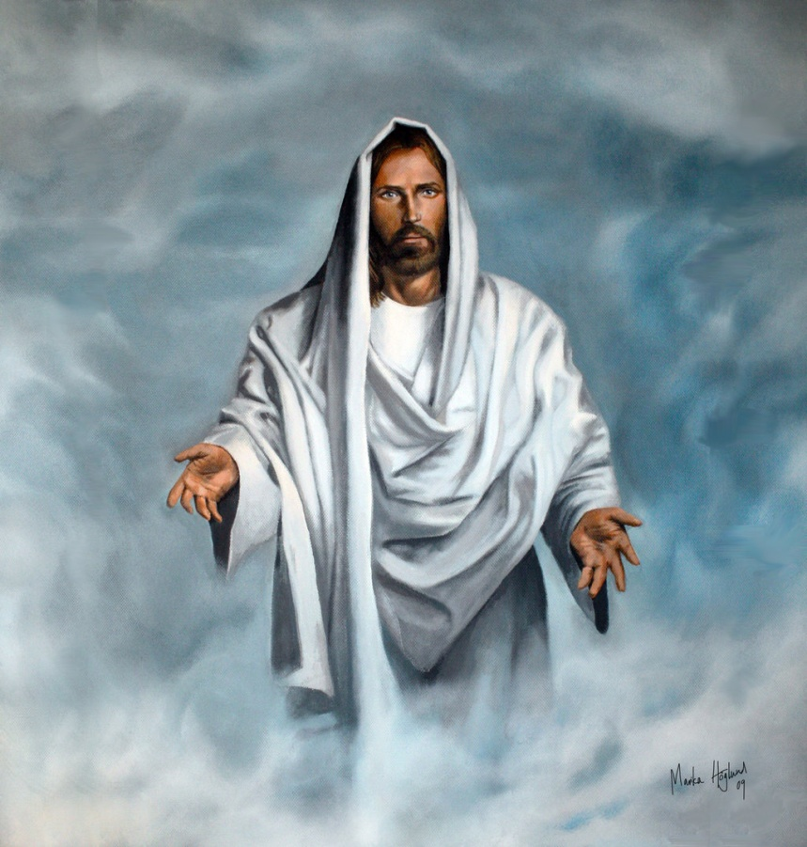
“And he that sent me is with me: the Father hath not left me alone; for I do always those things that please him.” (John 8:29)

Slide 62
“For even hereunto were ye called: because Christ also suffered for us, leaving us an example, that ye should follow his steps.” (I Peter 2:21)

Slide 64
The only way to bring pleasure to God is by fulfilling our God given duties and responsibilities.

Slide 65
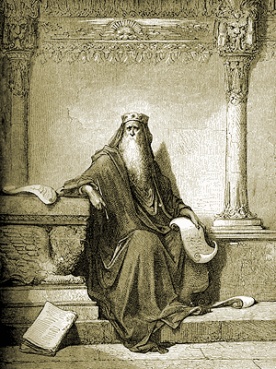
“Let us hear the conclusion of the whole matter: Fear God, and keep his commandments: for this is the whole duty of man.” (Eccl. 12:13)

Slide 66
“But which of you, having a servant plowing or feeding cattle, will say unto him by and by, when he is come from the field, Go and sit down to meat? And will not rather say unto him, Make ready wherewith I may sup, and gird thyself, and serve me, till I have eaten and drunken; and afterward thou shalt eat and drink? Doth he thank that servant because he did the things that were commanded him? I trow not. So likewise ye, when ye shall have done all those things which are commanded you, say, We are unprofitable servants: we have done that which was our duty to do.” (Luke 17:7-10)

Slide 67
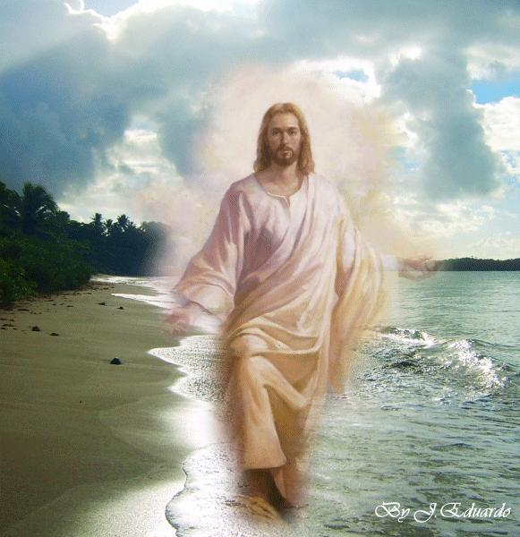
“For unto whomsoever much is given, of him shall be much required.” (Luke12:48)

Slide 68
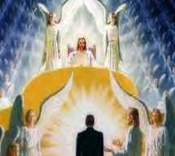
“And he called him, and said unto him, How is it that I hear this of thee? give an account of thy stewardship.” (Luke 16:2)

Slide 69
Upon His creation of Man God gave Him the following duties and responsibilities:

Slide 70
1# Man was to assume the headship over all nature
"And God said, Let us make man in our image, after our likeness: and let them have dominion over the fish of the sea, and over the fowl of the air, and over the cattle, and over all the earth, and over every creeping thing that creepeth upon the earth" (Gen.1:26).

Slide 71
The New Testament makes it clear that man was made to eventually assume headship over the entire universe. (Heb. 2:5-8)

Slide 72
“For unto the angels hath he not put in subjection the world to come, whereof we speak. But one in a certain place testified, saying, What is man, that thou art mindful of him? or the son of man, that thou visitest him? Thou madest him a little lower than the angels; thou crownedst him with glory and honour, and didst set him over the works of thy hands: Thou hast put all things in subjection under his feet. For in that he put all in subjection under him, he left nothing that is not put under him. But now we see not yet all things put under him.”

Slide 73
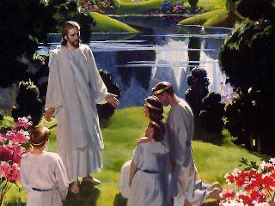
“Do ye not know that the saints shall judge the world? and if the world shall be judged by you, are ye unworthy to judge the smallest matters? Know ye not that we shall judge angels? How much more things that pertain to this life? ” (I Cor. 6:2-3)

Slide 74
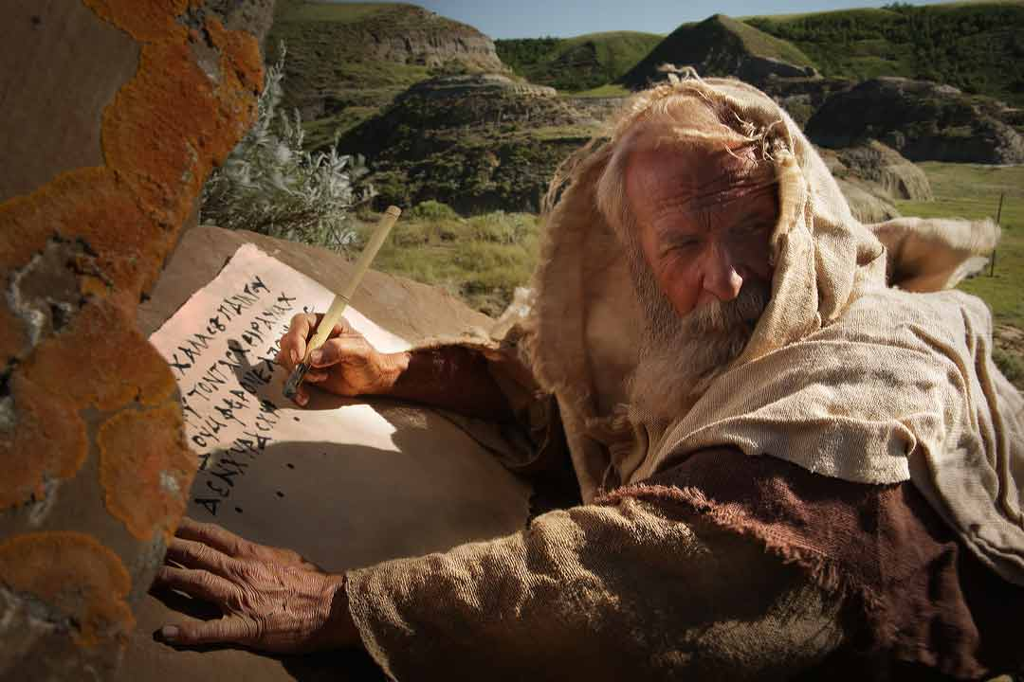
“And I saw thrones, and they sat upon them, and judgment was given unto them…”

Slide 75
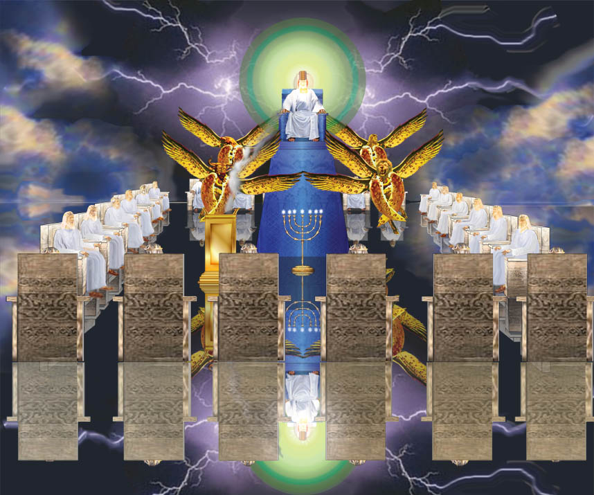

Slide 76
“…and I saw the souls of them that were beheaded for the witness of Jesus, and for the word of God, and which had not worshipped the beast, neither his image, neither had received his mark upon their foreheads, or in their hands; and they lived and reigned with Christ a thousand years….”

Slide 77
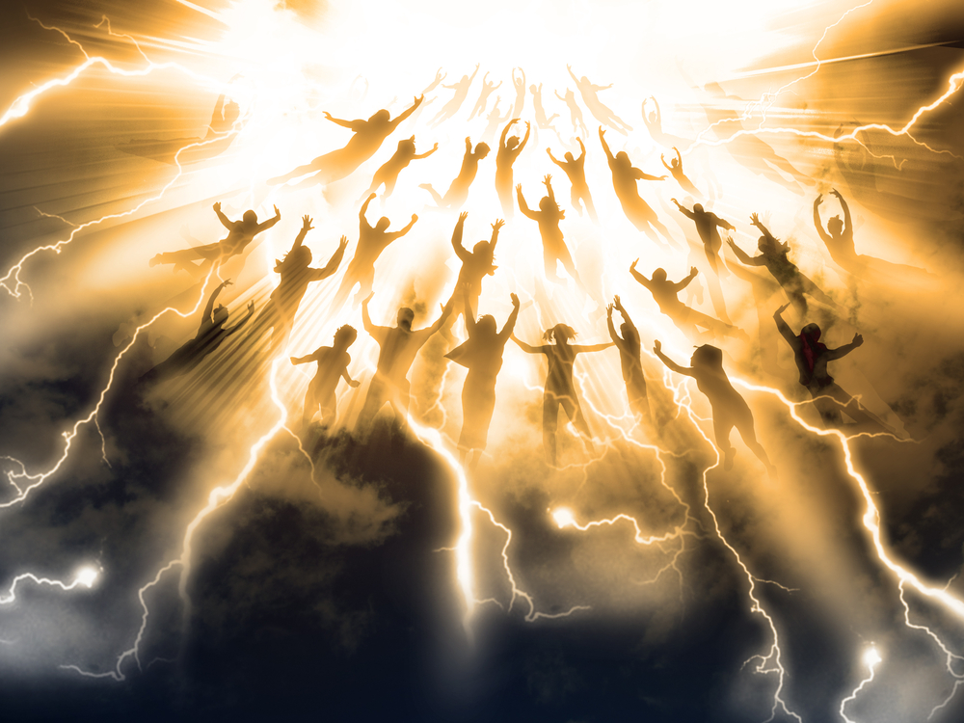
“Blessed and holy is he that hath part in the first resurrection: on such the second death hath no power, but they shall be priests of God and of Christ, and shall reign with him a thousand years.” (Rev. 20:6)

Slide 78
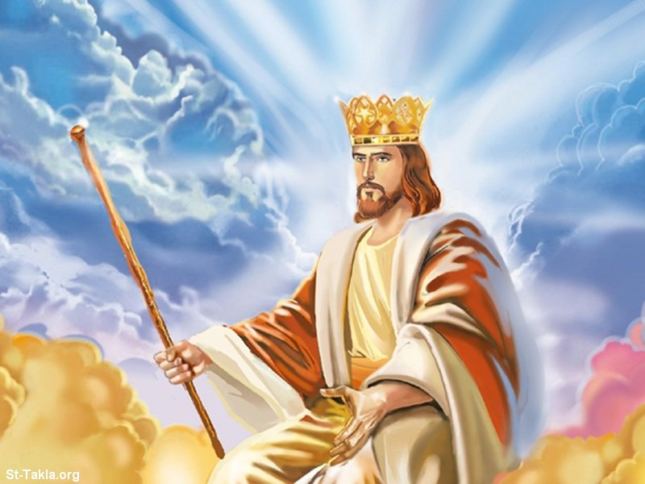

Slide 79
2# Man was to make his headquarters in Eden and especially to care for this beautiful garden paradise.
"And the Lord God took the man, and put him into the garden of Eden to dress it and to keep it" (Gen. 2:15)

Slide 80
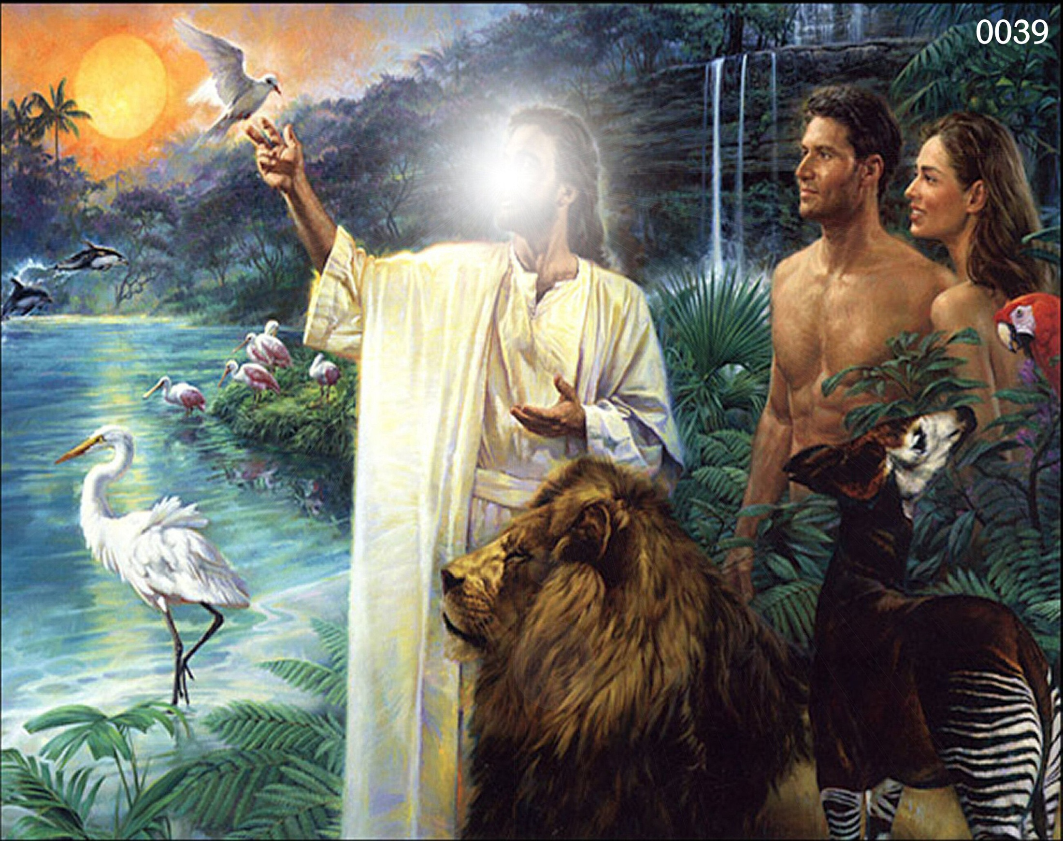

Slide 81
“For even when we were with you, this we commanded you, that if any would not work, neither should he eat.” (II Thess. 3:10)

Slide 82
3# Man was to provide names for every living creature.
"And out of the ground the Lord God formed every beast of the field, and every fowl of the air; and brought them unto Adam to see what he would call them: and whatsoever Adam called every living creature, that was the name thereof. And Adam gave names to all cattle, and to the fowl of the air, and to every beast of the field; but for Adam there was not found a help meet for him" (Gen. 2:19-20)

Slide 83
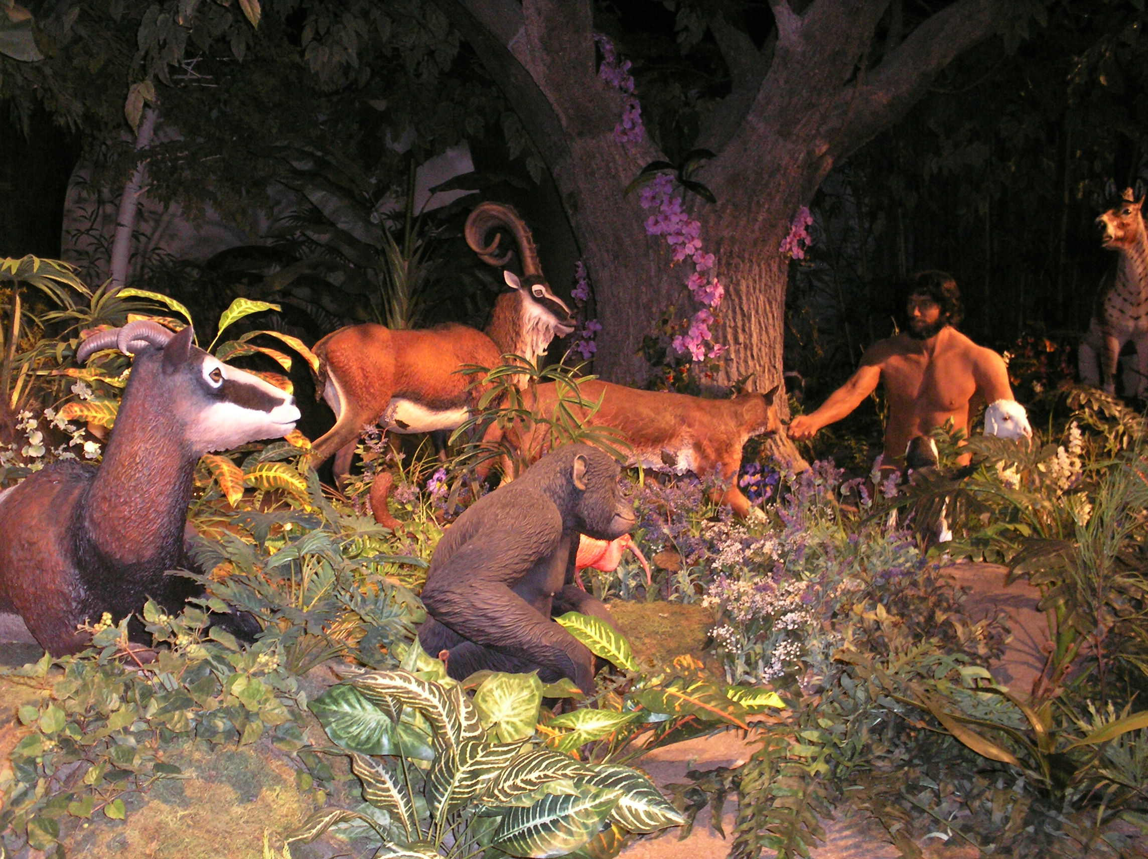

Slide 84
4# Man was to love and protect his wife and his wife was to love and submit to her husband
"Therefore shall a man leave his father and his mother, and shall cleave unto his wife: and they shall be one flesh" (Gen. 2:24)
“…thy desire shall be to thy husband, and he shall rule over thee.” (Gen. 3:16)

Slide 85
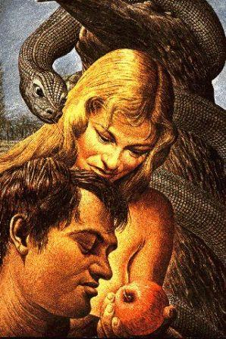

Slide 86
“Wives, submit yourselves unto your own husbands, as unto the Lord. For the husband is the head of the wife, even as Christ is the head of the church: and he is the saviour of the body. Therefore as the church is subject unto Christ, so let the wives be to their own husbands in every thing. Husbands, love your wives, even as Christ also loved the church, and gave himself for it; That he might sanctify and cleanse it with the washing of water by the word, That he might present it to himself a glorious church, not having spot, or wrinkle, or any such thing; but that it should be holy and without blemish. So ought men to love their wives as their own bodies. He that loveth his wife loveth himself. For no man ever yet hated his own flesh; but nourisheth and cherisheth it, even as the Lord the church: For we are members of his body, of his flesh, and of his bones. For this cause shall a man leave his father and mother, and shall be joined unto his wife, and they two shall be one flesh. This is a great mystery: but I speak concerning Christ and the church. Nevertheless let every one of you in particular so love his wife even as himself; and the wife see that she reverence her husband.” (Ephesians 5:22-33)

Slide 87
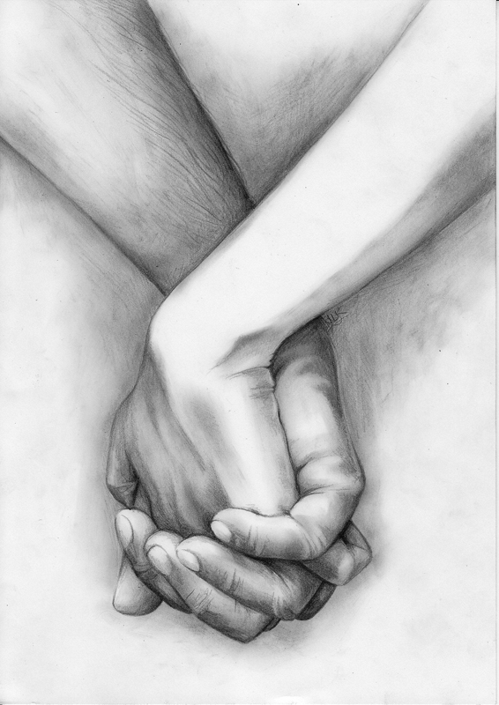

Slide 88
5# Man was to reproduce himself and populate the earth with his kind
"And God blessed them, and God said unto them, Be fruitful, and multiply, and replenish the earth, and subdue it: and have dominion over the fish of the sea, and over the fowl of the air, and over every living thing that moveth upon the earth“
(Gen. 1:28)

Slide 89
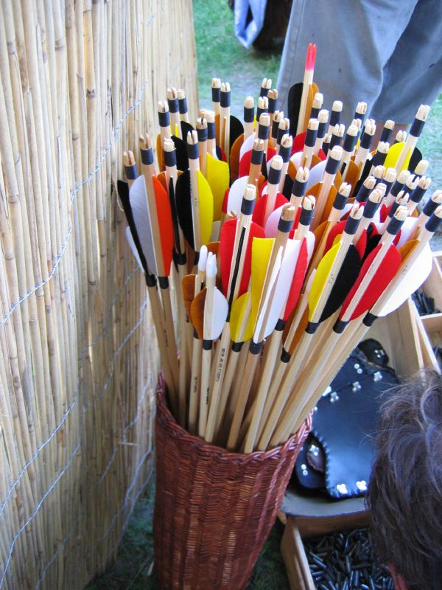
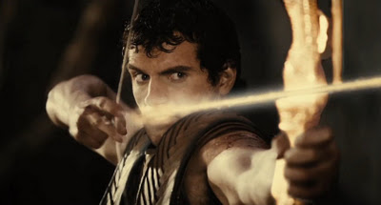
“As arrows are in the hand of a mighty man; so are children of the youth. Happy is the man that hath his quiver full of them.” (Psalms 127:4-5)

Slide 90
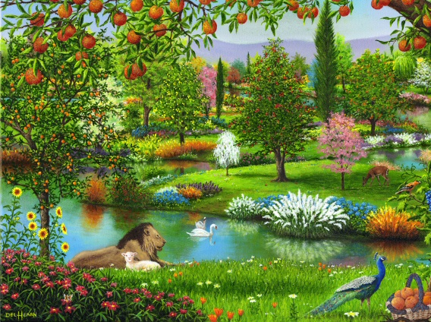
6# Man was to enjoy all the fruits of the various trees (except one).
"And the Lord God commanded the man, saying, of every tree of the garden thou mayest freely eat."
(Gen. 2:16)

Slide 91
7# Man was forbidden to partake of the fruit of the tree of the knowledge of good and evil.
"But of the tree of the knowledge of good and evil, thou shalt not eat of it: for in the day that thou eatest thereof thou shalt surely die." (Gen. 2:17)

Slide 92
