Slide 1
The Doctrine of Man (Part 6)
The Remedy for the Fall

Slide 4
Job 7:17 “What is man, that thou shouldest magnify him? and that thou shouldest set thine heart upon him?”
Job 15:14 “What is man, that he should be clean? and he which is born of a woman, that he should be righteous?”
Ps. 8:4 “What is man, that thou art mindful of him? and the son of man, that thou visitest him?”
Ps. 144:3 “LORD, what is man, that thou takest knowledge of him! or the son of man, that thou makest account of him!”
Heb. 2:6 “But one in a certain place testified, saying, What is man, that thou art mindful of him? or the son of man, that thou visitest him?”

Slide 6
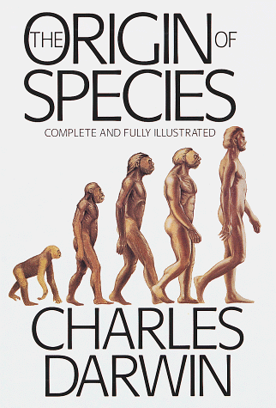
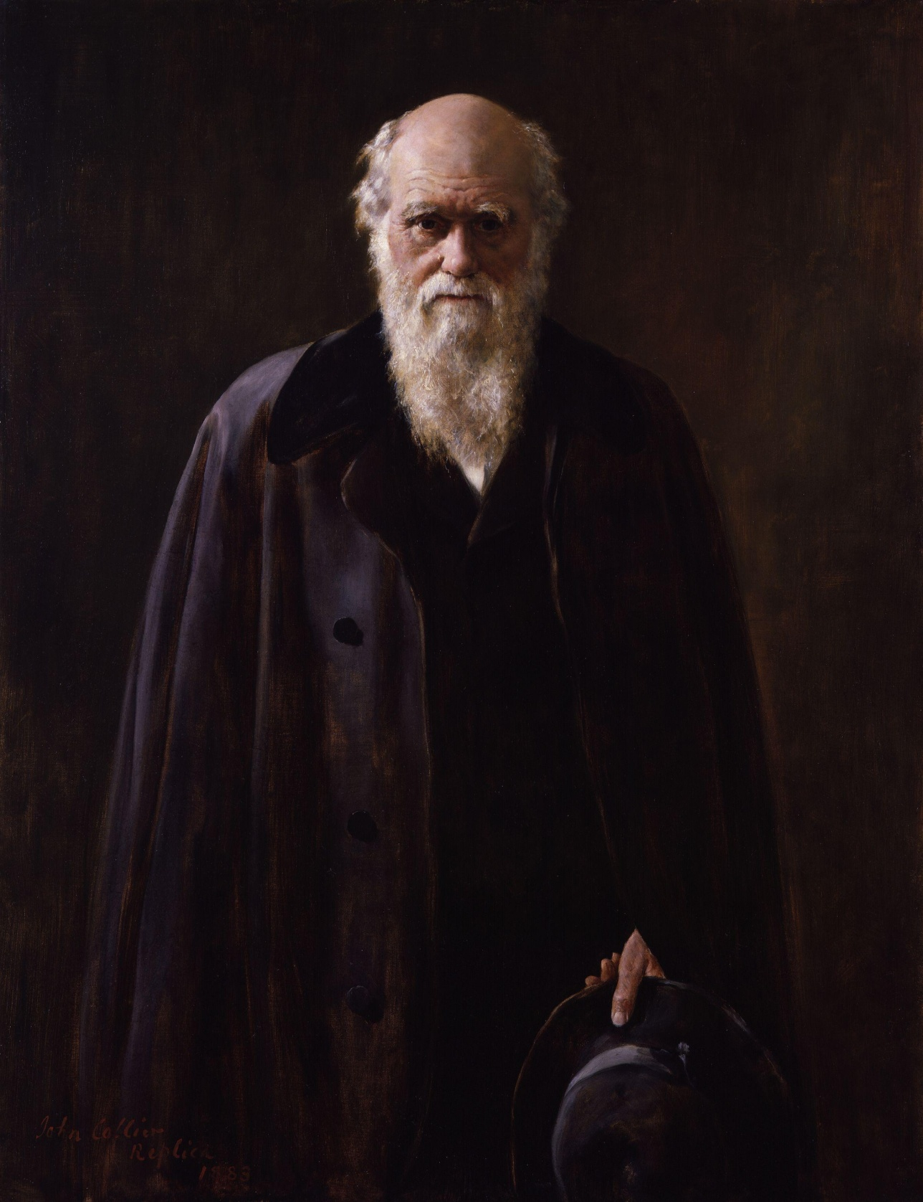

Slide 7
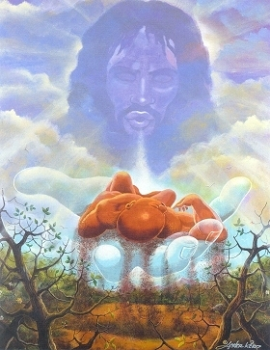
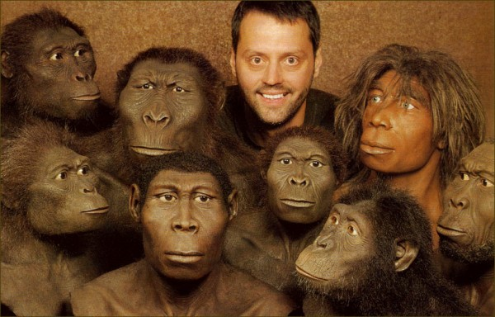

Slide 9
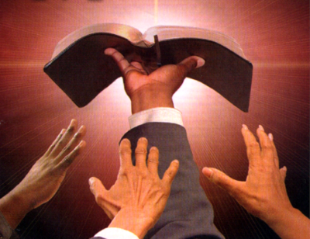
“Thy Word is Truth…”

Slide 11
"And God said, Let us make man in our image, after our likeness; and let them have dominion over the fish of the sea, and the fowl of the air, and over the cattle, and over all the earth, and over every creeping thing that creepeth upon the earth. So God created man in his own image, in the image of God created he him; male and female created he them" (Gen. 1:26, 27)

Slide 12
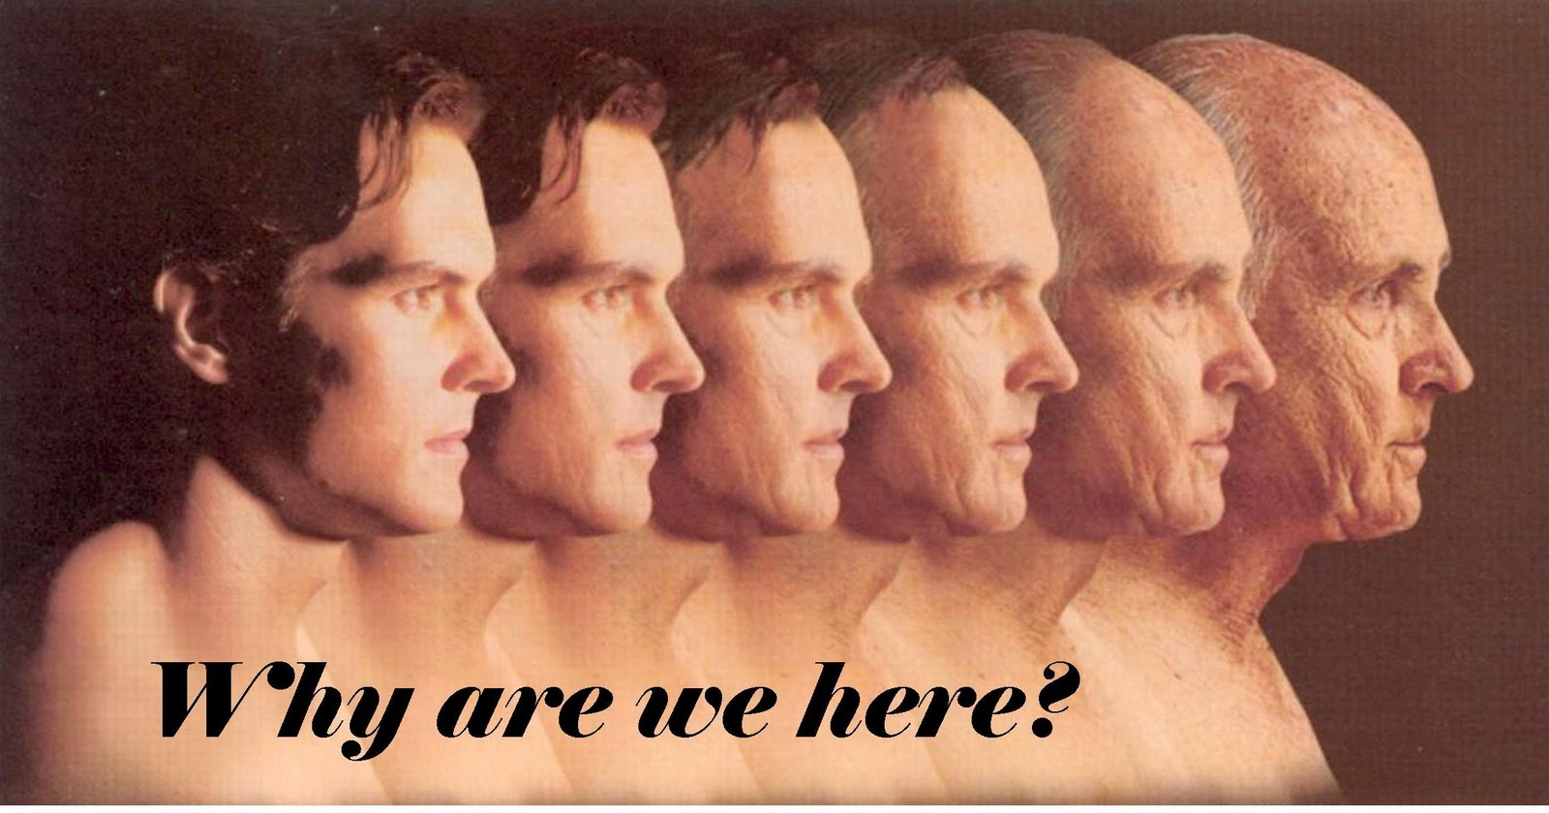

Slide 13
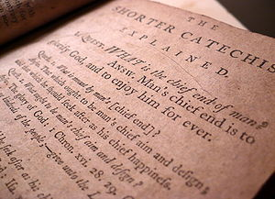

Slide 16
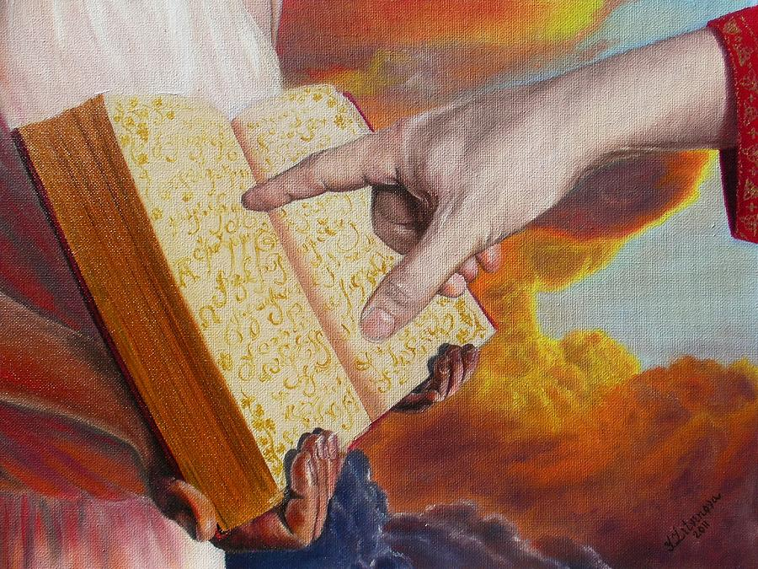
Rev. 20:15
“And whosoever was not found written in the book of life was cast into the lake of fire.”

Slide 17
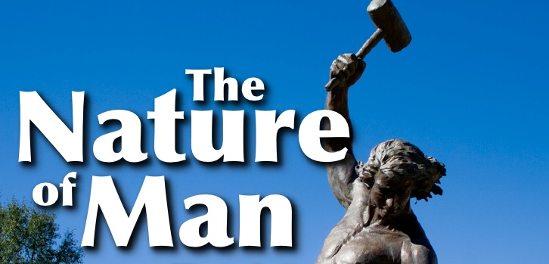

Slide 18
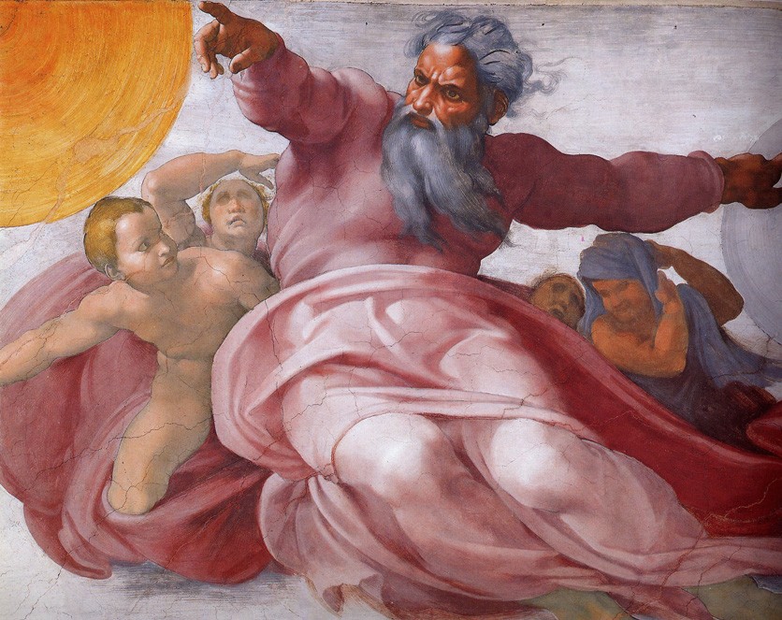
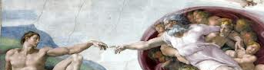
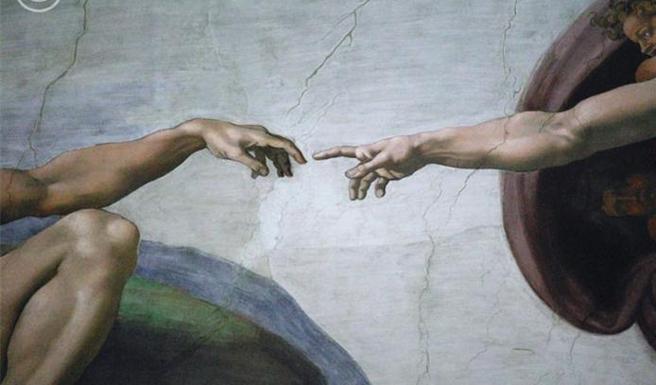
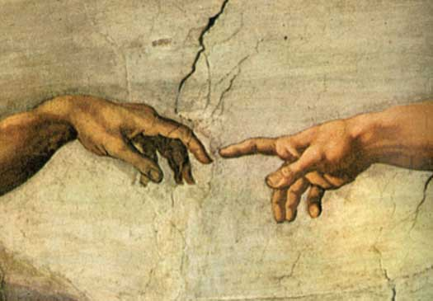
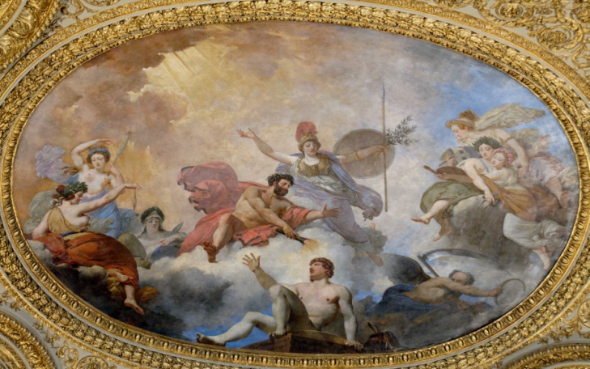
"And God said, Let us make man in our image, after our likeness; and let them have dominion over the fish of the sea, and the fowl of the air, and over the cattle, and over all the earth, and over every creeping thing that creepeth upon the earth. So God created man in his own image, in the image of God created he him; male and female created he them.” Gen. 1:26-27

Slide 20
Man’s Original Duties and Responsibilities

Slide 21
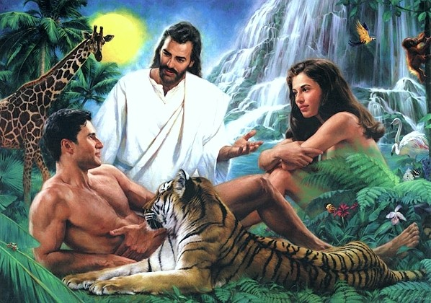
Why did God create man?

Slide 22
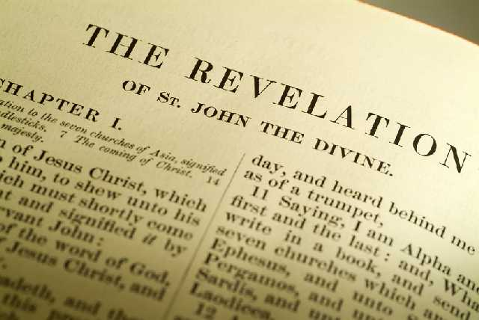
“Thou art worthy, O Lord, to receive glory and honour and power: for thou hast created all things, and for thy pleasure they are and were created.” (Rev. 4:11)

Slide 23
“Furthermore then we beseech you, brethren, and exhort you by the Lord Jesus, that as ye have received of us how ye ought to walk and to please God, so ye would abound more and more.” (I Thess. 4:1)

Slide 24
How do we bring pleasure to God?

Slide 25
The only way to bring pleasure to God is by fulfilling our God given duties and responsibilities.

Slide 26
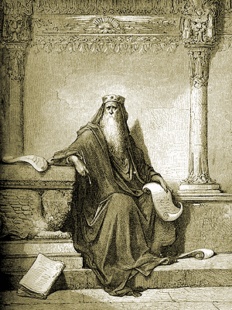
“Let us hear the conclusion of the whole matter: Fear God, and keep his commandments: for this is the whole duty of man.” (Eccl. 12:13)

Slide 27
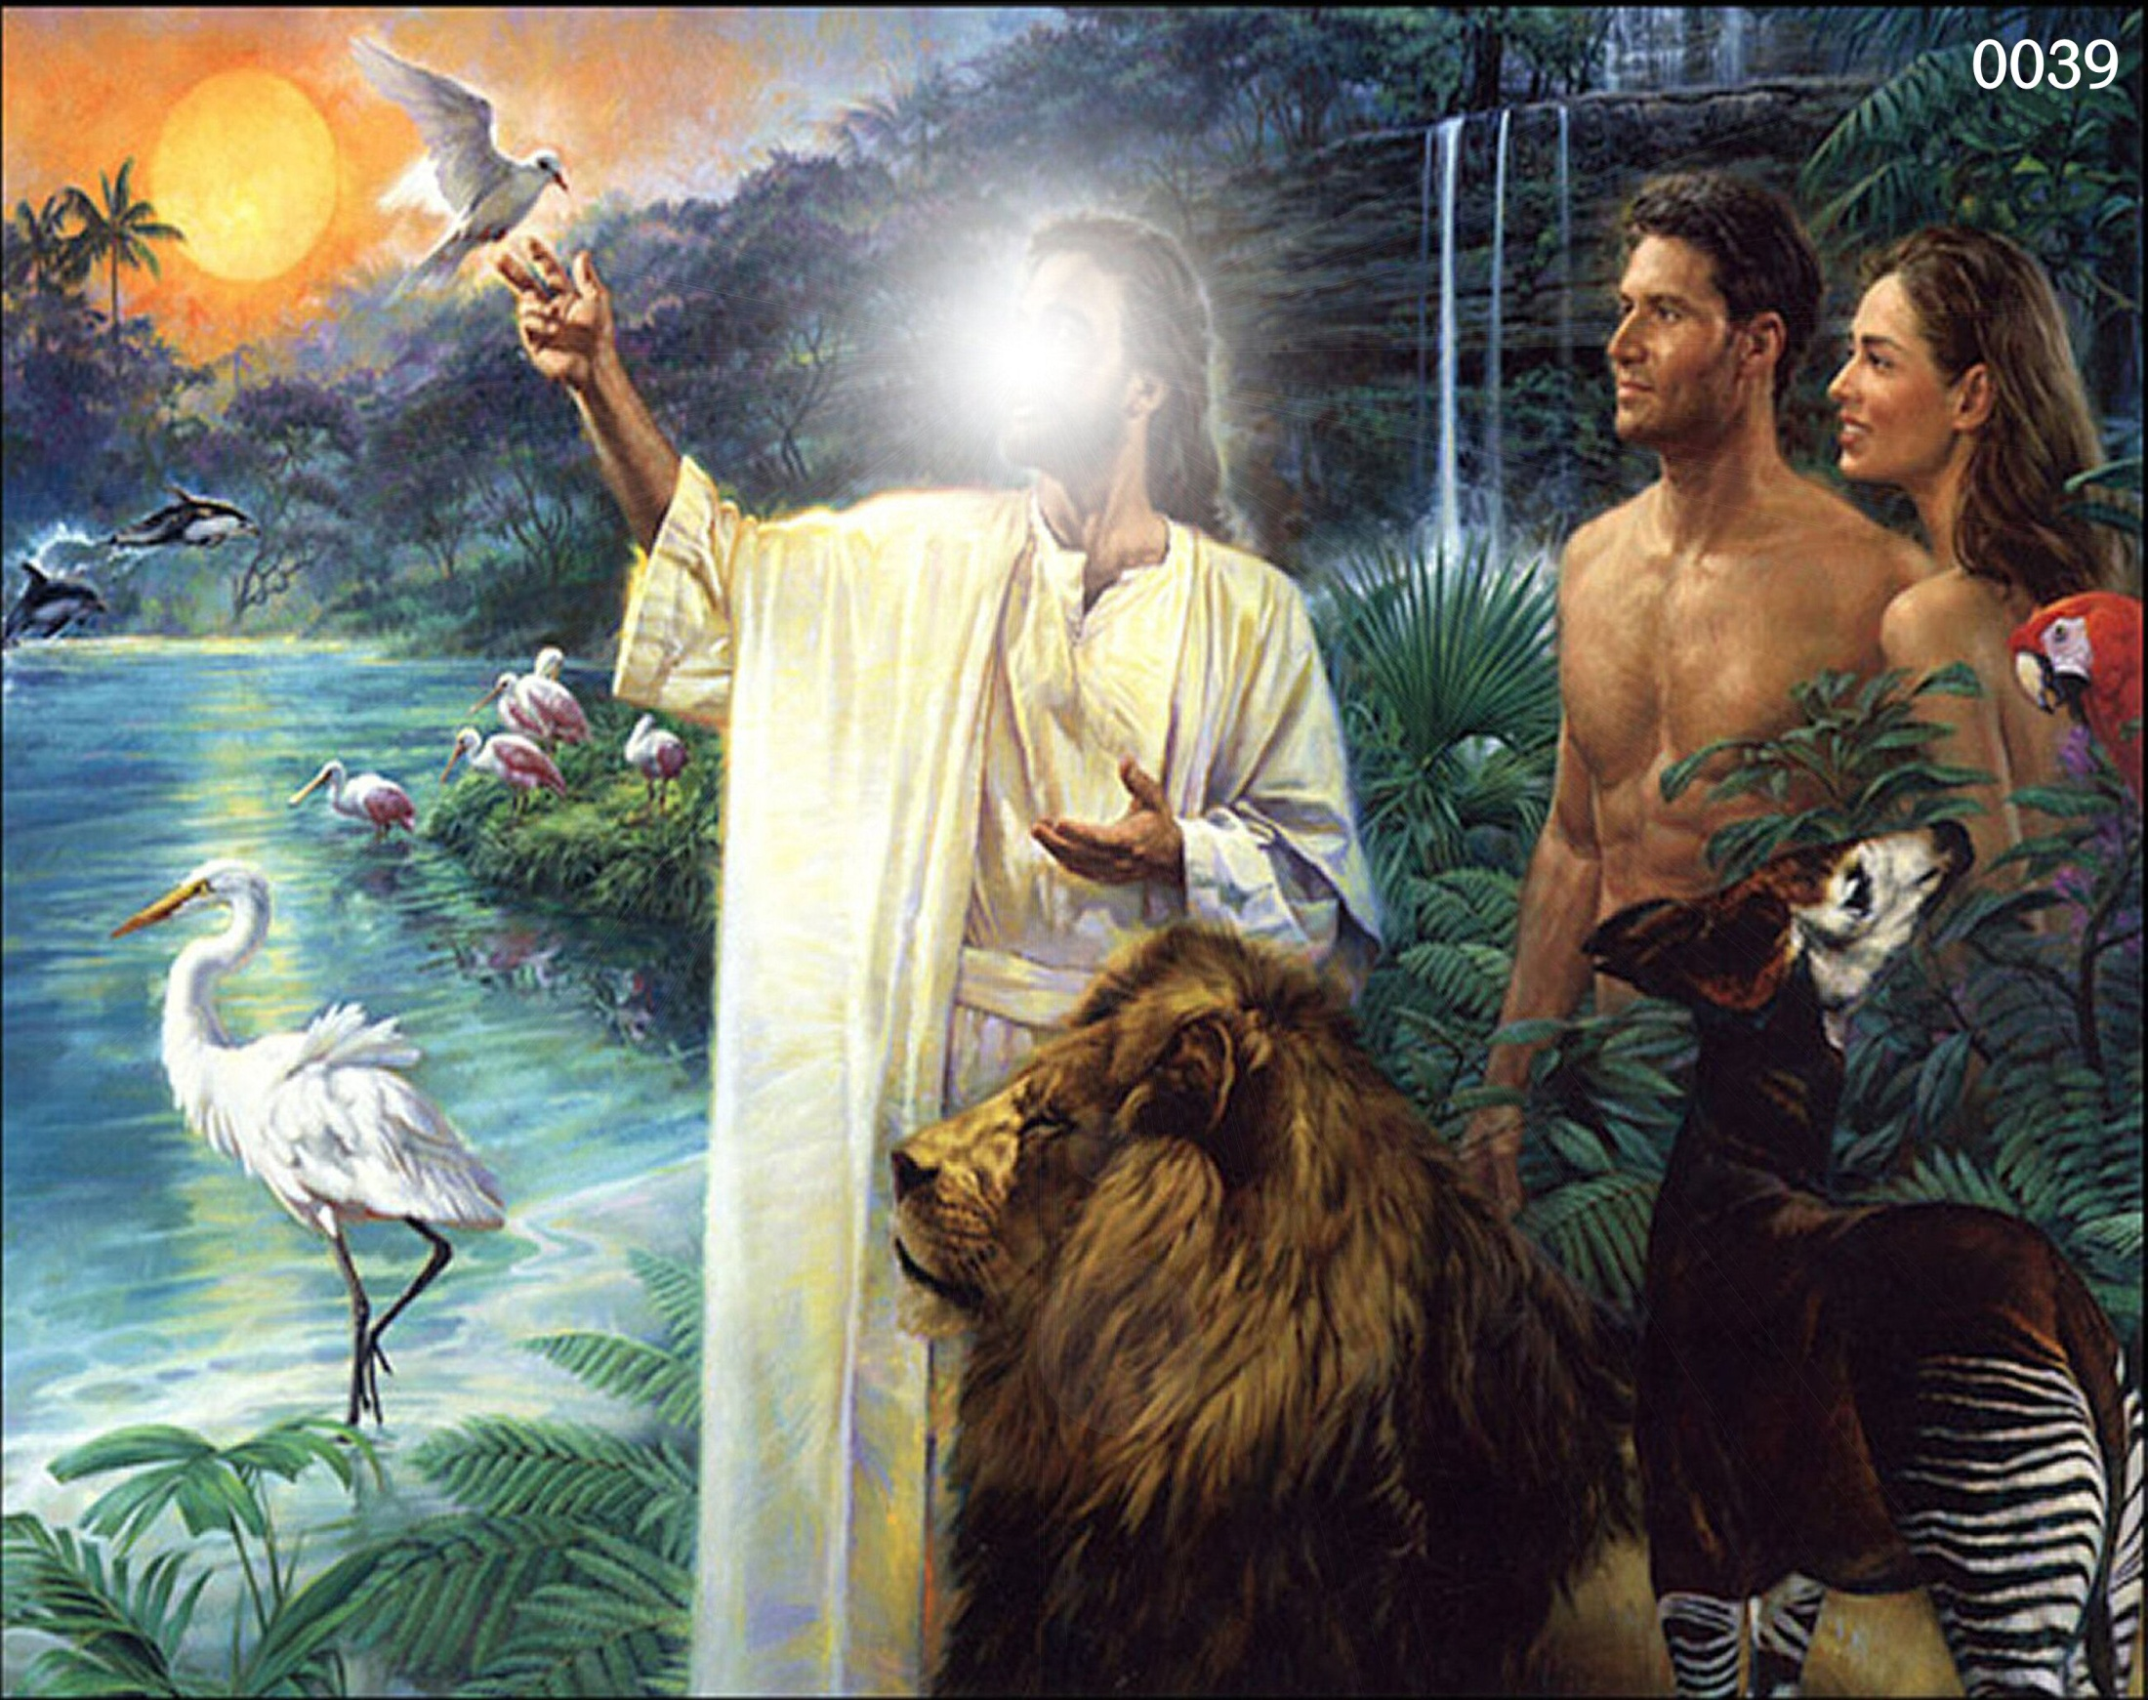

Slide 28
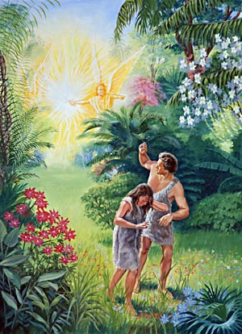
His Tragic Sin and Fall

Slide 29
"Now the serpent was more subtile than any beast of the field which the Lord God had made. And he said unto the woman, Yea, hath God said, Ye shall not eat of every tree of the garden?" (Gen. 3:1).

Slide 30
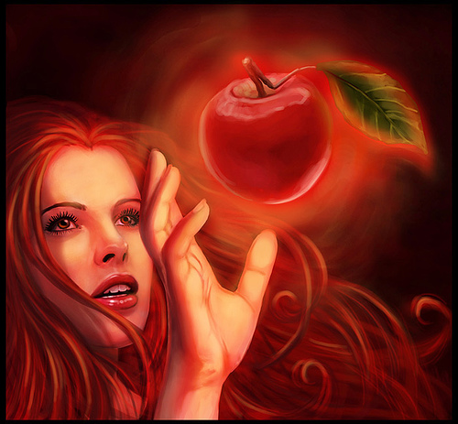
"And when the woman saw that the tree was good for food, and that it was pleasant to the eyes, and a tree to be desired to make one wise, she took of the fruit thereof and did eat…”

Slide 31
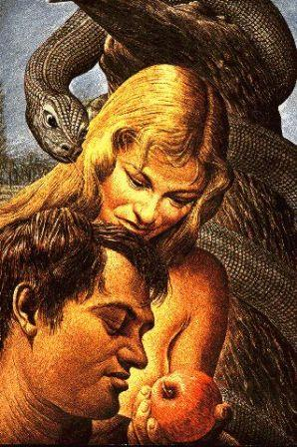
“…and gave also unto her husband with her; and he did eat."
(Gen. 3:6)

Slide 32
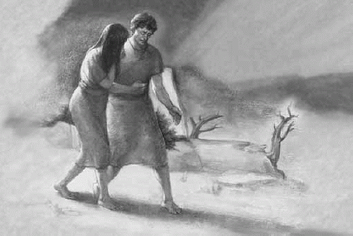
“The Consequences of the Fall”

Slide 33
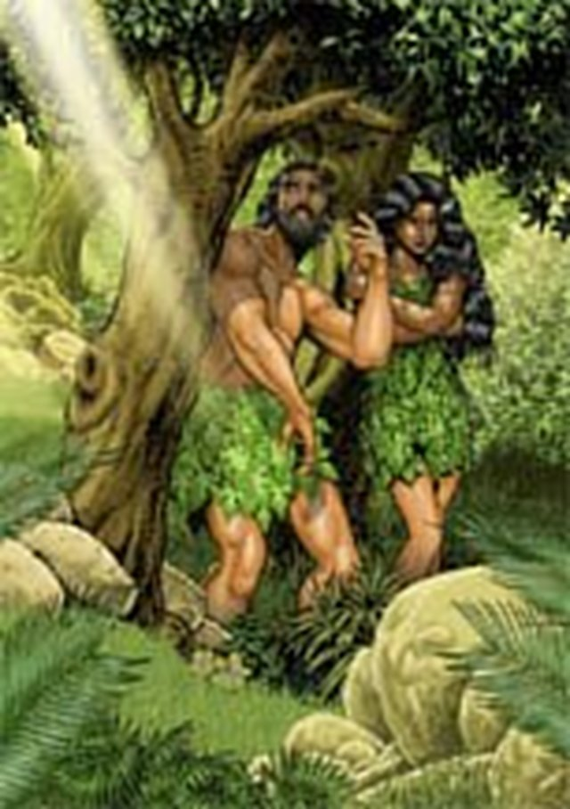
“And the eyes of them both were opened, and they knew that they were naked; and they sewed fig leaves together, and made themselves aprons.”

Slide 34
A threefold sentence passed

Slide 35
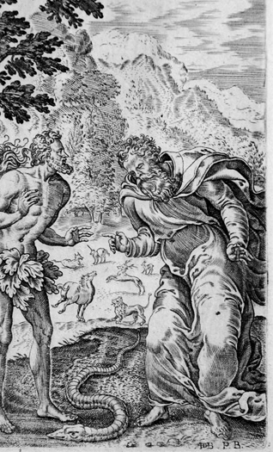
Judgment upon the Serpent

Slide 36
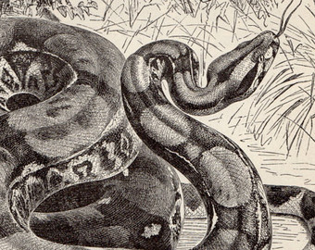
"And the Lord God said unto the serpent, Because thou hast done this, thou art cursed above all cattle, and above every beast of the field; upon thy belly shalt thou go, and dust shalt thou eat all the days of thy life." (Gen. 3:14)

Slide 37
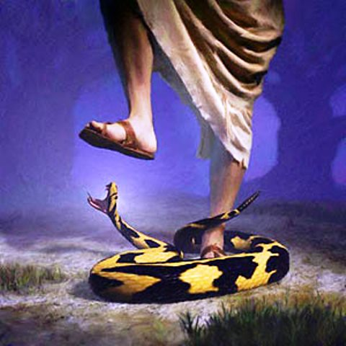
Judgment upon Satan

Slide 38
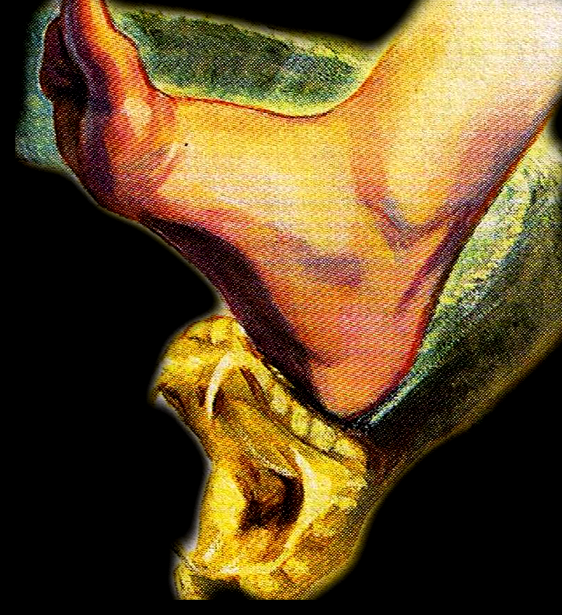
"And I will put enmity between thee and the woman, and between thy seed and her seed; it shall bruise thy head, and thou shalt bruise his heel" (Gen. 3:15)

Slide 39
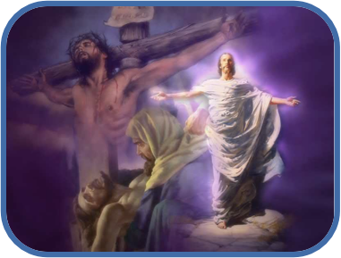
For in this verse we see no less than a thrilling prediction of the cross and the resurrection of the Savior’s and His great victory over Satan.

Slide 40
There will be an intense hatred between Satan and Christ. Eventually Christ shall crush the head of Satan, while suffering a heel wound in the process.

Slide 41
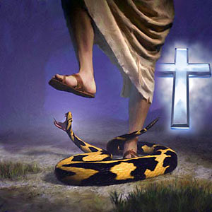

Slide 42
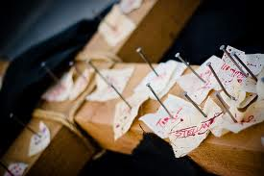
“And you, being dead in your sins and the uncircumcision of your flesh, hath he quickened together with him, having forgiven you all trespasses; Blotting out the handwriting of ordinances that was against us, which was contrary to us, and took it out of the way, nailing it to his cross; And having spoiled principalities and powers, he made a shew of them openly, triumphing over them in it.” Colossians 2:13-15

Slide 43
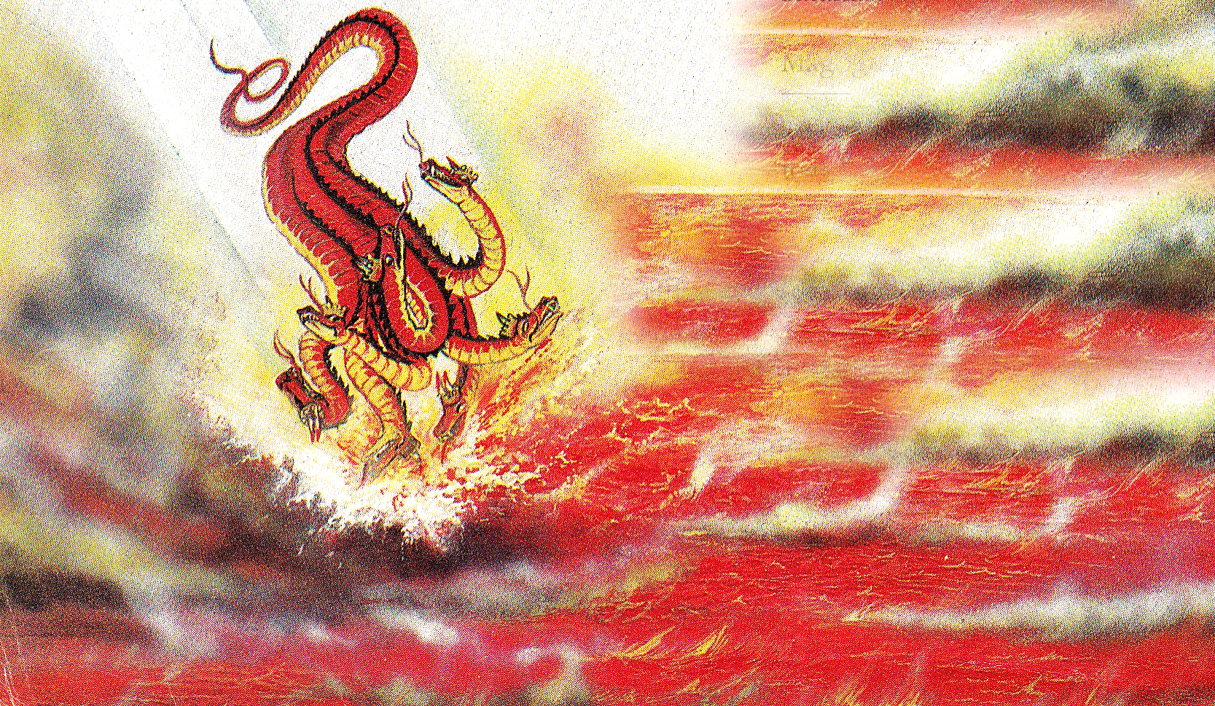
(Revelation 20:10)
“And the devil that deceived them was cast into the lake of fire and brimstone.”

Slide 44
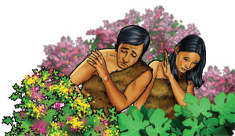
Judgment upon Adam and Eve (sevenfold sentence because of their sin)

Slide 45
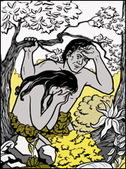
1# Guilt and Shame
"And the eyes of them both were opened, and they knew that they were naked; and they sewed fig leaves together, and made themselves aprons" (Gen. 3:7)

Slide 46
2# Fear
“And they heard the voice of the Lord God walking in the garden in the cool of the day: and Adam and his wife hid themselves from the presence of the Lord God amongst the trees of the garden. And the Lord God called unto Adam, and said unto him, Where art thou? And he said, I heard thy voice in the garden, and I was afraid, because I was naked; and I hid myself" (Gen. 3:8-10)

Slide 47
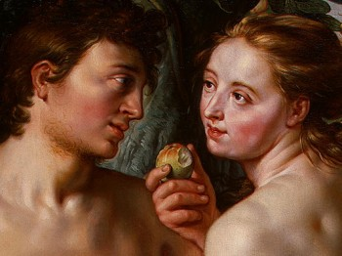
3# Discord
"And the man said, The woman whom thou gavest to be with me, she gave me of the tree, and I did eat.”"
(Gen. 3:12)

Slide 48
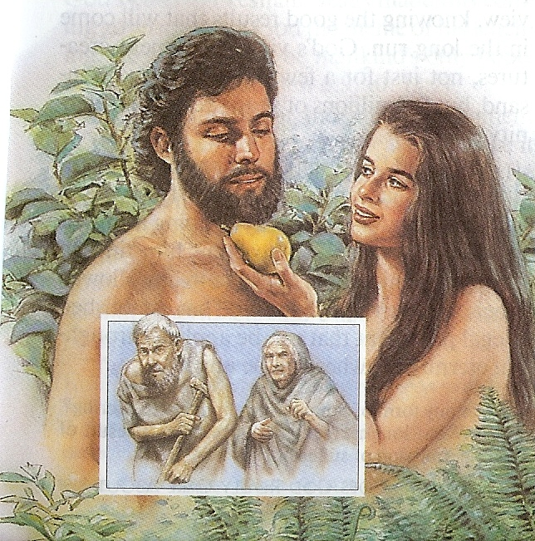
4# Death

Slide 49
Physical death
"And all the days that Adam lived were nine hundred and thirty years: and he died" (Gen. 5:5)
"The days of our years are threescore years (60) and ten (70); and if by reason of strength they be fourscore years (80), yet is their strength labour and sorrow; for it is soon cut off, and we fly away." (Psalm 90:10)

Slide 50
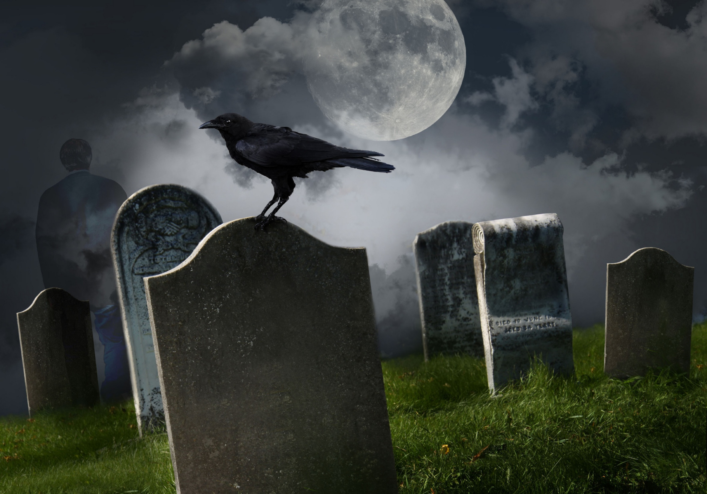

Slide 51
Spiritual death
"And then will I profess unto them, I never knew you: depart from me, ye that work iniquity" (Matt. 7:23)
"Then shall he say also unto them on the left hand, Depart from me, ye cursed, into everlasting fire, prepared for the devil and his angels" (Matt. 25:41)
"He that hath an ear, let him hear what the Spirit saith unto the churches; He that overcometh shall not be hurt of the second death" (Rev. 2:11)

Slide 52
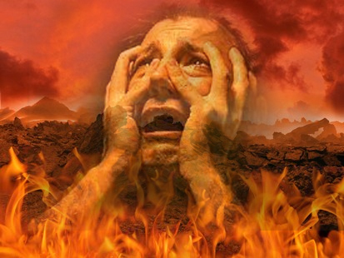

Slide 53
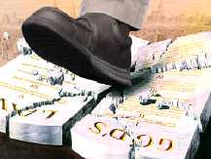
Romans 6:23 “For the wages of sin is death…”

Slide 55
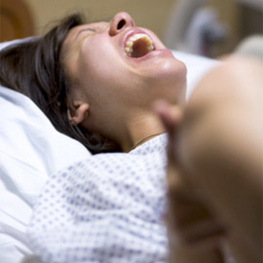
5# Suffering
"Unto the woman he said, I will greatly multiply thy sorrow and thy conception; in sorrow thou shalt bring forth children; and thy desire shall be to thy husband, and he shall rule over thee" (Gen. 3:16)

Slide 56
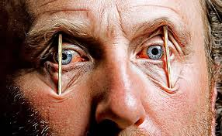
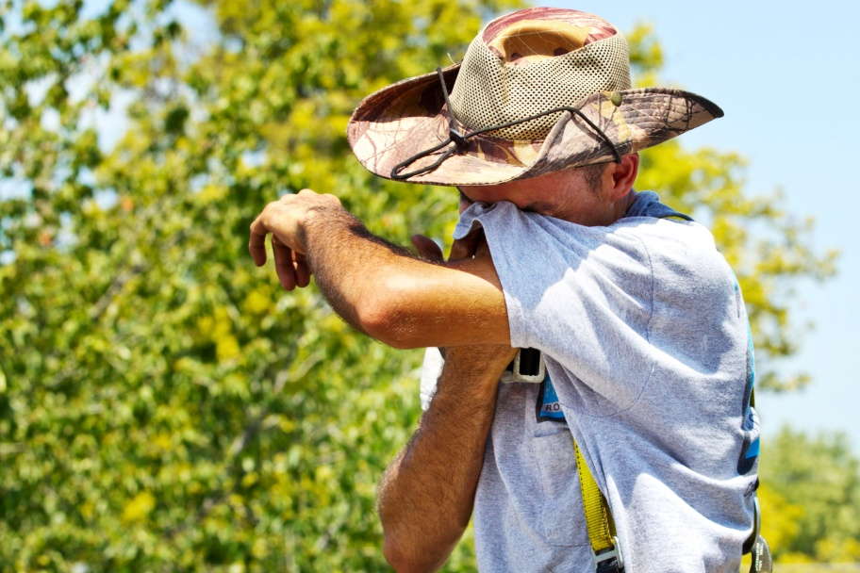
6# Weariness in labor

Slide 57
"And unto Adam he said, Because thou hast hearkened unto the voice of thy wife, and hast eaten of the tree, of which I commanded thee, saying, Thou shalt not eat of it; cursed is the ground for thy sake; in sorrow shalt thou eat of it all the days of thy life; thorns also and thistles shall it bring forth to thee; and thou shalt eat the herb of the field; In the sweat of thy face shalt thou eat bread, till thou return unto the ground; for out of it wast thou taken; for dust thou art, and unto dust shalt thou return" (Gen. 3:17-19)

Slide 58
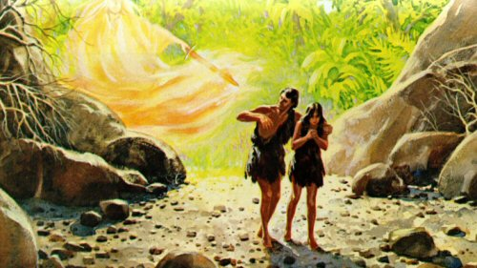
7# Separation from God

Slide 59
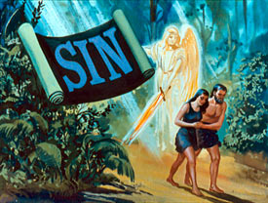
“But your iniquities have separated between you and your God, and your sins have hid his face from you, that he will not hear.” Isa 59:2

Slide 60
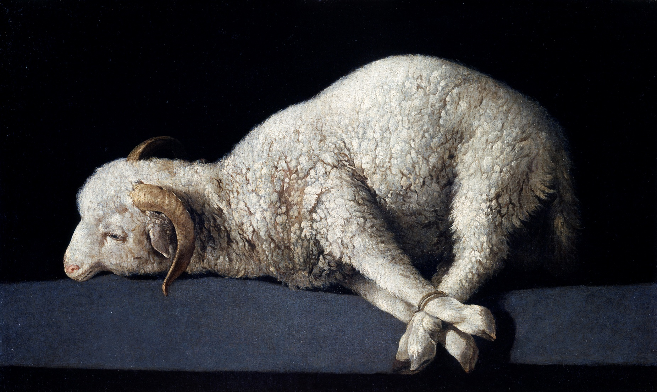
The innocent had to die for the guilty
The Remedy for the Fall

Slide 61
(Genesis 3:21-24) “Unto Adam also and to his wife did the LORD God make coats of skins, and clothed them. And the LORD God said, Behold, the man is become as one of us, to know good and evil: and now, lest he put forth his hand, and take also of the tree of life, and eat, and live for ever: Therefore the LORD God sent him forth from the garden of Eden, to till the ground from whence he was taken. So he drove out the man; and he placed at the east of the garden of Eden Cherubims, and a flaming sword which turned every way, to keep the way of the tree of life.”

Slide 62
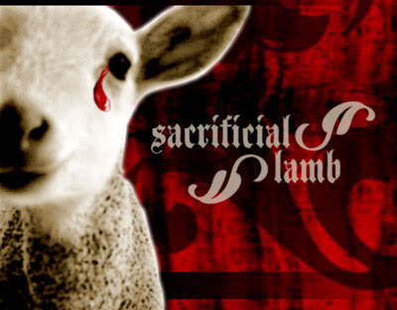
(Genesis 3:21) The first mention of the shedding of blood in the Bible.
“Without shedding of blood is no remission.” (Hebrews 9:22)

Slide 63
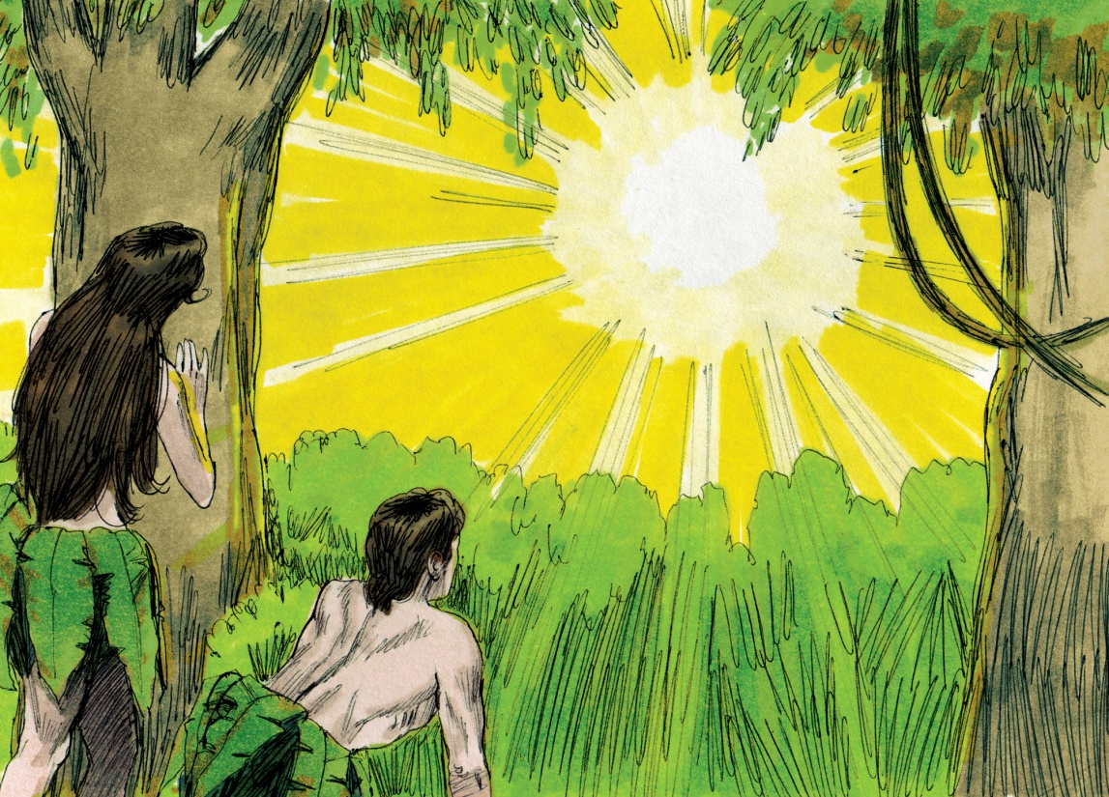
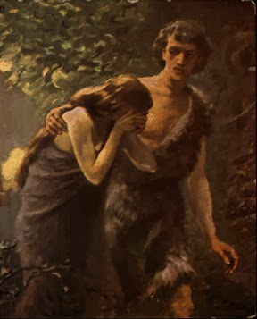
“And the eyes of them both were opened, and they knew that they were naked; and they sewed fig leaves together, and made themselves aprons.”
“And he said, Who told thee that thou wast naked? Hast thou eaten of the tree, whereof I commanded thee that thou shouldest not eat?”
“LORD God make coats of skins, and clothed them…”

Slide 64
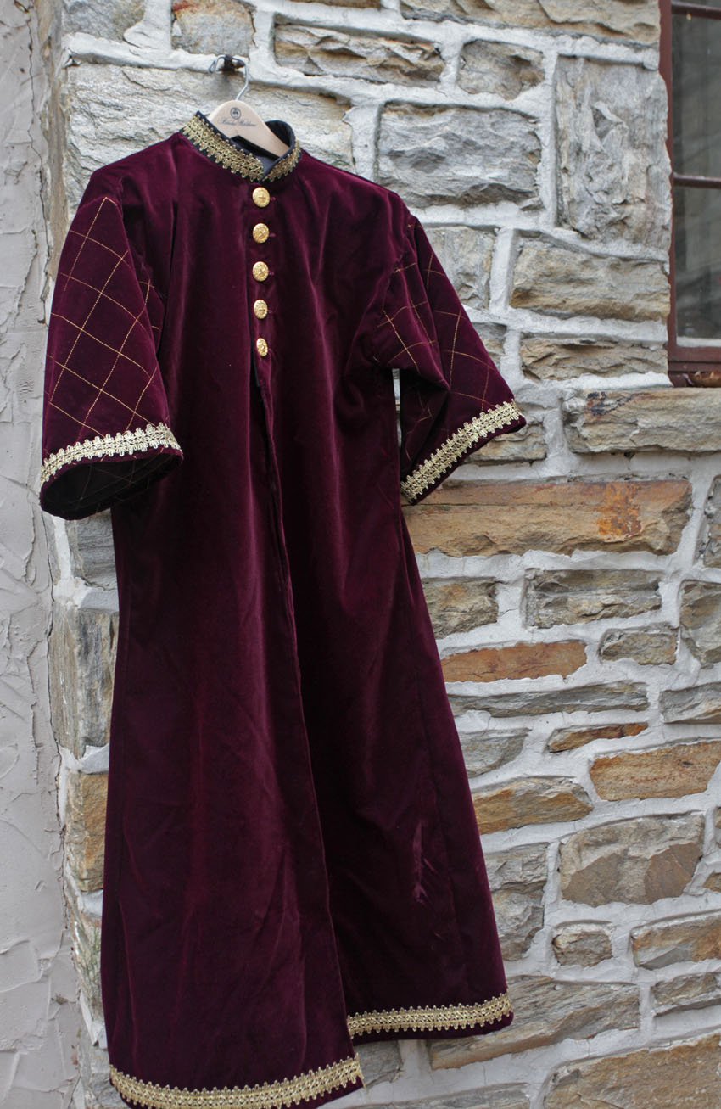
“Unto Adam also and to his wife did the Lord God make (designed) coats (tunic –garments) of skins and clothed them…”
Tunics - “coats of skins”
The Hebrew word for “Coats” according to Wilson’s Old Testament word studies means = a garment with sleeves, covering the entire body from the neck to below the knees, seldom to the ankles.

Slide 65
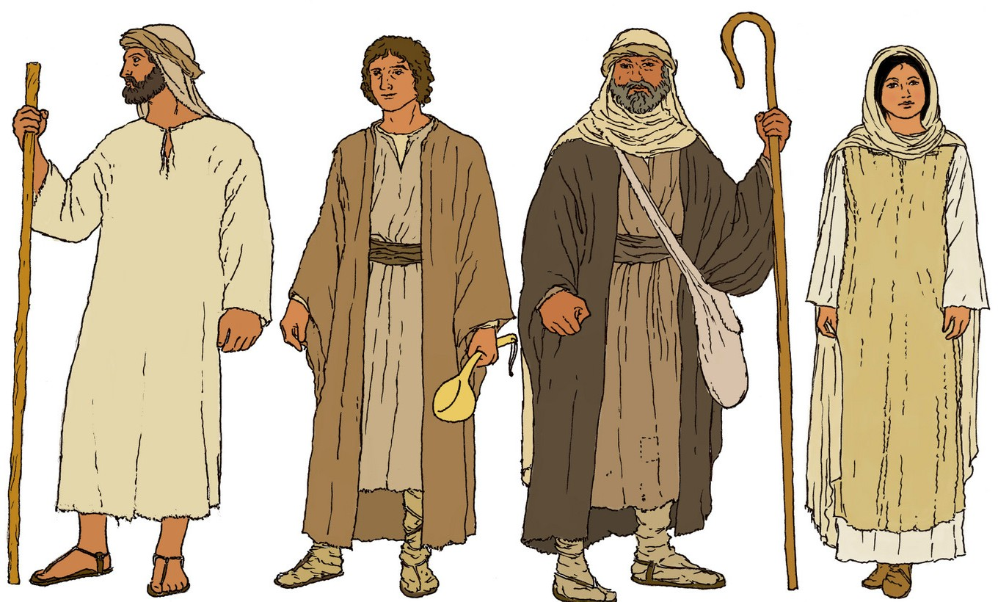
God designed clothing with modesty in mind

Slide 66
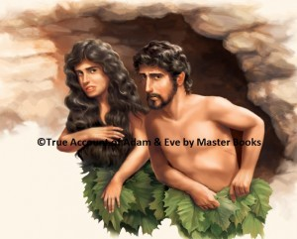
Modest dress draws attention to the face or countenance not the body!
Hair style draws attention to the countenance – “But if a woman have long hair it is a glory to her: for her hair is given her for a covering…”
Loose fitting cloths –
What draws the attention of men’s eyes to a woman’s body?
– Skin!
Short dresses or skirts
Sheer fabrics
Tight fitting cloths
Open slits
Form fitting pants
Fig leaves were not sufficient

Slide 67
“But of the tree of the knowledge of good and evil, thou shalt not eat of it: for in the day that thou eatest thereof thou shalt surely die.”

Slide 70
“Therefore the LORD God sent him forth from the garden of Eden, to till the ground from whence he was taken. So he drove out the man; and he placed at the east of the garden of Eden Cherubims, and a flaming sword which turned every way, to keep the way of the
tree of life and eat, and live forever.”

Slide 71
“He that hath an ear, let him hear what the Spirit saith unto the churches; To him that overcometh will I give to eat of the tree of life, which is in the midst of the paradise of God.” Revelation 2:7

Slide 72
(Matthew7:23, 25:41)
And then will I profess unto them, I never knew you: depart from me, ye that work iniquity…Then shall he say also unto them on the left hand, Depart from me, ye cursed, into everlasting fire, prepared for the devil and his angels.”

Slide 73
The Remedy for Man’s Sin
Sacrifice of the life of the innocent – “And Moses said, Thou must give us also sacrifices and burnt offerings, that we may sacrifice unto the LORD our God.”
Life Blood - “For the life of the flesh is in the blood: and I have given it to you upon the altar to make an atonement for your souls: for it is the blood that maketh an atonement for the soul.”

Slide 75
“And Abel, he also brought of the firstlings of his flock and of the fat thereof. And the LORD had respect unto Abel and to his offering: But unto Cain and to his offering he had not respect.” (Genesis 4:4-5)

Slide 84
Christ our Sacrifice

Slide 85
“For the law having a shadow of good things to come, and not the very image of the things, can never with those sacrifices which they offered year by year continually make the comers thereunto perfect. For then would they not have ceased to be offered? because that the worshippers once purged should have had no more conscience of sins. But in those sacrifices there is a remembrance again made of sins every year. For it is not possible that the blood of bulls and of goats should take away sins. Wherefore when he cometh into the world, he saith, Sacrifice and offering thou wouldest not, but a body hast thou prepared me…

Slide 86
In burnt offerings and sacrifices for sin thou hast had no pleasure. Then said I, Lo, I come, to do thy will, O God. Above when he said, Sacrifice and offering and burnt offerings and offering for sin thou wouldest not, neither hadst pleasure therein; which are offered by the law; Then said he, Lo, I come to do thy will, O God. He taketh away the first, that he may establish the second. By the which will we are sanctified through the offering of the body of Jesus Christ once for all. And every priest standeth daily ministering and offering oftentimes the same sacrifices, which can never take away sins: But this man, after he had offered one sacrifice for sins for ever, sat down on the right hand of God.”

Slide 87
The Shed Blood of Christ
I John 1:7 - “…the blood of Jesus Christ his Son cleanseth us from all sin.”
Matthew 26:28 – “For this is my blood of the new testament, which is shed for many for the remission of sins.”
Hebrews 9:12 – “Neither by the blood of goats and calves, but by his own blood he entered in once into the holy place, having obtained eternal redemption.”

Slide 88
Colossians 1:14 – “In whom we have redemption through his blood, [even] the forgiveness of sins.”
Acts 20:28 – “…the church of God, which he hath purchased with his own blood.”
Revelation– “And from Jesus Christ, [who is] the faithful witness, [and] the first begotten of the dead, and the prince of the kings of the earth. Unto him that loved us, and washed us from our sins in his own blood.”
Ephesians 2:13 – “But now in Christ Jesus ye who sometimes were far off are made nigh by the blood of Christ.”

Slide 90
Nothing but the Blood of Jesus
What can wash away my sin? Nothing but the blood of Jesus; What can make me whole again? Nothing but the blood of Jesus.
For my pardon, this I see, Nothing but the blood of Jesus; For my cleansing this my plea, Nothing but the blood of Jesus.

Slide 91
Nothing can for sin atone, Nothing but the blood of Jesus; Naught of good that I have done, Nothing but the blood of Jesus.
This is all my hope and peace, Nothing but the blood of Jesus; This is all my righteousness, Nothing but the blood of Jesus.

Slide 92
Refrain:
Oh! precious is the flow That makes me white as snow; No other fount I know, Nothing but the blood of Jesus.

Slide 94
Redemption
“In whom we have redemption through his blood, even the forgiveness of sins.” (Col 1:14)

Slide 95
Meaning of Redemption
The action of saving or being saved from sin, error, or evil.
The action of regaining or gaining possession of something in exchange for payment, or clearing a debt.

Slide 97
Reconciliation
“And all things are of God, who hath reconciled us to himself by Jesus Christ, and hath given to us the ministry of reconciliation.” (II Cor. 5:18)

Slide 98
Meaning of Reconciliation
The act of restoring a broken friendship.
The act of causing two people who were enemies to become friends.
(Colossians 1:21-22) “And you, that were sometime alienated and enemies in your mind by wicked works, yet now hath he reconciled In the body of his flesh through death, to present you holy and unblameable and unreproveable in his sight.”

Slide 99
(Romans 5:10)
“For if, when we were enemies, we were reconciled to God by the death of his Son, much more, being reconciled, we shall be saved by his life.”

Slide 100
Remission
“To him (Jesus) give all the prophets witness, that through his name whosoever believeth in him shall receive remission of sins.”
(Acts 10:43)

Slide 101
Meaning of Remission
Release, as from a debt, penalty, charges or obligation.
Forgiveness; pardon.

Slide 102
Redemption
Reconciliation
Remission

Slide 103
Propitiation
“Whom God hath set forth to be a propitiation through faith in his blood, to declare his righteousness for the remission of sins.”
(Romans 3:25)

Slide 105
The Meaning of Propitiation
The act of God, motivated by His immense love, whereby He accepts the blood of Christ as the complete and satisfying sacrifice for all sin.

Slide 106
Justification
“Who was delivered for our offences, and was raised again for our justification...Therefore as by the offence of one judgment came upon all men to condemnation; even so by the righteousness of one the free gift came upon all men unto justification of life.”
(Romans 4:25, 5:18)

Slide 107
The Meaning of Justification
The act of God whereby our legal standing before God and in heaven is changed from guilty to innocent and we are declared righteous.
II Cor. 5:21 “For he hath made him to be sin for us, who knew no sin; that we might be made the righteousness of God in him.”

Slide 108
The Remedy for the Fall

