Slide 1
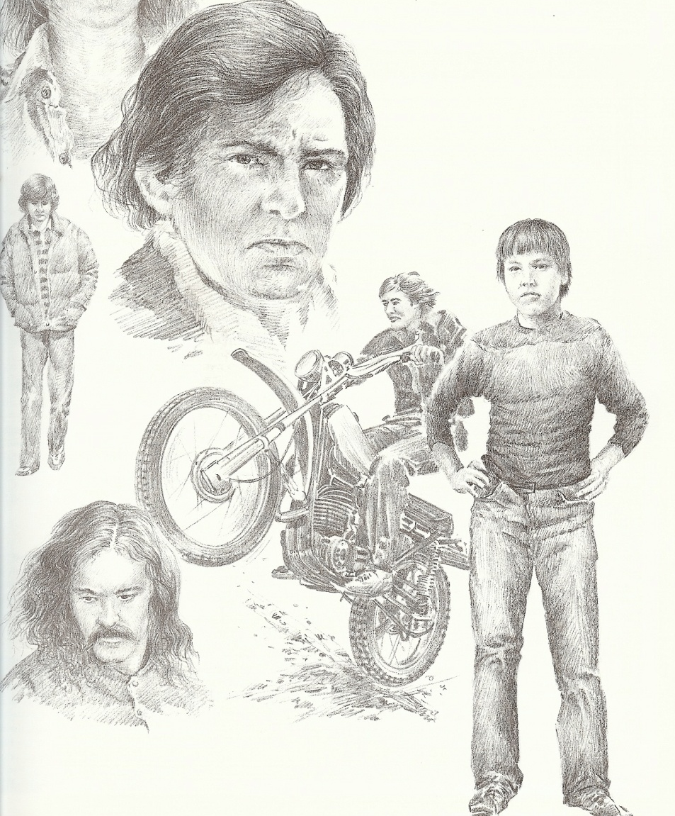
How to Provide Protection for your Son (Part 2)

Slide 2
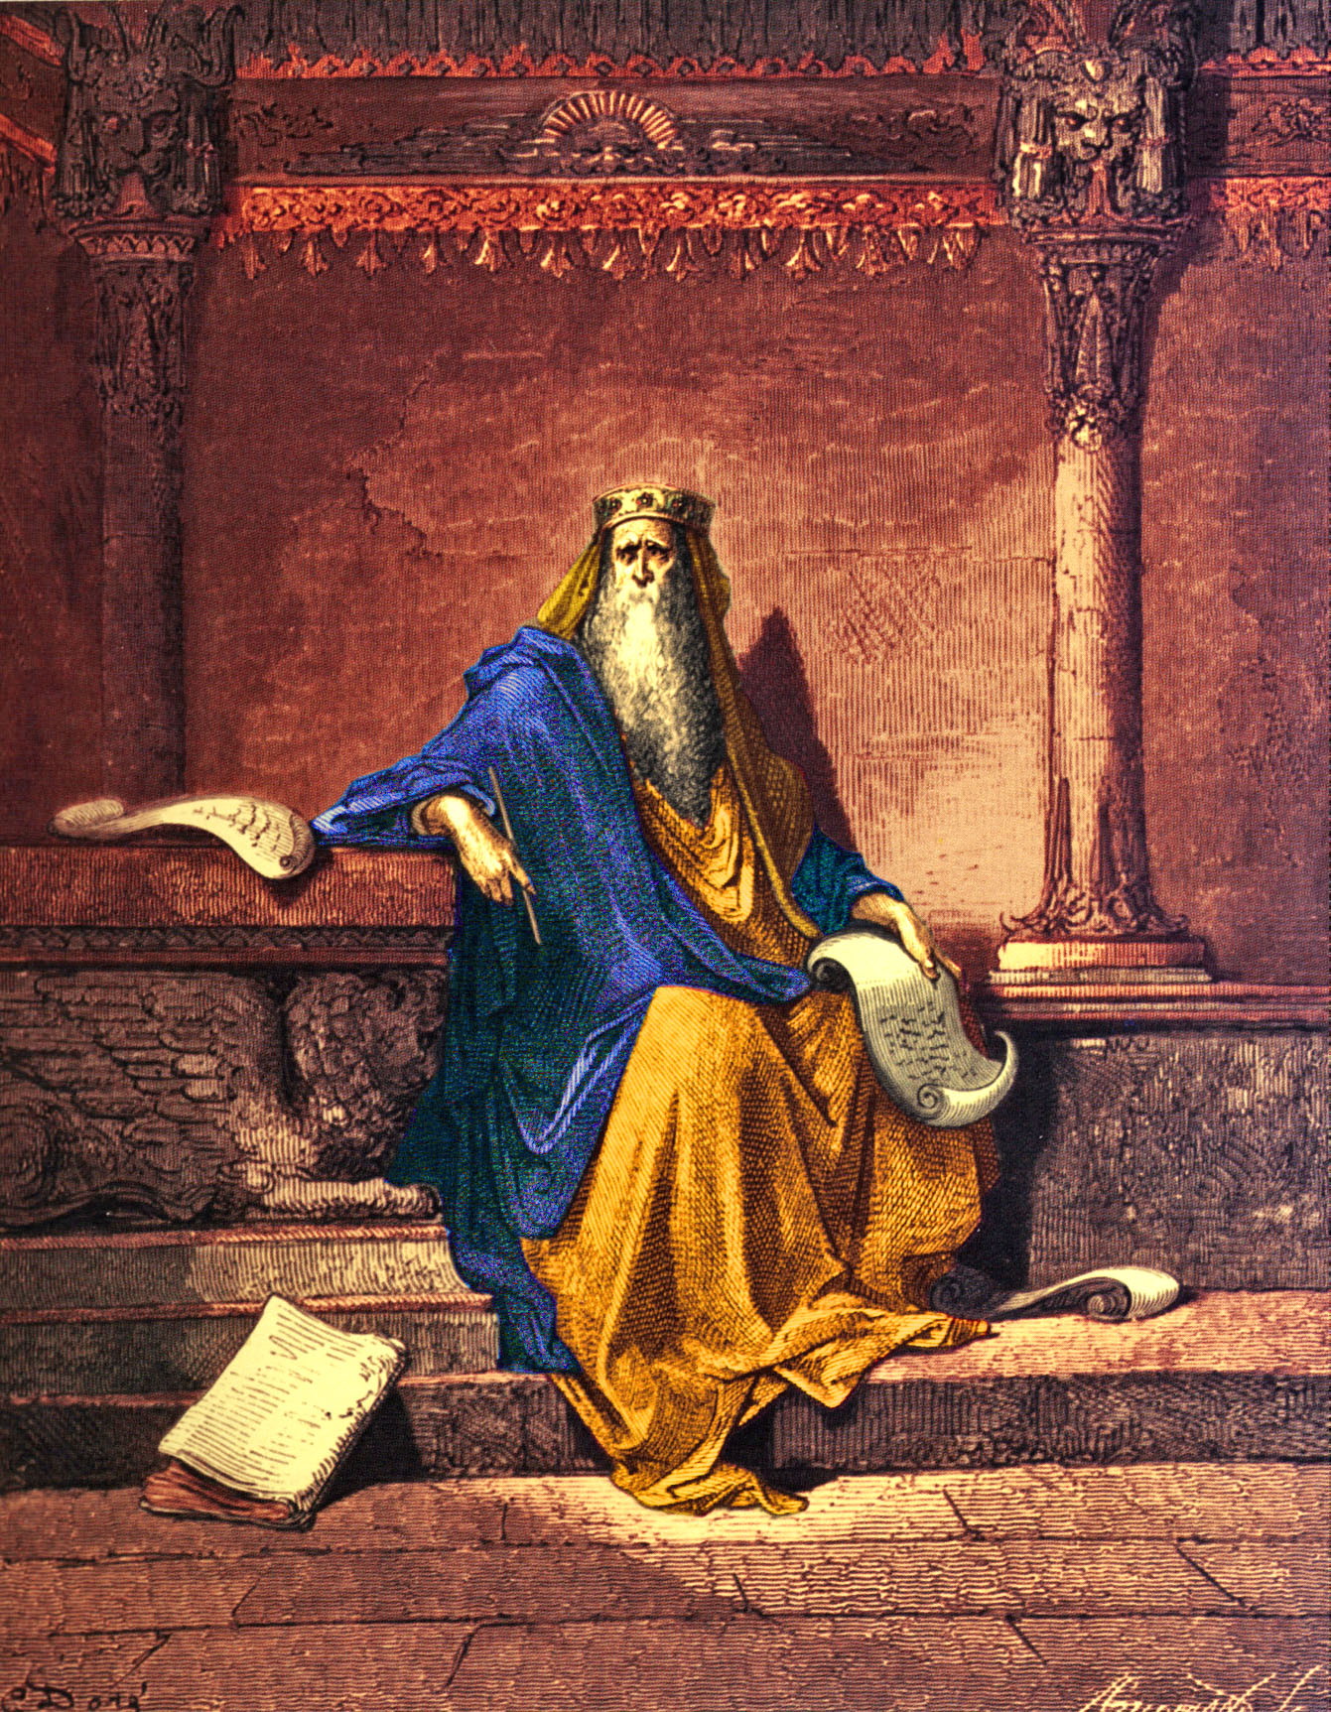
My son, hear the instruction of thy father
My son, if sinners entice thee, consent thou not
My son, fear thou the LORD
My son, despise not the chastening of the LORD
My son, give me thine heart

Slide 3
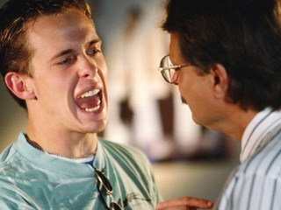
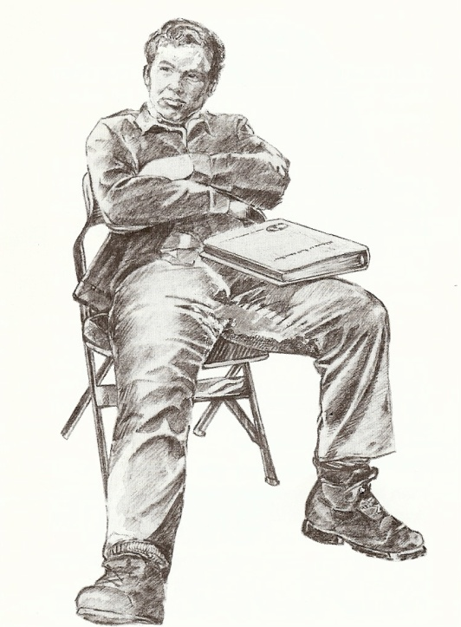
With the lack of interaction between fathers and their children it should be no surprise to us that our homes are in the condition
that they are!

Slide 4
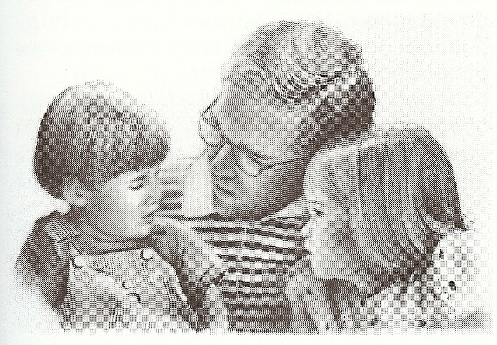
The Father Son Relationship is Critical to the Raising of Godly Children (Ephesians 6:1-4, 10-18)
Practical ways to protect your sons
from the “wiles of the devil…”

Slide 5
Lead your son to personal salvation – Rom.10:9-10
Dedicate your son to God – Ps. 127-128
Make sure that you are overcoming sin and temptation – Rom. 6-8
Challenge each son to total dedication – Rom. 12:1-2
Instill in your son the fear of the Lord – Prov. 1:7
6. Train each son to recognize and resist the Devil - James 4:7-10
7. Teach your son how Satan works to establish “Strongholds” in their lives –

Slide 6
II Corinthians 10:3-6
Stronghold
“False Ideas”
(John 8:44)
Ground
Surrendered
(Eph. 4:27)
Pride of Life
Immorality
(I Thess. 4:1-8)
Bitterness
(Heb. 12:15)
Temporal Values
(I Tim. 6:10)

Slide 7
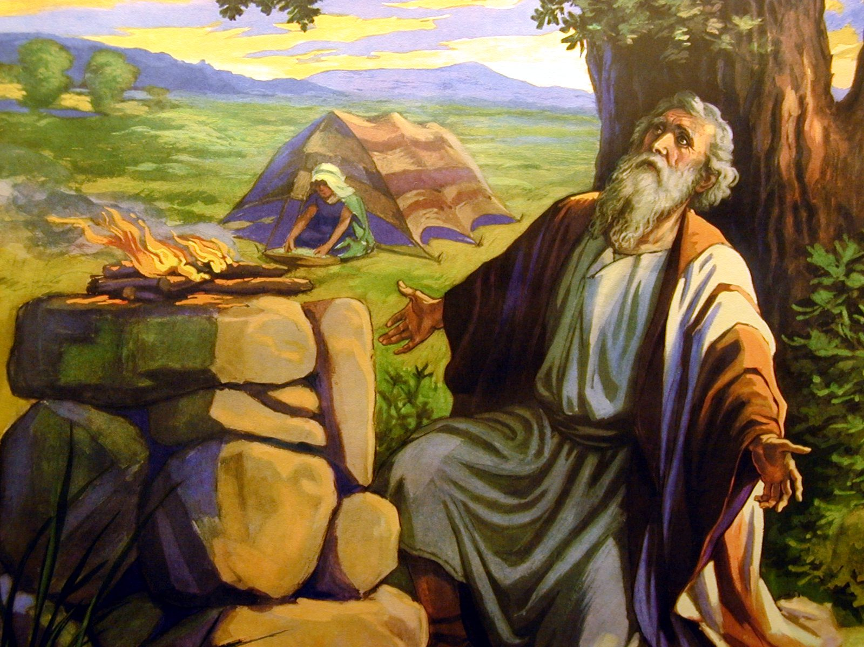
8. Pray a hedge of protection around your son – “Job sanctified them, and rose up early in the morning, and offered burnt offerings according to the number of them all: for Job said, It may be that my sons have sinned, and cursed God in their hearts. Thus did Job continually...Hast not thou made an hedge about him, and about his house, and about all that he hath on every side? Thou hast blessed the work of his hands, and his substance is increased in the land.” (Job 1:5, 10)

Slide 8
Three Parts to the Prayer for a Hedge
Ask God to bind and rebuke the power of Satan in the life of each one in your family – Mark 3:27
Pray in the name and through the blood of the Lord Jesus Christ – John 14:13
Claim the Scripture that related to the kind of protection that is needed –
Protection from temptation – I Cor. 10:13
Protection from fear of man – Matt. 10:26
Protection from pride – I Peter 5:1-8

Slide 9
Protection from anger – James 3:1-18
Protection from bitterness – Heb. 12:15
Protection from immorality – I Thess. 4:1-8
Protection from discouragement - Heb. 13:5
“Sin shall not have dominion over you…” Rom. 6:14

Slide 10
“Heavenly Father, I ask you in the name and through the blood of the Lord Jesus Chris to bind and rebuke the power of Satan in ____________ life. Will you put a hedge of protection around me and each one in my family. In the name of Jesus our Savior, Amen.” (Philippians 1:6)

Slide 11
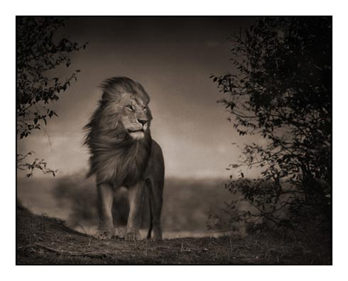
9. Teach you son how to stand along against evil – Daniel 1:8-9, 3:13-18
“The wicked flee when no man pursueth: but the righteous are bold as a lion.” (Prov. 28:1)

Slide 12
Ten Ways to Gain the Wisdom and Courage to Stand Alone
Wisdom and courage to stand alone are given to us by God when we meet the following conditions:
1# When we receive Jesus Christ as our personal Savior and become indwelt with the Spirit of the Living God – “Not by might, nor by power, but by my spirit, saith the LORD of hosts.” (Zech. 4:6)
2# When we renew our mind with the truths of God’s Word and begin to see life from God’s point of view – Rom. 12:2

Slide 13
3# When we become obedient to the promptings of the Holy Spirit and apply God’s truth to daily living, boldness is the by-product – Prov. 28:1
4# When we identify with Christ’s death, and resurrection and draw upon His power to do what is right - “That I may know him, and the power of his resurrection.” Phil. 3:10
(Ephesians 1:18-20, 2:5-6, 3:16, 20)
“The eyes of your understanding being enlightened; that ye may know what is the hope of his calling, and what the riches of the glory of his inheritance in the saints. And what is the exceeding greatness of his power to us-ward who believe, according to the working of his mighty power. Which he wrought in Christ, when he raised him from the dead, and set him at his own right hand in the heavenly places.”

Slide 14
“Even when we were dead in sins, hath quickened us together with Christ…And hath raised us up together, and made us sit together in heavenly places in Christ Jesus…That he would grant you, according to the riches of his glory, to be strengthened with might by his Spirit in the inner man…Now unto him that is able to do exceeding abundantly above all that we ask or think, according to the power that worketh in us.”
5# When we love the Lord to the point where we are
more concerned about protecting His reputation
then pleasing ourselves – John 14:21
6# When we realize that we are not really alone
because God will never leave us or forsake us, we
will have the courage to stand alone – Matt. 28:20

Slide 15
7# When we realize that rejection and persecution immediately brings more of God’s grace (power), and that it is God’s grace that gives us the ability to do His will – James 4:6
8# When we realize that this world is not our home, that we are only strangers and pilgrims - “Dearly beloved, I beseech you as strangers and pilgrims, abstain from fleshly lusts, which war against the soul.” I Peter 2:11
9# When we develop a fear of the Lord – “The fear of the Lord is to hate evil.” Prov. 8:13
10# When we have an attitude of humility before the God and others – I Peter 5:5-10

Slide 16
“I have given my life to Jesus and I am not able to do this.”

Slide 17
Standing alone is not based on our reaction to people but on our love for the Lord.

Slide 18
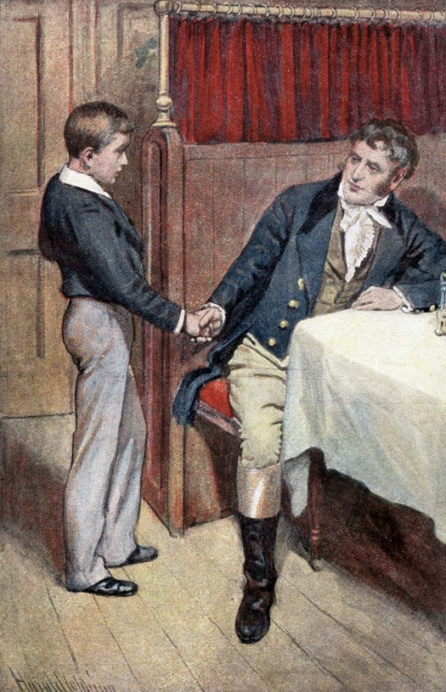
10. Keep an accountability with your son -
Sharing your struggles and failures
Praying together
Asking accountability questions
Are you reading your Bible
What is God teaching you
What did you get out of the pastor’s message
Has anything happened that I need to know about
Is there any sin that you are struggling with
Do you have any prayer request

Slide 19
11. Lead through personal example – Phil. 3:15-21
12. Apply firm, loving and consistent discipline –
Prov. 22:6
13. Teach your son how to identify and avoid the
snares of the Devil -
The snare of pride - I Tim. 3:6-7
The snare of riches - I Tim. 6:6-12, 17-19
The snare of spiritual apathy – II Tim. 2:26
The snare of idolatry - Judges 8:27
The snare of the fear of man - Prov. 29:25
The snare of immorality – Proverbs 7:21-27

Slide 20
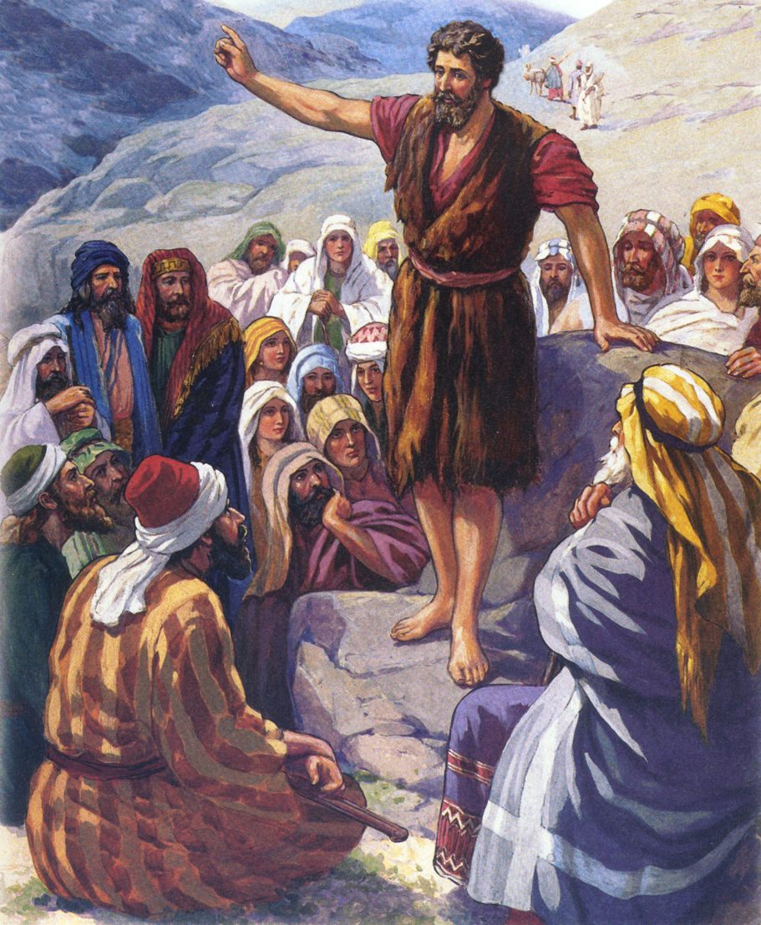
“And many of the children of Israel shall he turn to the Lord their God. And he shall go before him in the spirit and power of Elias, to turn the hearts of the fathers to the children, and the disobedient to the wisdom of the just; to make ready a people prepared for the Lord.”
(Luke 1:16-17)

Slide 21
