Slide 1
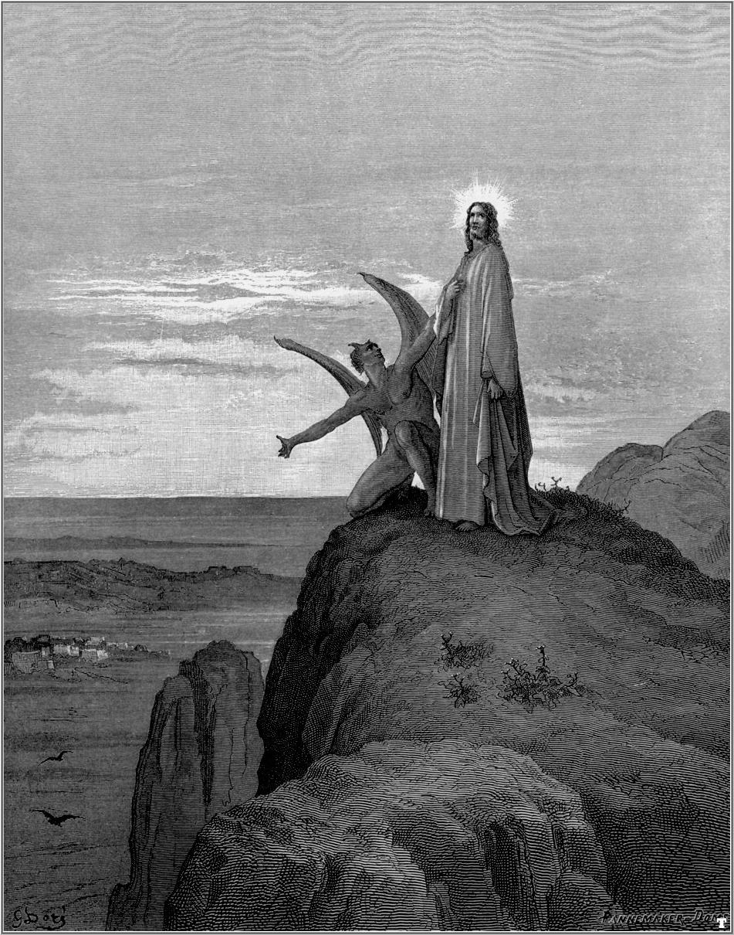
Ten Deadly Dangers that Cause Christians to Fail
“Resist the Devil and he
will flee from you…”
I Corinthians 10 :12-13
“Wherefore let him that thinketh he standeth take heed lest he fall. There hath no temptation taken you but such as is common to man: but God is faithful, who will not suffer you to be tempted above that ye are able; but will with the temptation also make a way to escape, that ye may be able to bear it.”

Slide 2
1. Pride
Believing that I have achieved what God and others have done for me.
Prov. 8:13 “The fear of the LORD is to hate evil: pride, and arrogancy, and the evil way, and the froward mouth, do I hate.”
Prov. 16:18 “Pride goeth before destruction, and an haughty spirit before a fall. Better it is to be of an humble spirit with the lowly, than to divide the spoil with the proud.”

Slide 3
Prov. 29:23 “A man's pride shall bring him low: but honour shall uphold the humble in spirit.”
Personal commitment – I will deflect praise
Proverbs 27:1-2 “Boast not thyself of tomorrow; for thou knowest not what a day may bring forth. Let another man praise thee, and not thine own mouth; a stranger, and not thine own lips.”
(Jesus)
“Every one that exalteth himself shall be abased; and he that humbleth himself shall be exalted.”

Slide 4
2. Wrong Priorities
Putting work or personal interest ahead of church attendance, serving the Lord, needs of your family, etc.
Matt. 6:33 “But seek ye first the kingdom of God, and his righteousness; and all these things shall be added unto you.”
Matt. 10:37 “He that loveth father or mother more than me is not worthy of me: and he that loveth son or daughter more than me is not worthy of me.”
Eph. 5:22-6:4; Col. 3:18-21; I Tim. 3:4-5

Slide 5
Personal commitment – I will put the Lord first in my life and my family needs ahead of my own.
(Colossians 3:18-21) “Wives, submit yourselves unto your own husbands, as it is fit in the Lord. Husbands, love your wives, and be not bitter against them. Children, obey your parents in all things: for this is well pleasing unto the Lord. Fathers, provoke not your children to anger, lest they be discouraged.”
(Colossians 3:24) “Knowing that of the Lord ye shall receive the reward of the inheritance: for ye serve the Lord Christ.”

Slide 6
3. Neglect of God
Allowing people and things to crowd out time for…
Prayer – Luke 18:1
Bible reading – I Tim. 4:13
Bible study – II Tim. 2:15
Bible memorization and meditation – Ps. 119
Church attendance – Heb. 10:24-25
Service for Christ in the Local Church – I Cor. 16:15

Slide 7
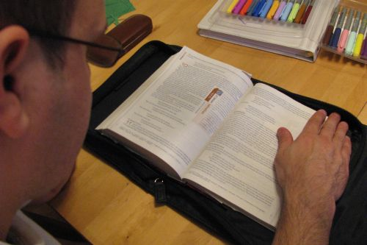
Personal commitment – I will build my life around Scriptural priorities (I Cor. 15:58)

Slide 8
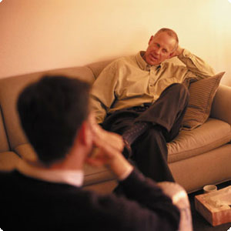
4. Unwise Counselors
Seeking the advice of popular/worldly people rather than godly people.
Psalms 1:1-3 “Blessed is the man that walketh not in the counsel of the ungodly, nor standeth in the way of sinners, nor sitteth in the seat of the scornful. But his delight is in the law of the LORD; and in his law doth he meditate day and night. And he shall be like a tree planted by the rivers of water, that bringeth forth his fruit in his season; his leaf also shall not wither; and whatsoever he doeth shall prosper.”

Slide 9
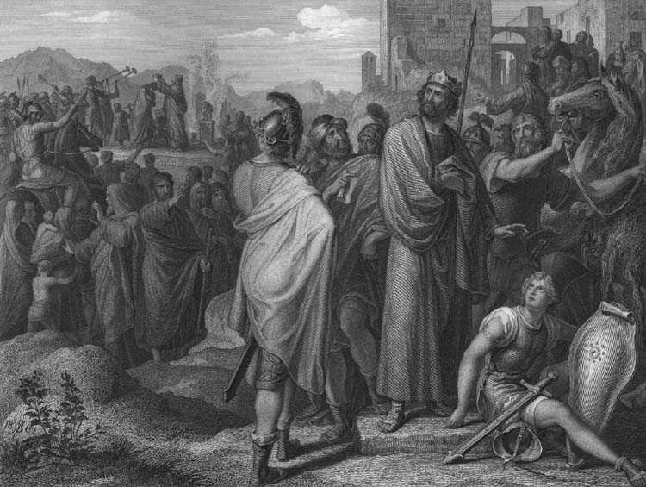
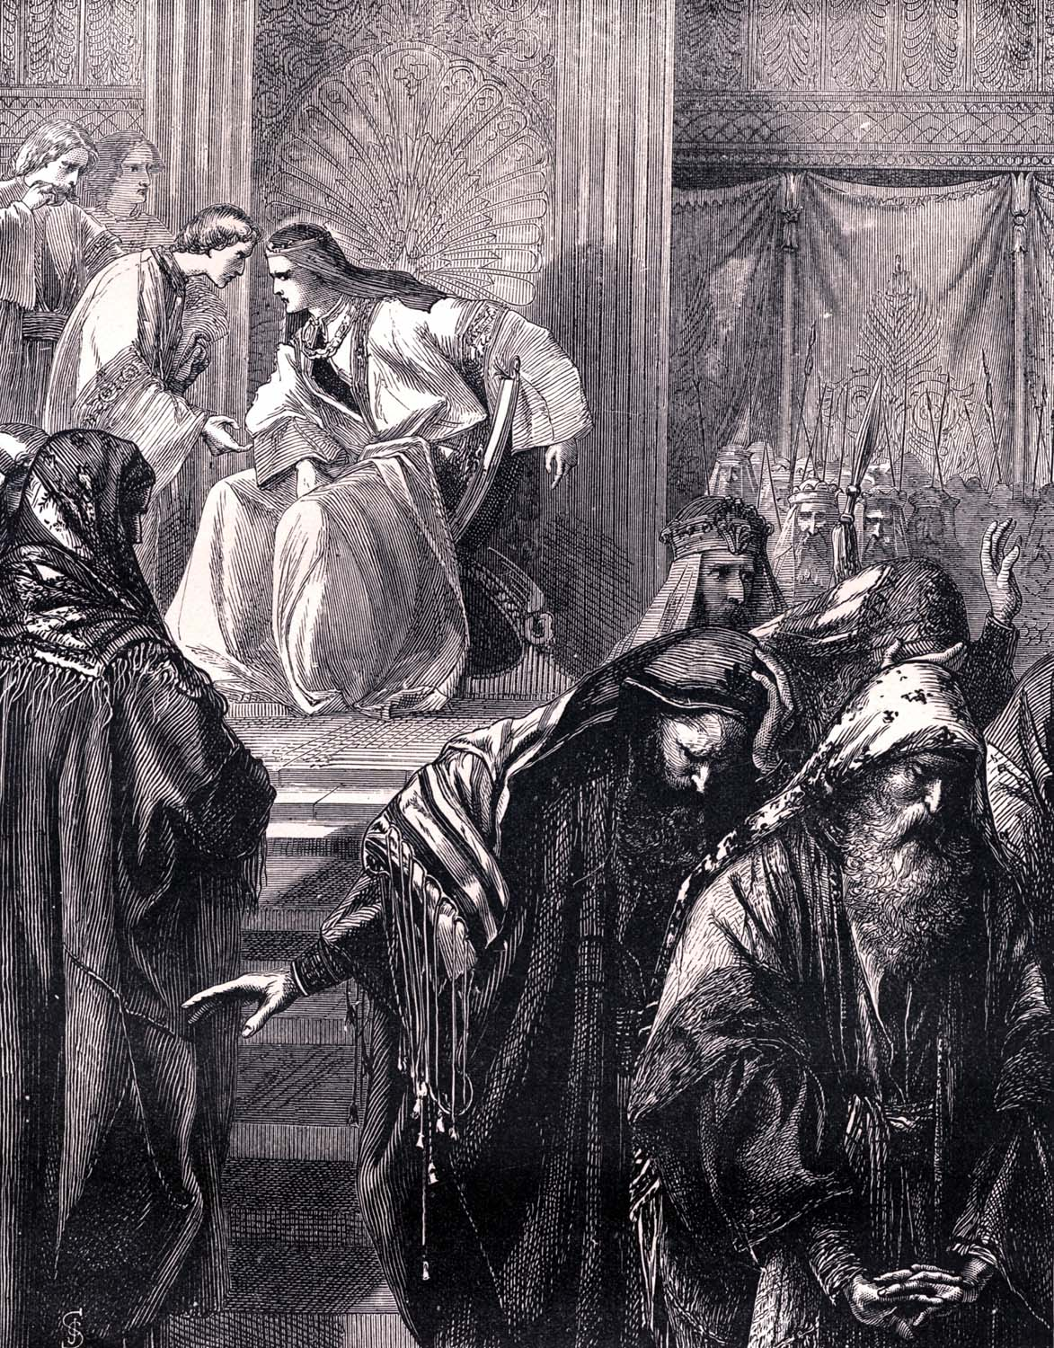
I Kings 12:8-11 “But he (Rehoboam) forsook the counsel of the old men, which they had given him, and consulted with the young men that were grown up with him, and which stood before him: And he said unto them, What counsel give ye that we may answer this people, who have spoken to me, saying, Make the yoke which thy father did put upon us lighter? And the young men that were grown up with him spake unto him, saying, Thus shalt thou speak unto this people that spake unto thee, saying, Thy father made our yoke heavy, but make thou it lighter unto us; thus shalt thou say unto them, My little finger shall be thicker than my father's loins. And now whereas my father did lade you with a heavy yoke, I will add to your yoke: my father hath chastised you with whips, but I will chastise you with scorpions.”

Slide 10
Personal commitment – I will seek out wise and godly advisors and will compare their advice with the counsel of Scripture.
Prov. 8:14 “Counsel is mine, and sound wisdom: I am understanding; I have strength.”
Prov. 11:14 “Where no counsel is, the people fall: but in the multitude of counsellors there is safety.”
Prov. 15:22 “Without counsel purposes are disappointed: but in the multitude of counsellors they are established.”
Prov. 24:26 “Every man shall kiss his lips that giveth a right answer.”

Slide 11
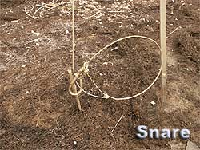
5. Fear of Man
Desiring people’s praise and approval rather than God’s.
Heb. 13:6 “So that we may boldly say, The Lord is my helper, and I will not fear what man shall do unto me.”
Gal. 1:10 “Do I seek to please men? For if I yet pleased men, I should not be the servant of Christ.”
Prov. 29:25 “The fear of man bringeth a snare: but whoso putteth his trust in the LORD shall be safe.”

Slide 12
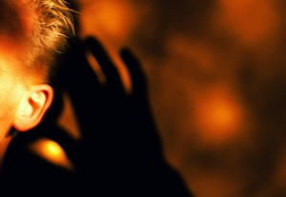
Personal commitment – I will follow and obey the Lord entrusting Him with my reputation (Phil. 2:1-11).

Slide 13
6. Love of Money
Expecting from money and things what only God can do for you.
Eccl. 5:10-17 “He that loveth silver shall not be satisfied with silver; nor he that loveth abundance with increase: this is also vanity. When goods increase, they are increased that eat them: and what good is there to the owners thereof, saving the beholding of them with their eyes? The sleep of a labouring man is sweet, whether he eat little or much: but the abundance of the rich will not suffer him to sleep…

Slide 14
There is a sore evil which I have seen under the sun, namely, riches kept for the owners thereof to their hurt. But those riches perish by evil travail: and he begetteth a son, and there is nothing in his hand. As he came forth of his mother's womb, naked shall he return to go as he came, and shall take nothing of his labour, which he may carry away in his hand. And this also is a sore evil, that in all points as he came, so shall he go: and what profit hath he that hath laboured for the wind? All his days also he eateth in darkness, and he hath much sorrow and wrath with his sickness.”

Slide 15
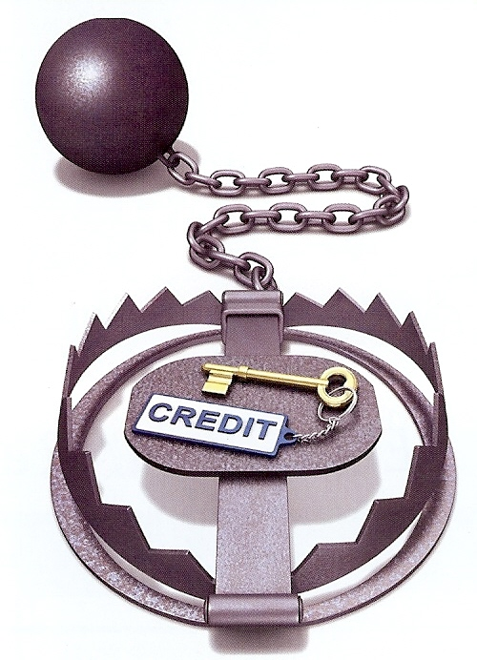
Personal commitment - I will reject debt, money from evil sources, and will set my affections on things above (Col. 3:2).
Rom.13:8 “Owe no man any thing, but to love one another.”
Prov. 28:8 “He that by usury and unjust gain increaseth his substance, he shall gather it for him that will pity the poor.”

Slide 16
7. Lust
Committing mental and physical adultery.
Proverbs 5:1-23
Proverbs 6:20-35
Proverbs 7:1-27
Matthew 5:27-28
I Thessalonians 4:1-8

Slide 17
Reprobation – Perversion. Not standing the test – the rejection of God in one’s mind resulting in the perversion of one moral sense – “Because they did not like to retain God in their knowledge, God gave them over to a reprobate mind…” (see Romans 1)
Lasciviousness – Absence of sexual restraint, indecency, expressions of lewdness, vile, wicked, base – “They have given themselves over to lasciviousness to work all uncleanness…”
Concupiscence – A stronger than normal desire or appetite for sexual fulfillment, to desire intensely – “Lust of concupiscence…”
Defrauding – To deprive of rights, to rob, cheat, deceive or defile – “Defraud ye not one another…”
Lust – An intense desire especially sexual desire. To long after – “Lust not after her beauty in thy heart…”

Slide 18
Bestiality - Lev. 18:22-30
Incest – I Cor. 5:1-13
Sodomy – II Peter 2:1-9
Adultery – Gal. 5:19
Fornication - Col. 3:5

Slide 19
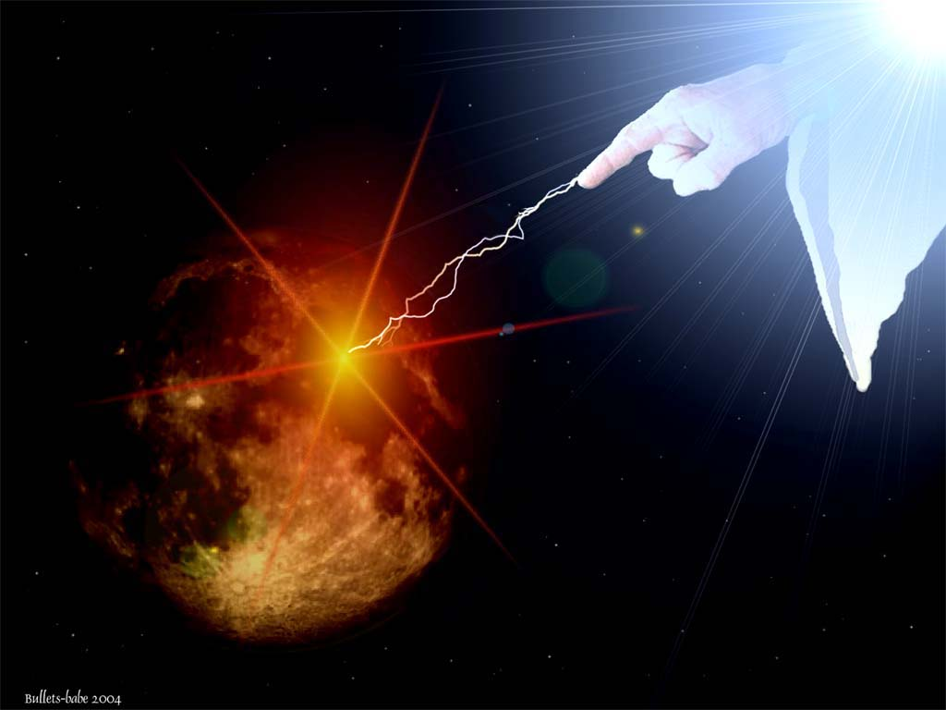
“Who knowing the judgment of God, that they which commit such things are worthy of death, not only do the same, but have pleasure in them that do them…But we are sure that the judgment of God is according to truth against them which commit such things.” (Rom. 1:32; 2:2)

Slide 20
Personal Commitment – I will reject the world’s standard of morality and look down and away when faced with moral temptations. I will avoid even the appearance of evil.
“I made a covenant with mine eyes; why then should I think upon a maid?” Job 31:1
“Abstain from all appearance of evil.” I Thess. 5:22

Slide 21
8. Bitterness
Failing to see God’s working through those who have caused you to suffer.
Heb. 12:15 “Looking diligently lest any man fail of the grace of God; lest any root of bitterness springing up trouble you, and thereby many be defiled.”
Eph. 4:31 “Let all bitterness, and wrath, and anger, and clamour, and evil speaking, be put away from you, with all malice.”

Slide 22
Personal commitment – I will…(Luke 6:27-38)
Love your enemies…
Do good to them which hate you…
Bless the that curse you…
Pray for them which despitefully use you…
Unto him that smiteth thee on the one cheek offer also the other…
Him that taketh away thy cloak forbid not to take thy coat also…
Give to every man that asketh thee…

Slide 23
Him that taketh away thy goods ask them not again…
As ye would that men should do to you, do ye also to them likewise…
Love your enemies…
Do good and lend hoping for nothing again…
Be ye therefore merciful, as your Father also is merciful…

Slide 24
9. Neglecting the Needs of Others
Being focused on one’s own personal needs and desires.
Phil. 2:3-5 “Let nothing be done through strife or vainglory; but in lowliness of mind let each esteem other better than themselves. Look not every man on his own things, but every man also on the things of others. Let this mind be in you, which was also in Christ Jesus.”

Slide 25
Acts 20:35 “I have shewed you all things, how that so labouring ye ought to support the weak, and to remember the words of the Lord Jesus, how he said, It is more blessed to give than to receive.”
James 1:27 “Pure religion and undefiled before God and the Father is this, To visit the fatherless and widows in their affliction.”
I John 3:17 "But whoso hath this world's good, and seeth his brother have need, and shutteth up his bowels of compassion from him, how dwelleth the love of God in him?
Personal commitment -

Slide 26
10. Failure to Act Quickly to Resolve a Problem
Hoping that a problem will simply improve, resolve itself or go away.
Matt. 5:24-25 “Therefore if thou bring thy gift to the altar, and there rememberest that thy brother hath ought against thee; Leave there thy gift before the altar, and go thy way; first be reconciled to thy brother, and then come and offer thy gift. Agree with thine adversary quickly, whiles thou art in the way with him.”
Eccl. 8:11 “Because sentence against an evil work is not executed speedily, therefore the heart of the sons of men is fully set in them to do evil.”

Slide 27
Personal commitment – I will act in the day I hear of the problem if at all possible.

Slide 29
Ten Deadly Dangers that Cause Christians to Fail
7. Lust
8. Bitterness
9. Neglecting the
Needs of Others
10. Failure to Act
Quickly to Resolve
a Problem
1. Pride
2. Wrong Priorities
3. Neglect of God
4. Unwise Counselors
5. Fear of Man
6. Love of Money

