Slide 1
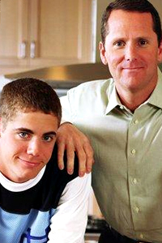
Keeping the Hearts of Your Children
The Key to Raising Godly Children

Slide 2
Raising children is a challenge – Eph. 6:1-4
Raising good children is a big challenge – Prov. 10:1
Raising godly children is an incredible, but possible challenge –
“For with God nothing shall be impossible.” (Luke 1:37)
“I can do all things through Christ which strengtheneth me.” (Phil. 4:13)
“Train up a child in the way he should go: and when he is old, he will not depart from it.” (Prov. 22:6)

Slide 3
Important ingredients needed to raise Godly children
Teach children to obey immediately with a sweet spirit - Colossians 3:20
Teach children to show respect and honor - Exodus 20:12
Protect children from evil influences - Romans 16:19

Slide 4
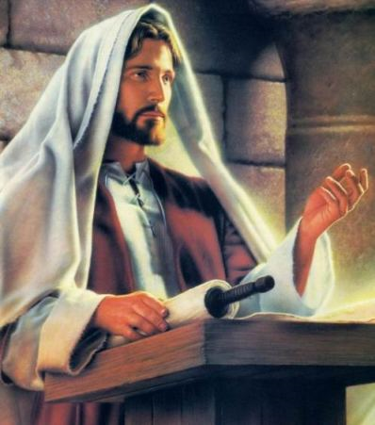
Teaching obedience, respect and protecting children from evil are three main ingredients necessary in raising godly children.
But they are not the key ingredient - “Touch not; taste not; handle not…” Col. 2:21
In fact, you may have those ingredients and still not succeed in raising godly children.
(Matt. 15:1-20)

Slide 5
“But sin, taking occasion by the commandment, wrought in me all manner of concupiscence…For sin, taking occasion by the commandment, deceived me, and by it slew me…For that which I do I allow not: for what I would, that do I not; but what I hate, that do I. If then I do that which I would not, I consent unto the law that it is good. Now then it is no more I that do it, but sin that dwelleth in me. For I know that in me dwelleth no good thing: for to will is present with me; but how to perform that which is good I find not. For the good that I would I do not: but the evil which I would not, that I do. Now if I do that I would not, it is no more I that do it,but sin that dwelleth in me…

Slide 6
I find then a law, that, when I would do good, evil is present with me. For I delight in the law of God after the inward man: But I see another law in my members, warring against the law of my mind, and bringing me into captivity to the law of sin which is in my members. O wretched man that I am! who shall deliver me from the body of this death? I thank God through Jesus Christ our Lord. So then with the mind I myself serve the law of God; but with the flesh the
law of sin.” (Romans 7:8, 11, 15-25)

Slide 7
The most important ingredient needed to raise godly children
Proverbs 23:26 “My son, give me thine heart.”
Malachi 4:6 “And he shall turn the heart of the fathers to the children, and the heart of the children to their fathers, lest I come and smite the earth with a curse.”

Slide 8
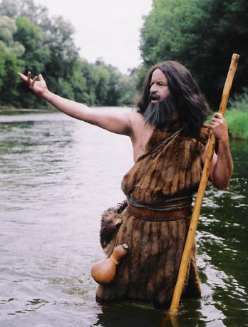
(Luke 1:17)
“And he (John the Baptist) shall go before him (Jesus) in the spirit and power of Elijah…
to turn the hearts of the fathers to the children…
and the disobedient (that’s the children)
to the wisdom of the just (that’s what parents are supposed to be)…
to make ready a people prepared for the Lord.”

Slide 9
When children see parents just, rather then unjust, they are more likely to cease their disobedience and rebellion and give their hearts to their parents.
Children will not be prepared for God to work in their lives until their hearts are turned from themselves, friends and others to their parents.

Slide 10
Key Ingredient
The key ingredient to raising godly children is to get their hearts early.
Keep their hearts.
Be extremely vigilant not to lose their hearts.
If you do lose your child’s heart, then quickly find out where and when you lost it and put into action a plan to get the heart back NO MATTER WHAT IT TAKES!

Slide 11
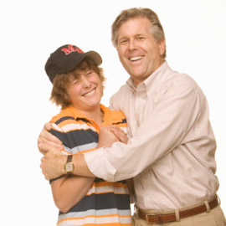
No matter…
How much time
Trouble
Money it takes to get back your child’s heart, you must decide you will be willing to pay the price.
It may cost you your job. Are you willing to pay the price?
It may cost you selling your home and relocating elsewhere. Are you willing to pay the price?
3. It may require radical changes in your own personal life. Are you willing to pay the price?

Slide 12
The heart of every problem is a problem in the heart (II Kings 10:15-16; Proverbs 4:23; 23:26; Matthew 12:34-35; 15:19)
The most vital organ in your body is your heart - You can live without your arm or leg, but you can’t live without a heart.
Your heart keeps everything else in your life living and functioning!

Slide 13
“For the word of God is quick, and powerful, and sharper than any two edged sword, piercing even to the dividing asunder of soul and spirit, and of the joints and marrow, and is a discerner of the thoughts and intents of the heart.” (Heb. 4:12)

Slide 14
Rebellion Originates in the Heart (Hebrews 3:10, 13)
“Wherefore I was grieved with that generation, and said, They do alway err in their heart; and they have not known my ways…But exhort one another daily, while it is called To day; lest any of you be hardened through the deceitfulness of sin.”

Slide 15
A parent who has his child’s heart will be able to speak into his child’s life - Proverbs 1:8-9
A parent who has his child’s heart will know what is going on in his child’s life - Proverbs 1:10-33
A parent who has his child’s heart can direct his child’s feet to go in the right direction - Proverbs 2:1, 20-22
A parent who has his child’s heart can protect his child’s eyes from immoral pictures and his or her ears from carnal music - Proverbs 6:20-33; Ephesians 5:10-19
A parent who has his child’s heart can determine who his child’s friends will be - Philippians 3:15-20

Slide 16
Every parent who loses his child’s heart runs the risk of raising a rebel, who will break his parent’s heart - Proverbs 17:25, 19:25-27; 29:15, 17

Slide 17
The one who has the child’s heart will eventually have the child’s life and loyalty
Proverbs 1:10
Romans 16:17-19
I Corinthians 15:33

Slide 18
The person to whom your child gives his or her heart will eventually have your child’s life and loyalty - I Kings 11:2-3; 12:5-14
The heart was not made to be kept. It was made to be given away - Proverbs 23:26
The world is continually pressing upon us and trying to capture our children’s hearts – Romans 12:1-2
The world knows that Whoever has the heart will eventually have the child - I John 2:15-17

Slide 19
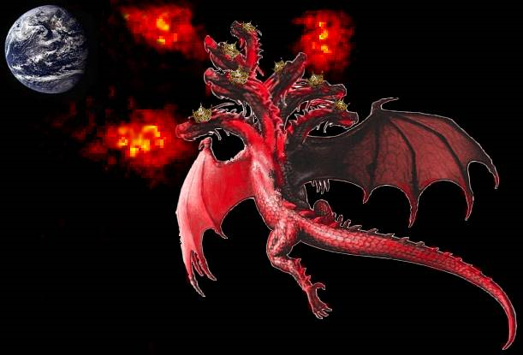
Peers
Friends
Boyfriends and girlfriends
TV and movie stars
Sports stars
Worldly music
Rock’n roll musicians
School teachers
Political leaders
Worldly entertainment
The list goes on. . .

Slide 20
How do you Know if you have your Child’s Heart
Does your child listen respectfully when you speak?
Does your child have a genuine desire to please you?
Does it hurt your child to displease you?
Is your child loyal to you in your presence, as well as behind your back?

Slide 21
Does your Child have a Boyfriend or Girlfriend?
One of Satan’s biggest ways of getting children’s hearts to prematurely turn away from their parents, is by getting them to play the boyfriend / girlfriend game - I Corinthians 7:32 II Corinthians 2:11 I Thessalonians 4:1-8

Slide 22
Children want Parents to Have their Hearts (II Samuel 14:32-33)
Every child is born with the desire to please their parents and to be close to their parents.
Parents who do not give praise and approval to their child will lose their child’s heart - I Corinthians 11:2
Parents who do not discipline their child in love will lose their child’s heart - I Samuel 2:12; 3:13-14; Proverbs 13:24; 19:18; 20:20; 22:15; 23:13-14; 29:15

Slide 23
The Story of David and Absalom (II Samuel 13-14)
A Father who lost
his son’s heart

Slide 24
The account of Absalom’s rebellion illustrates for us how a father loses the heart of his son.
David wasn’t as protective of Tamar as he should have been.
Fundamental Bible-believers are often accused of over-protecting their children.
We don’t lose our child’s heart by being protective. We lose their heart by being harsh, critical, unloving, and inconsistent - (I Corinthians 13:1-8)

Slide 25
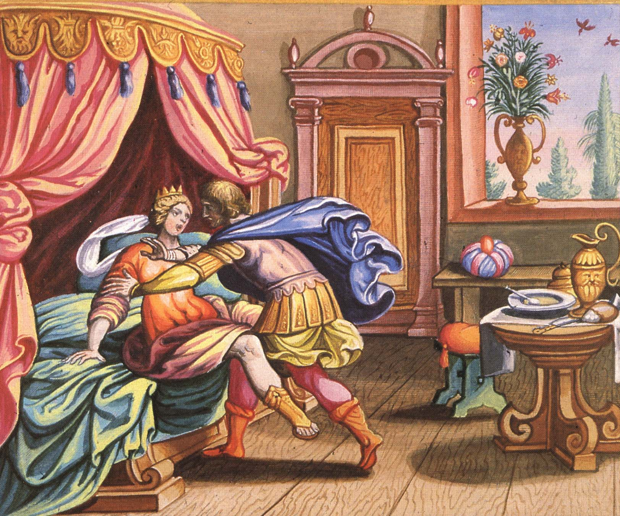
David allowed Tamar’s half-brother Amnon to be alone with Tamar - Tamar was raped by Amnon II Samuel 13:1-14

Slide 26
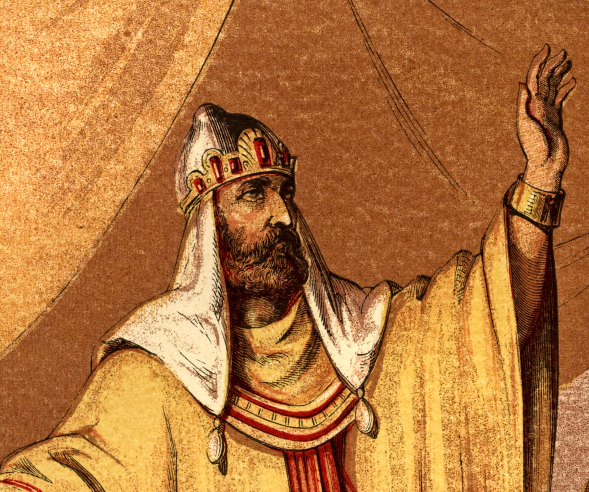
David was angry when he heard what happened, but he took no action - II Samuel 13:21; Ecclesiastes 8:11

Slide 27
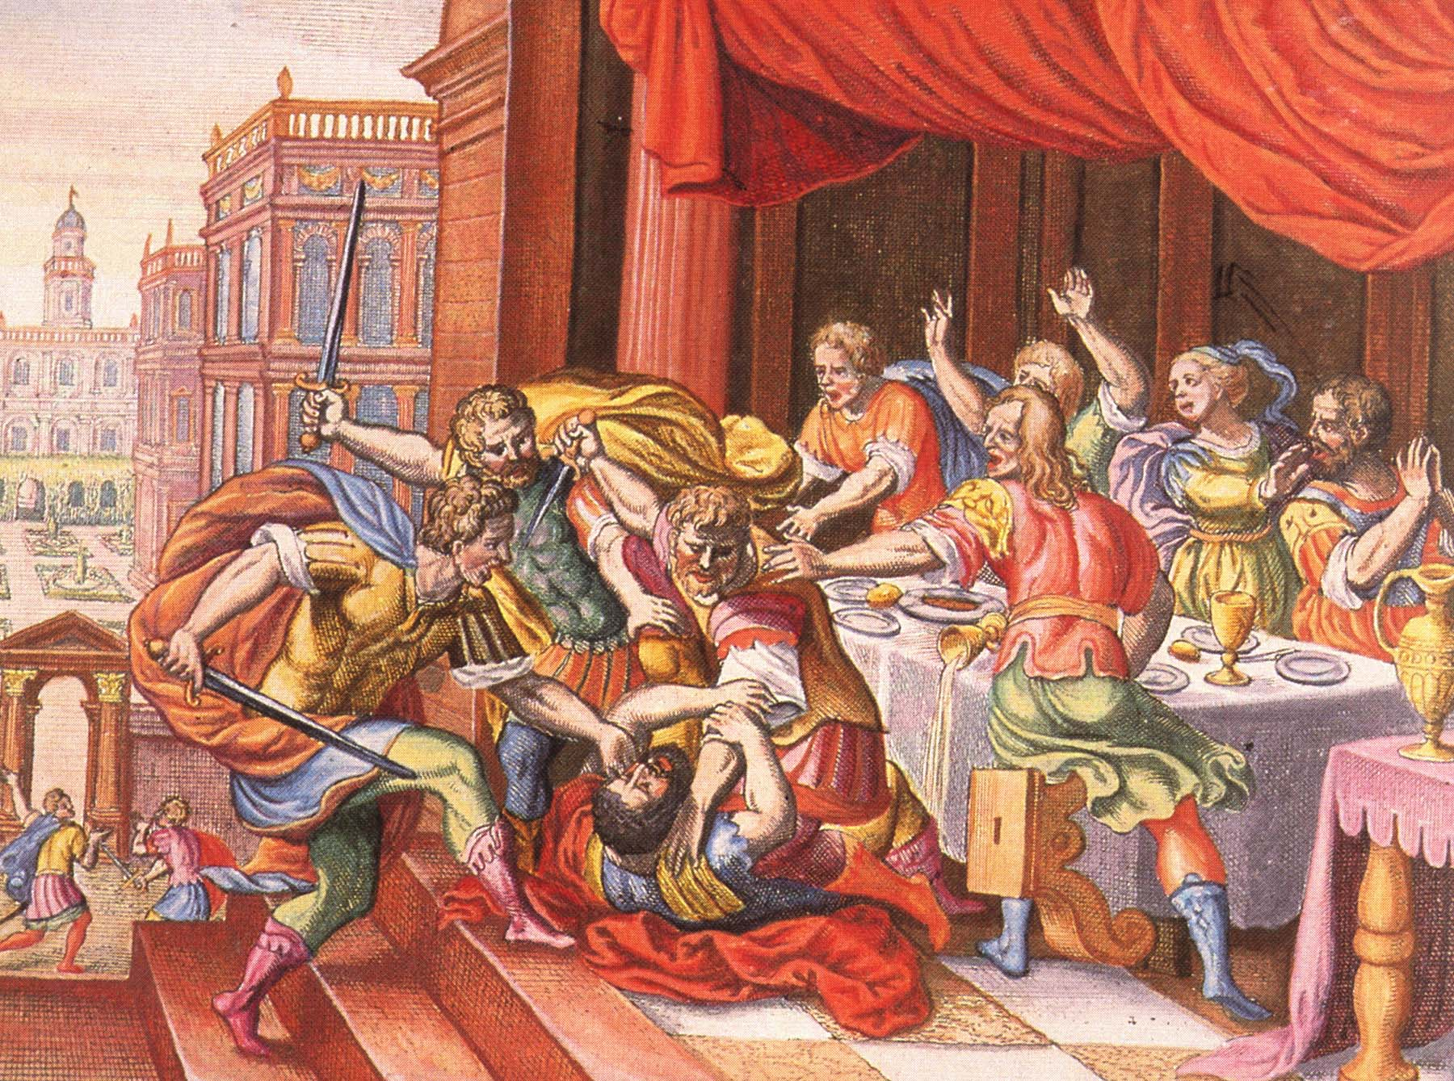
Two years later Absalom had his half-brother Amnon executed to revenge his sister’s rape II Samuel 13:28

Slide 28
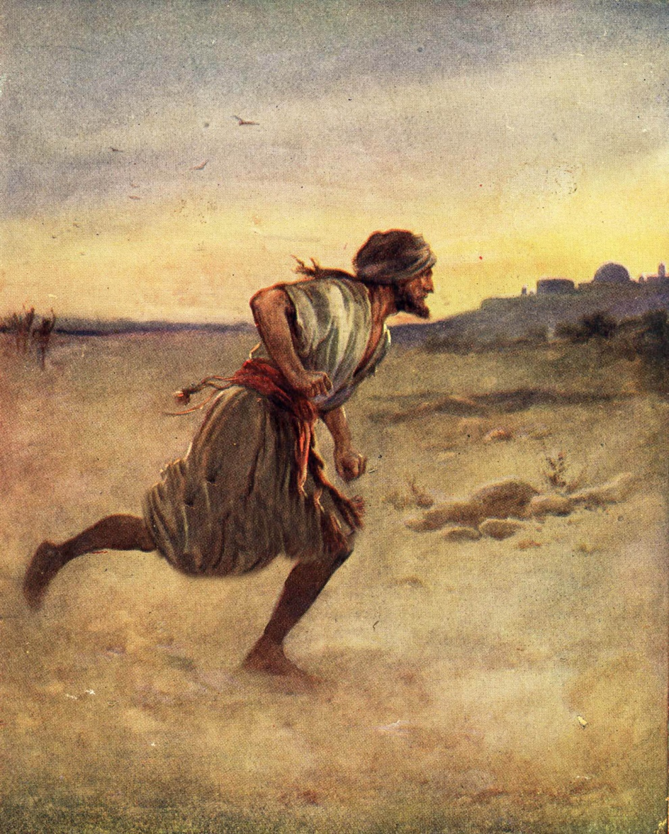
Absalom fled to Geshur for three years and David made no contact – II Samuel 13:37; Galatians 6:1-2

Slide 29
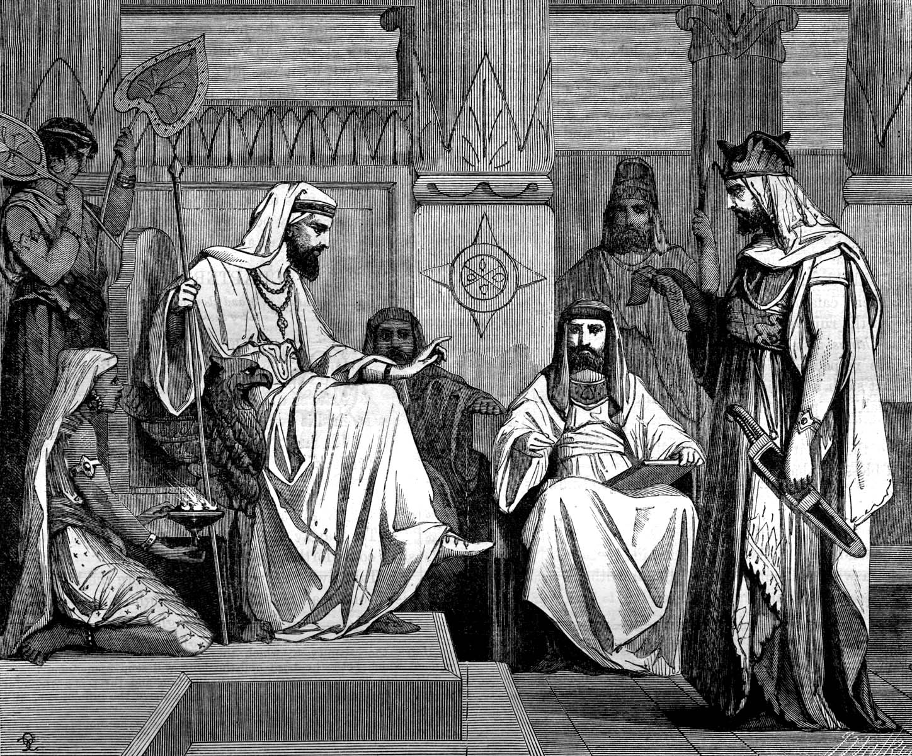
Joab (David’s general) noticed how badly David missed Absalom.
He convinced David to bring Absalom back to Jerusalem - II Samuel 14:21
David refused to see or talk to Absalom for two more years - II Samuel 14:24

Slide 30
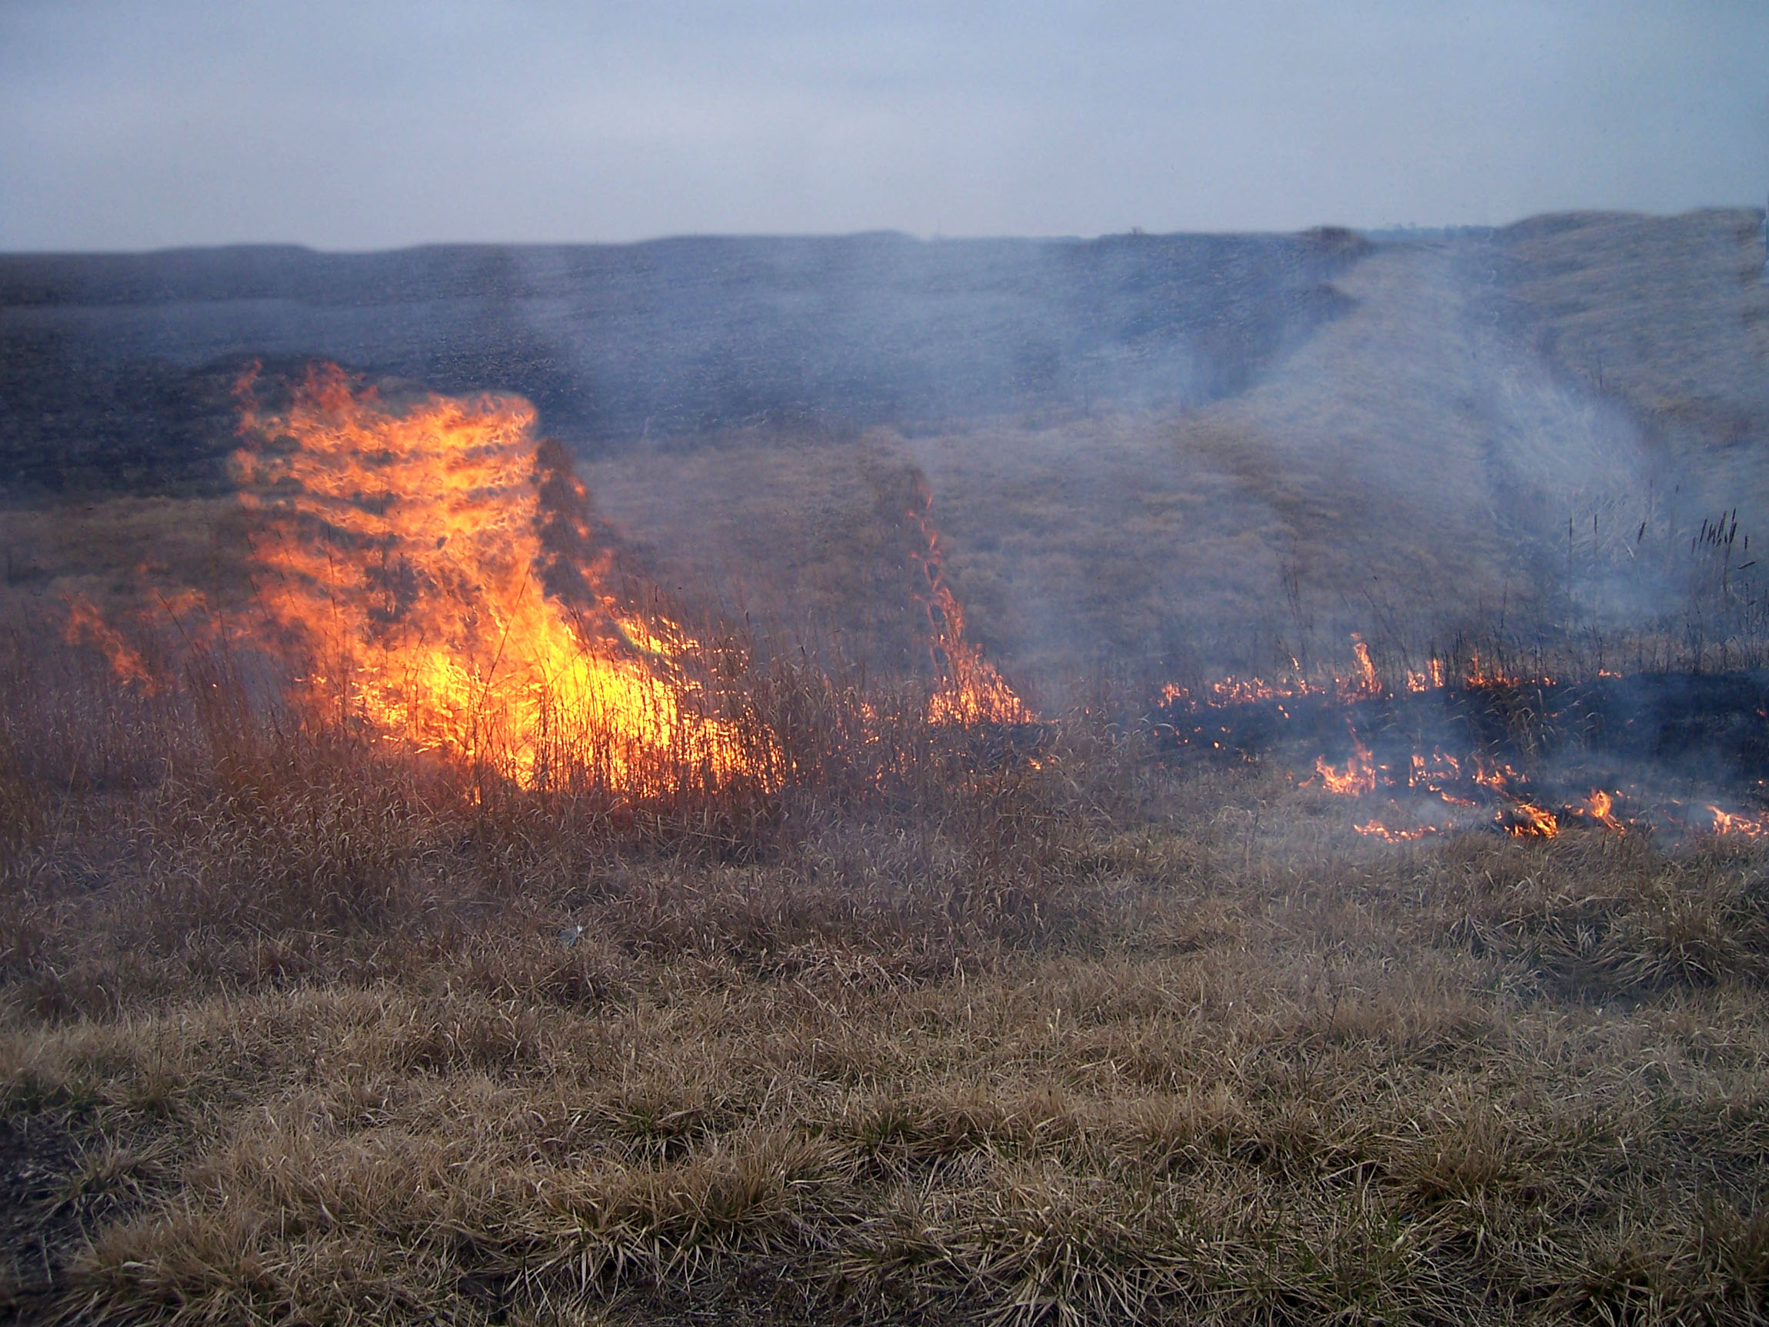
Absalom, provoked to wrath by his father’s silence and rejection, sent for Joab. When Joab didn’t come, he had Joab’s barley fields set on fire
II Samuel 14:30

Slide 31
Those fields on fire were a picture of Absalom’s heart burning with anger because of the anger and rejection he felt because of being cut off from his father.

Slide 32
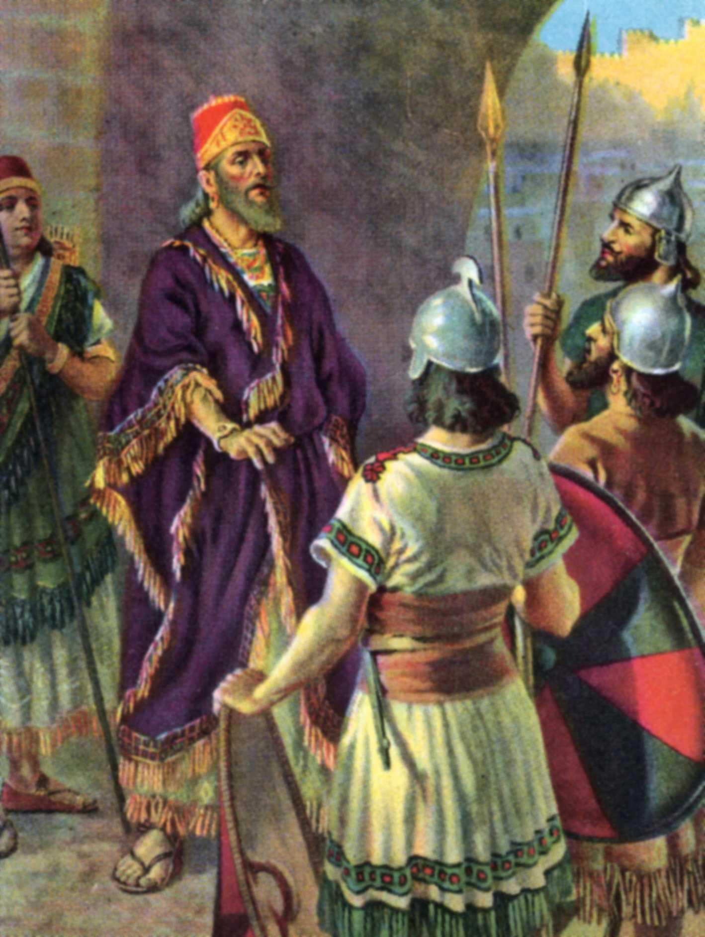
When Joab finally came to Absalom, Absalom said, “I want to see my father. If he wants to kill me, then let him kill me, but I want to see my father!”

Slide 33
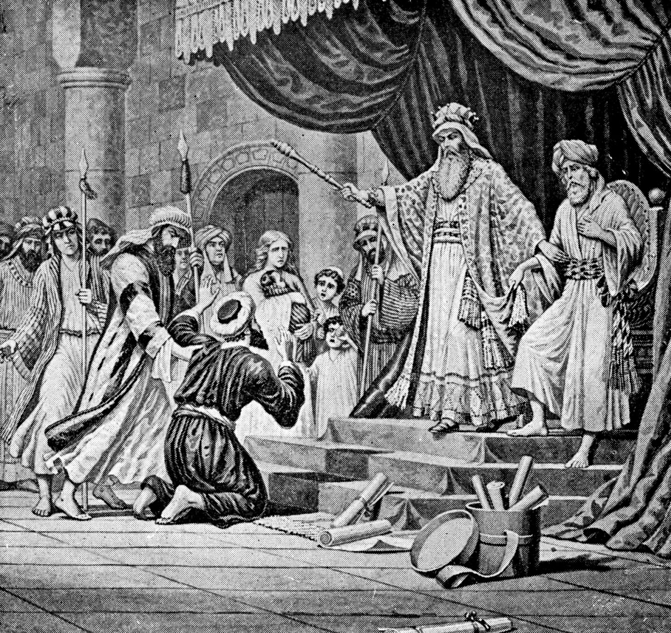
When Absalom presented himself before his father, he was treated like a subject and not a son II Samuel 14:33

Slide 34
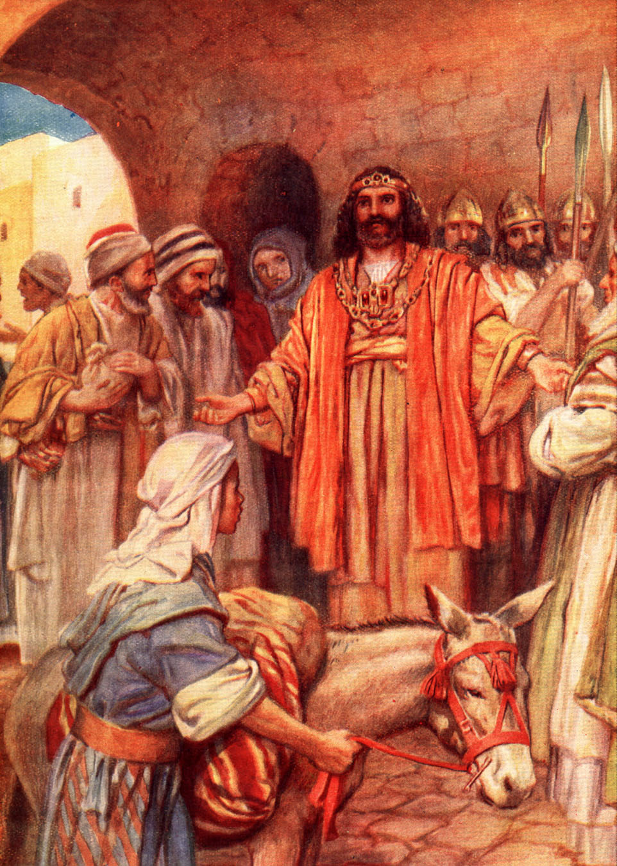
David never asked forgiveness for his actions.
Absalom’s bitterness was never dealt with - Hebrews 12:15
Absalom became a rebel - II Samuel 15:1-5
Absalom stole the hearts of the men of Israel - II Samuel 15:6
Absalom usurped his father’s throne - II Samuel 15:13-14

Slide 35
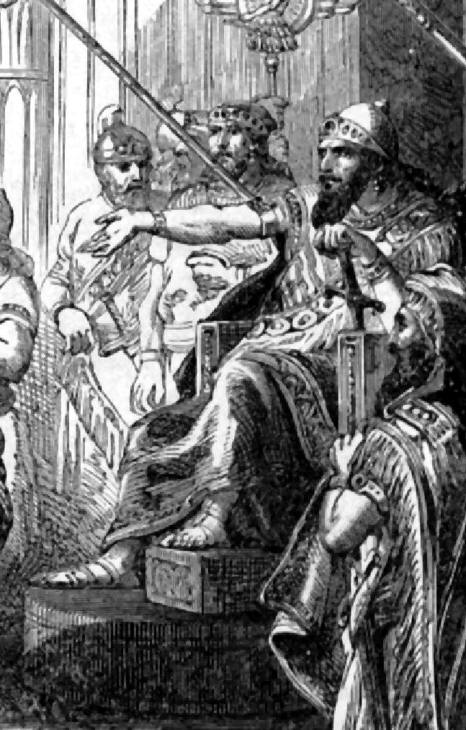
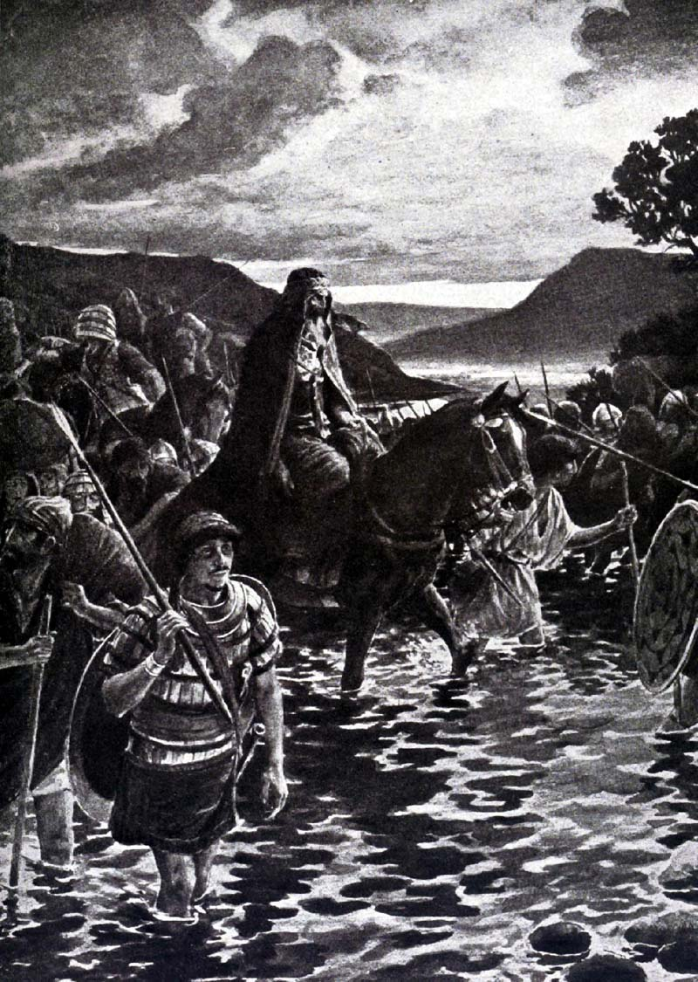
Before the chapter ends David is running for his life, and Absalom, the rebel, has taken the throne of Israel.

Slide 36
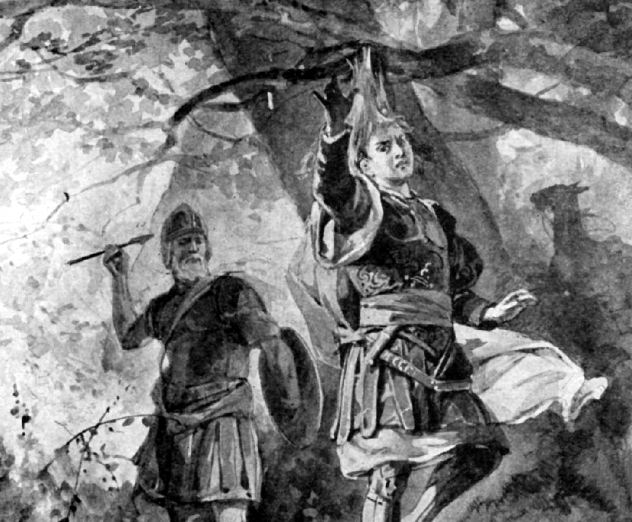
“Joab took three darts in his hand, and thrust them through the heart of Absalom, while he was yet alive in the midst of the oak.”

Slide 37
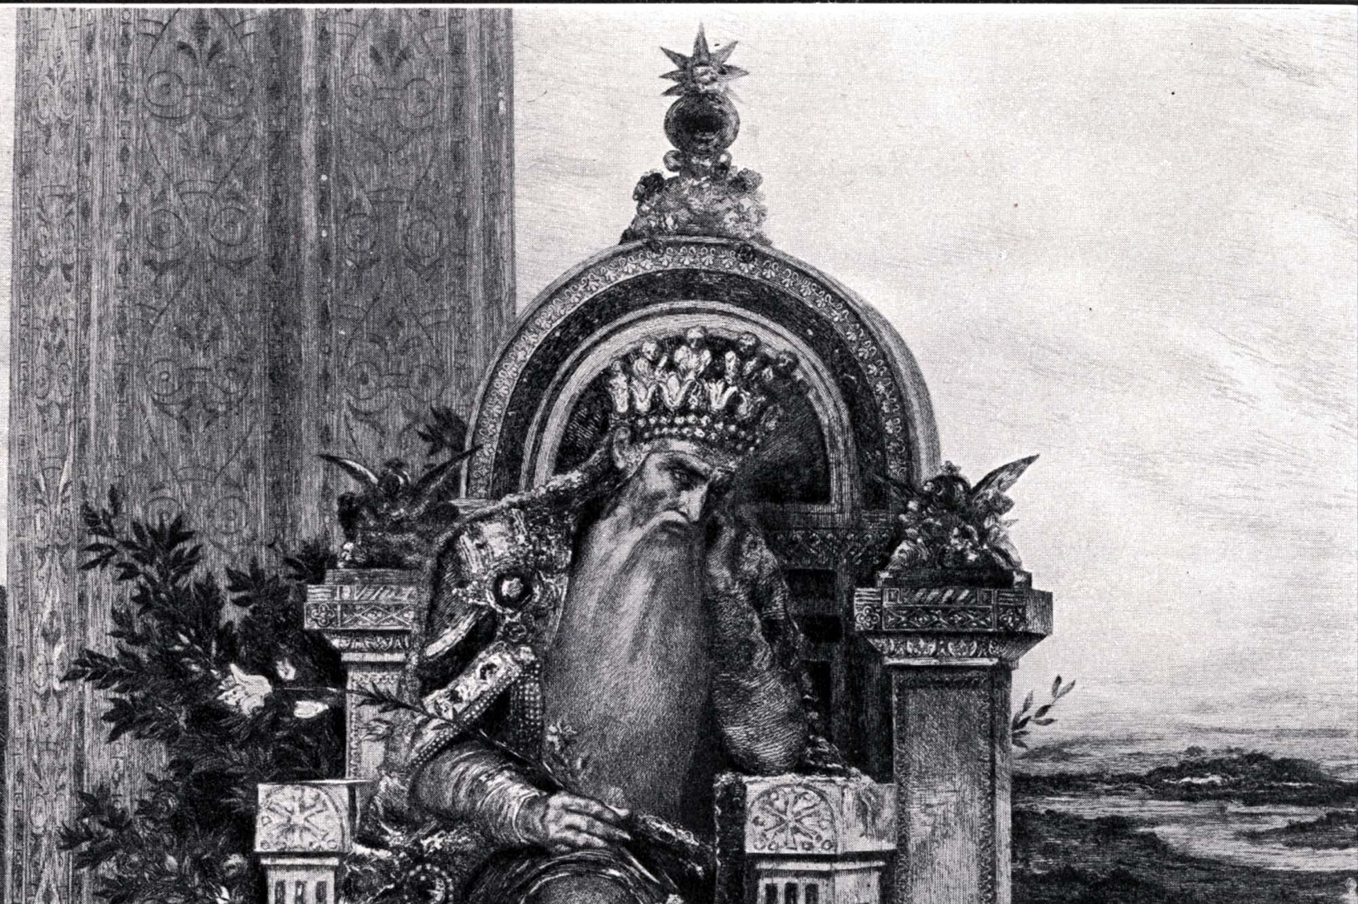
“And the king was much moved, and wept: and as he went, thus he said, O my son Absalom, my son, my son Absalom! would God I had died for thee, O Absalom, my son, my son!”

Slide 38
Four big dangers for the heart
1. The heart can be lost - Colossians 3:19-21
Parents often lose their child’s heart by expressing anger at the child - James 1:19-20
Anger does not break a child’s will - Ephesians 4:29-32
Anger breaks a child’s heart - Ephesians 6:4
2. The heart can be drawn away - Acts 20:30
3. The heart can become hardened - Hebrews 3:13
4. The heart can be stolen - II Samuel 15:6

Slide 39
“Keep thy heart with all diligence; for out of it are the issues of life.”
(Prov. 4:23)

