Slide 1
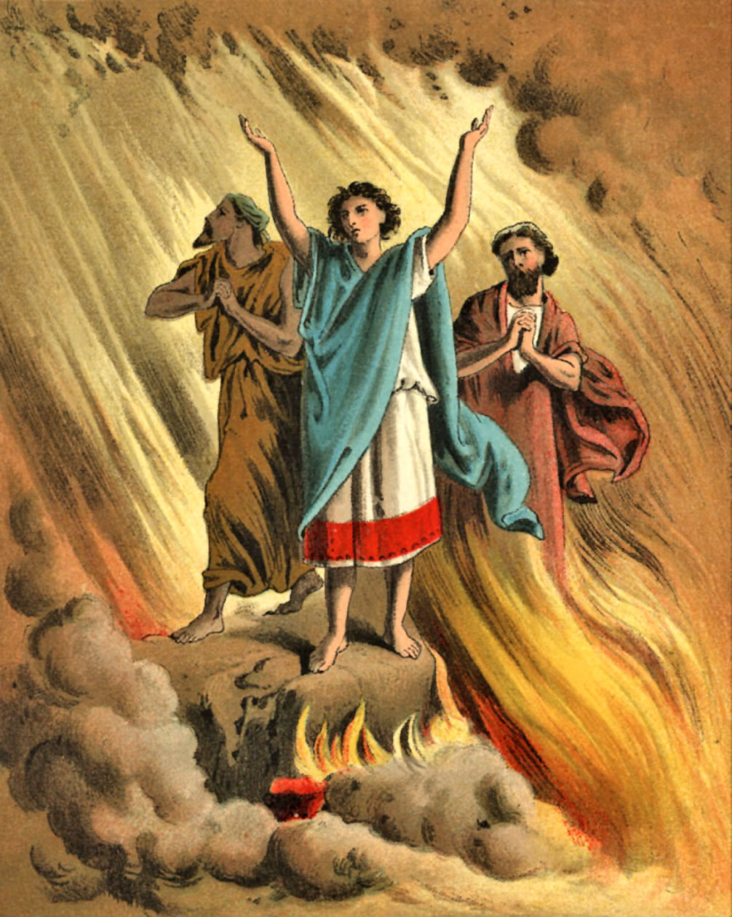
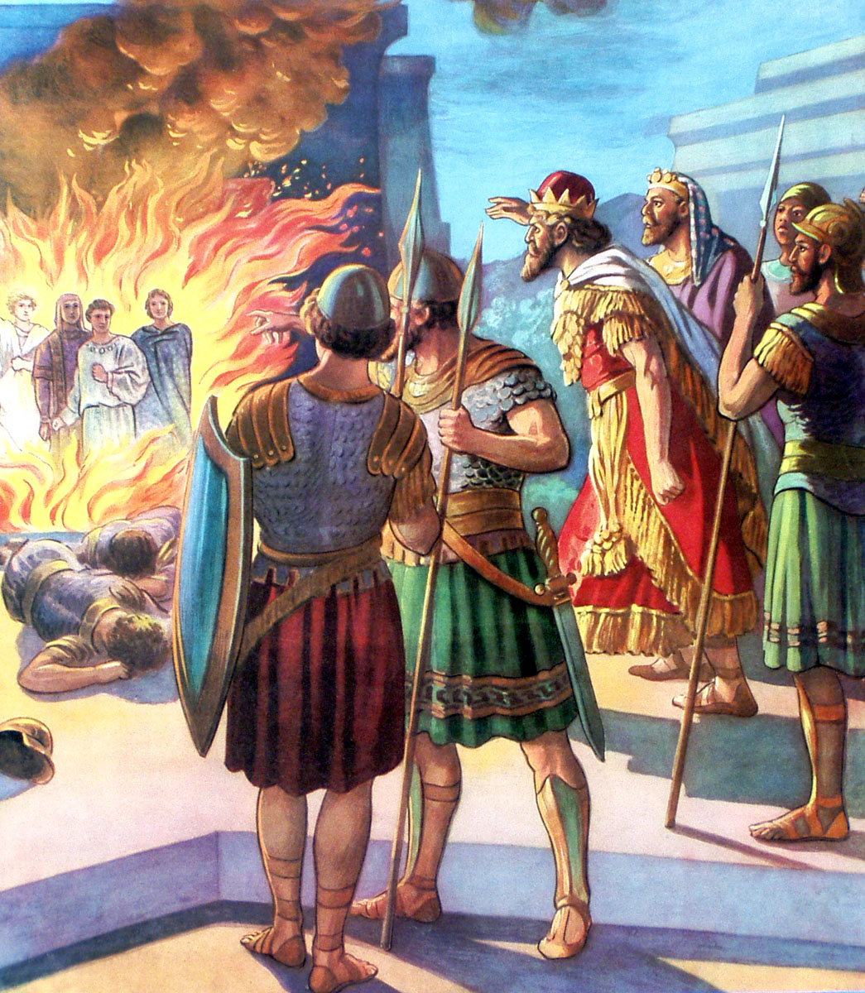
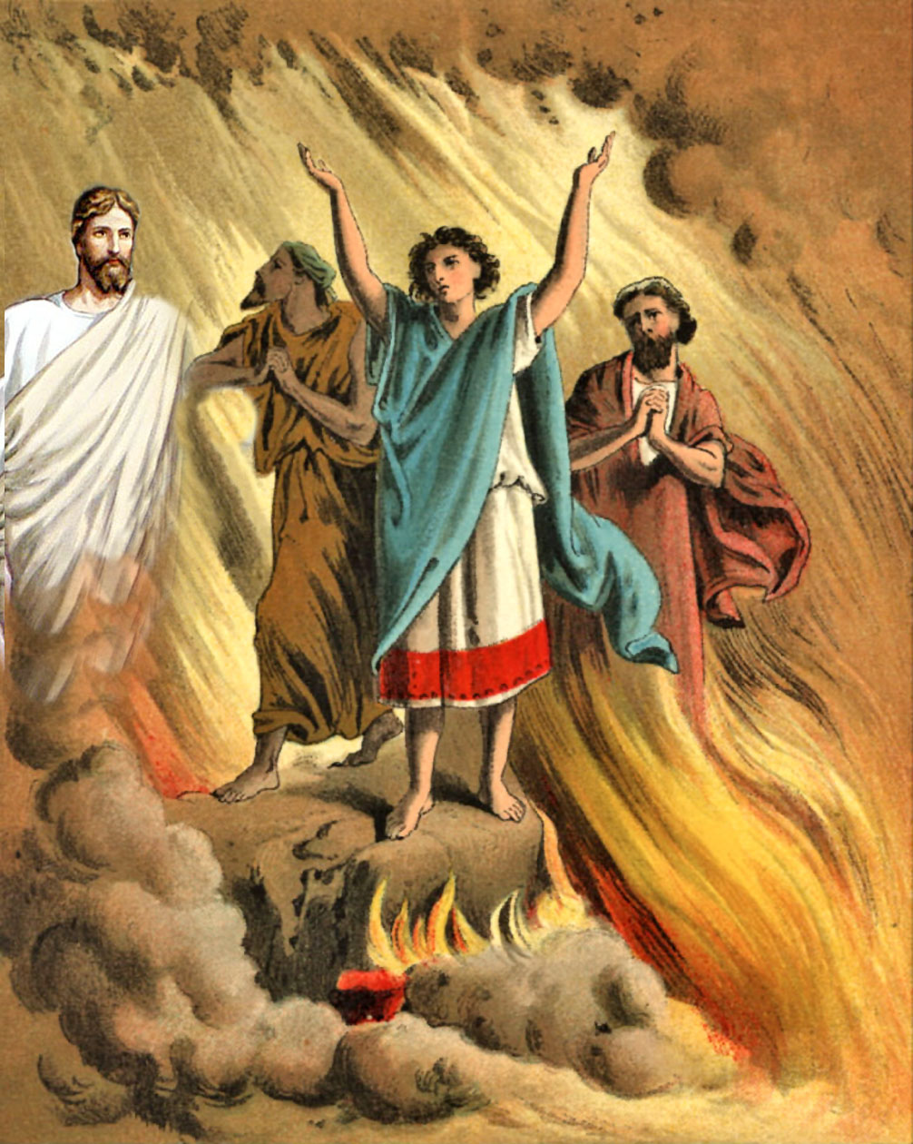
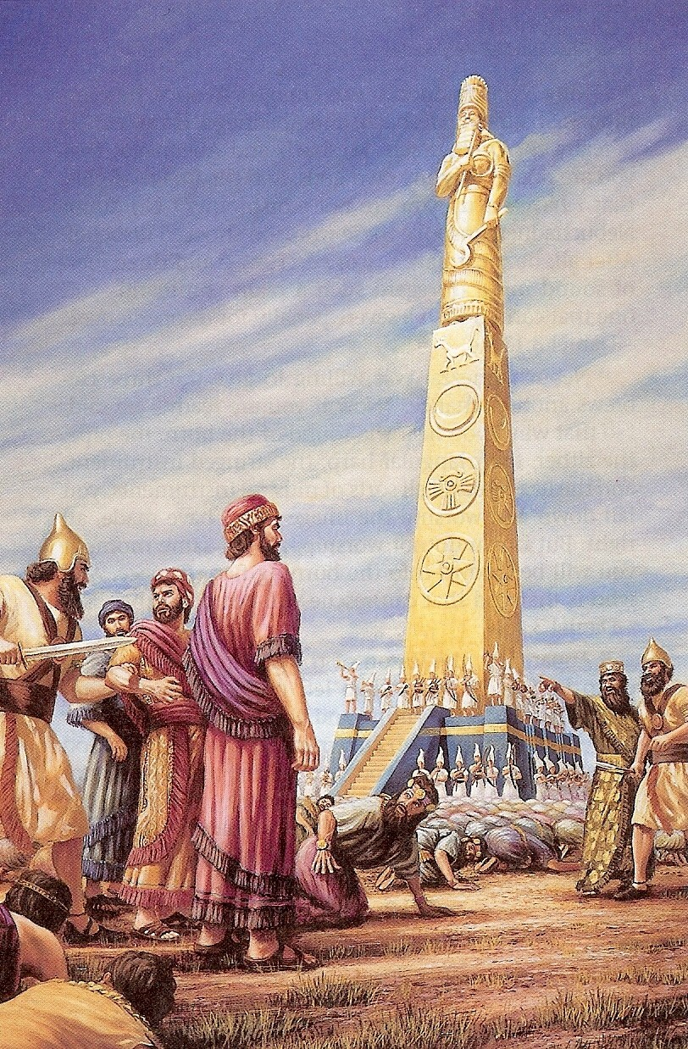
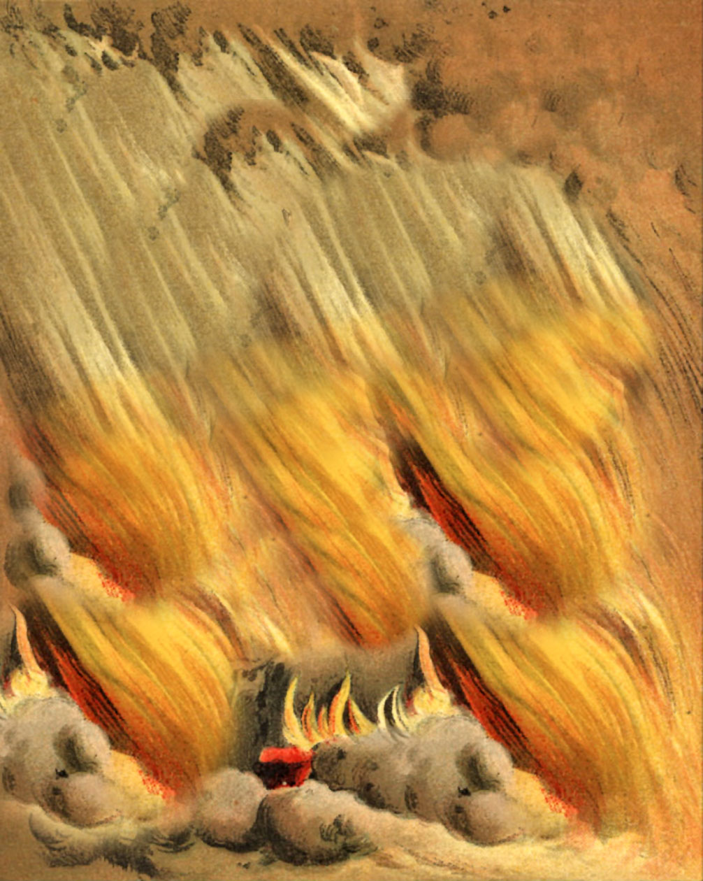
Standing up for what is right (Daniel 3:1-20)

Slide 2
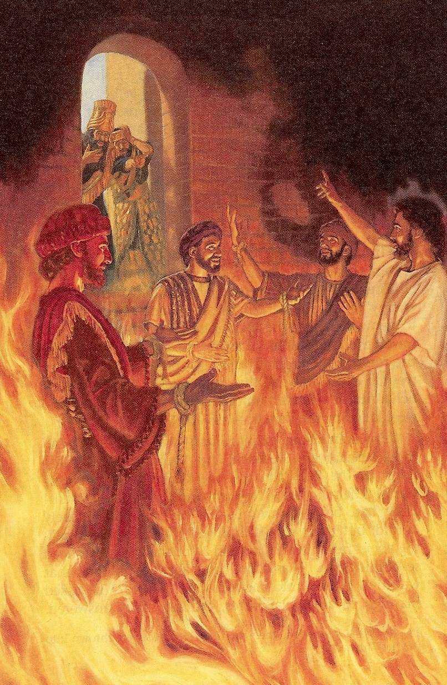
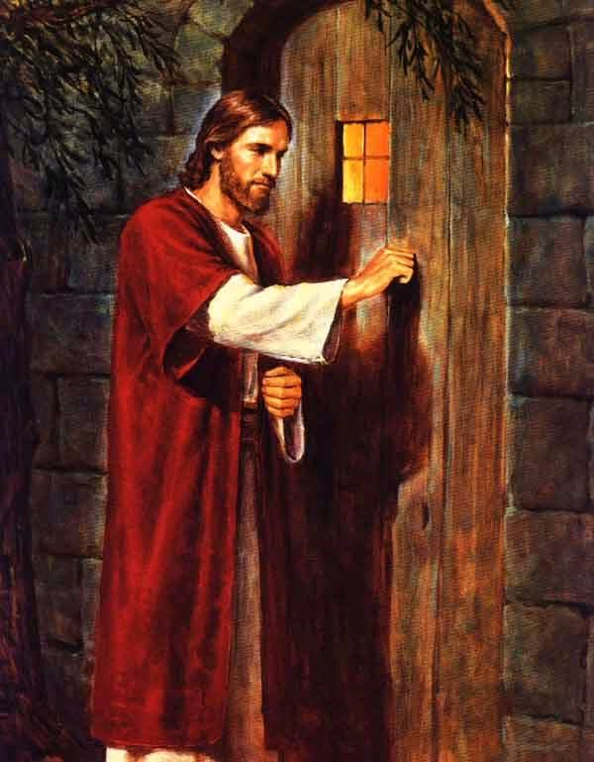
The decision to stand alone unites salvation and daily walk - Colossians 2:6
The ability to stand alone comes by knowing that we are never alone - Hebrews 13:6

Slide 3
WHY BELIEVER’S WILL NOT STAND UP FOR WHAT IS RIGHT
“Submit yourselves therefore to God. Resist the devil, and he will flee from you.” James 4:7

Slide 4
Acceptance of men - Gal.1:10 “For do I now persuade men, or God? or do I seek to please men? For if I yet pleased men, I should not be the servant of Christ.”
Approval of men - John 12:43 “For they loved the praise of men more than the praise of God.”
Avoidance of suffering - I Peter 3:14 “But and if ye suffer for righteousness' sake, happy are ye: and be not afraid of their terror, neither be troubled.”
Appeal of the flesh - Gal. 5:17 “For the flesh lusteth against the Spirit, and the Spirit against the flesh: and these are contrary the one to the other: so that ye cannot do the things that ye would.”

Slide 5
Eight basic concepts behind standing up for what is right
1. When you received Christ as personal Savior, you became a child of God - John 1:12; Romans 10:9
2. When you become obedient to the prompting of the Holy Spirit, you are applying God’s truth to daily living - Romans 8:13-14
3. When you identify with Christ, you will receive grace to do what’s right - Romans 6 - 8; Philippians 2:12-14

Slide 6
4. When you renew your mind with the truths of Scripture, you will begin to see life from God’s point of view - Proverbs; Romans 12:1-2
5. When you have a greater fear of God than man, you will develop a hatred of evil - Proverbs 8:13
6. When you love the Lord with all your heart, you will be more concerned about protecting His reputation then pleasing self - Psalm 23:3; John 14:21
7. When you make a commitment to live a righteous life, boldness is the by-product - Proverbs 28:1
8. When you realize that you are not really alone because God will never forsake you, you will have courage to stand alone - Hebrews 13:6

Slide 7
CONSEQUENCES of not standing alone
I Timothy 6:9-12
Galatians 6:7
I Cor. 10:13 “There hath no temptation taken you but such as is common to man: but God is faithful, who will not suffer you to be tempted above that ye are able; but will with the temptation also make a way to escape, that ye may be able to bear it.”
How could I have
been so stupid

Slide 8
response to Standing up for what is right
Importance of verbalizing: “I’ve given my life to Jesus and I am not able to do this.” - I Peter 3:15-17
Anticipating negative responses (John 15:18).
When rejection or persecution result from standing for what is right God gives more grace - James 4:6
Anticipating positive responses (I Thess. 2:14).

Slide 9
No immodest appearance (I Timothy 2:9)
Look in mirror - “Am I tempting people with my dress?”
Watch men’s eyes
Ask your father or husband
Fads often violate God’s design
I will be a “one-woman man” or “one- man woman” - Genesis 2:24; I Timothy 3:2
Wording: “I’ve given my life to Jesus. I’m thankful He made me a woman or a man, and I want to look like one.” - Deuteronomy 22:5

Slide 10
No moral impurity (I Thessalonians 4:1-8)
Reserve all physical love for after marriage - Heb. 13:4
See fornication as defiling God’s temple - I Cor. 3:17
Understand the value of virginity - II Cor. 11:2
Look at AIDS and venereal disease as God’s way of punishing moral impurity - Romans 1:27
Discern how world system tries to break down purity - James 1:13
“Maturity is seeing consequences of sin and using self-control to avoid them.” - Galatians 5:22-23

Slide 11
No unnatural affection (Hebrews 13:4)
Read Leviticus 18:22
Abhor sodomy as perversion and abomination - Romans 1:24-32
Refuse to accept the world’s view of Sodomy - Rom. 8:6
Wording: “I’ve given my life to Jesus. How could I commit such a wicked sin against Him?”

Slide 12
No lustful thoughts (Philippians 4:8)
Make a covenant with your eyes - Job 31:1
Cleanse out all pornography (prostitution)
Engraft Romans 6-8: Basis of victory
Wording: “What shall I say then? Shall I continue in sin that grace might abound, God forbid!”
Understand lust, defrauding, concupiscence, lasciviousness, reprobation

Slide 13
Concupiscence – Rom. 7:8; Col. 3:5; I Thess. 4:5
A stronger than normal desire for sexual fulfillment.
Defrauding – I Cor. 7:5; I Thess. 4:6
To deprive of rights, to rob, cheat, defile.
Lust – Rom. 6:12; 13:14; I Pet. 2:11
An intense desire especially sexual desire. To long after “Lust not after her beauty in thy heart.” – Prov.6:25

Slide 14
Reprobation (perversion) – Rom. 1:28; II Tim. 3:8; Titus 1:16
Not stand the test, rejected; a mind of which God cannot approve. It is the rejection of God in ones mind resulting in the perversion of ones moral sense.
Lasciviousness – II Cor. 12:21; Eph. 4:19; I Pet. 4:3
Absence of sexual restraint, indecency, expression of lewdness, vile, wicked, base

Slide 15
No defiance of authority (Proverbs 29:1)
Reject temptations to get your own way - I Corinthians 10:13
Do not choose friend’s approval over God’s and parent’s approval - Proverbs 27:10
Associate police, governmental leaders and others in authority as “ministers of God” - Romans 13:1-7
Wording: “I’ve given my life to Jesus, and I’ve chosen to obey Him and my God-given authority.”
Understand God’s four authority structures -

Slide 16
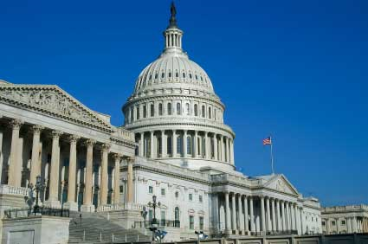
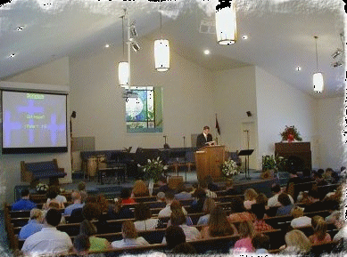
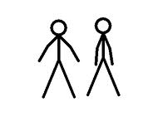

Slide 17
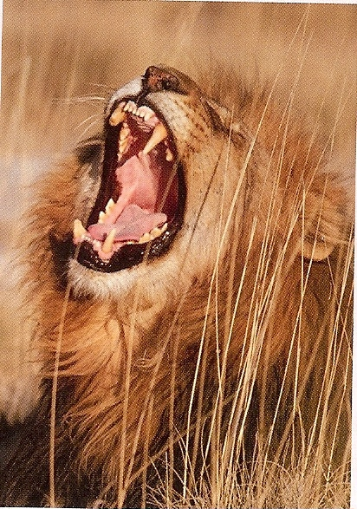
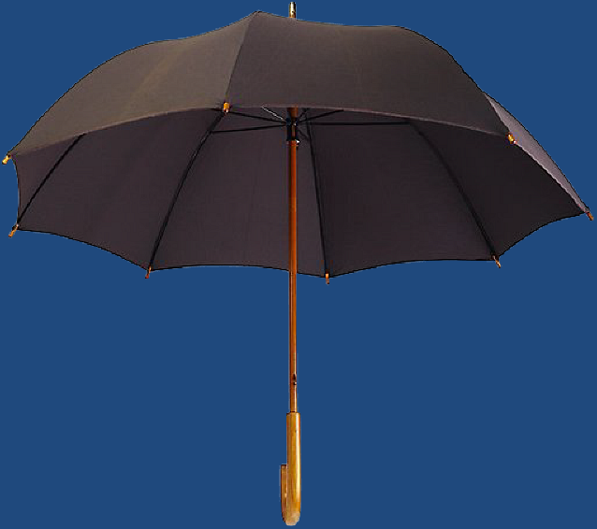
God Almighty
(I Timothy 6:15)
Satan
Destruction (John 10:10)
God Given
Authority
(Romans 13:1)
“Be sober, be vigilant; because your adversary the devil, as a roaring lion,
walketh about, seeking whom he may devour.” (I Peter 5:8)
I Corinthians 11:3
Colossians 3:18

Slide 18
God (I Timothy 6:15)
Authority
(I Tim. 2:2)
Satan
(I Peter 5:6-8)
Submission
Protection
Blessing
Rebellion
Destruction
Cursing
FOOL

Slide 19
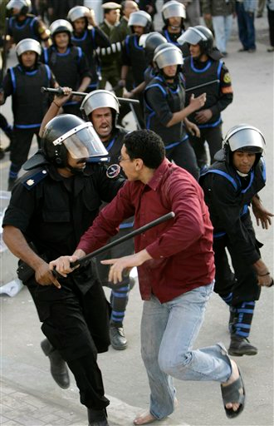
No Disrespect of Police (Romans 13:4)
Respect means no derogatory speech or terms -
Respect means “honor” I Peter 2:17
Respect means “submission” I Peter 2:11-15

Slide 20
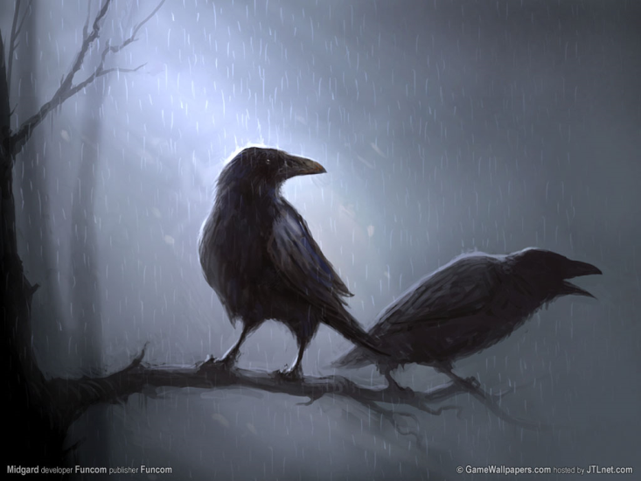
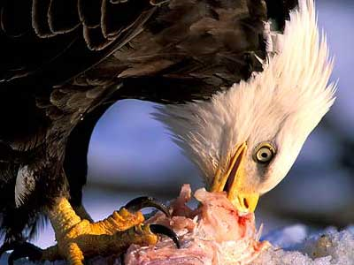
No Disobedience to Parents (Ephesians 6:2-3)
The consequences for disobedience - Proverbs 30:17 “The eye that mocketh at his father, and despiseth to obey his mother, the ravens of the valley shall pick it out, and the young eagles shall eat it.”
The promise for obedience - “That it may be well with thee, and thou mayest live long on the earth.” (Ephesians 6:3)

Slide 21
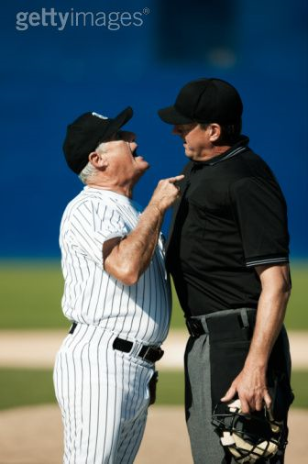
No disrespect when appealing (I Timothy 5:1-2)
God hates pride and arrogance as much as the evil way - Prov. 8:13
Appeal with humility and respect – Prov. 22:4

Slide 22
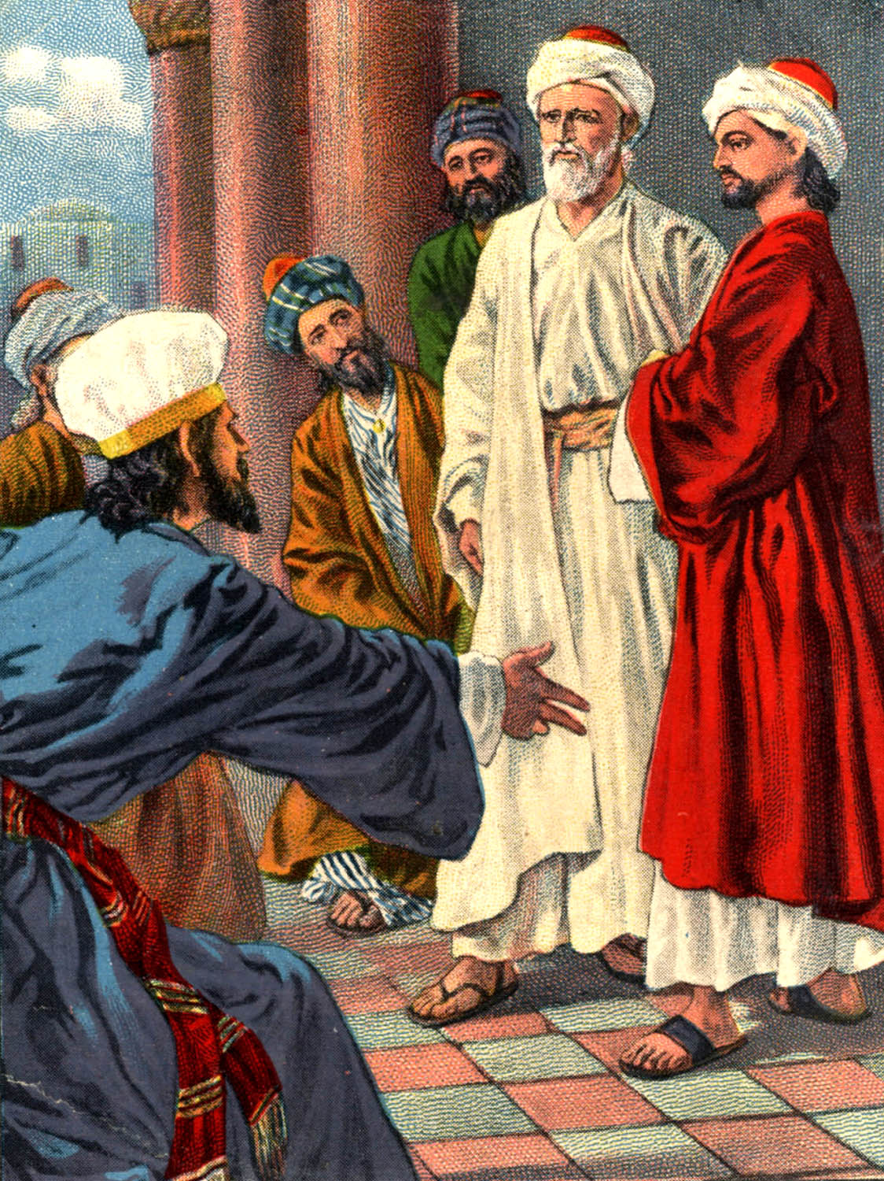

Slide 23
“And they called them, and commanded them not to speak at all nor teach in the name of Jesus. But Peter and John answered and said unto them, Whether it be right in the sight of God to hearken unto you more than unto God, judge ye. For we cannot but speak the things which we have seen and heard...Then Peter and the other apostles answered and said, We ought to obey God rather than men.” (Acts 4:18-20, 5:29)

Slide 24
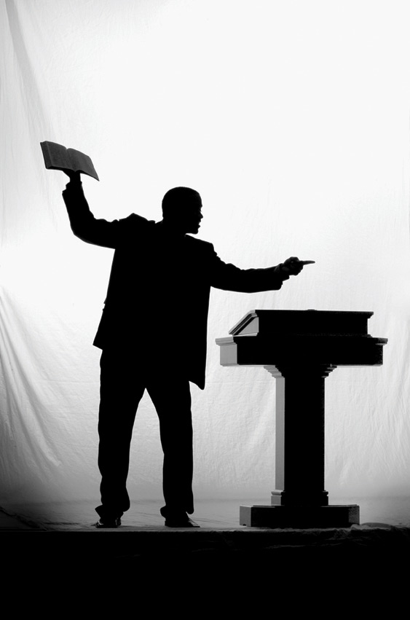
No Dishonor to Pastors (I Timothy 5:17)
“And we beseech you, brethren, to know them which labour among you, and are over you in the Lord, and admonish you; And to esteem them very highly in love for their work's sake. And be at peace among yourselves.” (I Thess. 5:12-13)

Slide 25
God wants every believer to be under spiritual accountability
“Remember them which have the rule over you, who have spoken unto you the word of God: whose faith follow, considering the end of their conversation… Obey them that have the rule over you, and submit yourselves: for they watch for your souls, as they that must give account, that they may do it with joy, and not with grief: for that is unprofitable for you.” (Hebrews 13:7, 17)

Slide 26
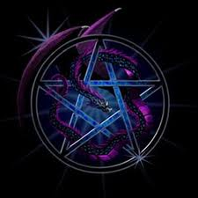
No occult INVOLVEMENT (Leviticus 19:31; Galatians 5:19-21)
Tarot Cards
Books
Palm Reading
Fortune Telling
Ouija Boards
Movies & videos
Séance
Video and computer games
Etc.

Slide 27
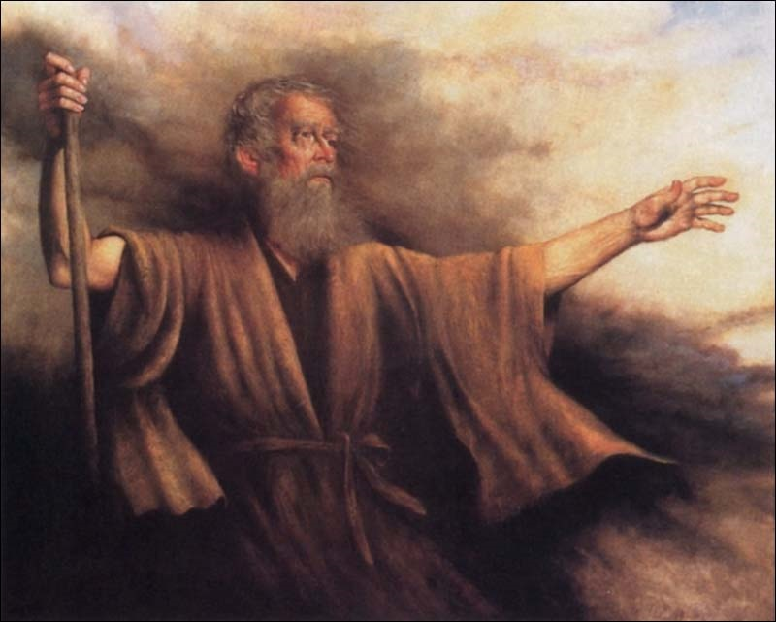
Biblical Warning Concerning Occult Involvement (Deuteronomy 18:9-13)
“When thou art come into the land which the LORD thy God giveth thee, thou shalt not learn to do after the abominations of those nations. There shall not be found among you any one that…For all that do these things are an abomination unto the LORD: and because of these abominations the LORD thy God doth drive them out from before thee. Thou shalt be perfect with the LORD thy God.”

Slide 28
Pass THROUGH THE FIRE: The worship of Molech which involved human sacrifices - Deuteronomy 12:31
Divination: General term covering all types of magic, witchcraft and occult practices - Acts 19:18-20
OBSERVER of times: One who interprets natural events of nature - Leviticus 19:26
Enchanter: One who interprets omens (Omens = sign oR indication of some future events: Tarot cards, fortune telling, palming, etc.) - Jeremiah 27:9
Enchantments: The art of casting spells or the use of magic to charm; bringing a person under a spell - Numbers 23:23

Slide 29
Witch: A woman who possess supernatural power by compact with the devil or evil spirits - Exodus 22:18
Witchcraft: The power or practice of witches; sorcery; black magic; bewitching - Micah 5:12
Charmer: One who uses the power of the devil to charm, deceive, subdue, or enchant another; The power of a charmer delights and attracts the affection of a person leading them into occult practices - Psalm 58:5

Slide 30
Consulter with FAMILIAR spirits: (Medium) - Leviticus 19:31
Wizard: (Spiritist) - Leviticus 20:6-7, A man who PRACTICES black magic; magician; sorcerer; one who RECEIVES his wisdom from the devil - I Samuel 28:3
Necromancer: A person who inquires and speaks with the dead - Deuteronomy 18:11
Soothsayer: A person who predicts or pretends to foretell the future - Numbers 23:23

Slide 31
Magician: A person who PRODUCES baffling effects or illusions by sleight of hand - Exodus 9:11
Curious Arts: Sorcery - Acts 19:19
Snake Charmer - Luke 10:19
Astrologers: A person who professes to interpret or determine the supposed influence of the stars on human events - Daniel 1:20; 2:2, 10, 27

Slide 32
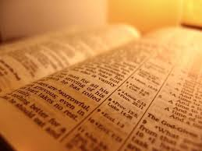
“And have no fellowship with the unfruitful works of darkness, but rather reprove them.”
(Ephesians 5:11)

Slide 33
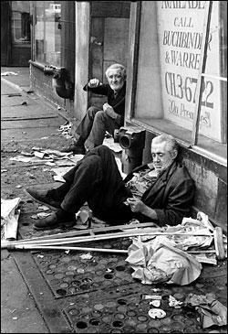
NO HARMFUL DRUGS (Proverbs 20:1)
Relate the word pharmacy with sorcery - Revelation 9:21; 21:8
One drink can damage vital inhibitions - Proverbs 23:29-31
Visit “skid row” mission

Slide 34
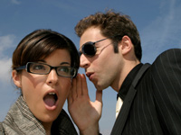
NO EVIL SPEAKING (EPHESIANS 4:31)
Gossip – Prov. 16:28
Slander – Psalms 31:13
Evil Report - II Cor. 6:8
Froward (willfully contrary) mouth – Prov. 8:13
Reviling (criticize in an abusive or insulting manner) – I Pet. 2:23
Cursing – James 3:10

Slide 35
NO DISHONESTY (Ezekiel 22:27)
Lying – Col. 3:9
Stealing – Eph. 4:28
Cheating – Prov. 26:29
Deceitful – Psalms 43:1
Unjust – Prov. 29:27
Prov. 11:1 “A false balance is abomination to the LORD: but a just weight is his delight.”

Slide 36
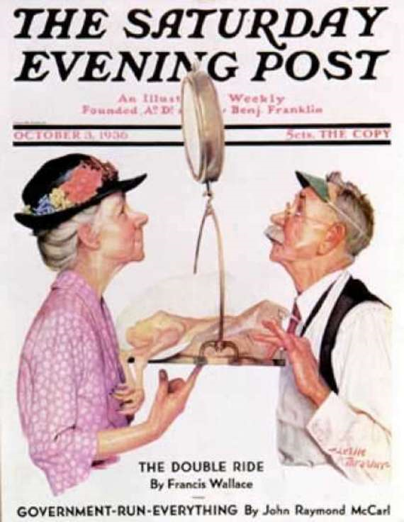

Slide 37
No Carnal music (Psalms 40:1-3)
Music is a powerful force of evil - Rebellion / immorality
Christian Rock produces the same destructive results as does non-Christian music - II Corinthians 6:14-7:1
Satanic involvement in music – Ezekiel 28:11-19
“It is better to hear the rebuke of the wise, than for a man to hear the song of fools.” - Ecclesiastes 7:5

Slide 38
No immodest appearance
No moral impurity
No unnatural affection
No lustful thoughts
No defiance of authority
No disrespect of Police
No disobedience to Parents
No disrespect when appealing
No dishonor to Pastors
No occult involvement
No harmful drugs
No evil speaking
No dishonesty
No Carnal music

