Slide 1
How to Deal with Discouragement
(Ephesians 6:10-18)

Slide 2
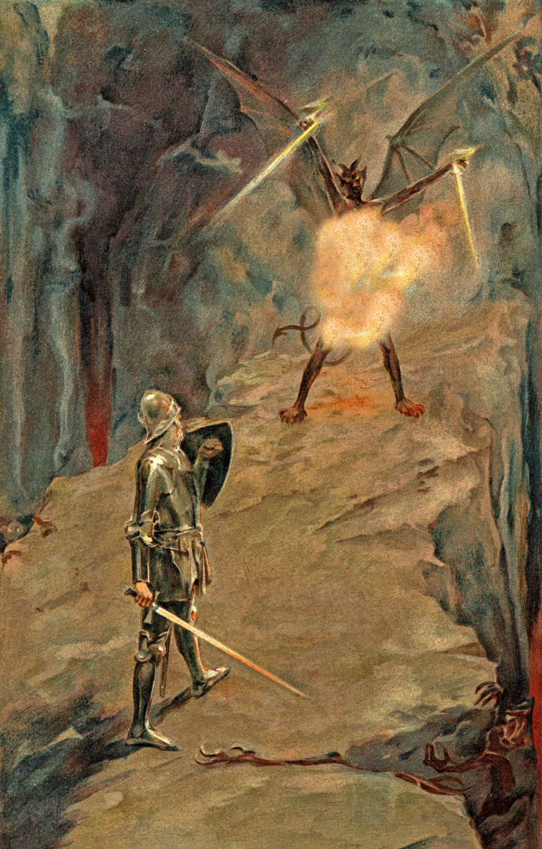
Discouragement one of Satan’s most effective weapons (Ephesians 6:16) “Fiery dart…”

Slide 3
Three Stages of Discouragement
Mild – Minor problems or pressures which effect our emotions - (II Corinthians 4:1-18)
Strong – Major problems or pressures which effect our spirit so that others notice - (I Thessalonians 5:14)
Disabling – Overwhelming problems or pressures which drain us of spiritual, mental, emotional and physical strength.
Note: Our heart melts within us and we do not have the desire, energy, or ability to go on – (Galatians 6:9; Hebrews 12:1-5, 12)

Slide 5
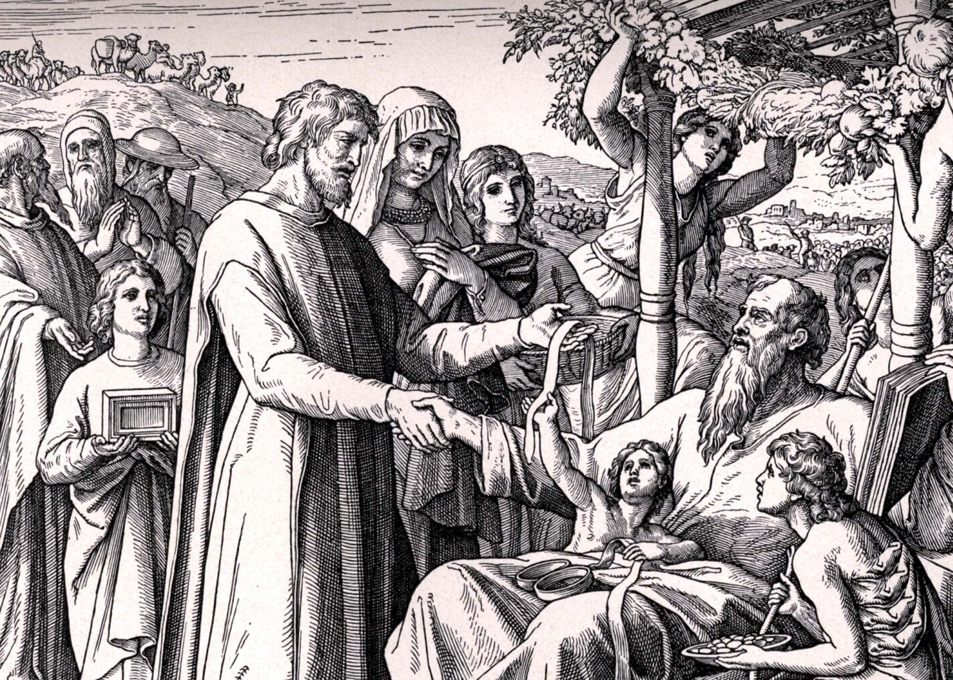
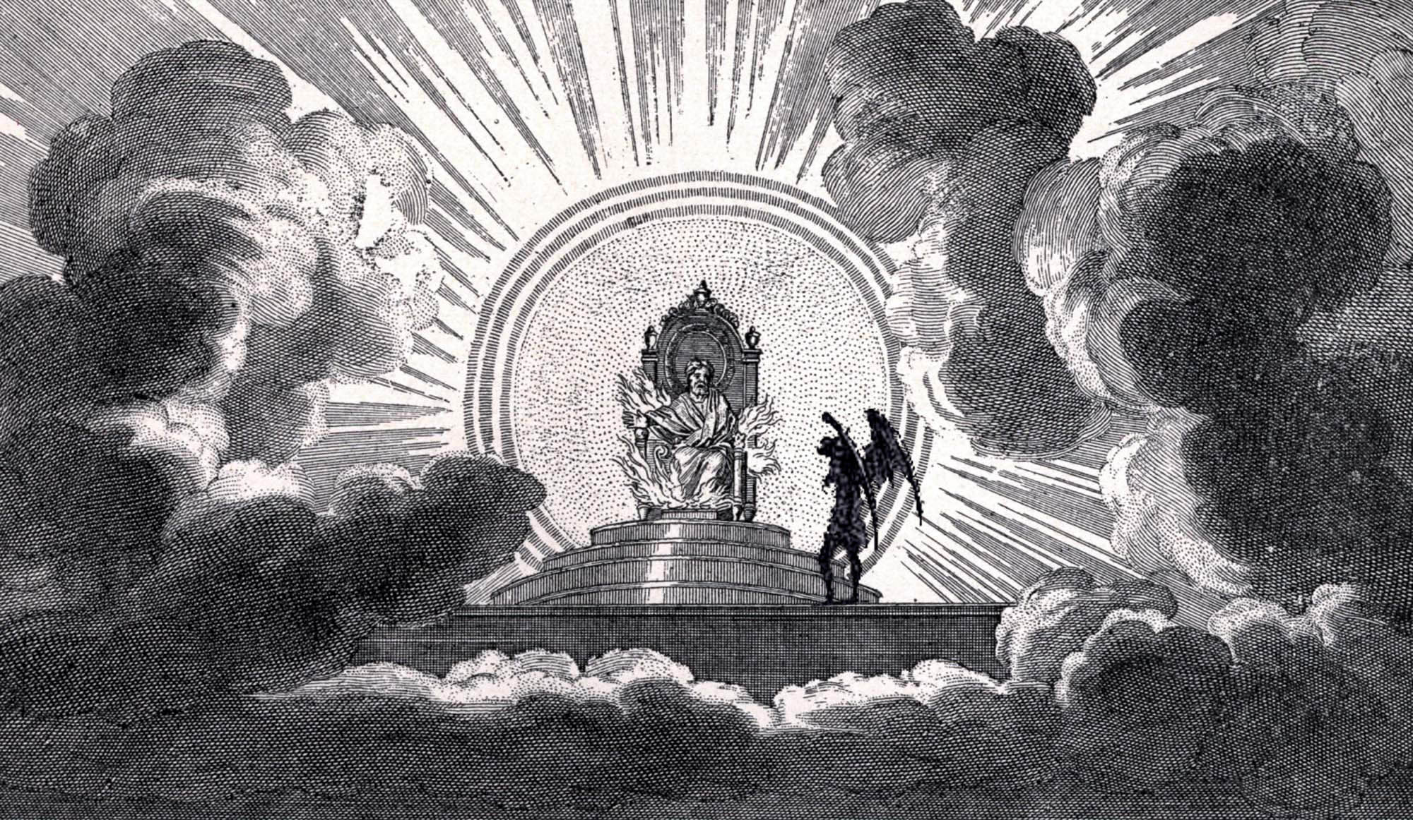
Satan’s Attack upon the Life of Job (Job 1-2)

Slide 6
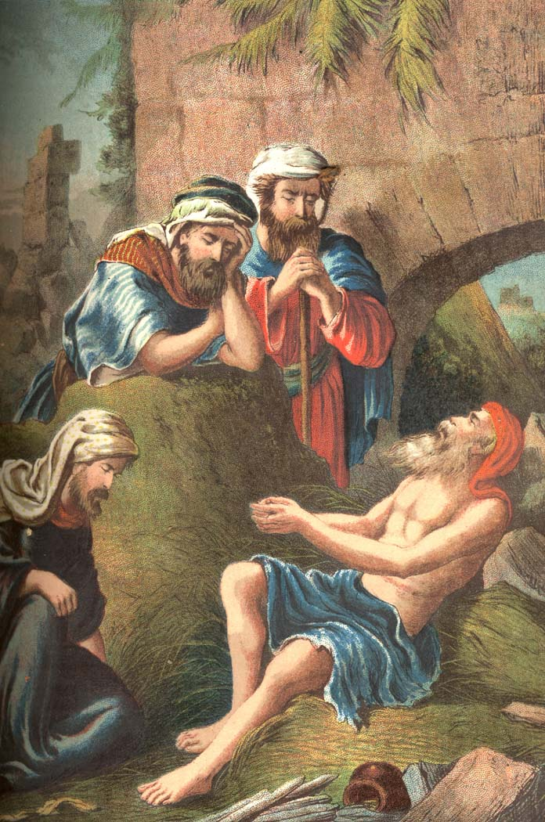
Job – 1:14, 17
Wealth (sheep) – 1:6
Transportation (camels) – 1:3
Family – 1:18-19
Health – 2:7
Marriage – 2:8-9
Friendships – 5:11

Slide 7
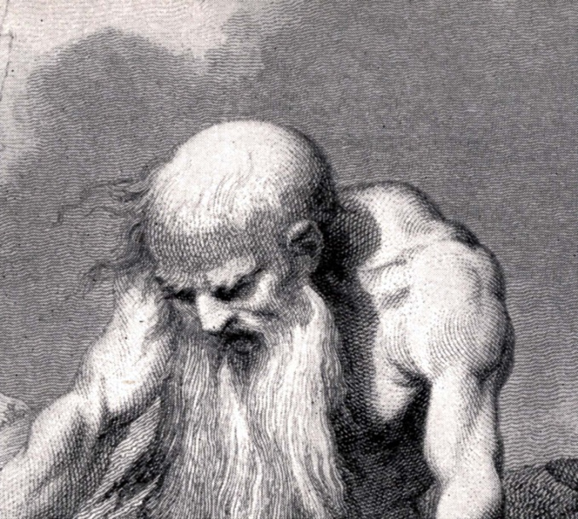
“Job arose, and rent his mantle, and shaved his head, and fell down upon the ground and worshiped.”
“Naked came I out of my mother’s womb, and naked shall I return thither: the Lord gave, and the Lord hath taken away; blessed be the name of the Lord. In all this Job sinned not, not charged God foolishly.”

Slide 8
“Thou He slay me, yet will I trust Him: But I will maintain mine own ways before Him. He also shall be my salvation; for a hypocrite shall not come before Him. Hear diligently my speech, and my declaration with your ears…

Slide 9
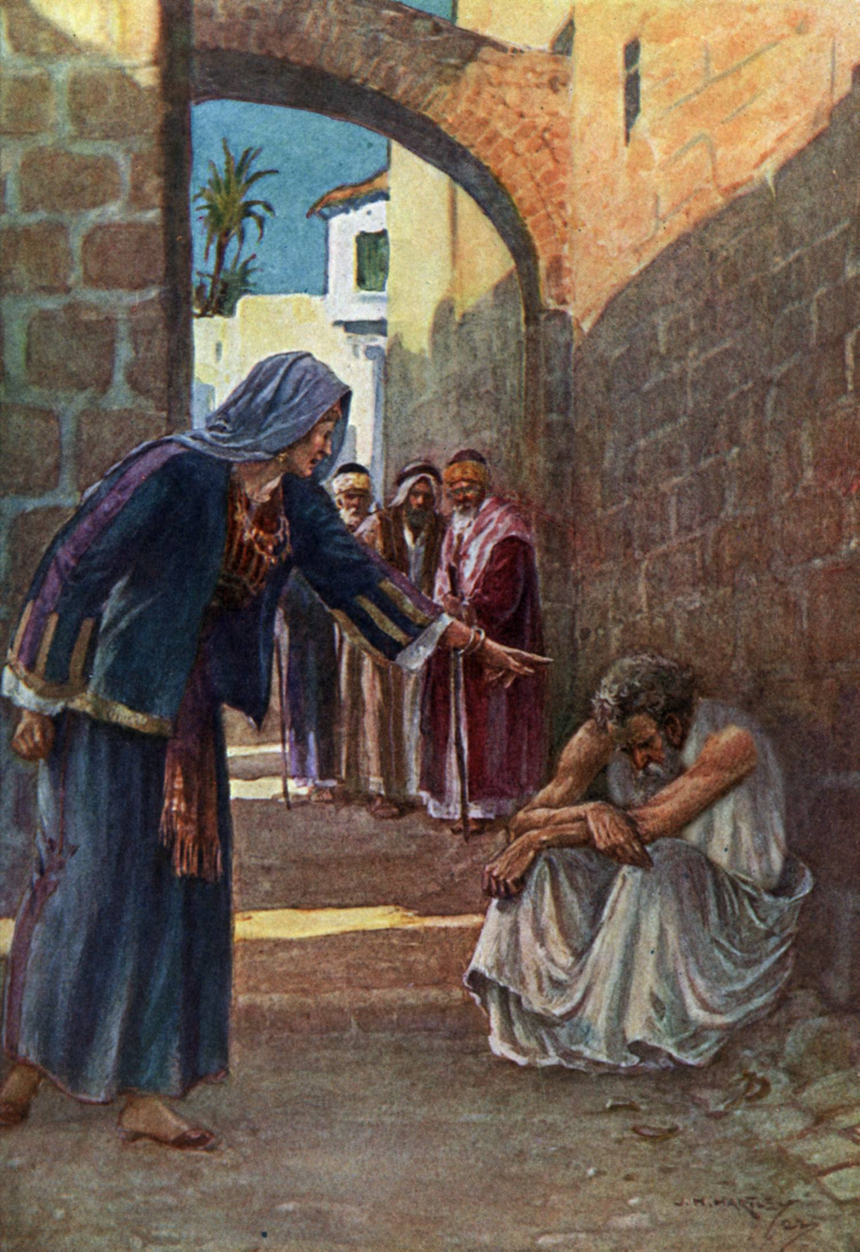
“Then said his wife unto him, Dost thou still retain thine integrity? Curse God, and die.”

Slide 10
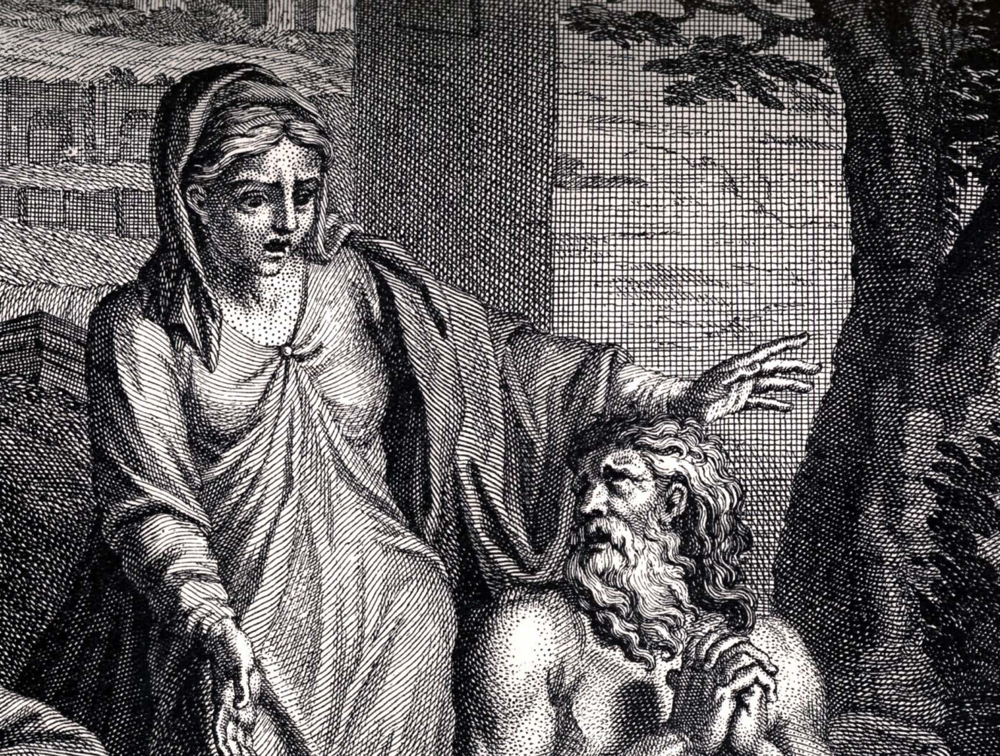
“Thou speakest as one of the foolish women speaketh. What? Shall we receive good at the hand of God, and shall we not receive evil? In all this did not Job sin with his lips.”

Slide 11
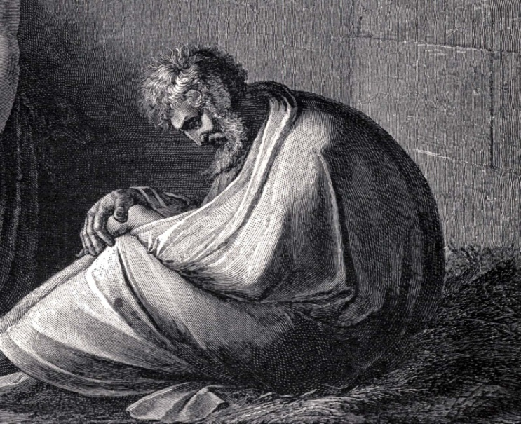
“Behold, I go forward, but He is not there; and backward, but I cannot perceive Him. I cannot behold Him.”
“He hideth Himself on the right hand,
that I cannot see Him.”

Slide 12
“But He knoweth the way that I take: when He hath tried me, I shall come forth as gold.”

Slide 13
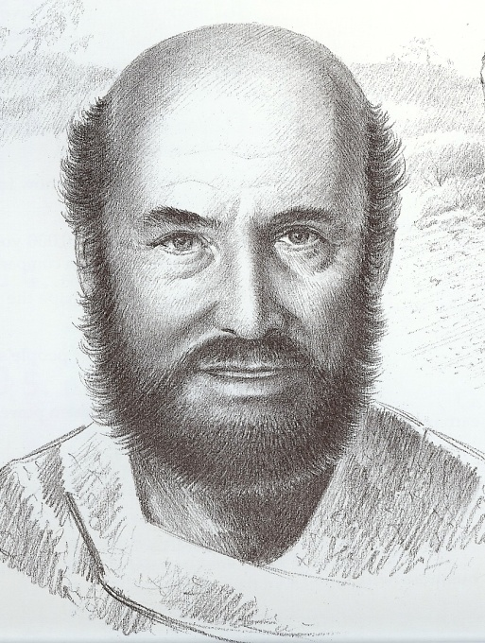
“According to my earnest expectation and my hope, that in nothing I shall be ashamed, but that with all boldness, as always, so now also Christ shall be magnified in my body, whether it be by life, or by death. For to me to live is Christ, and to die is gain. For I am in a strait betwixt two, having a desire to depart, and to be with Christ; which is far better.”

Slide 14
The Cause of Discouragement
At the base of every discouragement is a lie from Satan –
Jesus said - “He is a liar and the father of lies…”
“And ye shall know the truth, and the truth shall make you free…”

Slide 15
1. Fear – 365 “Fear not's” in the Scriptures
“God hath not given us the spirit of fear…”
2. Bitterness –
“Looking diligently lest any man fail of the grace of God; lest a root of bitterness springing up trouble you, and thereby many be defiled.”
Note: Unconditional forgivingness is the key to overcoming bitterness – (Ephesians 4:31-32)

Slide 16
3. Condemnation – Others or Self:
“Who shall lay any thing to the charge of God’s elect? It is God that justifieth. Who is he that condemneth? Is it Christ that died, yea rather, that is risen again, who is even at the right hand of God, who also maketh intercession for us…Who shall separate us from the love of Christ?”
“There is therefore now no condemnation to them which are in Christ Jesus…”

Slide 17
4. Unbelief – Mark 9:17-29
“For what if some did not believe? Shall their unbelief make the faithfulness of God without effect?”
“When we are not faithful, he abideth faithful: He cannot deny himself.”

Slide 18
5. Self-pity
God has forsaken you
Nothing good will come from this situation
No body loves you
People are always hurting you
God is punishing you
You cannot do that
You do not have enough wisdom
Hebrews 13:5
Romans 8:28
I John 4:9-10
Ephesians 6:12
Hebrews 11:5-11
II Corinthians 12:9
James 1:5

Slide 19
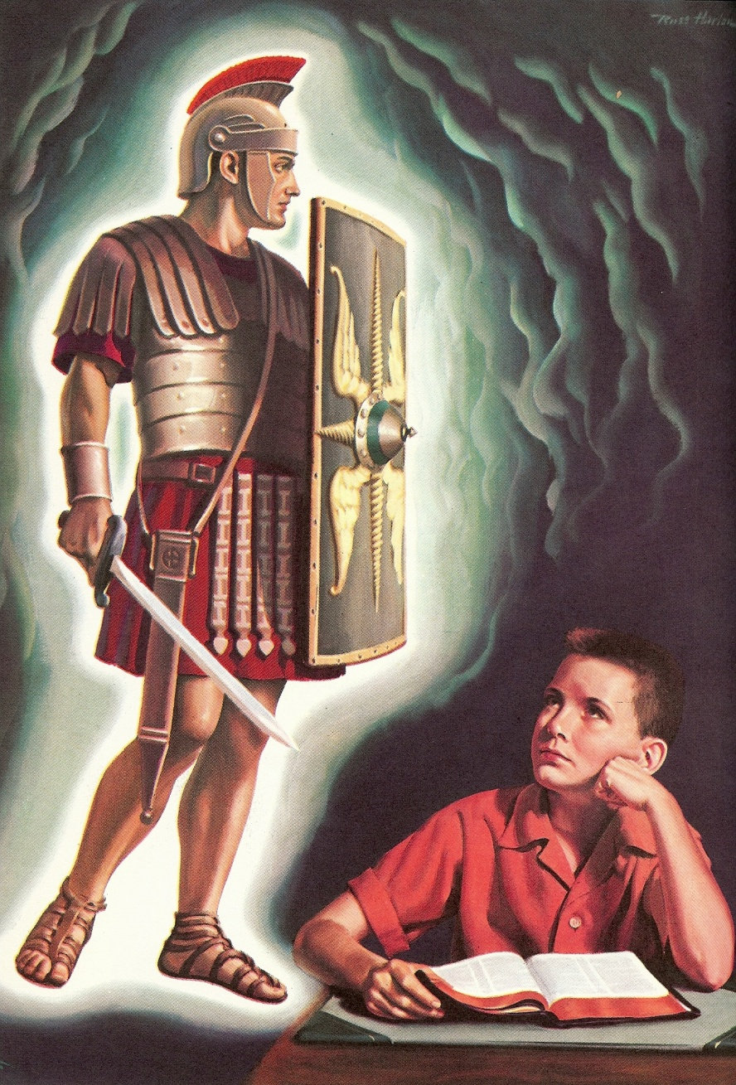
The Root Cause of Discouragement
Putting down the shield of Faith – Ephesians 6:12-16
When we lose sight of God’s ways (because of situations or problems that arise) we remove the spiritual protection Christ has provided us in the shield of faith.

Slide 20
Wisdom
Seeing life from God’s perspective
53 times Proverbs speaks about the protection God’s wisdom provides –
“The Lord giveth wisdom…He is a buckler to them that walk uprightly…He preserveth the way of His saints…when wisdom entereth into thine heart. Discretion shall preserve thee, understanding shall keep thee.”
“Every word of God is pure, He is a shield unto them that put their trust in Him.”

Slide 21
How to Conquer Discouragement
Take up the shield of faith
> This is done by recognizing Satan’s lies and quoting God’s truth – II Corinthians 12:9
Set up a place to be alone with God – Matthew 6:6; Luke 6:12
Encourage your heart in the Lord
> This is done through meditation on Scripture (Psalms and I and II Peter)

Slide 22
Remove your self from discouraged people as much as possible – Deuteronomy 20:8; Judges 7:2-3
Avoid making major decisions during times of discouragement – Philippians 4:11; I Timothy 6:6-8
Tell your authorities and other godly Christians that you are discouraged and ask them to pray for you – James 5:16
In every thing give thanks – I Thessalonians 5:18; Hebrews 13:15

Slide 23
Confess discouragement as sin (lack of faith) – “Whatsoever is not of faith is sin…”
(Proverbs 28:13-14; I Timothy 1:19; I John 1:9)
Read biographies of great Christians – I Corinthians 1:4
Listen to good up-lifting music - Psalms
Focus on God’s reputation – Matthew 6:9
Ask God for wisdom to discern how that the problems and pressures you are facing can develop faith and godly character in your life – Romans 5:1-3, 8:28-29; James 1:1-4

Slide 24
“And David was greatly distressed; for the people spake of stoning him…but David encouraged himself in the LORD his God.” I Sam. 30:6

