Slide 1
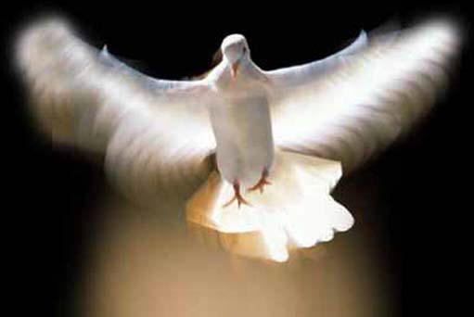
The Filling of the Holy Spirit
Ephesians 5:18

Slide 2
Of all the aspects of the person and work of the Holy Spirit none is more vital to the Christian’s growth and maturity than the filling of the Holy Spirit –
The filling of the Holy Spirit is the means by which He controls the attitude and behavior of believers, performing His ministries through them – “…to the glory of God!”

Slide 3
The Word of God Divides Believers into Two Categories
(I Cor. 3:1-3)

Slide 4
The Carnal Believer’s Characteristics
He lives according to the desires of his own flesh.
He is controlled by - “The lust of the flesh…
lust of the eyes and the pride of life…”
Self is on the throne of his life / The Lordship of Christ over his life has been rejected – “Whosoever ye yield your selves servants to obey his servants ye are to whom ye obey…”

Slide 5
He has grieved (Eph. 4:30) and quenched (I Thess. 5:19) the ministry of the Holy Spirit in his life.
When the Holy Spirit fills (controls) a believer He works in and through the life of that believer – “I am crucified with Christ…Christ liveth in me…”

Slide 6
Baptizes us into the body of Christ – “for by one spirit are baptized…”
Indwells us – “temple of the Holy Spirit”
Seals us unto the day of redemption – Eph. 1:13-14
Earnest – a down payment, a pledge – II Cor. 5:5
Imparts to us spiritual gifts which enable us (equips us) to effectively serve the Lord - I Peter 4:10 “gifts of the spirit”

Slide 7
Guides us into all truth – John 16:13
Teaches us as we study the Word of God
– “called the anointing” I John 2:27
Reveals Biblical truth to us – I Cor. 2:10
Empowers us to serve the Lord – Acts1:8
Imparts to us and through us the love of
God – Rom. 5:5
Conforms us into the image of Christ –
II Cor. 3:18
Gives us the assurance of our salvation –
Rom. 8:16

Slide 8
Comforts us – John 14:16
Puts His words in our mouth – Matt.
13:11
Strengthens us in our inner man – Eph.
3:16
Prompts us – Rom. 8:14
Produces His fruit in and through us –
Gal. 5:22-23

Slide 9
A carnal believer is not able to enjoy of these ministries of the Holy Spirit.
The fruit that he bears is just the opposite of the fruit of the Spirit!

Slide 10
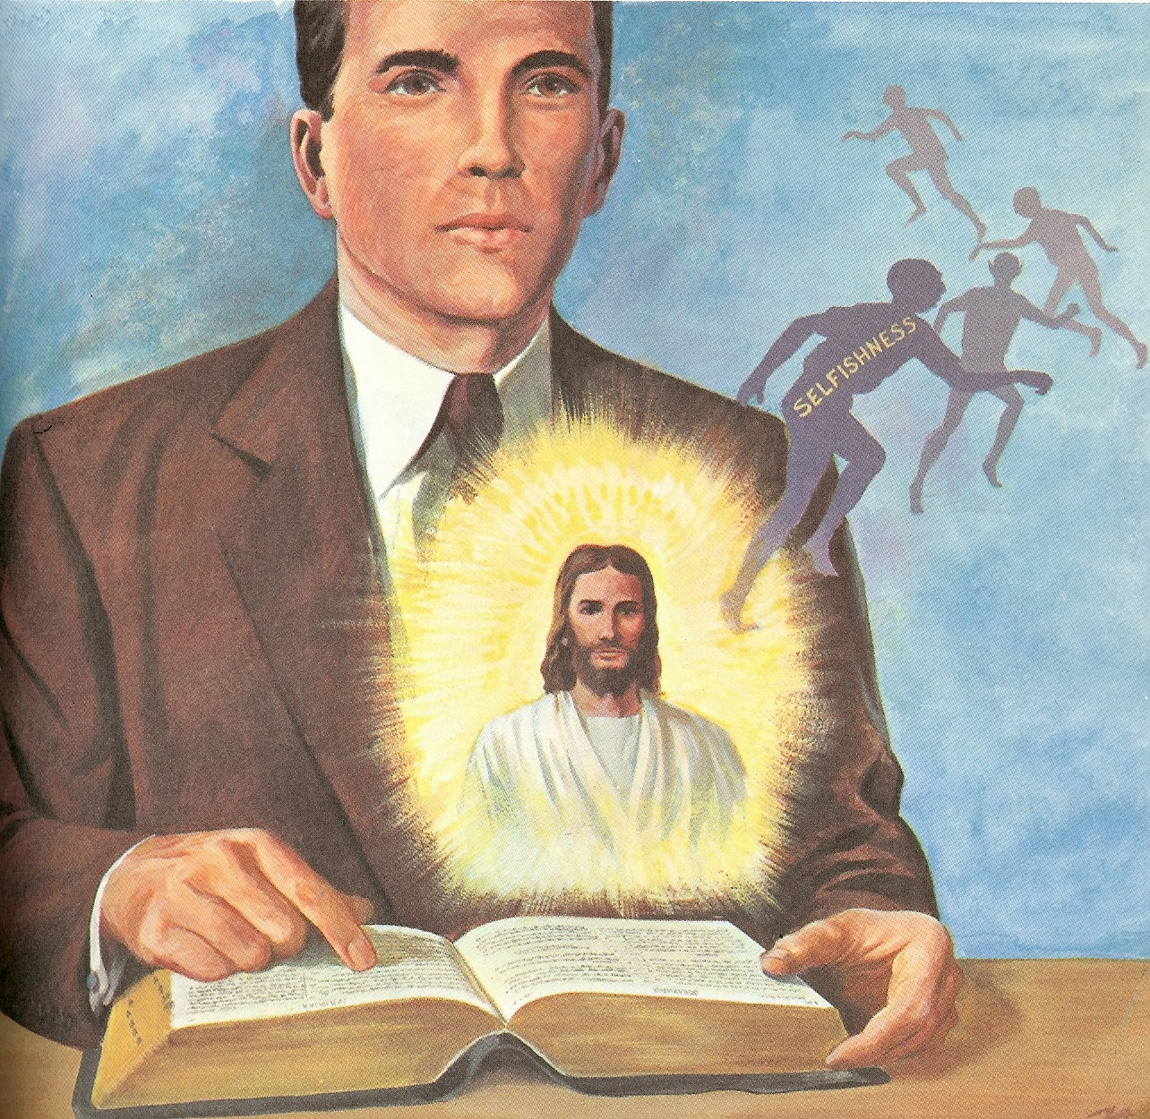
The Spiritual Believer’s Characteristics
Carnality and Spirituality
are Opposites
Gal. 5:16-17
Rom. 7:14-23

Slide 11
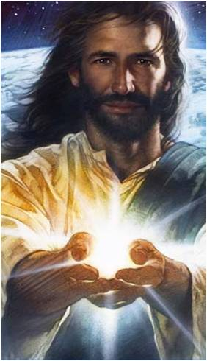
Every Christian experiences this inner struggle between the flesh and the spirit. But who controls you is a matter of personal choice – Jesus said “Shall not I give the Holy Spirit to them that ask…”
(When was the last time you asked the Holy Spirit to fill you?)

Slide 12
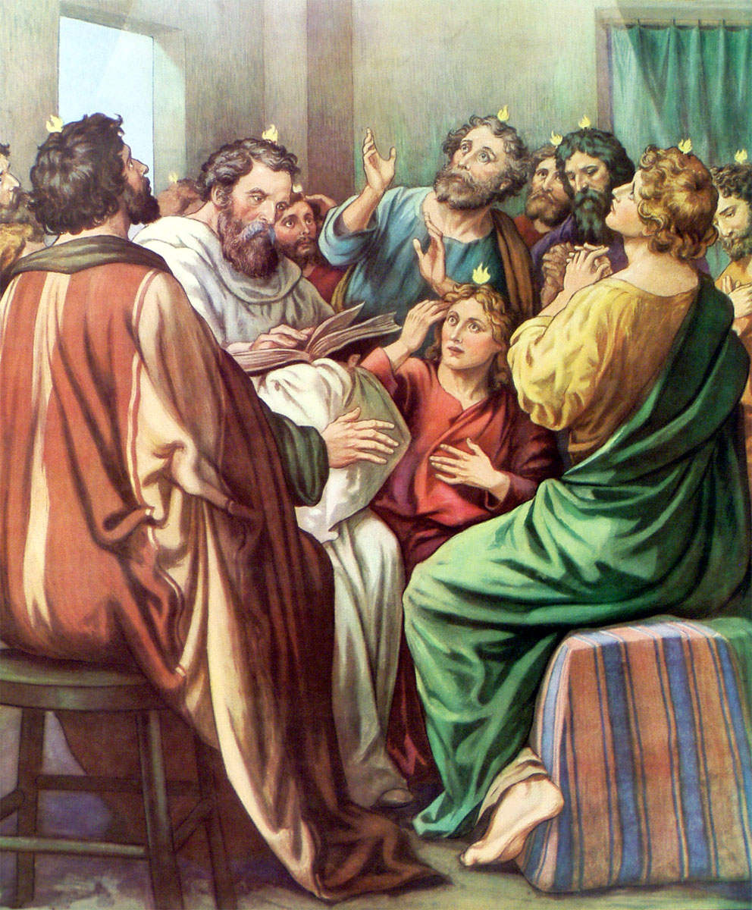
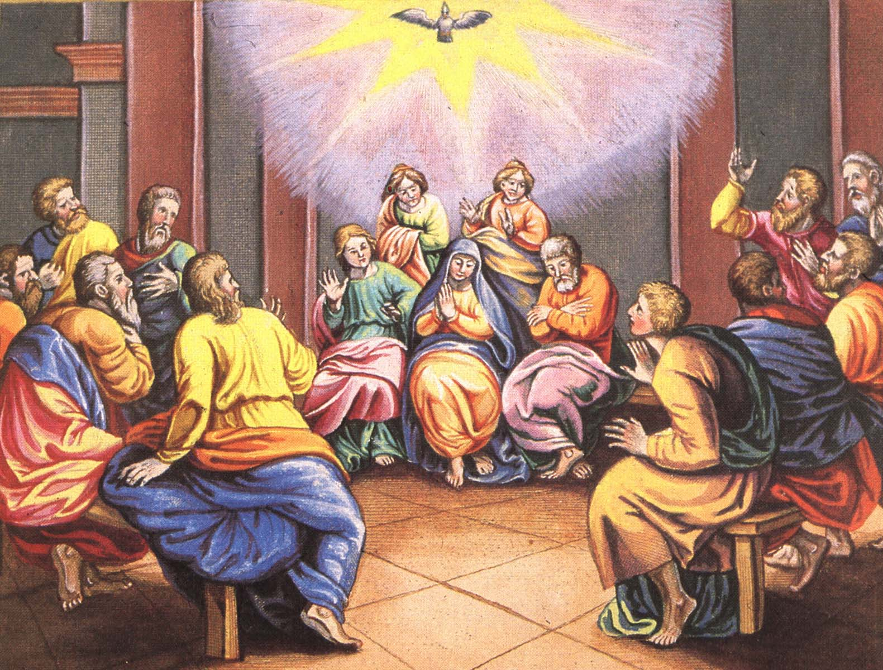
How to be Filled with the Holy Spirit

Slide 13
Purpose to live a holy life – I Thess. 4:1-8
Yield yourself to the Lord – Rom. 6, 12:1-2
Renew your mind daily – Eph. 4:23-24
Make no provision for the flesh – Rom. 13:14
Flee temptation – II Tim. 2:22
Resist Satan by continual submission to God – James 4:6-10

Slide 14
Do not give place to the devil – Eph. 4:27–31 (bitterness, immorality, covetousness)
Keep your thoughts centered on things pure and lovely – Phil. 4:6-8
Set your affections on things above – Col. 3:1-4
Keep sin confessed – Prov. 28:13-14
Keep your conscience clear – Acts 24:16
Obey the promptings of the Holy Spirit – Rom. 8:14

Slide 15
Avoid quenching and grieving the Holy Spirit – I Thess. 5:19, Eph. 4:25-31
Ask God to fill you with the Holy Spirit – Luke 11:15
Note: The Holy Spirit is called the “Spirit of Grace” in Heb. 10:29 - “God gives grace to the humble…”

Slide 16
Spirit Filling is Likened
unto Being Drunk
(Eph. 5:18)
A drunken person is under the control of alcohol and will think, speak and act in ways that are not natural when he is sober.

Slide 17
The Filling of the Holy Spirit
is to be Sought (pursued) by
Every Believer
We are never commanded to be indwelt, sealed or baptized with the Spirit.
This happened the moment you received Christ as your personal Savior.
We are however commanded to be “filled with the Spirit…”

