Slide 1
The Revelation of Jesus Christ
A study of the book
of Revelation

Slide 2
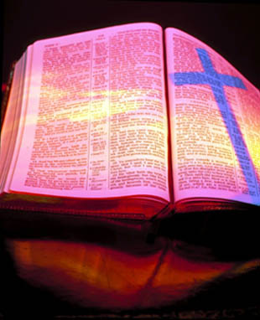
Revelation 21:1-22:5
“The New Heaven”
and
“The New Earth”

Slide 3
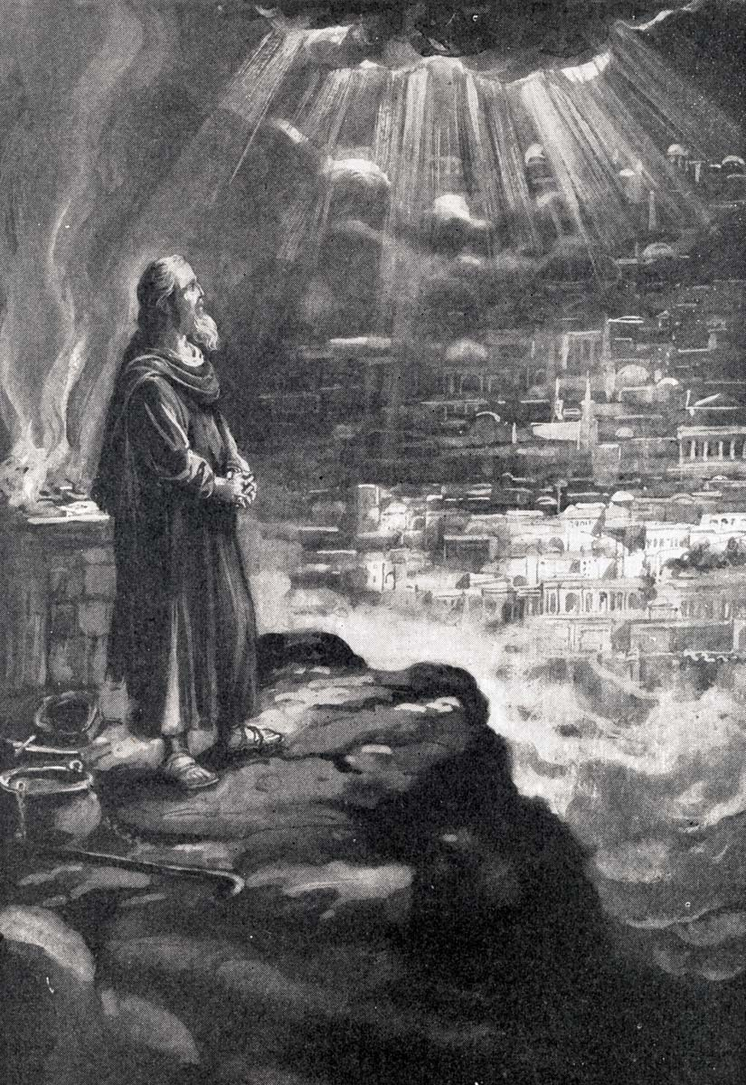
“And I saw a new heaven and a new earth: for the first heaven and the first earth were passed away; and there was no more sea.”

Slide 4
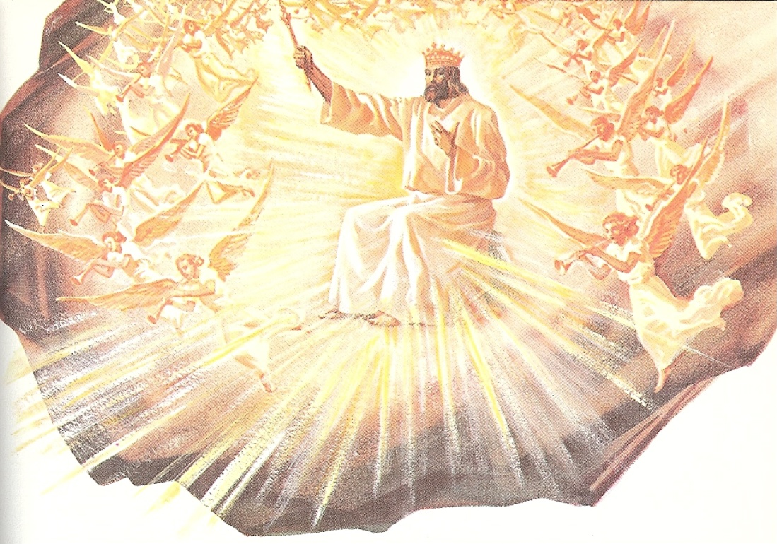
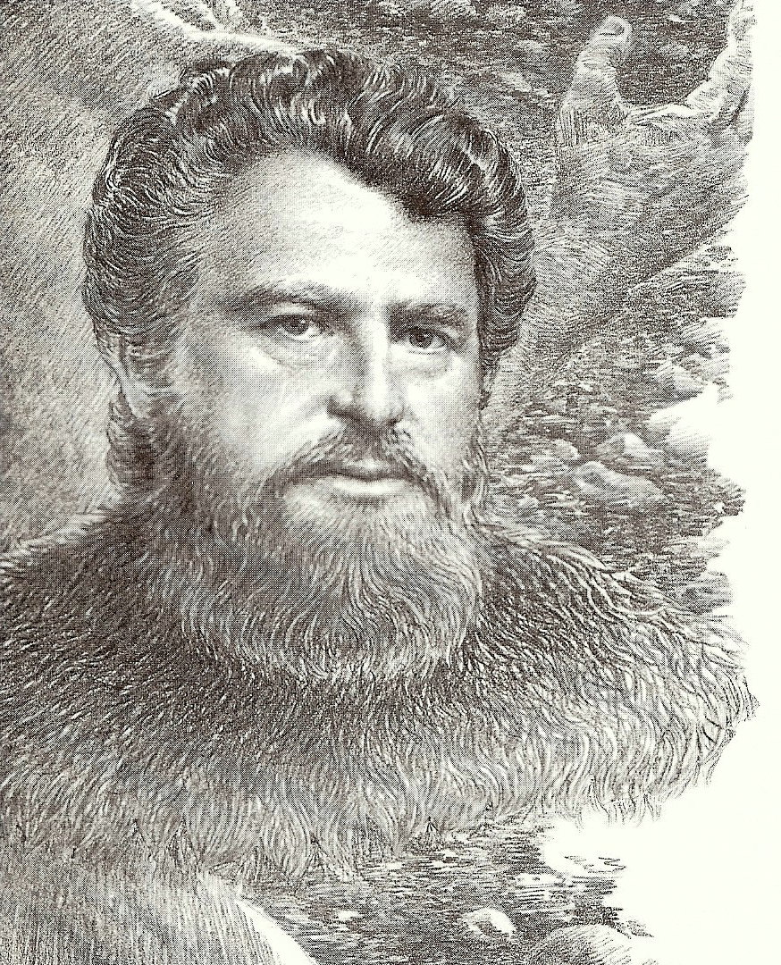
II Peter 3:9-13

Slide 5
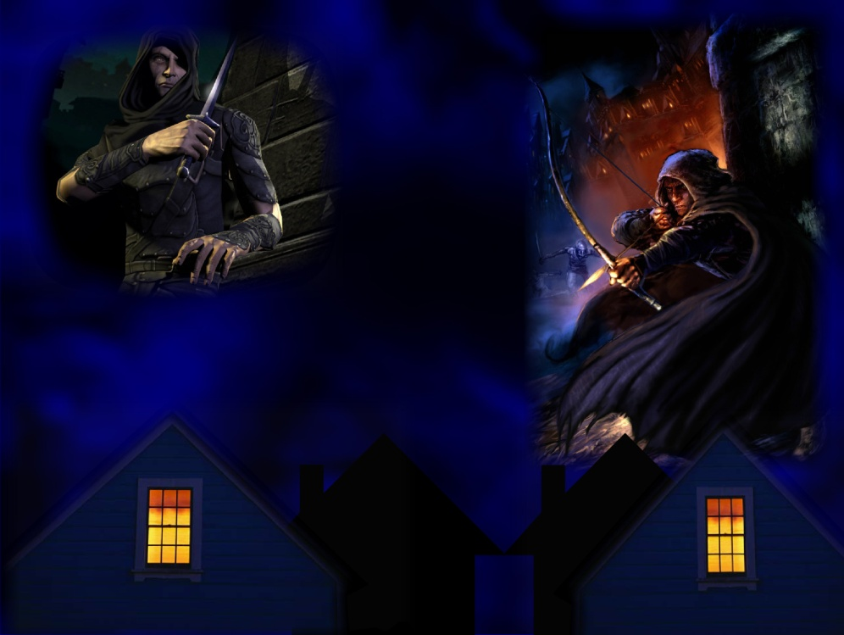
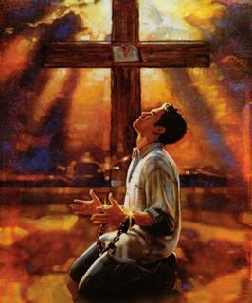
“The Lord is not slack concerning his promise, as some men count slackness; but is longsuffering to us-ward, not willing that any should perish, but that all should come to repentance. But the day of the Lord will come as a thief in the night.”

Slide 6
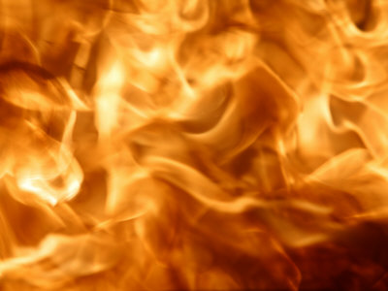
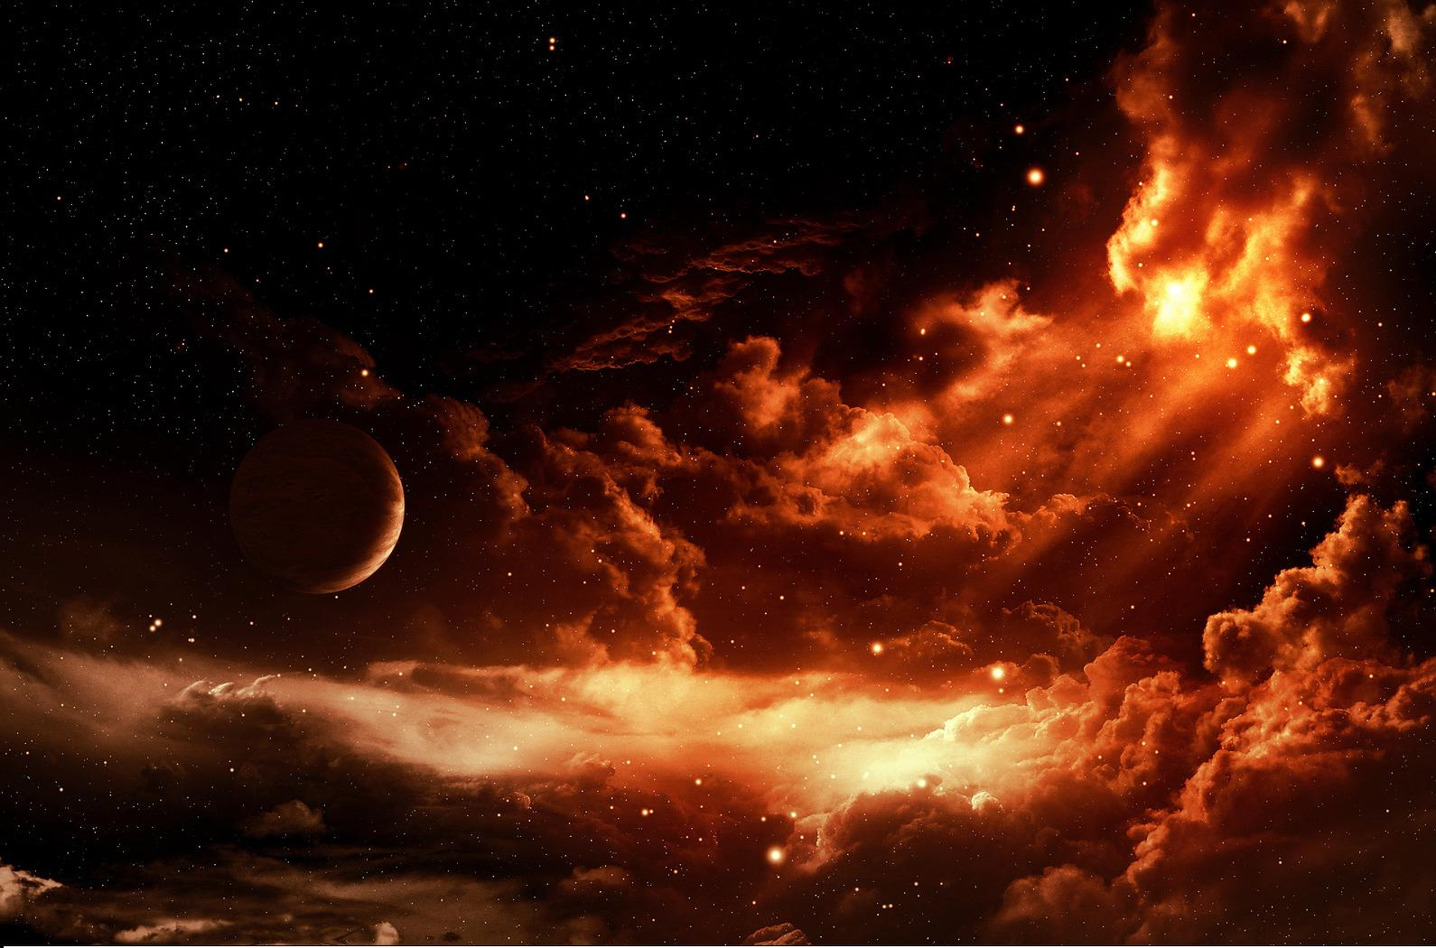
“In the which the heavens shall pass away with a great noise, and the elements shall melt with fervent heat.”

Slide 7
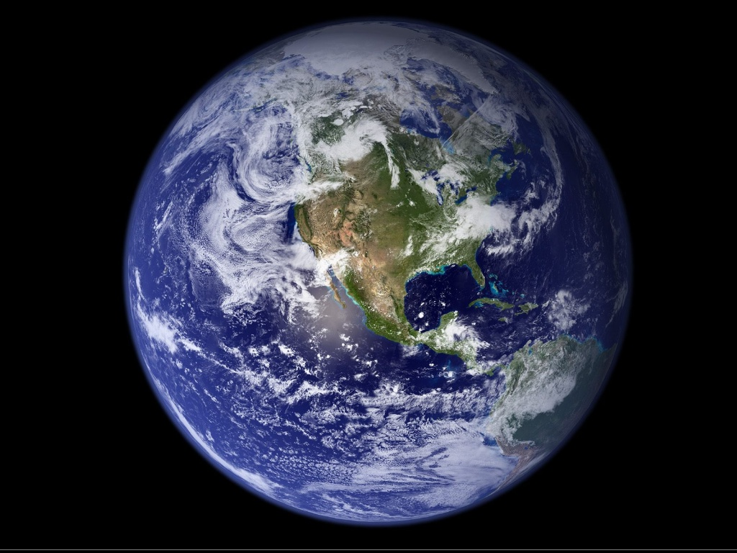
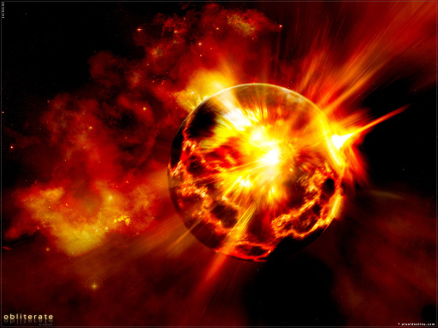
“The earth also and the works that are
therein shall be burned up.”

Slide 8
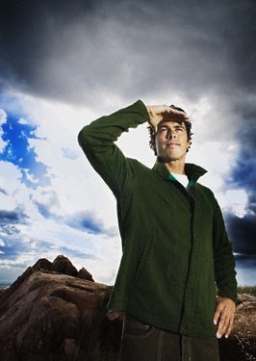
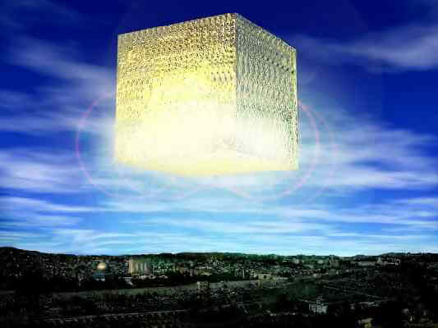
“Seeing then that all these things shall be dissolved, what manner of persons ought ye to be in all holy conversation and godliness, Looking for and hasting unto the coming of the day of God, wherein the heavens being on fire shall be dissolved, and the elements shall melt with fervent heat? Nevertheless we, according to his promise, look for new heavens and a new earth, wherein dwelleth righteousness.”

Slide 9
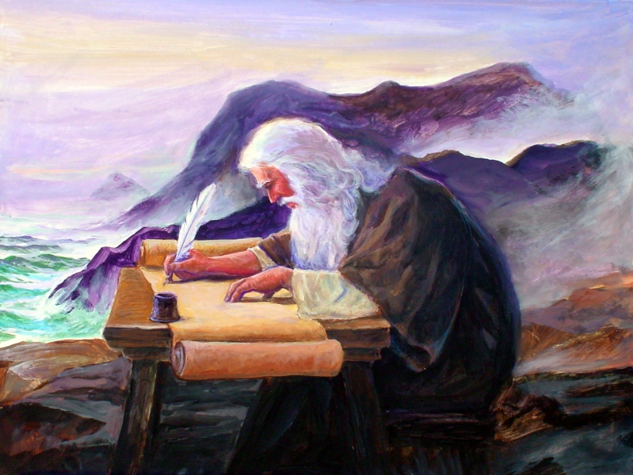
“And I John saw the holy city, new Jerusalem, coming down from God out of heaven, prepared as a bride adorned for her husband.”

Slide 10
“And I heard a great voice out of heaven saying, Behold, the tabernacle of God is with men.”

Slide 11
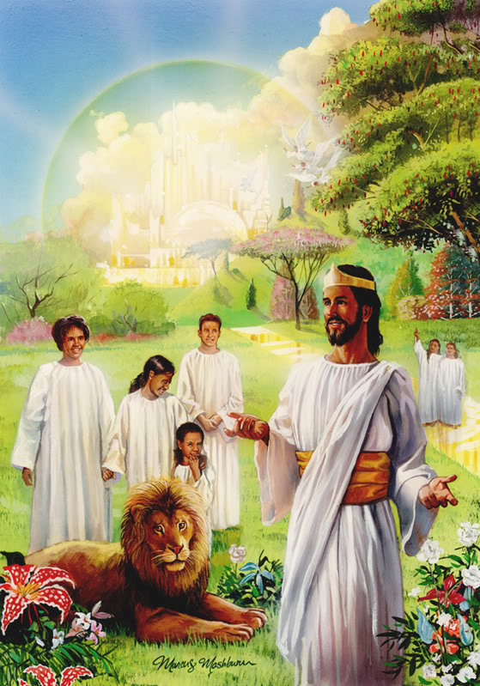
“…and he will dwell with them, and they shall be his people, and God himself shall be with them, and be their God.”

Slide 12
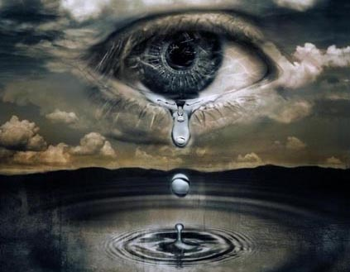
“And God shall wipe away all tears from their eyes...”

Slide 13
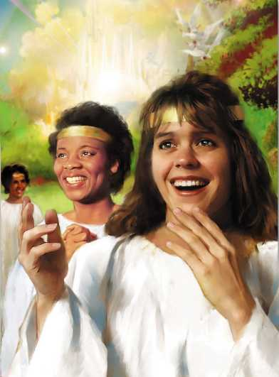
“…and there shall be no more death, neither sorrow, nor crying, neither shall there be any more pain: for the former things are passed away.”

Slide 14
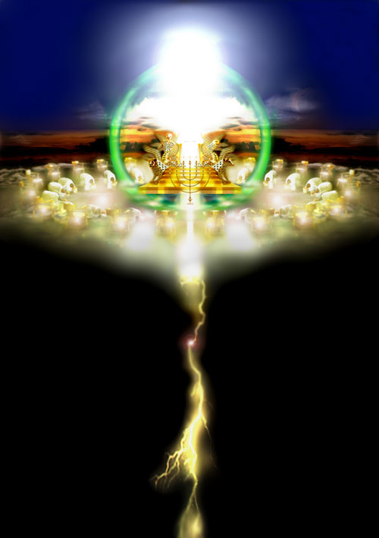
“And he that sat upon the throne said, Behold, I make all things new.”

Slide 15
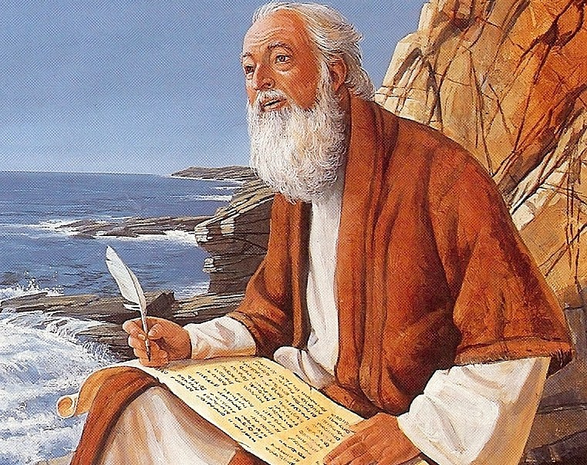
“And he said unto me, Write: for these words are true and faithful.”

Slide 16
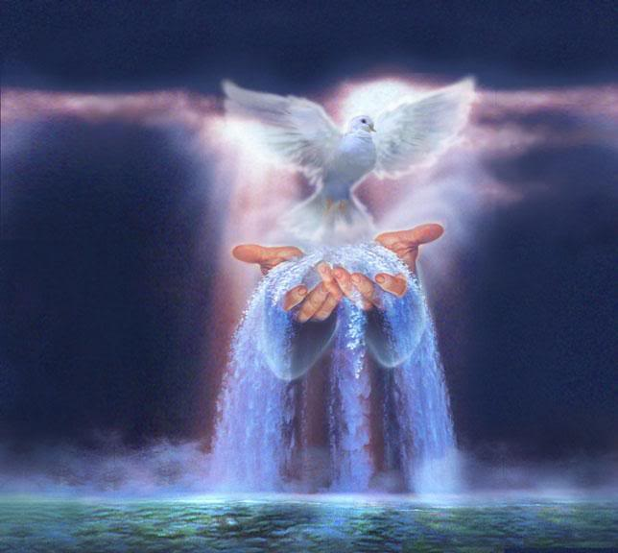
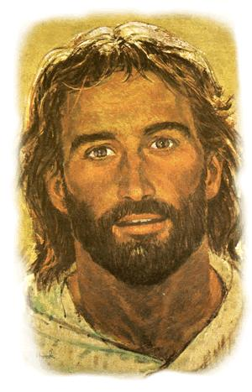
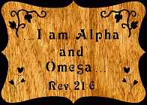
“I will give unto him that is athirst of the fountain of the water of life freely.”

Slide 17
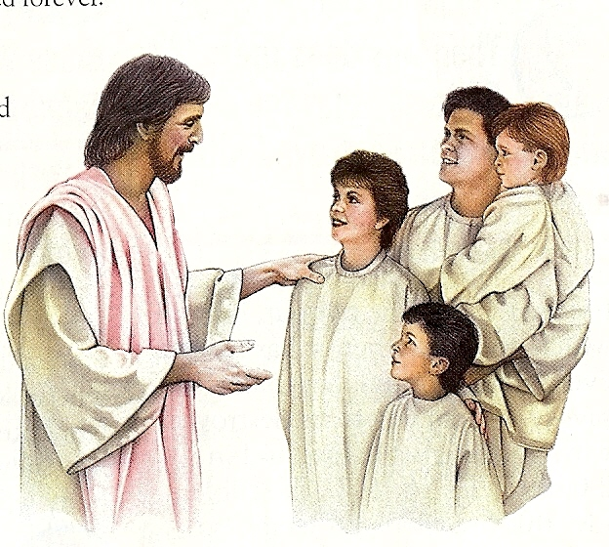
“He that overcometh shall inherit all things; and I will be his God, and he shall be my son. ”

Slide 18
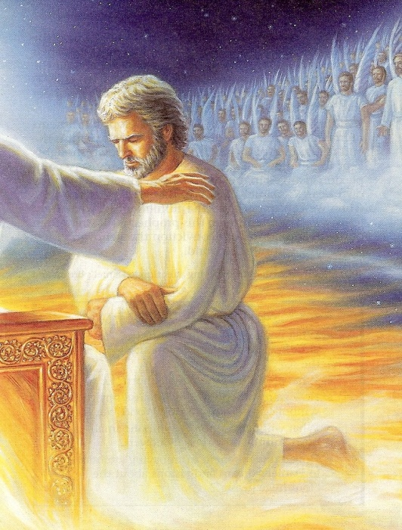
“For whoever is born of God overcometh the world: and this is the victory that overcometh the world, even our faith. Who is he that overcometh the world, but he that believeth that Jesus is the Son of God?” (I John 5:4-5)

Slide 19
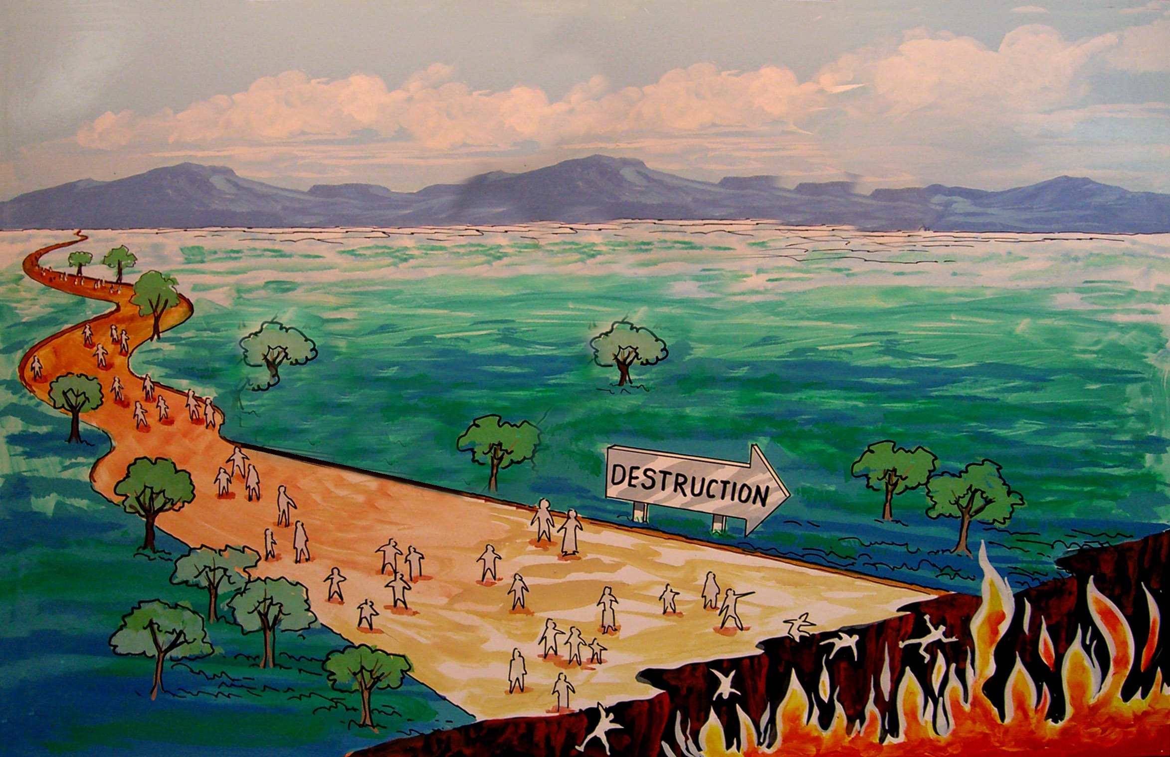
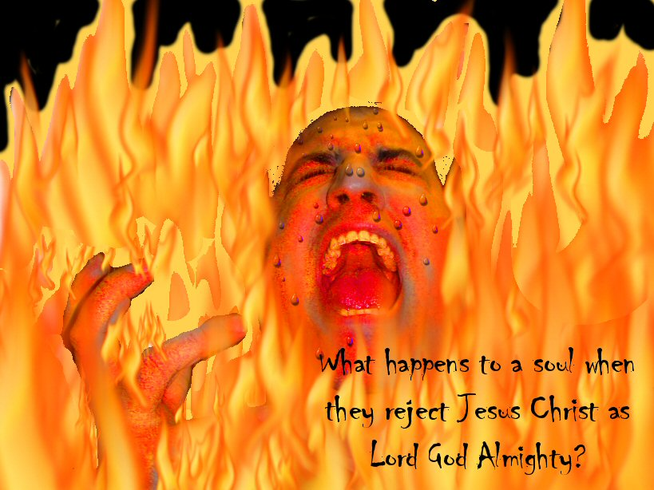
“But the fearful, and unbelieving, and the abominable, and murderers, and whoremongers, and sorcerers, and idolaters, and all liars, shall have their part in the lake which burneth with fire and brimstone: which is the second death.”

Slide 20
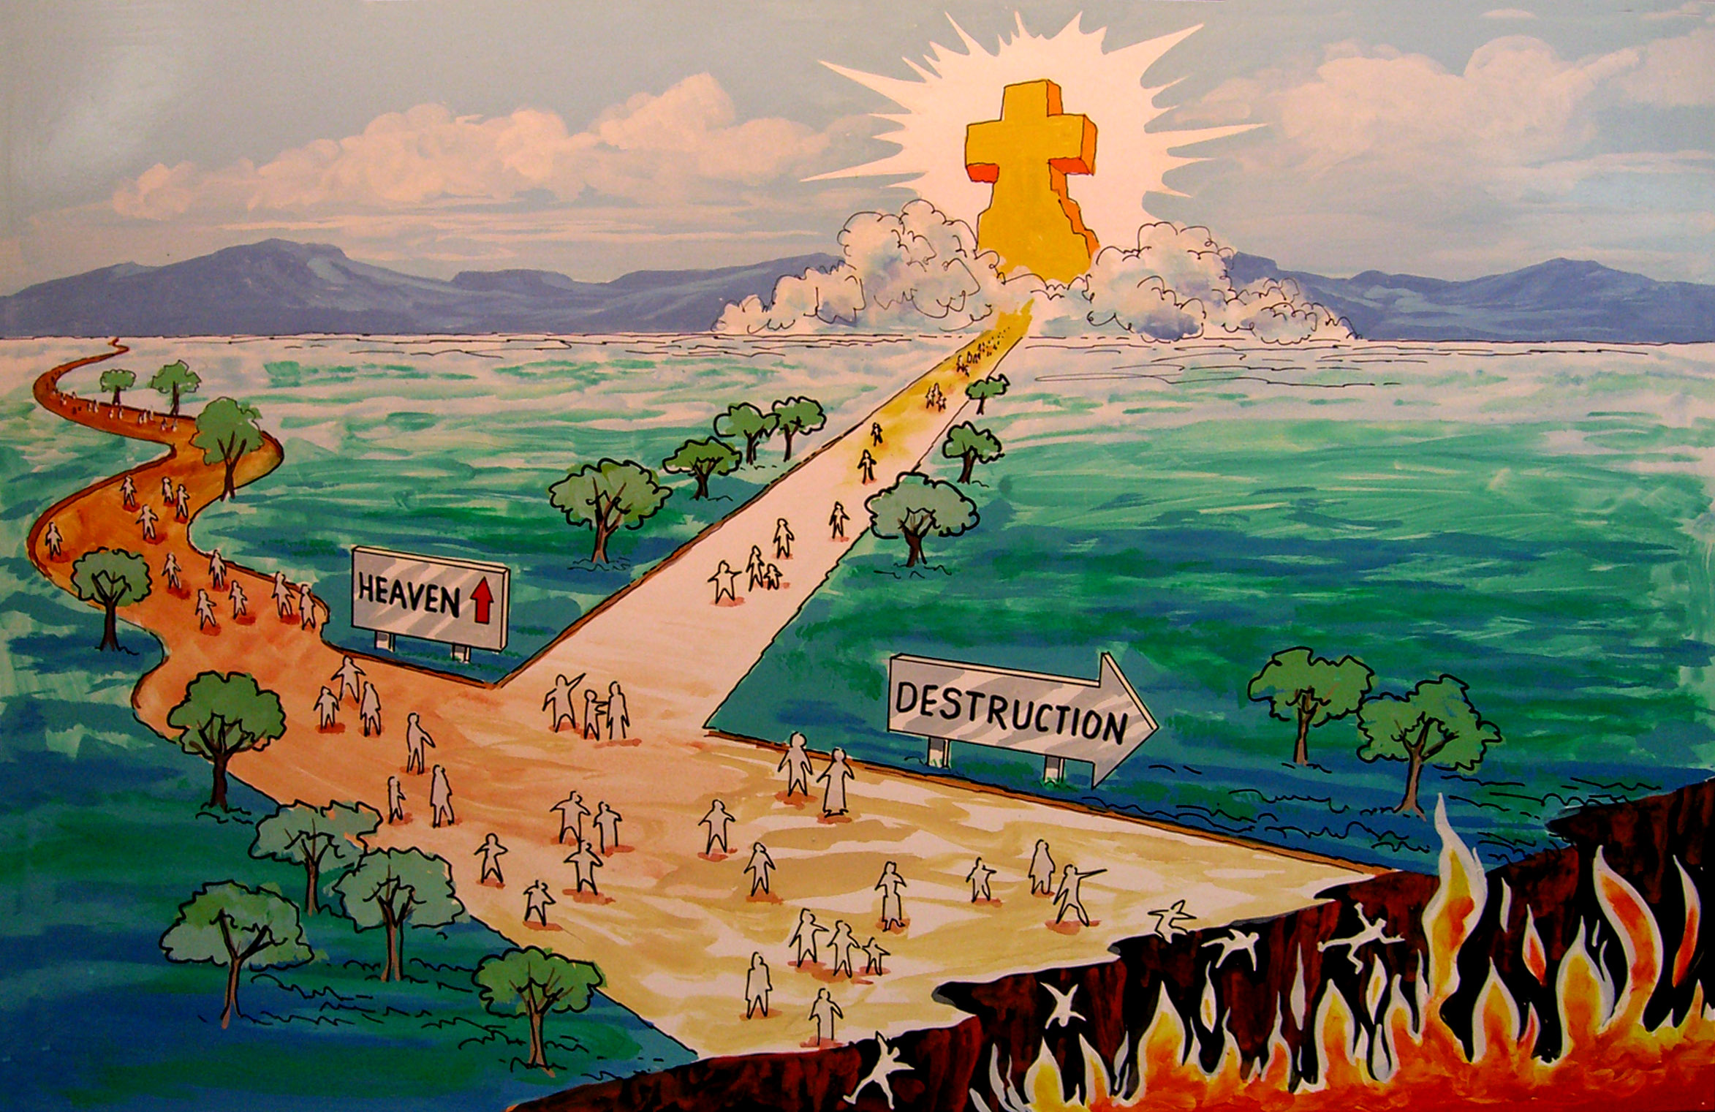

Slide 21
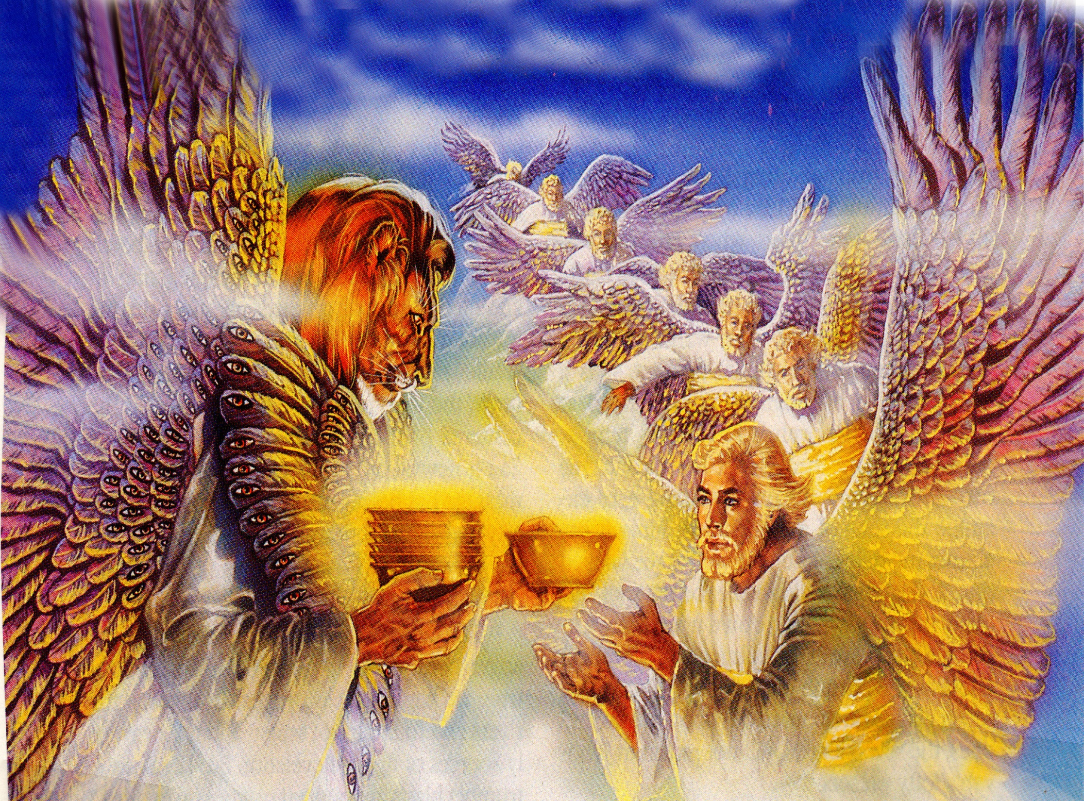
“And there came unto me one of the seven angels which had the seven vials full of the seven last plagues, and talked with me, saying, Come hither, I will shew thee the bride, the Lamb's wife.”

Slide 22
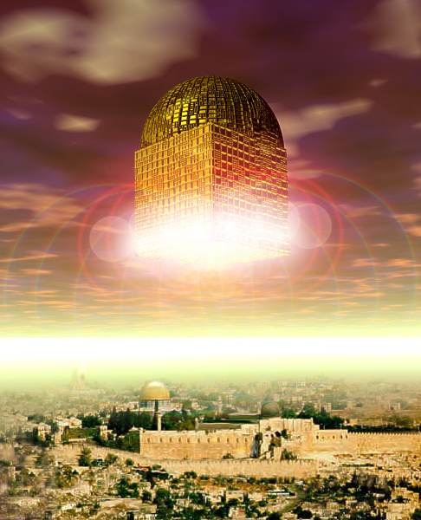
“And he carried me away in the spirit to a great and high mountain, and shewed me that great city, the holy Jerusalem, descending out of heaven from God.”

Slide 23
“Having the glory of God: and her light was like unto a stone most precious, even like a jasper stone, clear as crystal;.”

Slide 24
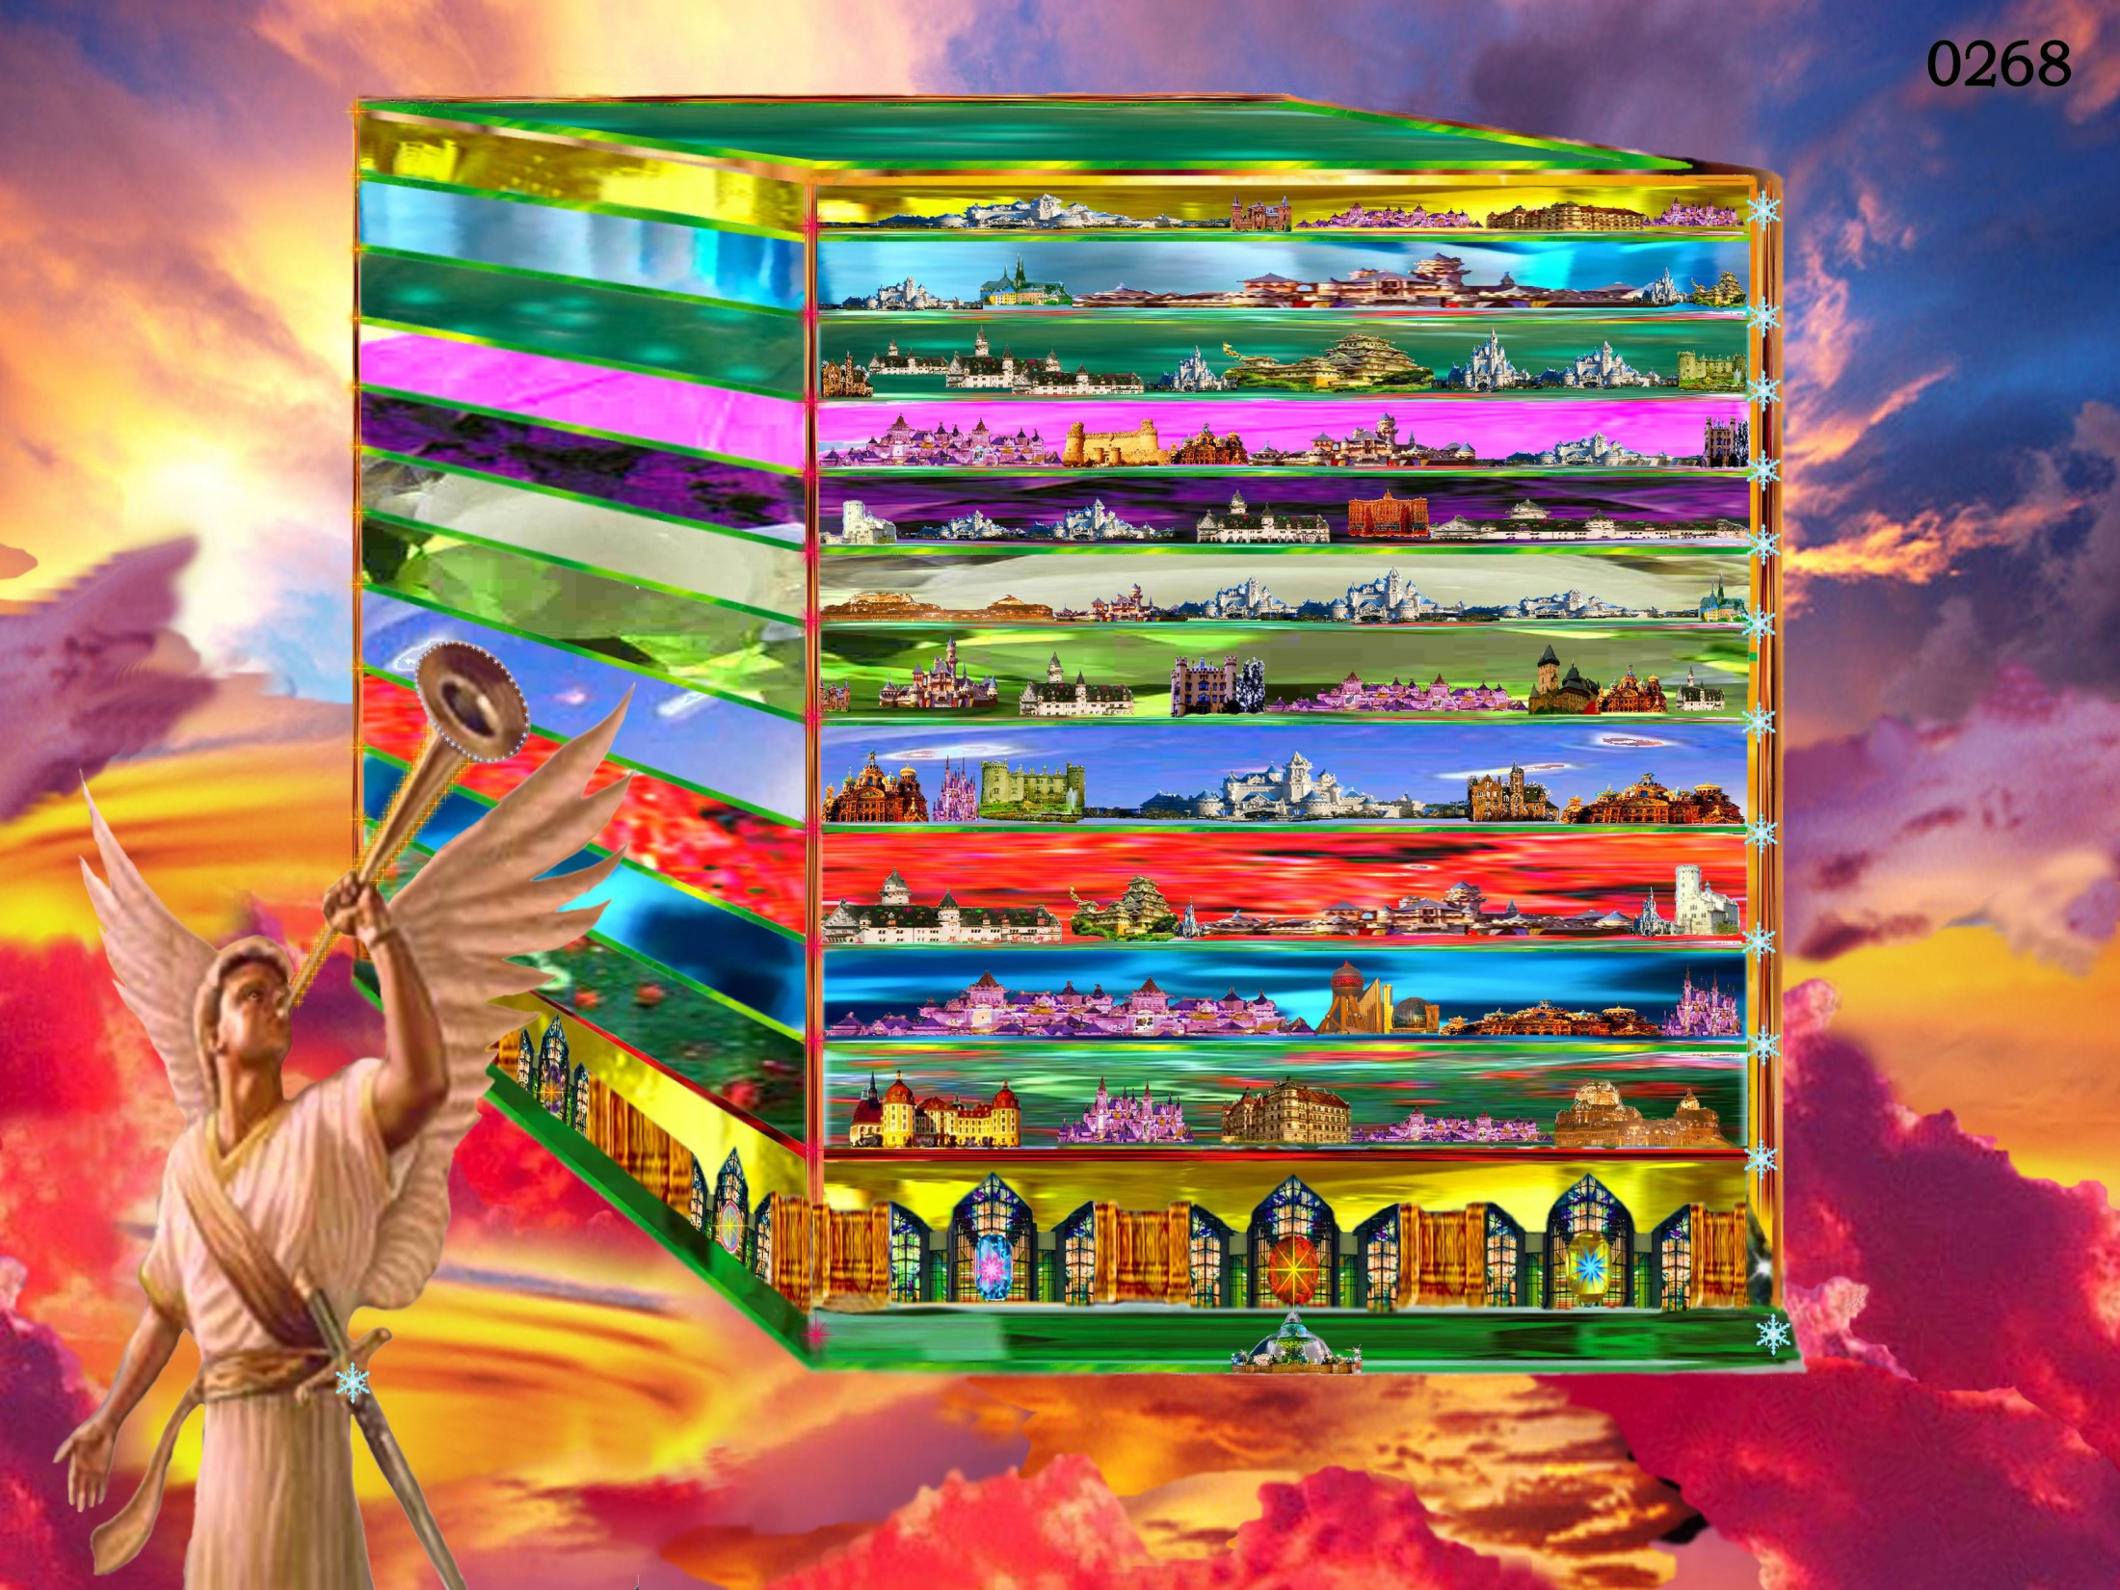
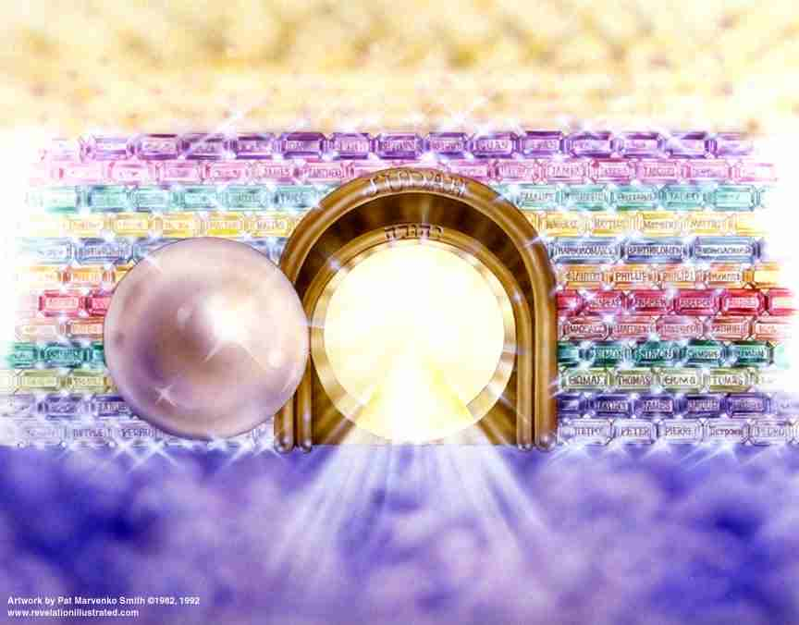
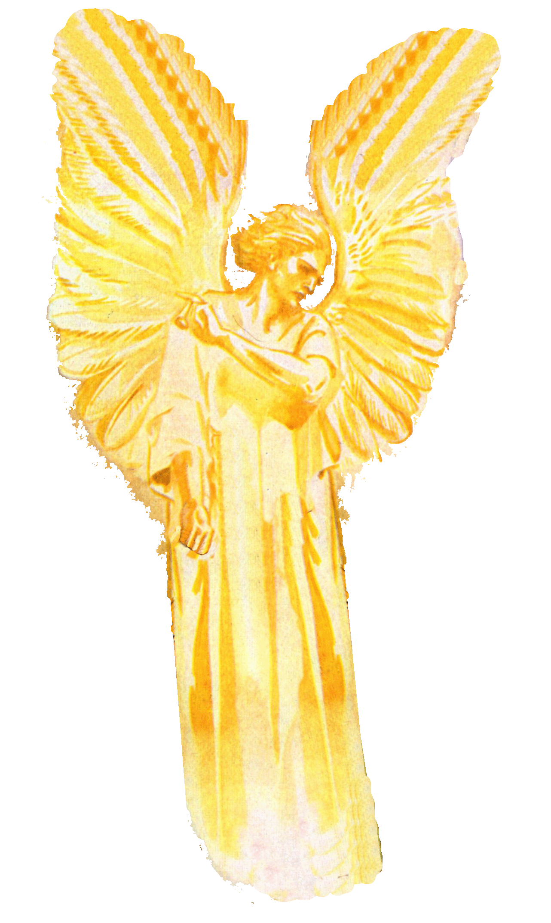
“And had a wall great and high, and had twelve gates, and at the gates twelve angels, and names written thereon, which are the names of the twelve tribes of the children of Israel.”

Slide 25
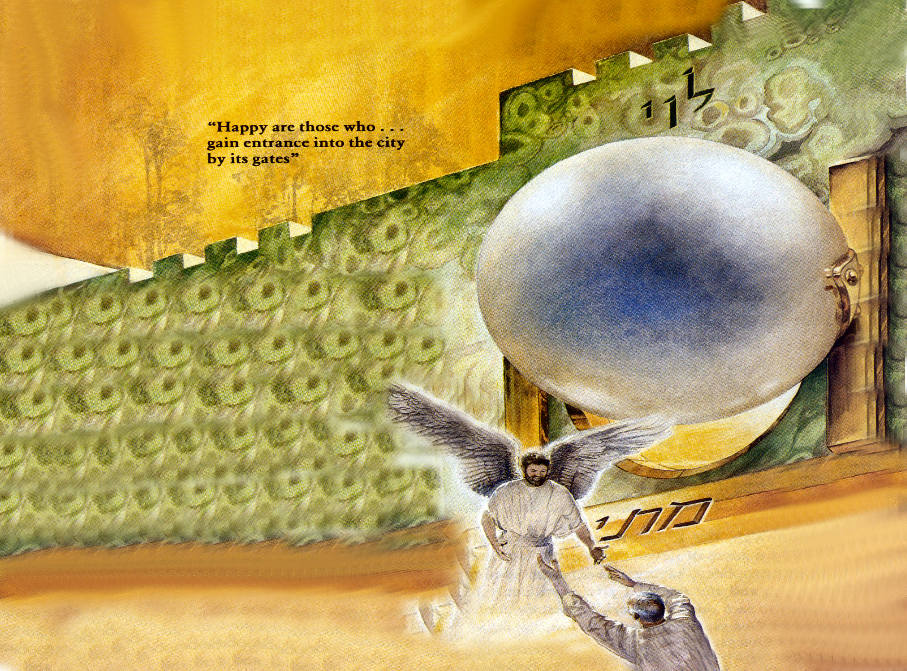
“On the east three gates; on the north three gates; on the south three gates; and on the west three gates. And the wall of the city had twelve foundations, and in them the names of the twelve apostles of the Lamb.”

Slide 26
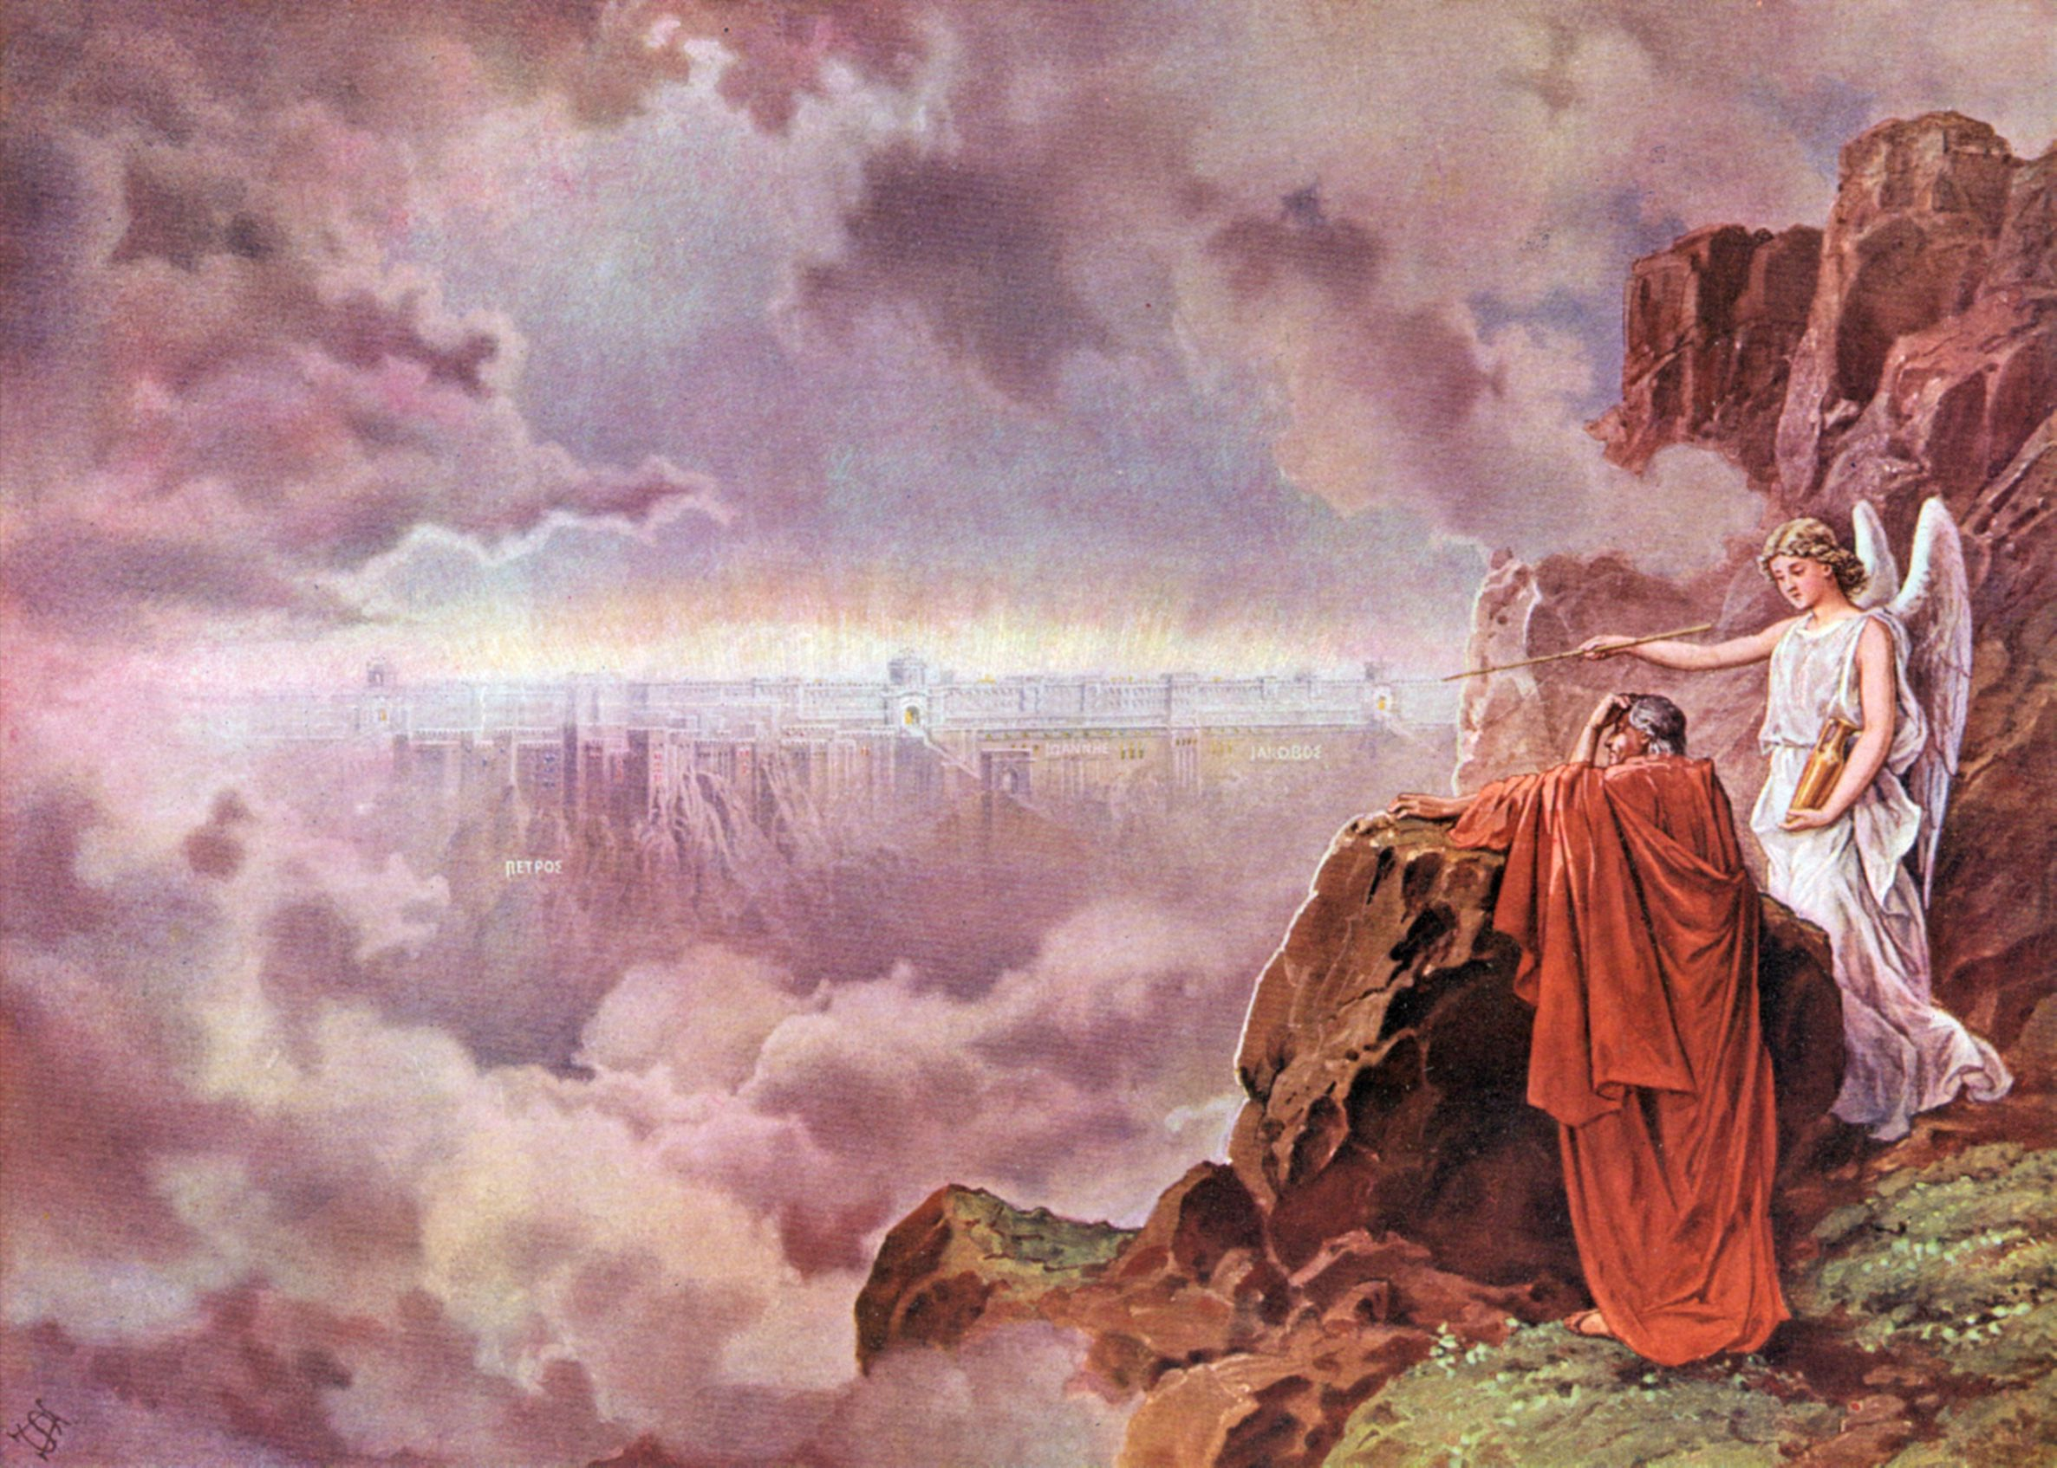
“And he that talked with me had a golden reed to measure the city, and the gates thereof, and the wall thereof.”

Slide 27
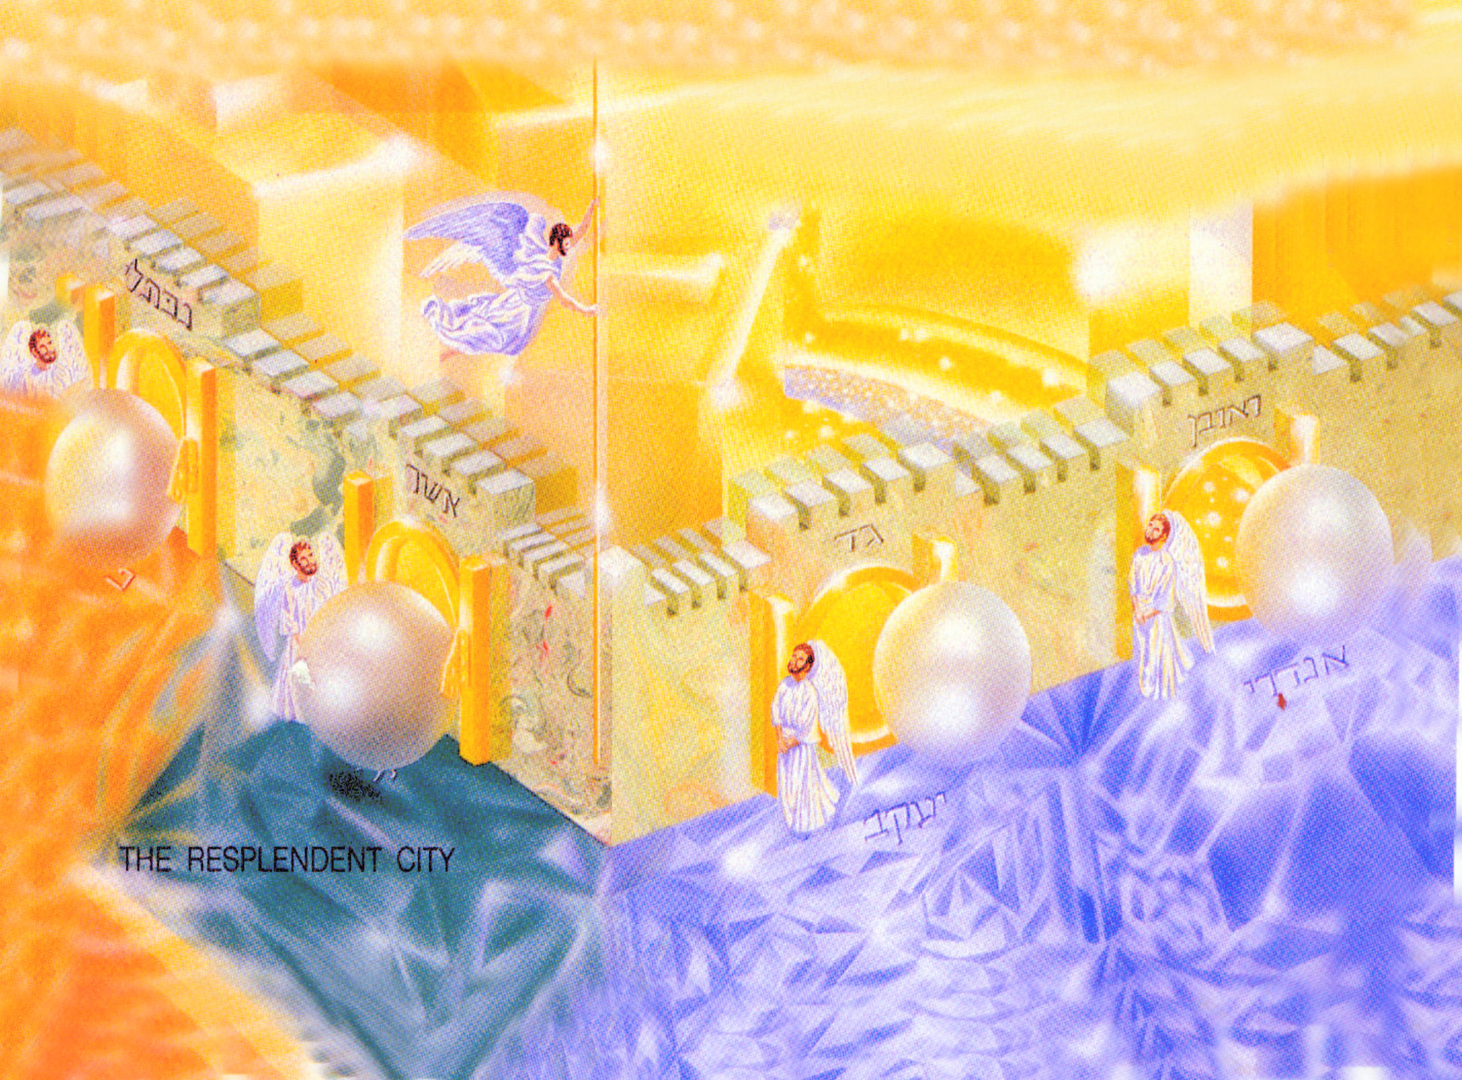
“And the city lieth foursquare, and the length is as large as the breadth: and he measured the city with the reed, twelve thousand furlongs. The length and the breadth and the height of it are equal. And he measured the wall thereof, an hundred and forty and four cubits, according to the measure of
a man, that is, of the angel.”

Slide 28
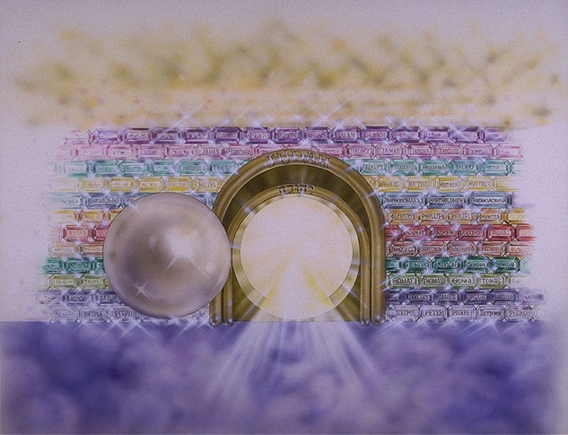
“And the foundations of the wall of the city were garnished with all manner of
precious stones.”

Slide 29
Amethyst
Pure gold
Jacinth
Chrysoprasus
Topaz
Chrysolite
Beryl
Sardius
Sardonyx
Emerald
Chalcedony
Sapphire
Jasper

Slide 30
“And the twelve gates were twelve pearls; every several gate was of one pearl: and the street of the city was pure gold, as it were transparent glass.”

Slide 31
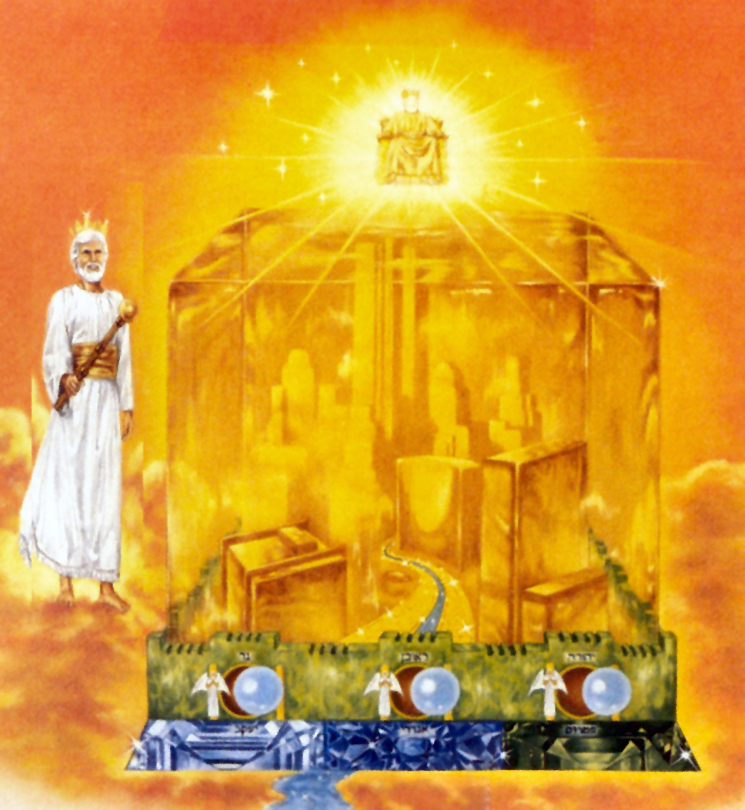
“And the city had no need of the sun, neither of the moon, to shine in it: for the glory of God did lighten it, and the Lamb is the light thereof.”

Slide 32
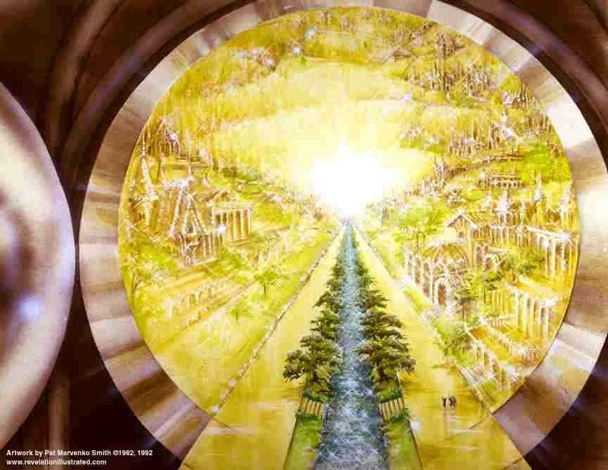
“And the nations of them which are saved shall walk in the light of it.”

Slide 33
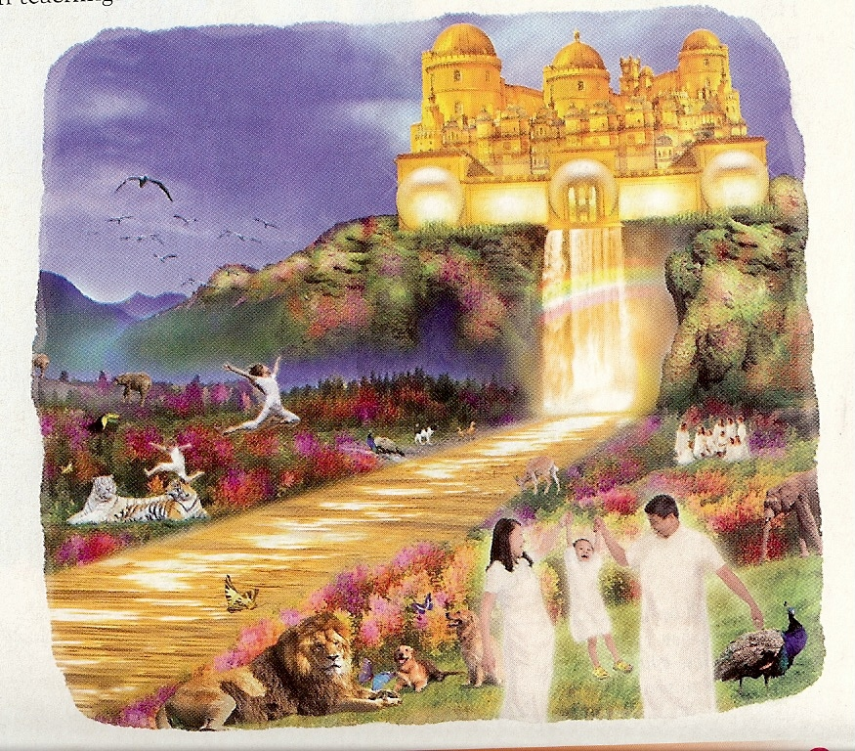
“And the gates of it shall not be shut at all by day: for there shall be no night there.”

Slide 34
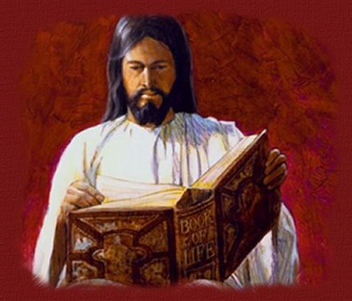
“And there shall in no wise enter into it any thing that defileth, neither whatsoever worketh abomination, or maketh a lie: but they which are written in the Lamb's book of life.”

Slide 35
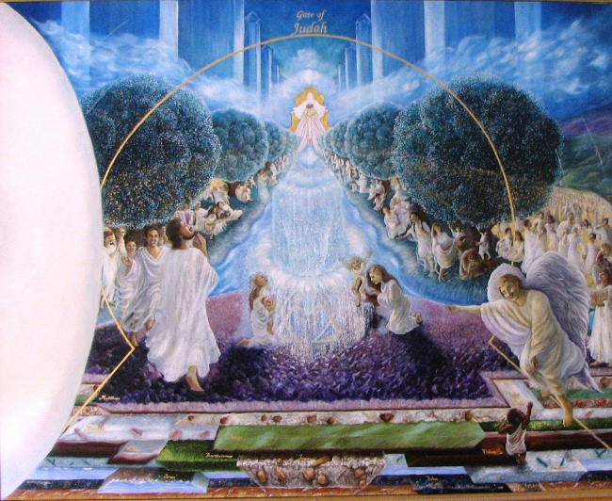
“And he shewed me a pure river of water of life...”

Slide 36
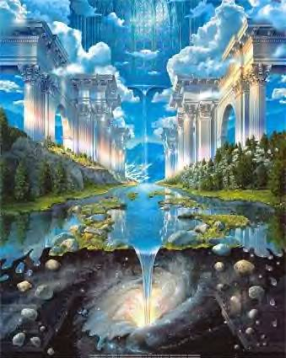
“…clear as crystal, proceeding out of the throne of God and of the Lamb.”

Slide 37
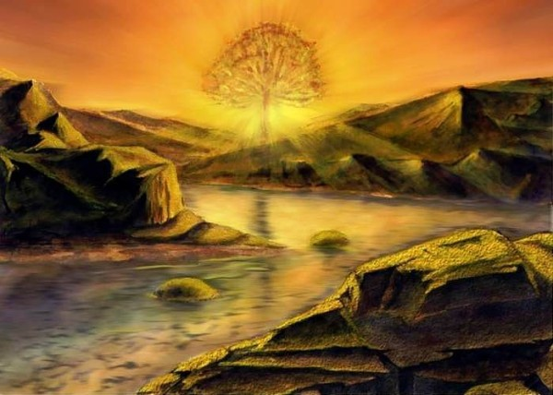
“In the midst of the street of it, and on either side of the river, was there the tree of life, which bare twelve manner of fruits, and yielded her fruit every month: and the leaves of the tree were for the healing of the nations.”

Slide 38
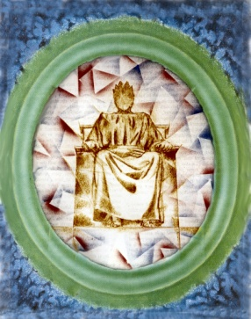
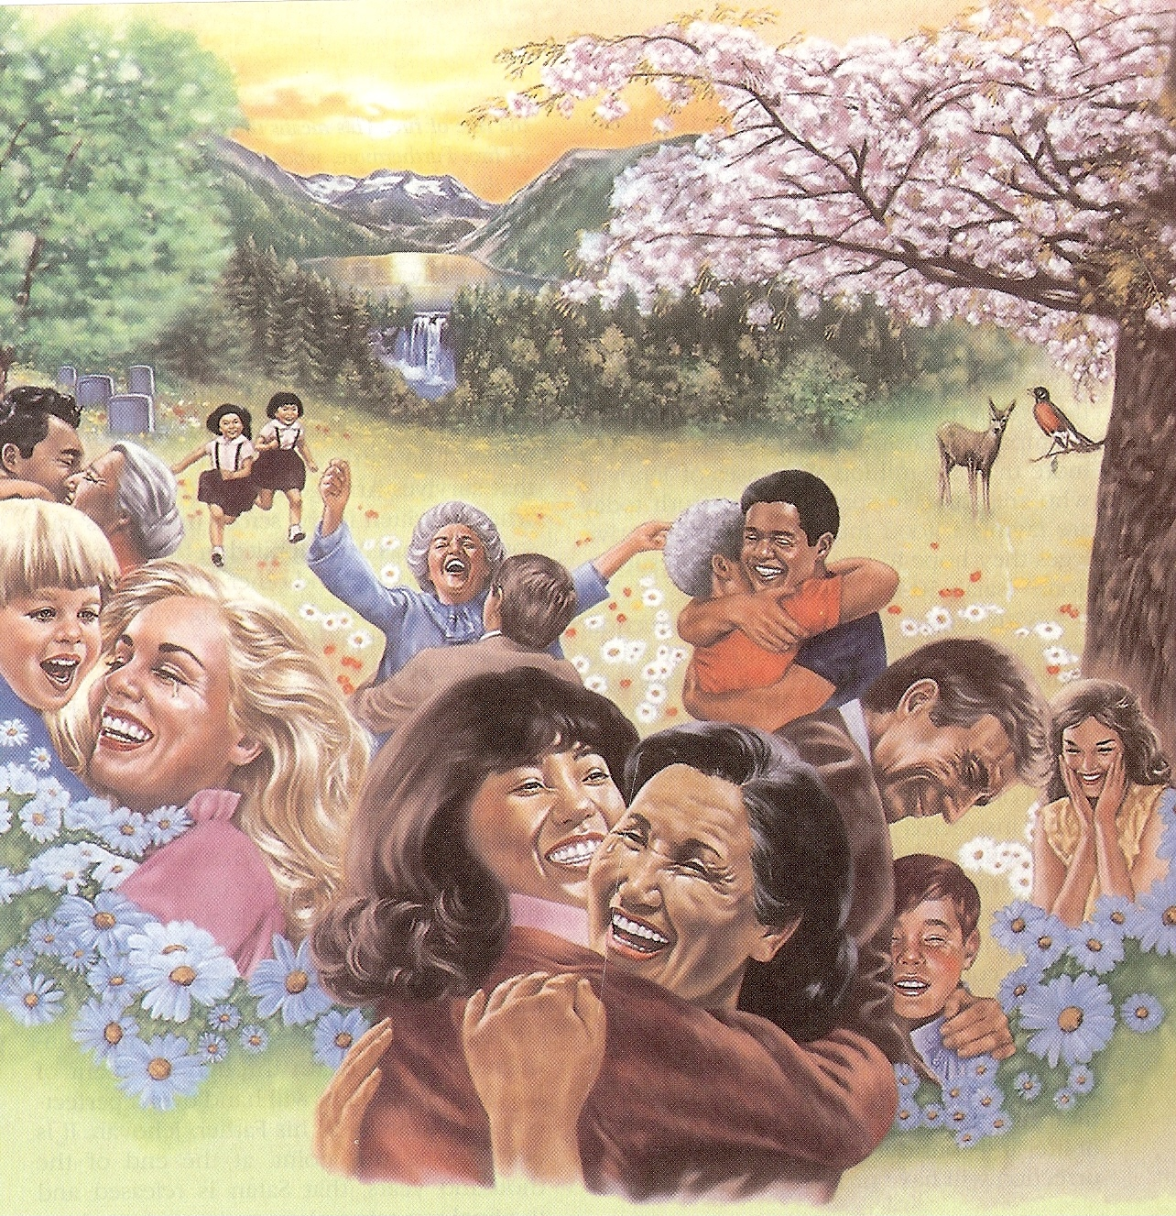
“And there shall be no more curse: but the throne of God and of the Lamb shall be in it; and his servants shall serve him.”

Slide 39
“And they shall see his face; and his name shall be in their foreheads.”

Slide 40
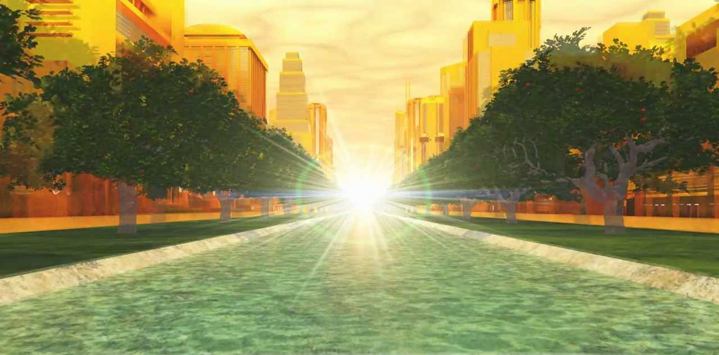
“And there shall be no night there; and they need no candle, neither light of the sun; for the Lord God giveth them light: and they shall reign forever and ever.”

Slide 41
Revelation 22:6-21
“The Conclusion”

Slide 42
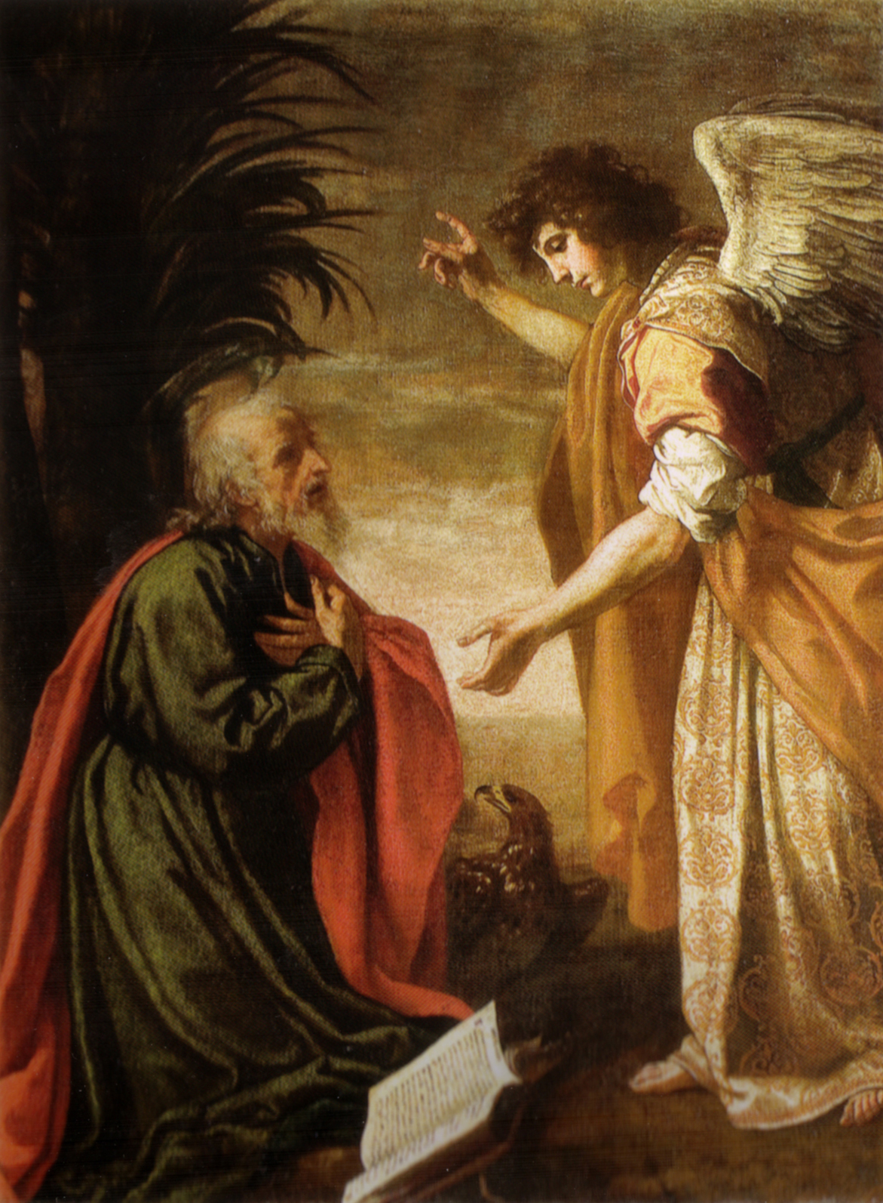
“And he said unto me, These sayings are faithful and true: and the Lord God of the holy prophets sent his angel to shew unto his servants the things which must shortly be done.”

Slide 43
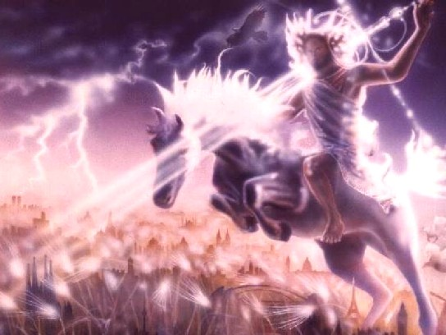
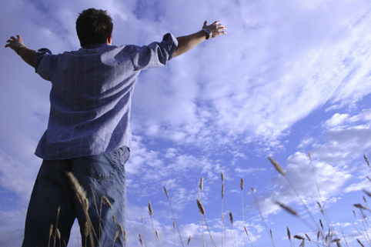
“blessed is he that keepeth the sayings of the prophecy of this book.”
“BEHOLD I COME QUICKLY…”

Slide 44
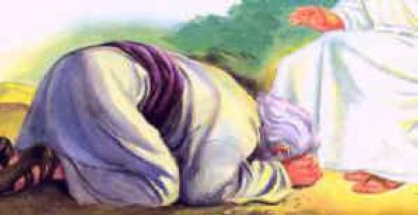
“And I John saw these things, and heard them. And when I had heard and seen, I fell down to worship before the feet of the angel which shewed me these things.”

Slide 45
“Then saith he unto me, See thou do it not: for I am thy fellowservant, and of thy brethren the prophets, and of them which keep the sayings of this book: worship God.”

Slide 46
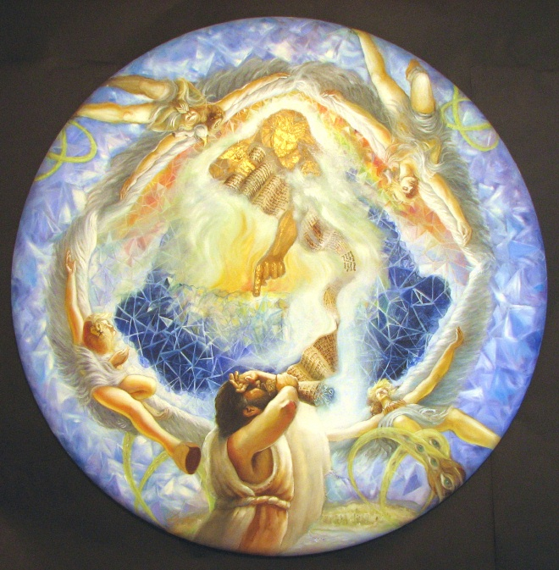
“Then saith he unto me, See thou do it not: for I am thy fellowservant, and of thy brethren the prophets, and of them which keep the sayings of this book: worship God.”

Slide 47
“Seal not the sayings of the prophecy of this book: for the time is at hand.”

Slide 48
“He that is unjust, let him be unjust still: and he which is filthy, let him be filthy still: and he that is righteous, let him be righteous still: and he that is holy, let him be holy still.”

Slide 49
“Behold, I come quickly; and my reward is with me, to give every man according as his work shall be.”

Slide 51
“Blessed are they that do his commandments”
“That they may have right to the tree of life, and may enter in through the gates into the city.”

Slide 52
“For without are dogs, and sorcerers, and whoremongers, and murderers, and idolaters, and whosoever loveth and maketh a lie.”

Slide 53
“I Jesus have sent mine angel to testify unto you these things in the churches.”

Slide 54
“I am the root and the offspring of David, and the bright and morning star.”

Slide 55
“The Spirit and the bride say, Come…”

Slide 56
“And let him that heareth say, Come. And let him that is athirst come. And whosoever will, let him take the water of life freely.”

Slide 57
“For I testify unto every man that heareth the words of the prophecy of this book, If any man shall add unto these things, God shall add unto him the plagues that are written in this book.”

Slide 59
“And if any man shall take away from the words of the book of this prophecy, God shall take away his part out of the book of life, and out of the holy city, and from the things which are written in this book.”

Slide 60
“Surely I come quickly. Amen. Even so, come, Lord Jesus.”

