Slide 1
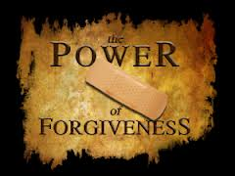
Forgiveness (Ephesians 4:30-32)
“It’s a choice”

Slide 2
(Ephesians 4:30-32) “And grieve not the holy Spirit of God, whereby ye are sealed unto the day of redemption. Let all bitterness, and wrath, and anger, and clamour, and evil speaking, be put away from you, with all malice: And be ye kind one to another, tenderhearted, forgiving one another, even as God for Christ's sake hath forgiven you.”

Slide 3
Discernment “Is there any unforgiveness in my heart” (Psalms 139:23-24)
If you have truly forgiven every person who has wronged, offended, hurt and sinned against you, then you are able to experience – Matthew 6:14-15
Freedom
Joy
Peace
Blessing

Slide 4
It is possible to live with an unforgiving spirit so long, that you become blinded to its presents in your life – Hebrews 12:15
The following exercise will help you discern if there is any forgiveness lodged in your heart -
Question: Have you ever been hurt?
Lied to
Promises broken
Neglected
Rejected
Find yourself telling others how that person hurt you.

Slide 5
If the person’s name comes up in a conversation I am more likely to say something negative about him/her then positive.
I cannot thank God for that person.
Note: If any of these statements are true it is an indication that you have not fully forgiven those who have sinned against you – Mark 11:25-26

Slide 6
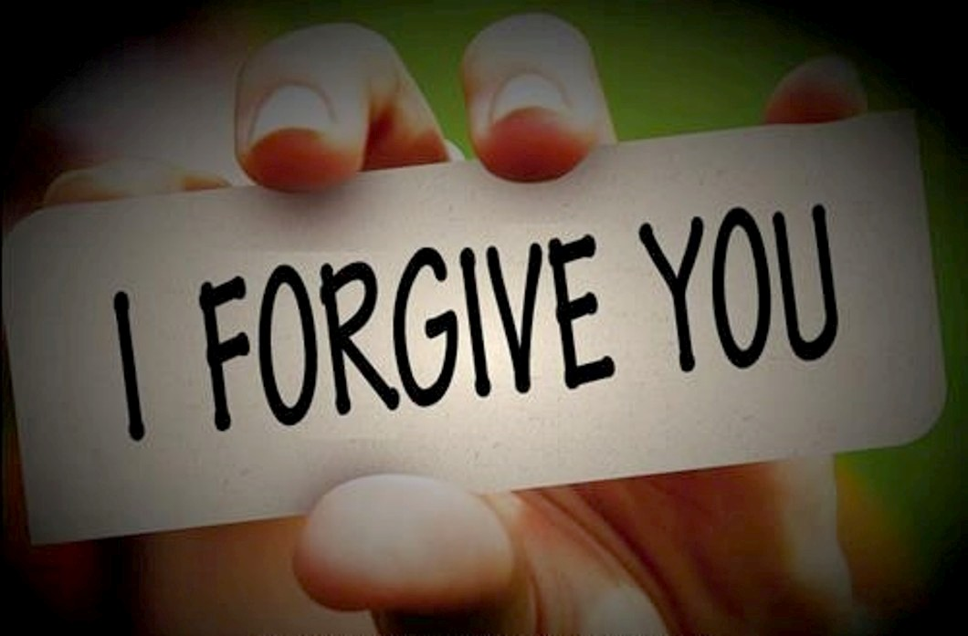
Definition “What is Biblical Forgiveness?”
Forgiveness means that you fully release your offender from his debt – Matthew 6:12
Forgiveness means that you fully clear his record – Psalms 103:12
Forgiveness means that never bring up the offense against him again – Hebrews 10:17-18

Slide 7
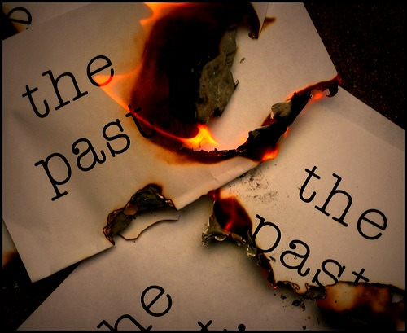

Slide 8
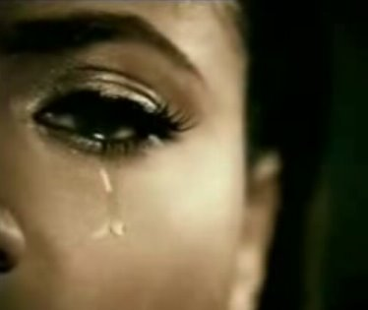
Violent crime against you or loved ones
Treated unfairly by a parent, employer, family member, husband, wife, children, friend, etc.
Slandered or falsely accused
Divorced by a mate
Mate committed adultery or other sexual sin
Stolen from
Cheated in business
Rebellious children

Slide 9
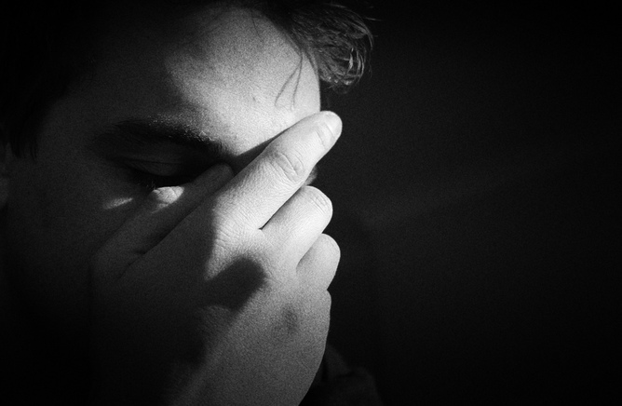
Physical abused
Sexually abused
Emotional abuse
Belittled
Publicly humiliated
Mocked
Ridiculed
Alcoholic parents or mate
Bad church experience
Etc.

Slide 10
Self-examination “As you reflect on ways you have been offended. Do you find any of these statements to be true?”
Every time I think of that person I still feel angry.
I have a subtle, secret desire to see that person pay for what the did to me.
Deep in my heart, I wouldn’t mind if something bad happened to that person.

Slide 11
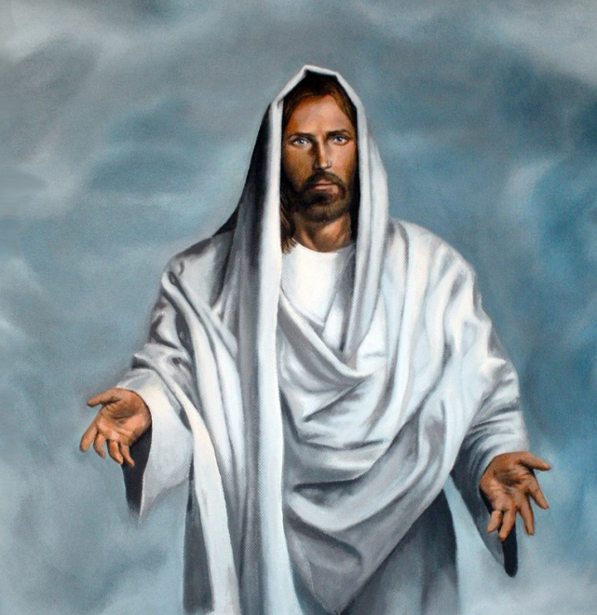
“It is impossible but that offences will come…take heed to yourselves: If thy brother trespass against thee, rebuke him; and if he repent, forgive him. And if he trespass against thee seven times in a day, and seven times in a day turn again to thee, saying, I repent; thou shalt forgive him…”
“But I say unto you which hear, love your enemies, do good to them which hate you, bless them that curse you, and pray for them which despitefully use you…”

Slide 12
“Forgive him seventy times seven…If ye do not forgive men their trespasses, neither will your Father forgive your trespasses…”
“When ye stand praying, forgive, if ye have ought against any…”
“If ye from your hearts forgive not every one his brother their trespasses…”
“Forgive and ye shall be forgiven…”
“If any brother trespass against thee forgive him…”

Slide 13
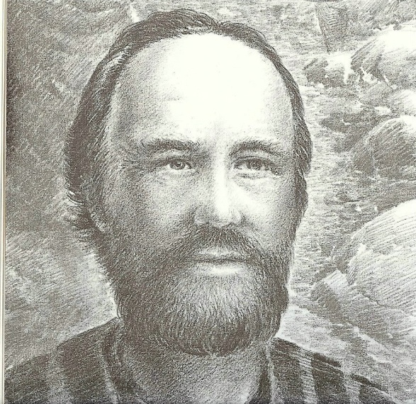
“Recompense to no man evil for evil. If it be possible, as much as lieth in you, live peaceably with all men.”
“Dearly beloved, avenge not yourselves…for it is written, Vengeance is mine; I will repay, saith the Lord. Therefore if thine enemy hunger, feed him; if he thirst, give him drink: for in so doing thou shalt heap coals of fire on his head. Be not overcome with evil, but overcome evil with good.”
(Romans 12:17-21)

Slide 14
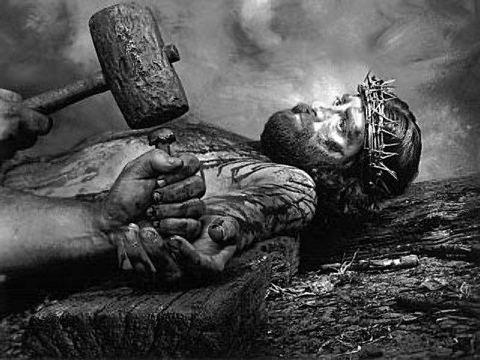
The Standard for our Forgiveness
“Then said Jesus, Father forgive them for they know not what they do…”
“And be ye kind one to another, tenderhearted, forgiving one another, even as God for Christ’s sake hath forgiven you.”
“Forbearing one another, and forgiving one another, if any man have a quarrel against any: even as Christ forgave you, so also do ye.”

Slide 15
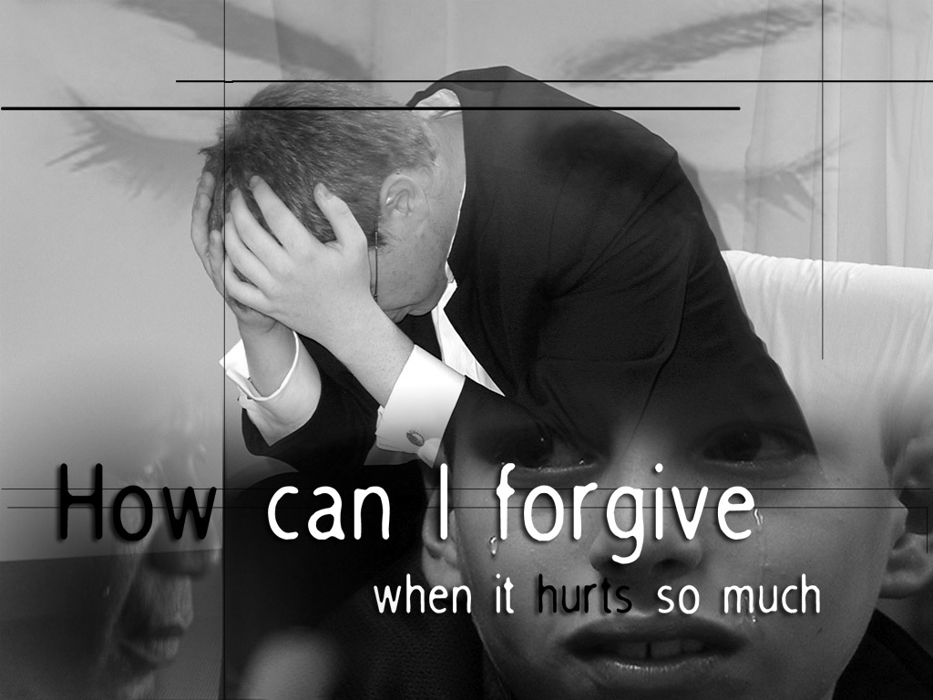
“I could never forgive that person, they have hurt me too deeply!”
“If there be therefore any consolation in Christ, if any comfort of love, if any fellowship of the Spirit, if any bowels and mercies, Fulfill ye my joy, that ye be likeminded, having the same love, being of one accord, of one mind.”

Slide 16
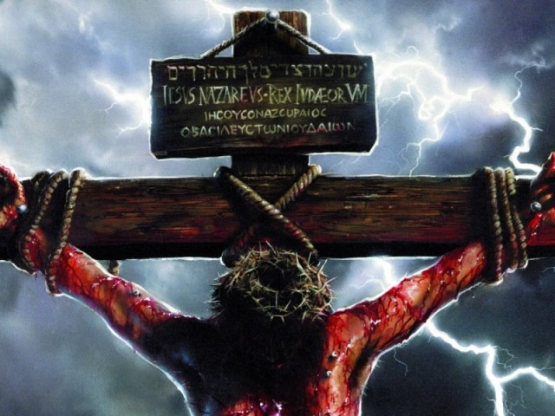
“Let nothing be done through strife and vainglory; but in lowliness of mind let each esteem others better than themselves. Look not every man on his own things, but every man also on the things of others. Let this mind be in you which was also in Christ Jesus…”

Slide 17
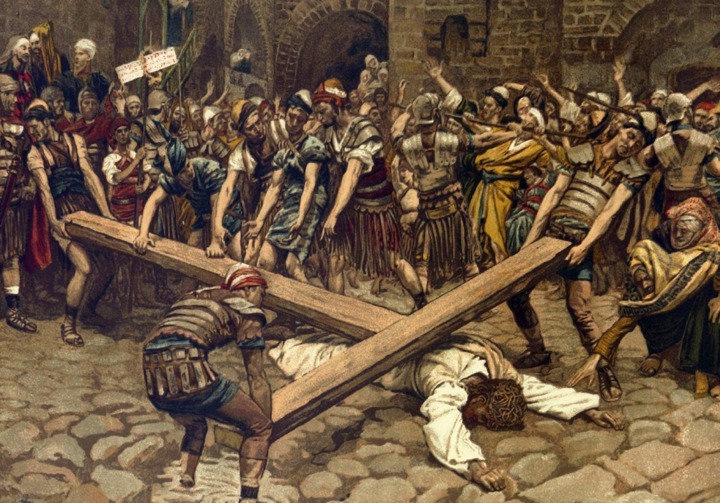
What are some of the hurts Jesus suffered? (Isaiah 53; Psalms 22:6-7, 16)
Despised
Rejected
Falsely accused
Betrayed
Forsaken
Mocked
Physically abused
Murdered

Slide 18
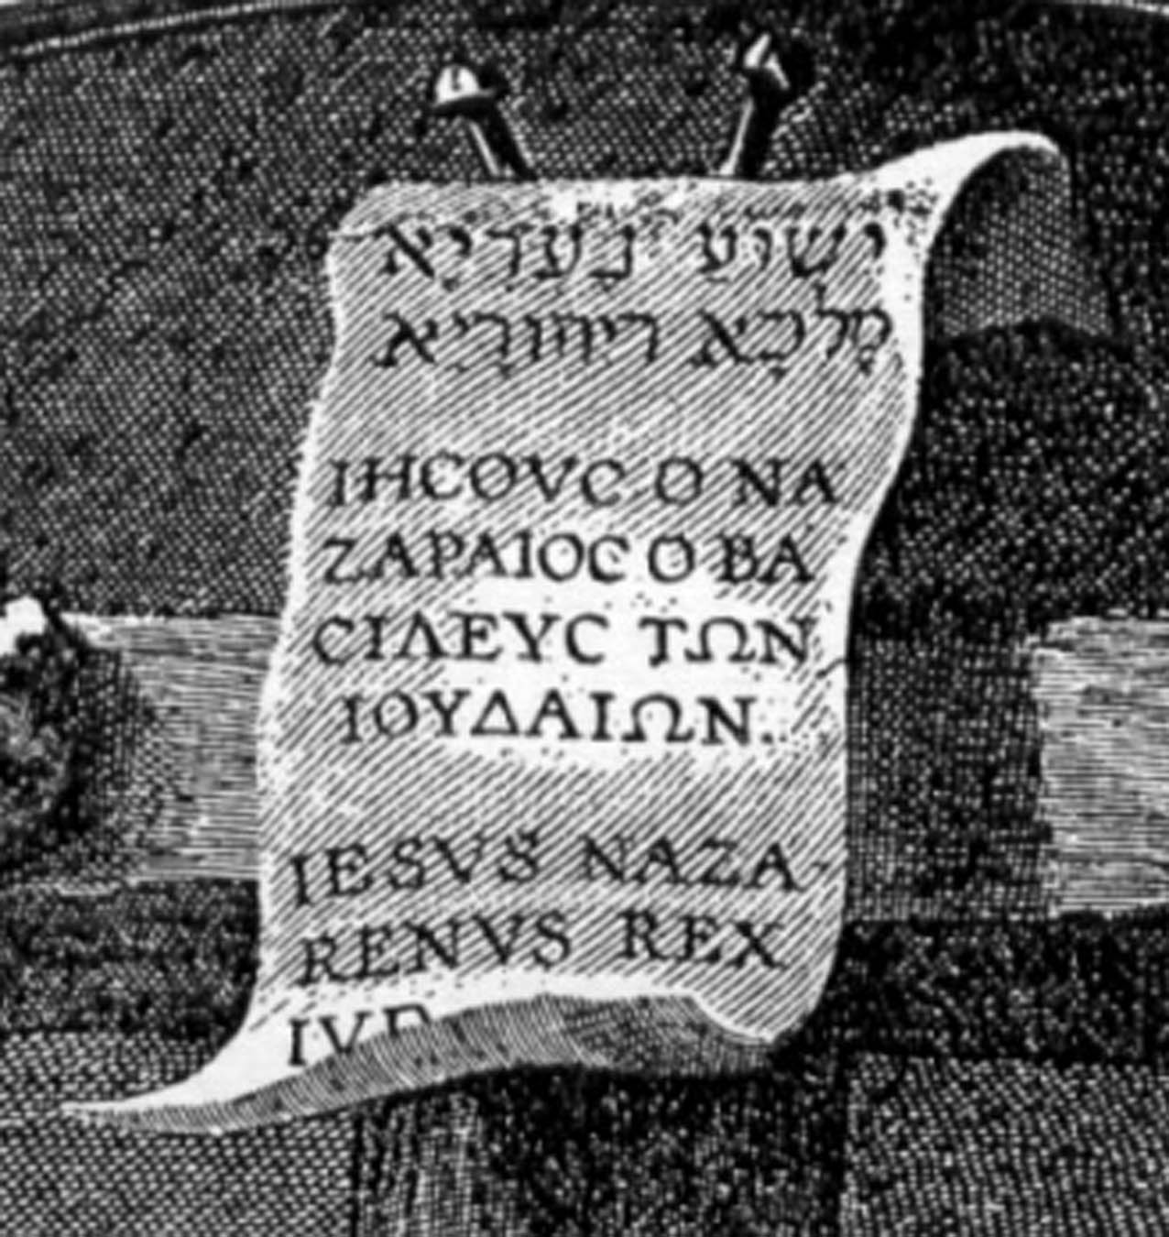
How has God dwelt with us who have sinned against Him so greatly?
Ephesians 2:4-5
Isaiah 43:25
Hebrews 10:17
Micah 7:18-19
Colossians 2:14

Slide 19
(Ephesians 2:4-5) “But God, who is rich in mercy, for his great love wherewith he loved us, Even when we were dead in sins, hath quickened us together with Christ, by grace ye are saved.”

Slide 20
(Isaiah 43:25) “I, even I, am he that blotteth out thy transgressions for mine own sake, and will not remember thy sins.”

Slide 21
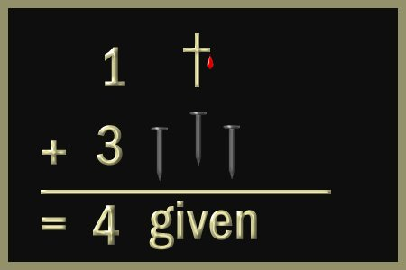
(Hebrews 10:17) “And their sins and iniquities will I remember no more.”

Slide 22
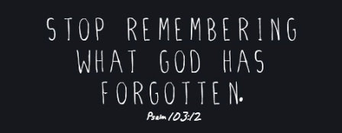

Slide 23
(Micah 7:19-18) “He will turn again, he will have compassion upon us; he will subdue our iniquities; and thou wilt cast all their sins into the depths of the sea.”

Slide 24
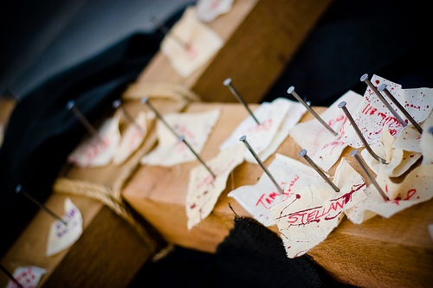
(Colossians 2:14-15) “Blotting out the handwriting of ordinances that was against us, which was contrary to us, and took it out of the way, nailing it to his cross.”

Slide 25
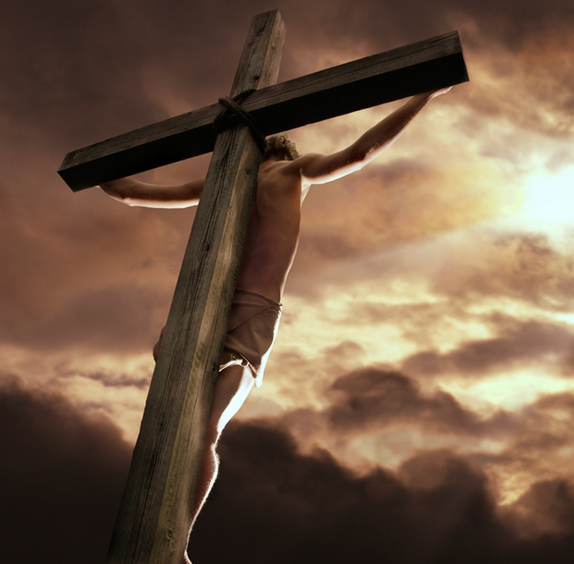
How did Jesus command us to respond to those who have wronged us?
“Forgive them…”

Slide 26
The act of forgiveness is only the starting place for dealing with those who have wronged us.
The initial act of releasing the offender must be followed by a commitment to invest positively in his or her life – Luke 6:27-31
This investment is the key to experiencing emotional healing and wholeness – “Where your treasure is there shall your heart be also…”

Slide 27
(Luke 6:27-31) “But I say unto you which hear, Love your enemies, do good to them which hate you, Bless them that curse you, and pray for them which despitefully use you. And unto him that smiteth thee on the one cheek offer also the other; and him that taketh away thy cloke forbid not to take thy coat also. Give to every man that asketh of thee; and of him that taketh away thy goods ask them not again. And as ye would that men should do to you, do ye also to them likewise.”

Slide 28
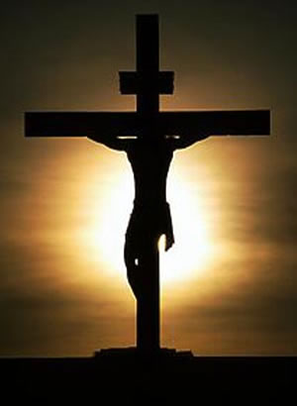
“They don’t deserve to be forgiven…”
What did we do to deserve God’s forgiveness?
“But God commendeth His love towards us, in that, while we were yet sinners, Christ died for us.” (Romans 5:18)

Slide 29
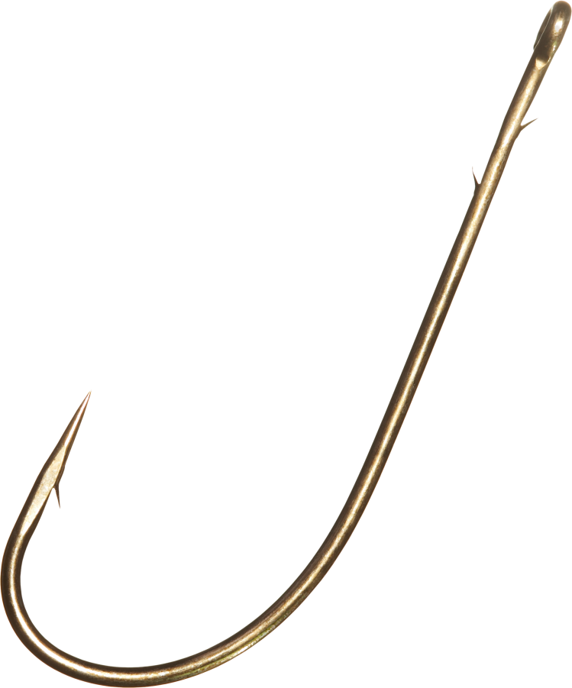
If I forgive them, they’re off the hook!
Letting your offender off your hook, does not mean that they are off God’s hook – Romans 12:19
Forgiveness involves transferring the prisoner over to the one who is able and responsible to meet out justice – “Shall not the judge of all the earth do right?”
Forgiveness relieves us of the burden and responsibility to hold them in prison ourselves -

Slide 30
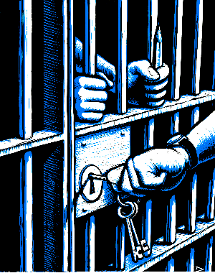

Slide 31
Ask God to search your heart to see if there is any unforgiveness there. (Psalms 26:2)
When you think of the person who has hurt you, which of the following attitudes do you experience?

Slide 32
Unforgiving spirit
Forgiving spirit
Emotional churning
Desire for revenge
Hard to ask God to bless them
Hard to see their good qualities
Want others to know what you know about them (negative)
Desire for God to bless them
Desire to see him spiritually restored
Sense of rest and relinquishment
Gratefulness to God for that person
Humbled by how greatly you have been forgiven by God

Slide 33
Why should we extend forgivingness?
The offender is genuinely sorry for what he has done.
The offender promises he will never do it again.
The offence was an “understandable mistake.”
God commands me to forgive.
I have been forgiven an infinite debt by God, so I forgive as I have been forgiven.

Slide 34
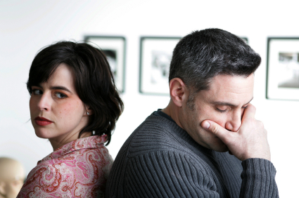
I am not going to forgive them!
If you refuse to forgive you can expect the following –
Matthew 6:14-15
Matthew 18:32-35
II Corinthians 2:10-11

Slide 35
(Matthew 6:14-15) “For if ye forgive men their trespasses, your heavenly Father will also forgive you: But if ye forgive not men their trespasses, neither will your Father forgive your trespasses.”

Slide 36
(Matthew 18:32-35) “Then his lord, after that he had called him, said unto him, O thou wicked servant, I forgave thee all that debt, because thou desiredst me: Shouldest not thou also have had compassion on thy fellowservant, even as I had pity on thee? And his lord was wroth, and delivered him to the tormentors, till he should pay all that was due unto him. So likewise shall my heavenly Father do also unto you, if ye from your hearts forgive not every one his brother their trespasses.”

Slide 38
(II Corinthians 2:10-11) “To whom ye forgive any thing, I forgive also: for if I forgave any thing, to whom I forgave it, for your sakes forgave I it in the person of Christ; Lest Satan should get an advantage of us: for we are not ignorant of his devices.”

Slide 39
I’ve forgiven them, but I’ll never be able to forget what they did to me.
When God forgives us, what does He promise?
Jeremiah 31:34 “For I will forgive their iniquity, and I will remember their sin no more.”
Hebrews 10:17 “And their sins and iniquities will I remember no more.”
Psalms 103:12 “As far as the east is from the west, so far hath he removed our transgressions from us.”

Slide 40
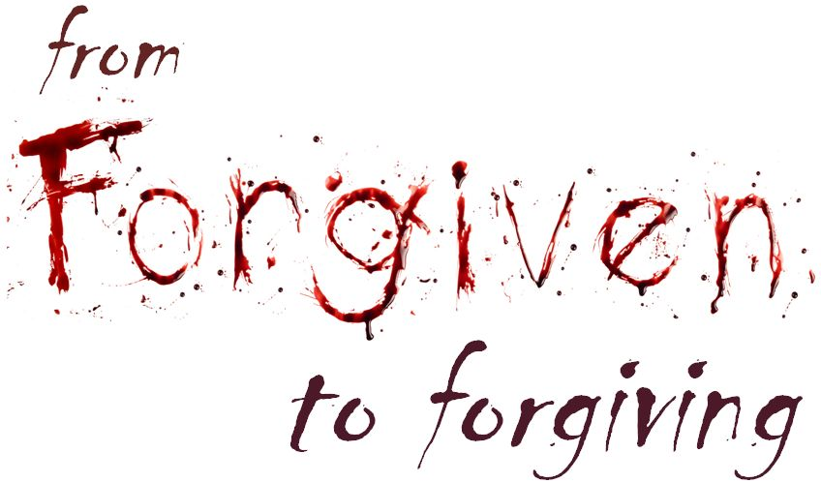
How are we to forgive?
Colossians 3:13
Ephesians 4:32

Slide 41
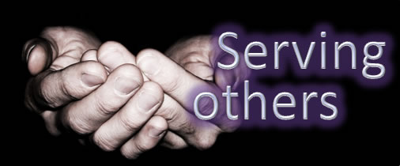
I really have forgiven, but I still struggle with feelings of hurt and bitterness.
Key to overcome hurts
Serve your offender

Slide 42
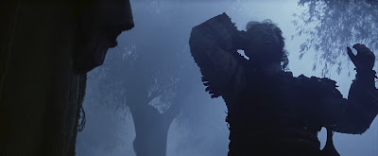
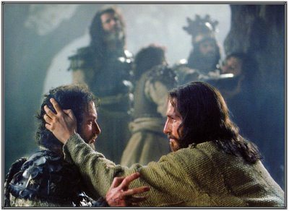

Slide 43
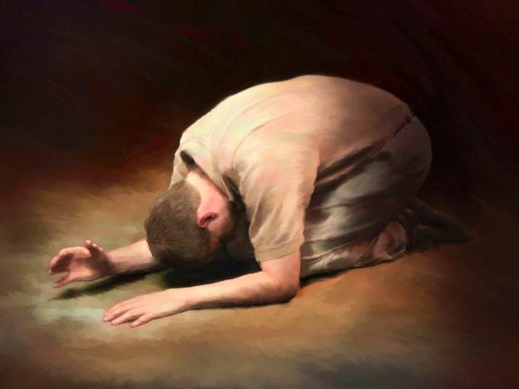
Forgiveness is a choice
Has God revealed any lack of forgiveness in your heart?
Do you desire to be set free from the prison of an unforgiving spirit?

Slide 44
Would you be willing for God to deal with you in the same way that you want to see your offender dealt with?

Slide 45
Are you ready to choose the pathway of forgiveness?
Bitterness
Forgiveness

Slide 46
Steps that must be taken in order to find freedom from an unforgiving spirit
Make a list of people who have wronged you and that you are bitter towards.
Ask God to forgive you for your wrong attitude and response to their wrong doing – I John 1:9
Thank God for each person who has wounded you – Romans 8:28

Slide 48
Confess to your offender your wrong attitude and response, ask them to forgive you – Matthew 5:23-25
As Christ has forgiven you, fully forgive each of your offenders – Ephesians 4:32
Confirm your love towards them by serving them – II Corinthians 2:8

