Slide 1
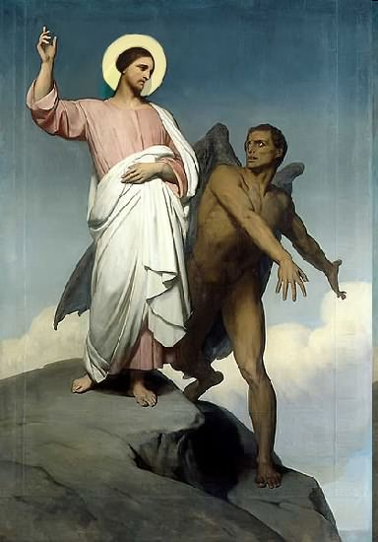

Slide 2
Topics to be studied
His existence
His origin
His fall
His personality
His names
His activities (Part 22)
His location – present and future
Our victory over him

Slide 4
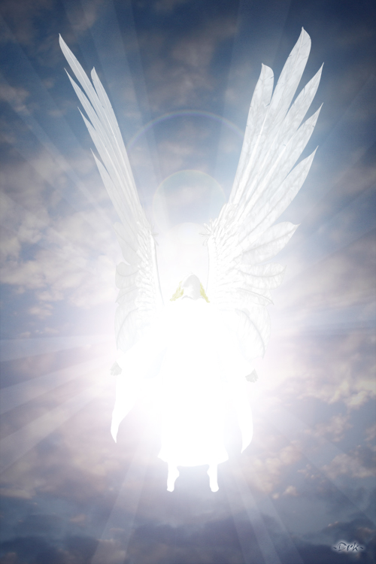
Satan imitates God?

Slide 5
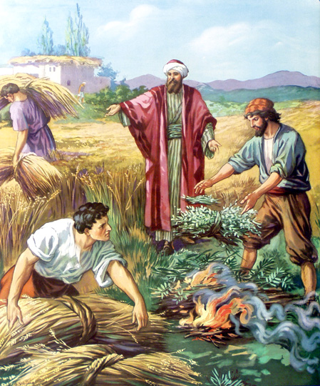
Matthew 13:24-42
Satan sows tares among God’s wheat

Slide 6
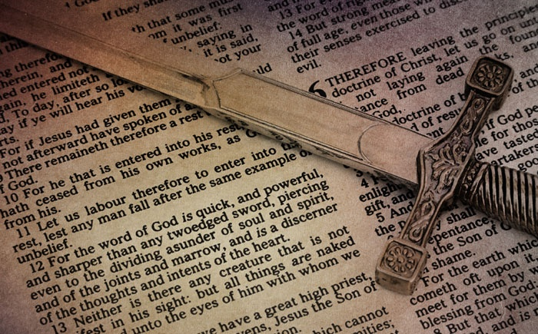
Satan perverts the Word of God
“For we are not as many, which corrupt the word of God.”
(2 Cor. 2:17)

Slide 7
Satan lays snares for men
“And that they may recover themselves out of the snare of the devil, who are taken captive by him at his will.”
(2 Tim. 2:26)

Slide 8
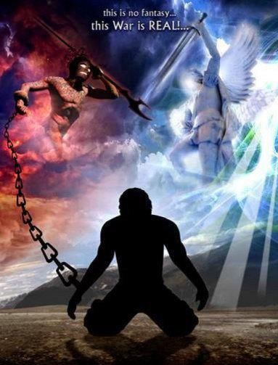
Satan hinders the work of the ministry
(1 Thessalonians 2:17-18) “But we, brethren, being taken from you for a short time in presence, not in heart, endeavoured the more abundantly to see your face with great desire. Wherefore we would have come unto you, even I Paul, once and again; but Satan hindered us.”

Slide 9
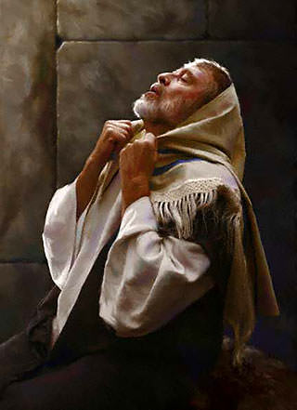
Satan resists the prayers of God’s servants
“Then said he unto me, Fear not, Daniel: for from the first day that thou didst set thine heart to understand, and to chasten thyself before thy God, thy words were heard, and I am come for thy words. But the prince of the kingdom of Persia (Satan) withstood me one and twenty days: but lo, Michael, one of the chief princes, came to help me; and I remained there with the kings of Persia.” (Dan. 10:12-13)

Slide 10
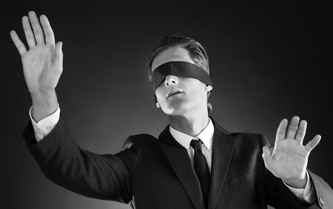
Satan blinds men from the truth of God’s Word
“Having the understanding darkened, being alienated from the life of God through the ignorance that is in them, because of the blindness
of their heart.”
(Eph. 4:18)

Slide 11
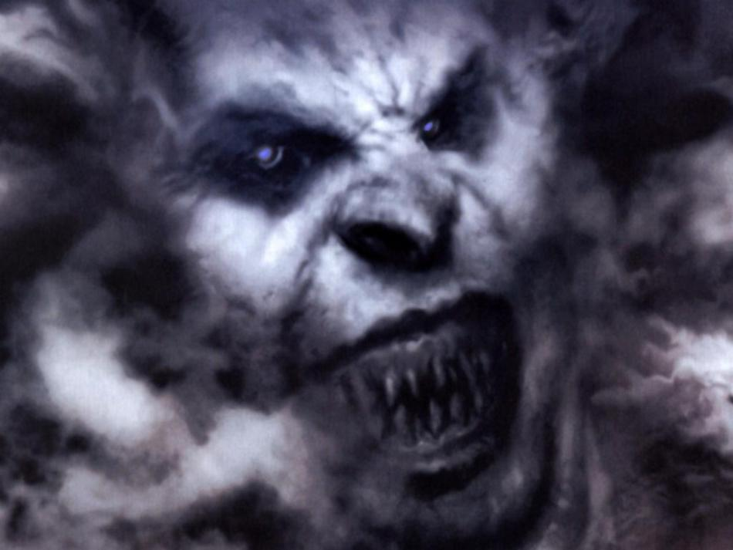
Satan steals the Word of God from human hearts
"When any one heareth the word of the kingdom, and understandeth it not, then cometh the wicked one, and catcheth away that which was sown in his heart. This is he which received seed by the way side." (Matt. 13:19)
“The thief cometh not, but for to steal, and to kill, and to destroy.”

Slide 12
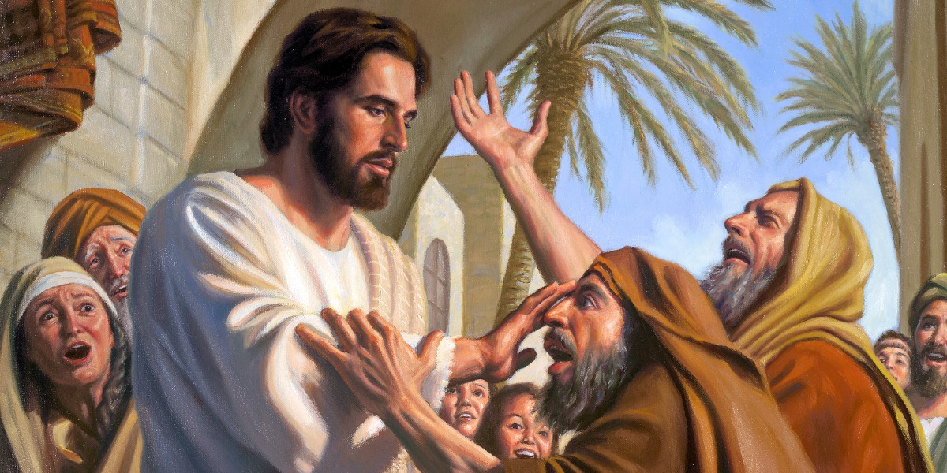
Satan afflicts men with physical and mental illness
“How God anointed Jesus of Nazareth with the Holy Ghost and with power: who went about doing good, and healing all that were oppressed of the devil; for God was with him.”
(Acts 10:38)

Slide 13
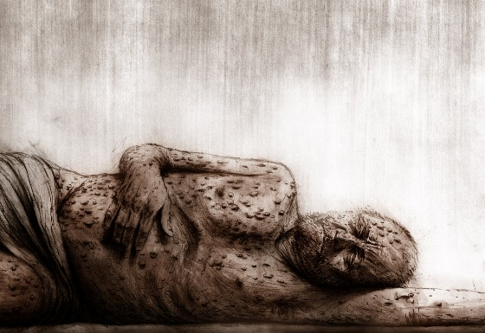
Satan can cause physical illness
"So went Satan forth from the presence of the Lord, and smote Job with sore boils from the sole of his foot unto his crown." (Job 2:7)

Slide 14
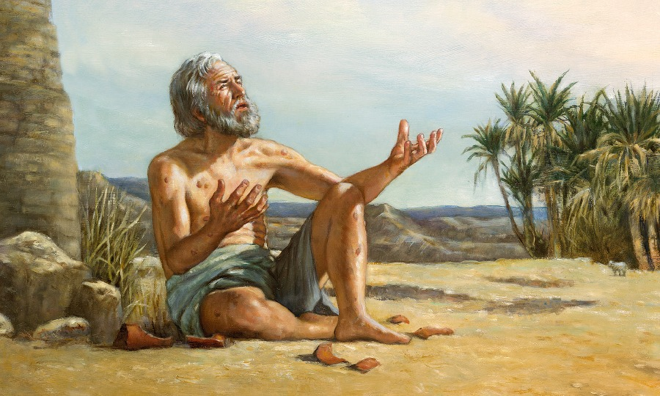
“Behold, I go forward, but He is not there; and backward, but I cannot perceive Him. I cannot behold Him.”
“Job arose, and rent his mantle, and shaved his head, and fell down upon the ground and worshiped.”
“Naked came I out of my mother’s womb, and naked shall I return thither: the Lord gave, and the Lord hath taken away; blessed be the name of the Lord. In all this Job sinned not, not charged God foolishly.”
“He hideth Himself on the right hand,
that I cannot see Him.”

Slide 15
“Behold, I go forward, but He is not there; and backward, but I cannot perceive Him. I cannot behold Him.”
“He hideth Himself on the right hand,
that I cannot see Him.”

Slide 16
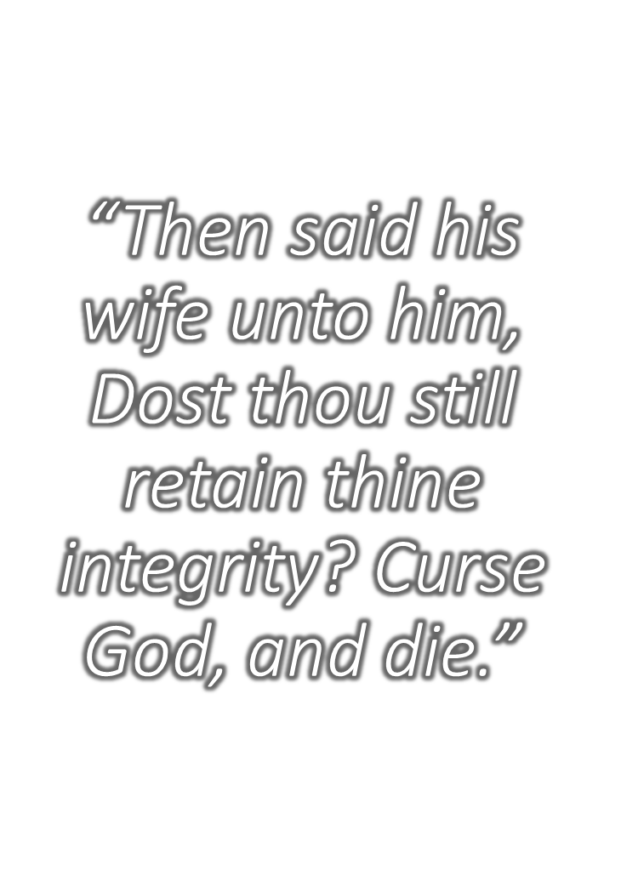

Slide 18
“Behold, I go forward, but He is not there; and backward, but I cannot perceive Him. I cannot behold Him.”
“He hideth Himself on the right hand, that I cannot see Him.”

Slide 19
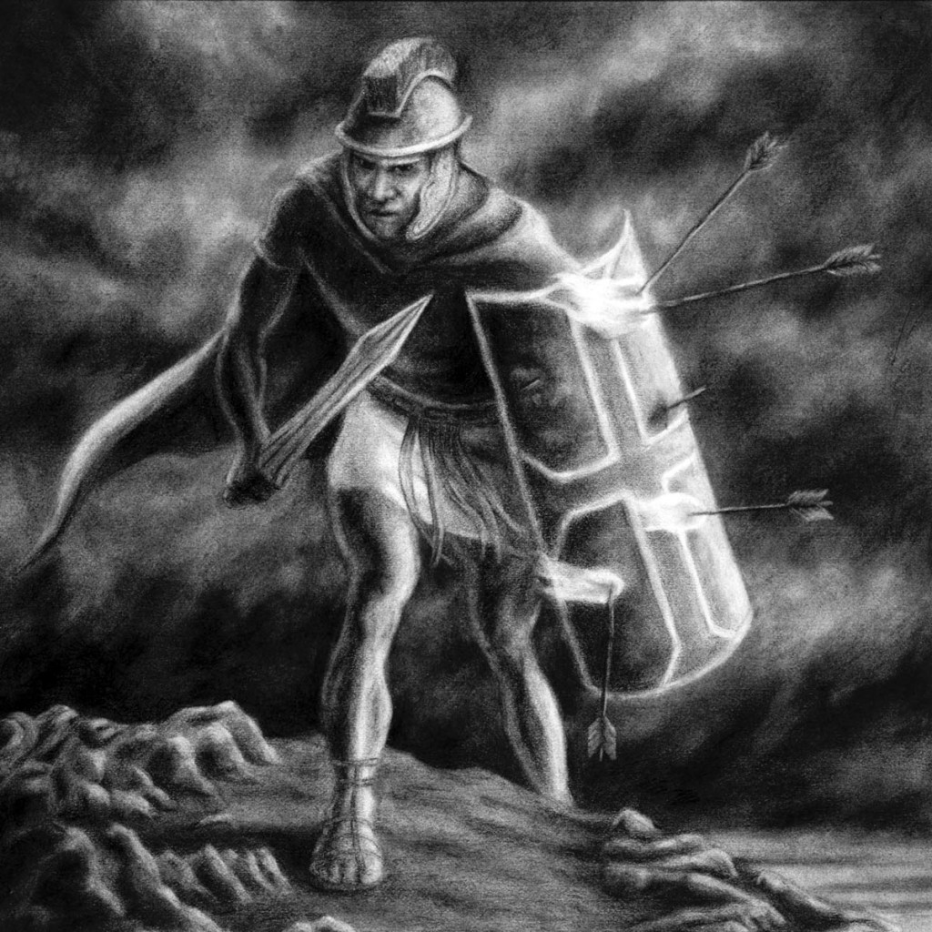
Discouragement one of Satan’s most effective weapons (Ephesians 6:16) “Fiery dart…”

Slide 20
Three Stages of Discouragement
Mild – Minor problems or pressures which effect our emotions - (II Corinthians 4:1-18)
Strong – Major problems or pressures which effect our spirit so that others notice - (I Thessalonians 5:14)
Disabling – Overwhelming problems or pressures which drain us of spiritual, mental, emotional and physical strength.
Note: Our heart melts within us and we do not have the desire, energy, or ability to go on – (Galatians 6:9; Hebrews 12:1-5, 12)

Slide 21
“Behold, I go forward, but He is not there; and backward, but I cannot perceive Him. I cannot behold Him.”
“But he knoweth the way that I take: when he hath tried me, I shall come forth as gold.”
“He hideth Himself on the right hand,
that I cannot see Him.”

Slide 22
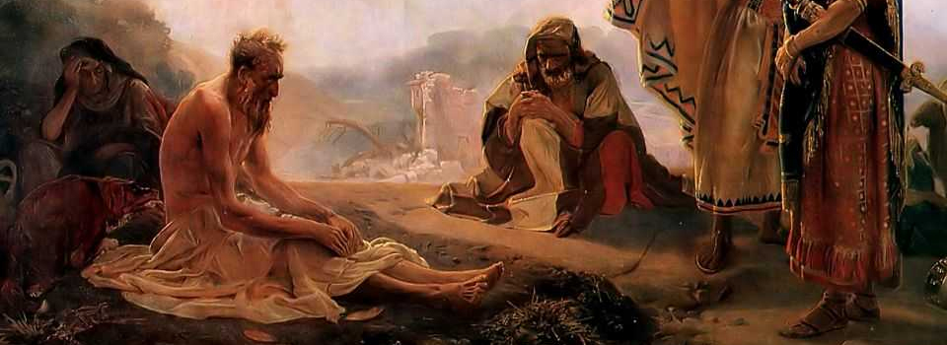
(Job 22:1-30) 1# You are a sinner 2# You are hiding your sin 3# You must confess and repent before God will help you
“My foot hath held his steps, his way have I kept, and not declined. Neither have I gone back from the commandment of his lips; I have esteemed the words of his mouth more than my necessary food.”

Slide 23
(Job 22:1-30) 1# You are a sinner 2# You are hiding your sin 3# You must confess and repent before God will help you
“For I know that my redeemer liveth, and that he shall stand at the latter day upon the earth: And though after my skin worms destroy this body, yet in my flesh shall I see God.”

Slide 25
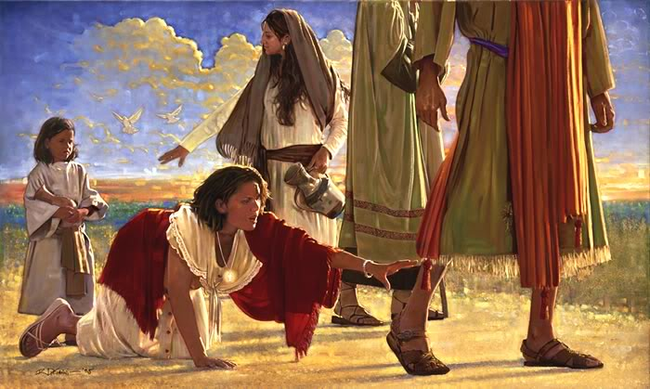
"And ought not this woman, being a daughter of Abraham, whom Satan hath bound, lo, these eighteen years, be loosed from this bond on the sabbath day?" (Luke 13:16)

Slide 26
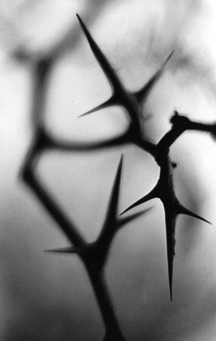
(2 Corinthians 12:7-10) “And lest I should be exalted above measure through the abundance of the revelations, there was given to me a thorn in the flesh, the messenger of Satan to buffet me, lest I should be exalted above measure. For this thing I besought the Lord thrice, that it might depart from me. And he said unto me, My grace is sufficient for thee: for my strength is made perfect in weakness. Most gladly therefore will I rather glory in my infirmities, that the power of Christ may rest upon me. Therefore I take pleasure in infirmities, in reproaches, in necessities, in persecutions, in distresses for Christ's sake: for when I am weak, then am I strong.”

Slide 27
(1 Corinthians 5:1-5) "It is reported commonly that there is fornication among you, and such fornication as is not so much as named among the Gentiles, that one should have his father’s wife. And ye are puffed up, and have not rather mourned, that he that hath done this deed might be taken away from among you. For I verily, as absent in body, but present in spirit, have judged already, as though I were present, concerning him that hath so done this deed, in the name of our Lord Jesus Christ, when ye are gathered together, and my spirit, with the power of our Lord Jesus Christ, to deliver such an one unto Satan for the destruction of the flesh, that the spirit may be saved in the day of the Lord Jesus."

Slide 28
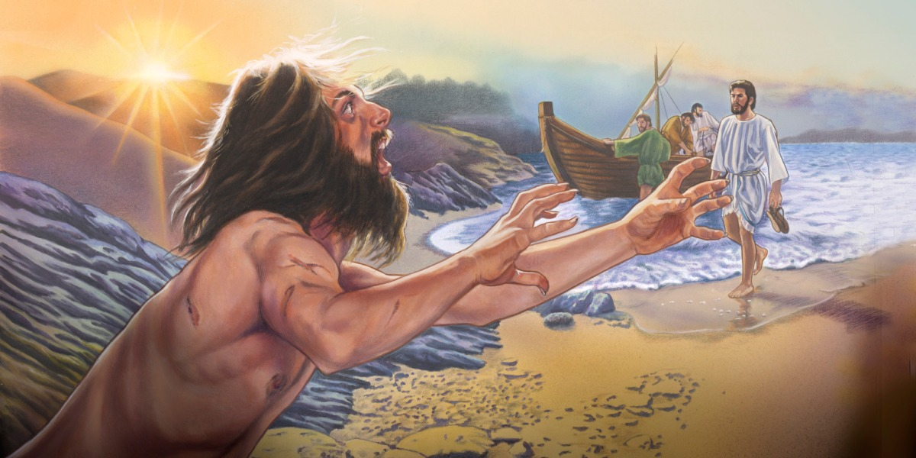
Satan can cause mental illness
(Luke 8:26-35)
“And they arrived at the country of the Gadarenes, which is over against Galilee. And when he went forth to land, there met him out of the city a certain man, which had devils long time, and ware no clothes, neither abode in any house, but in the tombs.”

Slide 29
“When he saw Jesus, he cried out, and fell down before him, and with a loud voice said, What have I to do with thee, Jesus, thou Son of God most high? I beseech thee, torment me not.”

Slide 30
“For he had commanded the unclean spirit to come out of the man. For oftentimes it had caught him: and he was kept bound with chains and in fetters; and he brake the bands, and was driven of the devil into the wilderness.”

Slide 31
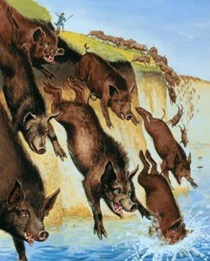
“And Jesus asked him, saying, What is thy name? And he said, Legion: because many devils were entered into him. And they besought him that he would not command them to go out into the deep. And there was there an herd of many swine feeding on the mountain: and they besought him that he would suffer them to enter into them. And he suffered them. Then went the devils out of the man, and entered into the swine: and the herd ran violently down a steep place into the lake, and were choked.”

Slide 32
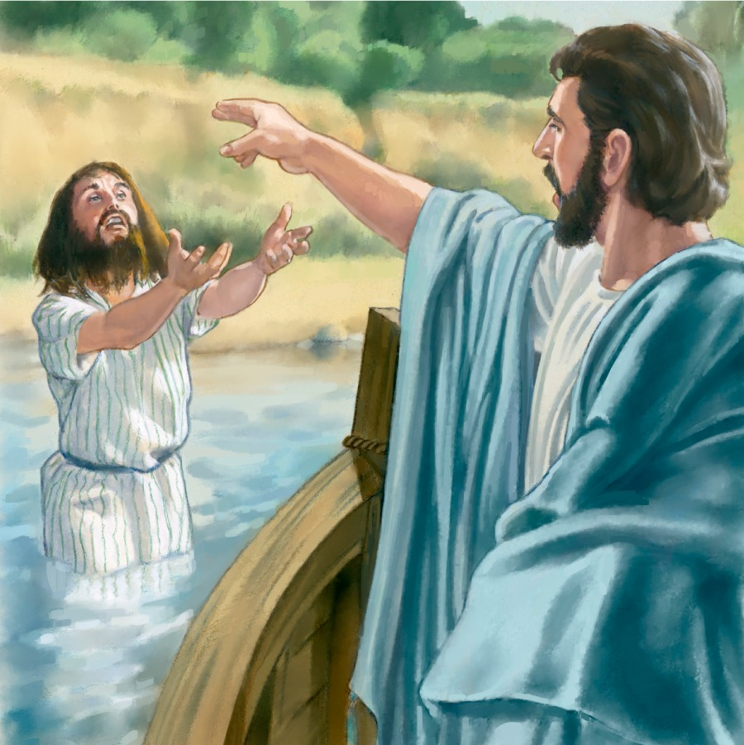
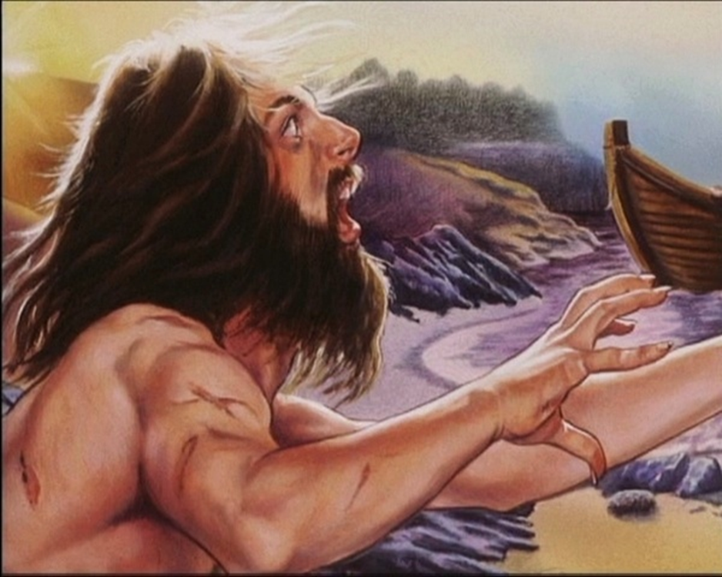
“When they that fed them saw what was done, they fled, and went and told it in the city and in the country. Then they went out to see what was done; and came to Jesus, and found the man, out of whom the devils were departed, sitting at the feet of Jesus, clothed, and in his right mind: and they were afraid.”

Slide 33
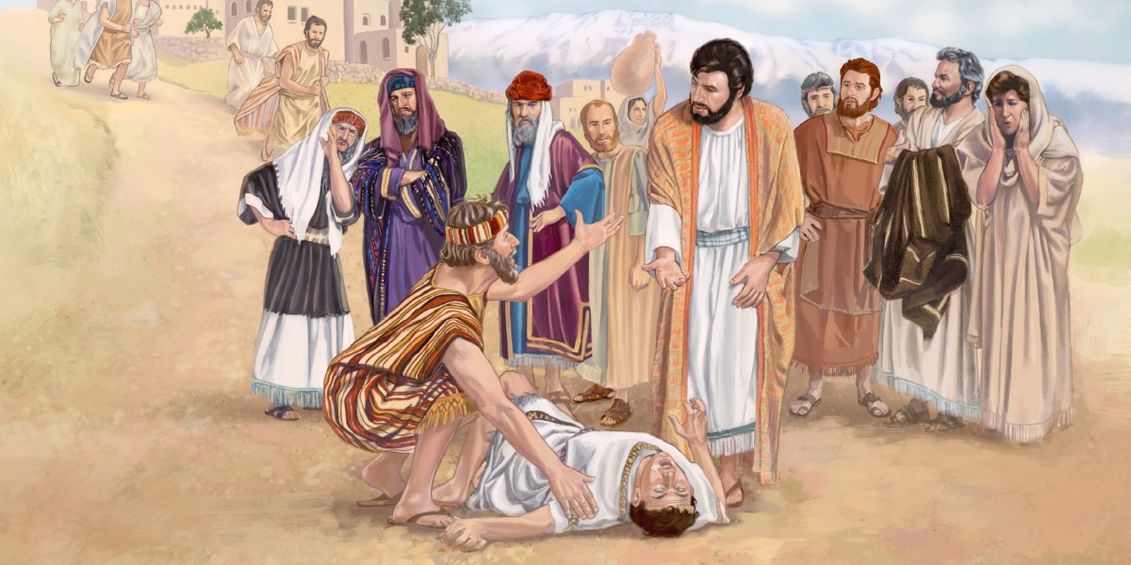

Slide 34
(Matthew 17:14-21) “And when they were come to the multitude, there came to him a certain man, kneeling down to him, and saying, Lord, have mercy on my son: for he is lunatic, and sore vexed: for oft times he falleth into the fire, and oft into the water. And I brought him to thy disciples, and they could not cure him. Then Jesus answered and said, O faithless and perverse generation, how long shall I be with you? how long shall I suffer you? bring him hither to me. And Jesus rebuked the devil; and he departed out of him: and the child was cured from that very hour. Then came the disciples to Jesus apart, and said, Why could not we cast him out? And Jesus said unto them, Because of your unbelief: for verily I say unto you, If ye have faith as a grain of mustard seed, ye shall say unto this mountain, Remove hence to yonder place; and it shall remove; and nothing shall be impossible unto you. Howbeit this kind goeth not out but by prayer and fasting.”

Slide 35
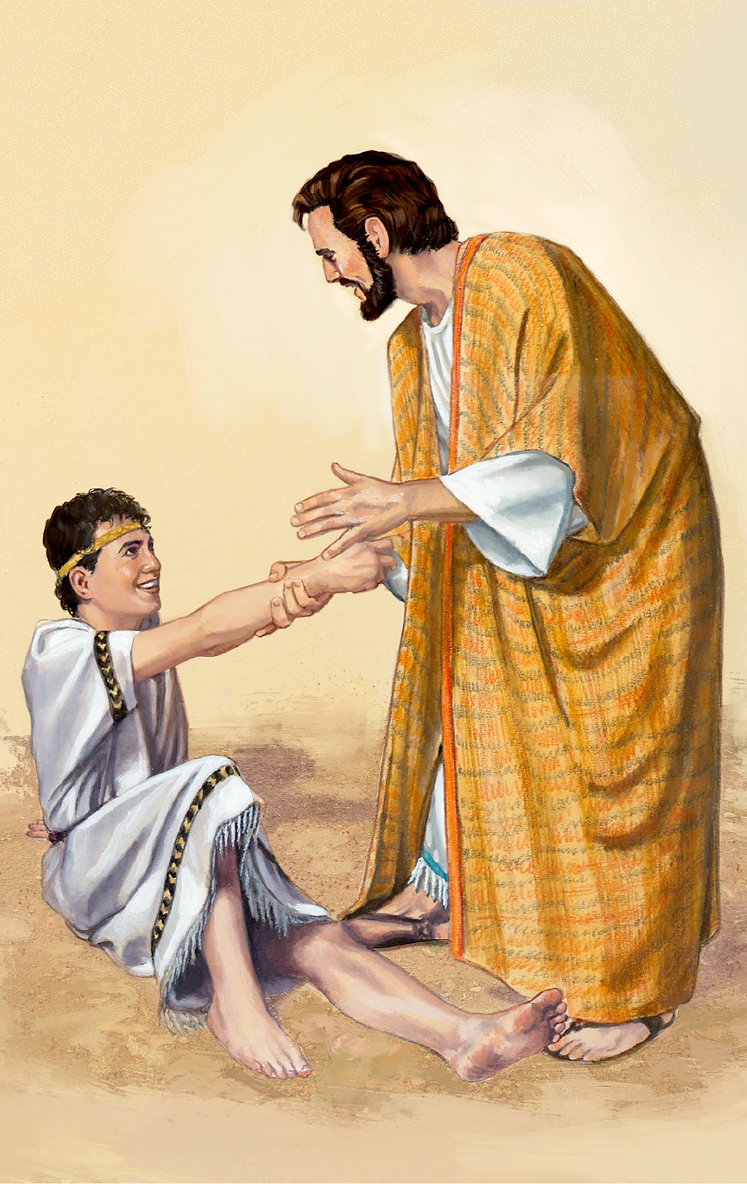
“And Jesus rebuked the devil; and he departed out of him: and the child was cured from that very hour.”

Slide 36
It is a mistake to say that all mental illness can be directly attributed to Satan –
The Bible teaches that every human being is totally depraved - Romans 3:10 “As it is written, There is none righteous, no, not one.”
Total depravity simply means that sin has affected every facet of our being, including both our soul (mind, will and emotion) as well as our body – Romans 7:14 “I am carnal, sold under sin.”
Apostle Paul - “Wherefore, as by one man sin entered into the world, and death by sin; and so death passed upon all men, for that all have sinned…But I see another law in my members, warring against the law of my mind, and bringing me into captivity to the law of sin which is in my members…the carnal mind is enmity against God…This I say therefore, and testify in the Lord, that ye henceforth walk not as other Gentiles walk, in the vanity of their mind.”

Slide 37
Total depravity means that nothing works as God originally intended – Titus 1:15 “Even their mind and conscience is defiled.”
Why do we get colds, backaches, flu, congestion, indigestion and infections?
Why do we have migraines, heart problems, kidney stones and glaucoma?
We experience these things because we inhabit bodies which have been marked and marred by sin.
Our outer self is wasting away.
Our bodies and minds don’t work correctly.
They are falling apart – 1 Cor. 15:23 “…corruptible body.”
While we live in this fallen world, we live in bodies that are wasting away.
Paul spoke directly to this when he said - 2 Corinthians 4:16 “For which cause we faint not; but though our outward man perish, yet the inward man is renewed day by day.”

Slide 38
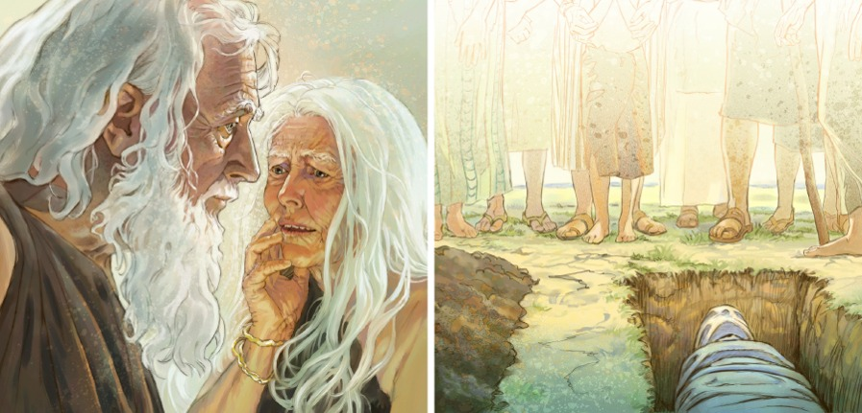
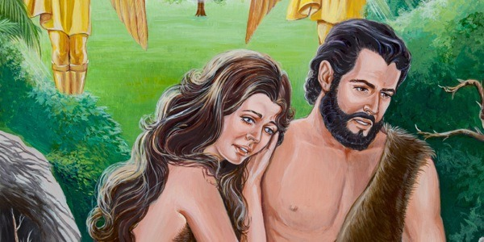
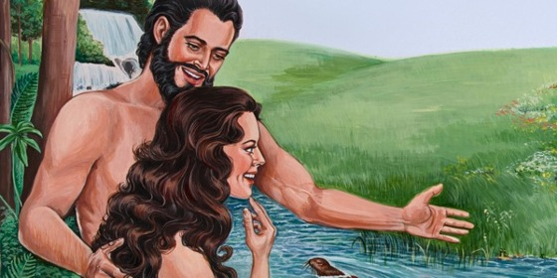
When God created man he created them is a perfect state. Their mind and body were free from the effects of sin. There was no physical illness or mental illness until sin entered the world.

Slide 39
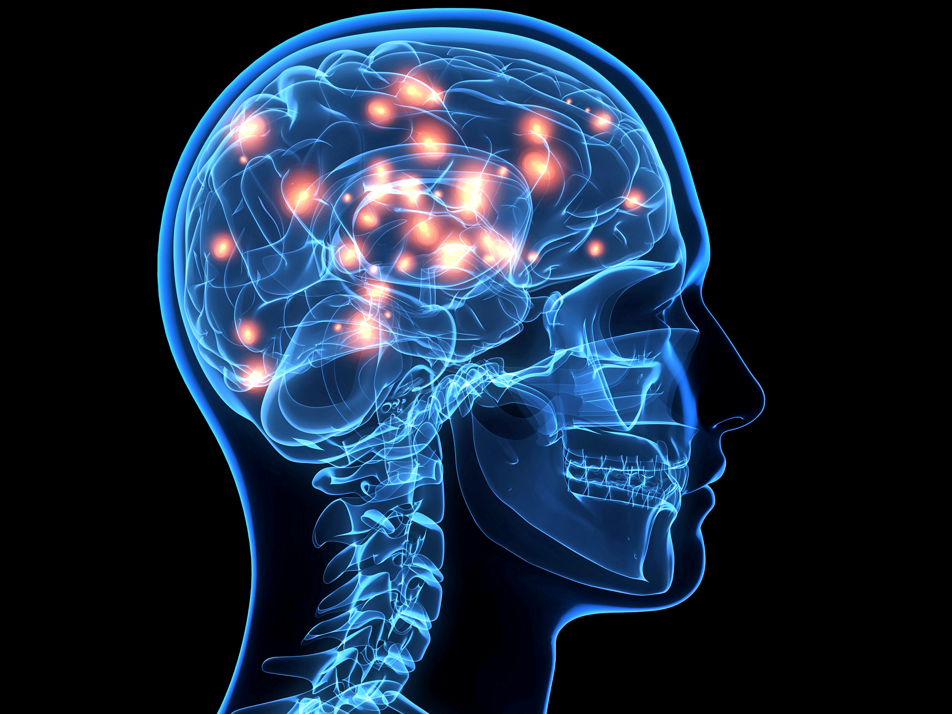
Our spiritual desires are affected and distorted by sin – (see Romans 3) “For the flesh lusteth against the Spirit, and the Spirit against the flesh: and these are contrary the one to the other.” (Gal. 5:17)
Our intellect is affected by sin – Rom. 8:7
Our genes have been effected by sin – Exod. 20:5
Our thoughts and emotions are directly traceable to a series of electrical and chemical impulses in the brain -

Slide 40
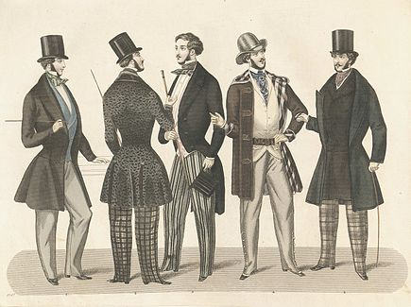
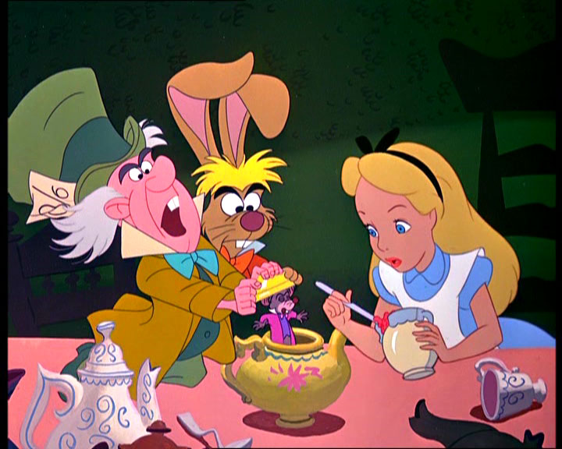
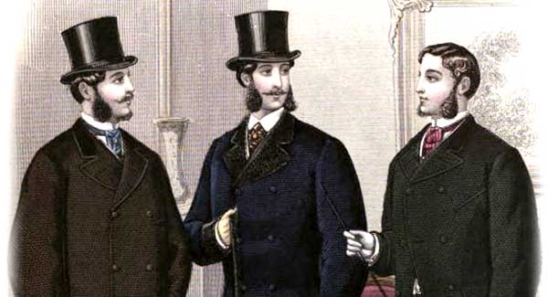

Slide 42
“For as he thinketh in his heart, so is he.” (Prov. 23:7)

Slide 43
(2 Corinthians 10:3-6) “For though we walk in the flesh, we do not war after the flesh: For the weapons of our warfare are not carnal, but mighty through God to the pulling down of strong holds; Casting down imaginations, and every high thing that exalteth itself against the knowledge of God, and bringing into captivity every thought to the obedience of Christ; And having in a readiness to revenge all disobedience, when your obedience is fulfilled.”

Slide 45
No Christian can be possessed by Satan or a demon – I John 4:4
Christians can however be influenced by Satan – Eph. 4:27
There's a very real, spiritual component that influences our thoughts and emotions – Indwelling presents and filling of the Holy Spirit Eph. 5:18
Positively, this spiritual component can protect us from fear, anxiety, worry, stress and its consequences – Phil. 4:6-8
Negatively, any area of our lives that is not brought under the controlled by the Holy Spirit is vulnerable to being controlled by Satan and his evil forces – Eph. 6:10-18
The key to resisting demonic influences in our lives is to make sure that every area of our lives is filled or controlled by the Spirit of God – “Be not drunk with wine, wherein is excess; but be filled with the Spirit.”

Slide 47
Key to being Filled with the Holy Spirit

Slide 48
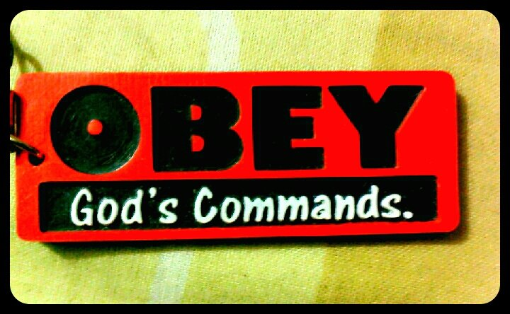
“If we say that we have fellowship with him, and walk in darkness, we lie, and do not the truth.” (1 John 1:6)

Slide 49
(Romans 8:5-7) “For they that are after the flesh do mind the things of the flesh; but they that are after the Spirit the things of the Spirit. For to be carnally minded is death; but to be spiritually minded is life and peace. Because the carnal mind is enmity against God: for it is not subject to the law of God, neither indeed can be.”

Slide 50
(Philippians 4:6-8) “Be careful for nothing; but in every thing by prayer and supplication with thanksgiving let your requests be made known unto God. And the peace of God, which passeth all understanding, shall keep your hearts and minds through Christ Jesus. Finally, brethren, whatsoever things are true, whatsoever things are honest, whatsoever things are just, whatsoever things are pure, whatsoever things are lovely, whatsoever things are of good report; if there be any virtue, and if there be any praise, think on these things.”

Slide 51
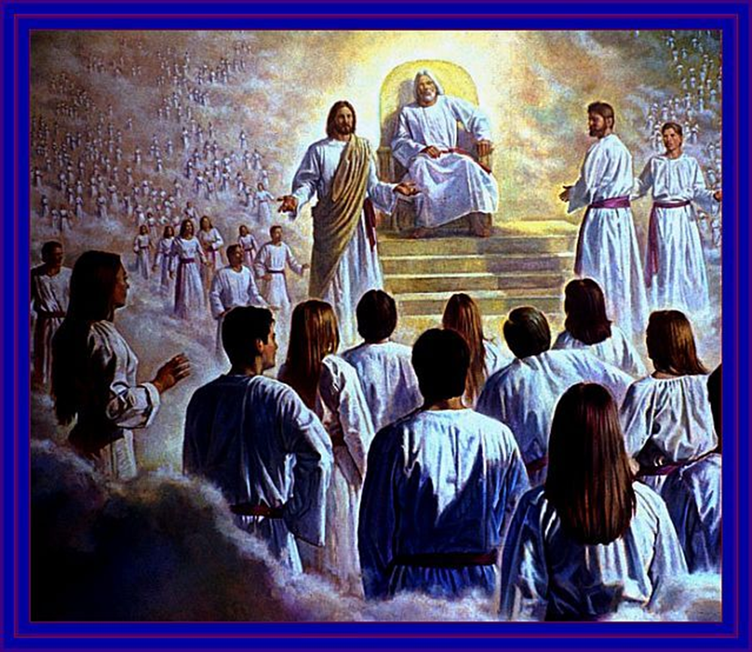
The Redemption of the body

Slide 52
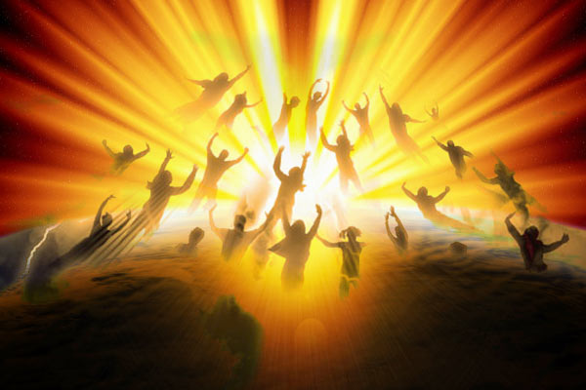
(1 Thessalonians 4:16-18) “For the Lord himself shall descend from heaven with a shout, with the voice of the archangel, and with the trump of God: and the dead in Christ shall rise first: Then we which are alive and remain shall be caught up together with them in the clouds, to meet the Lord in the air: and so shall we ever be with the Lord. Wherefore comfort one another with these words.”

Slide 53
(1 John 3:2-3) “Beloved, now are we the sons of God, and it doth not yet appear what we shall be: but we know that, when he shall appear, we shall be like him; for we shall see him as he is. And every man that hath this hope in him purifieth himself, even as he is pure.”

Slide 54
(Romans Chapter 8) “The Spirit itself beareth witness with our spirit, that we are the children of God: And if children, then heirs; heirs of God, and joint-heirs with Christ; if so be that we suffer with him, that we may be also glorified together. For I reckon that the sufferings of this present time are not worthy to be compared with the glory which shall be revealed in us. For the earnest expectation of the creature waiteth for the manifestation of the sons of God. For the creature was made subject to vanity, not willingly, but by reason of him who hath subjected the same in hope, Because the creature itself also shall be delivered from the bondage of corruption into the glorious liberty of the children of God…We ourselves groan within ourselves, waiting for the adoption, to wit, the redemption of our body.”

Slide 55
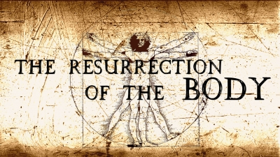
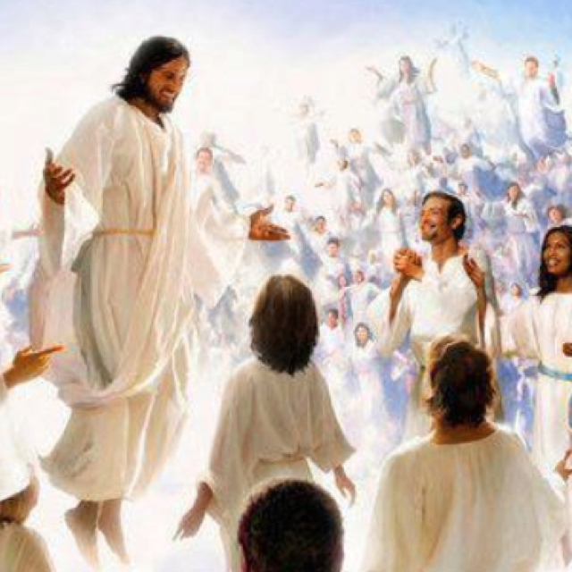
(Romans 7:24)
“O wretched man that I am! who shall deliver
me from the body of this death?”

Slide 56
(I Corinthians chapter 15) “The last enemy that shall be destroyed is death…All flesh is not the same flesh: but there is one kind of flesh of men, another flesh of beasts, another of fishes, and another of birds. There are also celestial bodies, and bodies terrestrial: but the glory of the celestial is one, and the glory of the terrestrial is another…There is one glory of the sun, and another glory of the moon, and another glory of the stars: for one star differeth from another star in glory. So also is the resurrection of the dead. It is sown in corruption; it is raised in incorruption: It is sown in dishonour; it is raised in glory: it is sown in weakness; it is raised in power: It is sown a natural body; it is raised a spiritual body. There is a natural body, and there is a spiritual body…Howbeit that was not first which is spiritual, but that which is natural; and afterward that which is spiritual…

Slide 57
Now this I say, brethren, that flesh and blood cannot inherit the kingdom of God; neither doth corruption inherit incorruption. Behold, I shew you a mystery; We shall not all sleep, but we shall all be changed, In a moment, in the twinkling of an eye, at the last trump: for the trumpet shall sound, and the dead shall be raised incorruptible, and we shall be changed. For this corruptible must put on incorruption, and this mortal must put on immortality. So when this corruptible shall have put on incorruption, and this mortal shall have put on immortality, then shall be brought to pass the saying that is written, Death is swallowed up in victory…O death, where is thy sting? O grave, where is thy victory? The sting of death is sin; and the strength of sin is the law. But thanks be to God, which giveth us the victory through our Lord Jesus Christ.”

Slide 58
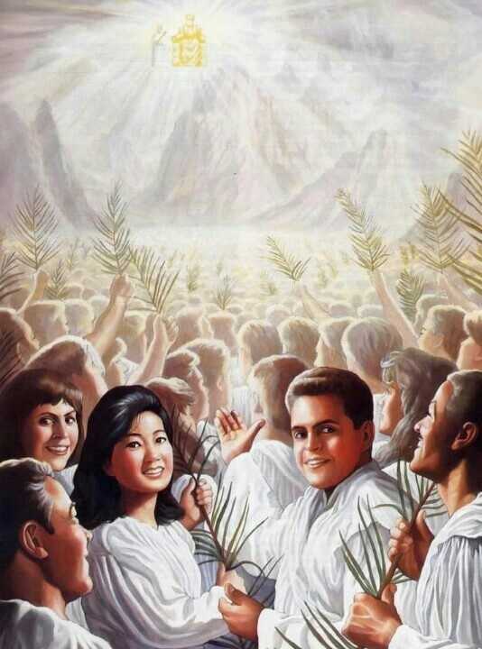
“Who shall change our vile body, that it may be fashioned like unto his glorious body.” (Phil. 3:21)

Slide 59
God’s purpose in allowing illness

Slide 60
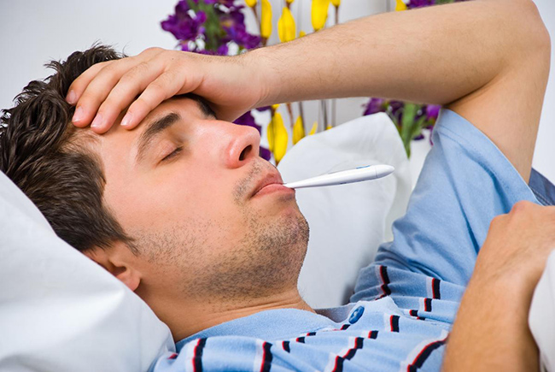
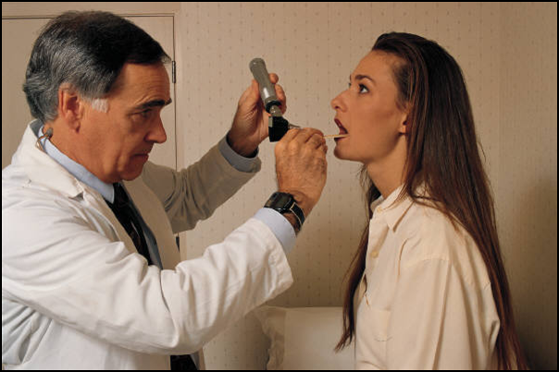
1# Sickness as a result of living in a corruptible (fleshly) body (normal or natural sickness) I Cor. 15:35-54; Phil. 3:21

Slide 61
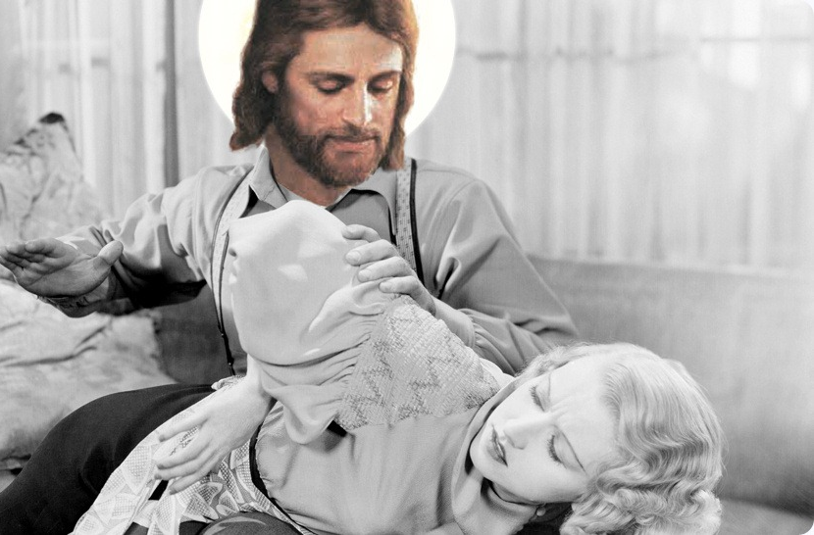
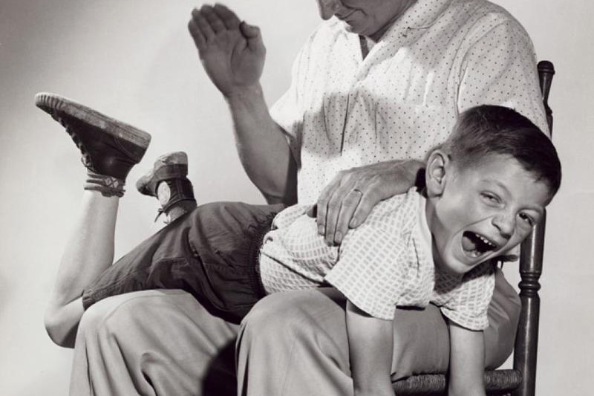
2# Sickness of chastisement
(sickness as a result of God’s discipline or correction) Heb. 12:6-10
“For this cause many are weak and sickly among you, and many sleep.”
(1 Cor. 11:30)

Slide 62
“For whom the Lord loveth he chasteneth…But if ye be without chastisement, whereof all are partakers, then are ye bastards (illegitimate in birth), and not sons…Now no chastening for the present seemeth to be joyous, but grievous: nevertheless afterward it yieldeth the peaceable fruit of righteousness unto them which are exercised thereby.”

Slide 63
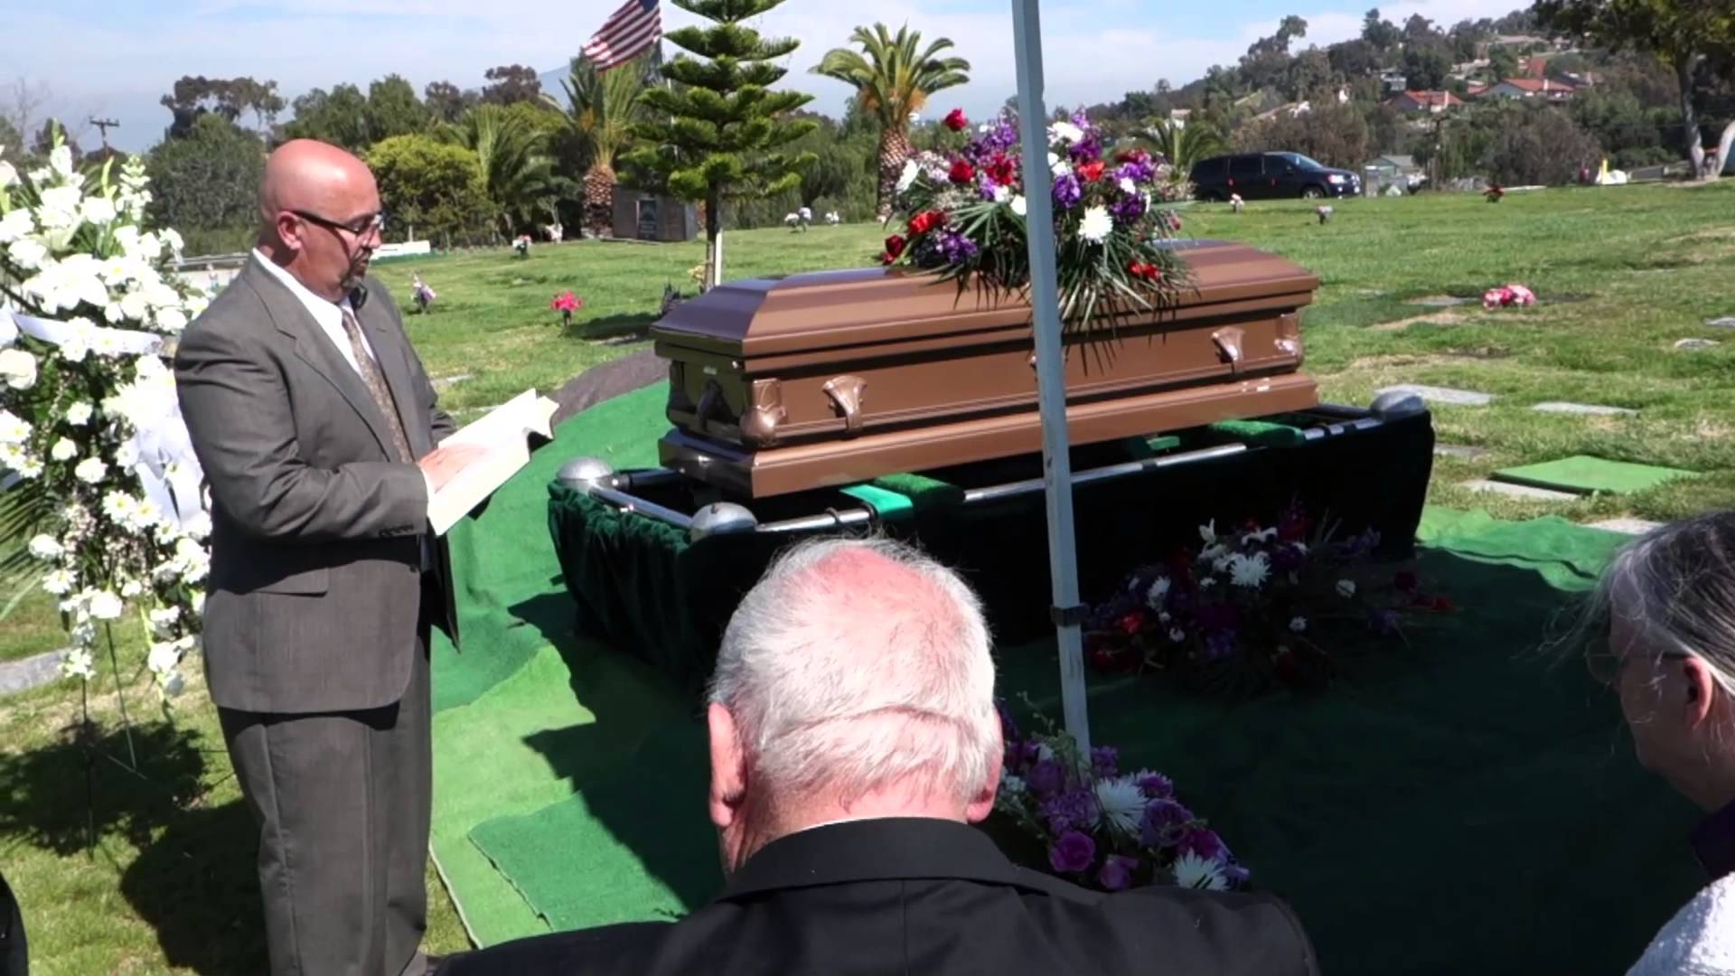
3# Sickness unto death (sickness that results in death)

Slide 64
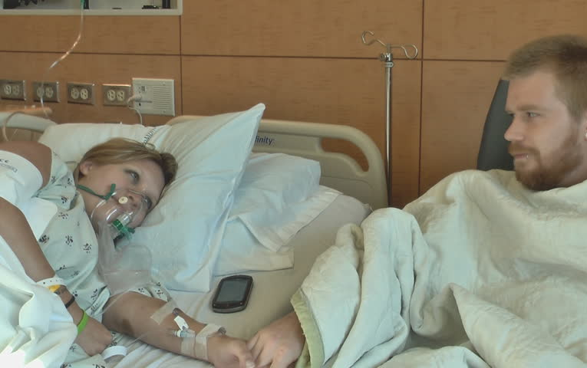
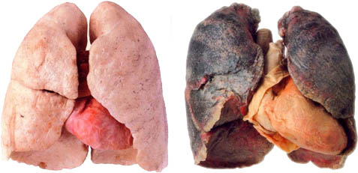
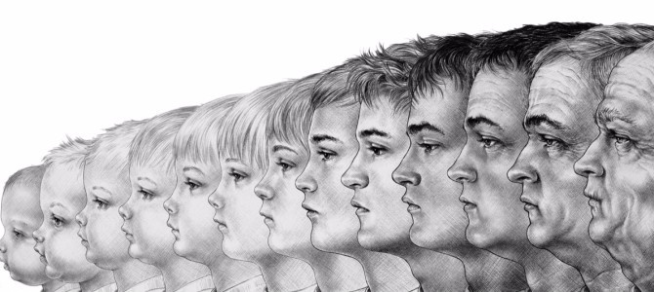
Could result from persistent disobedience - I John 5:16; I Cor. 5:5-7
Could result from the abuse of the body – Prov. 5:11; Rom. 1:18-32
Could result from the natural aging process - Eccl. 12:1-5

Slide 65
4# Sickness for the glory of God

Slide 66
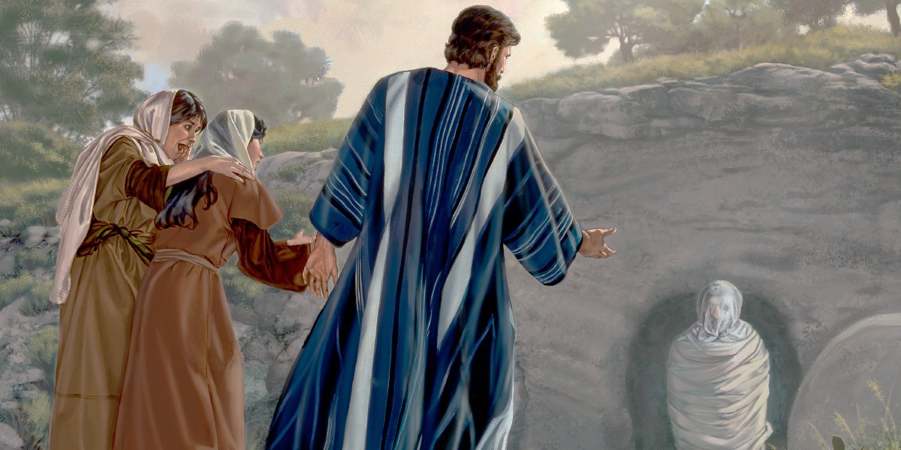
(John 11:1-4) “Now a certain man was sick, named Lazarus, of Bethany, the town of Mary and her sister Martha. (It was that Mary which anointed the Lord with ointment, and wiped his feet with her hair, whose brother Lazarus was sick.) Therefore his sisters sent unto him, saying, Lord, behold, he whom thou lovest is sick. When Jesus heard that, he said, This sickness is not unto death, but for the glory of God, that the Son of God might be glorified thereby.”

Slide 67
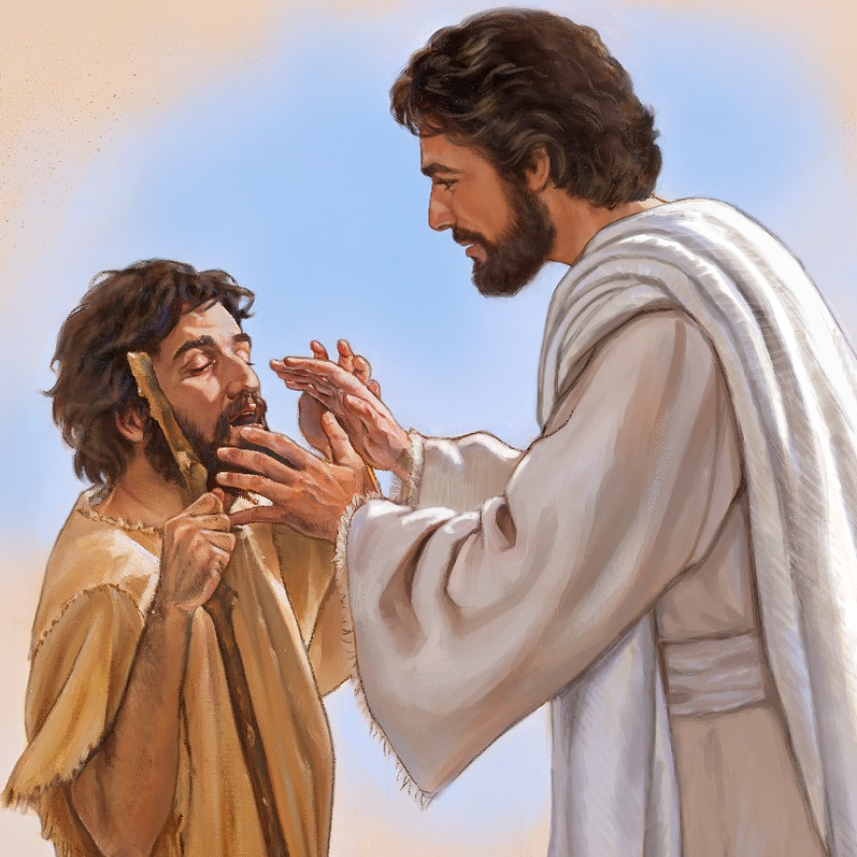
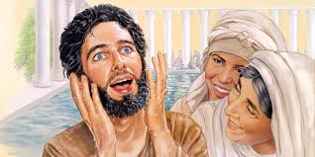
(John 9:1-3, 6-7) “And as Jesus passed by, he saw a man which was blind from his birth. And his disciples asked him, saying, Master, who did sin, this man, or his parents, that he was born blind? Jesus answered, Neither hath this man sinned, nor his parents: but that the works of God should be made manifest in him…When he had thus spoken, he spat on the ground, and made clay of the spittle, and he anointed the eyes of the blind man with the clay, And said unto him, Go, wash in the pool of Siloam. He went his way therefore, and washed, and came seeing.”

Slide 68
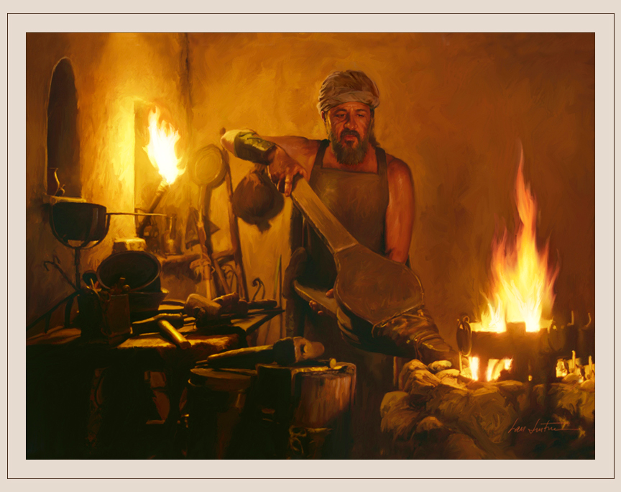
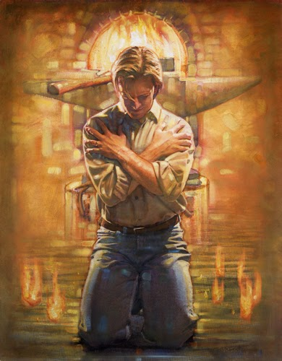
5# Sickness, trial, suffering, affliction for spiritual growth “The Refiners Fire” (I Pet. 1:6-7, 5:7-11)

Slide 69
“Wherein ye greatly rejoice, though now for a season, if need be, ye are in heaviness through manifold temptations: That the trial of your faith, being much more precious than of gold that perisheth, though it be tried with fire, might be found unto praise and honour and glory at the appearing of Jesus Christ…Casting all your care upon him; for he careth for you. Be sober, be vigilant; because your adversary the devil, as a roaring lion, walketh about, seeking whom he may devour: Whom resist stedfast in the faith, knowing that the same afflictions are accomplished in your brethren that are in the world. But the God of all grace, who hath called us unto his eternal glory by Christ Jesus, after that ye have suffered a while, make you perfect, stablish, strengthen, settle you. To him be glory and dominion for ever and ever. Amen.”

Slide 70
(2 Corinthians 12:7-10)
“And lest I should be exalted above measure through the abundance of the revelations, there was given to me a thorn in the flesh, the messenger of Satan to buffet me, lest I should be exalted above measure. For this thing I besought the Lord thrice, that it might depart from me. And he said unto me, My grace is sufficient for thee: for my strength is made perfect in weakness. Most gladly therefore will I rather glory in my infirmities, that the power of Christ may rest upon me. Therefore I take pleasure in infirmities, in reproaches, in necessities, in persecutions, in distresses for Christ's sake: for when I am weak, then am I strong.”

Slide 72
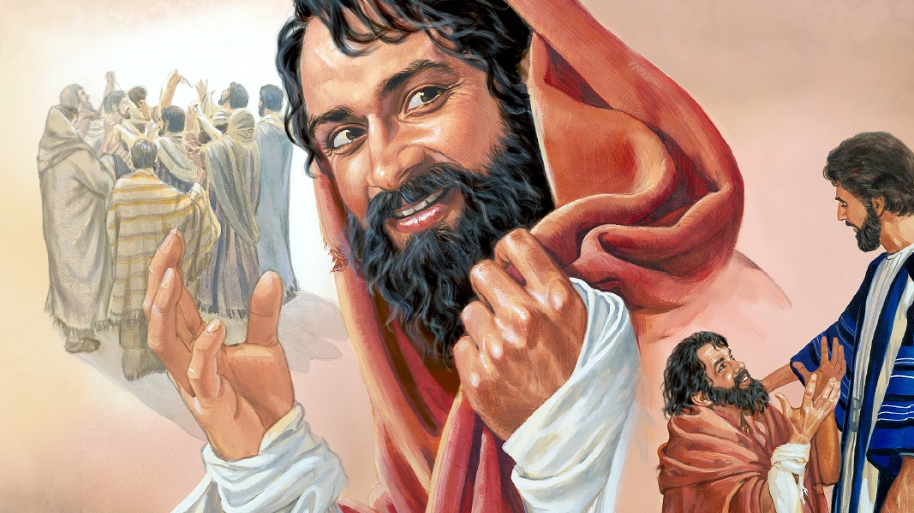
Next time you get sick – seek to know the reason and purpose to glorify the Lord through it!

