Slide 1
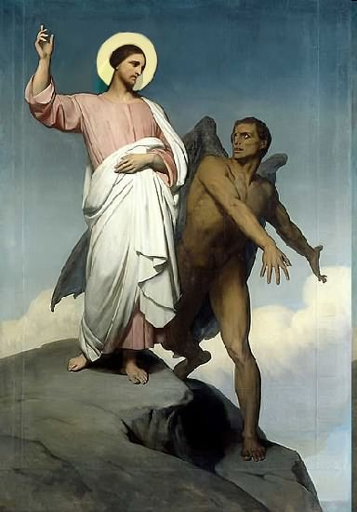

Slide 2
Topics to be studied
His existence
His origin
His fall
His personality
His names
His activities
His location – past, present and future
Our victory over him

Slide 5
1 John 5:4-5 - For whatsoever is born of God overcometh the world: and this is the victory that overcometh the world, even our faith. Who is he that overcometh the world, but he that believeth that Jesus is the Son of God?
Romans 6:14 - For sin shall not have dominion over you: for ye are not under the law, but under grace.
Romans 8:37 - Nay, in all these things we are more than conquerors through him that loved us.
2 Corinthians 2:14 - Now thanks be unto God, which always causeth us to triumph in Christ.
Philippians 4:13 - I can do all things through Christ which strengtheneth me.

Slide 6
“I have written unto you, young men, because ye are strong, and the word of God abideth in you, and ye have overcome the wicked one.” (I John 2:14)

Slide 7
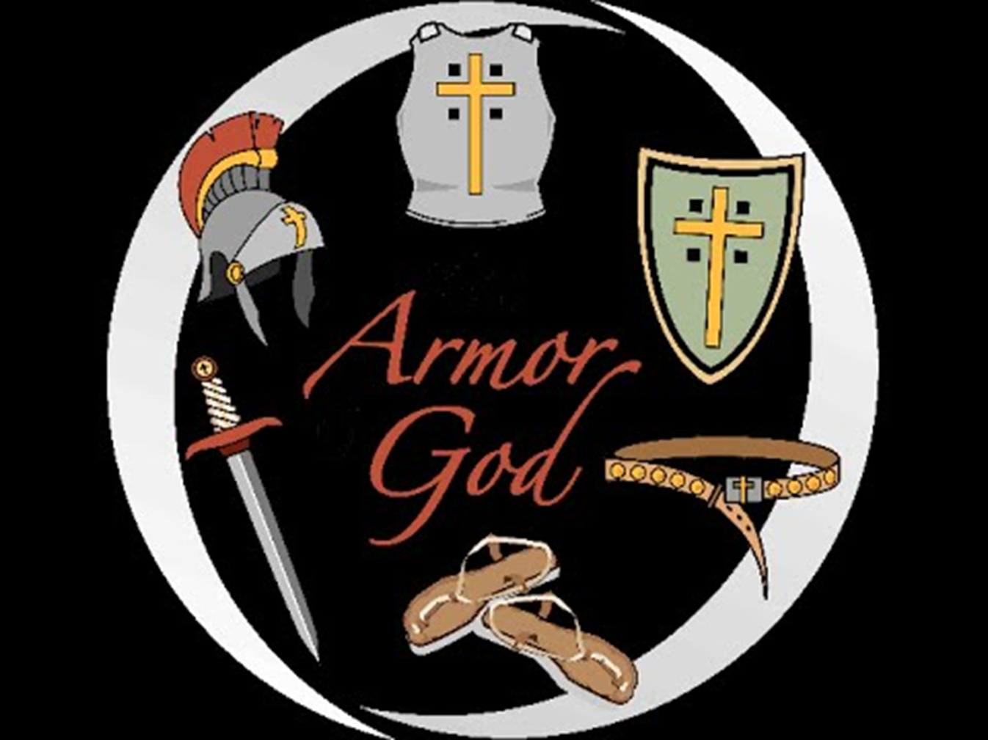
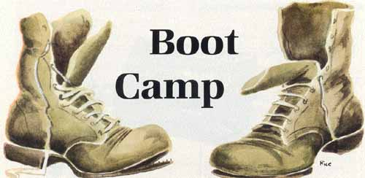
HOW TO PUT ON YOUR ARMOR AND WEAPONS
(Part 1)

Slide 10
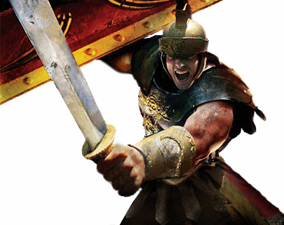

Slide 11
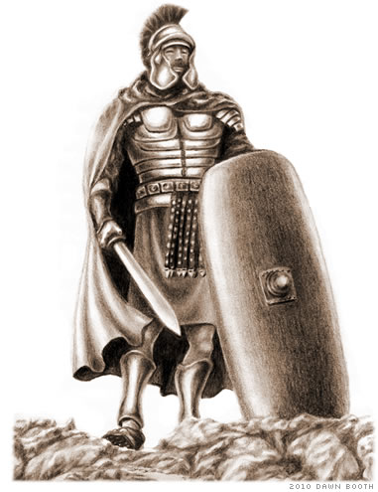
A soldier must expend a great amount of time and energy in order to put on his armor and take up his weapons.
Similarly, a Christian puts on each piece of armor through precise disciplines in the Christians life.
The spiritual armor of the Christian is compared to the physical armor of a soldier; however, it’s very different nature.
For example, David went out against Goliath in full (invisible) armor, all Goliath saw was a slingshot.
David’s (invisible) armor had been forged and put on through years of Godly disciplines which he had developed in the wilderness caring for his sheep.

Slide 12
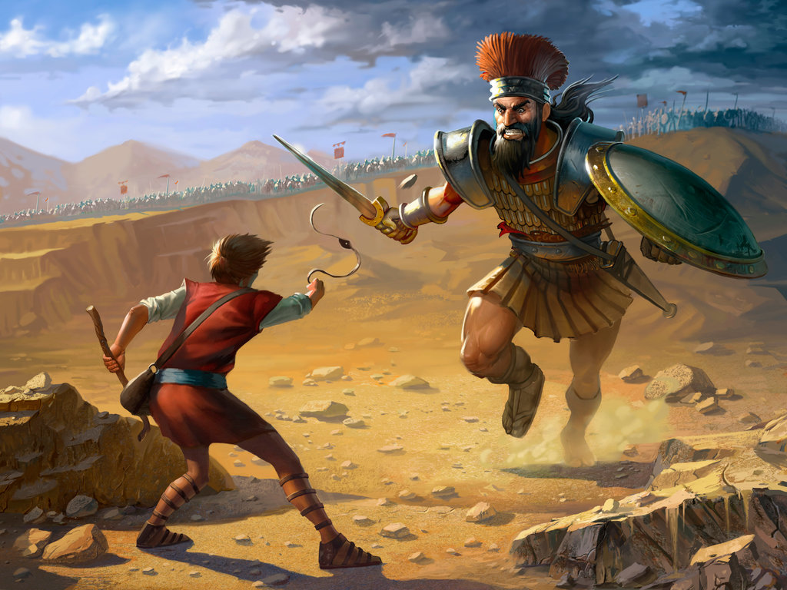

Slide 13
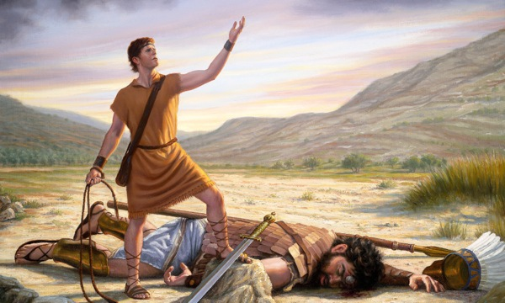

Slide 15
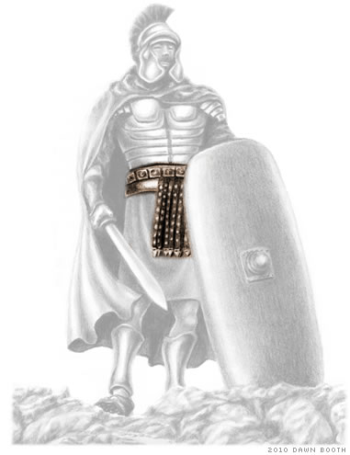
“Stand therefore, having your loins girt about
with truth.”

Slide 16
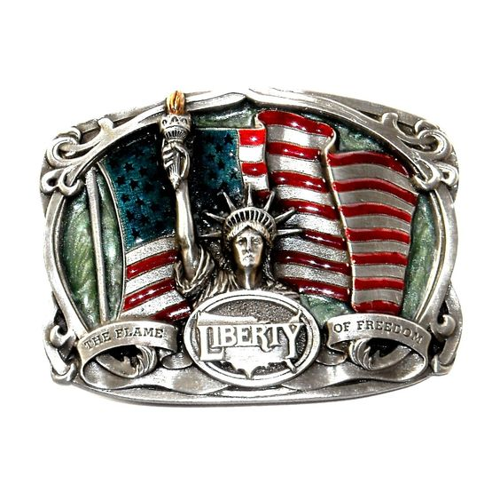
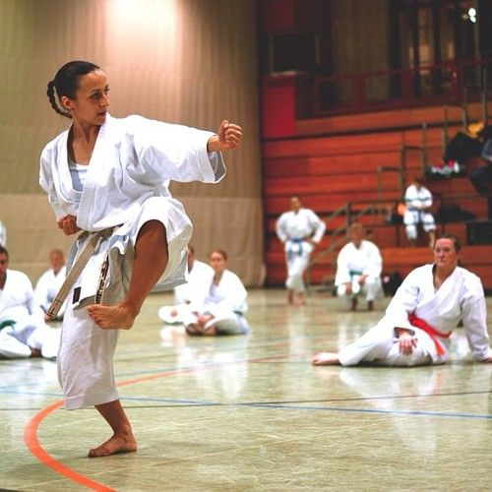
Throughout history, the belt has been a symbol of strength.
It has also been a means of freedom.
In Bible times, men wore outer garments that reached to the ground.
If they ran in battle, they were apt to step on their garments and stumble.
To avoid this danger, they would raise their garments to the knee and secure them around the waist with a belt.

Slide 17
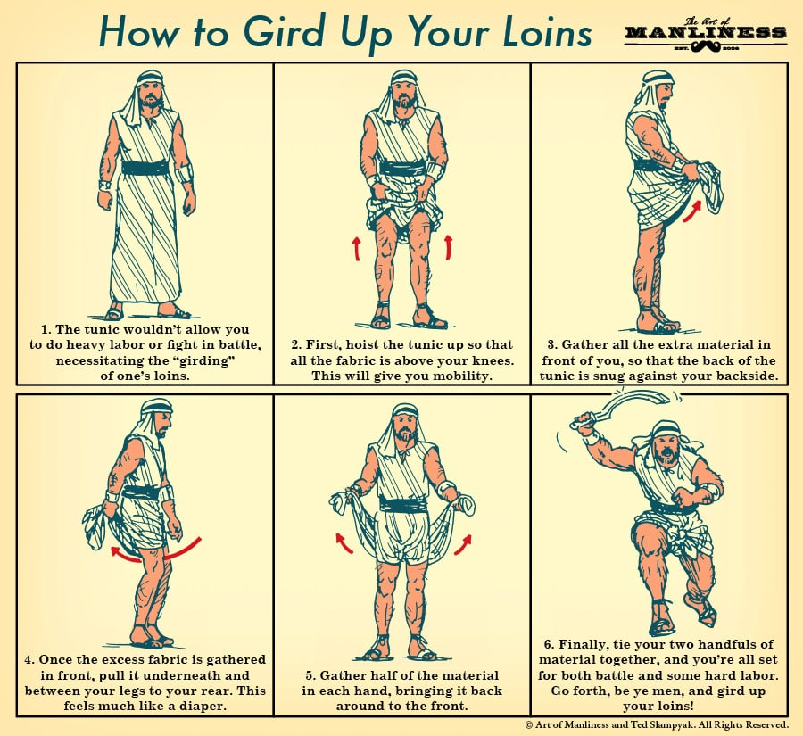

Slide 18
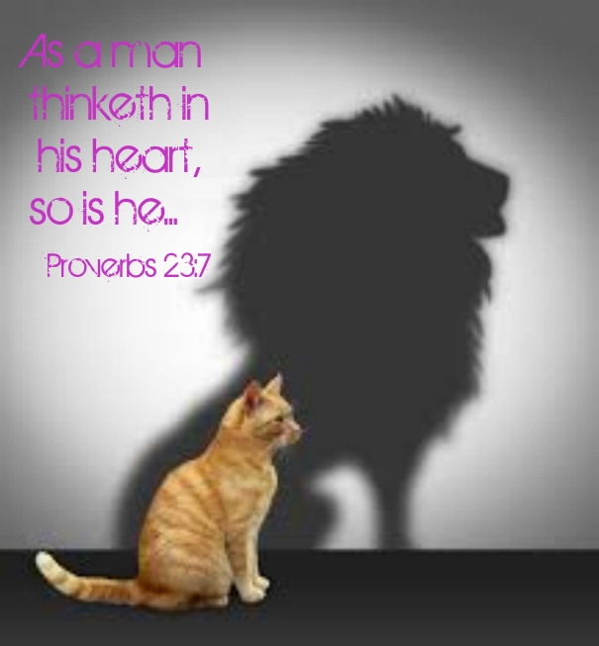
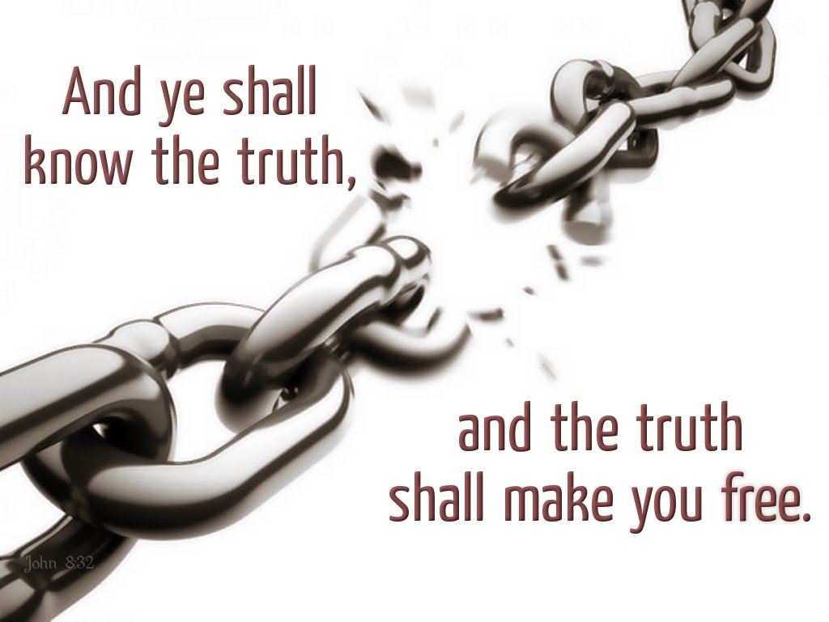
Peter had this picture in mind when he wrote, “... Gird up the loins of your mind ...” - I Peter 1:13
Truth is also a means of freedom, as Jesus said, “... Ye shall know the truth, and the truth shall make you free.” - John 8:32

Slide 19
THE DISCIPLINE RELATED TO THE BELT OF TRUTH
Reading the Bible Daily - Matt. 6:6
Satan is a liar and the father of lies - John 8:44
He will tell us lies about God
About our-selves
About sin and its consequences
About the purposes for which God created us
And about every other aspect of life
The best way to guard ourselves from Satan’s lies is to have a daily program of reading and studying God’s Truth – Isaiah 58:2

Slide 20
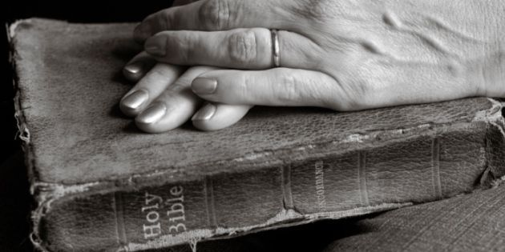
Since Satan is the author of rebellion, he will do all he can to lie to us and cause us to rebel against God and our God given authorities – Prov. 17:11
However, by engrafting Scripture into our mind, will, and emotion, we will be able to think God’s thoughts after Him – James 1:21
Meditation on Scripture is the way to engraft God’s Word into our lives so we can walk in God’s ways and experience His power and blessing upon our lives – Psalms 119:15

Slide 21
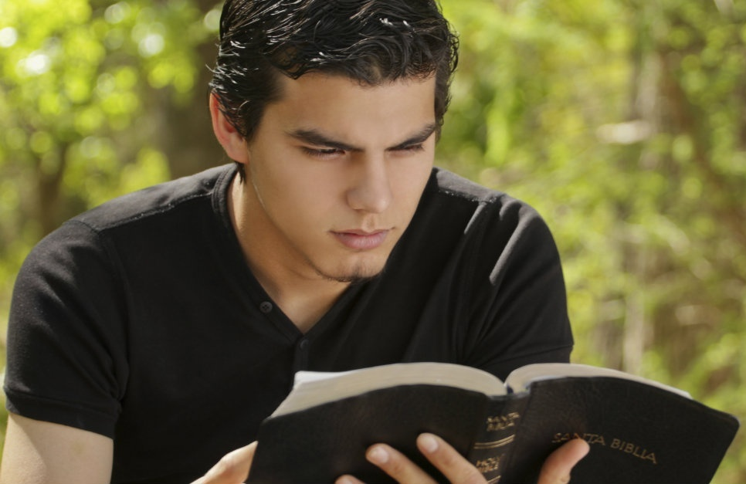
(Psalm 119:9-11) “Wherewithal shall a young man cleanse his way? by taking heed thereto according to thy word. With my whole heart have I sought thee: O let me not wander from thy commandments. Thy word have I hid in mine heart, that I might not sin against thee.”

Slide 22
(Hebrews 5:12-14)
“For when for the time ye ought to be teachers, ye have need that one teach you again which be the first principles of the oracles of God; and are become such as have need of milk, and not of strong meat. For every one that useth milk is unskilful in the word of righteousness: for he is a babe. But strong meat belongeth to them that are of full age, even those who by reason of use have their senses exercised to discern both good and evil.”

Slide 23
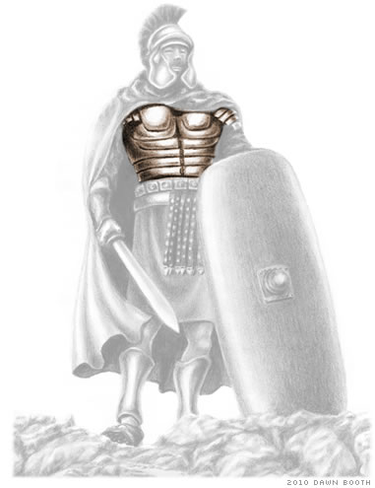
“And having on the breastplate of righteousness.”

Slide 24
The Roman warriors who directly engaged the enemy wore a plate of armor around the central part of their bodies to protect their vital organs.
In the same way, Christians are directed by God to guard “...their hearts with all diligence; for out of them are the issues of life.” - Proverbs 4:23

Slide 25
Luke 6:45 “A good man out of the good treasure of his heart bringeth forth that which is good; and an evil man out of the evil treasure of his heart bringeth forth that which is evil: for of the abundance of the heart his mouth speaketh.”
Proverbs 23:26 “My son, give me thine heart…”

Slide 26
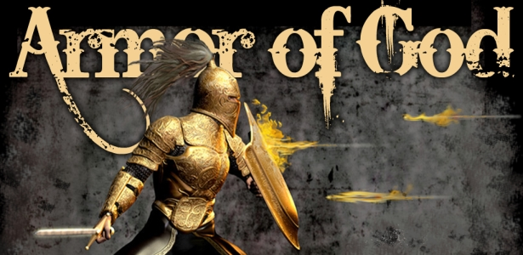
The plate armor was heavy and restricted motion; however, the protection it gave was necessary for the soldier’s survival.

Slide 27
THE DISCIPLINE RELATED TO THE BREASTPLATE OF RIGHTEOUSNESS
Purpose of heart to live righteously - Dan. 1:8 “But Daniel purposed in his heart that he would not defile himself.”
Development of Biblical convictions – “steadfast unmovable”
Commitment to live according to God’s righteousness commandments - Deut. 6:25 “And it shall be our righteousness, if we observe to do all these commandments before the LORD our God, as he hath commanded us.”
Psalm 119:172 “My tongue shall speak of thy word: for all thy commandments are righteousness.”

Slide 28
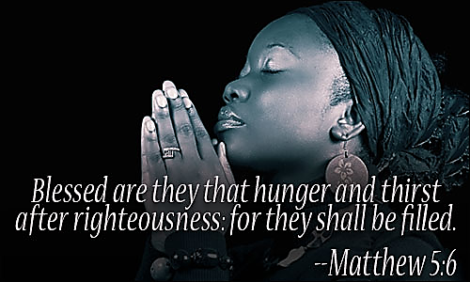
Righteous – 225 times / Righteousness – 297 times

Slide 29
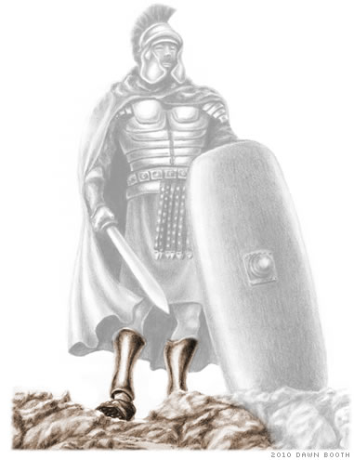
“And your feet shod with the preparation of the gospel of peace.”

Slide 30
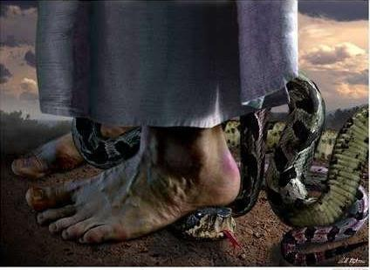
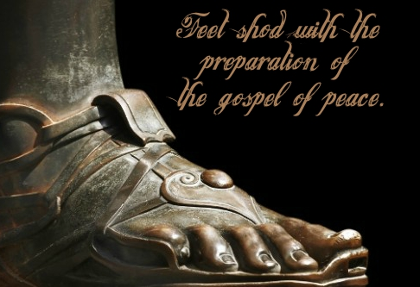
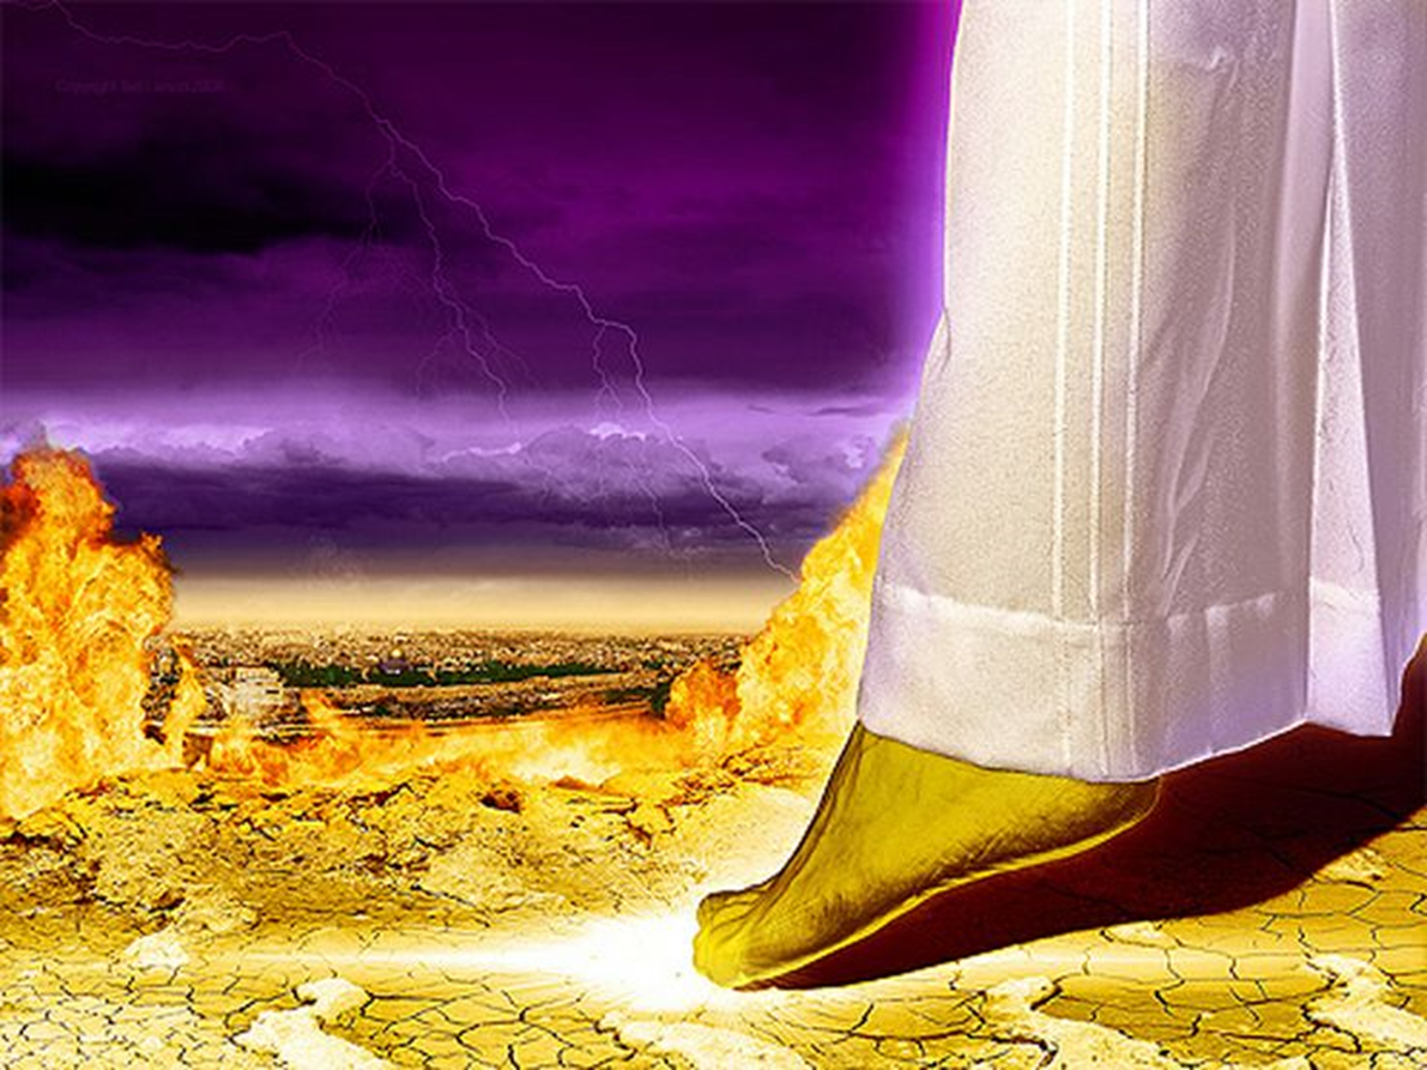
The foot is a symbol of authority
When Jesus Christ returns in His second coming Revelation says that His feet will be as “Fine Brass” – Rev. 1:15
When a king was conquered, he would be brought to the victorious ruler and made to bow his head down to the ground – Col. 2:15
The conqueror would put his foot on the neck of his defeated foe, symbolizing that he then had jurisdiction over him and his kingdom – Heb. 2:14-15

Slide 31
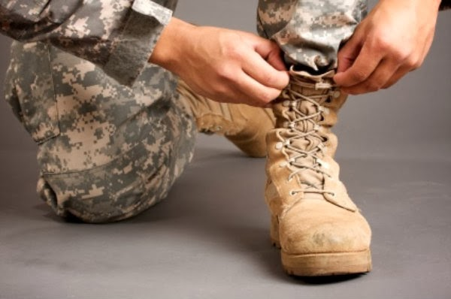
A Solider and his Army could never advance and conqueror the enemy with bare feet
(Romans 10:14-15) “How then shall they call on him in whom they have not believed? and how shall they believe in him of whom they have not heard? and how shall they hear without a preacher? And how shall they preach, except they be sent? as it is written, How beautiful are the feet of them that preach the gospel of peace, and bring glad tidings of good things!”

Slide 32
A victorious soldier had to be prepared for battle. He had to have studied his enemy’s strategy, be confident in his own strategy, and have his feet firmly planted so that he could hold his ground when the attacks came. A soldier’s battle shoes were studded with nails or spikes, like cleats, to help him keep his balance in combat. He knew that, if he lost his footing and went down, it wouldn’t matter how great the rest of his armor was; the enemy had him. When we are ready with the gospel of peace, we live with the understanding that we are continually under attack from Satan. 2 Timothy 4:2 says to “preach the word; be ready in season and out of season.”

Slide 33
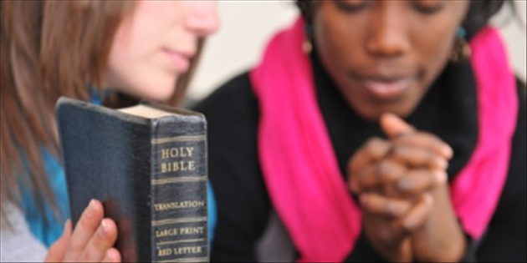
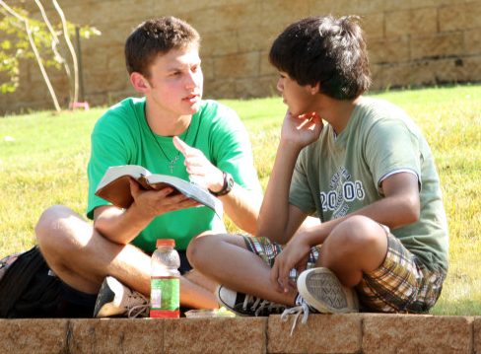
The gospel of peace is the message that Jesus gave to those who trust in Him - (John 14:27; Romans 10:15)
It comes with the assurance from God that we are His children and nothing can snatch us out of His hands - (John 10:29; 1 John 5:13)
It outlines clearly what is required to become a child of God - (1 Corinthians 15:1–6; John 1:12; Romans 10:8–10)
It is the message that Christ has entrusted to us to share with the world – “Go ye into all the world and preach the Gospel.”

Slide 34
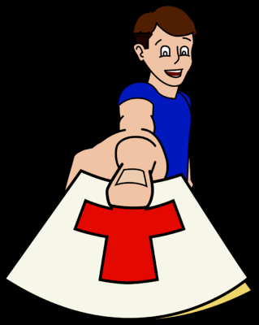
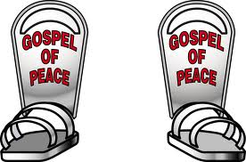
THE DISCIPLINE RELATED TO THE SHOES OF THE GOSPEL
Put on every day the “shoes of the gospel of peace” – Rom. 13:12
Always be prepared to share the gospel – “Preparation” - The word implies readiness and constant vigilance.
Realize that it’s the gospel message that Satan opposes – Matt. 13:39
It’s the gospel that advances Christ kingdom – “And this gospel of the kingdom shall be preached in all the world for a witness unto all nations.”

Slide 35
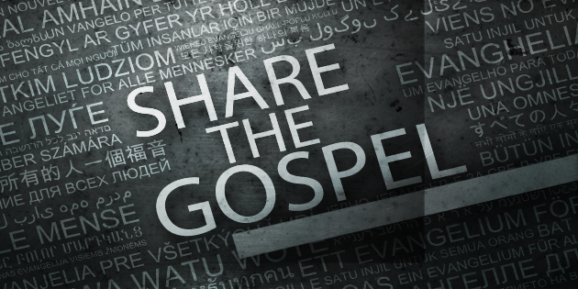

Slide 36
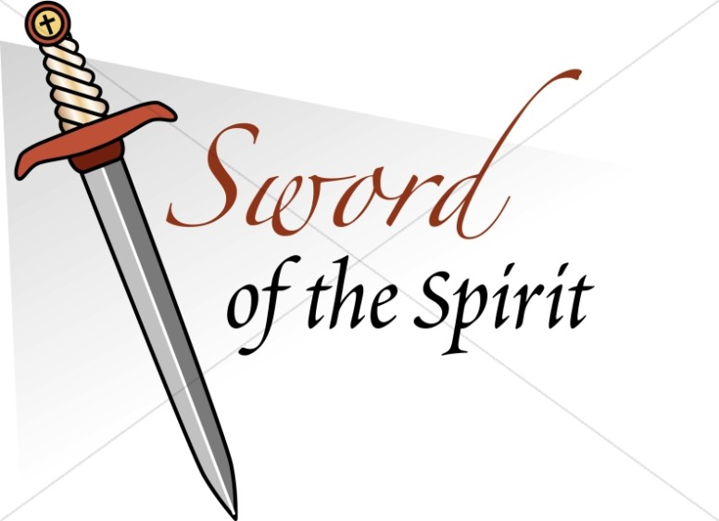
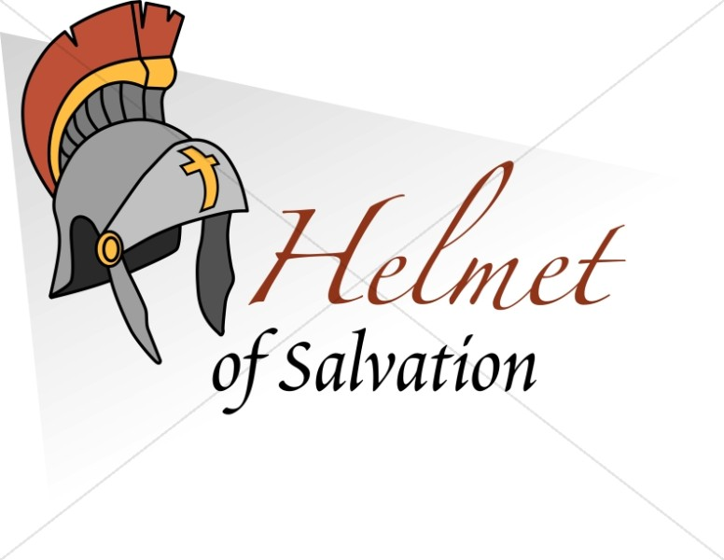

Slide 38
