Slide 1
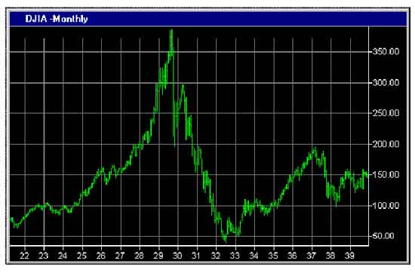
Financial Freedom
(Part 13)
What does it mean to be
financially free?
“And ye shall know the truth and the truth shall make you free.” (John 8:32)

Slide 2
Review:
Biblical principles of stewardship
What the Bible teaches about borrowing
The sting of interest
Establishing scriptural convictions
Developing a giving spirit
What it means to be financially free

Slide 3
Importance of living on a budget
Making a choice to serve God rather
than money or material possessions
Reasons for lack of funds
Establishing the tithe as a weekly
reminder that everything we have
belongs to God
Giving to meet the needs of others
Knowing who not to give money to
The Law of the Harvest

Slide 4
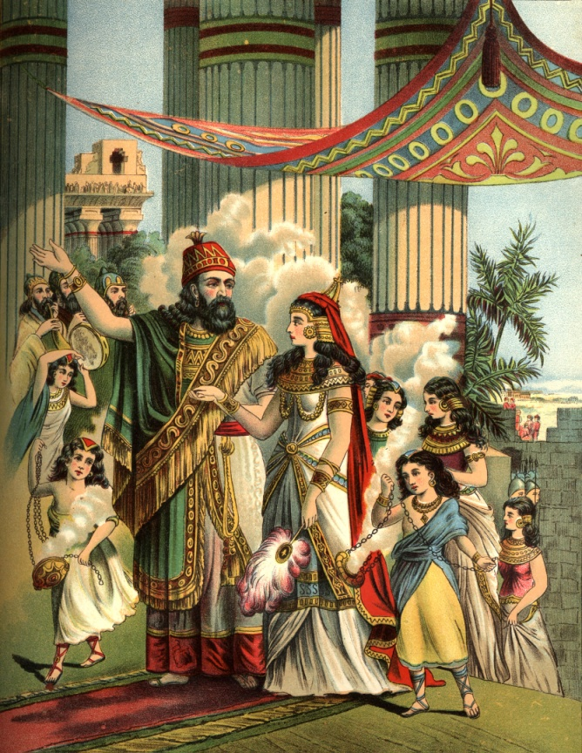
Gambling – Right or Wrong?
Violation of God’s Word results in financial loss – (Proverbs)
The Wisdom of Solomon concerning finances – (Study of the financial principles from the book of Proverbs)

Slide 5
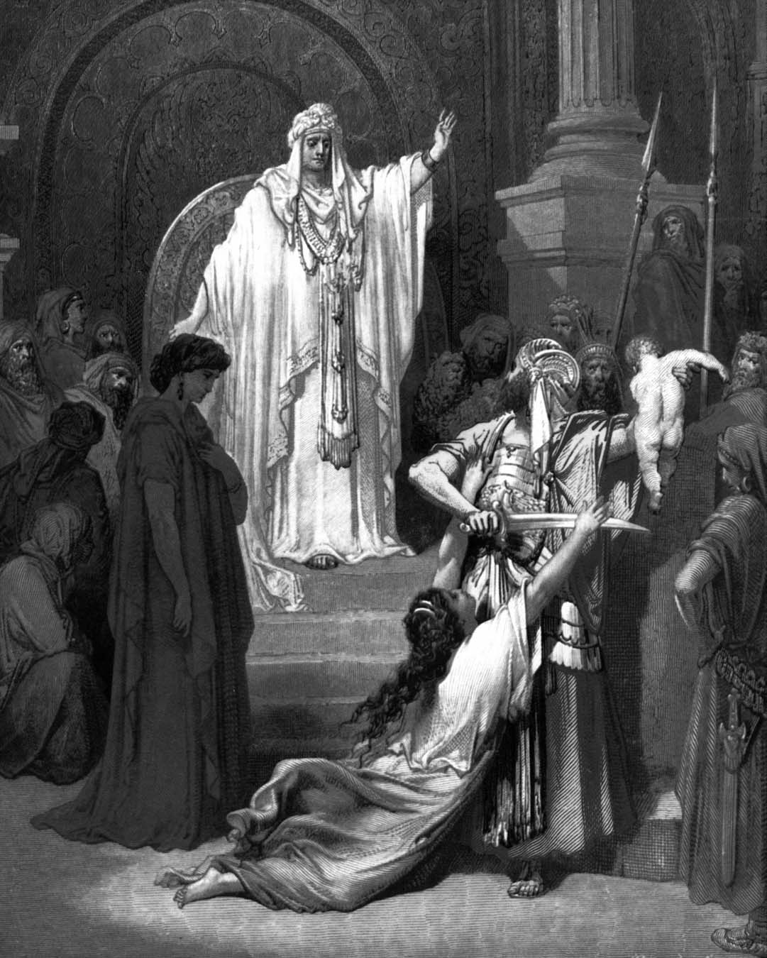
The Wisdom of Solomon Concerning Finances “More financial principles from Proverbs.”

Slide 6
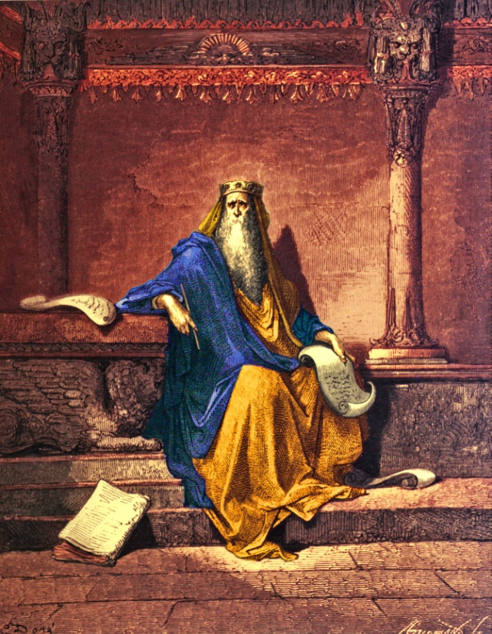
“Bow down thine ear, and hear the words of the wise, and apply thine heart unto my knowledge. For it is a pleasant thing if thou keep them within thee; That thy trust may be in the Lord.
I have made known to thee this day, even to thee. Have not I written to thee excellent things in counsels and knowledge, that I might make thee know the certainty of the words of truth, that thou mightest answer the words of truth to them that send thee.” – 22:17-21

Slide 7
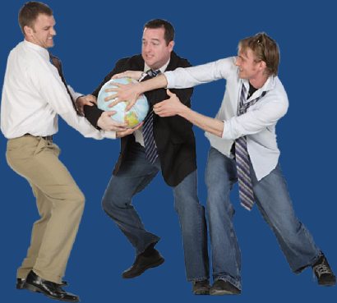
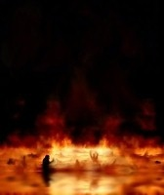
Covetousness and Greed
People are by nature inclined towards covetousness -
“Hell and destruction are never full; so the eyes of man are never satisfied.” - 14:14

Slide 8
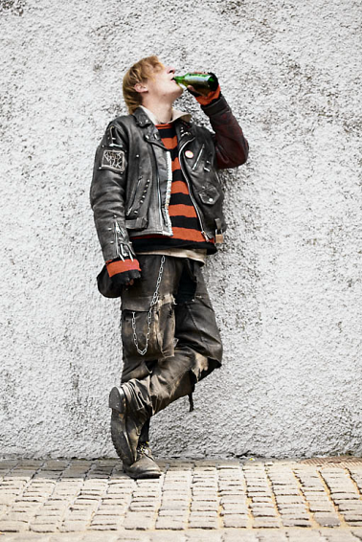
“The backslider in heart shall be filled with his own ways (selfish desires).” - 27:20

Slide 9
Evidences of Backsliding
Church attendance
Service
Tithing
Bible reading
Prayer life
Disobedience / Rebellion
Standards / Convictions
Worldly – clothing, hair, dress, appearance, attitudes, friendships, music, etc.
Cold to spiritual things
Stop listening to the preacher
Sports
Recreation
Entertainment
No contentment
Lack of joy and peace
No concern for the lost
Compromise
Selfish

Slide 10
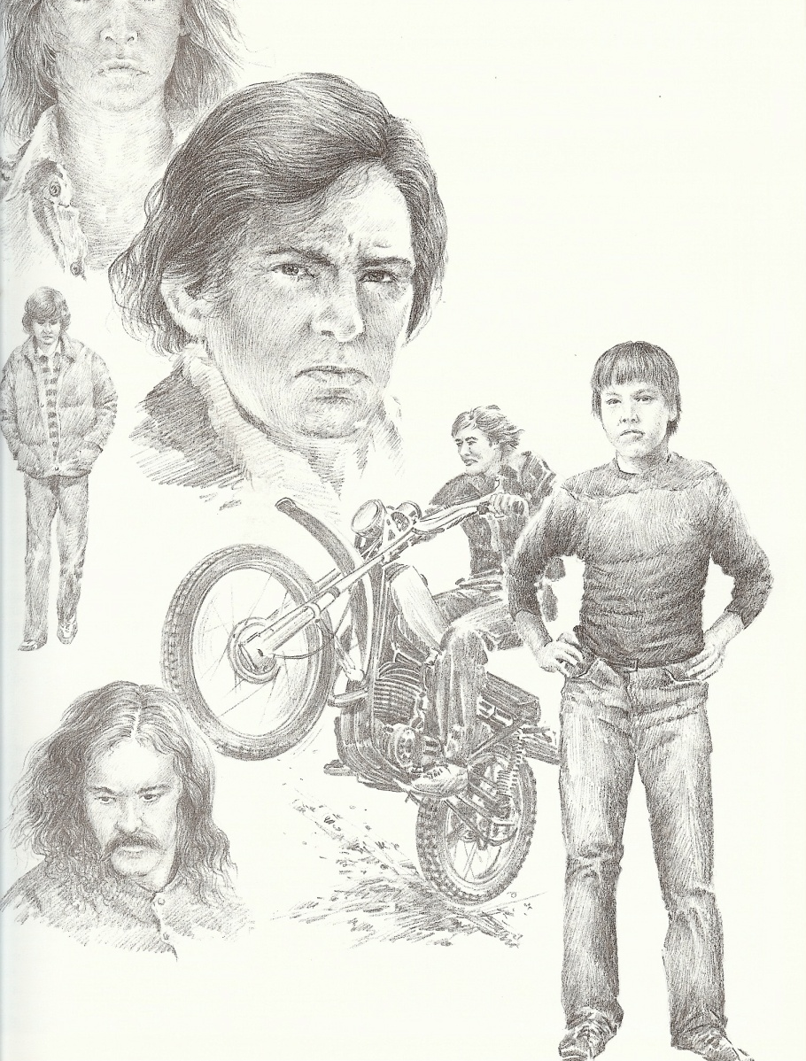
“Let not thine heart envy sinners: but be thou in the fear of the LORD all the day long.” - 23:17
“Envy thou not the oppressor, and choose none of his ways.” – 3:31
“Wrath is cruel, and anger is outrageous; but who is able to stand before envy.” - 27:4
“Evil pursueth sinners: but to the righteous good shall be repayed.” - 13:21
“The fear of the LORD is the beginning of knowledge.” - 1:7
“Then shalt thou understand the fear of the LORD, and find the knowledge of God .” - 2:5
“Better is little with the fear of the LORD than great treasure and trouble therewith.” - 15:16

Slide 11
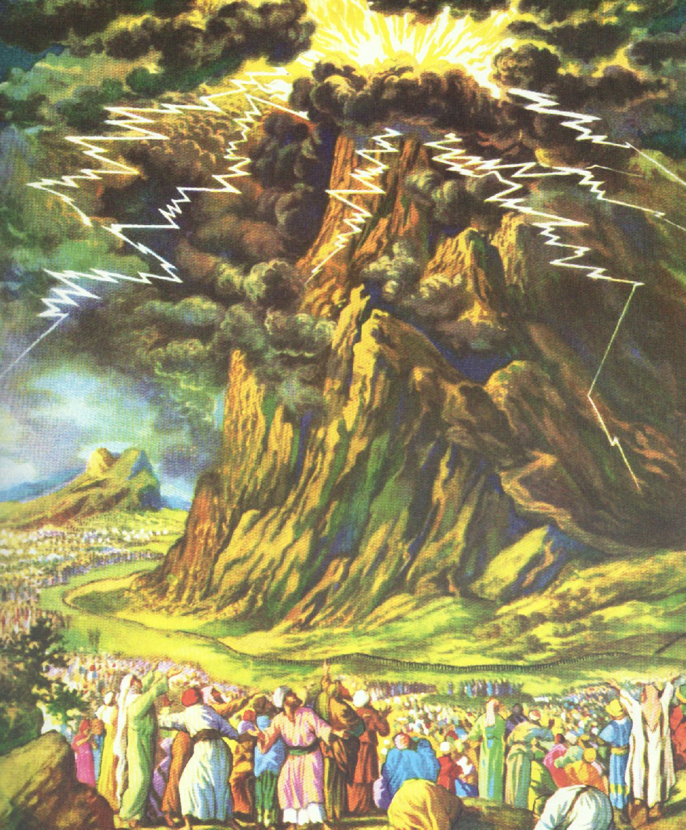
“The fear of the LORD prolongeth days.” - 10:27
“By humility and the fear of the LORD are riches, and honour, and life.” - 22:4
“By the fear of the LORD men depart from evil.” - 16:6
“The fear of the LORD is the instruction of wisdom.” - 15:33
“The fear of the LORD is a fountain of life, to depart from the snares of death.” -14:27
“In the fear of the LORD is strong confidence: and his children shall have a place of refuge.” - 14:26
“The fear of the LORD is the beginning of wisdom.” - 9:10
“The fear of the LORD is to hate evil: pride, and arrogancy, and the evil way, and the froward mouth, do I hate.” - 8:13
“The fear of the LORD tendeth to life: and he that hath it shall abide satisfied; he shall not be visited with evil.” - 19:23

Slide 12
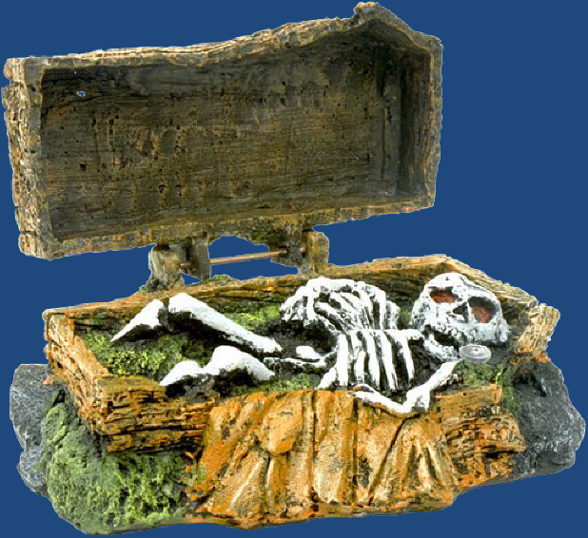
“A sound heart (spiritually healthy heart) is the life of the flesh: but envy the rottenness of the bones.” – 14:30

Slide 13
Covetousness and greed are self-destructive
Covetousness leads to wrong doing –
“He that tilleth his land shall have plenty of bread: but he that followeth after vain persons shall have poverty enough.
A faithful man shall abound with blessings: but he that maketh haste to be rich shall not be innocent.
To have respect of persons is not good: for for a piece of bread that man will transgress.
He that hasteth to be rich hath an evil eye, and considereth not that poverty shall come upon him.

Slide 14
Whoso robbeth his father or his mother, and saith, It is no transgression; the same is the companion of a destroyer.
He that is of a proud heart stirreth up strife: but he that putteth his trust in the LORD shall be made fat.
He that trusteth in his own heart is a fool: but whoso walketh wisely, he shall be delivered.
He that giveth unto the poor shall not lack: but he that hideth his eyes shall have many a curse.” - 28:19-27

Slide 15
Nine keys to prosperity, success and joy in life (Proverbs 28:19-27)
Do not be covetousness
Work hard
Avoid friendships with sinful (vain) people
Be faithful to God
Never show favoritism
Respect your parents
Be humble
Trust God
Be a giver

Slide 16
Covetousness results in trouble and even death -
“My son, if sinners entice thee, consent thou not.
If they say, Come with us, let us lay wait for blood, let us lurk privily for the innocent without cause:
Let us swallow them up alive as the grave; and whole, as those that go down into the pit:
We shall find all precious substance, we shall fill our houses with spoil:
Cast in thy lot among us; let us all have one purse:
My son, walk not thou in the way with them; refrain thy foot from their path.”

Slide 17
For their feet run to evil, and make haste to shed blood.
Surely in vain the net is spread in the sight of any bird.
And they lay wait for their own blood; they lurk privily for their own lives.
So are the ways of every one that is greedy of gain; which taketh away the life of the owners thereof.” – 1:10-19

Slide 18
“Flee also youthful lust…”

Slide 19
Envying evil doers will mislead a believer
“Their prosperity and success are temporary”
“Fret not thyself because of evil men, neither be thou envious at the wicked;
For there shall be no reward to the evil man; the candle of the wicked shall be put out. – 24:19-20

Slide 20
“He that is greedy of gain troubleth his own house.” (Proverbs 15:27)

Slide 21
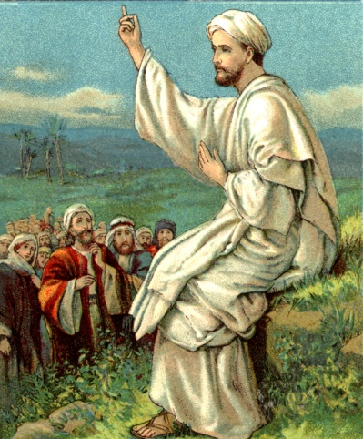
(Luke 12:13-31)

