Slide 1
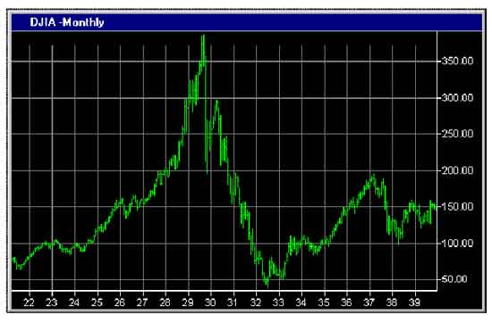
Financial Freedom
(Part 2)
What does it mean to be
financially free?
“And ye shall know the truth and the truth shall make you free.” (John 8:32)

Slide 2
Review
We are stewards of all God has entrusted to us.
We are responsible to manage God’s resources according to His Word -
“My money is a trust (stewardship) from God and must be earned and managed according to Biblical principles.”
Personal Commitment - “I will purpose to work towards gaining and maintaining financial freedom according to Biblical principles.”

Slide 3
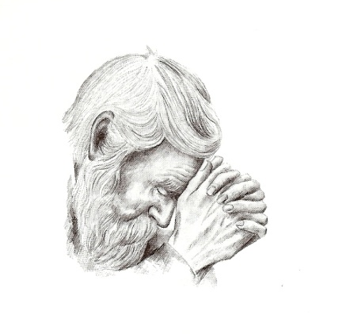
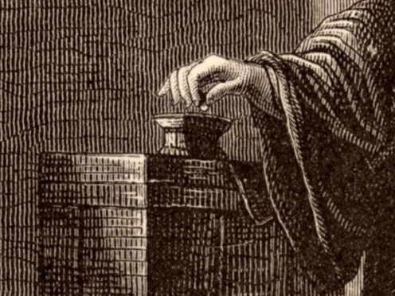
Financial freedom is knowing how to receive provisions from the Lord.
Financial freedom is knowing how to manage money.
Financial freedom is developing a giving spirit.

Slide 4
Financial Freedom
Financial freedom is committing ourselves to God’s purposes for money –
“The purpose of money is not to free us from daily dependence on God, but to demonstrate God’s love and power in our lives.”
“Give us this day our daily bread…If God so clothed the grass of the field, which today is, and tomorrow is cast into the oven, shall He not much more clothe you, O ye of little faith.”

Slide 5
1. To provide basic needs –
Only a few things, such as food, clothing and shelter, are necessary to maintain life – (Matthew 6:26, 28-30; I Timothy 6:8)
God’s wisdom in this purpose –
To establish daily dependence on Him – (Matthew 6:11)
To deepen our love for the Lord - (John 15:5)
To develop a grateful spirit - (Psalms 136:1)
To teach us contentment (key to living within our means) – (I Timothy 6:6)
To help us enjoy the things we have – “Be content with such things as ye have…”

Slide 6
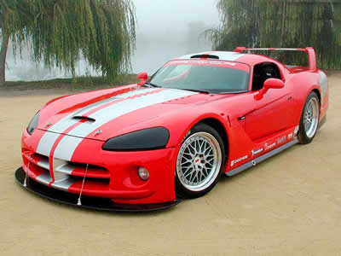
2. To confirm His direction for our lives - (Proverbs 3:5-7; Psalm 37:7)
God will use the supply of money or the lack of it to confirm His direction for many of the decisions we must make in our lives –
If you think that you should buy a new car but you do not have the money for it, you can safely assume that until God provides the funds, it is not His will for you to buy a car - “Owe no man any thing…thou shalt not borrow…”

Slide 7
Most people carry a car loan for their entire lives, paying an average of $378.00 a month. Take that same amount invested from age 25 to age 65 The amount of your retirement would be more than $4 million.

Slide 8
A new car loses 60% of its value in the first four years - $17,000 loss on the average car!
Dave Ramsey –
Myth: Car payments are a way of life; you’ll always have one.
Truth: Staying away from car payments by driving reliable used cars is what the average millionaire does; that is how he or she became a millionaire.
90% of people in our culture buy things they can’t afford.

Slide 9
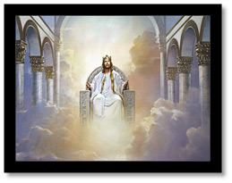
God’s wisdom in this purpose -
To build our faith – (Hebrews 11:7)
To determine who is the Lord of our life – (I Timothy 6:17)
To protect us from harm – (I Timothy 6:9)
To teach us patience – (James 1:3-4)
To cause us to focus on eternal things – (Philippians 3:7-8)

Slide 10
3. To give to others – (Romans 12:13; Proverbs 22:9; Matthew 6:22; Galatians 6:6, 10)
God’s wisdom in this purpose –
To keep us from becoming materialistic – (Prov. 28:22)
To demonstrate the mark of a true Christian – (Titus 2:14)
To meet others needs – (I John 3:17)
To glorify God – ( II Corinthians 9:11)

Slide 11
Debt Devours Resources and Our Ability to Give
If you had a debt of $41,754.00
If you paid $6000.00 a year at 12% interest
How much interest would you pay before the loan was repaid –
$3,500
$16,500
$53,696
Total $94,450.00

Slide 12
Home - $130,000
Down payment - $20,000
30 year mortgage - $110,000 (7% interest)
Final cost - $283,520 (30 years)
If you pay $256 extra per month.
You will save $85,680 and pay off your mortgage in 15 years.
97% of people do not pay extra on their mortgage.

Slide 13
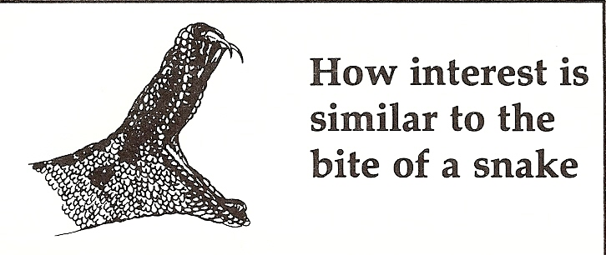
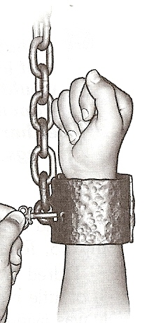
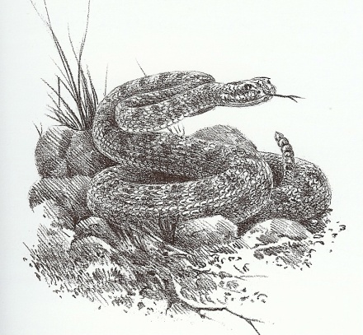
Interest (usury / naskak)
“To bite with a sting, like
a serpent”
A snake is a hidden danger.
A Snake strikes before its victim is aware.
Snake bites result in alarming symptoms and can even result in death.
Interest = bondage – (Proverbs 22:7)

Slide 14
4. To demonstrate God’s power to provide –
(Malachi 3:10; Philippians 4:19)
When God provides our needs, who receives the glory? (Ephesians 3:20)
God’s Wisdom in this purpose –
Cause us to trust Him (pray) – (I Kings 18:21-40)
To prove that we have a mighty God who can and will meet our needs – “Call upon me in the day of trouble: I will deliver thee, and thou shalt glorify me.” (Psalm 50:15)
Purify our hearts (confession of sin and selfish motives) – (Psalm 66:18)

Slide 15
Possible Reasons for Lack of Funds
Failure to tithe – (Malachi 3:10)
To much debt – (Romans 13:8)
Failure to budget – 95% of people do not live by a budget.
Poor self-worth (inferiority) – (Isaiah 45:9-10)
Immorality – (Proverbs 5:8-10)
Rebellion against authority – (Proverbs 3:33)
Failure to listen to cautions – (Proverbs 1:5)
Slothfulness – (II Thessalonians 3:10)

Slide 16
Loss of a good name – (Proverbs 22:1)
Overspending – (I Timothy 6:6)
Not paying bills on time – (Proverbs 10:4)
Co-signing – (Proverbs 6:1-3)
Business partnership – (II Corinthians 6:14)
Unwise investment decisions – (Proverbs 31: 11, 26)
Get rich quick schemes – (Proverbs 28:22)
Choosing to serve money rather than God – (Matthew 6:24)
Lack of meekness – “The meek will He guide in judgment: and the meek will He teach His ways.”

Slide 17
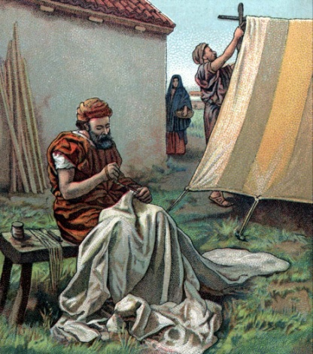
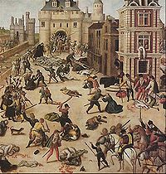
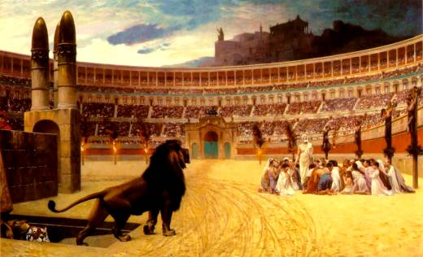
Do Godly Christians Ever Suffer Financial Need?
Philippians 4:10-20
Revelation 2:8-10
I Peter 1:3-8

Slide 18
Benefits in Suffering Financial Need
God’s way of getting our attention – (Matthew 11:28)
Causes us to examine our selves – (Proverbs 28:13)
Conquers pride – (Proverbs 16:18)
Motivation to cry out to God – (Psalms 3:4)
Purifies and strengthens our faith – (James 1:2-3)
Causes us to receive Christ’s power – (II Corinthians 12:7-10)

Slide 19
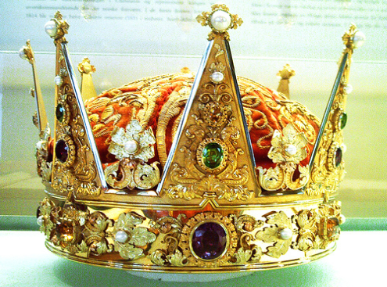
Causes us to reevaluate priorities – (Haggai 1:3-8)
Sifts our friendships – (Proverbs 17:17)
Prepares us to comfort others – (II Corinthians 1:3-5)
Tests our love and commitment for God – (Job)
Increases our hatred for disobedience – (Galatians 6:7-8)
Develops godly character – (I Peter 4:1-2)
Causes us to experience close fellowship with God – (II Timothy 1:12)
Unites families – (Ephesians 6:1-4)
Results in special rewards in heaven – (James 1:12)

Slide 20
What Happens if You do not See the Benefits in Financial Need?
Loss of joy – (Nehemiah 8:10)
Loss of peace – (John 14:27)
Loss of testimony – (II Thessalonians 1:10)
Anger – (Ephesians 4:31)
Resentment – (I Peter 2:1)
Bitterness – (Hebrews 12:15)
Unprofitable servant of the Lord – (I Corinthians 9:27)

